Slide 1
Deception and Trust
Sarah Ita Levitan
Guest Lecture
COMS 6998
April 21, 2020

Slide 2
Spoken language processing aims to teach computers to understand and generate speech.

Slide 3
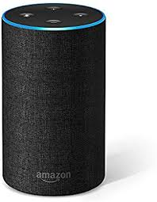
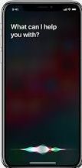
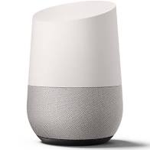
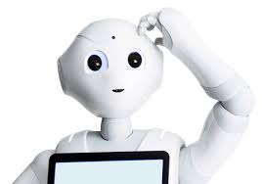
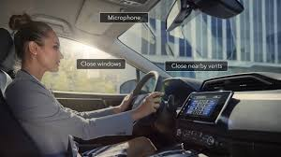

Slide 4
What can we convey and perceive from speech?
Gender
Age
Native language
Ethnicity
Personality
Physical health
Mental health
Charisma
Likeability
Emotion
Sarcasm
Humor
Deception
Trust

Slide 5
What can we automatically learn about speaker states and traits from their speech?

Slide 6
What can we automatically learn about speaker states and traits from their speech?
And how can we leverage this information to improve human-computer interactions?

Slide 7
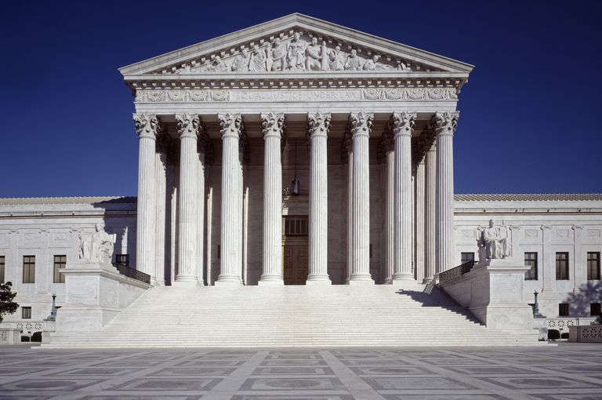

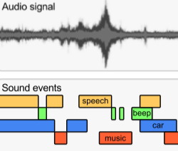



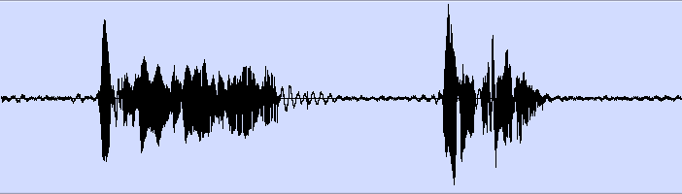


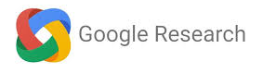

Entrainment in Supreme Court oral arguments
Acoustic event detection in YouTube videos
Deception detection in interview dialogues
Age and gender detection in call center dialogues
Analysis and classification of trust in written news
Linguistic cues to mental health from social media
Analysis and classification of trustworthy speech

Slide 8
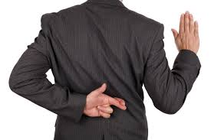

Deception
Trust

Slide 9
Deception
Trust
What are the characteristics of deceptive and truthful speech?
What makes humans perceive speech as truthful, or trust speech?
Can we automatically detect deceptive and trustworthy speech?

Slide 10

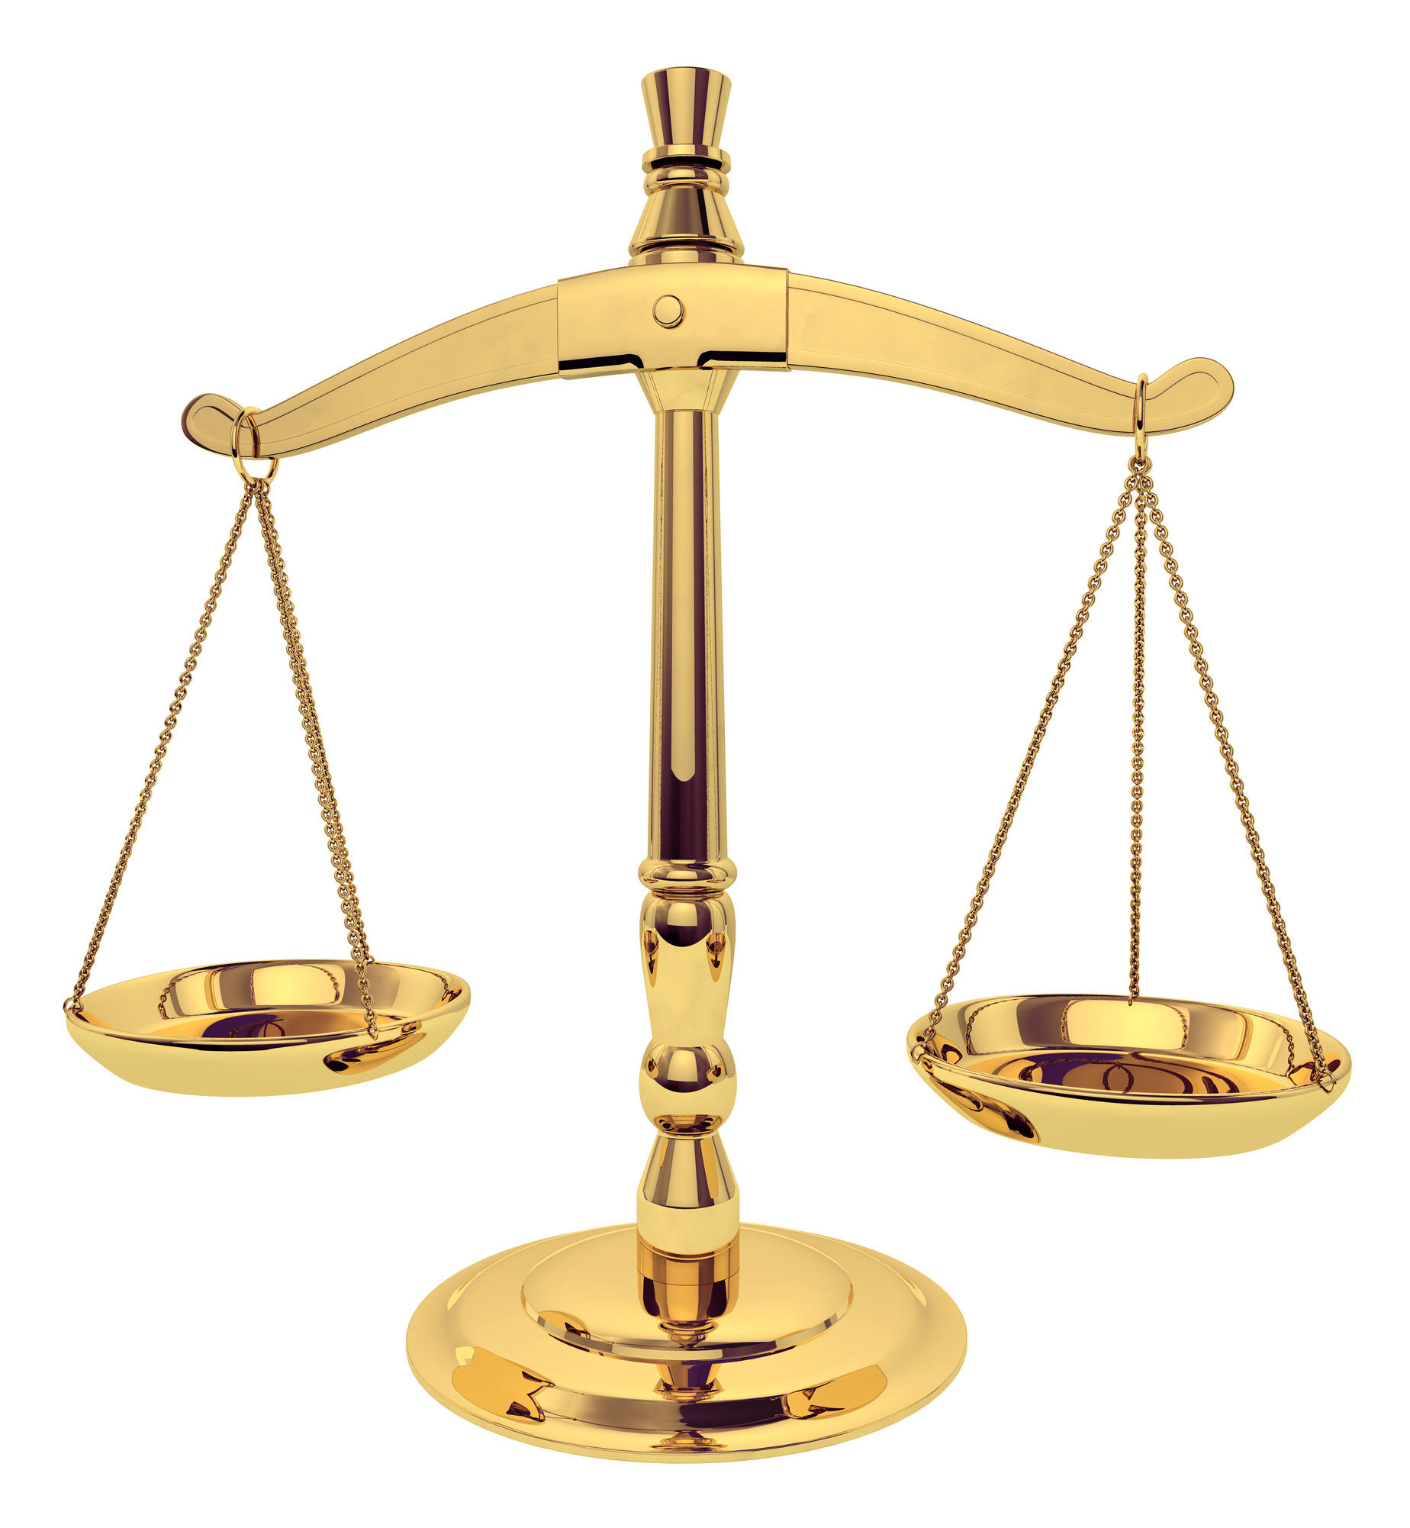
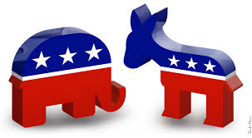


Slide 11
Human performance at deception detection is about 50% -> random chance.

Slide 12
Human performance at deception detection
(Aamodt & Mitchell, 2004; Hartwig et al., 2017)
Group | # Studies | # Subjects | Accuracy %
Criminals | 1 | 52 | 65.40
Secret service | 1 | 34 | 64.12
Psychologists | 4 | 508 | 61.56
Judges | 2 | 194 | 59.01
Police officers | 8 | 511 | 55.16
Federal officers | 4 | 341 | 54.54
Students | 122 | 8,876 | 54.20
Detectives | 5 | 341 | 51.16
Investment professionals | 1 | 215 | 49.4
Parole officers | 1 | 32 | 40.42

Slide 13
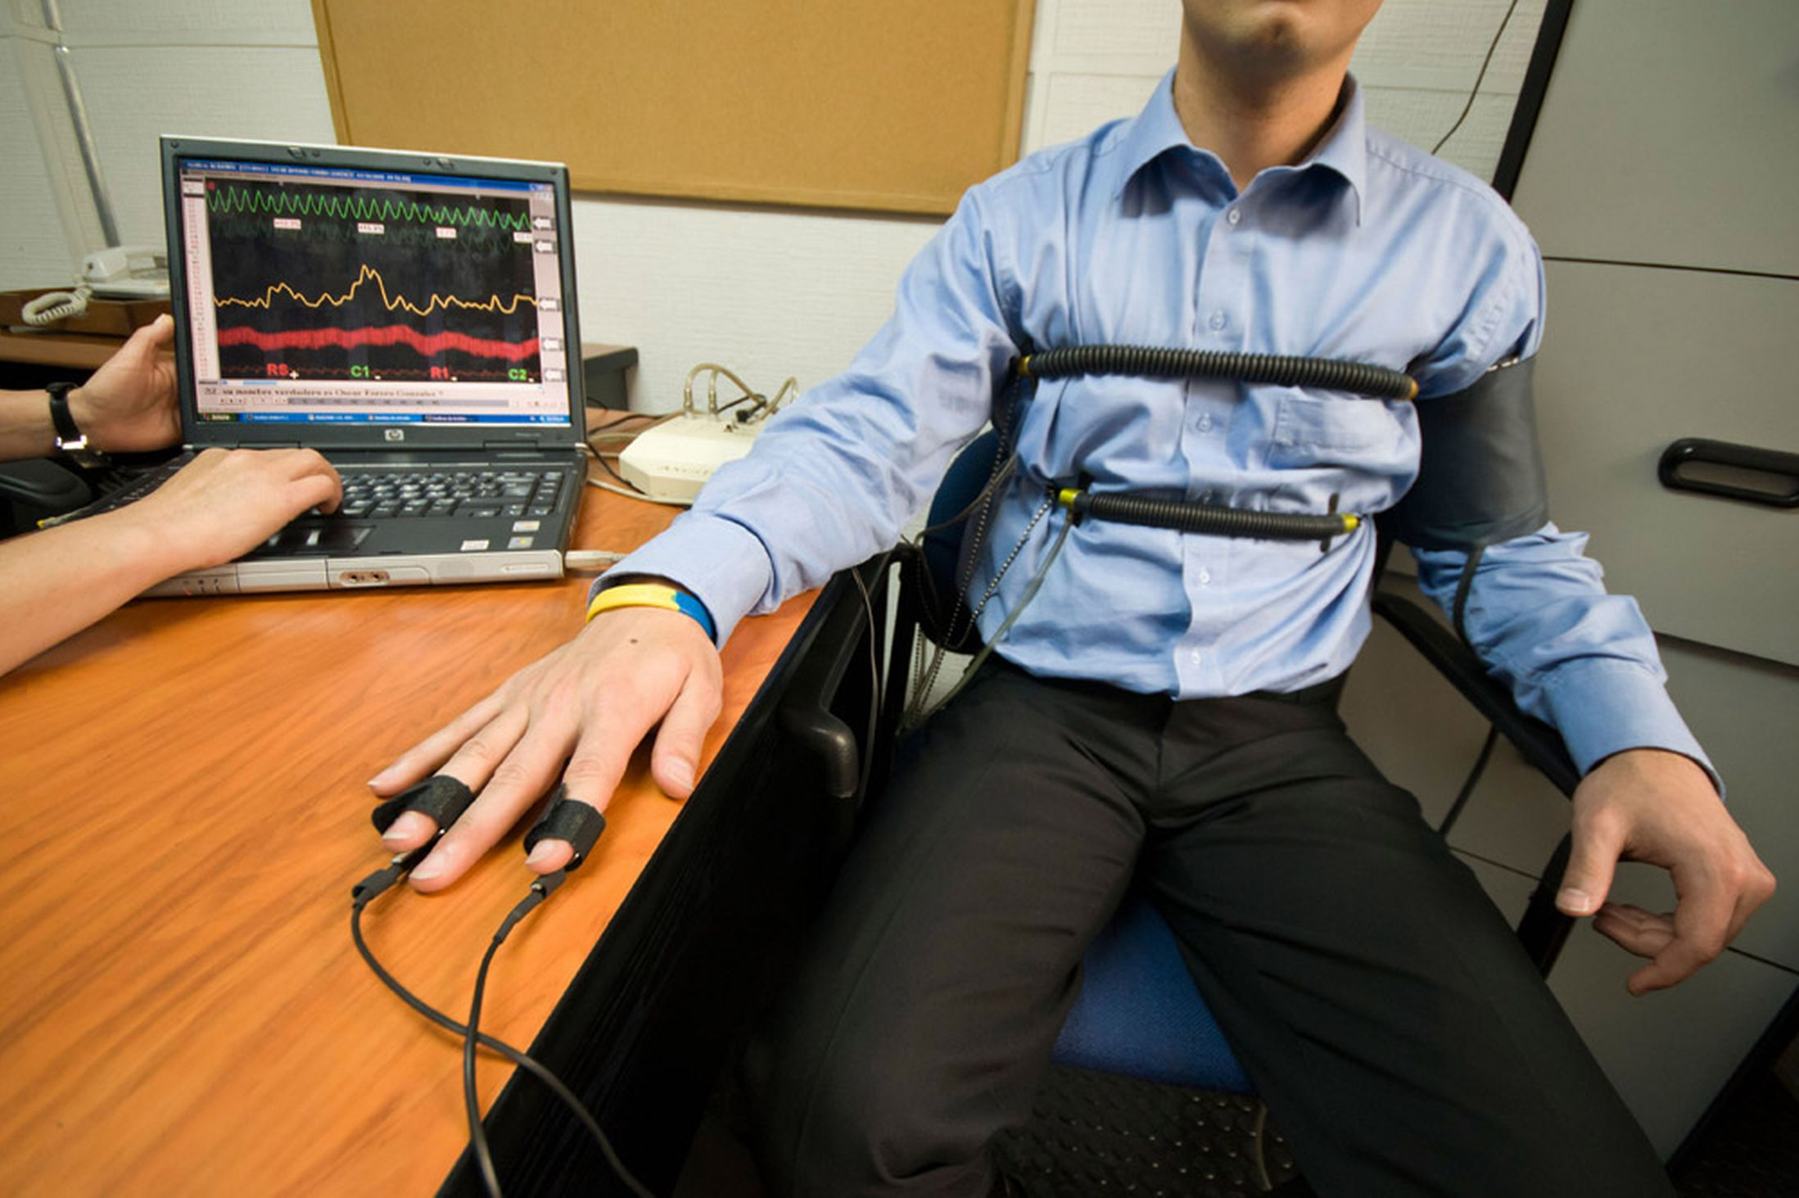
Modalities
Body posture and gestures (Burgoon et al, ‘94)
Facial expressions (Ekman, ‘76; Frank, ‘03)
Biometric factors (Horvath, ‘73)
Brain imaging technologies (Bles & Haynes, ‘08)
Language-based
  Text (Adams, ’96, Pennebaker et al., ‘01)
  Speech (Enos et al., ‘06)

Slide 14
Language-based deception detection
Practitioners
Statement analysis (Adams, 1996)
SCAN (Smith, 2001)
Reid & Associates (Buckley, 2000)
Forensic linguists
Text
Depositions
(Bachenko et al. 2008)
Hotel reviews
(Ott et al. 2011)
Crowd workers
(Perez-Rosas & Mihalcea, 2015)
Speech
Voice Stress Analysis (Horvath, 1982)
Streeter et al. (1977)
Ekman et al. (1991)
Enos (2009)

Slide 15

Challenges
Data
Ground truth annotation
Laboratory vs. real-world deception
Individual and cultural differences

Slide 16
Outline
Columbia X-Cultural Deception (CXD) Corpus
Deception detection from text and speech
  Acoustic-prosodic and lexical analysis
  Machine learning deception classification
Crowdsourced study of deception perception
  Acoustic-prosodic and lexical analysis
  Machine learning trust classification

Slide 17
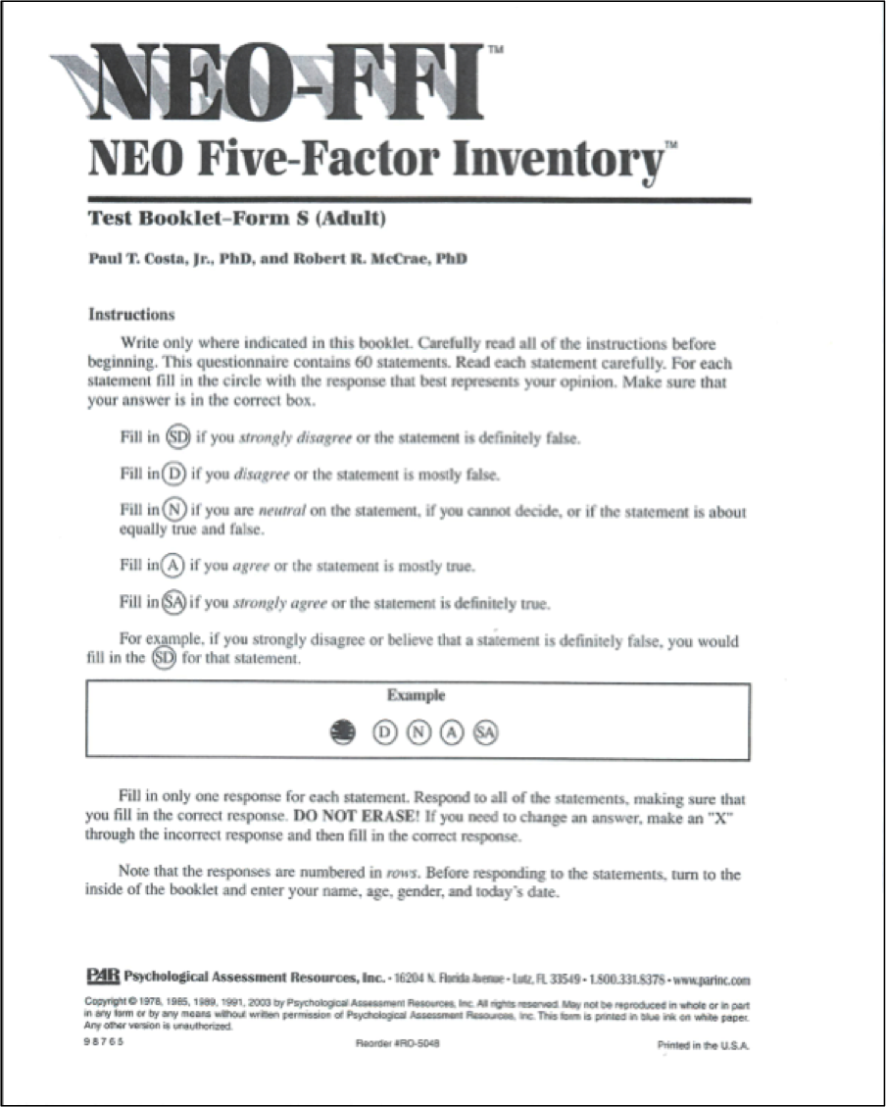
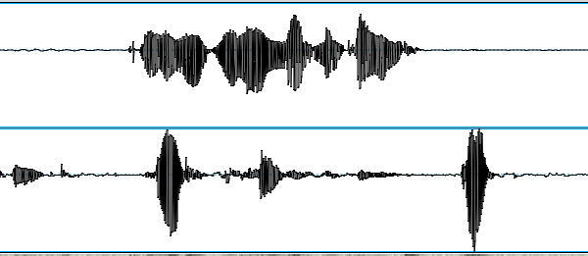
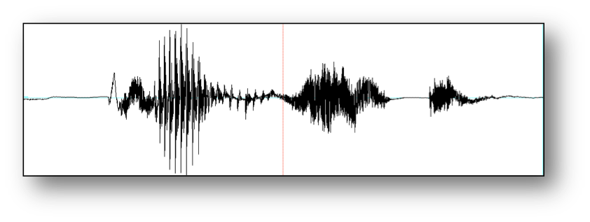
Columbia X-Cultural Deception Corpus
NEO-FFI
Survey
Biographical
Questionnaire
Lying game
Survey
Baseline

Slide 18
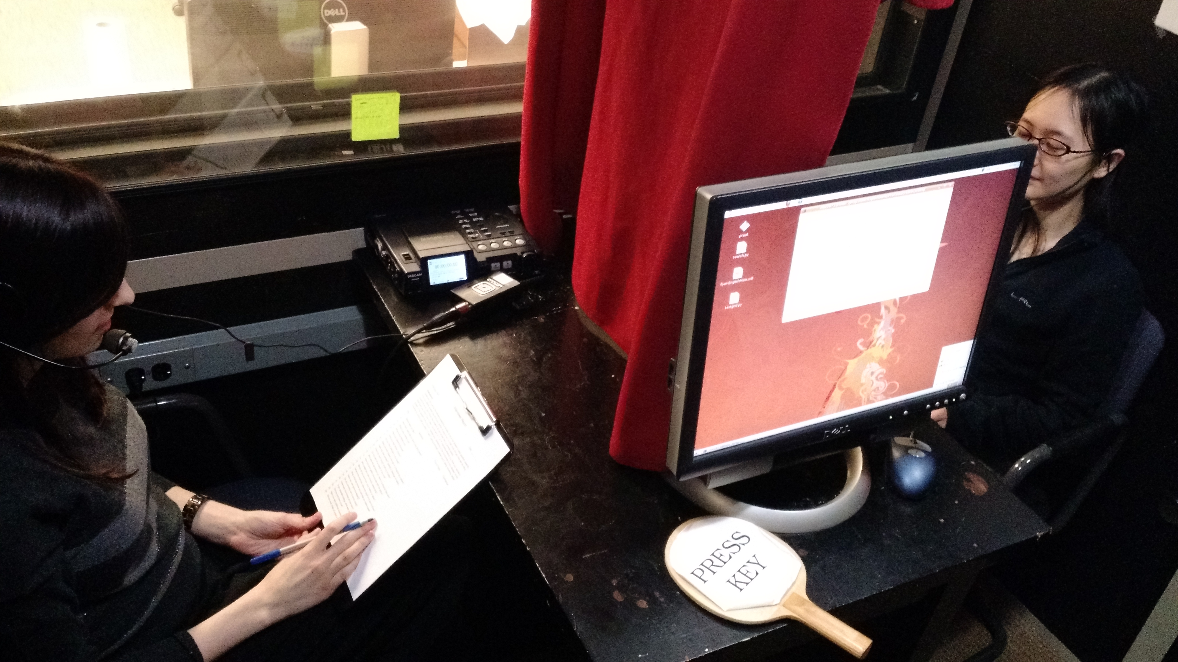
Columbia X-Cultural Deception Corpus
>120 hours of subject speech
340 subjects
Cross-cultural
Fake resume paradigm
NEO-FFI personality scores
Baseline sample
Financial incentive
Lie production/perception
Global/local deception labels

Slide 19
Units of analysis
IPU Pause-free segment of speech from a single speaker
Turn Sequence of speech from one speaker without intervening speech from the other speaker
Question response Interviewee turn following an interviewer biographical question
Question chunk Set of interviewee turns responding to an interviewer biographical question and subsequent follow-up questions

Slide 20
Units of analysis
Unit | Interviewer | Interviewee | Total
IPU | 81536 | 111428 | 192964
Turn | 41768 | 43673 | 85459
Question Response | 8092 | 8092 | 16184
Question Chunk | 8092 | 8092 | 16184

Slide 21
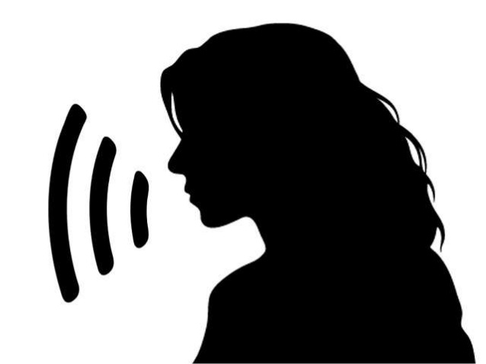

“Have you ever tweeted?”
TRUE or FALSE?

Slide 22

“Have you ever tweeted?”

Slide 23
Outline
Columbia X-Cultural Deception (CXD) Corpus
Deception detection from text and speech
  Identifying acoustic-prosodic and linguistic cues to deception
  Machine learning deception classification
Crowdsourced study of deception perception
  Acoustic-prosodic and lexical analysis
  Machine learning trust classification

Slide 24
Acoustic-prosodic and linguistic characteristics of deception and truth
Four feature sets
  Acoustic-prosodic (Praat; Boersma et al., 2002)
  Linguistic Deception Indicators (LDI)
  Linguistic Inquiry and Word Count (LIWC; Pennebaker et al., 2015)
  Complexity (Lu, 2010)
Two units of analysis
  Question response
  Question chunk
Paired t-tests; FDR correction, ⍺=0.05

Slide 25
Acoustic-prosodic and Lexical Features (152)
Acoustic-prosodic (8) pitch {max, mean}, intensity {max, mean}, speaking rate, jitter, shimmer NHR
LDI (28) hedge words, filled pauses, contractions, denials, laughter, DAL (Dictionary of Affect in Language; Whissel et al., 1986), specificity (Li & Nenkova, 2015)
LIWC (93) word counts for semantic classes – linguistic, markers of psychological processes, punctuation, formality
Complexity (23) measures of syntactic complexity (e.g. clauses per sentence, coordinate phrases per clause)

Slide 26
Acoustic-prosodic characteristics
Pitch max
Pitch mean
Intensity max
Intensity mean
Speaking rate
Jitter
Shimmer
NHR
Increased pitch
Ekman et al. (1976)
Streeter et al. (1977)
DePaulo et al. (2003)
Increased intensity
DePaulo et al. (2003) – no effect

Slide 27
Linguistic Deception Indicators (LDI)
hasAbsolutelyReally
hasContraction
hasI
hasWe
hasYes
hasNAposT
hasNo
hasNot
isJustYes
isJustNo
noYesOrNo
specificDenial
thirdPersonPronouns
hasFalseStart
hasFilledPause
numFilledPauses
hasCuePhrase
numCuePhrases
hasHedgePhrase
numHedgePhrases
hasLaugh
numLaugh
DAL.wc
DAL.pleasant
DAL.activate
DAL.imagery
specScores

Slide 28
Linguistic Inquiry and Word Count (LIWC)
Adj
Adverb
Affect
Affiliation
Analytic
Apostro
Article
Assent
Authentic
Auxverb
Bio
Clout
Cogproc
Compare
Conj
Dic
Differ
Drives
Family
Focuspast
Focuspres
Function
I
Informal
Insight
Ipron
Negate
Netspeak
Nonflu
Number
Posemo
Ppron
Prep
Pronoun
Relative
Sixltr
Social
Space
tentat
Time
Tone
Verb
WC
Work
WPS

Slide 29
Complexity
W words
VP verb phrase
C clauses
T t-units
DC dep. clause
CT complex t-unit
CP coordinate phrase
CN complex nominal
MLS mean length sentence
MLT mean length t-unit
MLC mean length clause
C.S clauses/sentence
VP.T verb phrases/t-unit
C.T clauses/t-unit
DC.C dep clauses/clause
DC.T dep clauses/t-unit
T.S t-units/sentence
CT.T complex t-units/t-unit
CP.T coord phrases/t-unit
CP.C coord phrases/clause
CN.T complex nom/t-unit
CN.C complex nom/clause

Slide 30
Entrainment
Phenomenon of interlocutors becoming similar to each other in conversation
Associated with task success, likeability, trust
Research questions:
  Do interlocutors entrain in deceptive dialogues?
  Are there differences in entrainment behavior between truthful and deceptive dialogues?

Slide 31
Entrainment
5 measures of global and local entrainment
  Local proximity, convergence, synchrony
  Global proximity, convergence
8 acoustic-prosodic features
  pitch {max, mean}, intensity {max, mean}, speaking rate, jitter, shimmer NHR
4 lexical features
  {100, 25} high frequency words, hedge words/phrases, cue phrases

Slide 32
Entrainment results
Local entrainment
  Proximity: all acoustic features except pitch max
  Convergence: intensity {mean, max}, speaking rate, voice quality
  Synchrony: all acoustic features
Global entrainment
  Proximity: high frequency words, hedge words, intensity {mean, max}, speaking rate, voice quality
  Convergence: high frequency words
-> Evidence of acoustic-prosodic and lexical entrainment in deceptive dialogues, at global and local levels

Slide 33
Entrainment (local proximity)
Pitch max
Pitch mean
Intensity max
Intensity mean
Speaking rate
Jitter
Shimmer
NHR

Slide 34
Summary: acoustic-prosodic and linguistic characteristics of deception and truth
Deception
Increased pitch & intensity max
Poor speech planning
Descriptive, detailed
Complex
Hedge
Entrainment
Truth
Negation
Cue phrases
Cognitive process
Function words

Slide 35

Automatic deception detection
Four units of analysis:
  IPU, turn, question response, question chunk
Four statistical classifiers: Random Forest, Logistic Regression, SVM, Naïve Bayes
Three neural network classifiers: DNN, LSTM, Hybrid
Three feature sets: Acoustic (A), Lexical (L), Syntactic (S)
Evaluation metric:
  F₁ =
Baselines:
  Random: 50% accuracy
  Human: 56.75% accuracy (question chunk units)

Slide 36
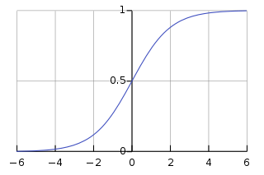

Logistic Regression

Slide 37
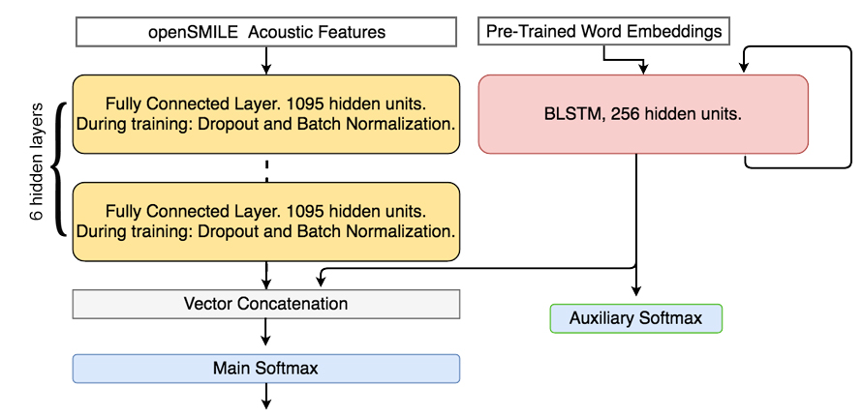
Hybrid: BLSTM-lexical + DNN-acoustic

Slide 38
Deception classification

Slide 39
Deception classification

Slide 40
Deception classification

Slide 41
Deception classification

Slide 42
Deception classification

Slide 43
Deception
Trust
What are the characteristics of deceptive and truthful speech?
What makes humans perceive speech as truthful, or trust speech?
Can we automatically detect deceptive and trustworthy speech?

Slide 44
Outline
Columbia X-Cultural Deception (CXD) Corpus
Deception detection from text and speech
  Acoustic-prosodic and lexical analysis
  Machine learning deception classification
Crowdsourced study of deception perception
  Acoustic-prosodic and lexical analysis
  Machine learning trust classification
Conclusions and future work

Slide 45
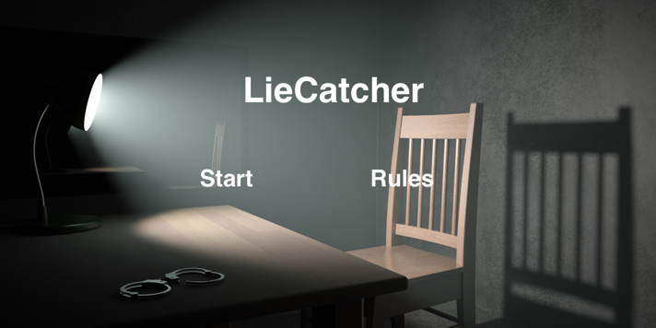
LieCatcher

Slide 46
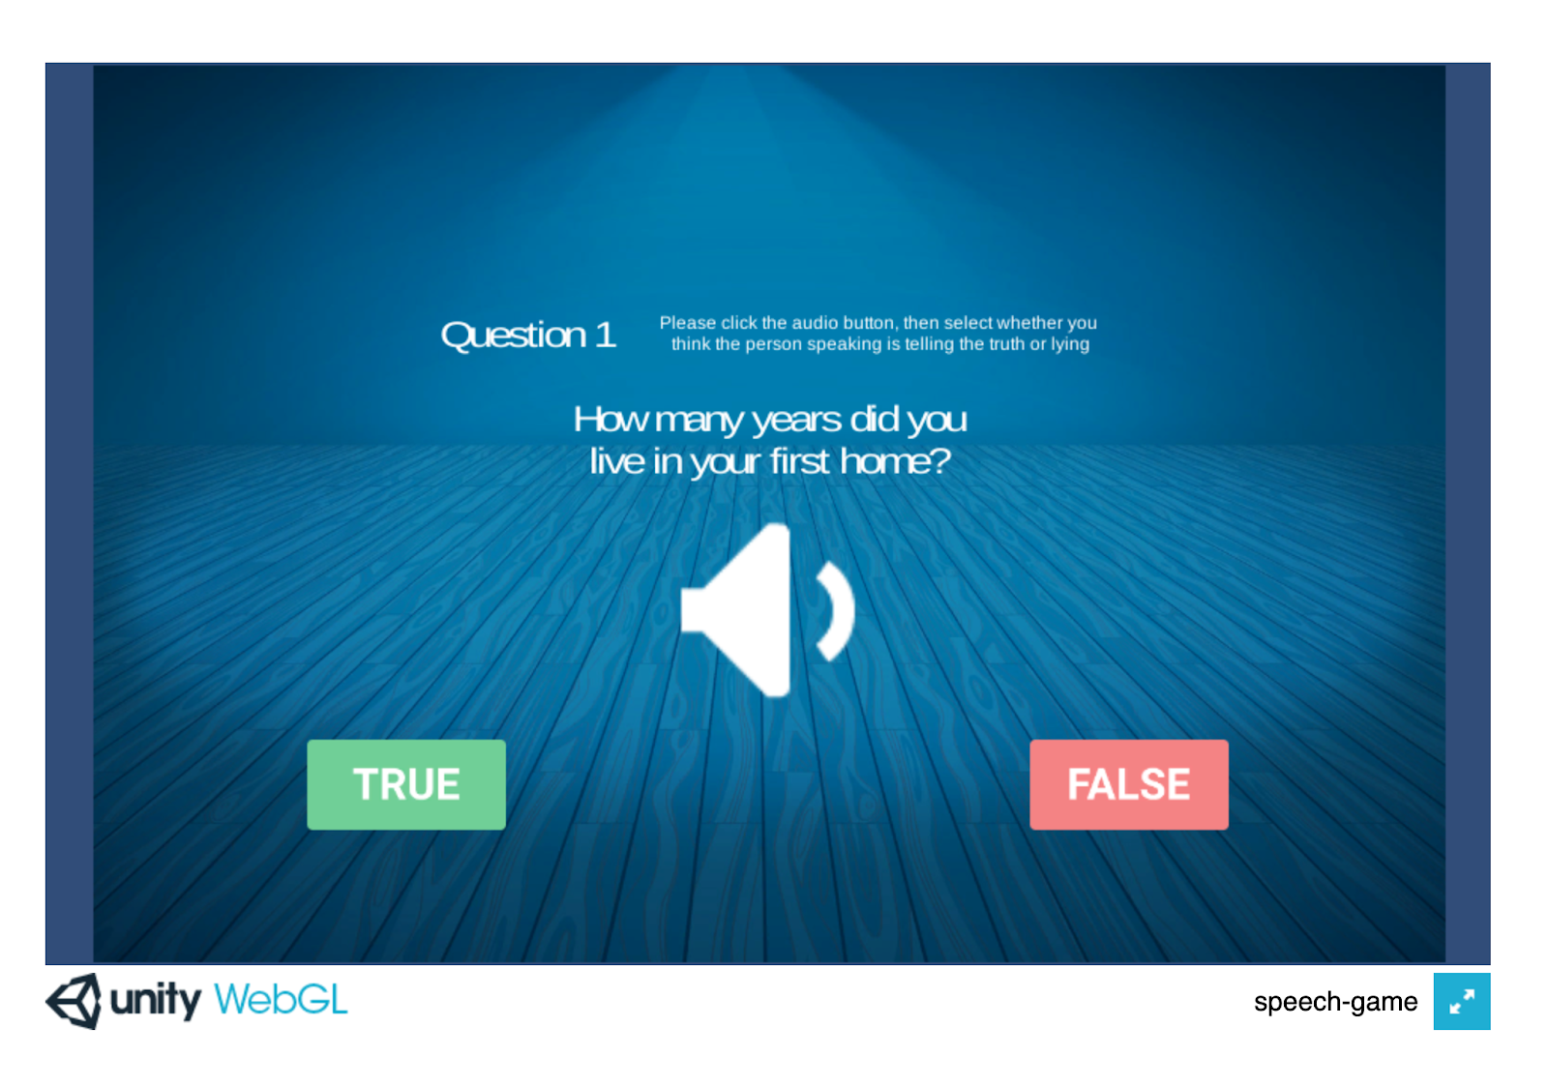

Slide 47

Crowdsourcing Study
5,340 utterances
3 judgments per utterance
431 unique annotators
38.9% male, 59.1% female, 2.1% unreported
Notes:
13 per task, balanced by gender, native language, veracity

Slide 48
Lie Detection Ability
Overall accuracy = 49.93%
Fleiss’ kappa: 0.135
Truth bias – 65% trusted
  Truth Default Theory (T.R. Levine, 2014)

Slide 49
Features Examined
Disfluency “um…er”
Complexity more words, more detailed
Affect sentiment
Uncertainty “sort of”, “probably”
Creativity difference from “standard” responses for same question
Prosody pitch, speaking rate, loudness

Slide 50
Disfluency
Features | Trust | Deception
Has filled pause | ↓↓↓↓ | ↑↑↑↑
# filled pause | ↓↓↓↓ | ↑↑↑↑
Response latency | ↓↓↓↓
Repetition | ↓↓↓↓ | ↑
False start | ↓↓↓ | ↑↑
↓ indicates negative relationship; ↑ indicates positive relationship
↓: <.05, ↓↓ : <.01, ↓↓↓ : <.001, ↓↓↓↓ : <.0001

Slide 51
Prosody
Features | Trust | Deception
Speaking rate | ↑↑↑↑
Pitch max | ↑↑↑↑ | ↑↑↑↑
Pitch mean | ↑↑
Pitch std | ↑↑ | ↑↑
Intensity max |  | ↑↑↑
Intensity mean | ↑↑↑↑
Intensity std | ↓↓↓↓ | ↑
Jitter, shimmer, nhr | ↑↑↑↑
↓ indicates negative relationship; ↑ indicates positive relationship
↓: <.05, ↓↓ : <.01, ↓↓↓ : <.001, ↓↓↓↓ : <.0001

Slide 52
Characteristics of Successful Lies
Features | Successful Lie
Duration | ↓↓↓↓
Speaking rate | ↑↑↑↑
Response latency | ↓↓↓↓
Intensity mean | ↑↑↑↑
Repetition | ↓↓↓↓
Filled pauses | ↓↓↓↓

Slide 53
Analysis of strategies
Ask raters to provide strategies that they used
Annotate strategies by category
Investigate which strategies are useful

Slide 54
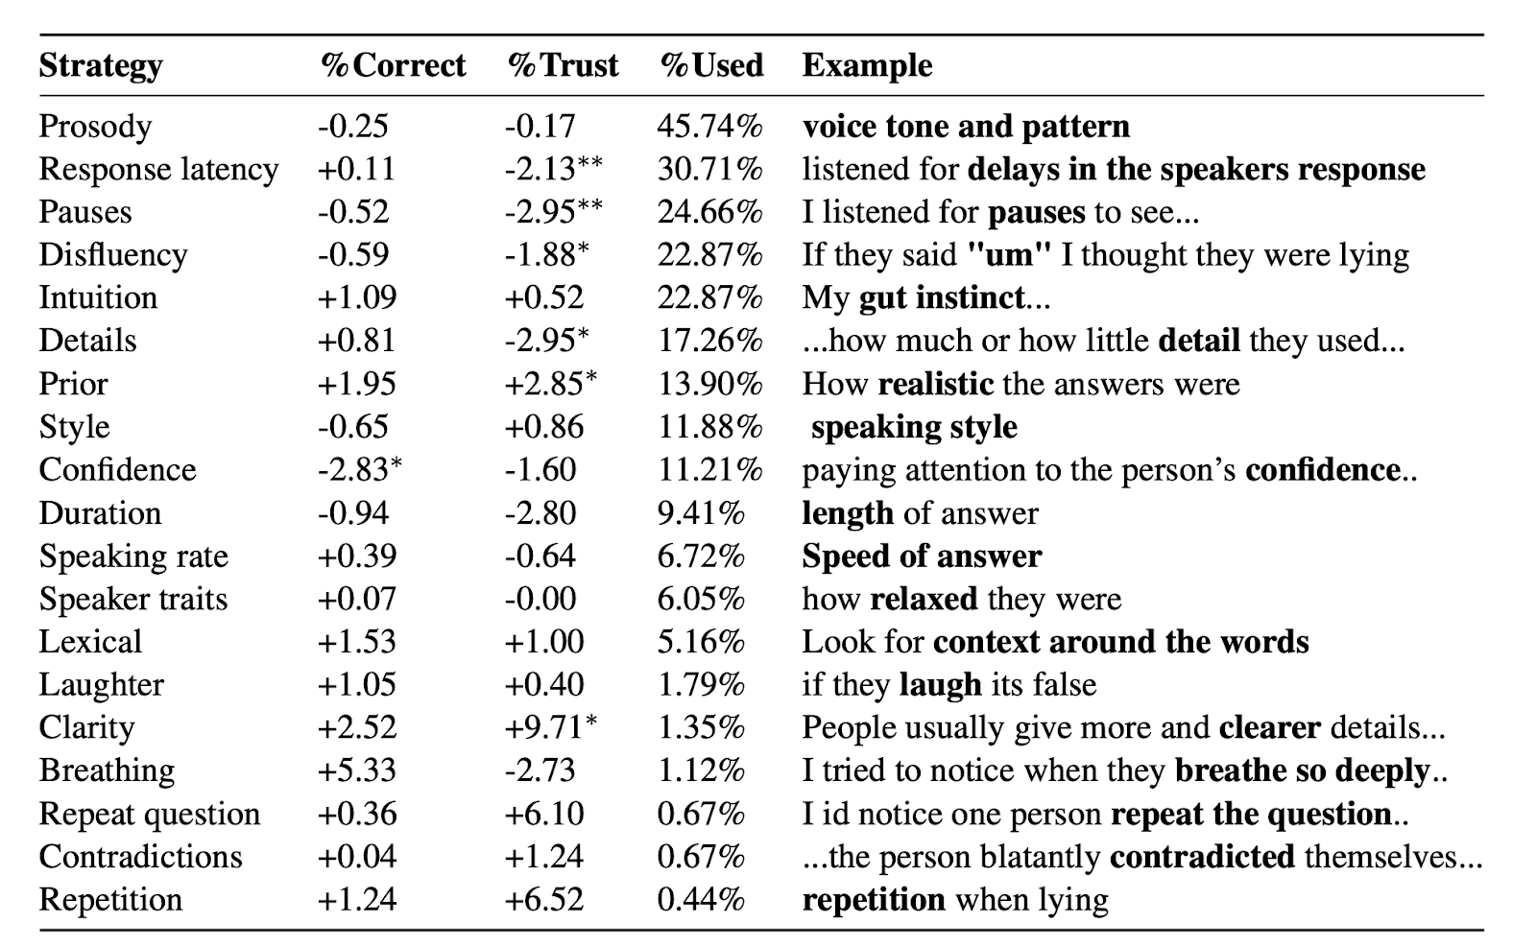

Slide 55
Does complex reasoning help?
How long do people take to make judgments?
  no correlation between the response time and whether the answer is correct (spearman, ρ=0.008, p>0.05)
  negative correlation between the response time and whether the answer is trusted (spearman, ρ=-0.101, p<0.0001)
How many strategies do people use?
  no correlation between the number of strategies and the score (spearman, ρ=0.029, p>0.05)
  a negative correlation between the percentage of utterances that annotators trust and the number of strategies they use (spearman, ρ=-0.133, p<0.01)

Slide 56
Can we predict trusted speech?
5-fold cross validation, speaker independent
Low agreement task -> only classify utterances with consensus
Logistic regression
Evaluate with macro-F1
Baseline (random): 44.62 F1

Slide 57
Can we predict trusted speech?
NLP Data-driven features
  GloVe embeddings
  Dependency parse n-grams
  Word n-grams
Hypothesized deception features
  Disfluency
  Complexity
  Prosody
  Speaker traits

Slide 58
Trust classification results

Slide 59
Summary: Trusted Speech
Subjective task
Characteristics of trust vs. deception
Trust classification: 66.62 F1
Why people are bad at lie detection:
  Mismatch between features of trusted and truthful speech
  Ineffective strategies reported

Slide 60
Ongoing/Future Work
Trusted speech:
  Synthesize trustworthy voices, evaluate
  Analyze discourse features
Trusted news:
  Scale up to social media analysis

Slide 61
Contributions
Large-scale corpus of deceptive dialogues
Acoustic-prosodic and linguistic cues to deception
Automatic deception classification: >70% accuracy
Crowdsourced study of deception perception
Identified characteristics of trusted speech
Predictive models for trusted speech detection

Slide 62
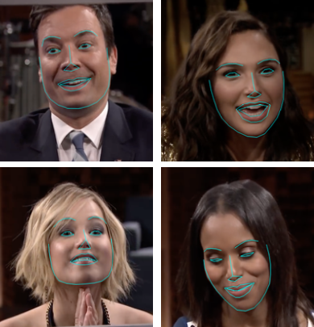
Multimodal Real-World Deception Detection

Slide 63
Publications
Acoustic-prosodic and lexical cues to deception and trust: Deciphering how people detect lies. X. Chen, S.I. Levitan, M. Levine, M. Mandic, J. Hirschberg. TACL 2020.
Acoustic-prosodic indicators of deception and trust in interview dialogues. S.I. Levitan, A. Maredia, J. Hirschberg. Interspeech 2018.
Deep personality recognition for deception detection. G. An, S.I. Levitan, J. Hirschberg, R. Levitan. Interspeech 2018.
Acoustic-prosodic and lexical entrainment in deceptive dialogue. S.I. Levitan, J. Xiang, J. Hirschberg. Speech Prosody 2018.
Linguistic cues to deception and perceived deception in interview dialogues. S.I. Levitan, A. Maredia, J. Hirschberg. NAACL 2018.
LieCatcher: game framework for collecting human judgments of deceptive speech. S.I. Levitan, J. Shin, I. Chen, J. Hirschberg. Games4NLP, LREC workshop 2018.

Slide 64
Publications
Hybrid acoustic-lexical deep learning approach for deception detection. G. Mendels, S.I. Levitan, K.Z. Lee, J. Hirschberg. Interspeech 2017.
Combining acoustic-prosodic, lexical, and phonotactic features for automatic deception classification. S.I. Levitan, G. An, M. Ma, R. Levitan, A. Rosenberg, J. Hirschberg. Interspeech 2016.
Automatically classifying self-rated personality scores from speech. G. An, S.I. Levitan, R. Levitan, A. Rosenberg, M. Levine, J. Hirschberg. Interspeech 2016.
Identifying individual differences in gender, ethnicity, and personality from dialogue for deception detection. S.I. Levitan, Y. Levitan, G. An, M. Levine, R. Levitan, A. Rosenberg, J. Hirschberg. NAACL workshop CADD 2016.
Cross-cultural production and detection of deception from speech. S.I. Levitan, G. An, M. Wang, G. Mendels, J. Hisrchberg, M. Levine, A. Rosenberg. ICMI WMDD 2015.
Individual differences in deception and deception detection. S.I. Levitan, M. Levine, J. Hirschberg, N. Cestero, G. An, A. Rosenberg. Cognitive 2015. (Best paper award)

Slide 65


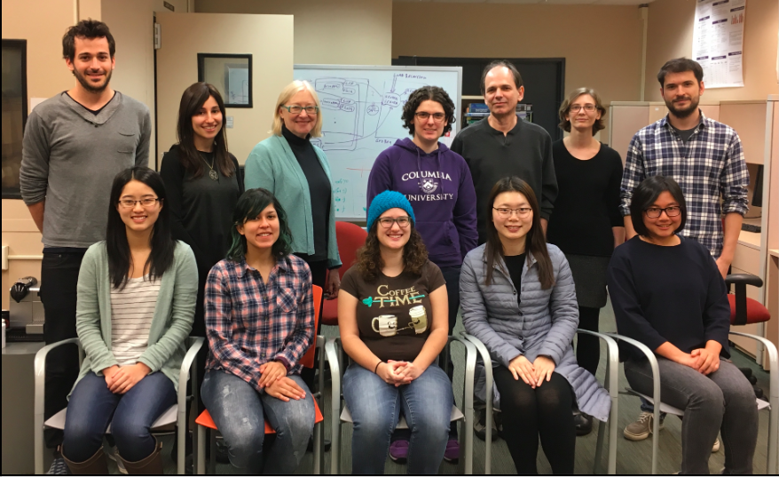
Thank you!
Julia Hirschberg
Michelle Levine
Angel Maredia
Jessica Xiang
Arthur Shen
Marco Mandic
Eric Bolton
Xi Chen
William Wang
James Shin

