Slide 1
Emotion and Sentiment Detection
Zixiaofan (Brenda) Yang
COMS 6998
April 2020

Slide 2
Outline
Emotion in speech
  Emotion theory
  Emotional speech corpora
  Features for emotional speech
  Models for emotion recognition
  Expressive synthetic speech
Sentiment and emotion in text

Slide 3
Emotion in Speech

Slide 4
Outline
Emotion in speech
  Emotion theory
  Emotional speech corpora
  Features for emotional speech
  Models for emotion recognition
  Expressive synthetic speech
Sentiment and emotion in text

Slide 5
What is Emotion?
Two families of theories of emotion
  Categorical approach
    Emotions are categories
    Limited number of basic emotions
  Dimensional approach
    Emotions are dimensions
    Limited number of labels but unlimited number of emotions

Slide 6
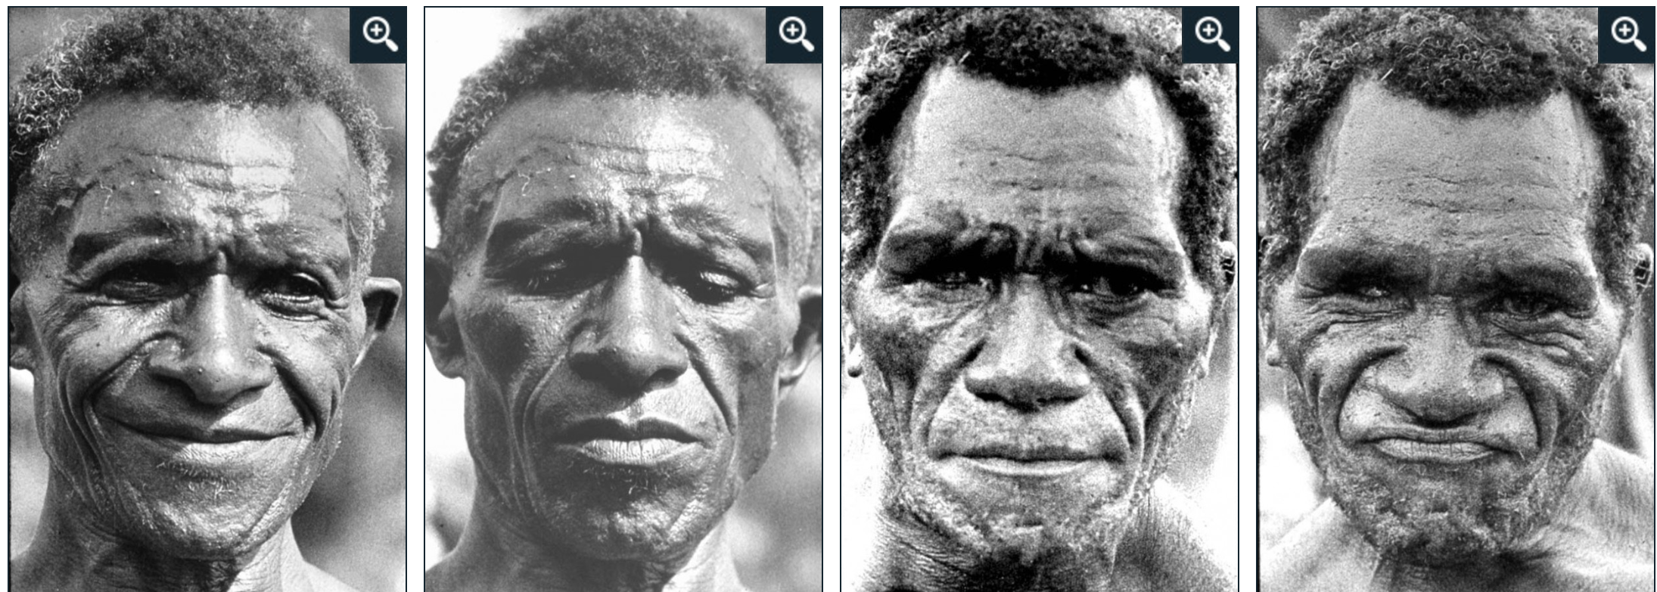
Emotion - Categorical Approach
(Ekman et al., 1987)
Discrete ‘basic emotions’
Originate from facial expressions
?
Anger Sadness Disgust Happiness

Slide 7
Emotion - Categorical Approach
(Ekman et al., 1987)
Discrete ‘basic emotions’
Originate from facial expressions
?
Anger Sadness Disgust Happiness

Slide 8
Emotion - Dimensional Approach
(Russell and Barrett, 1999)
Continuous multi-dimensional space
Common physiological system

Slide 9
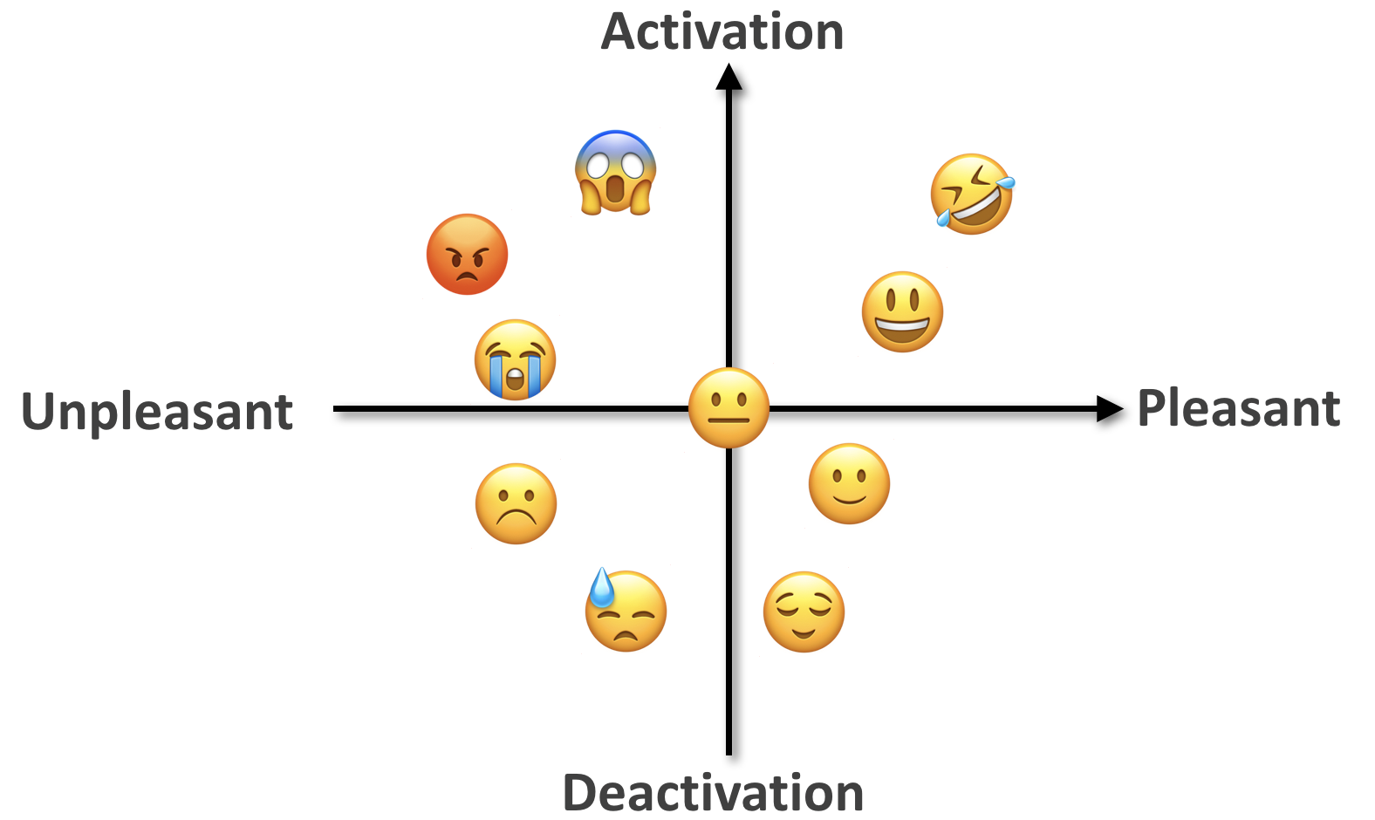
Emotion - Dimensional Approach
(Russell and Barrett, 1999)
Continuous multi-dimensional space
Common physiological system
Arousal-Valence space

Slide 10
Why Study Emotional Speech?
Recognition
  Customizing virtual assistants
  Anger/frustration in call centers
  Confidence/uncertainty in online tutoring systems
  “Hot spots” in meetings
Generation
  TTS for virtual assistants, computer games, etc.
Other applications: Speaker state identification
  Deception, charisma, sleepiness, interest, humor…
Some emotional clues are only in speech

Slide 11
Outline
Emotion in speech
  Emotion theory
  Emotional speech corpora
  Features for emotional speech
  Models for emotion recognition
  Expressive synthetic speech
Sentiment and emotion in text

Slide 12

Emotion in Speech
Acted speech
  Easier to collect & control
  Extreme emotions
Mostly categorical approach
Examples: (Emotional Prosody Speech)
  Which emotion do you hear?
Spontaneous speech
  Harder to collect & annotate
  Subtle changes in emotion
Both categorical & dimensional approach

Slide 13
Emotion in Speech
Acted speech
  Easier to collect & control
  Extreme emotions
Mostly categorical approach
Examples: (Emotional Prosody Speech)
  Happy, Sad, Angry, Bored
Spontaneous speech
  Harder to collect & annotate
  Subtle changes in emotion
Both categorical & dimensional approach

Slide 14
Emotion in Speech
Acted speech
  Easier to collect & control
  Extreme emotions
Mostly categorical approach
Examples: (Emotional Prosody Speech)
  Happy, Sad, Angry, Bored
Spontaneous speech
  Harder to collect & annotate
  Subtle changes in emotion
Both categorical & dimensional approach
Example: (AT&T “How May I Help You?” System)
  Categorical emotion(s)?
  Arousal and Valence?

Slide 15
Emotion in Speech
Acted speech
  Easier to collect & control
  Extreme emotions
Mostly categorical approach
Examples: (Emotional Prosody Speech)
  Happy, Sad, Angry, Bored
Spontaneous speech
  Harder to collect & annotate
  Subtle changes in emotion
Both categorical & dimensional approach
Example: (AT&T “How May I Help You?” System)
  Neutral -> frustrated -> angry
  Arousal ↑, Valence ↓

Slide 16
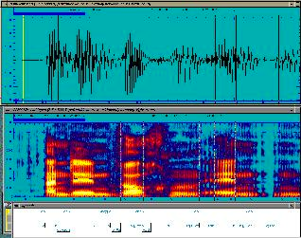
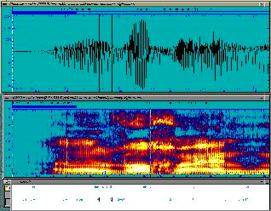
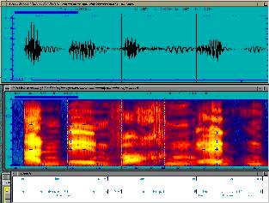
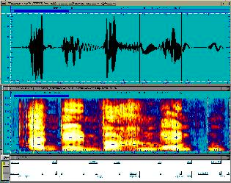
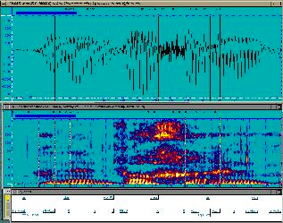
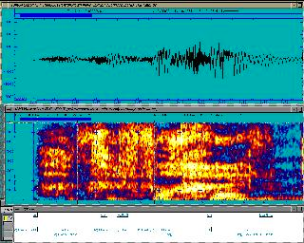
Emotional Speech Corpora - Acted & Categorical
(EmoDB, German)
Neutral
Bored
Angry
Happy
Sad
Frightened

Slide 17
Acted & Categorical Speech: Actors vs Students
(Emotional Prosody Speech) (Mandarin Affective Speech)
Anger
Elation
Neutral
Panic
Sadness
Sad
Happy
Angry
Bored
Interested

Slide 18
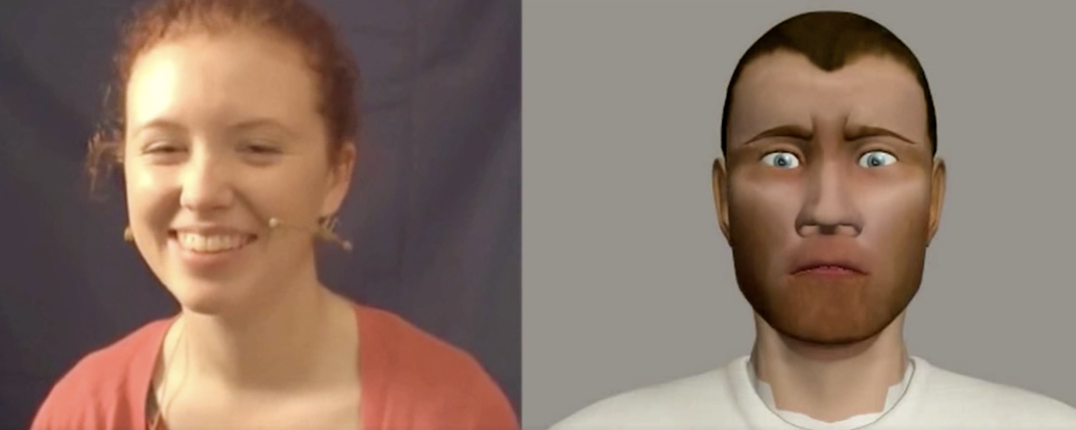
Spontaneous Speech with Dimensional Annotations
(SEMAINE database)
The goal of the Sensitive Artificial Listener operator (right) is to engage the user (left) in emotional conversations
    “Anything nice happened this week?” “It’s all rubbish.”
6-8 annotators. Annotations range from -1 to 1 with 20ms intervals.
  Valence score : -0.88
  Valence score : 0.58
  Valence score : 0.83

Slide 19
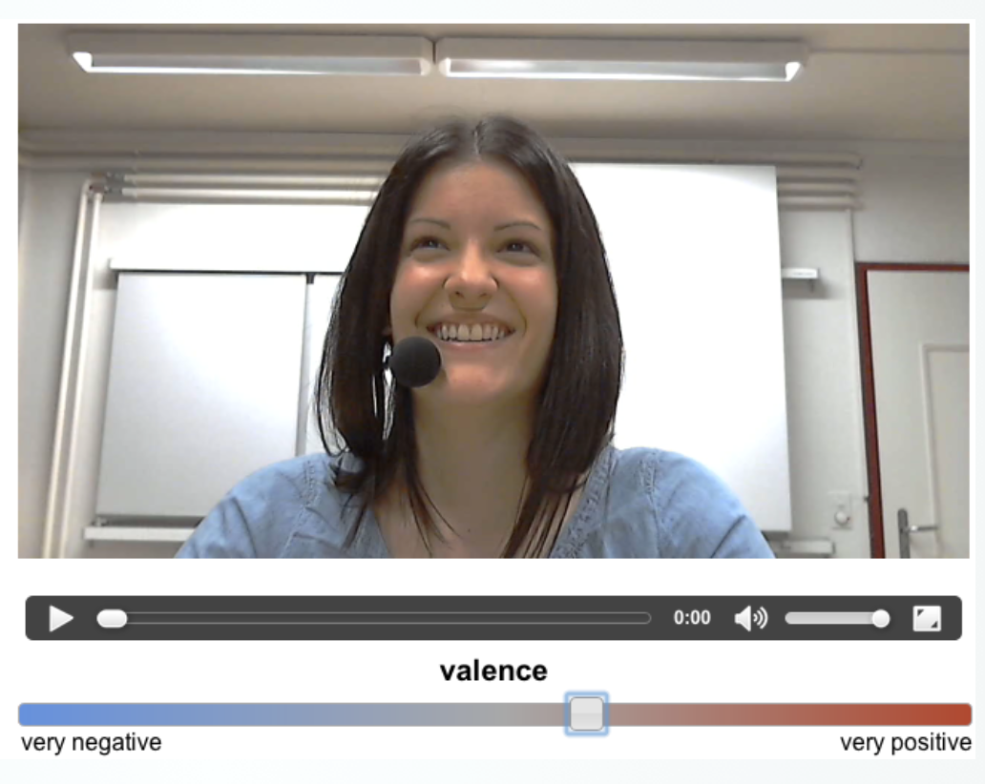
Spontaneous Speech with Dimensional Annotations
(RECOLA database)
3 hours of audio, visual, and physiological recordings of between 46 French speaking participants
Participants were asked to reach consensus on how to survive in a disaster scenario
6 annotators. Annotations range from
-1 to 1 with 40ms intervals.

Slide 20


Spontaneous Speech with Dimensional Annotations
(RECOLA database)
Arousal
Valence
Arousal
Valence

Slide 21
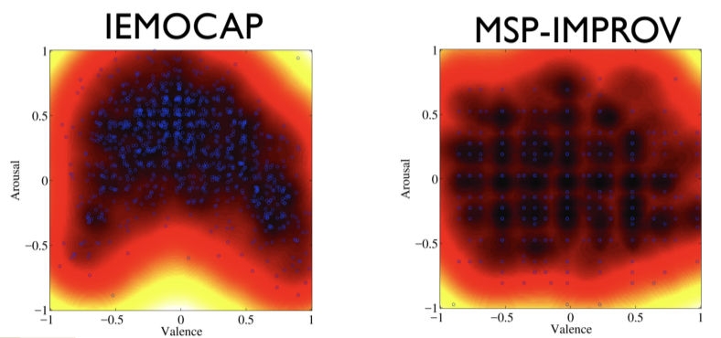
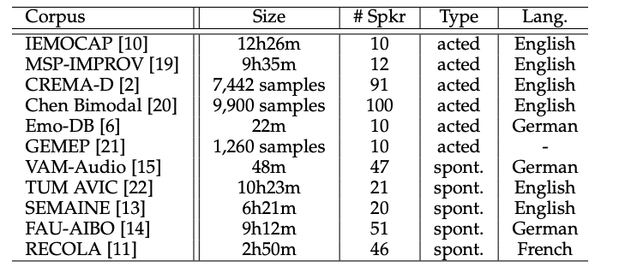
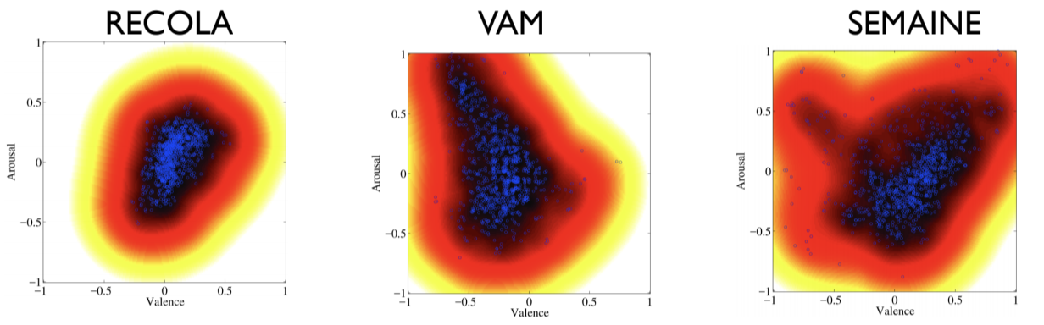
Partial List of the Existing Emotion Corpora
Lack of naturalness (acted)
Unbalanced emotional content (spontaneous)
Limited in size, limited number of speakers
Acted
Spontaneous

Slide 22
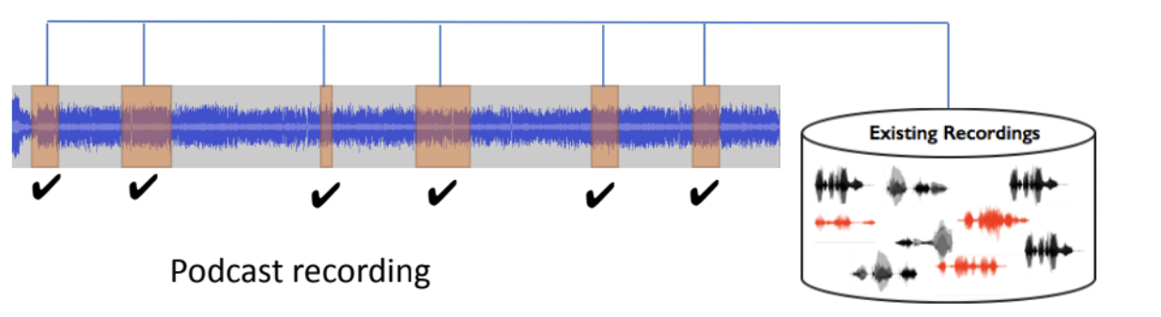
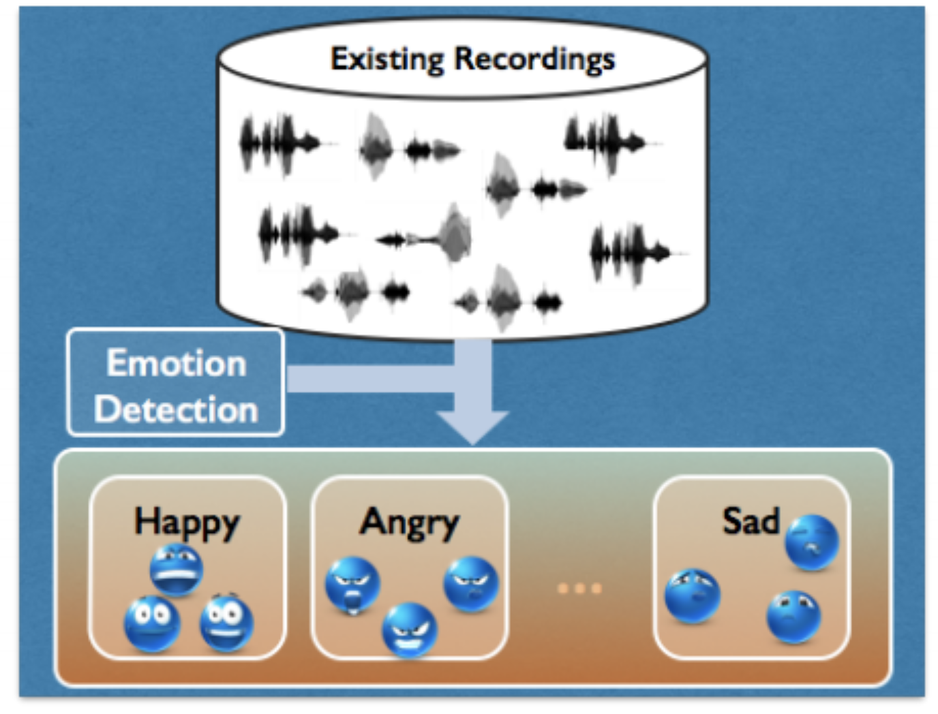
MSP-Podcast Corpus
Use existing podcast recordings, divided into speaker turns
Emotion retrieval to balance the emotional content
Annotate using crowdsourcing framework
843 speakers, 43,797 speaking turns
~73 hours of speech (data collection is still ongoing)

Slide 23
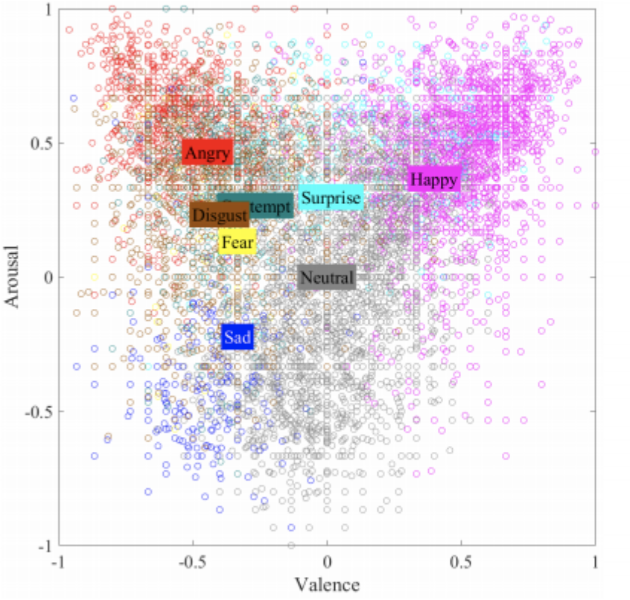
MSP-Podcast Corpus
Annotations
  Dimensional: activation, valence, dominance
  Categorical: anger, happiness, sadness, disgust, surprised, fear, contempt, neutral and other
Emotion distribution
in arousal/valence space
Rater disagreement per emotion category

Slide 24
Outline
Emotion in speech
  Emotion theory
  Emotional speech corpora
  Features for emotional speech
  Models for emotion recognition
  Expressive synthetic speech
Sentiment and emotion in text

Slide 25
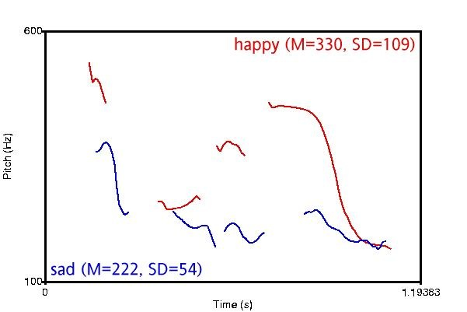
Features for Emotional Speech - Pitch
Different Valence / Different Arousal

Slide 26
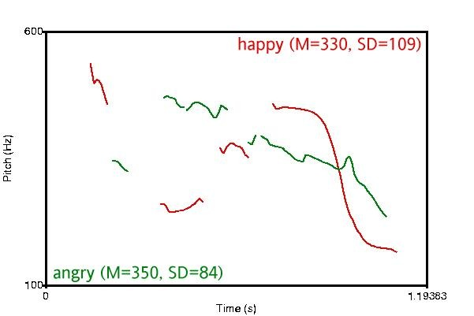
Features for Emotional Speech - Pitch
Different Valence / Same Arousal

Slide 27
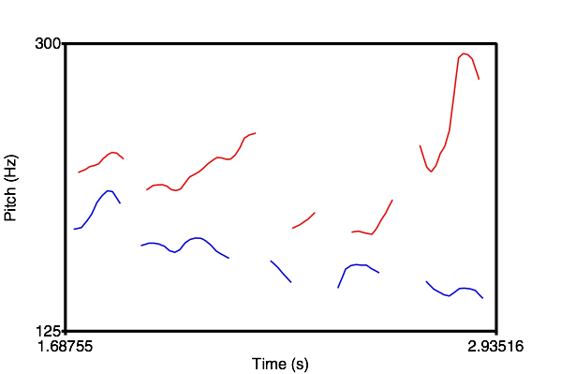
Pitch Contour Differences
Very Frustrated
Somewhat Frustrated

Slide 28
Features for Emotional Speech

Slide 29
Outline
Emotion in speech
  Emotion theory
  Emotional speech corpora
  Features for emotional speech
  Models for emotion recognition
  Expressive synthetic speech
Sentiment and emotion in text

Slide 30
Emotion Recognition in Speech
Categorical Approach
Discrete ‘basic emotions’
Classification problem
Dimensional Approach
Continuous Arousal - Valence space
Regression problem

Slide 31
Emotion Recognition - Categorical
(Dellaert et al., 1996)
Emotions: happiness, sadness, anger, fear, normal
Data: 5 speakers * 5 emotions * 50 utterances = 1250
Human performance on 4-way classification: 82% (anger easiest, fear hardest)
Features: rhythm, smoothed pitch, individual voiced parts
Best model (KNN with majority voting of specialists): 79.5%

Slide 32
Emotion Recognition - Categorical
(Petrushin, 1999)
Dataset 1
  Emotions: happiness, anger, sadness, fear, and normal
  Data: (30+5) speakers * 5 emotions * 4 utterances = 700
  Human performance: 63.5% (anger easiest, fear hardest)
  Features: F0, energy, speaking rate, first three formants and their bandwidths
  Best model: feature selection + ensembles of 15 neural networks
    Normal: 60-75%, happiness: 60-70%, anger: 70-80%, sadness: 70-85%, fear: 35-55%
    Average: ~70%

Slide 33
Emotion Recognition - Categorical
(Petrushin, 1999)
Dataset 2 (call centers)
  Distinguish between two states:
    “Agitation”: anger, happiness and fear
    “Calm”: normal state and sadness
  Data: 56 telephone messages (15~90 seconds)
    Automatically split into 1-3 second chunks
  Model: feature selection + ensembles of neural networks
  Average accuracy: 77%

Slide 34
Emotion Recognition - Categorical
(Liscombe et al., 2003)
10 emotions and neutral
  ‘Positive’ valence: confident, encouraging, friendly, happy, interested
  ‘Negative’ valence: angry, anxious, bored, frustrated, sad
Subset: 4 speakers * (10+1) emotions = 44
Human rating: Emotions in the same valence group are positively correlated; vise versa
Features: Pitch, energy, speaking rate; nuclear accent, pitch contour
Results:
  Pitch, energy, and speaking rate are correlated with arousal
  Spectral tilt and pitch contour are correlated with valence

Slide 35
Emotion Recognition - Categorical
(Liscombe et al., 2003)
Full dataset (EPSaT): 1760 utterances
Acoustic-prosodic features:
  Pitch, energy, speaking rate; nuclear accent, pitch contour
Accuracy: ~75%
Feature selection:
  Some single features performed as well or better than the entire feature set

Slide 36
Emotion Recognition - Categorical
(Jin et al., 2015)
Emotions: happy, angry, sad, and neutral
Data (USC-IEMOCAP): 5531 utterances
Features:
  Acoustic: openSMILE (intensity, F0, jitter, shimmer and MFCCs)
  Lexical: emotion vector (eVector), Bag-of-Words (BoW)
Best model: SVM, late fusion of acoustic and lexical features
Accuracy: 69.2%

Slide 37
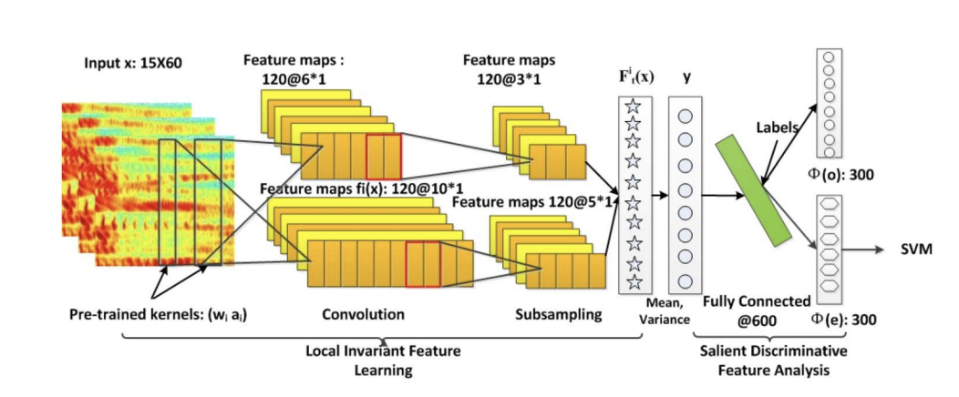
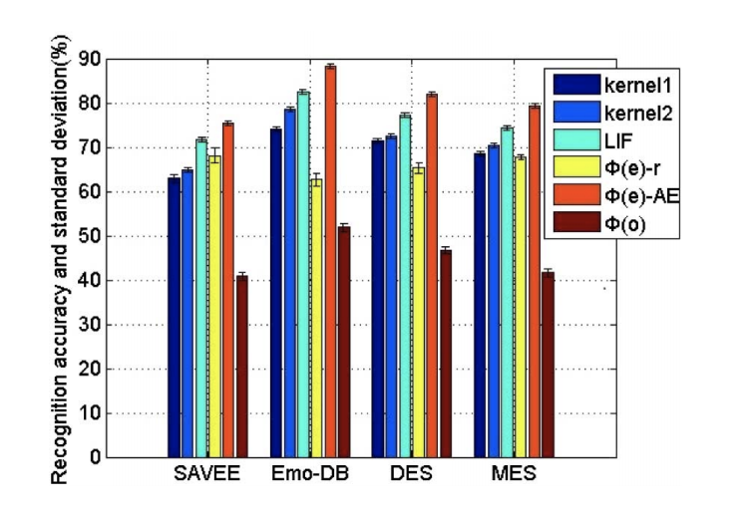
Emotion Recognition - Categorical
(Mao et al. 2014)
Learning emotion from spectrograms
Evaluation on 4 datasets:
  anger, disgust, fear, happiness, sadness, surprise, and neutral
  anger, disgust, fear, joy, sadness, boredom, and neutral
  anger, joy, surprise, sadness, and neutral
  anger, joy, surprise, sadness, and disgust

Slide 38
Emotion Recognition in Speech
Categorical Approach
Discrete ‘basic emotions’
Classification problem
Dimensional Approach
Continuous Arousal - Valence space
Regression problem

Slide 39
Emotion Recognition - Dimensional
(Karadogan and Larsen, 2012)
Emotion: arousal, valence (discrete value 1~9 for each dimension)
Data: 59 short movie clips (5~25 seconds)
Features and models:
  Acoustic: openSMILE, feature selection, support vector regression
  Lexical: affective norms for English words (ANEW) for keywords with arousal & valence scores + latent semantics analysis (LSA) to generate emotion scores for other words
Results (mean absolute error): arousal: 1.28, valence: 1.40
Semantic features-> valence, acoustic features -> arousal

Slide 40
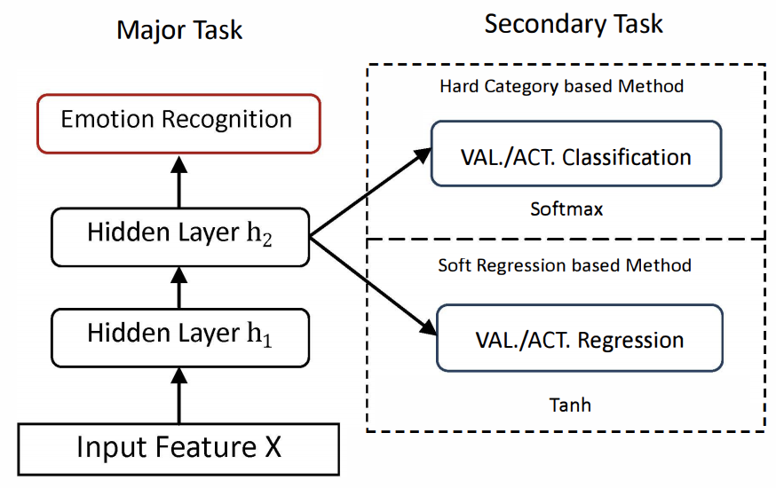
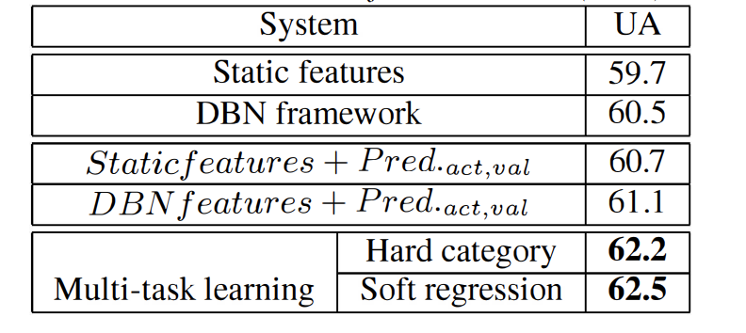
Emotion Recognition - Dimensional
(Xia and Liu, 2015)
Major task: angry, happy, sad, and neutral
Secondary task: valence, activation
  Classification
    map the continuous labels into low, medium, high
  Regression
    project the continuous labels into [-1,1] range
Data (USC-IEMOCAP): 5531 utterances
Features: openSMILE
Model: Deep Belief Network (DBN) + SVM

Slide 41
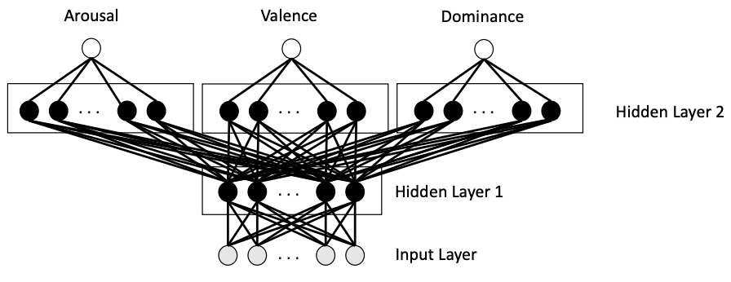
Emotion Recognition - Dimensional
(Parthasarathy and Busso, 2017)
Emotion: arousal, valence, dominance (discrete value 1~7 scaled to [-1,1])
Data (MSP-PODCAST): 12,621 speech segments (2~11 seconds)
Features: openSMILE
Best multi-task learning model: shared first layer, individual second layer
Results: A: 0.7635, V: 0.2894, D: 0.7130
Multi-task learning helps
  Dominance > valence > arousal
  Learn better representations

Slide 42
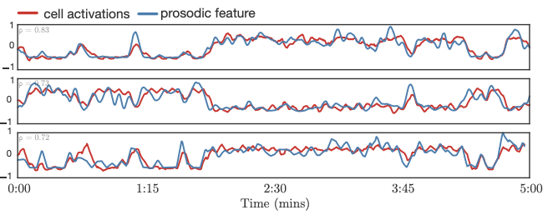
Emotion Recognition - Dimensional
(Trigeorgis et al., 2016)
Emotion: arousal, valence (continuous value [-1,1])
Data (RECOLA): 46 French conversations, 5 min each
Feature: raw waveforms
Model: convolutional recurrent neural networks
Results (Concordance correlation coefficient): arousal: 0.686, valence: 0.261
Some cells learn acoustic features automatically
  Range of RMS energy (ρ = 0.81)
  Loudness (ρ = 0.73)
  Mean of fundamental frequency (ρ = 0.72)

Slide 43
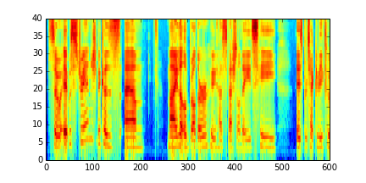
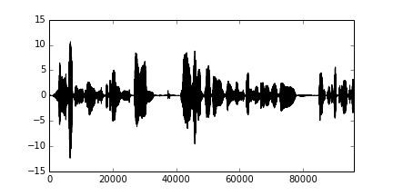
Emotion Recognition - Dimensional
Spectrogram
Waveform
Do spectrograms and waveforms contain complementary information for emotion recognition in speech?

Slide 44
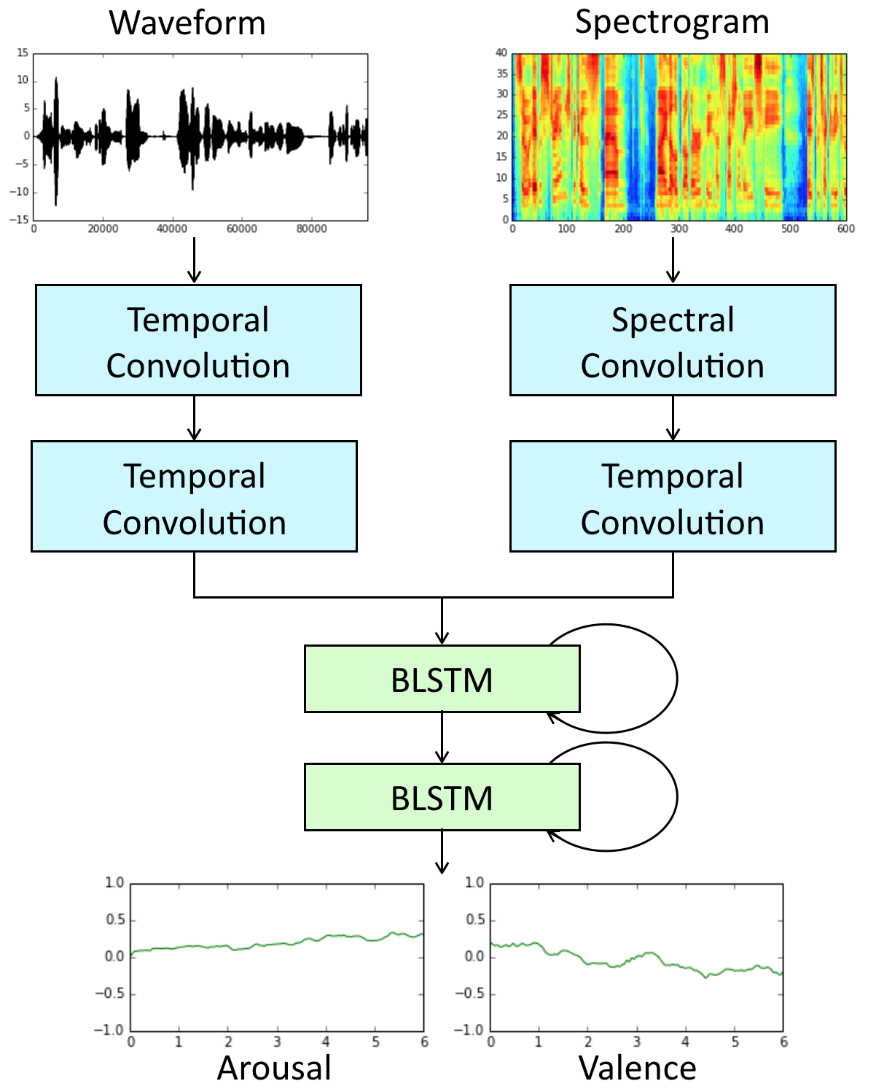
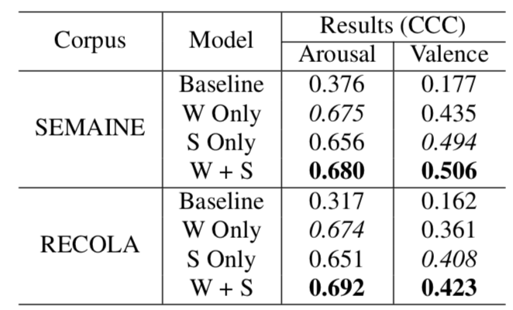
Emotion Recognition - Dimensional
(Yang and Hirschberg, 2018)
Input: raw waveform and spectrogram
Model: convolutional recurrent neural networks
Task: Predict arousal and valence
  Continuous in both time and value
Results:

Slide 45
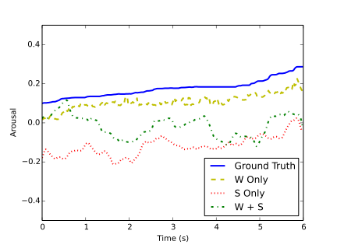
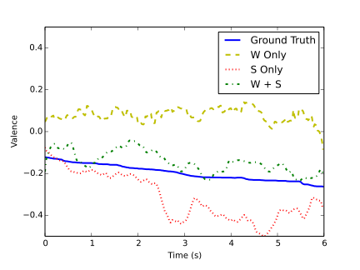
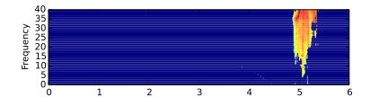
Example Analysis - Dimensional
Arousal
Valence
Local
Interpretable
Modelagnostic
Explanations
(LIME)
“…cos she’s so frigging superior"

Slide 46
Outline
Emotion in speech
  Emotion theory
  Emotional speech corpora
  Features for emotional speech
  Models for emotion recognition
  Expressive synthetic speech
Sentiment and emotion in text

Slide 47
Expressive Synthetic Speech
http://emosamples.syntheticspeech.de/
Murtaza Bulut (2005): neutral anger
Greg Beller (2005): neutral sad
Acapela (2013): neutral happy sad
bad guy from afar
Laughters: Greg Beller(2009)
                Shiva Sundaram(2007)

Slide 48

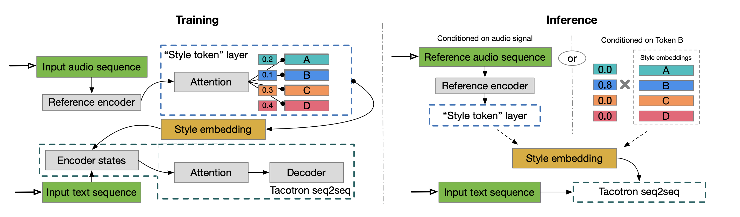
Expressive Synthetic Speech
Tacotron (/täkōˌträn/): An end-to-end speech synthesis system by Google
Tacotron + Style Tokens (Wang et al. 2018)
“United Airlines five six three from Los Angeles to New Orleans has Landed.”
  5 different “styles”:

Slide 49
Expressive Synthetic Speech
Tacotron (/täkōˌträn/): An end-to-end speech synthesis system by Google
Tacotron + Style Tokens (Wang et al. 2018)
“Here you go, a link for Biondo Racing Products and other related pages.”
  Style token A (-0.3/0.1/0.3/0.5):

Slide 50
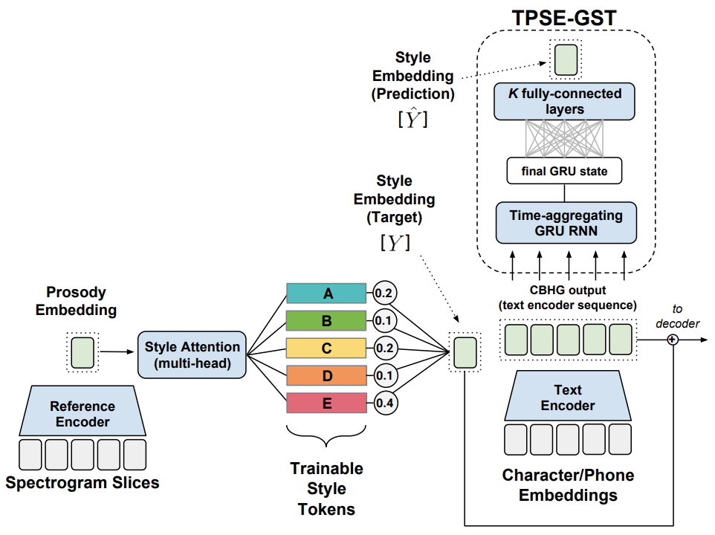
Expressive Synthetic Speech
Tacotron (/täkōˌträn/): An end-to-end speech synthesis system by Google
Tacotron + predicting Style Tokens from text (Stanton et al. 2018)
"Thirty-six," he said, looking up at his mother and father. "That's two less than last year." "Darling, you haven't counted Auntie Marge's present, see, it's here under this big one from Mommy and Daddy.”
Tacotron
Tacotron + predicted style token

Slide 51
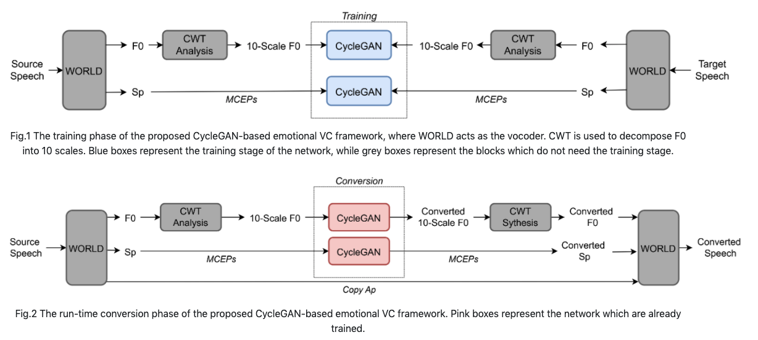

Emotional Voice Conversion
(Zhou et al., 2020)
Neutral
Anger
Converted
Neutral
Sad
Converted

Slide 52
Sentiment and Emotion in Text

Slide 53
English Sentiment Lexicon
The General Inquirer (Stone et al. 1966)
  Positive (1915), Negative (2291), Strong vs Weak, Pleasure, Pain, etc.
LIWC (Linguistic Inquiry and Word Count)
  Negative emotion (anxiety, anger, sadness); Positive emotion
MPQA Subjectivity Cues Lexicon
  2718 positive, 4912 negative
Bing Liu Opinion Lexicon
  2006 positive, 4783 negative
SentiWordNet
  WordNet synsets automatically labeled with positivity, negativity, and objectiveness

Slide 54
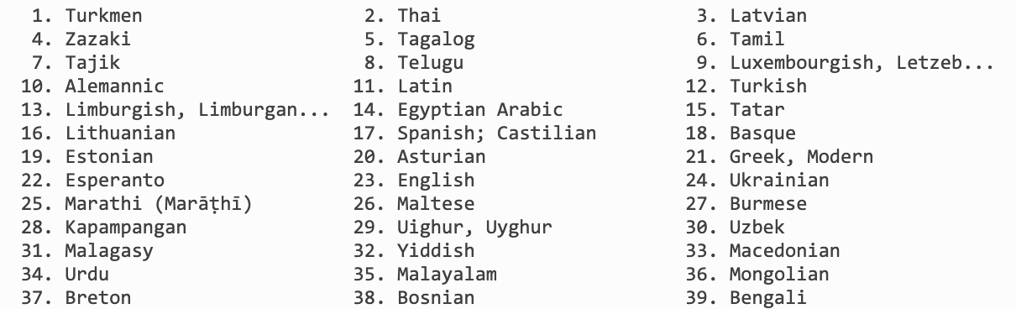
Polyglot (Multilingual text processing toolkit )
Sentiment polarity lexicons for 136 languages
  7,741,544 high-frequency words from 136 languages in Wikipedia
  Use Bing Liu Opinion Lexicon (English) as seed
  Wiktionary + Google Translation + Transliteration + WordNet to generate edges between words
  Propagate sentiment labels through the edges

Slide 55
Plutchick’s wheel of emotion
8 basic emotions in four opposing pairs
  joy–sadness
  anger–fear
  trust–disgust
  anticipation–surprise

Slide 56
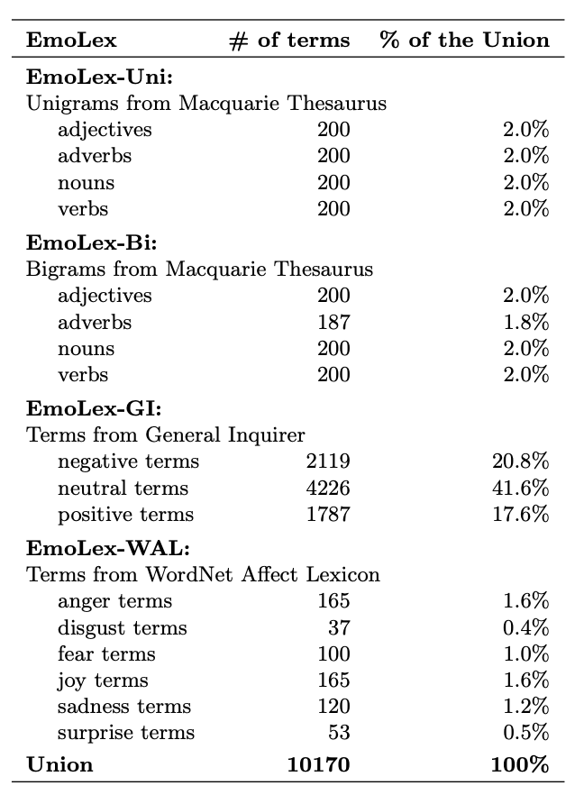
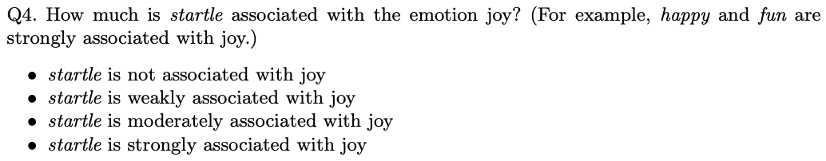
NRC Word-Emotion Association Lexicon
(Mohammad and Turney 2011)
Categorical approach of emotion
10k words chosen mainly from earlier lexicons
Labeled by Amazon Mechanical Turk
  Joy, sadness, anger, fear, trust, disgust, anticipation, surprise; positive, negative

Slide 57
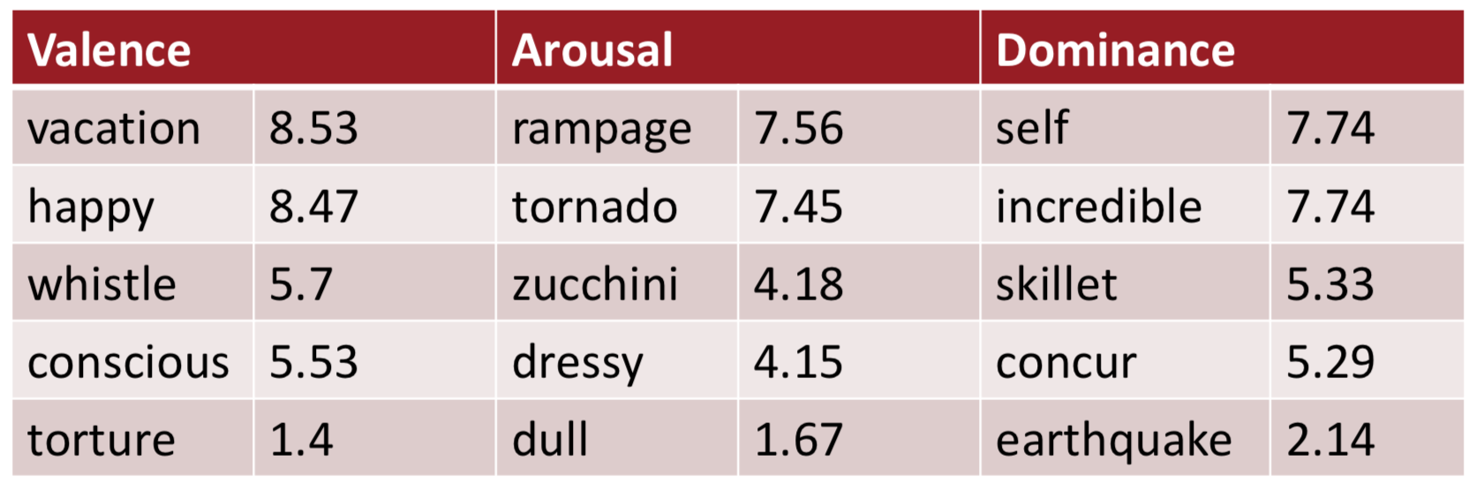
Lexicon of Valence, Arousal, and Dominance
(Warriner at al. 2013)
Dimensional approach of emotion
AMT Ratings for 14,000 words for emotional dimensions
  Valence (the pleasantness of the stimulus)
  Arousal (the intensity of emotion provoked by the stimulus)
  Dominance (the degree of control exerted by the stimulus)
Examples: (range 1-9)

Slide 58
Detecting Sentiment/Emotion in Text
Simplest unsupervised method
  Sum the weights of each positive word in the document
  Sum the weights of each negative word in the document
  Choose whichever value (positive or negative) has higher sum
Simplest supervised method
  Use “counts of lexicon categories” as features (e.g. LIWC)
  Baseline: use all unigram/bigram counts + POS tags
  Hard to beat, but only works if the training and test sets are very similar

Slide 59
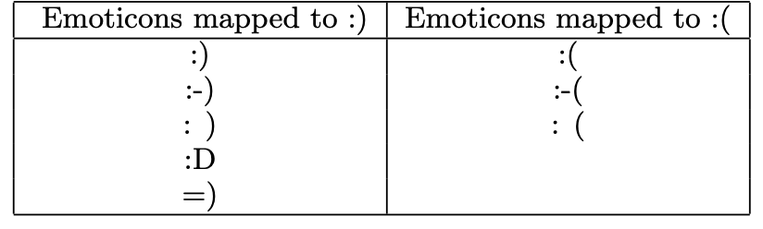
Sentiment in Twitter :) (Go et al. 2009)
Use emoticons to find tweets with sentiment
Training set:
  800k tweets with positive emoticons, and 800k tweets with negative emoticons
  Seed emoticons are stripped off before training
Test set: 359 tweets manually annotated
Accuracy: ~80%

Slide 60
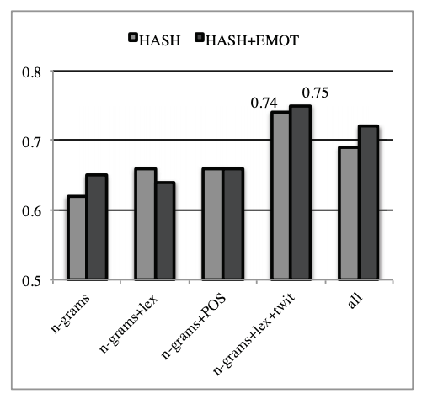
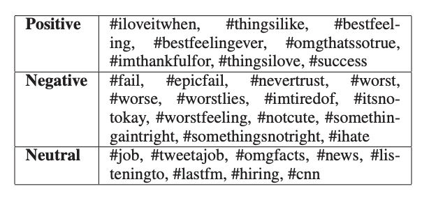
Sentiment in Twitter #thingsilike (Kouloumpis et al. 2011)

Slide 61
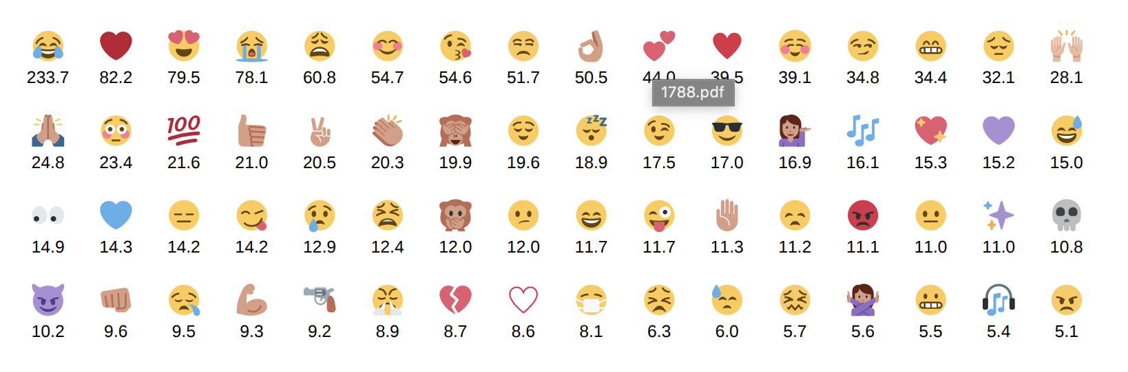
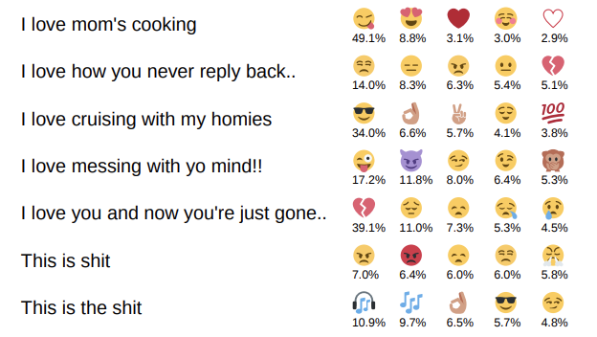
Emoji in Twitter (Felbo et al. 2017)
Number of training data (in millions)
Output: probability of emoji labels

Slide 62
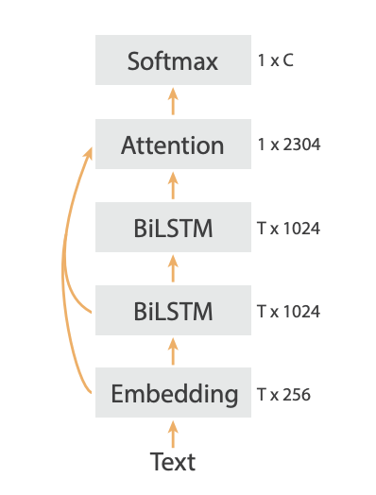
Emoji in Twitter (Felbo et al. 2017)
DeepMoji model architecture

Slide 63
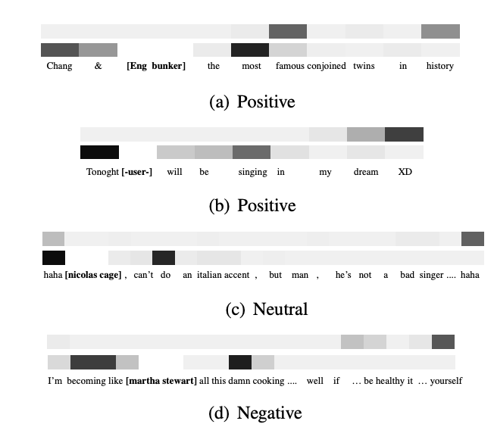
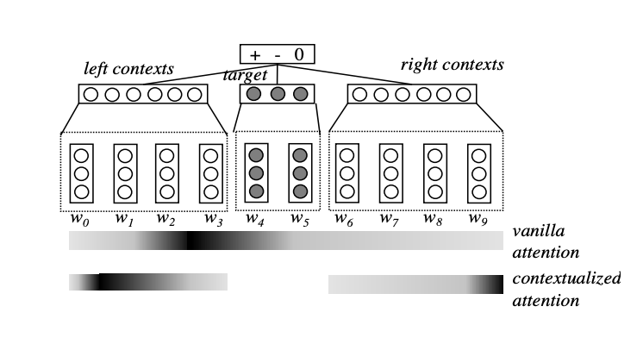
Attention Modeling for Targeted Sentiment
(Liu and Zhang 2017)
Targeted Sentiment
  “She began to love miley ray cyrus since 2013 :)”
  “#nowplaying lady gaga - let love down”

Slide 64
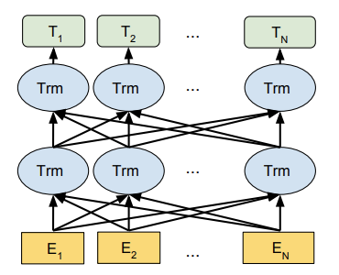
BERT in Sentiment Analysis (Google AI Language)
BERT: Bidirectional Encoder Representations from Transformers
  Transformer: stacked self-attention blocks
Training: mask part of the input tokens at random, then predict those masked tokens

Slide 65
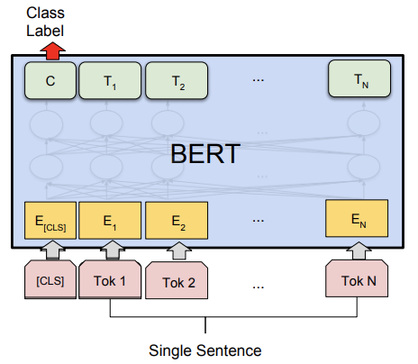
BERT in Sentiment Analysis (Google AI Language)
Fine-tuning for single sentence classification task
  Add a classification layer on the output of [CLS] token
Accuracy on the Stanford Sentiment Treebank dataset: 94.9%

Slide 66
Text Sentiment Analysis Dataset
Product reviews on Amazon
  Multidomain sentiment analysis dataset
  Amazon product data, 143 million reviews
Movie reviews on IMDB
  Cornell movie review data, labeled with sentiment polarity, scale, and subjectivity
  Large Movie Review Dataset v1.0, 25k movie reviews
  IMDB Movie Reviews Dataset, 50k movie reviews
  Bag of Words Meets Bags of Popcorn, 50k movie reviews
Reviews from Rotten Tomatoes
  Stanford Sentiment Treebank, 11k reviews

Slide 67
Text Sentiment Analysis Dataset
Tweets with emoticon
  Sentiment140, 160k tweets
Twitter data on US airlines
  Twitter US Airline Sentiment, with negative reasons (e.g. “rude service”)
Paper reviews
  Paper Reviews

Slide 68
Thank you!

