Slide 1
Personality and Mental State
Julia Hirschberg
COMS 6998
Columbia University
(thanks to Sarah Ita Levitan for some slides)

Slide 2
Today
Personality
Guest lecture: Professor Michelle Levine
Mental state
Depression, Bipolar, Seasonal Affective Disorder, Post Traumatic Stress Disorder
Schizophrenia
Dementia – Alzheimer’s Disease
Ethics

Slide 3
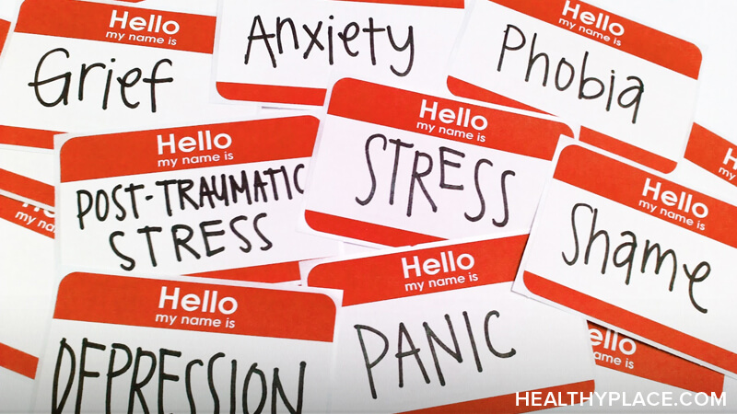
Notes:
Also suicidal tendencies

Slide 4
Language as a Cue for Diagnosis

Slide 5
Quantifying Mental Health Signals in Twitter (Coppersmith et al., 2014)
Automatically identify self-expressions of mental illness diagnoses
Leverage these to construct a labeled dataset
Genuine statements of diagnosis:
@USER The VA diagnosed me with PTSD, so I can’t go in that direction anymore
I wanted to share some things that have been helping me heal lately. I was diagnosed with severe complex PTSD and... LINK
Disingenuous statement of diagnosis:
LOL omg my bro the “psychologist” just diagnosed me with seasonal ADHD AHAHAHAAAAAAAAAAA IM DYING.
Notes:
ADHD: Attention-deficit/hyperactivity disorder

Slide 6
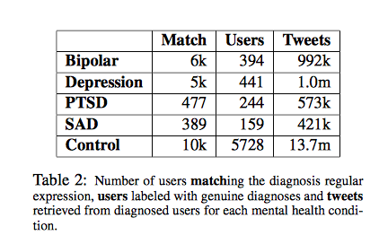
Quantifying Mental Health Signals in Twitter (Coppersmith et al., 2014)
Notes:
PTSD: Post Traumatic Stress Disorder
SAD: Seasonal Affective Disorder
Bipolar (was Manic-Depressive)
Depression
First used regular expressions to find tweets likely to indicate diagnosis (match) then manually labeled genuine match users (Users) then collected 3200 tweets from each.

Slide 7
Features
LIWC
Language Models (LMs)
Unigrams (ULM)
Characters (CLM)
Pattern of life
Social engagement
Insomnia
Exercise
Sentiment
Notes:
Social engagement: User tweet rate: how often a twitter user posts; Proportion of tweets: Number of @mentions: how often the user in question engages other users, while Number of self @mentions: how often the user responds; Size of social network: # of unique users @mentioned and # @mentioned at least 3 times
Insomnia: proportion of tweets user makes between midnight and 4am (in local timezone)
Exercise: tweets mentioning exercise-related terms
Sentiment: # positive or negative or neither words (<0, 0, >0

Slide 8
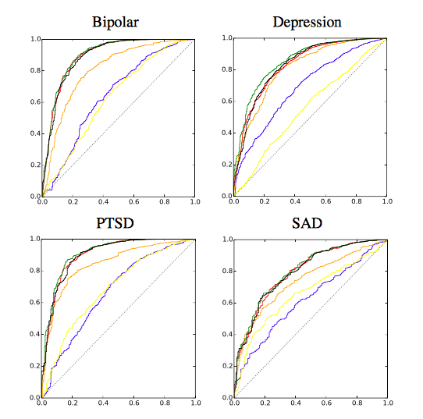
ROC Curves of Analytic Performance
Blue: LIWC
Yellow: Pattern of Life
Red: CLM
Green: ULM
Black: All features
Dotted line: Chance
Notes:
ROC curves of performance of individual analytics for each disorder: LIWC in blue, pattern of life in yellow, CLM in red, ULM in green, all in black. Chance performance is indicated by the dotted black line.
A receiver operating characteristic curve, or ROC curve, is a graphical plot that illustrates the diagnostic ability of a binary classifier system as its discrimination threshold is varied. The ROC curve is created by plotting the true positive rate against the false positive rate at various threshold settings.The Area under the Curve (AUC) tells you how well the classifier is at making binary predictions, e.g. Bipolar or not Bipolar

Slide 9
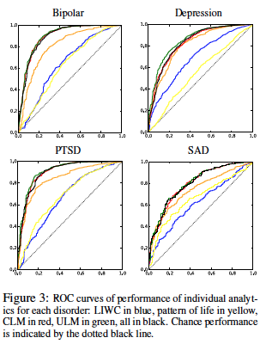
ROC Curves of Analytic Performance
Blue: LIWC
Yellow: Pattern of Life
Red: CLM
Green: ULM
Black: All features
Dotted line: Chance
Notes:
ROC curves of performance of individual analytics for each disorder: LIWC in blue, pattern of life in yellow, CLM in red, ULM in green, all in black. Chance performance is indicated by the dotted black line.
Some differences in feature performance over the 4 mental problems (e.g. pattern of life): bipolar and ptsd predicted best by all features
A receiver operating characteristic curve, or ROC curve, is a graphical plot that illustrates the diagnostic ability of a binary classifier system as its discrimination threshold is varied. The ROC curve is created by plotting the true positive rate against the false positive rate at various threshold settings.The Area under the Curve (AUC) tells you how well the classifier is at making binary predictions, e.g. Bipolar or not Bipolar

Slide 10
Depression
Mood disorder that causes a persistent feeling of sadness and loss of interest
Statistics
16 million adults had at least 1 major depressive episode in 2012 (NIMH)
350 million people worldwide suffer from depression (WHO)
Depression is the cause of over 2/3 of suicides in the US each year (White House Conference on Mental Health)
Women experience depression at 2x the rate of men (Journal of AMA)

Slide 11
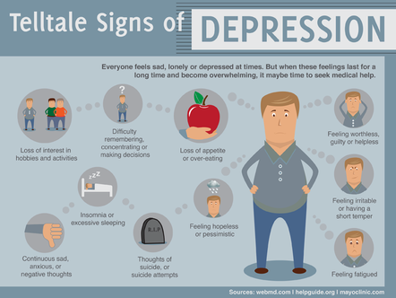

Slide 12
Diagnosis
Diagnostic assessment by GP, psychologist, or psychiatrist
Examine biological, psychological, social factors
Rating scales
Hamilton rating scale for depression
Beck depression inventory
Suicide behaviors questionnaire

Slide 13
Treatments
Psychotherapy
Mediation – antidepressants
Electroconvulsive therapy
Lifestyle
Exercise
Smoking cessation
Diet

Slide 14
Predicting Depression via Social Media (De Choudhury et al., 2013)
Use crowdsourcing to identify Turkers who are Twitter users with Major Depressive Disorder
Measure behavioral attributes from their tweets 1 yr prior to diagnosis
Estimate risk of depression before diagnosis from
Social engagement: volume, retweets, replies, shared links, posted questions
Emotion
Linguistic style:
Ego network: # people they engage with
Medication mentions
Notes:
We explore the potential to use social media to detect and diagnose major depressive disorder in individuals. We first employ crowdsourcing to compile a set of Twitter users who report being diagnosed with clinical depression, based on a standard psychometric instrument. Through their social media postings over a year preceding the onset of depression, we measure behavioral attributes relating to social engagement, emotion, language and linguistic styles, ego network, and mentions of antidepressant medications. We leverage these behavioral cues, to build a statistical classifier that provides estimates of the risk of depression, before the reported onset. We find that social media contains useful signals for characterizing the onset of depression in individuals, as measured through decrease in social activity, raised negative affect, highly clustered ego networks, heightened relational and medicinal concerns, and greater expression of religious involvement.

Slide 15
Data
Depression screening test: CES-D questionnaire
http://cesd-r.com
Amazon Mechanical Turk
Workers could opt in to share Twitter username
Quality control
Self-reported information
Clinical diagnosis of depression?
Estimated time of onset
Using antidepressants?
Notes:
CES-D: Center for Epidemiologic Studies Depression scale – 20 item self-report scale – answer questions about past week
“I thought my life was a failure”, “I felt lonely”, “I had crying spells”
Scores are 0-60
Quality control?
Discard data if workers took less than 2min
Include screening test – BDI (Beck depression inventory) – checked for correlation between the 2 tests

Slide 16
Data
1,583 responses; 40% shared Twitter feeds
476 users with depression diagnosis (after removing noisy responses)
243 male, 233 female
171 users who scored positive for depression on CES-D
2,157,992 tweets retrieved

Slide 17
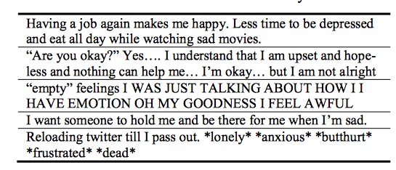
Sample Data

Slide 18
Measuring Depressive Behavior
Engagement: # posts-per-day, replies, retweets, links shared, questions
Insomnia index: %night posts vs. day posts
Egocentric social graph of exchanges with others measuring size, density, amount of exchange
Emotion: pos/neg; activation (intensity); dominance (control of emotion)
Linguistic style: LIWC
Depression language: depression lexicon; anti-depressants mentioned
Notes:
Night: 9pm-6am
Egocentric social graph: of a user to be an undirected network of the set of nodes in u ’s
two-hop neighborhood (neighbors of the neighbors of users in our dataset), where an edge between u and v implies
that there has been at least one @-reply exchange each, from u to v , and from v to u on a given day.

Slide 19
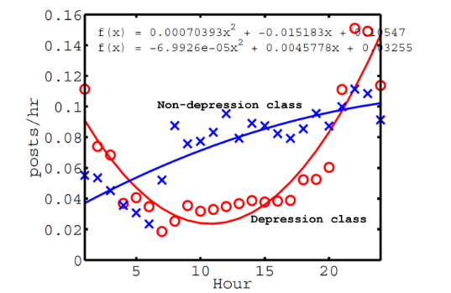
Tweet Activity and Depression
Notes:
All times are local time
Mean num of posts per hour, over entire year history

Slide 20
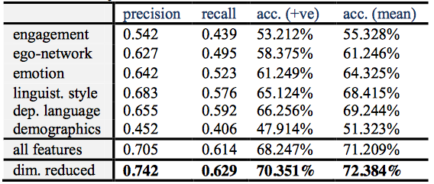
Depression Prediction Pre-Onset
Notes:
3rd col: mean accuracy of predicting positive class
Dimensionality reduction: use only principal variables

Slide 21
Schizophrenia
Chronic mental disorder
Symptoms:
Positive: hallucination, delusion, thought disorders, movement disorders
Negative: “flat affect”, reduced feelings of pleasure, reduced speaking
Cognitive: poor executive functioning, trouble focusing or paying attention, problems with working memory
Notes:
1% of population

Slide 22
Schizophrenia and language
“Negative thought disorder”
Alogia: poverty of speech
“Positive thought disorder”
Derailment
“I always liked geography. My last teacher in that subject was Professor August A. He was a man with black eyes. I also like black eyes. There are also blue and grey eyes and other sorts, too…” (Bleuler, 1950)
Tangentiality

Slide 23
“Well, in myself I have been okay what with the prices in the shops being what they are and my flat is just round the corner. I keep a watch for the arbiters most of the time since it is just round the corner. There is not all that much to do otherwise.”
Word-level abnormalities
“I got so angry I picked up a dish and threw it at the geshinker”
“So I sort of bawked the whole thing up”

Slide 24
Word salad
“They’re destroying too many cattle and oil just to make soap. If we need soap when you can jump into a pool of water, and then when you go to buy your gasoline, my folks always thought they should, get pop but the best thing to get, is motor oil, and, money. May may as well go there and, trade in some, pop caps and, uh, tires, and tractors to grup, car garages, so they can pull cars away from wrecks, is what I believe in. So I didn’t go there to get no more pop when my folks said it. I just went there to get a ice-cream cone, and some pop, in cans, or we can go over there to get a cigarette”

Slide 25
Quantifying the Language of Schizophrenia in Social Media (Mitchell et al., 2015)
Data: 174 Twitter users with self-stated diagnosis of schizophrenia
Age and gender matched controls, balanced dataset
Features:
LIWC
Open-vocabulary approaches
Latent Dirichlet Allocation (LDA), Brown clustering, character n-grams, perplexity
Notes:
LDA: unsupervised topic modeling – imagines a set of topics and tries to map all documents into that set; each user is then matched to a topic

Slide 26
LIWC Analysis
Schizophrenia users had more words from these categories: Cognitive mechanisms, death, function words, negative emotion
And fewer words from these categories: home, leisure, positive emotion

Slide 27
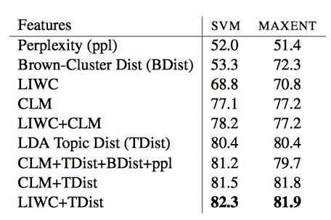
Classification Results
Notes:
Topic Distribution is the main LDA topic matched to each user; Bdist is the Brown cluster matched to the user
Perplexity (predictability) of user language

Slide 28
Linguistic Analysis of Schizophrenia in Reddit Posts (Zomick et al., 2019)
Reddit:
No limits on post length
Subreddits on particular topics or for particular groups
Used a Python API Wrapper (PRAW)

Slide 29
Data
Subreddits:
r/schizophrenia
r/schizophrenic
r/AskReddit: “Any Redditors With Schizophrenia?”
Manual inspection for formal diagnosis
e.g. “my diagnosis of schizophrenia”

Slide 30
Data
SZ: 159 users; 66,454 comments
Control: 159 users; 113,570 comments
At least 10 posts per user in each group
Notes:
SZ: schizophrenia

Slide 31
LIWC Analysis
Comparison of LIWC findings across 5 studies in multiple domains (Reddit, Twitter, discussion boards)
SZ indicators across studies:
- Increased: negative emotion, first person singular pronouns, tentative, cognitive process, health, anxiety, third person plural pronouns
- Decreased: leisure
SZ indicators in Reddit:
- Increased: word count

Slide 32
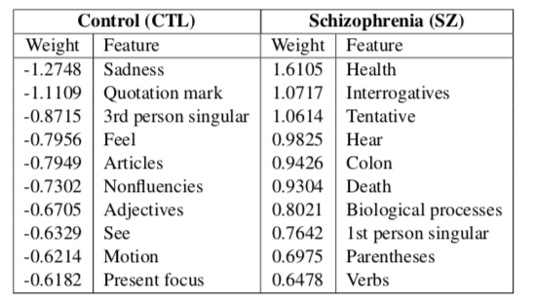
LIWC Analysis
Logistic Regression: 81.56% accuracy

Slide 33
Dementia
Broad category of brain diseases that cause long term decrease in ability to think and remember
Most common type - Alzheimer’s disease (AD)
60%-70% of cases
Affects 27.5 million people
3% of people 65-74
19% of people 75-84
~50% of people >85
$604 billion in costs per year

Slide 34
Alzheimer’s Disease Symptoms
Short-term memory loss
Problems with language
Disorientation
Mood swings
Decreased motivation

Slide 35
Cause
70% of risk is believed to be genetic
Risk factors:
Head injuries
Depression
Obesity
Hypertension: high blood pressure
Cardiovascular disease
Smoking and excessive alcohol
Sleep problems

Slide 36
Pathology
Amyloid plaques: protein fragments that clump together in brains killing neurons
Tau tangles: twisted protein fibers that form inside neurons ultimately killing them
Notes:
How to prevent: proper diet and regular exercise but hard to clear these away altho much research and clinical trials

Slide 37
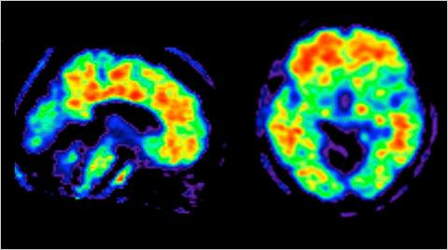
Amyloid Plaques in Brains

Slide 38
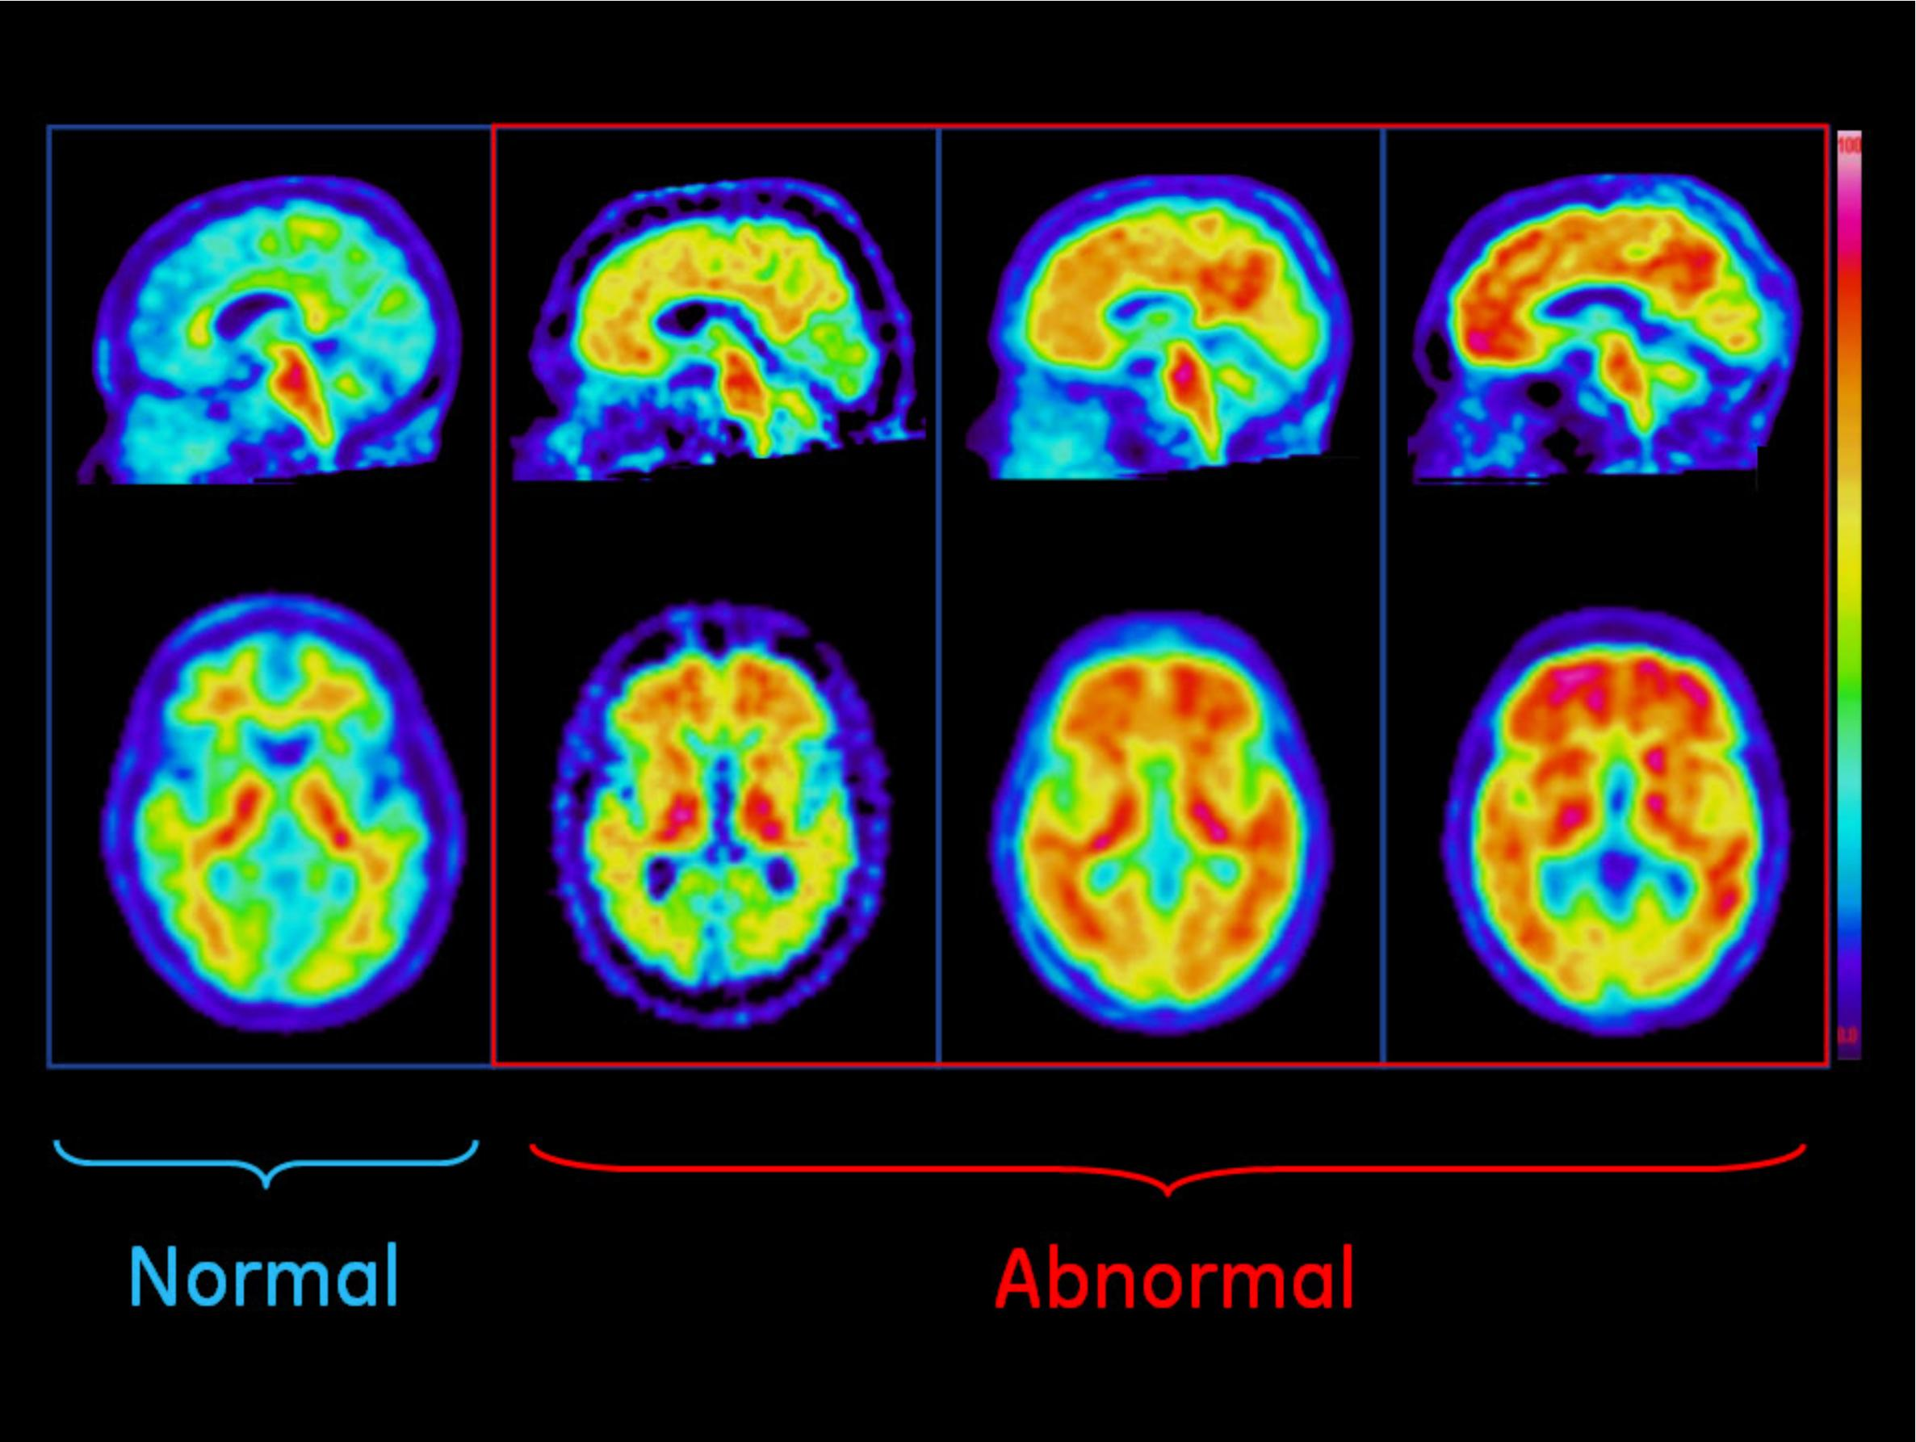
Amyloid Plaques in Normal and Abnormal Brains

Slide 39
Dementia Diagnosis
Can only be definitively diagnosed in a postmortem brain tissue examination
Clinical assessment
Medical history
Physical exam
Neurological exam
Mental status tests

Slide 40
Mental status tests
Mini-mental state exam (MMSE)
Mini-cog
http://mini-cog.com/wp-vontent/uploads/2018/03/Standardized-English-Mini-Cog-1-19-16-EN_v1-low-1.pdf
Notes:
Ask people to remember 3 words, produce a picture of a clock with a certain time, recall the 3 words

Slide 41
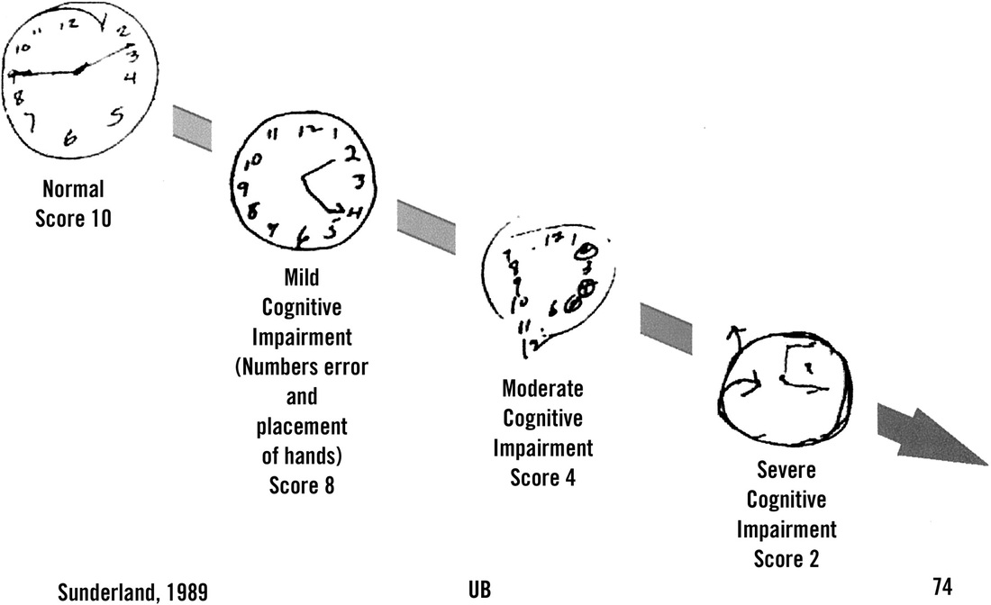
Draw a clock that shows the time at 2:45
Notes:
Draw a clock that represents the time 2:45

Slide 42
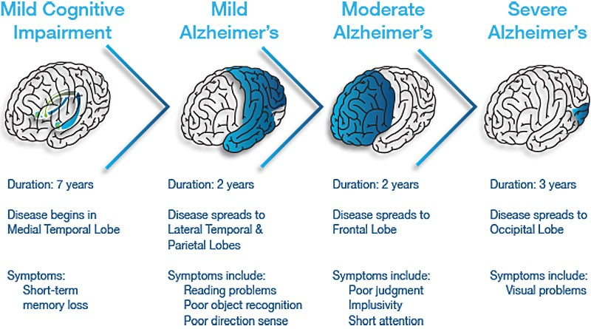
Stages of AD
Notes:
implusivity → impulsivity

Slide 43
Stages of AD
Pre-dementia
Mild Cognitive Impairment (MCI)
Short-term memory loss
Early
Increased impairment of learning and memory
Moderate
Increased impairment of learning and memory
Severe
Visual problems appear

Slide 44
Treatment
Medication for symptoms
Clinical trials

Slide 45
Language Indicators of AD
Can we identify/predict AD from writing analysis?

Slide 46
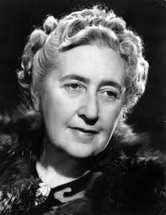
Case Study: Agatha Christie’s Novels
Notes:
Christie never diagnosed with Alzheimer’s but…

Slide 47
Language Use Changes with Age
U Toronto researchers Ian Lancashire, Graeme Hirst counted the numbers of words and word types she used from age 28 to 82
Vocabulary size decreased sharply by 15-30%
Increases in repeated phrases and indefinite nouns (something, thing, anything)
Elephants Can Remember (age 81) showed 30% fewer word than Destination Unknown (age 63)
Similar findings for Iris Murdoch

Slide 48
Nun Study
Longitudinal study, 1986-- (David Snowden)
678 Roman Catholic sisters
Homogenous group
Asked to write autobiographical essays at different age stages

Slide 49
Excerpts from Different Sisters
"It was about a half hour before midnight between February 28 and 29 of the leap year 1912 when I began to live, and to die, as the third child of my mother, whose maiden name is Hilda Hoffman, and my father, Otto Schmidt...”
"I was born in Eau Claire, Wisconsin on May 24, 1913, and was baptized in St. James Church..."

Slide 50
Nun Study Findings
Sisters who scored poorly on
Idea density
Grammatical complexity
…were much more likely to develop dementia
E.g. sisters in lower third of idea density were 60 times more likely to develop AD than sisters in upper third
Using essays, could predict with 92% accuracy whether the brain would contain plaques post-mortem

Slide 51
Vector-space Topic Models for Detecting Alzheimer’s Disease (Yancheva & Rudzicz, 2016)
Measure semantic content deficiency
Idea density: ratio of semantic units to total number of words
Efficiency: rate of semantic units over duration of speech sample

Slide 52
Measuring Semantic Content
Picture description task: humans asked to provide free-form verbal descriptions of visual stimulus
Human-supplied information content units (hsICUs) representing subjects, objects, locations and actions from image
HsICUs then counted for scoring an AD group vs. a control group: AD sufferers provide fewer ICUs than healthy persons

Slide 53
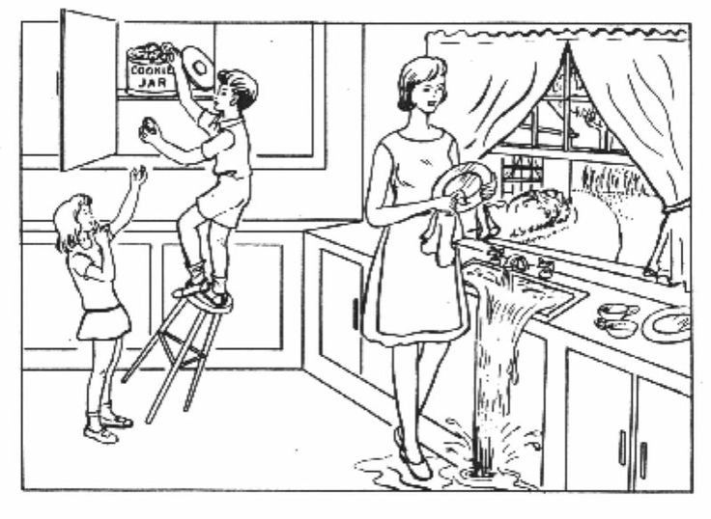

Slide 54
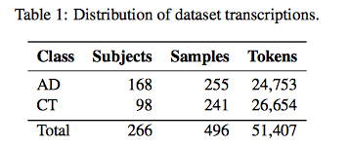
Method
Authors also automatically generate ICUs for any given picture building word vector representation from a large general corpus
Data: DementiaBank
Notes:
ICU: information content unit
Speech samples

Slide 55
Automatic ICU Generation
Train word vector model on large general purpose corpus (GloVe)
Extract vector representations of words in DementiaBank corpus they had collected
Cluster vectors separately for AD and CT groups to represent “topics”

Slide 56
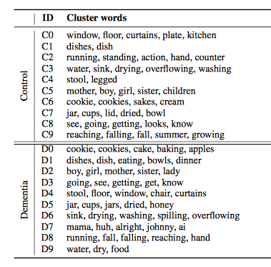
Notes:
overlap: C3 and D6, C7 and D5, C1 and D1, etc.

Slide 57
Cluster Analysis
Do clusters match originally collected hsICUs?
Do the topics differ between groups?
Notes:
Human-supplied content units

Slide 58
Cluster Analysis
Do clusters match hsICUs?
Yes (except “dishcloth”)
Do the topics differ between groups?
Yes!
Groups differ in the time spent on topics
Control group: overflowing, sink, indifferent, mother, apron, window, curtain, cupboard, counter
AD group: brother, sister, son, daughter

Slide 59
Quantifying Irrelevance
Align pairs of clusters between AD and CT models
All control clusters are aligned with AD models but one AD model (D7) is not aligned with any CT model: i.e. is never mentioned by CTs
AD produces “extraneous terms”: mama, huh, alright, johnny, ai
Notes:
AD: Alzheimers disease
CT: control group

Slide 60
Are Topics Discussed in Same Contexts?
Augment word vectors with local context windows
Results:
All control cluster words were used in the same contexts by both groups
Frequency of control words is higher in control group than AD group

Slide 61
Classification Experiments
Features:
Distance metrics for AD and CT clusters – how far is each item in the topic from the topic centroid (i.e. how coherent is the topic?)
Idea density: # expected topics mentioned/total words in transcript
Idea efficiency: # expected topics mentioned/total duration of recording

Slide 62
Random Forest classifier, 10-fold cross-validation
Compare models: cluster models (CT, AD, combined), feature sets, and w/wout context
Baseline: hsICU features extracted by Fraser et al 2016

Slide 63
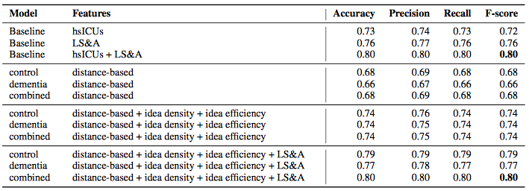
Classification Results
Notes:
LS&A (lexicosyntaic and acoustic features used by Fraser et al 2016)
Our 12 automatically generated features (i.e., the combined set of distance-based
measures, idea density, and idea efficiency) result in higher F-scores (0.74) than using 85 manually
generated hsICUs (0.72); a two-sample paired t-test shows no difference (using control cluster
model: t(9) = 1.10, p = 0.30; using dementia cluster model: t(9) = 0.74, p = 0.48) indicating
the similarity of our method to the manual gold standard. Furthermore, we match state-of-the-art
results (F-score of 0.80) when we augment the set of LS&A (linguistic syntactic and acoustic) features with our automatically generated
semantic features.

Slide 64
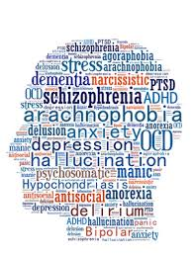
Ethics of Using Social Media for Health Research
Notes:
Discuss concerns about using social media for health research
Ethical guidelines:
IRB – institutional review board – required for all federally funded human subjects research in the US
Informed consent whenever possible
Protections for sensitive data – e.g. usernames
-> separate annotations from user data
De-identify data in public presentations

Slide 65
Ethics in NLP workshop
Why might it be unethical to use human data?
http://www.ethicsinnlp.org
Harvard “Embedded Ethics” in courses

Slide 66
Conclusions
NLP and speech processing are very useful tools for identifying and predicting mental illness
Social media provide rich natural data
But we must take ethical considerations into account

Slide 67
Next (Now this) Week
Emotion and Sentiment Analysis (Guest Speaker: Zixoafan Yang)
HW3 assigned

