Slide 1
Advanced Topics in Spoken Language Processing
Julia Hirschberg
CS 6998
Spring 2020

Slide 2
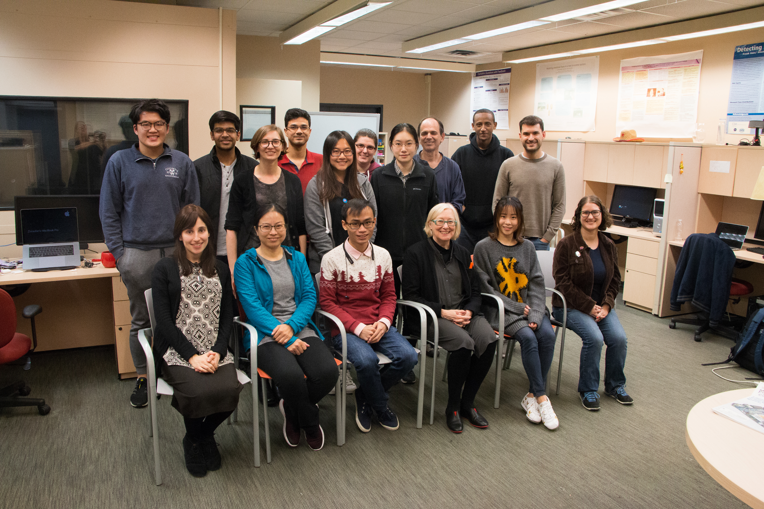
Columbia Speech Lab Last Spring

Slide 3
Getting to know each other
Notes:
turn to the person sitting next to you and introduce yourself!

Slide 4
Speech Processing Questions
How do you produce sounds that other people interpret as language?
How does your hearer decode what you are trying to convey?
In a conversation, how do you know when it’s your turn to talk?
Once you decide what you want to say, how do you decide how to say it?:
How do you decide where to pause in the sentence?
How do you decide what words to emphasize?
How do you decide what intonational contour to use?
How do you convey your own feelings and emotions?
Notes:
Angry, sad, happy

Slide 5
Different languages can convey this information in different ways but most use intonation or sometimes word order in the process – and of course facial expression and body gesture also play a role in communication
How do you ask a question in your native language? How do you make a statement?
What we’ll be learning in this class is a wide range of the information that speech can convey to others and what we in turn can learn about others from their speech

Slide 6
What Can We Convey and Learn from Speech
What speech can convey
What else we can learn from speech
Emotion
Sarcasm
Speech Acts
Humor
Empathy
Trust
Likability/Charisma
Intent
Deception
Mental health
Physical health
Autism Spectrum
Entrainment
Charisma
Vocal Attractiveness
Age and gender
Personality
Notes:
I know that.
I really believe you.

Slide 7
Applications for Speech Technologies are Everywhere
Basic technologies
Speech synthesis (TTS): Wavenet, demo
Speech recognition (ASR): Nuance, Kaldi, Google, IBM
Speech analysis: Praat, Sox, WaveSurfer, Adobe Audition
Applications
Speech to Speech Translation: Google Translate
Speech Search: Google Voice Search
Governments: Deception Detection, Dialect and Language ID, Speaker ID, trust, aids for first responders in Low Resource Languages
Notes:
Wavenet: demo down toward the bottom
TTS:
Do you live at 288 110th St. West?
The city hall parking lot was chock full of cars.
Martín Pérez plays for the Twins.

Slide 8
Accessibility: Web access for visually or manually challenged, TTS’d audio books
Voices for people who cannot speak clearly (Parrotron) or who have never been able to speak at all (Vocalid:Kids) or who are losing their voice (Vocalid: Elderly):
Spoken Dialogue Systems:
Over-the-phone (Siri, Android)
Alexa, Cortana, Google Home, Echo
Tutoring systems: Duolingo (uses Chrome to handle speech)
Recognizing/Generating Speaker State
Recognizing or generating emotion, e.g.
Recognizing anger/frustration in SDS
Generating excitement/fear in games

Slide 9
Recognizing confidence vs. uncertainty in tutoring systems
Medical diagnosis e.g. depression, aphasia, schizophrenia
Degree of interest e.g. for salespeople
Sleepiness or drunkenness for drivers
Deception for police, military, social services
Charisma for politicians – and Alexa??

Slide 10
What you will Learn in This Class
By the end of the course, you should be able to:
Analyze acoustic and prosodic features of speech and connect these with text information
Analyze and classify corpora using these features to identify different types of information (dialogue acts, emotion)
Evaluate research papers on spoken language processing

Slide 11
What You Should Know/Have before You Start
A laptop or access to a computer (hopefully a Mac but…)
Headphones with close-talking mic for recording
Some knowledge of NLP or speech processing
Some experience using Machine Learning (not necessarily Deep Learning) – scikit-learn.org, e.g.

Slide 12
Syllabus Overview
Course syllabus
Part 1: basic concepts, tools, analysis approaches
Acoustics, prosody, tools, TTS, ASR, dialogue systems
Part 2: speech analysis applications
Entrainment, emotion, sentiment, deception, trust, sarcasm, humor, charisma, personality, mental state

Slide 13
Grade breakdown
10% Attendance and participation
20% Weekly posts
20% HW 1
25% HW 2
25% HW 3

Slide 14
Weekly readings
Textbook
Required: Speech and Language Processing, Jurafsky & Martin (use links from course syllabus)
Optional: Acoustic and Auditory Phonetics, Keith Johnson (3rd edition)
Conference and journal articles

Slide 15
Weekly Posts
For each required reading, post:
One positive and one negative aspect of each assigned reading
Some weeks: Find a new article on the same topic that you think is good and provide location, authors/title/abstract and reasons why you think this would be good to include in our reading assignments next year
Deadline: Mondays 11:59am; Points 0-4
Late policy: 1 day,1 point loss

Slide 16
Homework Assignments
Praat emotion recording and analysis
Dialogue Act identification (e.g. question, statement)
Emotional Speech identification (e.g. anger, sadness)
Late policy: 3 days; 5 points lost for each day

Slide 17
Teaching Assistants
Becky Calinsky
Jessica Yin Huyhn

Slide 18
Todo
Are you officially enrolled in this class?
Do you intend to stay in it? If not please drop asap and send me mail
Are you on the waitlist?
If so, do you still want to take the course? If so please send me new email with your NLP/speech course background and grades
Note: if we can find another TA for this class we will be able to raise the cap to include more students so I will inform the waitlist when/if this occurs

Slide 19
Honor policy on syllabus
We will announce office hours by the end of this week
Julia Hirschberg office hours: CEPSR 705
Jessica Yin Huyn office hours: CEPSR 7LW3 (Speech Lab)
Becky Calinsky: office hours, CEPSR 7LW3 (Speech Lab)

Slide 20
For next week
Look at today’s slides and follow the links that weren’t played (or those that were)
Reading: J&M Chapter 7 (7.1-7.3)
Post on Courseworks before next Monday 11:59am
Record your name on Courseworks → NameCoach so we can learn to pronounce everyone’s name correctly ☺

Slide 21
Questions?

