Slide 1
Speech Synthesis: Then and Now
Julia Hirschberg
CS 4706

Slide 2
Today
Then: Early speech synthesizers
Now: Overview of Modern TTS Systems
Think about: how do we evaluate a synthesizer

Slide 3
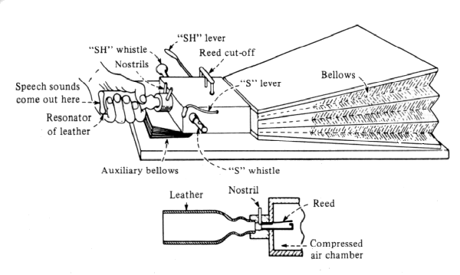
The First ‘Speaking Machine’
    Wolfgang von Kempelen, Mechanismus der menschlichen Sprache nebst Beschreibung einer sprechenden Maschine, 1791 (in Deutsches Museum still and playable)
    First to produce whole words, phrases – in many languages
Notes:
First experimental phonetician: therapeutic applications: how do humans produce speech?
First machine which could produce whole words
3 weeks to learn to ‘play’ in latin, french or italian – german was harder due to consonant clusters, closed syllables
Bellows: lungs (operated with right forearm; counterweight for inhale; aux. bellows to simulate stop release)
Wind box, mouth (cover for unvoiced sounds), nostrils (cover except for nasal)
Thumb in mouth → [l]
Hissing whistle to make sibilants
Vocal cords (ivory reed): can’t change length on the fly, so monotone only
Wire dropped on read simulated [r]

Slide 4
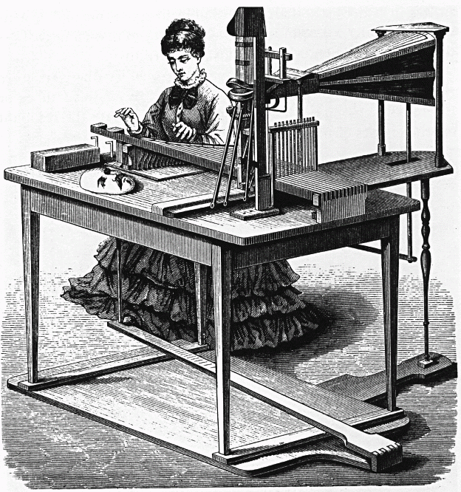
Joseph Faber’s Euphonia, 1846
Notes:
Built in 1835
Modeled tongue and pharyngeal cavity, with manual control of shape
Very good for singing
Pedal and keyboard control
Sang ‘God Save the Queen’ at public exhibition

Slide 5

Constructed 1835 w/pedal and keyboard control
  Whispered and ordinary speech
  Model of tongue, pharyngeal cavity with manipulable shape
  Singing too: “God Save the Queen”
Riesz’s 1937 synthesizer with almost natural vocal tract shape
Forerunners of Modern Articulatory Synthesis: George Rosen’s DAVO synthesizer (1958) at MIT

Slide 6
Notes:
First notable EE synthesizer, presented at World’s Fair in 1939
Requires lots of training to use

Slide 7
World’s Fair in NY, 1939
Requires much training to ‘play’
Purpose: coding/compression
  Reduce bandwidth needed to transmit speech, so many phone calls can be sent over single line

Slide 8
Notes:
First attempt to synthesise speech by breaking it down into component sounds and reproducing sound patterns electronically
Produced two sounds: a tone generated by a radio valve to produce the vocal sounds and a hissing noise produced by a gas discharge tube to create the sibilants.
These basic sounds passed through a set of filters and an amplifier that mixed and modulated them

Slide 9
Notes:
Goal: investigating speech perception
Inverse of spectrograph: from spectral information to speech
Lamp produces light ray directed against rotating disk with 50 concentric tracks whose transparence varies systematically to produce 50 partials (pure tones) w/f0 of 120 hz – transparences rep sound pressures
Light also projected against spectrogram whose reflectance corresponds to sound pressure level of each partial
Variation in light converted into variation in sound pressure
Spectrogram passed thru light on rollers to reproduce the speech of the spectrogram
Can create ‘fake’ spectrograms to produce new speech
Last used for an experimental study by Robert Remez in 1976!

Slide 10
Answers:
  These days a chicken leg is a rare dish.
  It’s easy to tell the depth of a well.
  Four hours of steady work faced us.
‘Automatic’ synthesis from spectrogram – but can also use hand-painted spectrograms as input
Purpose: understand perceptual effect of spectral details

Slide 11
Formant/Resonance/Acoustic Synthesis
Parametric or resonance synthesis
  Specify minimal parameters, e.g. f0 and first 3 formants
  Pass electronic source signal thru filter
    Harmonic tone for voiced sounds
    Aperiodic noise for unvoiced
    Filter simulates the different resonances of the vocal tract
E.g.
  Walter Lawrence’s Parametric Artificial Talker (1953) for vowels and consonants
  Gunnar Fant’s Orator Verbis Electris (1953) for vowels
  Formant synthesis download

Slide 12
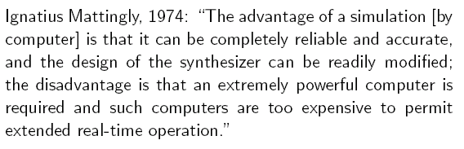
Synthesis by Computer
Beginnings ~1960; dominant from 1970—

Slide 13
Concatenative Synthesis
Most common type today
First practical application in 1936: British Phone company’s Talking Clock
  Optical storage for words, part-words, phrases
  Concatenated to tell time
E.g.
And a ‘similar’ example from Radio Free Vestibule (1994)
Bell Labs TTS (1977) (1985)
Notes:
RFV comedy troup: tape and editing are phone concatenations. Is it a fake?

Slide 14
Variants of Concatenative Synthesis
Inventory units
  Diphone synthesis (e.g. early Festival)
  Microsegment synthesis
  “Unit Selection” – large, variable units (e.g. current Festival)
Issues
  How well do units fit together?
  What is the perceived acoustic quality of the concatenated units?
  Is post-processing on the output possible, to improve quality?

Slide 15
Overview: Synthesizer I/O
Front end: From input to control parameters
  Acoustic/phonetic representations, naturally occurring text, constrained mark-up language, semantic/conceptual representations
Back end: From control parameters to waveform
  Articulatory, formant/acoustic, concatenative, (diphone, unit-selection/corpus, HMM) synthesis

Slide 16
TTS Production Levels
Knowledge
Task
World Knowledge
Syntax, semantics, lexicon
Phonetics/phonology
Acoustics/signal processing
Text Normalization
Pronunciation, intonation assignment
Duration, f0, durations
Waveform production
Notes:
The children read to Dr. Smith.

Slide 17
Text Normalization Issues
Reading is what W. hates most.
Reading is what Wilde hated most.
The NAACP just elected a new president.
In 1996 she sold 2010 shares and deposited $42 in her 401(k).
The duck dove supply.
Homographs, numbers, abbreviations

Slide 18
Pronunciation Issues
Rules for disambiguation in context: bass
Lexicon: comb, tomb, Punxsutawney Phil
  Letter-to-Sound Rules
    Hand built
    Learned from data (pronunciation dictionary)
    Hard to get good accuracy and coverage – many exceptions
  Dictionary of pronunciations
    More accurate
    New (Out-of-Vocabulary) words a problem

Slide 19
Intonation Assignment Issues: Phrasing
Traditional: hand-built rules
  Use punctuation: 234-5682, New York, NY
  Context/function word: no breaks after function word: He went to dinner. He came to and went to dinner.
  Syntax: She favors the nuts and bolts approach. She went home and Dave stayed.
Current: machine learning on large labeled corpus

Slide 20
Intonation Assignment Issues: Accent
Hand-built rules
  Function/content distinction He went out the back door/He threw out the trash
  Complex nominals:
    Main Street/Park Avenue
    city hall parking lot (stress shift)
Statistical procedures trained on large corpora
  Need lots of data
  Why learn what you already know?

Slide 21
Intonation Assignment Issues: Contours
Simple rules
  ‘.’ = declarative contour
  ‘?’ = yes-no-question contour unless wh-word present at/near front of sentence
    Well then, how did he do it? And what do you know?
Pretty monotonous in long stretches of speech
Problem: no one knows how to assign other contours from text

Slide 22
Phonological Specification Issues
Task is to produce a phonological representation from phones and intonational assignment
    Align phones and f0 contour
    Specify durations and intensity
Select/create appropriate acoustic realization from this specification:
  Acoustic transformation
  Concatenation: diphone, unit selection
  HMM

Slide 23

Not Quite There
Festival concatenative:
Acuvoice concatenative:
HMM synthesis (Rob Donovan):
Rhetorical unit selection
  (acquired by Nuance)
AT&T Labs Naturally Speaking
Other TTS systems

Slide 24
Next Class
Project Phase I assigned: building a TTS System
Introduction to Festival TTS

