Slide 1
Speech Synthesis: Then and Now
Julia Hirschberg and Sarah ita Levitan
CS 6998

Slide 2
Today
Then: Early speech synthesizers
What information do we need?
Now: Modern TTS Systems
How do we evaluate a TTS System?

Slide 3
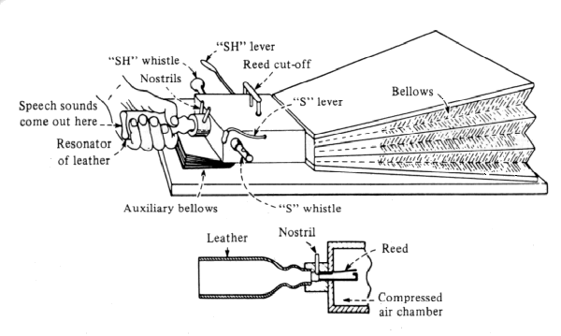
The First ‘Speaking Machine’
    Wolfgang von Kempelen, Mechanismus der menschlichen Sprache nebst Beschreibung einer sprechenden Maschine, 1791 (in Deutsches Museum still and playable)
    First to produce whole words, phrases – in many languages
Notes:
First experimental phonetician: therapeutic applications: how do humans produce speech?
First machine which could produce whole words
3 weeks to learn to ‘play’ in latin, french or italian – german was harder due to consonant clusters, closed syllables
Bellows: lungs (operated with right forearm; counterweight for inhale; aux. bellows to simulate stop release
World’s largest science museum, munich
Wind box, mouth (cover for unvoiced sounds), nostrils (cover except for nasal)
Thumb in mouth → [l]
Hissing whistlea to make sibilants
Vocal cords (ivory reed): can’t change length on the fly, so monotone only
Wire dropped on read simulated [r]

Slide 4
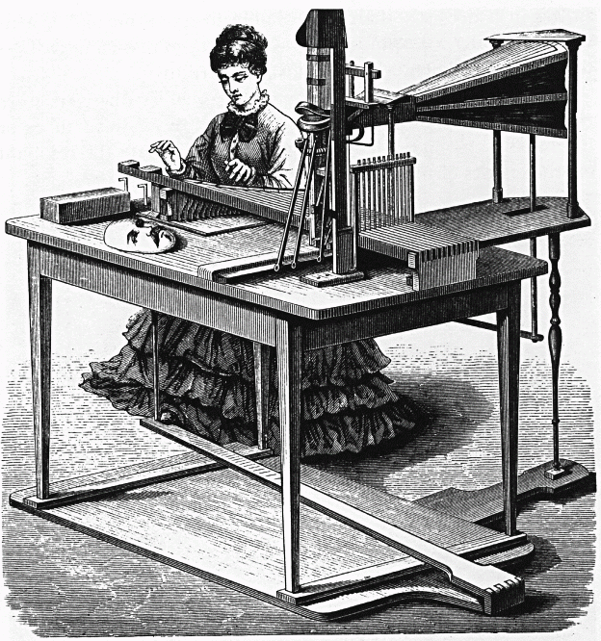
Joseph Faber’s Euphonia, 1846
Notes:
Built in 1835
Modeled tongue and pharyngeal cavity, with manual control of shape
Very good for singing
Pedal and keyboard control
Sang ‘God Save the Queen’ at public exhibition

Slide 5

Constructed 1835 w/pedal and keyboard control
  Whispered and ordinary speech
  Model of tongue, pharyngeal cavity with manipulable shape
  Singing too: “God Save the Queen”
Riesz’s 1937 synthesizer with almost natural vocal tract shape
Forerunners of Modern Articulatory Synthesis: George Rosen’s DAVO synthesizer (1958) at MIT

Slide 6
Notes:
First notable EE synthesizer, presented at World’s Fair in 1939
Requires lots of training to use

Slide 7
World’s Fair in NY, 1939
Requires much training to ‘play’
Purpose: coding/compression
  Reduce bandwidth needed to transmit speech, so many phone calls can be sent over single line

Slide 8
Notes:
First attempt to synthesise speech by breaking it down into component sounds and reproducing sound patterns electronically
Produced two sounds: a tone generated by a radio valve to produce the vocal sounds and a hissing noise produced by a gas discharge tube to create the sibilants.
These basic sounds passed through a set of filters and an amplifier that mixed and modulated them

Slide 9
Notes:
Goal: investigating speech perception
Inverse of spectrograph: from spectral information to speech
Lamp produces light ray directed against rotating disk with 50 concentric tracks whose transparence varies systematically to produce 50 partials (pure tones) w/f0 of 120 hz – transparences rep sound pressures
Light also projected against spectrogram whose reflectance corresponds to sound pressure level of each partial
Variation in light converted into variation in sound pressure
Spectrogram passed thru light on rollers to reproduce the speech of the spectrogram
Can create ‘fake’ spectrograms to produce new speech
How are different spectral features perceived?
Last used for an experimental study by Robert Remez in 1976!

Slide 10
Answers:
  These days a chicken leg is a rare dish.
  It’s easy to tell the depth of a well.
  Four hours of steady work faced us.
‘Automatic’ synthesis from spectrogram – but can also use hand-painted spectrograms as input
Purpose: understand perceptual effect of spectral details

Slide 11
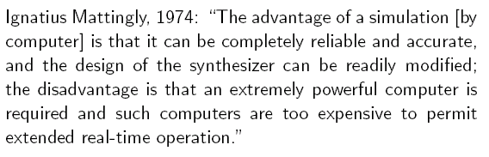
Synthesis by Computer
Beginnings ~1960; dominant from 1970—

Slide 12
Requirements for a TTS System
Knowledge
Task
World Knowledge
Syntax, semantics, lexicon
Phonetics/phonology
Acoustics/signal processing
Text Normalization
Pronunciation, intonation assignment
Duration, f0, durations
Waveform production
Notes:
The children read to Dr. Smith.

Slide 13
Overview: Synthesizer I/O
Front End: From input to control parameters
  Acoustic/phonetic representations, naturally occurring text, constrained mark-up language, semantic/conceptual representations
Back End: From control parameters to waveform
  Articulatory, formant/acoustic, concatenative, (diphone, unit-selection/corpus, HMM, DNN) synthesis

Slide 14
Requirements for a TTS System
Front End:
  Pronunciation Modeling
  Text Normalization
  Intonation, Duration, F0 Assignment
Back End:
  Waveform Production

Slide 15
Pronunciation Issues
Rules for disambiguation in context: bass, desert
Lexicon: comb, tomb, Punxsutawney Phil
  Letter-to-Sound Rules
    Hand built
    Learned from data (pronunciation dictionary)
    Hard to get good accuracy and coverage – many exceptions
  Pronunciation Dictionary
    More accurate but…
    Out-of-Vocabulary words a problem (e.g. proper names)

Slide 16
Text Normalization Issues
Homographs, numbers, abbreviations
  Reading is what W. hates most.
  Reading is what Wilde hated most.
  The NAACP just elected a new president.
  In 1996 she sold 2010 shares and deposited $42 in her 401(k).
  The duck dove supply.
  Emojis? (ASR yes but TTS??)

Slide 17
Phonological Specification Issues
Task is to produce a phonological representation from phones and intonational assignment
    Align phones and f0 contour
    Specify durations and intensity
Select/create appropriate acoustic realization from this specification:
  Acoustic transformation
  Concatenation: diphone, unit selection
  HMM

Slide 18
Intonation Assignment Issues: Phrasing
Traditional: hand-built rules
  Use punctuation: 234-5682; New York, NY
  Context/function word: no breaks after function word: He went to dinner. He came to and stayed to dinner.
  Syntax: She favors the nuts and bolts approach. She went home and Dave stayed.
Current: machine learning on large labeled corpus

Slide 19
Intonation Assignment Issues: Accent
Hand-built rules
  Function/content distinction:
    They called in (particle) the doctor/They called in (preposition) the afternoon.
  Complex nominals:
    Main Street/Park Avenue
    city hall parking lot (stress shift)
Statistical procedures trained on large corpora
  Need lots of data – but why learn what you already know?

Slide 20
Intonation Assignment Issues: Contours
Simple rules
  ‘.’ = declarative contour, wh-question
  ‘?’ = yes-no-question contour unless wh-word present at/near front of sentence
    Well then, how did he do it? And what do you know?
Pretty monotonous in long stretches of speech
Problem: no one knows how to assign other contours from text… yet

Slide 21
How do we get from Text to Speech?
3/1/19
21
TTS Back End takes segments+f0+duration information derived from front-end and creates a waveform from the Front End
A full system needs to go all the way from random text to sound
Notes:
21

Slide 22
Front End and Back End
3/1/19
Speech and Language Processing Jurafsky and Martin
22
PG&E will file schedules on April 20.
TEXT ANALYSIS: Text to intermediate representation:
WAVEFORM SYNTHESIS: From intermediate representation to waveform
Notes:
22

Slide 23
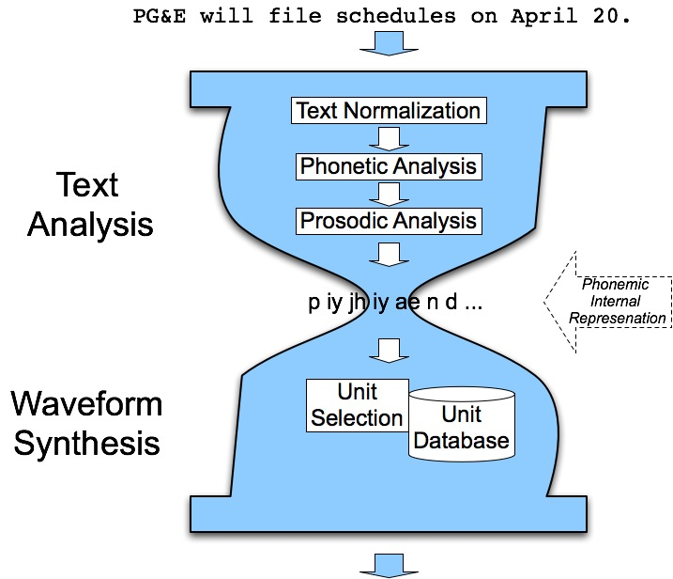
The Hourglass
3/1/19
Speech and Language Processing Jurafsky and Martin
23
Notes:
23

Slide 24
Waveform Generation
Articulatory Synthesis: Model movements of articulators and acoustics of vocal tract
Formant Synthesis: Start with acoustics, create rules/filters to create each formant
Concatenative Synthesis: Diphone or Unit Selection using databases to store speech segments
HMM Synthesis: Parametric learning methods
Deep Learning-based and End2End Models
3/1/19
Text from Richard Sproat slides
24
Speech and Language Processing Jurafsky and Martin
Notes:
24

Slide 25
Formant/Resonance/Acoustic Synthesis
Parametric or resonance synthesis
  Specify minimal parameters, e.g. f0 and first 3 formants
  Pass electronic source signal thru filter
    Harmonic tone for voiced sounds
    Aperiodic noise for unvoiced
    Filter simulates the different resonances of the vocal tract
  Walter Lawrence’s Parametric Artificial Talker (1953) for vowels and consonants
  Gunnar Fant’s Orator Verbis Electris (1953) for vowels
  Formant synthesis download (M$demo)
Notes:
Demo if you have a windows machine

Slide 26

Later Formant Synthesizers
3/1/19
Speech and Language Processing Jurafsky and Martin
26
Most common commercial systems were formant synthesizers in early days (while computers relatively underpowered)
1979 MIT MITalk (Allen, Hunnicut, Klatt)
1983 DECtalk system
  Voice of Stephen Hawking
Notes:
26
Theoretical physicist who lost his voice due to ALS – DecTalk’s perfect paul voice (Dennis Klatt)

Slide 27
Concatenative/Unit Selection Synthesis
Most common commercial TTS today
First practical application in 1936: British Phone company’s Talking Clock
  Optical storage for words, part-words, phrases
  Concatenated to tell time
And a ‘similar’ example from Radio Free Vestibule (1994)
Bell Labs TTS (1977) (1985)
Notes:
RFV comedy troup: tape and editing are phone concatenations. Is it a fake?

Slide 28
Variants of Concatenative Synthesis
Inventory units
  Diphone synthesis (e.g. Festival)
  Microsegment synthesis
  “Unit Selection” – large, variable units
Issues
  How well do units fit together?
  What is the perceived acoustic quality of the concatenated units?
  Is post-processing on the output possible, to improve quality?

Slide 29

Concatenative Synthesis
3/1/19
Speech and Language Processing Jurafsky and Martin
29
Diphone Synthesis
  Units are diphones; middle of one phone to middle of next.
  Why? Middle of phone is steady state.
  Record 1 speaker saying each diphone in different contexts
Unit Selection Synthesis
  Larger units
  Record 10 hours or more, so have multiple copies of each unit
  Use search to find best sequence of units
Notes:
29
accuvoice

Slide 30
Waveform Synthesis
3/1/19
Speech and Language Processing Jurafsky and Martin
30
Given:
  String of phones
  Prosody
    Desired F0 for entire utterance
    Duration for each phone
    Stress value for each phone, possibly accent value
Generate:
  Waveforms
Notes:
30

Slide 31
Diphone TTS Architecture
Training:
  Choose units (kinds of diphones)
  Record 1 speaker saying at least 1 example of each
  Mark boundaries and segment to create diphone database
Synthesizing from diphones
  Select relevant set of diphones from database
  Concatenate them in order, doing minor signal processing at boundaries
  Use signal processing techniques to change prosody (F0, energy, duration) of sequence
3/1/19
Speech and Language Processing Jurafsky and Martin
31
Notes:
31

Slide 32
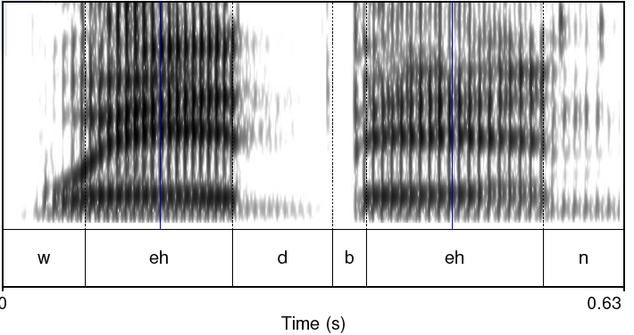
Diphones
3/1/19
Speech and Language Processing Jurafsky and Martin
32
Where is the stable region?
Notes:
32

Slide 33
Diphone Database
Middle of phone more stable than edges
Need O(phone2) number of units
  Some phone-phone sequences don’t exist
  ATT (Olive et al.’98) system had 43 phones
    1849 possible diphones but only 1172 actual
    Phonotactics:
      [h] only occurs before vowels
      Don’t need diphones across silence
  But…may want to include stress or accent differences, consonant clusters, etc
Requires much knowledge of phonetics in design
Database relatively small (by today’s standards)
  Around 8 megabytes for English (16 KHz 16 bit)
3/1/19
33
Notes:
33

Slide 34
Voice
3/1/19
Speech and Language Processing Jurafsky and Martin
34
Speaker
  Called voice talent
  How to choose?
Diphone database
  Called a voice
  Modern TTS systems have multiple voices
Notes:
34

Slide 35
Prosodic Modification
3/1/19
Text from Alan Black
35
Speech and Language Processing Jurafsky and Martin
Modifying pitch and duration independently
Changing sample rate modifies both:
  Chipmunk speech
Duration: duplicate/remove parts of the signal
Pitch: re-sample to change pitch
Notes:
35

Slide 36
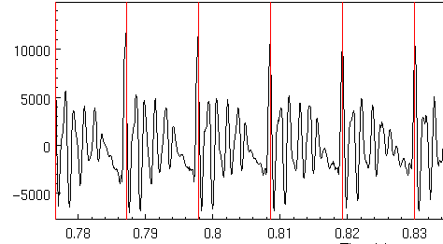
Speech as Sequence of Short Term Signals
3/1/19
Alan Black
36
Speech and Language Processing Jurafsky and Martin
Notes:
36

Slide 37
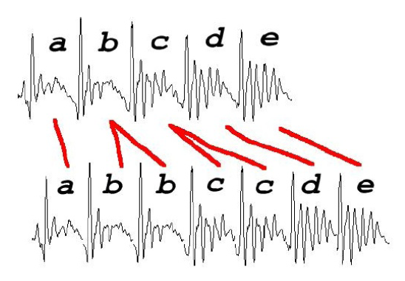
Duration Modification
3/1/19
Slide from Richard Sproat
37
Duplicate/remove short term signals
Notes:
37

Slide 38
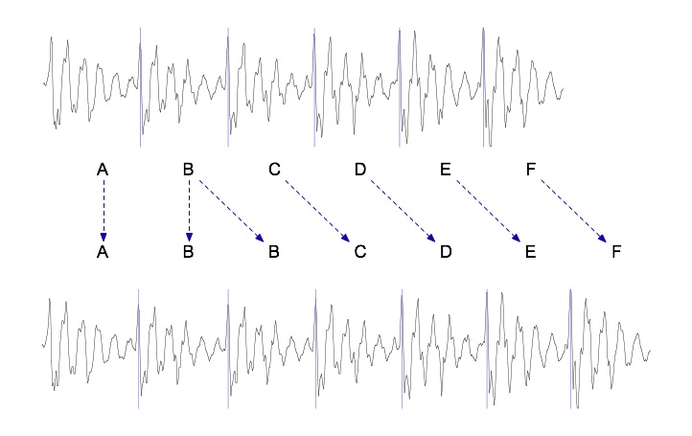
Duration modification
3/1/19
Speech and Language Processing Jurafsky and Martin
38
Duplicate/remove short term signals
Notes:
38

Slide 39
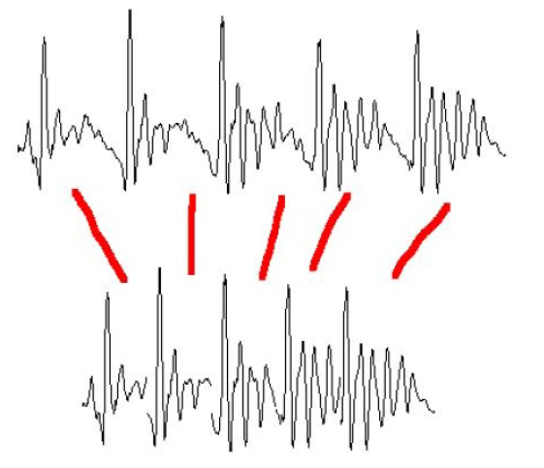
Pitch Modification
Move short-term signals closer together/further apart: more cycles per sec means higher pitch and vice versa
Add frames as needed to maintain desired duration
3/1/19
Slide from Richard Sproat
39
Speech and Language Processing Jurafsky and Martin
Notes:
39

Slide 40
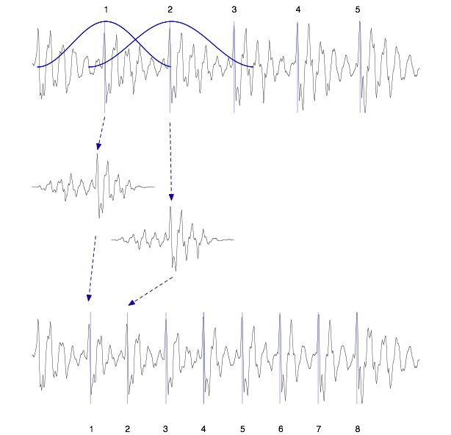
TD-PSOLA ™
Time-Domain Pitch Synchronous Overlap and Add
Patented by France Telecom (CNET)
Epoch detection and windowing
Pitch-synchronous
Overlap-and-add
Very efficient
Can modify Hz up to two times or by half
Smoother transitions
3/1/19
Speech and Language Processing Jurafsky and Martin
40
Notes:
40

Slide 41
Unit Selection Synthesis
3/1/19
41
Generalization of the diphone intuition
  Larger units
    From diphones to phrases to …. sentences
  Record many copies of each unit
    E.g., 10 hours of speech instead of 1500 diphones (a few minutes of speech)
  Label diphones and their midpoints
Notes:
41

Slide 42
Unit Selection Intuition
Given a large labeled database, find the unit that best matches the desired synthesis specification
What does “best” mean?
  Target cost: Find closest match in terms of
    Phonetic context
    F0, stress, phrase position
  Join cost: Find best join with neighboring units
    Matching formants + other spectral characteristics
    Matching energy
    Matching F0
3/1/19
Speech and Language Processing Jurafsky and Martin
42
Notes:
42

Slide 43
Targets and Target Costs
Target cost C(t,u): How well does target specification t match db unit u?
Goal: find unit least unlike target
Examples of labeled diphone midpoints
  /ih-t/ +stress, phrase internal, high F0, content word
  /n-t/ -stress, phrase final, high F0, function word
  /dh-ax/ -stress, phrase initial, low F0, word=the
Costs of different features have different weights
3/1/19
43
Notes:
43

Slide 44
Target Costs
3/1/19
44
Comprised of p weighted subcosts
  Stress
  Phrase position
  F0
  Phone duration
  Lexical identity
Target cost for a unit:
Notes:
44

Slide 45
Join (Concatenation) Cost
Measure of smoothness of join between two database units u_{i} and u_{j} (target irrelevant)
Features, costs, and weights
Comprised of p weighted subcosts:
  Spectral features
  F0
  Energy
Join cost:
3/1/19
45
Notes:
45

Slide 46
Total Costs
Hunt and Black 1996
We now have weights (per phone type) for features set between target and database units
Find best path of units through database that minimize:
Standard problem solvable with Viterbi search with beam width constraint for pruning
3/1/19
Slide from Paul Taylor
Speech and Language Processing Jurafsky and Martin
46
Notes:
46

Slide 47
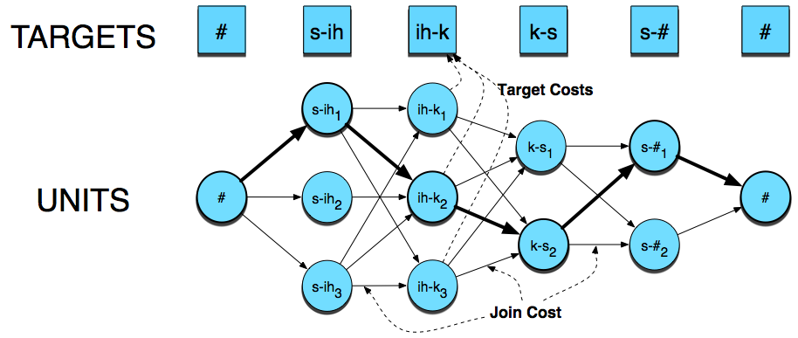
Synthesizing….
3/1/19
Speech and Language Processing Jurafsky and Martin
47
Notes:
47

Slide 48
Unit Selection Summary
Advantages
  Quality far superior to diphones: fewer joins, more choices of units
  Natural prosody selection sounds better
Disadvantages:
  Quality very bad when no good match in database
    HCI issue: mix of very good and very bad quite annoying
  Synthesis is computationally expensive
  Hard to control prosody
    Diphone technique can vary emphasis
    Unit selection can give result that conveys wrong meaning
3/1/19
48
Notes:
48

Slide 49
TTS Demos (all Unit-Selection)
3/1/19
49
Festival
  http://www-2.cs.cmu.edu/~awb/festival_demos/index.html
Cepstral
  https://www.cepstral.com/en/demos
AT&T
  http://www.wizzardsoftware.com/text-to-voice.php
Notes:
49
http://research.spa.aalto.fi/publications/theses/lemmetty_mst/appa.html

Slide 50
New Trend: HMM Synthesis
Hidden Markov Model Synthesis
Won recent TTS bakeoff
  Sounds less natural to researchers but naïve subjects preferred
  Has potential to improve over both diphone and unit selection
  Generate speech parameters from statistics trained on data
  Voice quality can easily be changed by transforming HMM parameters
3/1/19
Speech and Language Processing Jurafsky and Martin
50
Notes:
50

Slide 51
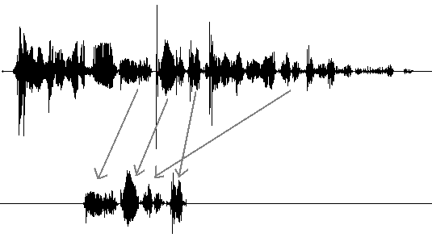
From Concatenation to Generation

Slide 52
HMM Synthesis
A parametric model
Can train on mixed data from many speakers
Model takes up a very small amount of space
Speaker adaptation

Slide 53
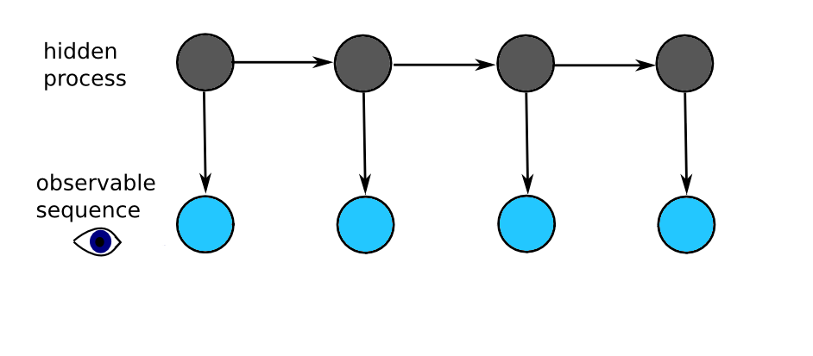
Idea Behind HMMs
There is some hidden process tht has generated some audible observation – learn that process

Slide 54
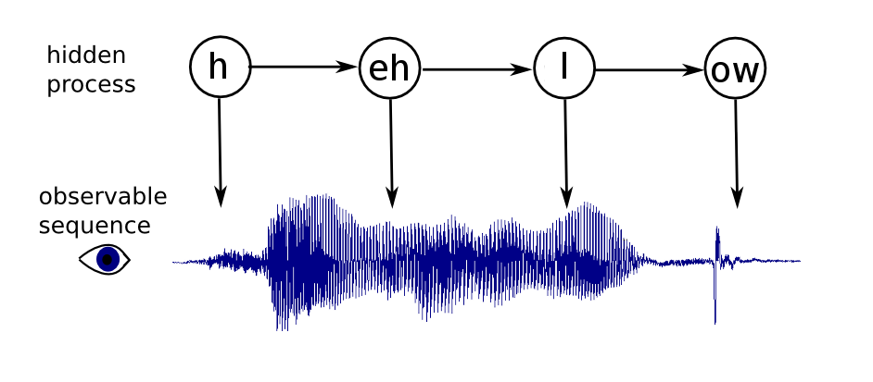
HMMs
Some hidden process has generated some audible observation.

Slide 55
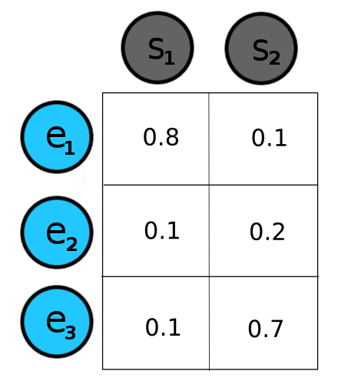
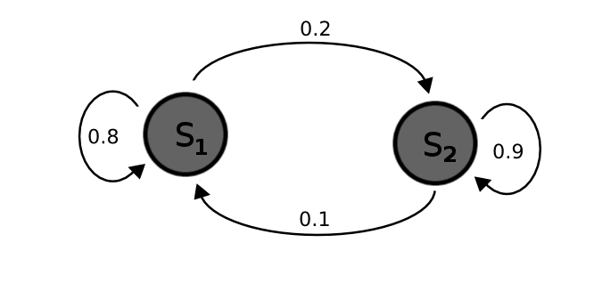
HMMs
Hidden states have transition probabilities and emission probabilities.

Slide 56
HMM Synthesis
Every phoneme+context is represented by an HMM
  The cat is on the mat.
  The cat is near the door.
Sample < phone=/th/, next_phone=/ax/, word='the',
next_word='cat', num_syllables=6, .... >
Acoustic features extracted that are aligned with this: f0, spectrum, duration
Train full HMM with these examples.
Notes:
Every phoneme+context is represented by an HMM.
The cat is on the mat.
The cat is near the door.
< phone=/th/, next_phone=/ax/, word='the',
next_word='cat', num_syllables=6, .... >
Acoustic features extracted: f0, spectrum, duration
Train HMM with these examples.

Slide 57
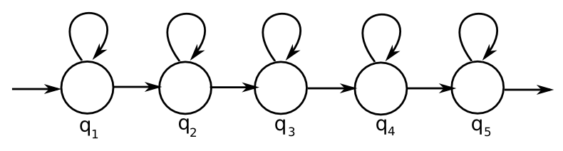
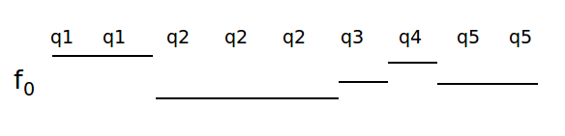
HMM Synthesis
Each state outputs acoustic features (a spectrum, an f₀, and duration)

Slide 58
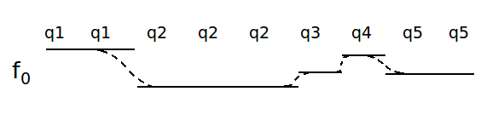
HMM Synthesis
Each state outputs acoustic features (a spectrum, an f₀, and duration) based on input

Slide 59
HMM Synthesis Issues
Many contextual features = data sparsity
Cluster similar-sounding phones
  e.g: 'bog' and 'dog’
  the /aa/ in both have similar acoustic features, even though their context is a bit different
Make one HMM that produces both, and was trained on examples of both
Notes:
Many contextual features = data sparsity
Cluster similar-sounding phones
e.g: 'bog' and 'dog'
the /aa/ in both have similar acoustic features, even though their context is a bit different
Make one HMM that produces both, and was trained on examples of both.

Slide 60

Experiments: Google, Summer 2010
Can we train on lots of mixed data? (~1 utterance per speaker)
More data vs. better data
15k utterances from Google Voice Search as training data
ace hardware rural supply

Slide 61
More Data vs. Better Data
Voice Search utterances filtered by speech recognition confidence scores
50%, 6849 utterances
75%, 4887 utterances
90%, 3100 utterances
95%, 2010 utterances
99%, 200 utterances

Slide 62
Future Work
Speaker adaptation
Phonetically-balanced training data
Listening experiments
Parallelization
Other sources of data
Voices for more languages
Notes:
http://hts.sp.nitech.ac.jp

Slide 63
Reference
http://hts.sp.nitech.ac.jp

Slide 64
Tokuda et al ’02

Slide 65

HMM Synthesis
Unit selection (Roger)
HMM (Roger)
Unit selection (Nina)
HMM (Nina)
3/1/19
Speech and Language Processing Jurafsky and Martin
65
Notes:
65

Slide 66
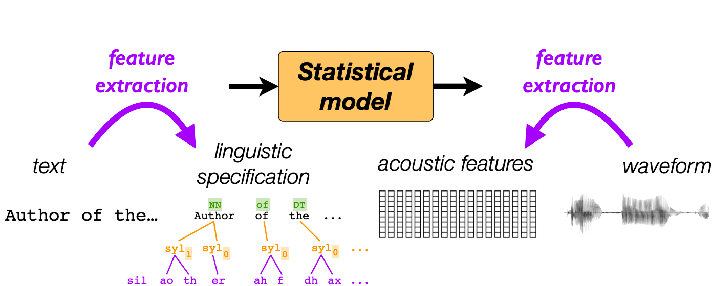
Merlin and Neural Net Synthesis
A newer toolkit for TTS synthesis
Map linguistic features to acoustic features using a neural net

Slide 67
Neural nets
Notes:
Describing neural nets in detail is far outside the scope of this class, but the basic concept is that we transform an input vector through a series of nonlinear transformations into an output vector.
Neural nets are very good at learning patterns from large amounts of data – very commonly used in speech these days
Merlin uses an LSTM-based model

Slide 68
Input Vectors
Each phone has a number of features:
  Current phone
  Surrounding phones
  Position in syllable/word/sentence
  Stress
  Etc.
We can add any linguistic features we wish to incorporate
Notes:
Output vectors are the same acoustic features as HMM-based synthesis, but what are the input vectors?

Slide 69
The model
phone vectors
duration model
linguistic frames
acoustic model
acoustic frames
Notes:
Two steps (each a NN): duration model determines length of phone and duplicates it into the correct number of frames, acoustic model converts phone vector + position into same acoustic features as HMM

Slide 70
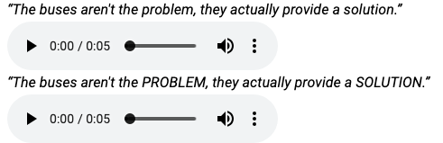
End-to-End Systems
Merlin still requires feature extraction on both ends
WaveNet
  Output waveform instead of acoustic features
  Uses a lot of data but is state of the art
Tacotron
  Truly end-to-end
Notes:
Tacotron goes from characters to waveforms, but this allows less customization on the front end

Slide 71
Some Sample Results
Festival concatenative:
Acuvoice concatenative:
HMM synthesis (Rob Donovan):
Rhetorical (now Nuance) unit selection
Speech synthesis API for developers (Matt West) and demo
http://research.spa.aalto.fi/publications/theses/lemmetty_mst/appa.html
WaveNet today

Slide 72
TTS Evaluation
3/1/19
Speech and Language Processing Jurafsky and Martin
72
Intelligibility Tests
Mean Opinion Scores
Preference Tests
Notes:
72

Slide 73
Intelligibility Tests
Diagnostic Rhyme Test (DRT)
  Listening test
  Listeners choose between two words differing by a single phonetic feature (voicing, nasality, sustenation, sibilation)
  DRT: 96 rhyming pairs
    Dense/tense, bond/pond, …
      Subject hears dense, chooses either dense or tense
      % of correct answers is intelligibility score
  Problem: Only tests single word synthesis

Slide 74
Modified DRT:
  300 words, 50 sets of 6 words (went, sent, bent, tent, dent, rent)
  Embedded in carrier phrases:
    Now we will say dense again
Mean Opinion Score
  Have listeners rate output on a scale from 1 (bad) to 5 (excellent)
Preference tests:
  Reading addresses out loud, reading news text, using two different systems or systems against human voice
  Do a preference test (prefer A, prefer B)

Slide 75
Applications
Low Resource Languages (Elshadai Tesfaye Biru, Yishak Tofik Mohammed)

Slide 76
Next Week
Automatic Speech Recognition
HW2 assigned today

