Slide 1
From Sounds to Language
CS 4706
Julia Hirschberg

Slide 2
Linguistic Sounds
What is the sound inventory of a language X?
How are they produced?
What sounds are shared by languages X and Y? Which are not?
How do particular sounds vary in context?

Slide 3
Discounts
A burger costing $4.59 is on sale for $2.33 at Mel’s
Repeat the sale price to yourself 3 times
A taco costing $4.53 is on sale for $2.22 at Noche Mexicana
Repeat the sale price to yourself 3 times
Which is the better deal?

Slide 5
How do we represent speech sounds?
Why do we need representations?
  Translating between sounds and words (ASR, TTS), learning pronunciation, talking about language similarities and differences,…
How should we represent sounds?
  Regular orthography
  Special-purpose symbol sets
  Abstract sound classes based upon sound similarities

Slide 6
Orthographic Representation?
A single letter may have many different acoustic realizations, e.g., in English
  o comb, tomb, bomb oo blood, food, good
  c court, center, cheese s reason, surreal, shy
A single sound may have different orthographic correspondences
  [i] sea, see, scene, receive, thief [s] cereal, same
  [u] true, few, choose, lieu, do [ay] prime, buy, rhyme
Is orthography a good choice for English?
For Japanese? Spanish?

Slide 7
Phonetic Symbol Sets
International Phonetic Alphabet (IPA)
  Single character for each sound
  Represents all sounds of the world’s languages but is quite large and requires special fonts
ARPAbet, TIMIT, …
  Ascii but multiple characters for sounds
  English specific, so new symbol sets required for each new language to be represented

Slide 8
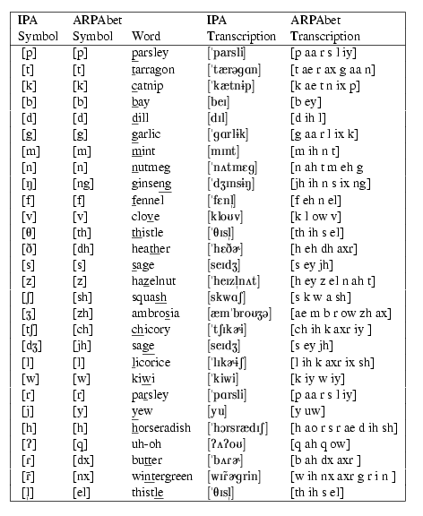
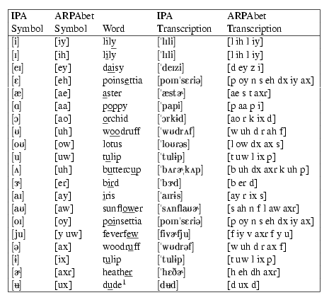
Figures 7.1 and 7.2:
Jurafsky & Martin
Exercise:
Write your first name in English
orthography and in ARPAbet.

Slide 9
Sound Categories
Phone: Basic speech sound of a language
  A minimal sound difference between two words (e.g. too, zoo)
  Not every human sound is phonetic, e.g.
    Sniffs, laughs, coughs,…
Phoneme: Class of speech sounds
  Phoneme may include several phones (e.g. the /t/ in top, stop, little, butter, winter)
Allophone: the set of phonetic variants that comprise a phoneme, e.g. {[t], [ɾ],…}

Slide 10
Articulatory Phonetics: How do people produce speech?
The articulatory organs
General process:
  Air expelled from lungs through windpipe (trachea) leaving via mouth (mostly) and nose (nasals) (e.g. [m], [n])
  Air passing thru trachea goes thru larynx, which contains vocal folds – space between them is the glottis
  When vocal folds vibrate, we get voiced sounds (e.g. [v]); o.w. voiceless (e.g. [f])

Slide 11

Vocal fold vibration
[UCLA Phonetics Lab demo]

Slide 12
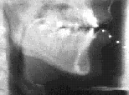
Articulators in action
(Sample from the Queen’s University / ATR Labs
X-ray Film Database)
Examples
Notes:
French Canadian subjects from the early 1970s

Slide 13
How do we capture articulatory data?
X-ray/pellet film archive
X-Ray Microbeam Database
  Sample output (English: light)
Electroglottography
Electromagnetic articulography (EMA)
  3 transmitters on helmet produce alternating magnetic fields at different frequencies, forming equilateral triangle
  Creates alternating current in 5-15 sensors to calculate sensor positions via XY coordinates

Slide 14
Classes of Sounds
Consonants and vowels:
  Consonants:
    Restriction/blockage of air flow (e.g. [s])
    Voiced or voiceless [s] vs. [z]
  Vowels:
    Generally voiced, less restriction (e.g. [u]
  Semivowels (glides): [w], [y]

Slide 15
Consonants: Place of Articulation
What is the point of maximum (air) restriction?
  Labial: bilabial [b], [p]; labiodental [v], [f]
  Dental: [θ], [δ] thief vs. them
  Alveolar: [t], [d], [s], [z]
  Palatal: [∫], [t∫] shrimp vs. chimp
  Velar: [k], [g]
  Glottal: [?] glottal stop

Slide 16
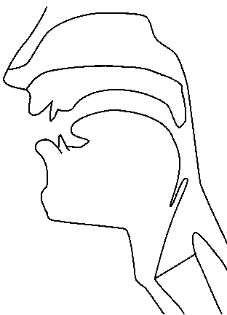
Places of articulation
alveolar
post-alveolar/palatal
dental
velar
uvular
labial
pharyngeal
laryngeal/glottal
http://www.chass.utoronto.ca/~danhall/phonetics/sammy.html

Slide 17
Consonants: Manner of Articulation
How is the airflow restricted?
  Stop: [p],[t],[g],… aka plosive
    Airflow completely blocked (closure), then released (release)
    Glottal stop, e.g. before word-initial vowels in English after pause (extra)
  Nasal: air released thru nose [m],[ng],…
  Fricative: [s], [z], [f] air forced thru narrow channel
  Affricates [t∫] begin as stops and end as fricatives

Slide 18
  Approximant: [w],[y]
    2 articulators come close but don’t restrict much
    Between vowels and consonants
    Lateral: [l]
  Tap or flap: [ ] e.g. butter

Slide 19
 | PLACE OF ARTICULATION
 |  | bilabial |  | labio-dental |  | inter-dental |  | alveolar |  | palatal |  | velar |  | glottal
 | stop | p | b |  |  |  |  | t | d |  |  | k | g | q
 | fric. |  |  | f | v | th | dh | s | z | sh | zh |  |  | h
 | affric. |  |  |  |  |  |  |  |  | ch | jh
 | nasal |  | m |  |  |  |  |  | n |  |  |  | ng
 | approx |  | w |  |  |  |  |  | l/r |  | y
 | flap |  |  |  |  |  |  | dx
MANNER OF ARTICULATION
VOICING:
voiceless | voiced

Slide 20
Vowels
All voiced
Vowel height
  How high is the tongue? high or low vowel
  Where is its highest point? front or back vowel
How rounded are the lips?
Mono- [eh] vs. diphthong, e.g. [ey]
  1 vowel sound or 2?

Slide 21
American English vowel space
HIGH
iy
uw
ih
ix
ux
uh
oy
ey
ow
ax
FRONT
BACK
eh
ah
aw
ao
ay
ae
aa
LOW

Slide 22
Compare to British English, Indian English, Swedish, Spanish, Japanese, Mandarin?

Slide 23
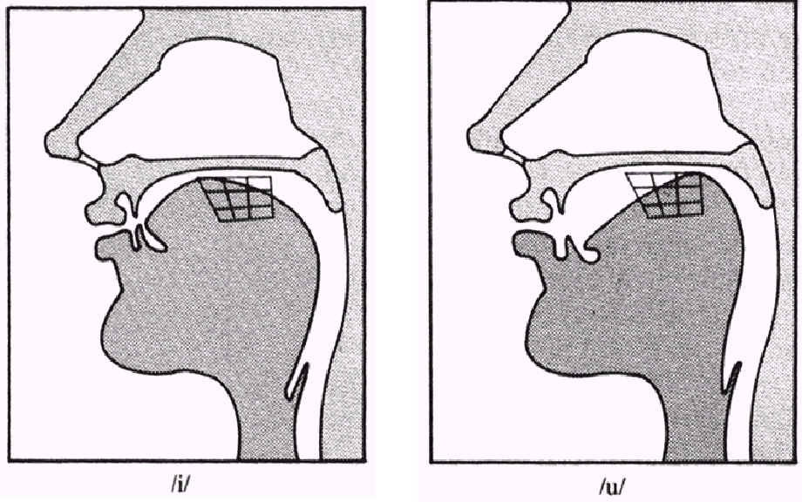
[iy] vs. [uw]
(From a lecture given by Rochelle Newman)

Slide 24
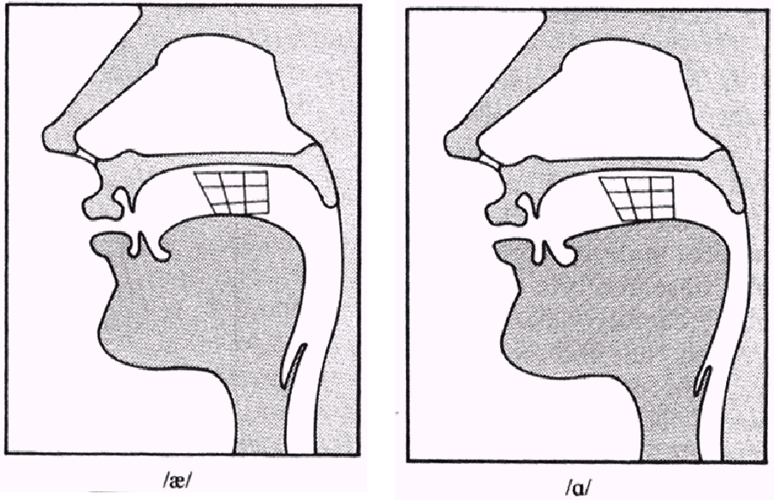
[ae] vs. [aa]
(From a lecture given by Rochelle Newman)

Slide 25
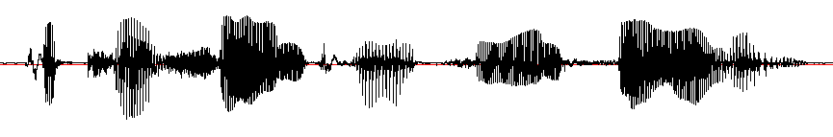

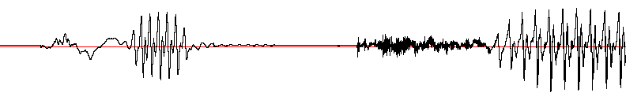
Acoustic landmarks
[p]
[ix]
[t]
[ih]
[sh]
[ax]
[n]
[p]
[ae]
[t]
[s]
[iy]
[n]
[s]
[ae]
[l]
[iy]
“Patricia and Patsy and Sally”
[p]
[ix]
[t]
[ih]

Slide 26
A Problem: Coarticulation
Same phone produced differently depending on phonetic context
Occurs when articulations overlap as articulators are moving in different timing patterns to produce different adjacent sounds
  Eight vs. Eighth
    Place of articulation moves forward as /t/ is dentalized
  Met vs. Men
    Vowel is nasalized

Slide 27
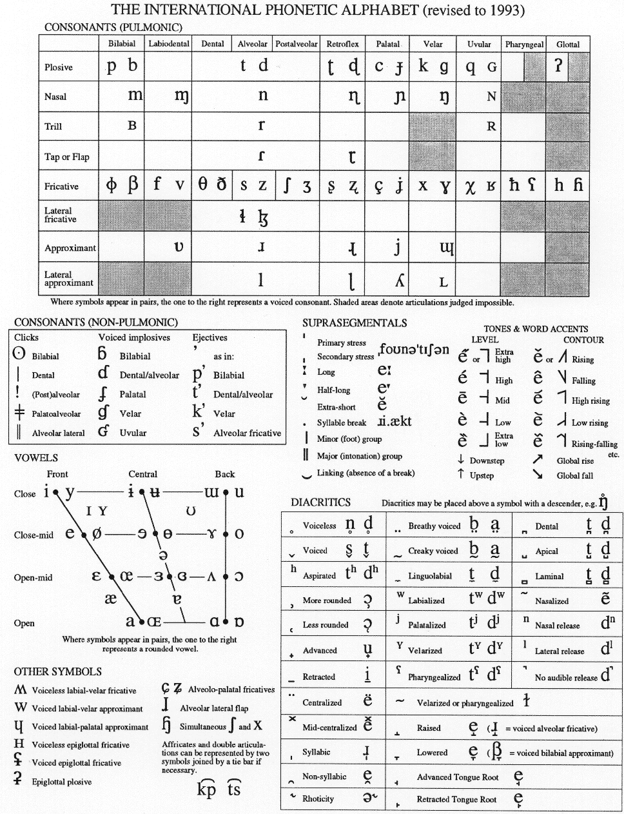
IPA consonants
(Distributed by the International Phonetics Association.)

Slide 28
IPA vowels
(Distributed by the International Phonetics Association.)

Slide 29
Representations for Sounds
Now we have ways to represent the sounds of a language (IPA, Arpabet…) and to classify similar sounds
  Automatic speech recognition
  Speech synthesis
  Speech pathology, language id, speaker id
But…how can we recognize different sounds automatically?
  Acoustic analysis and tools

Slide 30
Next Class
Readings: J&M 7.4
Make appointment to discuss your projects

