Slide 1
Entrainment
Rivka Levitan, PhD
Guest Lecture: Advanced Topics in Spoken Language Processing
Spring 2019

Slide 2
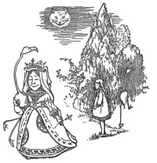
What is entrainment?
'Are their heads off?' shouted the Queen.
'Their heads are gone, if it please your Majesty!' the soldiers shouted in reply.
'That's right!' shouted the Queen. 'Can you play croquet?’
'Yes!' shouted Alice.
'Come on, then!' roared the Queen, and Alice joined the procession, wondering very much what would happen next.
−Alice’s Adventures in Wonderland

Slide 3
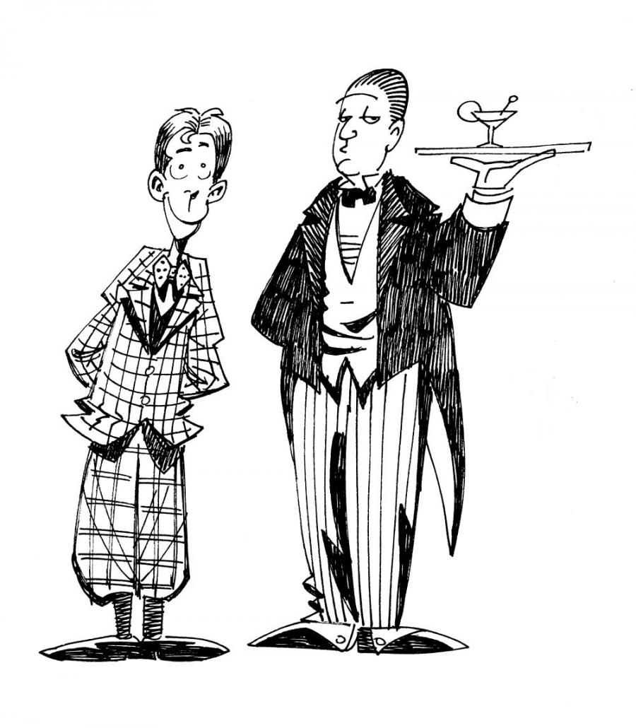
What is entrainment?
'Jeeves,' I said, 'you're talking rot.’
'Very good, sir.’
'Absolute drivel.’
'Very good, sir.’
'Pure mashed potatoes.’
'Very good, sir.’
'Very good, sir − I mean, very good, Jeeves, that will be all,' I said.
And I drank a modicum of tea, with a good deal of hauteur.
−Very Good, Jeeves

Slide 4
Evidence of entrainment
Lexical
  Referring expressions: Brennan & Clark, 1992
  High frequency words: Nenkova et al., 2008
  Syntax: Branigan et al., 2000; Reitter et al., 2010
  Linguistic Style Matching: Niederhoffer & Pennebaker, 2002; Danescu-niculescu-mizil et al., 2011
  To a computer: Brennan, 1996; Stoyanchev & Stent, 2009
Acoustic-prosodic:
  Response time: Matarazzo & Wiens, 1967; Street, 1984
  Intensity, pitch: Natale, 1975; Gregory et al., 2003; Ward & Litman, 2007
  To a computer: Bell et al., 2003; Coulston et al., 2002
  Intensity, pitch, speaking rate, voice quality, backchannel-inviting cues, pitch contours: Levitan et al. 2011, 2012, 2014, 2015, 2016

Slide 5
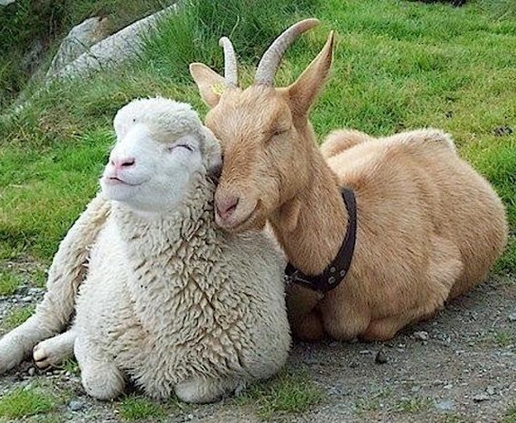
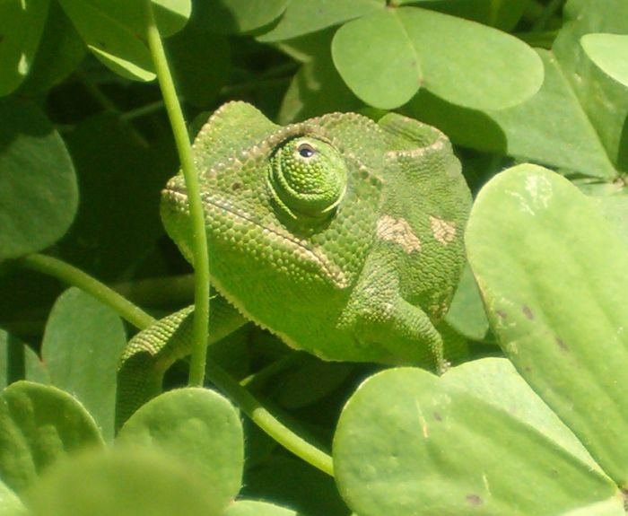
Entrainment theory
Communication Accommodation Theory (Giles et al., 1991)
Communication model (Natale, 1975)
Perception-behavior link (Chartrand & Bargh, 1999)
Interactive Alignment Theory (Pickering & Garrod, 2004)
Social
Automatic

Slide 6
Dialogue quality
Positive interactions in married couples (Lee et al., 2010)
Score on the Map Task (Reitter and Moore, 2007)
Liking, smoother interaction (Chartrand & Bargh, 1999)
Social desirability (Natale, 1975)
Power (Danescu-Niculescu-Mizil et al., 2012)
Smoother interaction, task success (Nenkova et al., 2008)
Romantic interest (Ireland et al., 2014)
Turn taking, encouraging, trying to be liked (Levitan et al., 2012)

Slide 7
Columbia Games Corpus
~9 hours recorded dialogue
12 sessions (~30 minutes each) (each 4 games)
13 participants: 6 female, 7 male
Native speakers of Standard American English

Slide 8
Units of analysis
Inter-pausal unit (IPU) Pause-free segment of speech from a single speaker.
speech <silence> speech <silence> speech
Turn Sequence of speech from one speaker without intervening speech from the other speaker.
Session Complete interaction between two subjects.

Slide 9
Units of analysis
Inter-pausal unit (IPU) Pause-free segment of speech from a single speaker.
speech <silence> speech <silence> speech
Turn Sequence of speech from one speaker without intervening speech from the other speaker.
Session Complete interaction between two subjects.
IPU
IPU
IPU

Slide 10
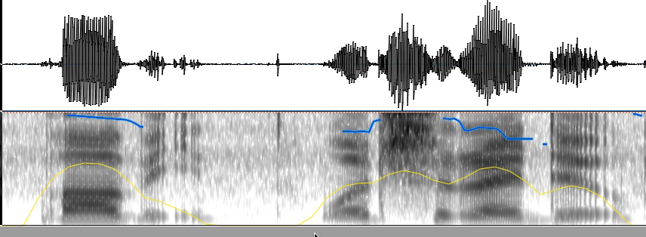
Features
Intensity
Pitch (F0)
Syllables per second
Jitter
Shimmer
Noise-to-harmonics ratio (NHR)

Slide 11
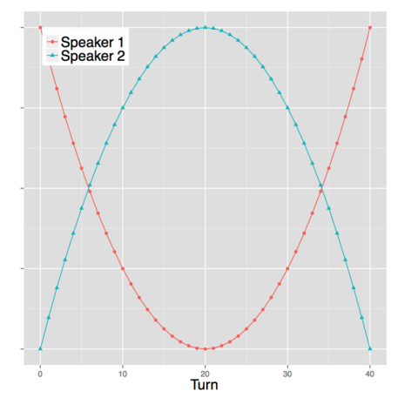
Measuring entrainment
Global vs. local
Global: compare average to baseline
  other speakers
  self in other conversation
Local: compare difference at turn exchanges to baseline
  non-adjacent turns

Slide 12
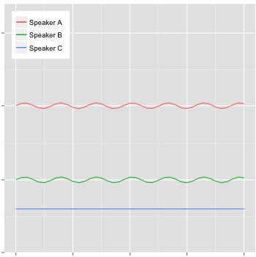
Measuring entrainment
Global vs. local
Exact vs. relative
Exact: compare difference between adjacent feature values to baseline
Relative: correlation of adjacent feature values

Slide 13
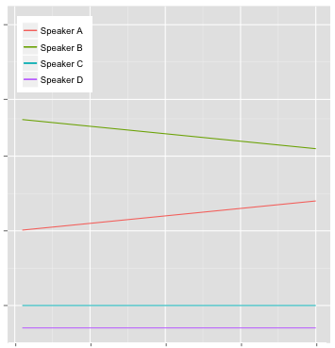
Measuring entrainment
Global vs. local
Exact vs. relative
Converging vs. constant
Global: compare difference in averages over time
Local: correlate adjacent differences with time

Slide 14
Results
Global: intensity, speaking rate
  Convergence: Pitch max, NHR, speaking rate (reset effect)
Local: intensity, NHR
  Convergence: all except jitter and speaking rate; weak
Synchrony: moderate for intensity, none for speaking rate, others weak

Slide 15
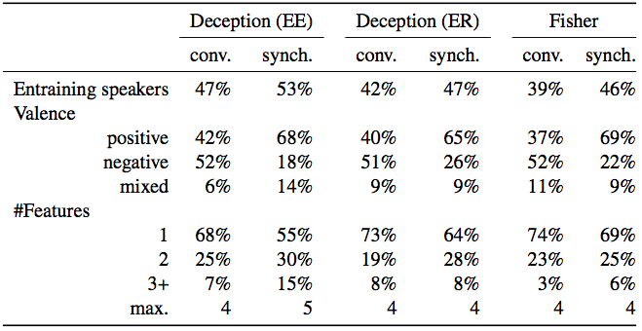
Variation across speakers

Slide 16
Variations across speakers
Some speakers don’t entrain at all
Some entrain only positively
Some entrain only negatively
Some entrain positively for some features, negatively for others
This variation is not explained by gender, native language, or conversational role

Slide 17
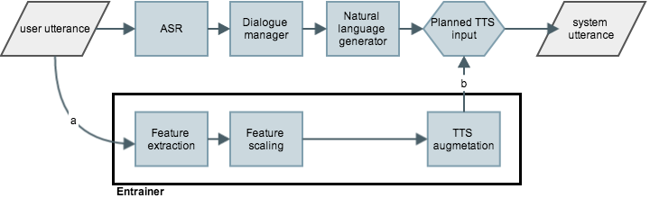
Implementing entrainment

Slide 18
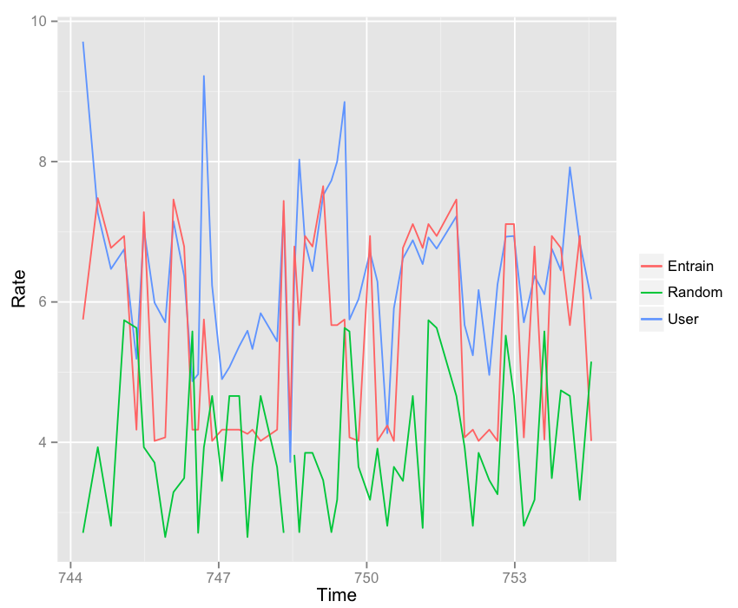
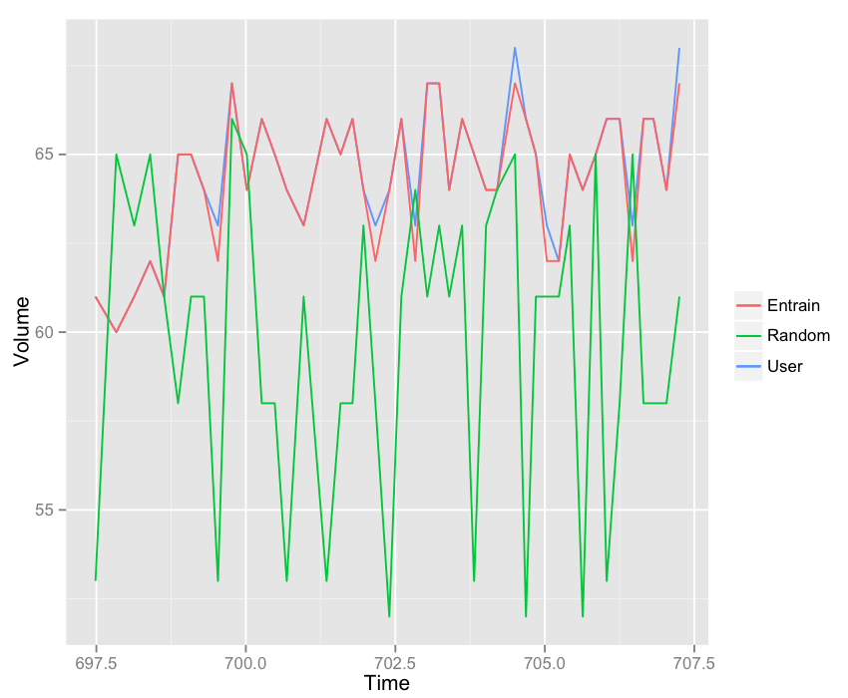

Performance

Slide 19
Errors
Feature extraction
  Sanity checks
SSML compliance
TTS output quality
“What ho!" I said.
"What ho!" said Motty.
"What ho! What ho!"
"What ho! What ho! What ho!"
After that it seemed rather difficult to go on with the conversation.
― P.G. Wodehouse, My Man Jeeves

Slide 20
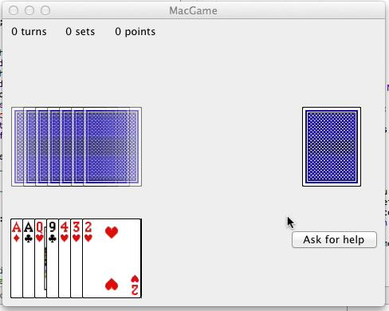
Do users prefer an entraining system?

Slide 21
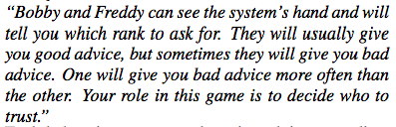
Do users prefer an entraining system?

Slide 22
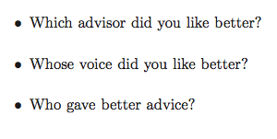
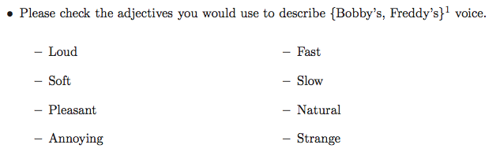
Do users prefer an entraining system?

Slide 23
Do users prefer an entraining system?
19 participants: 9 female, 10 male; ages 20—35
Each session: ~45 user turns, entraining + control turns
~ 9 minutes
Acoustic-prosodic features extracted by Praat
Advice logged

Slide 24
Do users prefer an entraining system?
Trust
“Who gave better advice?” ✗
Implicit trust scores ✓
Liking
“Which advisor did you like better?” ✓
Voice
“Whose voice did you like better?” ✗

Slide 25
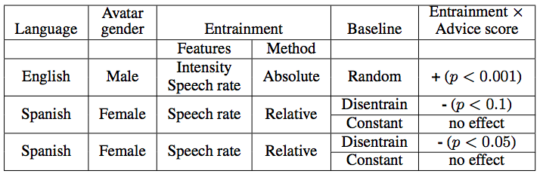
Do users prefer an entraining system?

Slide 26
What we don’t know
How much? (effect size)
Significance of different kinds of entrainment (feature, measure)
Influence of speaker traits/identity
Influence of dialogue context

Slide 27
Collaborators
Andreas Weise (CUNY Graduate Center)
Julia Hirschberg (Columbia University)
Stefan Benus (Constantine the Philosopher University)
Agustin Gravano (Universidad de Buenos Aires)
Sarah Ita Levitan (Columbia University)
Shirley Xia (Jiangsu Normal University)

