Slide 1
Analyzing Speech Prosody
Julia Hirschberg and Sarah Ita Levitan
CS 6998

Slide 2
Today
How can we represent differences in how people produce speech that influence interpretation?
  Expanded vs. compressed pitch range?
  Louder vs. softer speech?
  Faster vs. slower speech?
  Differences in intonational prominence?
  Differences in intonational phrasing?
  Differences in pitch contours?

Slide 3
Joseph Steele, 1775
Notes:
Figure 1. Transcription of Pope’s Happiness (Steele, 1775, p. 13)
Since speech is composed of slides, and not stable, discrete pitches, he developed note heads which were lines, curves, and circumflex notes that could cover several pitches. To these curved heads, he then added a tail which marked the duration of the syllable in a number of beats within a musical bar.

Slide 4

Limitations of Music Representations
Hard to represent similarities between contours
  E.g. these contours are the same
  but in a different pitch range
Too tied to particular instances – hard to generalize

Slide 5
Language Learning Approaches
A simpler approach with arrows
  / IS it INteresting /
  / d’you feel ANGry? /
  / WHAT’S the PROBlem? / (McCarthy, 1991:106)
Too general
  Doesn’t capture full contours or type of pitch accents or phrase boundaries

Slide 6
What Do We Really Need?
Capture sufficient variation to
  Explain both similarities and differences in prosodic meaning in a language
  Compare prosody across languages
How much detail do we need to capture?

Slide 7

Prosodic Prominence
Terms: Prominence, emphasis, [pitch] accent, stress
Prominence is an acoustic excursion use to make a word or syllable “stand out” from the rest
Used to draw a listeners attention to some quality of an utterance: Topic, Contrast, Focus, Information Status
there’s ALSO some SHOPPING
BDC h1s9

Slide 8
Prosodic Prominence
Terms: Prominence, emphasis, [pitch] accent, stress
Prominence is an acoustic excursion use to make a word or syllable “stand out” from the rest
Used to draw a listeners attention to some quality of an utterance: Topic, Contrast, Focus, Information Status
there’s ALSO some SHOPPING
BDC h1s9

Slide 9
Prosodic Phrasing
An acoustic “perceived disjuncture” between words
Physiologically necessary – a speaker cannot produce sound indefinitely
Used to structure information in an utterance, grouping words into regions
  Phrasing structure may be related to syntactic structure – or it may not…
finally we will get off - - at Park Street - and get on the Red Line - -
BDC h1s9
Notes:
Again, we will return to acoustic correlates of phrasing later. Now let’s just get a sense of what’s going on.
Examples

Slide 10
Prosodic Phrasing
An acoustic “perceived disjuncture” between words.
Physiologically necessary – a speaker cannot produce sound indefinitely.
Used to structure the information in an utterance, grouping words into regions.
  Phrasing structure may be related to syntactic structure.
finally we will get off - - at Park Street - and get on the Red Line - -
BDC h1s9
Notes:
Again, we will return to acoustic correlates of phrasing later. Now let’s just get a sense of what’s going on.
Examples

Slide 11
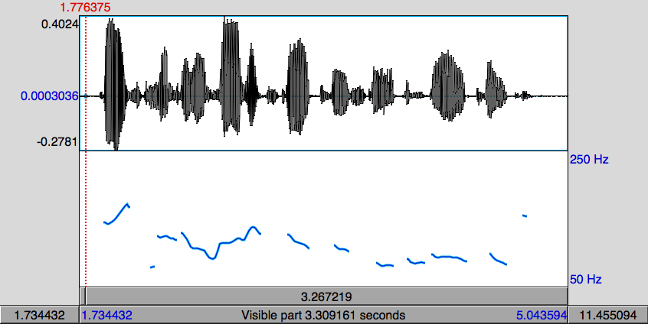
Pitch Contour Example
DoublingError
Halving Error
Pitch (fundamental frequency) is estimated by finding the length of the period of the speech signal.
  If a cycle is missed, the period appears to be twice as long (pitch halving)
  If an extra cycle is found, the period appears to be half as long (pitch doubling)

Slide 12
Tone Sequence Models
Intonation generated from sequences of categorically different, phonologically distinctive tones
Basic unit of intonational description: intonation phrase (tone unit, breath group)
  Delimited by pauses, phrase-final lengthening, pitch
Syllables may be stressed or accented
  Accent aligned with primary stress -- telephone
  Indicated by F0, duration, intensity, voice quality
Notes:
O’Connor and Arnold 1972:
Earliest textbook for English instruction that tells user which contour appropriate in which context

Slide 13
Types of Tone-sequence Models
Type 1: based on pitch movements
a
t
r
g
Type 2: based on pitch levels
e
t
H
The British School The Dutch School
a
t
r
g
L
e
t
The American School

Slide 14

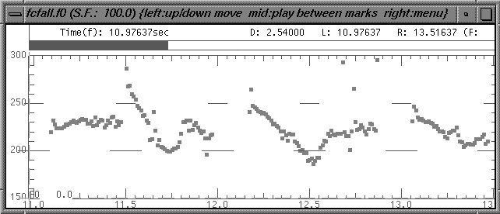
Note the Pitch Accent Location
and I think it’s HOrriblerrible
...a POINT where
you have to CLEAN it
There’s a point where you have to clean it and I think it’s horrible...

Slide 15
British School
Each accent defines the beginning of a prosodic constituent
Prenuclear accent unit
Nuclear accent unit
Prehead
‘Head’
‘Nucleus’
Stressed syllable
But
JOHN’s never BEEN to Jamaica
Notes:
Two types of accent unit in the British School:
Prenuclear accent units; also called the Head
Nuclear accent units; also called the Nucleus
The nuclear accent unit is the last accent unit in the IP
The head comprises all prenuclear accent units

Slide 16
Six nuclear choices in English
m
a
a
a
i
c
J
c
i
a
a
a
J
m
falling
rising
m
a
a
a
i
i
J
c
a
a
c
J
m
a
rising-falling
falling-rising
i
a
i
m
a
c
a
c
a
a
a
J
J
m
a
Rising-falling-rising
level

Slide 17
The American School
American school-type models make a distinction between accents (what makes a particular word prominent) and boundary tones (how a phrase ends)
Autosegmental metrical or two-tone models
Only two tones, which may be combined
  H = high target
  L = low target

Slide 18
Price, Ostendorf et al
Defined different types of prosodic phrases by the degree of juncture between words
Break indices from 0 to 8
  0 no word boundary
  1 word boundary
  2 strong juncture with no tonal markings
  3 intermediate phrase boundary
  4 intonational phrase boundary
  5,6,7 increasing length of phrase boundary

Slide 19
Pierrehumbert 1980 Put Phrases and Accents Together
Contours = pitch accents, phrase accents, boundary tones
Pitch Accents*
Phrase Accents*
Boundary Tone
H* L*
L*+H L+H*
H*+L H+L*
L- H-
L% H%
Notes:
Jd

Slide 20
To(nes and)B(reak)I(ndices)
Developed by prosody researchers in four meetings over 1991-94 plus several more to refine the system and address problem issues
Putting Pierrehumbert ‘80 and Price, Ostendorf, et al together
Goals:
  Devise common labeling scheme for Standard American English that is robust and reliable
  Promote collection of large, prosodically labeled, shareable corpora

Slide 21
Prosody is described by high (H) and low (L) tones that are associated with prosodic events (pitch accents, phrase accents, and boundary tones) and break indices which describe the degree of disjuncture between words.
ToBI is inherently categorical in its description of prosody

Slide 22
Minimal ToBI Transcription
Recording of speech
F0 contour
ToBI tiers:
  Orthographic Tier: words
  Break-index Tier: degrees of junction (Price et al ‘89)
  Tonal Tier: pitch accents, phrase accents, boundary tones (Pierrehumbert ‘80)
  Miscellaneous Tier: disfluencies, laughter and other non-speech sounds, etc.

Slide 23
Downstepped accents:
  !H*,
  L+!H*,
  L*+!H
Degree of prominence:
  within a phrase: HiF0 (~nuclear accent)
  across phrases ??

Slide 24
Prosodic Phrasing in ToBI
‘Levels’ of phrasing:
  intermediate phrase: one or more pitch accents plus a phrase accent, H- or L-
  intonational phrase: 1 or more intermediate phrases + boundary tone, H% or L%

Slide 25
ToBI Pitch Accent Types in Standard American English
Words are accented or deaccented
5 pitch accent types (in SAE) defined by target level
  H* simple high (declarative)
  L* simple low (ynq)
  L*+H scooped, late rise (uncertainty/ incredulity)
  L+H* early rise to stress (contrastive focus)
H*
L*
L*+H
L+H*
H+!H*
Notes:
Examples!!!!

Slide 26
  L+H* early rise to stress (contrastive focus)
  H+!H* fall onto stress (implied familiarity)
High tones can be produced in an increasingly compressed pitch range – catathesis, or “downstepping”

Slide 27
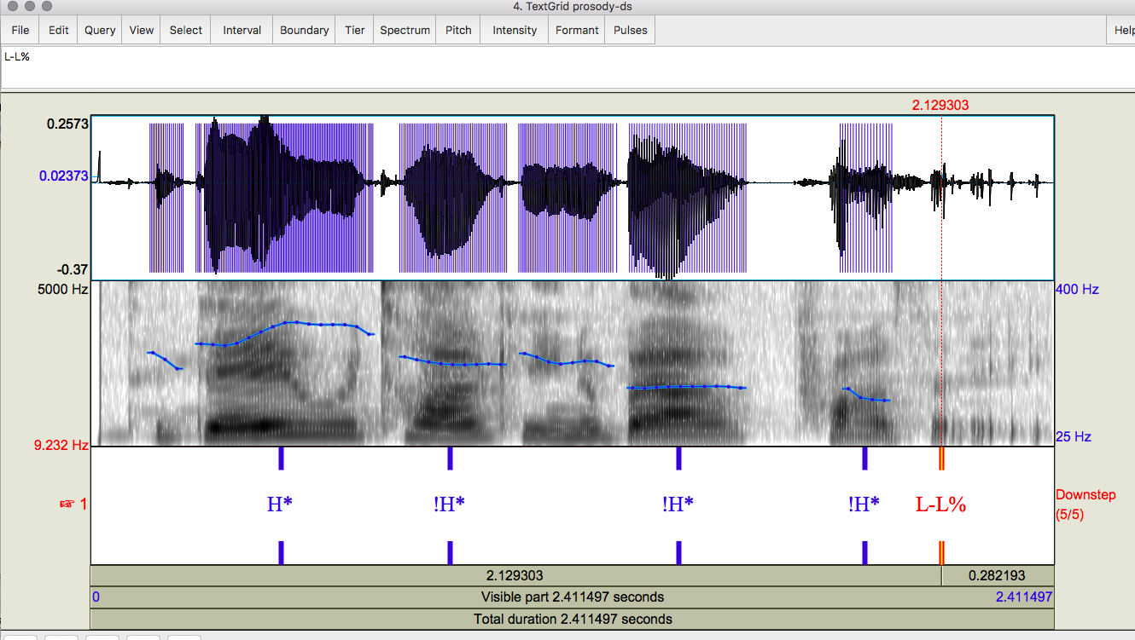
Today….

Slide 28
ToBI Phrasing
ToBI describes phrasing as a hierarchy of two levels.
  Intermediate phrases contain one or more words.
  Intonational phrases contain one or more intermediate phrases
Word boundaries are marked with a degree of disjuncture, or break index
  Break indices range from 0-4
  0 is no boundary (it’s a)
  1 is a word boundary
  2 is between a word and a phrase boundary
  3 intermediate phrase boundary
  4 intonational phrase boundary
Notes:
Examples!!!!

Slide 29
ToBI Phrase Ending Types
Intermediate Phrase boundaries have associated Phrase Accents describing the pitch movement from the last accent to the phrase boundary
  Phrase Accents: H-, !H- or L-
Intonational phrase boundaries have Boundary Tones describing the pitch movement immediately before the boundary
  Boundary Tones: H% or L%
L-L%
L-H%
H-H%
H-L%
!H-L%
Notes:
Examples!!!!

Slide 30
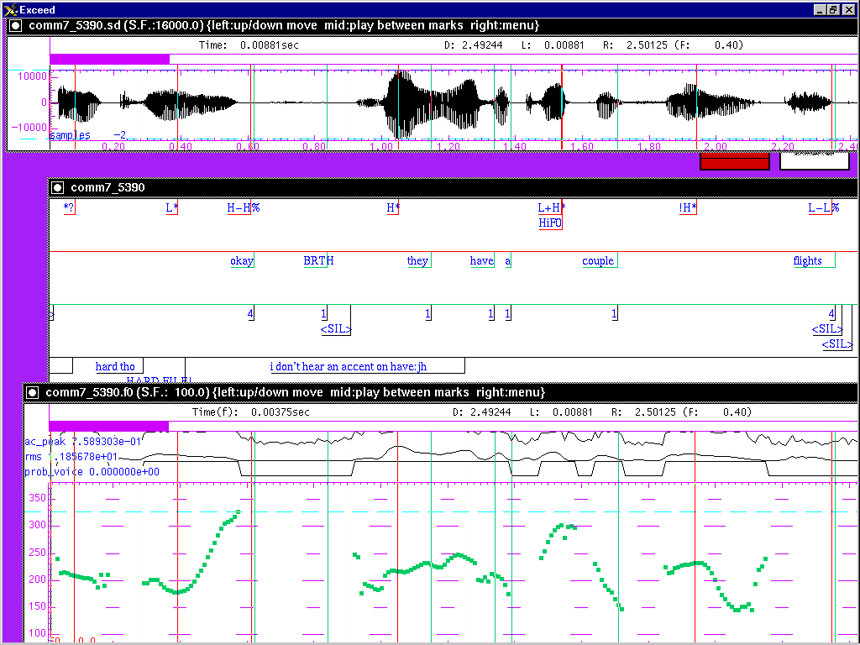
Sample ToBI Labeling

Slide 31
ToBI Example (in Praat)
Notes:
Include audio example

Slide 32
L-L%
L-H%
H-L%
H-H%
H*
L*
L*+H

Slide 33
L-L%
L-H%
H-L%
H-H%
L+H*
H+!H*
H* !H*

Slide 34
Original ToBI training for English at:
  https://www.ling.ohio-state.edu/~tobi/ame_tobi/
New online training material,available at:
  http://anita.simmons.edu/~tobi/index.html
Simpler guidelines here:
  http://www.speech.cs.cmu.edu/tobi/ToBI.1.html

Slide 35
Evaluation
Good inter-labeler reliability for expert and naive labelers
  88% agreement on presence/absence of tonal category, 81% agreement on category label, 91% agreement on break indices to within 1 level (Silverman et al. ‘92,Pitrelli et al ‘94) but…
ToBI Lite and other simpler schemes created for English (e.g. Yoon et al 2004)
  E.g. Binary classification of pitch accents and phrase boundaries
  Crowd-sourcing

Slide 36
ToBI Conventions in Many Languages
Mandarin, Taiwanese, Cantonese
German (many)
Spanish (many)
Catalan
Slovak
Japanese
Korean
Greek
Australian, British, Glasgow English
Serbian
Italian (many)

Slide 37
AuToBI (Rosenberg 2010)
Automatic ToBI labels for multiple languages:
  https://github.com/AndrewRosenberg/AuToBI
Identifies pitch accents and boundaries with high accuracy using many acoustic-prosodic features
Input:
  Word boundaries
    TextGrid, CPROM, BURNC forced alignment (.ala), flat text
  Wav file
  Trained models (available from AuToBI website)

Slide 38
Output:
  Hypothesized ToBI tones (with confidence scores) and break indices
  Praat TextGrid format
Developed for English and adapted for Mandarin, German, Italian, Portuguese and French, with small amounts of labeled data

Slide 39
AuToBI Command Line Example
java –jar AuToBI.jar \
-text_grid_file=in.TextGrid \
-wav_file=in.wav \
-out_file=out.TextGrid \
-pitch_accent_detector=accent.model \
-pitch_accent_classifier=pa_type.model \
-intonational_phrase_detector=ip.model \
-intermediate_phrase_detector=interp.model \
-phrase_accent_classifier=phraseac.model \
-boundary_tone_classifier=bt.model
Notes:
TODO fix command line example

Slide 40
AuToBI Schematic
Audio (wav)
Normalization Parameters
Segmentation
(TextGrid)
ToBI Annotation Specific Feature Extraction
ToBI Annotation Specific Classifier
Hypothesized Prosodic Events
Evaluation

Slide 41
AuToBI Performance
Cross-Corpus Performance: BURNC → CGC
Available models
  Boston Directions Corpus
    Read, Spontaneous, Combined
  Boston Radio News Corpus
Developing models for French, Italian, European and Brazillian Portuguese
Task | Accuracy
Pitch Accent Detection | 73.5%
Pitch Accent Classification | 69.78%
Intonational Phrase Boundary Detection | 90.8% (0.812 F1)
Phrase Accents/Boundary Tones | 35.34%
Intermediate Phrase Boundary Detection | 86.33% (0.181 F1)
Phrase Accents | 62.21%

Slide 42
Available ToBI Labeled Corpora
Boston University Radio News Corpus
  Available from LDC
  6 speakers (3M, 3F)
  Professional News Readers (Broadcast News)
  Reading the same news stories
Boston Directions Corpus
  Read and Spontaneous Speech
  4 non-professional speakers (3M, 1F)
  Speakers perform a direction giving task (spontaneous)
  ~2 weeks later, speakers read a transcript of their speech with disfluencies removed.
Switchboard Corpus
  Available from LDC
  Spontaneous phone conversations
  543 speakers
  Subset annotated with ToBI labels

Slide 43
C-ToBI Labels
Pinyin tier with tones
Syllable initial labels tier
Tone and intonation tier
Break index tier (0-4)
Stress index tier (1-4): @ indicates contrastive stree
Sentence function tier: interrogagive, imperative, declarative, exclamation
Regional accent tier for dialect/accent
Turn-taking tier: start and end of each tier
Miscellaneous tier: paralinguistics (e.g. laughter)

Slide 44
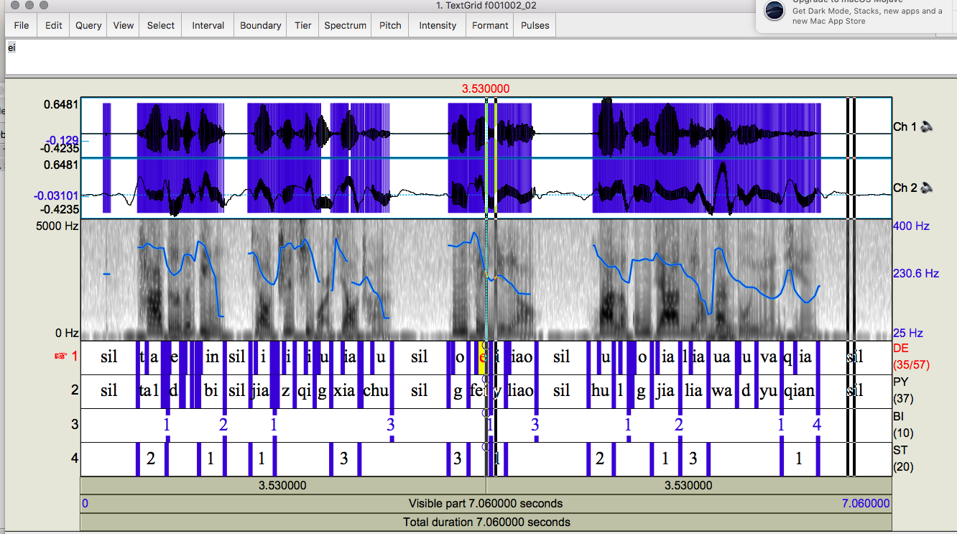
C-ToBI Corpora
Notes:
From the ASCCD (Annotated Speech Corpus of Chinese Discourse): label tiers seem to include phones on tier DE
We’ve just acquired another corpus, the COSPRO corpus of Taiwanese Chinese

Slide 45
Weizmann Prosody Quantification Project (Biron et al)
An integrative theory for prosody analysis combining:
  Para-syntactic Prototype: Dialogue Act
  Discourse functions: e.g. rhetorical question, item in a list, parenthetical phrase
  Information structure: marked focus on shouldn’t
  Attitude/sentiment: Insistent reprimand

Slide 46

[If you’re poorly educated,] Why shouldn’t you steal/shoot/go to prison
Three segments
Para-syntactic Prototype: Wh- question
Discourse function I: Rhetorical question
Discourse function II: Item in a list
Discourse function III: Apodosis to an implied protasis
Information structure: marked focus on shouldn’t
Attitude/sentiment: Insistent reprimand

Slide 47
“[If you’re poorly educated,] Why shouldn’t you steal?”
Para-syntactic prototype
WH question
Discourse functions
Rhetorical; list; apodosis
Information structure
Contrastive shouldn’t
Sentiment/Attitude
Insistent reprimand

Slide 48
Other Prosodic Models
Developed for database retrieval, phonological analysis and text-to-speech synthesis
  How can we extract information from large speech corpora that go beyond pitch, intensity, speaking rate?
  How can we analyze the way subjects convey different kinds of information?
  How can we generate synthetic speech that sounds like a human being?

Slide 49
F0 Modeling for Research and for TTS
Generation or Event Detection
  ToBI
  Fujisaki model
  TILT
  Tonal Center of Gravity
  Quantized Contour Modeling

Slide 50
Superpositional models
Pitch pattern of intonation modeled with two components: phrase component and accent component.
Phrase has basic shape, and pitch movements for individual accents are superimposed over basic shape:
plus
=
Apples, oranges and tomatoes

Slide 51
Fujisaki model
Superpositional view of intonation Fujisaki & Hirose 1982
Prosody is described by a phrase command which is modified by accent commands.
In the Fujisaki model, this is an additive process in log Hz space.

Slide 52
Fujisaki model

Slide 53
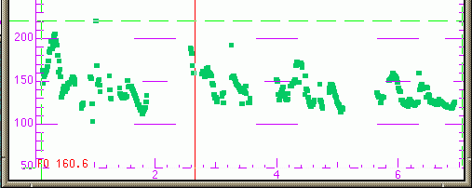
Good for modeling utterance-level trends
Declination: downtrend in f0 over the course of an utterance
Successful in speech synthesis for languages like Japanese (little variation in accent type, e.g.)
Lily and Rosa thought this was divine.
Prince William was gorgeous
and he was looking for a bride.
They dreamed of wedding bells.

Slide 54
Superpositional vs. Sequential
Superpositional models require identification of a phrase signal
Sequential models describe one prosodic event – phrasing or prominence – at a time
Similarities
  Both describe phrasing and accenting
  If the phrasal context can be accommodated by a sequential model, there are no analytical reasons to do otherwise
Differences
  Categorical vs. continuous accent types
  Superpositional model is tightly coupled with pitch

Slide 55
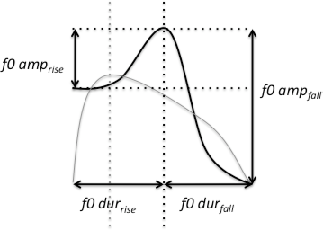
TILT Model
Describes an F0 excursion based as a single parameter (Taylor 1998)
Compact representation: TILT parameters allow generation/db retrieval
Notes:
Tilt=+1 all rise
Tilt= -1 all fall
In betw, some of each

Slide 56
Tonal Center of Gravity (ToG)
A measure of the distribution of the area under the F0 curve within a region
Perceptually robust
Better classification of pitch accent types than peak timing measures
(Veilleux et al. 2009, Barnes et al. 2010)
Notes:
X is F0

Slide 57
Quantized Contour Modeling
A Bayesian approach to simultaneously model contour shape and classify prosodic events
(Rosenberg 2010)
Specify a number of time, M, and value, N, bins
Represent a contour as an M dimensional vector where each entry can take one of N values.
For extension to higher dimensions, allow values to be multidimensional vectors

Slide 58
Next Class
HW2 assigned
Text-to-Speech Synthesis

