Slide 1
Word Pronunciation
Julia Hirschberg
CS 4706

Slide 2
Today
Motivation
Challenges for automatic word pronunciation
Standard methods
Innovative solutions

Slide 3
TTS demos:
  AT&T
  Cepstral
SNL Robot Repair
2/18/12
3
Notes:
3

Slide 4
Motivation
Intelligibility
Naturalness
Applications to language learning
  Unlimited vocabulary
  Type a word or phrase and hear it spoken in your target language
    To imitate
    To learn to recognize
Speech therapy

Slide 5
Word Pronunciation
What determines how a word is pronounced?
  History/Language Origin/Dictionaries:
    shoe (ME shoo), phoenix (Gr)
    mole, attaches, resume
  Part-of-speech:
    use, close, dove, multiply, coax
  Morphology:
    ferryboat, ferryboats
    Popemobile (pope+mobile)

Slide 6
Letter2Sound Rules
Define correspondences between orthography and phonemic representation, e.g.
  i _{C}e$ → /ai/ rise
  Else i → /ih/ rip
Deals with any input

Slide 7
Problems with Rule-Based Systems
Must be built by hand
Many exceptions, e.g.
    i _{C}e$ → /ai/ matches magazine, crevice, beige
    Proper names: Nice, Rise
Symbols and abbreviations: &c, evalu8, cu, tsp
Assigning lexical stress is also tricky
  Rules to decide primary stress
  Monotone, monotony, monolingual, montage
Solutions
  More complex rules
  Consult exceptions dictionary first
  But how do we handle morphological variation? E.g. Rise’s hat
Notes:
ripper

Slide 8
Dictionary-based Approaches
Rely on very large dictionary with orthography and pronunciation for each word
Typically created by hand or by expansion of online pronouncing dictionary

Slide 9
Problems
Redundancy of representation
  Cat, cats, cat’s, cats’
Out-of-vocabulary (OOV) items
  Proper names: covering all U.K. surnames requires >5,000,000 entries
  New words: …
    Technical terms: liposuction, anova, bernaise
    Foreign borrowings: frappe, ciao, louche

Slide 10
Solutions
  Even larger dictionary
  Morphological preprocessing before dictionary look-up
  Fall back to Letter2Sound rules if no dictionary ‘hit’

Slide 11
Major Challenges for TTS
Disambiguating homographs
  bass/bass
Pronouncing new words
  New names in the news:
  New words: iPad, Kindle
Expanding abbreviations and pronouncing acronyms correctly

Slide 12
Homograph Disambiguation by Decision List Classifiers (Yarowsky ‘97)
E.g., bass/bass, nice/Nice, live/live, desert/desert, lead/lead

Slide 13
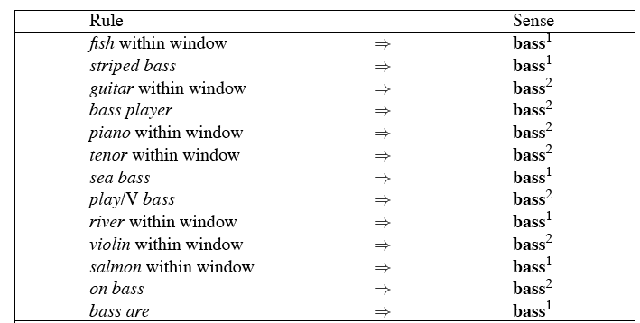
Decision List for Bass/Bass
Can be treated as a case statement….

Slide 14
Learning Decision Lists
Restrict lists to rules that test a single feature
Evaluate each possible test and rank them based on how well they classify
Order the top-N tests as the decision list

Slide 15
Yarowsky’s Metric
On a binary (homonymy) distinction used the following metric to rank the tests
This gives about 95% on bass

Slide 16
Semi-supervised Extensions
Bootstrap from decision list built from small amount of labeled data
Classify unlabeled data
Create decision list from new labeled corpus

Slide 17
Bootstrapping Phonetic Lexicons (Maskey et al ’04)
For some languages, online pronouncing lexicons exist – but for Low Resource Languages ….e.g. Nepali
  How to minimize effort in creating lexicons?
Approach
  Given a native speaker and a large amount of online text in the language…
    Native speaker builds small lexicon by hand for seed set of N most common words in text, e.g.
      is: /izh/
      the: /dhax/

Slide 18
    Automatically derive L2S rules from lexicon, e.g.
      is → ih{zh}
      the → {dh}ax …
    Loop: Choose the next N most common words from the corpus and use lexicon + L2S rules to predict pronunciations, e.g.
      telephone -> /telaxfown/
      He -> /hax/?
      Rise -> /rihzhax/?
    Assign a confidence score to each prediction by comparing each word to all words in lexicon
      If is -> /ihzh} in lexicon and no other orthographically similar words are pronounced differently, then new rule his -> /hihzh/ scores high

Slide 19
    For low confidence pronunciations, Active Learning step:
      Inspect and calculate error rate
      Hand correct errors and add all to lexicon
  Iterate from Loop until performance stabilizes
Results
  English:
    94% success on test set after 23 iterations, 16K entry lexicon
    Performance comparable to CMUDict and 1/7 the size
  German:
    90% accuracy after 13 iterations, 28K lexicon
  Nepali
    94.6% accuracy after 16 iterations, 5K lexicon

Slide 20
Pronouncing OOV Words
Techniques for handling OOVs
  Inferring country of origin:
    Takashita, Leroy, Kirov, Lima, Infiniti
  Pronunciation by analogy
    Analog/dialog
    Risible/visible
    Proper names: Alifano/Califano
  AT&T
  Cepstral

Slide 21
Improving Pronunciation Dictionary Coverage (Fackrell and Skut ’04)
Idea: Many proper names have more than one spelling (e.g. More/Moore; Smith/Smythe)
  Homophones: different spelling, same pronunciation
  Identify spelling alternations that are ‘pronunciation-neutral’ in an existing lexicon
    I. e., homophones (right, write, Wright)
    Produce rewrite rules, e.g. /wr/ → /r/, /ight/=/ite/
  Find a ‘fuzzy’ mapping between new, OOV words and words already in the lexicon using these rules (e.g. Wrothman)

Slide 22
Pros?
Cons?

Slide 23
Deriving Pronunciations from the Web (Ghoshal et al ’09)
Extract candidate orthography/pronunciation pairs (ad-hoc and IPA)
  E.g. “…bruschetta (pronounced broo-SKET-uh)…”
Validate the candidates: how likely are these pairs to represent a word and its pronunciation
Normalize ad-hoc and IPA pronunciations

Slide 24
Pros?
Cons?

Slide 25
Pronunciation Evaluation
How would you evaluate the pronunciation module of a TTS system?

Slide 26
Next Class
Readings
Download the ToBI cardinal examples (see http://www1.cs.columbia.edu/~agus/tobi/ for instructions)
  You will first need to download WaveSurfer
    http://www.speech.kth.se/wavesurfer/
  Then download the cardinal examples
    http://www1.cs.columbia.edu/~agus/tobi/cardinals/manual.php
  Follow the installation directions carefully
Listen to the cardinal examples for the following and see if you can hear the differences:
  H* H- L%, H* H- H%, L* H- H%, H* !H- H%

