Slide 1
Intonation and Computation: Mental Illness
Julia Hirschberg
LSA 2017
julia@cs.columbia.edu

Slide 2
Cues to Mental Illness
Depression
Schizophrenia
Dementia – Alzheimer’s Disease
Ethics

Slide 3


Slide 4

Language as a Marker of Cognitive and Physiological Change
Notes:
The idea behind using language (speech and lexical content) as a marker of mental illness comes from the following hypothesis:
Mental illness is associated with both cognitive and physiological changes, which then influence the speech production process. This in turn affects the acoustic quality of speech produced and or the lexical quality, which we can then measure.

Slide 5
Quantifying Mental Health Signals in Twitter (Coppersmith et al., 2014)
Mental health research lacks large amounts of quantifiable data
Collect surveys and gain access to social media for respondents
  Automatically identify self-expressions of mental illness diagnoses (e.g. “I was diagnosed with …”)
  Leverage these to construct a labeled corpus
  But…limited by # of respondents and diagnostic information that might be available on line
Notes:
Mark dredze, JHU: mining twitter for public health (since at least 2011)

Slide 6
Quantifying Mental Health Signals in Twitter (Coppersmith et al., 2014)
Sample tweets
  @USER The VA diagnosed me with PTSD, so I can’t go in that direction anymore
  I wanted to share some things that have been helping me heal lately. I was diagnosed with severe complex PTSD and... LINK
Disingenuous tweets:
  LOL omg my bro the “psychologist” just diagnosed me with seasonal ADHD AHAHAHAAAAAAAAAAA IM DYING.

Slide 7
Only captures a subpopulation of each disorder (those going public)
No verification (but given the stigma, why would people make it up?)
Control group could also have mental illness
Twitter users are not representative

Slide 8
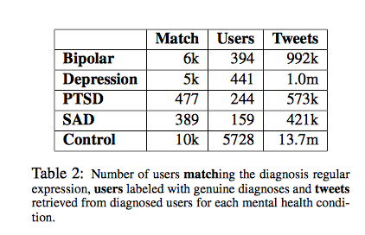
Quantifying Mental Health Signals in Twitter (Coppersmith et al., 2014)

Slide 9
Features for Classification
LIWC
Language Models (LMs)
  Unigrams (ULM)
  Characters (CLM)
Pattern of life
  Social engagement
  Insomnia
  Exercise
  Sentiment
Notes:
LM estimate how likely a given sequence of words is
N-gram language model refers to a model that examines strings of up to n words long
This is not ideal for social media – spelling, abbreviations, no spaces…
2 LMS:
ULM – examines the probability of each word
CLM – examines sequences of up to 5 characters
Build one of each model for each diagnosis, and one of each for the control group
Score each tweet by computing the probabilities and classifying it according to which model has a higher probability

Slide 10
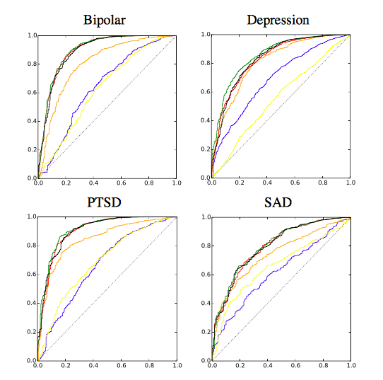
LIWC blue
CLM red (char)
ULM green (unigram)
All features black
Chance (dotted line)
Notes:
ROC curves of performance for each disorder: true positives on y axis, false positives on x
LIWC blue
CLM red (char)
ULM green (unigram)
All black
Chance – dotted line

Slide 11
Depression
Mood disorder that causes a persistent feeling of sadness and loss of interest
Statistics
  16 million adults had at least 1 major depressive episode in 2012 (NIMH)
  350 million people worldwide suffer from depression (WHO)
  Depression is the cause of over 2/3 of suicides in the US each year (White House Conference on Mental Health)
  Women experience depression at 2x the rate of men (Journal of AMA)

Slide 12
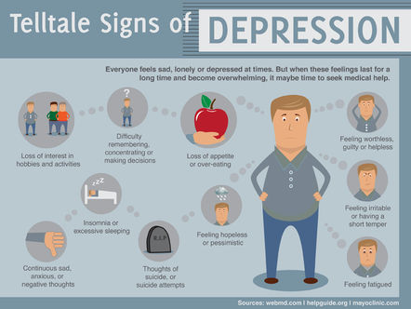

Slide 13
Standard Diagnosis
Diagnostic assessment by GP, psychologist, or psychiatrist
  Examine biological, psychological, social factors
Rating scales
  Hamilton rating scale for depression
  Beck depression inventory
  Suicide behaviors questionnaire

Slide 14
Treatments
Psychotherapy
Mediation – antidepressants
Electroconvulsive therapy (ECT)
Lifestyle
  Exercise
  Smoking cessation
  Diet

Slide 15
Predicting Depression via Social Media (De Choudhury et al., 2013)
Use crowdsourcing to identify Twitter users with clinical depression by giving them a standard test
Measure behavioral attributes from tweets 1 yr prior to diagnosis
Estimate risk of depression before diagnosis: can we predict upcoming depression
Notes:
social media provides a means to capture behavioral attributes that are relevant to an individual’s thinking, mood, communication, activities, socialization
Ppl with depression often withdraw from social situations – might find similar trends on social media
Social media can reflect changing social ties

Slide 16
Data
Depression screening test: CES-D questionnaire
  http://cesd-r.com
  Amazon Mechanical Turk
  Workers could opt in to share Twitter username
  Quality control using additional depression test
Self-reported information
  Clinical diagnosis of depression
  Estimated time of onset
  Using antidepressants
Notes:
Quality control
- Discard data if workers took less than 2min
Include screening test – BDI (Beck depression inventory) – checked for correlation between the 2 tests

Slide 17
Data
1,583 responses; 40% shared Twitter feeds
476 users with depression diagnosis (after removing noisy responses)
  243 male, 233 female
171 users who scored positive for depression on CES-D
2,157,992 tweets retrieved

Slide 18
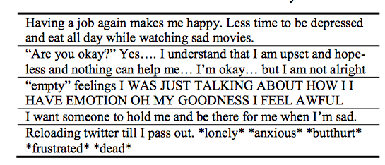
Data
Notes:
Example posts from depressed class

Slide 19
Measuring Depressive Behavior
Degree of engagement
Insomnia index
Egocentric network measures: the personal network characteristics
Emotion
Linguistic style
Depressive language

Slide 20
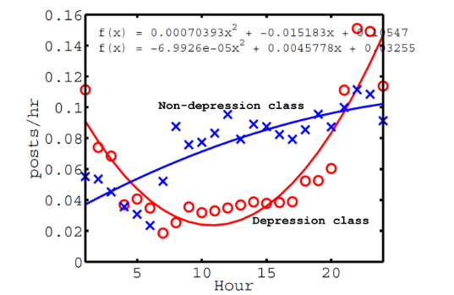
Tweet Activity Timing and Depression
Notes:
All times are local time
Mean num of posts per hour, over entire year history
Show polynomial fits for both plots

Slide 21
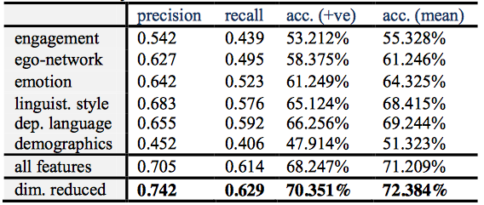
Depression Prediction
Notes:
3rd col: mean accuracy predicting positive class (i.e. depression)
F1= 2 * prec*rec/prec+rec

Slide 22
Schizophrenia
Chronic mental disorder
Symptoms:
  `Positive’: hallucination, delusion, thought disorders, movement disorders
  Negative: “flat affect”, reduced feelings of pleasure, reduced speaking, withdrawal
  Cognitive: poor executive functioning, trouble focusing or paying attention, problems with working memory

Slide 23
Schizophrenia and Language
“Negative thought disorder”
  Alogia – poverty of speech – lack of additional unprompted context
“Positive thought disorder”
  Derailment
  Tangentiality

Slide 24
Schizophrenia and language
Derailment
“I always liked geography. My last teacher in that subject was Professor August A. He was a man with black eyes. I also like black eyes. There are also blue and grey eyes and other sorts, too…” (Bleuler, 1950)
Tangentiality
“Well, in myself I have been okay what with the prices in the shops being what they are and my flat is just round the corner. I keep a watch for the arbiters most of the time since it is just round the corner. There is not all that much to do otherwise.”

Slide 25
Schizophrenia and Language
Word-level abnormalities
“I got so angry I picked up a dish and threw it at the geshinker”
“So I sort of bawked the whole thing up”
Notes:
In addition to phenomena at sentence or discourse level, positive thought disorder can include abnormalities at the word level
People produce non words
Severe cases – unintelligible speech – word salad

Slide 26
Severe Cases: Word Salad
“They’re destroying too many cattle and oil just to make soap. If we need soap when you can jump into a pool of water, and then when you go to buy your gasoline, my folks always thought they should, get pop but the best thing to get, is motor oil, and, money. May may as well go there and, trade in some, pop caps and, uh, tires, and tractors to grup, car garages, so they can pull cars away from wrecks, is what I believe in. So I didn’t go there to get no more pop when my folks said it. I just went there to get a ice-cream cone, and some pop, in cans, or we can go over there to get a cigarette”

Slide 27
Quantifying the Language of Schizophrenia in Social Media (Mitchell et al., 2015)
Data: 174 Twitter users with self-stated diagnosis of schizophrenia
  Age- and gender-matched controls, balanced dataset
Features:
  LIWC
  Open-vocabulary approaches
    LDA (to id topics), Brown clustering (to measure distrib of topics for each user), character n-gram language model (CLM: to identify differences in sequences), perplexity (to show `word salad’)
Notes:
LDA: Latent Dirichllet Allocation and Brown clustering to identify topics and distributions of topics over each user
This is difficult due to the low prevalence of the condition – only 1%

Slide 28
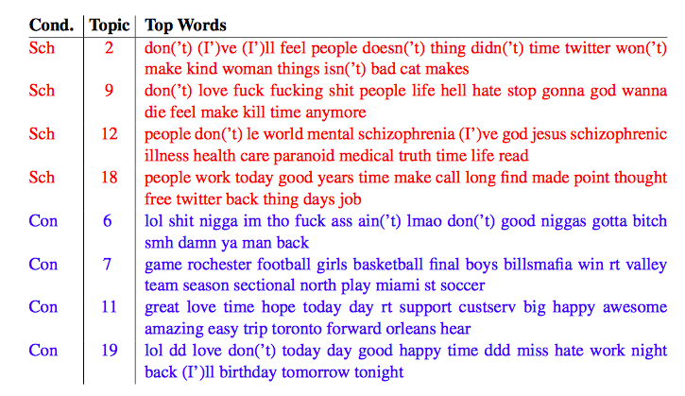
Notes:
LDA topics with statistically significant differences between groups (i.e. more use of topic by one group or another)

Slide 29
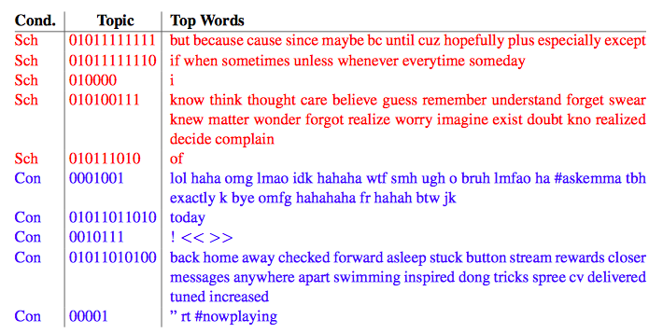
Notes:
Brown clusters with statistically significant differences between groups
Laughter category – more common in control group
<<>> emoji processing; and ! – more likely in control group (maybe flat affect in sch group?)

Slide 30
LIWC analysis
  Schizophrenia users had more words from these categories: Cognitive mechanisms, death, function words, negative emotion
  And fewer words from these categories: home, leisure, positive emotion

Slide 31
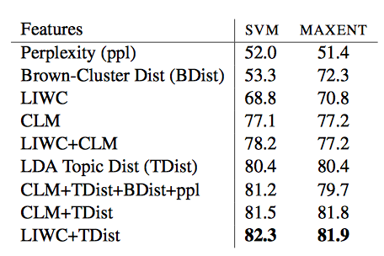
Classification results
Notes:
CLM: Character Language model – why does it do so well?? Picks out abbreviations?

Slide 32
Dementia
Broad category of brain diseases that cause long term decrease in ability to think and remember
Most common type - Alzheimer’s Disease (AD)
  60%-70% of cases
Affects 27.5 million people
  3% of people 65-74
  19% of people 75-84
  ~50% of people >85
$604 billion in costs per year

Slide 33
Alzheimer’s Symptoms
Short-term memory loss
Problems with language
Disorientation
Mood swings
Decreased motivation
Notes:
Short term memory loss – difficulty remembering recent events
Disorientation – easily getting lost
As condition declines – withdraw from family and society
Ultimately causes decline of bodily function and results in death
Average life expectancy following diagnosis is 3-9 years

Slide 34
Cause
Genetic component
Risk factors:
  Head injuries
  Depression
  Hypertension

Slide 35
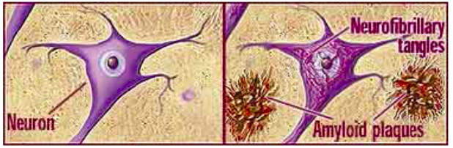
Pathology
Amyloid plaques
Tau tangles
Notes:
Aggregates of proteins that disrupt the functioning of healthy tissues
Tau tangles: aggregates of hyperphosphorylated tau protein that are most commonly known as a primary marker of Alzheimer's disease

Slide 36
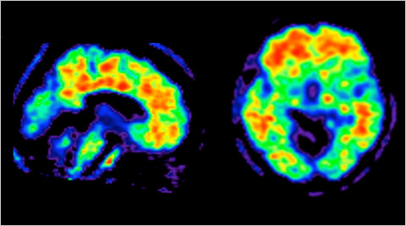
Amyloid plaques
Notes:
Brain scan of AD patient
Red indicates areas of plaque buildup

Slide 37
Diagnosis
Can only be definitively diagnosed in a postmortem brain tissue examination
Clinical assessment

Slide 38
Clinical Assessment
Medical history
Physical exam
Neurological exam
Mental status tests

Slide 39
Mental status tests
Mini-mental state exam (MMSE)
  http://www.dementiatoday.com/wp-content/uploads/2012/06/MiniMentalStateExamination.pdf
Mini-cog
  http://www.alz.org/documents_custom/minicog.pdf
Notes:
Disadvantages – affected by demographics – age and education
Also, it can pick up on MCI, (Mild Cognitive Impairment) and not distinguish between that and AD

Slide 40
What is your name?
What is today’s date?
What year is it?
What year were you born?
Draw a picture of a clock

Slide 41
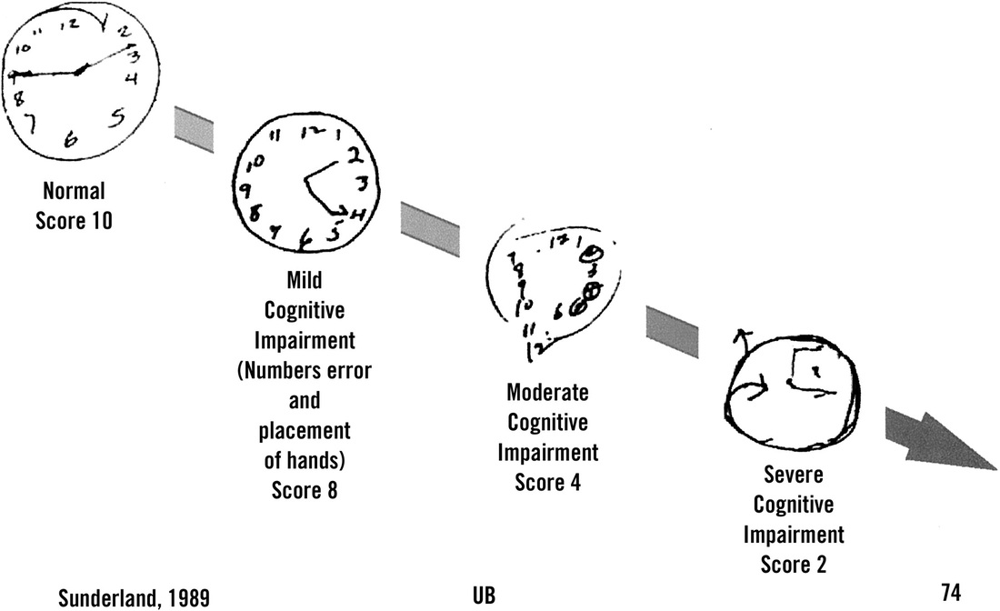

Slide 42
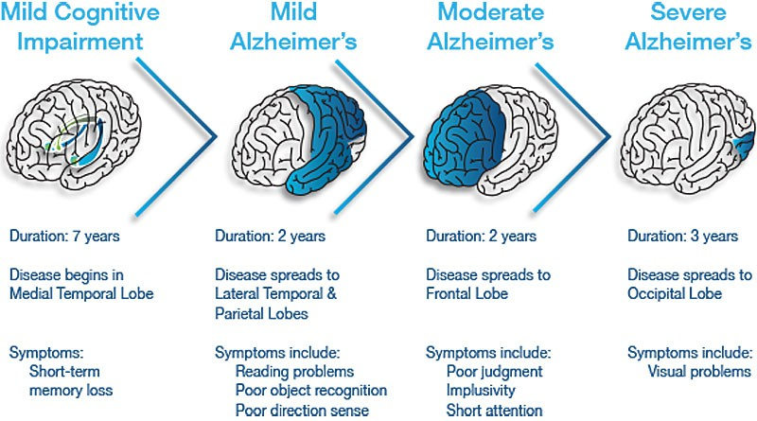
Stages of AD

Slide 43
Treatment
Medication for symptoms
Clinical trials

Slide 44
Linguistic Indicators of AD
Can we predict AD from writing analysis?

Slide 45
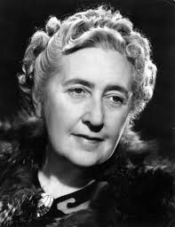
Case study: Agatha Christie
Notes:
Elephants Can Remember (age 81): sharp drop in vocabulary

Slide 46
The Nun Study (Snowden et al, 1996, 1997)
Longitudinal study of 678 Roman Catholic sisters
Homogenous group
Autobiographical essays over multi-years
Periodic standard tests for dementia

Slide 47
Essay Excerpts
"It was about a half hour before midnight between February 28 and 29 of the leap year 1912 when I began to live, and to die, as the third child of my mother, whose maiden name is Hilda Hoffman, and my father, Otto Schmidt...”
"I was born in Eau Claire, Wisconsin on May 24, 1913, and was baptized in St. James Church..."

Slide 48
Findings
Sisters who scored poorly on
  Idea density
  Grammatical complexity
  were much more likely to develop dementia
E.g. sisters in lower third of idea density were 60 times more likely to develop AD than sister in upper third
Using essays, predict with 92% accuracy whether the brain would contain plaques post-mortem

Slide 49
Towards Automatic Detection of Abnormal Cognitive Decline and Dementia Through Linguistic Analysis of Writing Samples
Weissenbacher, Travis, Wojtulewicz, Dueck, Locke, Caselli, Gonzalez
Presented by Monica He

Slide 50
Using linguistic features longitudinally to predict clinical scores for Alzheimer’s disease and related dementias
Maria Yancheva, Kathleen Fraser, Frank Rudzicz
Presented by Yuanda Liao

Slide 51
Vector-Space
Topic Models for Detecting AD
(Yancheva & Rudzicz, 2016)
Measure semantic content deficiency
  Idea density – ratio of ‘sematic units’ to total number of words
  Efficiency – rate of semantic units over duration of speech sample
Notes:
goal: automatic assessment of semantic content of speech; use this to distinguish people with AD from healthy older adults

Slide 52
Measuring Semantic Content
Picture description task
Human-supplied information content units (hsICUs)

Slide 53
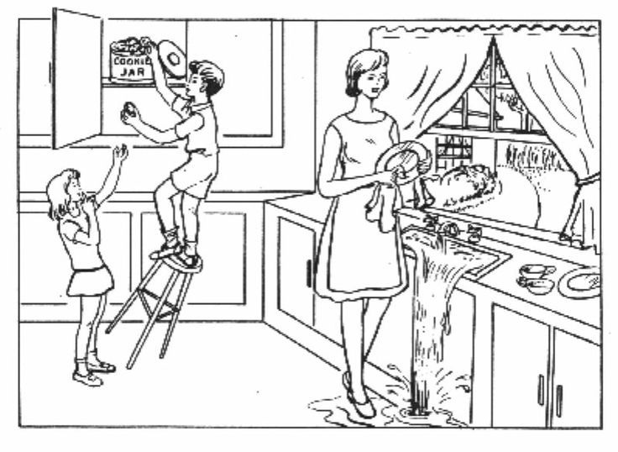
Notes:
Boston cookie theft picture description task
ICUs:
Subject: boy, girl, mother
Places: kitchen, outside window
Objects: cabinets, cookies, dishes, sink, water
Actions: boy taking cookie, boy falling, stool falling, women drying plate, girl asking for cookie, woman
Synonyms are accepted (mother, mom)
What are problems with this approach?
Subjective – different researchers use different number of hsICUs for the same pic (e.g. from 7-25 for this pic)
It might not be optimal for detecting linguistic impairment! They are not exhaustive, nor reflective of the content units that differ most between the groups
Not generalizable! Picture specific. Results in inconsistencies.
Can we automatically generate ICUs?

Slide 54
Method
Data: DementiaBank
  Samples: http://www.talkbank.org/browser/index.php?url=DementiaBank/English/Pitt/Dementia/cookie/010-4.cha
  http://talkbank.org/browser/index.php?url=DementiaBank/English/Pitt/Control/cookie/013-0.cha
Notes:
DB is one of the largest public longitudinal datsets of spontaneous speech from ppl with and without dementia. Collected at U Pitt and contains verbal descriptions of cookie theft picture, along with manual transcriptions

Slide 55
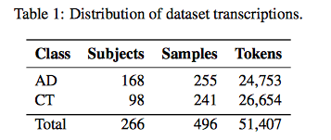
DementiaBank Subset
255 speech samples from people diagnosed with probable/possible AD vs. 241 from healthy controls.
Combine all hsICUs from previous work on cookie theft descriptions.
Notes:
Includes Cookie theft picture descriptions

Slide 56
Automatic ICU generation
Train word vector model on large general purpose corpus (GloVe)
Extract vector representations of words in DementiaBank corpus
Cluster vectors separately for AD and control group -> represent “topics”
Notes:
Use GloVe to train obtain word embeddings model – corpus is Wikipedai + Gigaword
400k vectors, 50 dimensions
Augment with context windows from clinical dataset
Use k-means clustering, separately for control and AD groups. These clusters represent topics – groups of semantically related word vectors
Optimize k on dev set – k=10

Slide 57
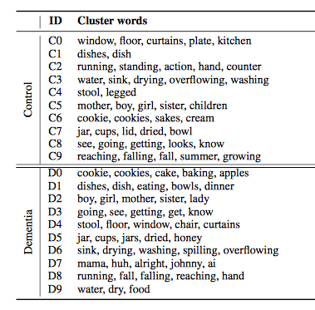
Notes:
How do we know if these clusters are meaningful?

Slide 58
Cluster analysis
Do clusters match hsICUs?
  Yes (except “dishcloth”)
Do the topics differ between groups?
  Yes!
  Control group: overflowing, sink, indifferent, mother, apron, window, curtain, cupboard, counter
  AD group: brother, sister, son, daughter

Slide 59
Quantifying Irrelevance
Align pairs of clusters between 2 models
All control clusters are recalled by AD model
D7 not recalled by control model – “extraneous terms”
Notes:
How can we quantify irrelevance?

Slide 60
Are Topics discussed in same Contexts?
Augment word vectors with local context windows
Results:
  All control cluster words were used in the same contexts by both groups
  Frequency of control words is higher in control group than AD group

Slide 61
Classification
Features:
  Distance metrics for AD and control clusters
  Idea density
  Idea efficiency
  LS&A cognitive impairment lexicon
Random Forest classifier, 10-fold cross-validation
Compare models (control, AD, combined), feature sets, and context
Baseline: hsICU features
Notes:
Idea density - # of expected topics mentioned (# word vectors in transcript whose distance is close to mean of at least one cluster) divided my number of words in transcript
Idea efficiency - # expected topics mentioned / duration of recording
Expected topics are from automatic ICUs

Slide 62
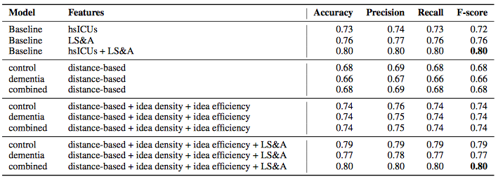
Classification results
Notes:
The automatic distance measures and idea efficiency and density outperform hsICU baseline
Adding LS and A features is equivalent to baseline hsICU with acoustic and lexical features
This automatic approach matches the state-of-the-art performance of manual features
Limitation – requires high quality transcription
Experimenting with using ASR – much lower performance (.69 fscore)

Slide 63
Detecting late-life depression in Alzheimer’s disease through analysis of speech and language
Kathleen C. Fraser, Frank Rudzicz, and Graeme Hirst (2016)
Presented by Betsy Miller, LSA Institute, 2017

Slide 64
Problem
Depression and dementia
  Have similar symptoms
  Have the tendency to co-occur in elderly populations
  Can lead to rapid deterioration of a patient if untreated

Slide 65
Research Questions
Through the use of a description task (elicited speech) can they determine:
  If cognitively healthy people are being diagnosed with Alzheimer's disease?
  If people with Alzheimer’s disease have depression?

Slide 66
Selected Detection Tools
Depression in speech:
  Mean Jitter, F0 variations, latency in response time to questions, MFCCs, loudness & intensity features, use of I in narratives, N-grams
Alzheimer’s in speech:
  N-grams, POS tags, lexical diversity, # of voice breaks, use of fewer nouns,

Slide 67
Prior Study (Murray 2010)
If clinical depression can be distinguished from Alzheimer’s disease by looking at narrative speech
Picture description task
  Depressed patients: same amount of info as healthy
  Alzheimer’s patients: reduction in info content
  Quantity of speech and syntactic complexity wasn’t different between groups
  Did not have participants with both disorders Depression and dementia

Slide 68
Data
Pitt corpus (1983-88) in the DementiaBank database
Language samples: “Cookie Theft” picture description task
Subset of speakers have Hamilton Depression Rating scale for comparisons
EI: 196 AD with HAM-D scores/ 128 Control narratives
EII: 65 AD & Depression/ 65 AD no Depression narratives

Slide 69
Features
Textual: Part-of-speech tags, parse constituents, psycholinguistic measures, complexity measures, vocabulary measures, informativeness
Acoustic: MFCCs, fluency measures, voice quality features, periodicity, symmetry
Classified using a correlation-based filter, fed to machine learning classifier that used logistic regressions & support vector machines, which was then cross-validated

Slide 70
Experiment I: Does depression affect classification accuracy?
No
It works (70 features)
The presence or absence of depression doesn’t change the accuracy of the classifier
☺

Slide 71
Experiment II: Can they detect depression in Alzheimer’s disease?
Not really well
The best they could do was 65.8% (60 features)
☹

Slide 72
So They Tried
Gender-dependent classification
It didn’t work (statistically speaking)
☹

Slide 73
They Also Tried
Additional features
  mostly glottal features
  3 psycholinguistic features:
    valence (positive/negative emotions)
    arousal (intensity of emotion associated with word)
    dominance (degree of control associated with word)
  first-person word frequencies
These did not work either
☹

Slide 74
Conclusions
When they tested out the prior speech analysis & machine learning techniques to see if people were being misdiagnosed, they weren’t. ☺
When they tried to differentiate between people with AD and depression and just AD, they couldn’t.
  Their best accuracy rate was 65.8%. ☹
  Data limitation is a huge problem
    Need older people and emotional speech
    Need more depressed people
    Need to account for confounding variables of age and education

Slide 75
Conclusions
NLP and speech processing can be useful tools for prediction of mental illness
  No substitute for trained medical personell
  Can identify people who may need help
But… there are ethical considerations

Slide 76
Next
Trust

