Slide 1
Personality
Professor Michelle Levine
October 24, 2019

Slide 2
Agenda
Main Goals:
What is personality?
Can we automatically detect personality?
Will also (briefly) address:
How personality factors help predict differences in how people deceive and how people detect deception.
Next steps in automatic personality detection

Slide 3
Think about someone you know well.
Write down how you would describe this person to others. Use as many words/phrases as necessary to fully describe the person.
Notes:
Then ask the class, how may words did you think of? Do we need them all or can we eliminate/combine some to come up with a much smaller/basic set of traits, ie personality traits?

Slide 4
What is Personality?
This is about who you are – your characteristic style of behaving, thinking, and feeling.
How can we assess differences in personality?
4 main approaches in psychology:
Trait
Psychodynamic
Humanistic
Social-Cognitive
Notes:
As with with attitudes, emotions, and beliefs, personality is thought to determine behavior.
At end of slide say:
For the research we will be discussing today, we will focus on the trait approach.
The other approaches look at personality as a more fluid concept, but the work we are looking at, and the prevalent modern day theory, rests heavier on the trait approach because these are the models that most effectively predict how people act.

Slide 5
Trait Approach
Personality = a combination of traits
Assumes:
People differ from each other in (relatively) stable ways.
Traits are consistent ways of behaving and therefore can predict future actions.
Attempts to find a taxonomy (classification scheme) for core traits that define personality.
Notes:
Personality = a combination of traits
Assumes:
After first point add:
Examples: honest, dependable, moody, impulsive
-After second point:
-Traits: Relatively stable patterns of thoughts, feeling, or behavior that characterize an individual.
-Traits are in opposition to states, which are temporary patterns of thought, feeling or behavior
(ie, being in a state of anger at this particular moment vs the trait of being generally hot-headed)
After last comment:
Traits allow us to summarize something about a person usually in a single word(s) and then predict from that how they will act.

Slide 6
Dimensions of Personality
Why dimensions (versus types)?
How are the dimensions determined?
18,000 words for potential traits (Allport & Odbert, 1936)
Goal: sort words into underlying dimensions
Uses both self-report and informant data to measure personality.
Notes:
Why dimensions of personality vs types of personality? allows for infinite variations in personality, rather than a few basic types.
We will see later today that in some research it may be helpful to create types by using clusters or categories (hi, med, low)
But for trait theory the
goal is to compress the vast range of human traits into dimensions which then the dimensions together (ie, the big 5 dimensions) make up different facets of a person’s personality.
18,000 English dictionary personality-relevant terms
People such as Cattell would see which words overlapped and were used most often and were able to eventually yield 16 primary personality dimensions.
Then further research by others showed even more overlap in his 16 dimensions
At one point down to 2 or 3.
Now much consensus around 5.

Slide 7
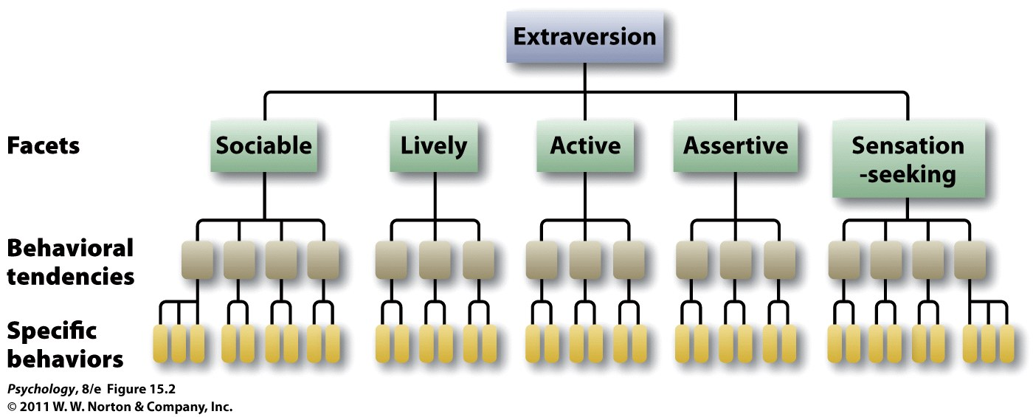
Determining Core Traits
Notes:
15.2 The hierarchical organization of personality One of the Big Five personality traits, extraversion, encompasses a broad summary of many, more specific, facets of personality, each of which is defined by particular behavioral tendencies and still more specific behaviors.

Slide 8
The Big Five
Openness to experience
Conscientiousness
Extraversion
Agreeableness
Neuroticism

Slide 9
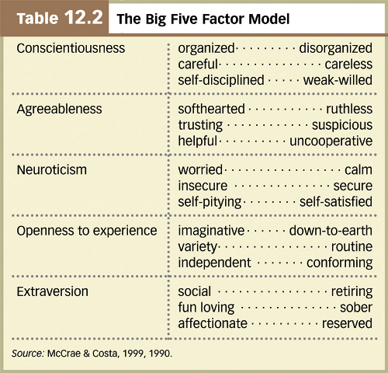
Notes:
Costa & McCrae (1992) NEO-FFI Personality Measures
Openness to Experience: intellect/imagination, originality, curiosity, ingenuity, imaginative, insightful
“I have a lot of intellectual curiosity.”
Conscientiousness: orderliness, responsibility, dependability, organized, thorough, planful
“I strive for excellence in everything I do.”
Extraversion: talkativeness, assertiveness, energy
“I like to have a lot of people around me.”
Agreeableness: good-naturedness, cooperativeness, sympathetic, kind, affectionate, trust
“I would rather cooperate with others than compete with them.”
Neuroticism: anxiety, emotional instability,intense, moody,
“I often feel inferior to others.”
(opposite of this is emotional stability)

Slide 10
Questions About The Big Five
How stable are the traits?
Change over development
Stable in adulthood
How heritable are they?
~50% for each trait (.40 to .55 heritability)
Influence of temperament?
Other factors, ie, in extraversion
How about other cultures?
Traditionally traits are thought to be common across cultures
But research has shown cultural differences in personality
Notes:
HEREDITY:
adopted children: zero correlation between adopted children and their adoptive siblings
identical twins: strong correlation between identical twins reared together or apart
E.g., Temperament may play a role:
There is growing evidence that personality traits develop from an individual’s temperament, which is evident from an early age and thought to be genetically determined.
Twin studies of the Big Five dimensions confirm a high heritability
extraversion—genetic influences depend on level of central nervous system reactivity, with introverts more reactive than extraverts
- sensation seeking and inhibited temperament
Culture can influence personality, as evidenced by the observation of national character and the fact that different cultures vary in average levels of the Big Five traits.

Slide 11
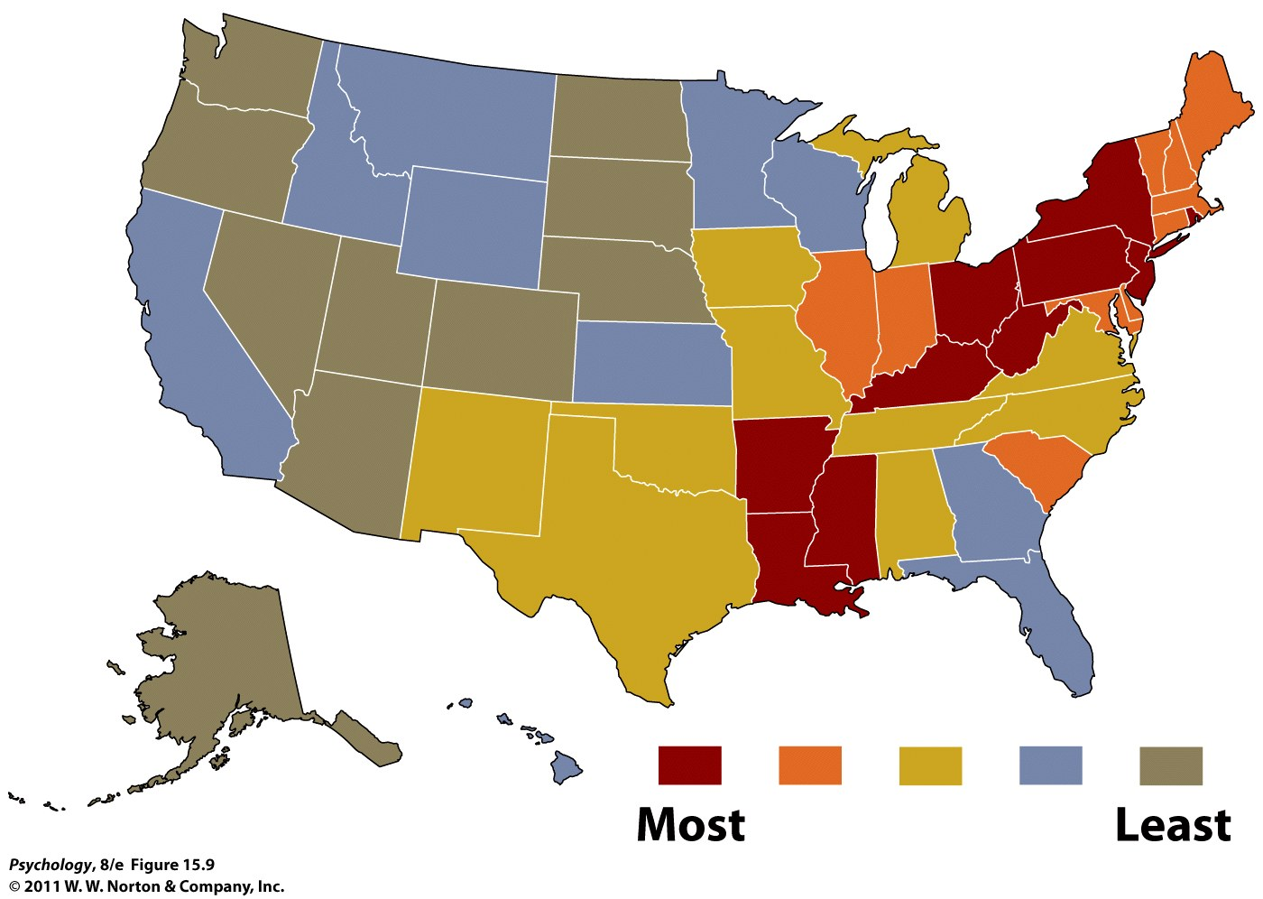
Where are the more “neurotic” places to live?
Notes:
15.9 Map of neuroticism in the United States According to these data, the eastern side of the country is a more “neurotic” place to live than the western side (Rentfrow, Gosling, & Potter, 2008).

Slide 12
Are Traits Truly Constant?
Personality paradox: people often behave less consistently than expected
Part of the explanation for this paradox is the power of the situation
Person-Situation Controversy
E.g., Walter Mischel (1968, 1984, 2004)
Counter-argument:
Trait theorists argue that behaviors from a situation may be different, but average behavior remains the same
Therefore, traits matter
Notes:
Person-situation controversy: points out that traits may be enduring, but the resulting behavior in various situations is different. Therefore, traits are not good predictors of behavior.
Critics of the trait approach (e.g., Mischel) argue that there is no such thing as stable personality traits because behaviors appear to vary considerably from one situation to the next. In other words, they argue that there is no consistent expression of a trait across different situations.

Slide 13
Is Consistency of Behavior a Trait?
Interaction between personality and situations
Situations interact with individual differences
Some people are more consistent in their behaviors—the Self-Monitoring Scale
Notes:
1) Both personality and situations matter, usually in interaction.
At end say all the following,
Overall:
Consistency of behavior, in and of itself, appears to be a trait that varies from person to person and is mediated by the degree to which individuals self-monitor their behavior to fit the situation.
Although some strong situations producing nearly uniform behavior among different individuals,
It turns out, however, that some degree of cross-situational consistency can be observed if we look at specific types of situations.
Thus, for example, someone might be consistently helpful with friends and consistently not helpful with strangers, and thus appear inconsistent in helpfulness if we combine these different types of situations.

Slide 14
Assessing Traits
Personality inventories: questionnaires (often with true-false or agree-disagree items) designed to gauge a wide range of feelings and behaviors assessing several traits at once
The Minnesota Multiphasic Personality Inventory (MMPI) is the most widely researched and clinically used of all personality tests.
Notes:
The MMPI-2 is a 567 item, true/false self-report measure of a person's psychological state.
Takes around 1.5 hours to complete.

Slide 15
NEO-FFI
Short questionnaire to assess the big 5 traits
Widely used in research
60 items (12/trait)
Likert scale
SD (strongly disagree) — SA (strongly agree)
0 - 4
Example questions:
When I’m under a great deal of stress, sometimes I feel like I’m going into pieces.
I usually prefer to do things alone.
Notes:
11 – neuroticism
27 – extraversion (reverse-scored)

Slide 16
TIPI
Newer, even shorter questionnaire to assess the big 5 traits
Starting to be used in research
10 items (2/trait)
Likert scale
1 - 7
1 = Disagree strongly; 7 = Agree strongly
Notes:
11 – neuroticism
27 – extraversion (reverse-scored)

Slide 18
Personality and Emotions
Emotions = transient
Personality = consistent
Notes:
Before we move on, it’ll be good to consider the relationship between personality and emotions.
Robert Plutchik –

Slide 19
Automatic Personality Detection
Automatic Personality Detection (APD)
What type of cues are more/less useful? Let’s look at research on:
Written language
Nonverbal vocal behaviors
Spoken/conversational language
Notes:
**look up spoken/conversational language from lecture from following week

Slide 20
Detection with Written Language
Written language use → personality
Pennebaker and King (1999), Linguistic styles: Language use as an individual difference
Stream-of-conscious essays
Big 5 personality assessment
Lexical features (LIWC)
Findings, ie.,
Agreeableness
more positive emotion words
fewer negative emotion words
fewer articles
more first-person
Notes:
One of the original studies on this looked at whether language use reflects personality style.
They did many different experiments in this article but let’s focus on the one about LIWC and five factors of personality

Slide 21
Notes:
Patterns that emerge:
Openness to experience and immediacy
Extroversion and making distinctions
Conscientiousness and making distinctions

Slide 22
Detection with Prosodic Cues
Nonverbal vocal (prosodic) behaviors → personality
Are there cues in how something is said?
E.g., Mohammadi, Vinciarelli & Mortillaro (2010)
Data:
Short audio clips from a French Speaking Swiss national broadcasting service
Personality ratings from 3 judges
Features:
Praat (pitch, formants, energy, speaking rate)
Notes:
*Not assigned reading
Nonverbal meaning everything in speech except words
Psychologists would argue that a person’s personality is shown in the way they behave, which includes in the way they speak.
So now looking at how it is said versus what is said
DATA:
From short ten second audio clips, labeled by human judges (640 speech samples that are 40 ms long, broken into 10 second segments)
Judges did not speak the language in speech samples so only judged nonverbal cues
Observers rated the speakers’ personality scores (as opposed to self-assessment)
Prosodic features – accuracy up to 75%
640 clips
Around 40 seconds each

Slide 23
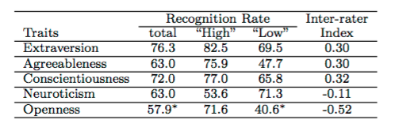
Results
Notes:
Table 2: Trait attribution performance. The results of this table have been obtained by using the average of the personality scores over the three assessors. When the difference with respect to a random classifier
is not statistically significant, the values are denoted with a ’*’.
The negative inter-rater agreement values are due to the errors of one of the assessors that has misunderstood one of the assessors that has misunderstood one of the questions in roughly 15% of the questions.
**FOUND: recognition rate significantly higher than chance for all dimensions except openness
Only dimensions for which performance can be considered satisfactory are extraversion and conscientiousness

Slide 24
Detection with Lexical Cues
E.g., Mairesse & Walker (2006)
Can personality be recognized automatically in conversation?
Data (previously collected by Mehl & Pennebaker):
Daily life conversations, collected and transcribed
Personality ratings from 5-7 independent observers
Features/analyses:
5-7 judges of personality
LIWC (linguistic features)
MRC psycholinguistic database
Utterance type (ie, commands, back-channels)
Praat (pitch, intensity, speech rate)
Notes:
96 participants wore ear recorder for 2 days
Corpus:
97,468 words and 15,269 utterances
Research has shows that speech factors help, such as:
Fundamental frequency
Voice quality
Intensity
Frequency and duration of silence pauses

Slide 25
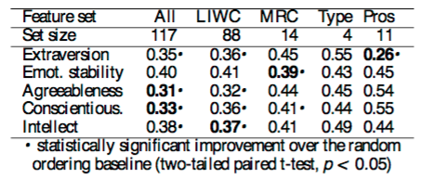
Results
Notes:
Table 3: Ranking errors over a 10 fold cross- validation for different feature sets (Type=utterance type, Pros=prosody). Best models are in bold.
**go through each column
What about specific features?
Go to next slide

Slide 26
Results: Specific Features
Notes:
Table 4: Best RankBoost models for each trait. Rows 1-10 represent the rules producing the highest score increase, while rows 11-20 indicate evidence for the other end of the scale, e.g. introversion.
e.g., for extraversion, confirmed previous findings that they are more likely to have a higher speech rate, longer conversations, and now also see:
Higher pitch compared to introverts

Slide 27
Columbia X-Cultural Deception (CXD) Corpus
Corpus of within-subject deceptive and non-deceptive speech
Fake resume paradigm - interview format using 24-item biographical questionnaire
Native speakers of SAE and MC, all speaking in English
170 dialogues between 340 subjects, >122 hours of speech
3-4 minutes of truthful baseline speech for each subject
Notes:
In the speech lab, we have data that allows us to ask a similar question – can we classify people’s personality?

Slide 28
Predicting Personality*
Which features are most useful?
Used baseline speech samples and quantized raw NEO-FFI scores (high, medium, low)
*From Sarah Ita Levitan’s dissertation, 1/19

Slide 29
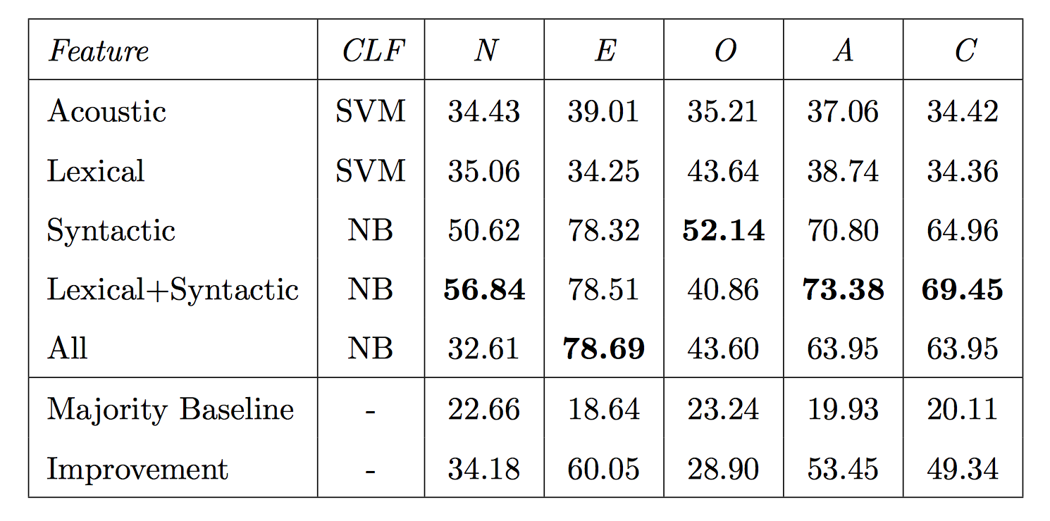
Notes:
Table 15.3: Personality bin classification with combined feature sets. (SVM=Support Vector Machine, NB=Naive Bayes)
We obtained results well above a majority class baseline for all five personality traits: N-score 56.84 (+34.18 from baseline), E-score 78.69 (+60.05), O-score 52.14 (+28.9), A-score 73.38 (+53.45), and C-score 69.45 (+49.34).

Slide 30
Personality as a Predictor
In cases where we know people’s personality, how can we use this to predict speaking behavior?
When would this be useful?
One area we have looked at is:
Can knowing people’s personality help to predict differences in deception?
Can people’s personality affect ability to detect deception?
Notes:
I want to end with shifting the topic to look at it from the other angle
Now, let’s think about how in the case where we know people’s personality, how can this be helpful?
(we also ask: What makes some people better at judging deception? Do people’s personality play a role?)

Slide 31
Personality & Deception
Some effects are found when using quantized personality factors (Levitan ‘19)
Examples:
subjects who score high in Neuroticism have increased intensity max when lying vs subjects who scored low in Neuroticism have decreased intensity max when lying
subjects who scored high for Extroversion use “we” more when lying vs those who scored low used “we” more when telling the truth
subjects who scored high in Openness used filled pauses more when lying vs those who scored low in Openness used filled pauses more when telling the truth
Notes:
F. Enos, S. Benus, R. Cautin, M. Graciarena, J. Hirschberg, and E. Shriberg, “Personality factors in human deception detection: Comparing human to machine performance.” Interspeech 2006. Pittsburgh.
-- openness to experience and agreeableness correlates to ability to detect deception
-- negative correlation between neuroticism and number of things labeled lie
SI’s dissertation:
Differences in acoustic-prosodic and linguistic cues to deception were observed between subjects with different personality types, however these differences were not statistically significant after correction for multiple comparisons.
The majority of the differences in cues to deception were between speakers who scored high vs. low for the five personality dimensions. For example, subjects who scored high in Neuroticism had increased intensity max when lying, while subjects who scored low in Neuroticism had de- creased intensity max when lying. Subjects who scored high for Extroversion used “we” more when lying, while those who scored low used “we” more when telling the truth. Subjects who scored high in Openness used filled pauses more when lying, and those who scored low in Openness used filled pauses more when telling the truth.

Slide 32
Personality & Deception Detection
When looking at personality factors on a continuous scale,
No effect of personality factors in deception detection found so far
Contra earlier findings for English speakers (Enos et al ’06)
But this is real-time detection vs. later judgments
However, some effects are found when using quantized personality factors (Levitan ‘19)
Notes:
F. Enos, S. Benus, R. Cautin, M. Graciarena, J. Hirschberg, and E. Shriberg, “Personality factors in human deception detection: Comparing human to machine performance.” Interspeech 2006. Pittsburgh.
-- openness to experience and agreeableness correlates to ability to detect deception
-- negative correlation between neuroticism and number of things labeled lie
SI’s dissertation:
Differences in acoustic-prosodic and linguistic cues to deception were observed between subjects with different personality types, however these differences were not statistically significant after correction for multiple comparisons.
The majority of the differences in cues to deception were between speakers who scored high vs. low for the five personality dimensions. For example, subjects who scored high in Neuroticism had increased intensity max when lying, while subjects who scored low in Neuroticism had de- creased intensity max when lying. Subjects who scored high for Extroversion used “we” more when lying, while those who scored low used “we” more when telling the truth. Subjects who scored high in Openness used filled pauses more when lying, and those who scored low in Openness used filled pauses more when telling the truth.

Slide 33
Personality and Social Media
More recent work includes personality detection from:
Blogs
Twitter posts
Facebook posts

Slide 34
Computer vs Human Judgments
E.g., Youyou, Kosinski & Stillwell (2015)
Assessed accuracy of personality judgments by humans vs computers using 3 different criteria:
Self-other agreement
Interjudge agreement
External validity
And compared it to scores on the IPIP (International Personality Item Pool)
Notes:
IPIP
100 items
Used by myPersonality project that was a popular Facebook application
Self-other agreement – personality inventory & Likes on FB versus personality inventory & judgments of friends/family/spouse
Found:
Computer models only need 100 likes to outperform an average human judge
Likes-based models are more diagnostic of some traits, such as openness
Interjudge agreement – is it better accuracy between human judges or computer judges?
Used agreement of judgments of two friends VS agreement between two models each using half of the FB Likes
- found: consensus across computer models was much higher than for human judges
External validity – personality scores, humans’ judgments and computers’ judgments ability to predict 13 life outcomes and traits linked to personality
- found: external validity of computer judgments was higher than that of human judges in 12/13 outcomes/traits
Overall findings: computer judgments more accurate than ones made by close others and acquaintances
ASK CLASS -- Why?
Personality ratings more accurate with more information. Computers can store more information can more readily access it/recall it.
Statistical modeling optimizes accuracy vs humans are affected by biases (although one can argue that advantage of human flexiblity may capture the nuances of persanlity better)

Slide 35
Next Steps
Any critiques of the prior studies discussed?
Next steps in APR research?
Notes:
How to assess true personality baseline? Ie, self-assessment vs observer assessment etc
How to treat personality scores? Is each factor a discrete category or some interdependence?
- Should look at clusters

Slide 36
Findings with Quantized Scores*
Syntactic cues to deception differed based on whether people were high vs average vs low on Neuroticism
High in Neuroticism = more syntactic complexity when deceiving
*From Sarah Ita Levitan’s dissertation, 1/19
Notes:
SI’s dissertation:
Differences in syntactic cues to deception between personality types were statistically significant, and they were all for speakers in high vs. low or average vs. low on the Neuroticism scale. All measures of syntactic complexity were increased in deceptive responses of speakers who scored high in Neuroticism. Overall, the greatest number of trait-specific cues were observed for Neuroticism (14), and the fewest for Agreeableness (2).

