Slide 1
Prosodic Dimensions of Entrainment in Dialogue
Julia Hirschberg
COMS 4706

Slide 2
Collaborators
Rivka Levitan, Adele Chase, Laura Willson, Columbia University
Agustín Gravano, University of Buenos Aires
Štefan Beňuš, Constantine the Philosopher University
Ani Nenkova, University of Pennsylvania
Jens Edlund, Mattias Heldner, KTH Stockholm

Slide 3
Entrainment
AKA: Adaptation, Accommodation, Alignment Priming, `the Chameleon Effect’
Definition: In conversation, people tend to adapt their communicative behavior to that of their conversational partner.
Notes:
When we speak with others, we each tend to adapt to our conversational partners way of speaking: in syntax, word choice, pronunciation, and acoustic and prosodic production. This entrainment (also called….) is part of a larger communicative phenomenon which Howard Giles and colleagues describe in CAT.
Howard Giles
Giles, H., Mulac, A., Bradac, J.J. & Johnson, P. Speech accommodation theory: The first decade and beyond. In M. McLaughlin (ed.): Communication Yearbook, 10, Newbury Park, CA, Sage, pp. 13-48, 1987.

Slide 4
Evidence of Entrainment in Many Dimensions
Lexical and syntactic (Brennan ’00, Reitter et al ’07)
Acoustic/Prosodic (Matarazzo et al ’68, Jaffe & Feldstein ’70, Natale ’77, Cappella & Planalp ’81, Street ’84, Sherlom & La Riviere ’87, Guitar & Marchinkoski ’01)
Phonological/Phonetic (Pardo ’06)
Socio-cultural (Azuma ’97, Roth ’05)
Jokes and laughter (Bales ’50, Raganath et al ’11)
Facial expression and gesture (Mauer & Tindall ’83, Hale & Burgoon ’84, Chartrand & Bargh ’99)
Posture (Condon & Ogston ‘67)
Notes:
Norma Mendoza-Denton

Slide 5
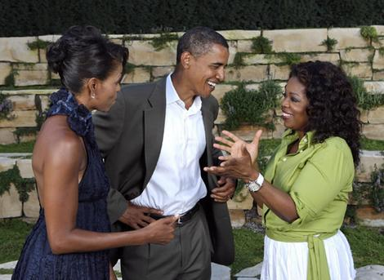
An Example in Pronunciation (Hay et al ’99)
Oprah Winfrey’s monophthongization of [ai] to [a:] in Southern U.S. and Af/Am English – e.g. for ‘I’– predicted by word frequency and ethnicity of guest
Notes:
For example, when Oprah Winfrey (the most powerful woman in the U.S.) pronounces ‘I’, she varies her pronunciation between SAE and Southern/AAVE depending upon the ethnic background of her guests, in a show of social solidarity.
Norma mendoza denton (oprah and /ay/) '99

Slide 6

Evidence for Disentrainment Too
Bourhis & Giles ('77):
  Welsh subjects broadened their Welsh accent significantly when interviewed by an arrogant interviewer with a strong British accent who called Welsh “a dying language with a dismal future”
Notes:
Conversely, Bourhis & Giles report that Welsh subjects did the opposite when interviewed by an arrogant British confederate who disparaged the Welsh language. They increased the Welsh aspects of their speech to diverge from the interviewer.

Slide 7
Evidence from Many Cultures
Hungarian (Kontra & Gosy ‘88)
Frisian and Dutch (Gorter ‘87; Ytsma '88)
Hebrew (Yaeger-Dror '88)
Taiwanese Mandarin (van den Berg '86)
Japanese (Welkowitz et al '84)
Cantonese (Feldstein & Crown '90)
Thai (Beebe '81)
Notes:
There is also evidence of entrainment from studies in many cultures.
Cited by Giles et al ‘87

Slide 8
Why is Entrainment Important in Conversation?
Subjects who accommodate on speech rate
  Perceived as more socially attractive (Putnam & Street '84, Bourhis et al '75)
  Perceived as more competent (Street '84)
  Speech perceived as more intimate (Buller & Aune '88)
Entrainment leads subjects to like their conversational partners (and their computers) more and to perceive interactions as more successful (Nass et al ’95, Chartrand & Bargh ‘99)
Long-term syntactic entrainment a good predictor of actual task success in Map Task (Reitter et al ’07)
Notes:
From consequences to motivations?

Slide 9
Theoretical Explanations of Entrainment
Reflects Social need
  Communication Accommodation Theory (Giles et al ’87): Convergence reflects speakers’ need for social integration or identification with another
  Similarity Attraction (Byrne ’71): `If I become more similar to you, you will like me more.’
Entrainment is Automatic
  Condon & Ogston ’66, Chartrand & Bargh, Pickering & Garrod ‘04
  Perception-Behavior Link Chartrand & Bargh ’99): “Accommodation may cause greater liking”
Coordination-Engagement Theory
  Niederhoffer & Pennebaker ‘02): The more two people are actively engaged with each other, the more their verbal coordination
Notes:
However, there is no agreement on WHY people entrain and somewhat contradictory findings.

Slide 10
Our Research Plan
Goal: Build Spoken Dialogue Systems that entrain to their users
Method:
  Discover the multiple dimensions along which humans entrain to other humans in a single corpus
  Using WOZ experiments, determine which of these dimensions
    Are important to dialogue success
    Can be modeled in SDS

Slide 11
The Columbia Games Corpus
12 spontaneous task-oriented dyadic conversations (9h 8m speech)
2 subjects play series of computer games, no eye contact (45m 39s mean session time)
  2 sessions per subject, w/different partners
Multiple games and types
Recorded on separate channels in soundproof booth, digitized and downsampled to 16k
All user and system behaviors logged
Notes:
~73K words

Slide 12

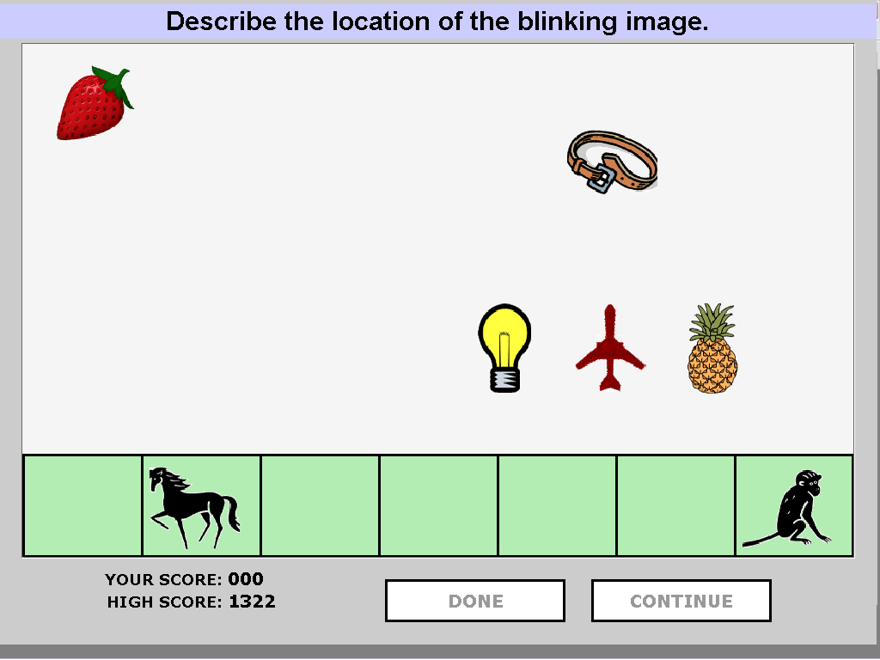
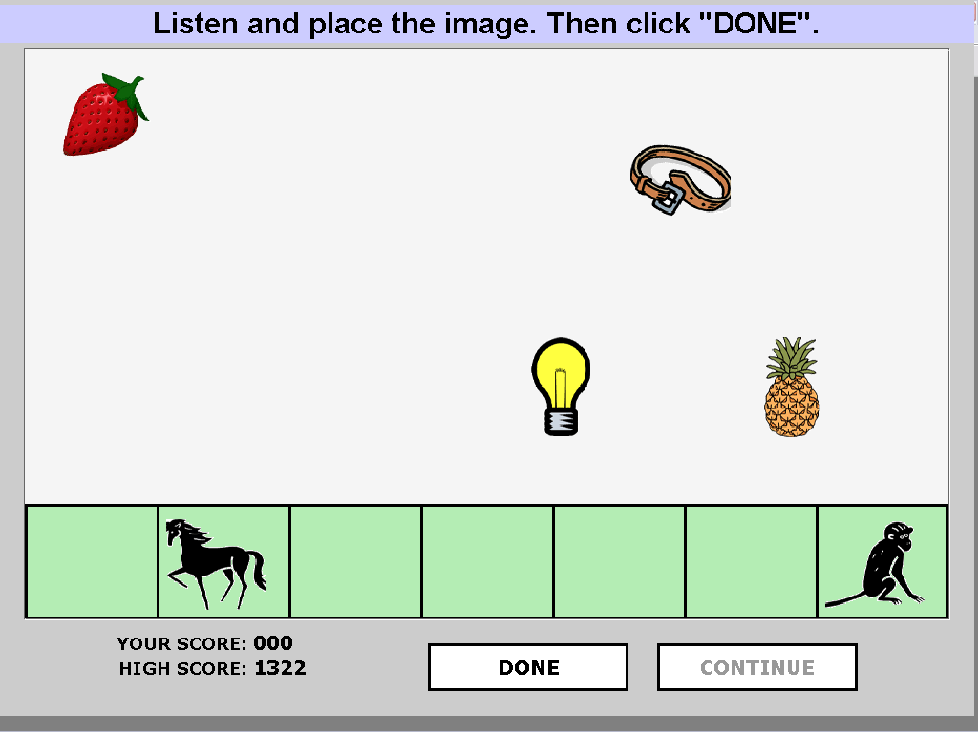

Objects Game
Follower must place the target object where it appears on the Describer’s screen solely via the description provided (4h 19m)
Describer:
Follower:

Slide 13
Annotation
Orthographic transcription and alignment (~73k words)
Intonation, using ToBI conventions
Laughs, coughs, breaths, smacks, throat-clearings.
Self-repairs
Affirmative Cue Words (alright, mm-hm, okay, right, uh-huh, yeah, yes, …) and their (10) functions
Question form and function
Turn-taking behaviors

Slide 14
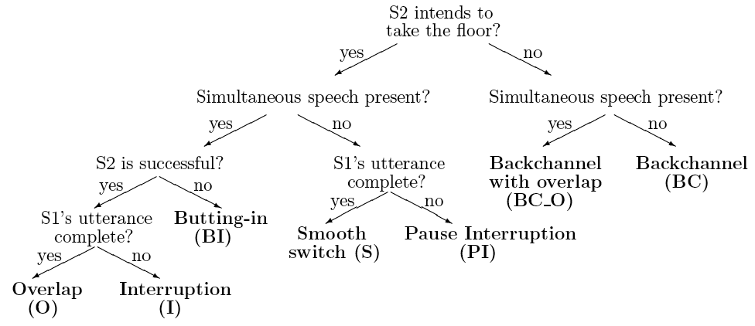
Entrainment in Turn-taking Behaviors in CGC
Notes:
Trained annotators distinguished Smooth Switches from Interruptions and Backchannels using a scheme based on Ferguson 1977, Beattie 1982

Slide 15
Backchannels (BCs)
Short expressions uttered by a speaker to indicate that they are still attending to their interlocutor
  Speaker A: All right so I have a- a a nail on top
  Speaker B: okay
  Speaker A: with an owl in the lower left
Units of Analysis: IPUs defined by >=50ms pause; N=16,257; Holds (8123); BCs (553)
Hold
Backchannel
IPU1
IPU2
IPU4
Speaker A:
IPU3
Speaker B:

Slide 16
Local Entrainment in Speech/BC Sequences (Heldner, Edlund & Hirschberg ’10)
Typically, entrainment has been measured over entire conversations – could it be a much more local phenomenon?
Hypothesis: BCs align with speech preceding them
Method: Compare distance in normalized mean pitch of
  BCs to preceding interlocutor speech
  BCs to following interlocutor speech
  Other (non-overlapping) turn types to their prior turns
Findings: BCs are significantly more similar in mean pitch to interlocutor speech preceding them than
  They are to subsequent speech (which is lower)
  Other turn types are to prior turns (they are higher)
For SDS, easier to keep track of local values…
Notes:
All pitch features were calculated from stylized semitone transformed F0 values from all dialogue segments containing a single speaker. Segments with overlapping speech were excluded throughout to avoid the risk of crosstalk contaminating the pitch values. Speaker means and standard deviations were calculated for all speaker/session pairs. These statistics were used for all speaker based normalizations. Pitch calculated over
To describe the transitions, we used the mean pitch over
the last 500 ms preceding (and including) the last voiced
frame before the transition, and the mean pitch over the first
500 ms following (and including) the first voiced frame after
the transition. Instances where less than 50 ms of either 500
ms interval was voiced were excluded from further analyses.
For comparison, we extracted traditional, individual pitch
means (based on the current speaker only) by (i) calculating
the distance from the speaker’s mean over the current session
(OWN). We also calculated relative pitch distances between
speakers across the transitions based on (ii) raw pitch
(RAWREL), (iii) mean normalized pitch (MEANREL), and (iv)
z-score normalized pitch (ZREL). A hybrid measure which can
be seen as part individual and part relative was also included:
the distance between the current speaker’s raw pitch and the
previous speaker’s overall pitch mean (OTHER).
ANOVAs

Slide 17
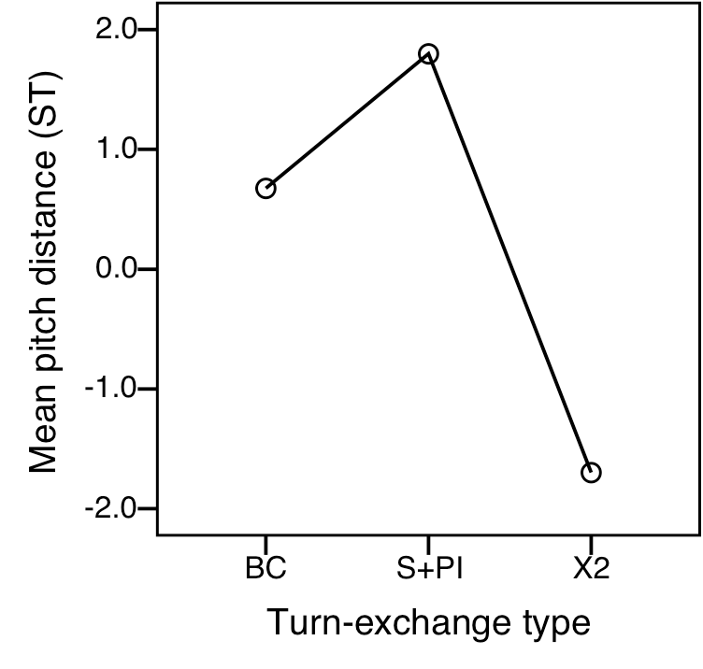
Mean Difference from Prior Speech
Notes:
In semitones
S: smooth switch
PI: pause interruptions
X2: other speaker’s continuation after BC

Slide 18
Entrainment in Other Turn-taking Behaviors
These findings led us to investigate entrainment in interlocutor speech preceding BCs
Backchannel-Inviting Cues (Ward & Al Bayyari ’07)
  Cues from one speaker that signal to another that a BC would be welcome
  Or, features of one speaker’s speech that tend to precede BCs from an interlocutor

Slide 19
Backchannels (BCs) Again
Short expressions uttered by a speaker to indicate that they are still attending to their interlocutor
  Speaker A: All right so I have a- a a nail on top
  Speaker B: okay
  Speaker A: with an owl in the lower left
Units of Analysis: IPUs defined by >=50ms pause; N=16,257; Holds (8123); BCs (553)
Hold
Backchannel
IPU1
IPU2
IPU4
Speaker A:
IPU3
Speaker B:

Slide 20
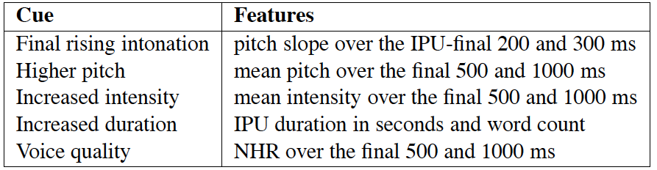
Backchannel-Preceding Cues (Gravano & Hirschberg ’09)
5 acoustic-prosodic BPCs occur significantly more often in IPUs preceding BCs than IPUs preceding Holds or Smooth Switches
  But, different speakers display different cues and different speakers realize acoustic cues in different degrees
  Do speaker pairs entrain on these BPCs, becoming more similar in their use over the conversation?

Slide 21
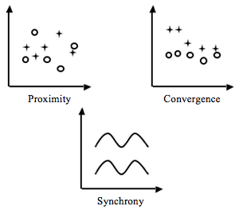
Multiple Dimensions and Levels of Entrainment (Levitan, Gravano, & Hirschberg ‘11)
What dimensions do speakers entrain on? (pitch, intensity, rate, voice quality)
How is entrainment best measured?
    Similarity/proximity
    Convergence
    Synchrony
Is entrainment more local or global?

Slide 22
Entrainment on BPCs (Levitan, Gravano & Hirscherg’11)
Three Metrics
  Global Entrainment Metrics
    Measure 1: Do speakers have similar cue sets?
    Measure 2: Do speakers realize cues similarly?
  Local Entrainment Metric:
    Measure 3: Do speakers produce BPCs that are similar to the cues of the other speaker’s most recent BPCs?
Notes:
22

Slide 23
Measure 1: Do speakers use similar sets of cues?
Determine Cue Presence for each feature:
  ANOVA between Hold- and BC-preceding IPUs to determine if a cue is present in a speaker’s speech (diff in speaker means signif at .05 level)
Findings:
  Speakers displayed 2.17 cues on average
  Speakers have significantly more cues in common w/ partner than w/ random non-partner speakers in corpus (t=-2.2, df=23, p<0.05) or w/ mean of all non-partners
Notes:
We consider a speaker to use a certain BPC if, for one of the features modeling that cue, the difference between backchannel preceding IPUs and hold-preceding IPUs is significant at the p<0.05 level according to an ANOVA
test.
23

Slide 24
Measure 2: Do speakers realize these BPCs similarly?
Compare speaker pairs’ means (e.g. mean f0) for each feature over all BC-preceding IPUs in session vs. each speaker mean compared to all non-partners in corpus
  We say that a speaker entrains on a cue if, for either of the features modeling that cue, her mean is closer to her partner’s than to all non-partners in the corpus
  We say speakers mutually entrain on a cue if (a) is true for both speakers in a session

Slide 25
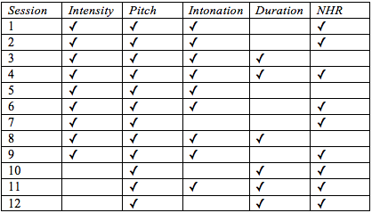
Measure 2: Mutual Entrainment in Cue Realization
Notes:
We measure how similarly two speakers S1 and S2 in a conversation realize a BPC as follows:
First, we compute the difference (df 1,2) between both speakers for the mean value of a feature f over all backchannel-preceding IPUs. Second, we compute the same difference between each of S1 and S2 and the averaged values of all other speakers in the corpus who are not partnered with that speaker in any session (df 1, and df ,2). Finally, if for any feature f modeling a given cue, it holds that df 1,2 < min(df
1,df 2), we say that that session exhibits mutual entrainment on that cue.
25

Slide 26
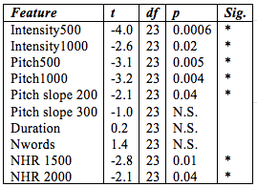
Measure 2: Differences between Partner and non-Partner Means
Notes:
For each of the 10 features associated with backchannel invitation, we compare the differences
between conversational partners and the averaged differences between each speaker and the other
speakers in the corpus (again excluding the speaker’s partners in any session). Paired t-tests (Table 2)
show that the differences in intensity, pitch and voice quality in backchannel-preceding IPUs are smaller
between conversational partners than been speakers and their non-partners in the corpus.
26

Slide 27
Measure 2: Cue realization convergence?
Does coordination in realization of backchannel-preceding cues converge over time?
Paired t-tests: Differences between partners in intensity and pitch in IPU-final 1000ms are significantly smaller in the second
half of a conversation than
the first → yes
Notes:
27

Slide 28
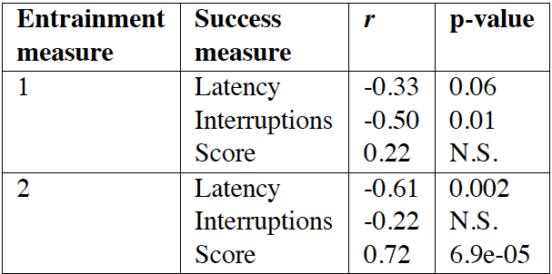
Global BPC Entrainment and Dialogue Success
Notes:
1: Cue presence: correlate # of cues a pair of speakers has in common
2: Cue realization: Our second entrainment metric, Measure 2, captures
the similarities between speaker means of the 10 features associated with BPCs. To test correlations
of this measure with task success, we collapse the ten features into a single measure by taking the
negated Euclidean distance between each speaker pair’s 2 vectors of means; this measure tells us how
close these speakers are across all features examined.
28

Slide 29
Measure 3: Local BPC entrainment
IPU
backchannel
IPU
backchannel
Does one speaker’s BPC IPU affect her partner’s next BPC IPU?
……….
Correlations for mean pitch and intensity between sequential IPUs that precede BCs are significant (r=0.3, p<0.05)
Notes:
29

Slide 30
Conclusions
Strong evidence of entrainment on BPCs:
  Speaker pairs use similar cue sets
  Speaker pairs realize cues in similar ways
  Global entrainment on BPCs is correlated with task success and dialogue coordination
  Entrainment is local as well as global

Slide 31
Next
Evaluation in SDS

Slide 32
Units of analysis
IPU
IPU
IPU
IPU
IPU
Session (sampled every 10 ms)
Inter-pausal unit (IPU): contiguous cross-speaker IPUs
  S1: speech <pause> speech <pause> speech
  S2: speech <pause> speech

Slide 33
Features
Intensity
  Mean and max
Pitch
  Mean and max
Speaking rate
  Syllables per second
Voice quality
  Jitter, shimmer, noise-to-harmonics ratio (NHR)
Notes:
These features calculated over entire session, and also for each IPU comprising turn exchange
33

Slide 34

Measures of entrainment
Proximity
Convergence
Synchrony
Notes:
At the turn level, we looked for evidence of proximity in the following way. For each target IPU, we computed a partner distance (Eq.1) and other distance (Eq.2), s.t. IPUp is adjacent
to the target IPU and uttered by the target IPU speaker’s conversational partner, and IPUi is uttered by the target IPU speaker’s conversational partner but is not adjacent to the target IPU, for
ten random IPUs.
partner distance = |IPU| - IPUpj (1)
other distance =
X10
i=1
jIPUt 􀀀 IPUij
10
(2)
We compared partner differences and other differences
with a paired t-test.
Following Edlund et al. [9], we also computed synchrony
at the turn level as the Pearson’s correlation coefficient between
adjacent IPUs from different speakers, testing for significance
with a two-sided t-test. Similarly, turn-level convergence was
computed as the Pearson’s correlation coefficient between the
absolute value of the difference between adjacent IPUs and
time. We repeated each correlation ten times with randomly
ordered data to verify that significant results were not just a
product of the size of our data; we consider a result valid if at
least nine of the ten random permutations fail to exhibit significant
correlation. (In all experiments, we consider results with
p < 0:05 to be statistically significant, and results with p < 0:1
to approach significance.)

Slide 35
Proximity - session
For each speaker in a session…
Partner difference
  between the speaker and her partner.
Self difference
  between the speaker and herself in another session
Other difference
  between the speaker and everyone she’s not paired with in any session

Slide 36
At the Session-level
 | Proximity | Convergence
Intensity mean | ✓ | ✓
Intensity max | ✓
Pitch mean |  | ✓
Pitch max | ✓
Speaking rate | ✓
Jitter |  | ✓
Shimmer | (✓ ) | ✓
NHR |  | ✓
Notes:
Proximity:
In intensity, they are actually more similar to their partners than they are to themselves in their other session
In the other dimensions, they are more similar to themselves than to their partners, but more similar to their partners than to everyone else.
Shimmer and NHR don’t show significant proximity overall, but they do in the second half of the first game – after they have converged
Convergence:
For convergence, we compared the two halves of the first game, and of the entire session.
Intensity, shimmer and NHR converged over the first game
Pitch and jitter converge over the entire session

Slide 37
Proximity - turn
For each IPU ending a turn exchange…
Partner difference
  between the IPU and its adjacent IPU (the one beginning the next turn)
Other difference
  between the IPU and ten non-adjacent IPUs from the conversational partner

Slide 38
Session-level
 | Proximity | Convergence
Intensity mean | ✓ | ✓
Intensity max | ✓
Pitch mean |  | ✓
Pitch max | ✓
Speaking rate | ✓
Jitter |  | ✓
Shimmer | (✓ ) | ✓
NHR |  | ✓
Notes:
They are more similar to their partners than themselves in intensity…
38

Slide 39
Session-level
 | Proximity | Convergence
Intensity mean | ★ ✓ | ✓
Intensity max | ★ ✓
Pitch mean |  | ✓
Pitch max | ✓
Speaking rate | ✓
Jitter |  | ✓
Shimmer | (✓ ) | ✓
NHR |  | ✓
Notes:
In intensity, they are actually more similar to their partners than they are to themselves in their other session
In the other dimensions, they are more similar to themselves than to their partners, but more similar to their partners than to everyone else.
39

Slide 40
Session-level
 | Proximity | Convergence
Intensity mean | ✓ | ✓
Intensity max | ✓
Pitch mean |  | ✓
Pitch max | ✓
Speaking rate | ✓
Jitter |  | ✓
Shimmer | (✓ ) | ✓
NHR |  | ✓
Notes:
For convergence, we compared the two halves of the first game, and of the entire session.
40

Slide 41
Session-level
 | Proximity | Convergence
Intensity mean | ✓ | ✓
Intensity max | ✓
Pitch mean |  | ✓
Pitch max | ✓
Speaking rate | ✓
Jitter |  | ✓
Shimmer | (✓ ) | ✓
NHR |  | ✓
Notes:
Intensity, shimmer and NHR converged over the first game
41

Slide 42
Session-level
 | Proximity | Convergence
Intensity mean | ✓ | ✓
Intensity max | ✓
Pitch mean |  | ✓
Pitch max | ✓
Speaking rate | ✓
Jitter |  | ✓
Shimmer | (✓ ) | ✓
NHR |  | ✓
Notes:
Pitch and jitter converge over the entire session
42

Slide 43
Session-level
 | Proximity | Convergence
Intensity mean | ✓ | ✓
Intensity max | ✓
Pitch mean |  | ✓
Pitch max | ✓
Speaking rate | ✓
Jitter |  | ✓
Shimmer | (✓ ) | ★ ✓
NHR |  | ★ ✓
Notes:
Shimmer and NHR don’t show significant proximity overall, but they do in the second half of the first game – after they have converged.
43

Slide 44
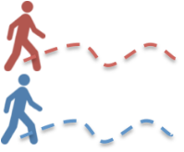
Turn-level
 | Proximity | Synchrony | Convergence
Intensity mean | ✓ | ✓
Intensity max | ✓ | ✓
Pitch mean | ✓ | ✓ | ✓
Pitch max | ✓ | ✓ | ✓
Speaking rate | ✓ | ✓
Jitter | ✓ | ✓
Shimmer | ✓ | ✓
NHR | ✓ | ✓
Notes:
Only high correlations

Slide 45
Turn-level
 | Proximity | Synchrony | Convergence
Intensity mean | ✓ | ★ ✓
Intensity max | ✓ | ★ ✓
Pitch mean | ✓ | ✓ | ✓
Pitch max | ✓ | ✓ | ✓
Speaking rate | ✓ | ✓
Jitter | ✓ | ✓
Shimmer | ✓ | ✓
NHR | ✓ | ✓
Notes:
Correlations for intensity mean and max are the only ones that are high
45

Slide 46
Conclusions
Four prosodic dimensions (intensity, pitch, voice quality, speaking rate) exhibit entrainment.
Evidence of entrainment is strongest for intensity.
Entrainment is most prevalent at the turn level.
Entrainment seems to be a dynamic process.
Different dimensions are entrained on in different ways.

Slide 47
Entrainment and Social Variables: Annotations
Games Corpus Object Games AMT annotations
  Social behaviors
  Gender- and Role-differentiated conversants
Correlate these with acoustic/prosodic entrainment
Who entrains more?
What social annotations correlate most with entrainment?

Slide 48
Questions about the Conversants
  Does Person A/B believe s/he is better than his/her partner?
  Make it difficult for his/her partner to speak? Seem engaged in the game?
  Seem to dislike his/her partner?
  Is s/he bored with the game?
  Directing the conversation?
  Frustrated with his/her partner?
  Encouraging his/her partner?
  Making him/herself clear?

Slide 49
Planning what s/he is going to say?
Polite?
Trying to be liked?
Trying to dominate the conversation?

Slide 50
Collaborators
4/23/12
50
Rivka Levitan, Adele Chase, Laura Willson, Columbia University
Agustín Gravano, University of Buenos Aires
Štefan Beňuš, Constantine the Philosopher University
Ani Nenkova, University of Pennsylvania
Jens Edlund, Mattias Heldner, KTH Stockholm

