Slide 1
Automatic Dialect/Accent Recognition
Fadi Biadsy
April 12th, 2010
Notes:
Hi I’m presenting now my proposal .. First I would like to thank you for agreeing to be on my proposal committee..

Slide 2
Outline
Problem
Motivation
Corpora
Framework for Language Recognition
Experiments in Dialect Recognition
  Phonotactic Modeling
  Prosodic Modeling
  Acoustic Modeling
  Discriminative Phonotactics

Slide 3
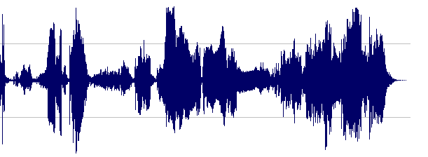
Problem: Dialect Recognition
Given a speech segment of a predetermined language
Great deal of work on language recognition
Dialect and Accent recognition have more recently begun to receive attention
Dialect recognition more difficult problem than language recognition
Dialect = {D1, D2,…,DN}

Slide 4
Motivation: Why Study Dialect Recognition?
Discover differences between dialects
To improve Automatic Speech Recognition (ASR)
  Model adaptation: Pronunciation, Acoustic, Morphological, Language models
To infer speaker’s regional origin for
  Speech to speech translation
  Annotations for Broadcast News Monitoring
  Spoken dialogue systems – adapt TTS systems
  Charismatic speech
Call centers – crucial in emergency situations

Slide 5
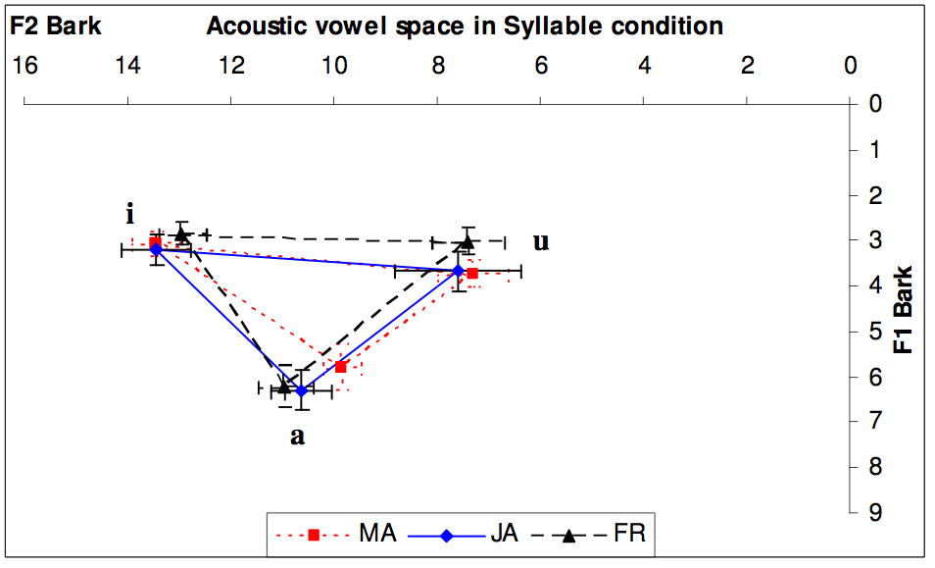
Motivation: Cues that May Distinguish Dialects/Accents
Phonetic cues:
    Differences in phonemic inventory
    Phonemic differences
    Allophonic differences (context-dependent phones)
Phonotactics: Rules/Distribution that govern phonemes and their sequences in a dialect
Example: /r/
Approximant in American English [ɹ] – modifies preceding vowels
Trilled in Scottish English in [Consonant] – /r/ – [Vowel] and in other contexts
Differences in phonetic inventory and vowel usage
Differences in Morphology
“She will meet him”
MSA: /s/ /a/ /t/ /u/ /q/ /A/ /b/ /i/ /l/ /u/ /h/ /u/
Egy: /H/ /a/ /t/ /?/ /a/ /b/ /l/ /u/
    Lev: /r/ /a/ /H/ /t/ /g/ /A/ /b/ /l/ /u/
(Al-Tamimi & Ferragne, 2005)
Notes:
There are multiple cues that humans and machines can use to distinguish dialects

Slide 6
Motivation: Cues that May Distinguish Dialects/Accents
Prosodic differences
  Intonational patterns
  Timing and rhythm
Spectral distribution (Acoustic frame-based features)
Morphological, lexical, and syntactic differences
Subjects rely on intonational cues to distinguish two German dialects (Hamburg urban dialects vs. Northern Standard German) (Peters et al., 2002)

Slide 7
Outline
Problem
Motivation
Corpora
Framework for Language Recognition
Experiments in Dialect Recognition
  Phonotactic Modeling
  Prosodic Modeling
  Acoustic Modeling
  Discriminative Phonotactics
Contributions
Future Work
Research Plan

Slide 8
Case Study: Arabic Dialects
Iraqi Arabic: Baghdadi, Northern, and Southern
Gulf Arabic: Omani, UAE, and Saudi Arabic
Levantine Arabic: Jordanian, Lebanese, Palestinian, and Syrian Arabic
Egyptian Arabic: primarily Cairene Arabic

Slide 9
Corpora – Four Dialects – DATA I
Recordings of spontaneous telephone conversation produced by native speakers of the four dialects available from LDC
Dialect | # Speakers | Total Duration | Test Speakers | Corpus
Gulf | 965 | 41h | 150 | Gulf Arabic conversational telephone Speech database (Appen Pty Ltd, 2006a)
Iraqi | 475 | 26h | 150 | Iraqi Arabic conversational telephone Speech database (Appen Pty Ltd, 2006b)
Egyptian | 398 | 76h | 150 | CallHome Egyptian and its Supplement (Canavan et al., 1997) CallFriend Egyptian (Canavan and Zipperlen, 1996)
Levantine | 1258 | 79h | 150 | Arabic CTS Levantine Fisher Training Data Set 1-3 (Maamouri, 2006)
Notes:
We could find a set of corpora of….
Held out 150 speakers from each corpus…600 speakers.. It’s a good number of speakers

Slide 10
Outline
Problem
Motivation
Corpora
Framework for Language Recognition
Experiments in Dialect Recognition
  Phonotactic Modeling
  Prosodic Modeling
  Acoustic Modeling
  Discriminative Phonotactics
Contributions
Future Work
Research Plan

Slide 11
Probabilistic Framework for Language ID
Task:
Hazen and Zue’s (1993) contribution:
Prior
Phonotactic
Prosodic model
Acoustic model

Slide 12
Outline
Problem
Motivation
Corpora
Framework for Language Recognition
Experiments in Dialect Recognition
  Phonotactic Modeling
  Prosodic Modeling
  Acoustic Modeling
  Discriminative Phonotactics
Contributions
Future Work
Research Plan

Slide 13
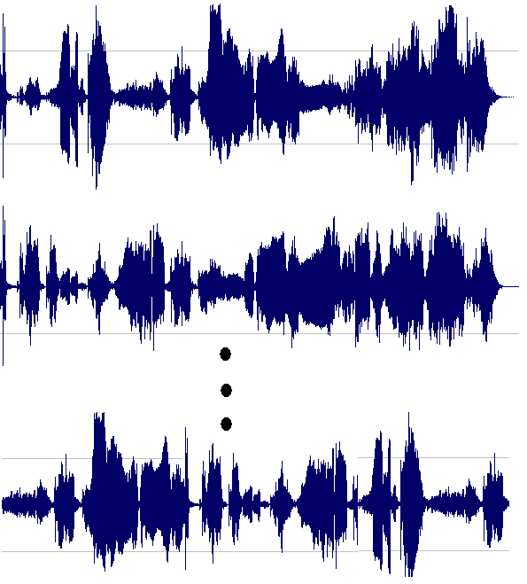
Phonotactic Approach
Hypothesis: Dialects differ in their phonotactic distribution
Early work: Phone Recognition followed by Language Modeling (PRLM) (Zissman, 1996)
Training: For each dialect D_{i} :
Train an n-gram model: λ_{i}
dh uw z hh ih n d uw ey...
f uw v ow z l iy g s m k dh...
h iy jh sh p eh ae ey p sh…
Run a phone recognizer

Slide 14

Phonotactic Approach – Identification
Test utterance:
C
uw hh ih n d uw w ay ey uh jh y eh k oh v hh ...
Run the phone recognizer

Slide 15

Applying Parallel PRLM (Zissman, 1996)
Use multiple (k) phone recognizers trained on multiple languages to train k n-gram phonotactic models for each language of interest
Experiments on our data: 9 phone recognizers, trigram models
Arabic phones
Perplexities
Iraqi LM
Arabic Phone Recognizer
Gulf LM
Egyptian LM
Levantine LM
MSA LM
English phones
Iraqi LM
English Phone Recognizer
Gulf LM
Back-End Classifier
Acoustic Preprocessing
Egyptian LM
Levantine LM
MSA LM
Japanese phones
Hypothesized Dialect
Iraqi LM
Japanese Phone Recognizer
Gulf LM
Egyptian LM
Levantine LM
MSA LM

Slide 16
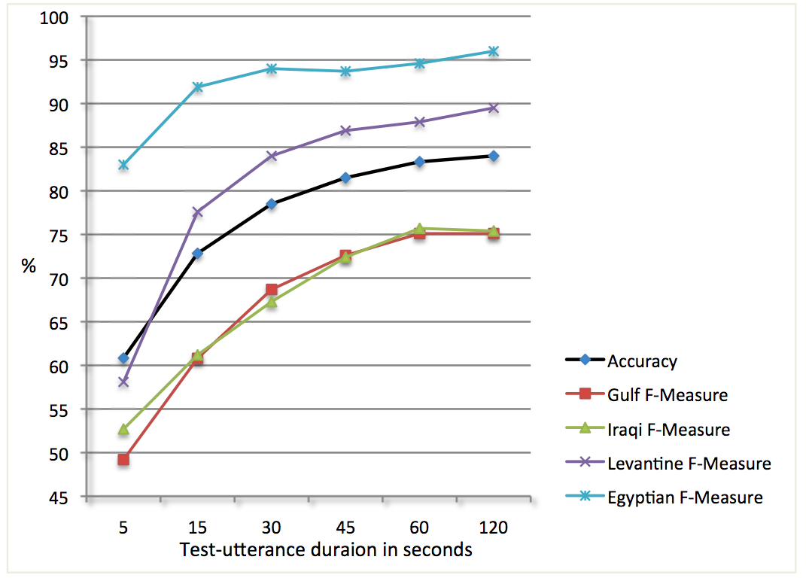
Our Parallel PRLM Results – 10-Fold Cross Validation
Test utterance duration in seconds

Slide 17
Outline
Problem
Motivation
Corpora
Framework for Language Recognition
Experiments in Dialect Recognition
  Phonotactic Modeling
  Prosodic Modeling
  Acoustic Modeling
  Discriminative Phonotactics
Contributions
Future Work
Research Plan

Slide 18
Prosodic Differences Across Dialects
Hypothesis: Dialects differ in their prosodic structure
  What are these differences?
Global Features
  Pitch: Range and Register, Peak Alignment, STDV
  Intensity
  Rhythmic features: ∆C, ∆V, %V (using pseudo syllables)
  Speaking Rate
  Vowel duration statistics
Compare dialects using descriptive statistics

Slide 19
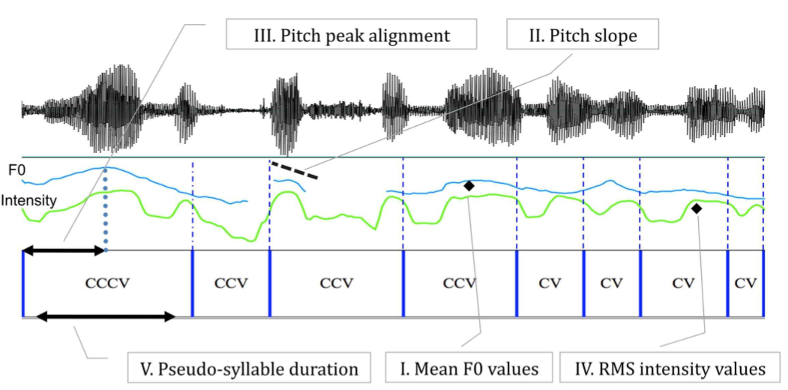
New Approach: Prosodic Modeling
Pseudo-syllabification
Sequential local features at the level of pseudo-syllables:
Learn a sequential model for each prosodic sequence type using an ergodic continuous HMM for each dialect

Slide 20
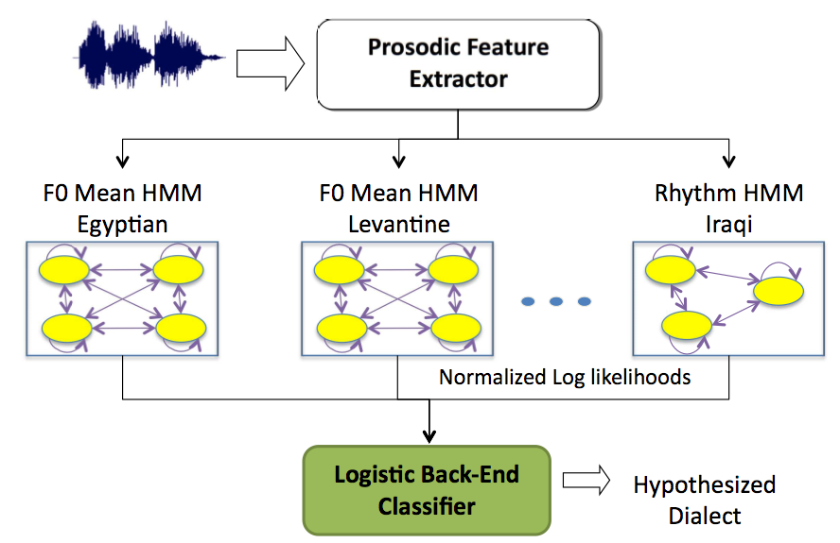
New Approach for Prosodic Modeling
Dialect Recognition System:
Global Features
Logistic Backend Classifier

Slide 21
Prosodic Modeling – Results (2m test utterances)
10-fold cross-validation (on Data I)
* p<0.05; *** p<0.001

Slide 22
Outline
Problem
Motivation
Corpora
Framework for Language Recognition
Experiments in Dialect Recognition
  Phonotactic Modeling
  Prosodic Modeling
  Acoustic Modeling
  Discriminative Phonotactics
Contributions
Future Work
Research Plan

Slide 23



Baseline: Acoustic Modeling
Hypothesis: Dialect differ in their spectral distribution
Gaussian Mixture Model – Universal Background Model (GMM-UBM) widely used approach for language and speaker recognition (Reynolds et al., 2000)
a_{i}: 40D PLP features
Dialect 2
Train GMM-UBM using EM
Dialect 1
Maximum A-Posteriori (MAP) Adaptation to create a GMM for each dialect
During recognition

Slide 24
Corpora – Four Dialects – DATA II
For testing:
  (25% female – mobile, 25% female – landline, 25% male – mobile, 25 % male – landline)
Egyptian: Training: CallHome Egyptian, Testing: CallFriend Egyptian
Dialect | # Speakers | Test 20% – 30s test cuts | Corpus
Gulf | 976 | 801 | (Appen Pty Ltd, 2006a)
Iraqi | 478 | 477 | (Appen Pty Ltd, 2006b)
Levantine | 985 | 818 | (Appen Pty Ltd, 2007)
Dialect | # Training Speakers | # 120 speakers 30s cuts | Corpora
Egyptian | 280 | 1912 | (Canavan and Zipperlen, 1996) (Canavan et al., 1997)

Slide 25
NIST LREC Evaluation Framework
Detection instead of identification: given a trial and a target dialect
  Hypothesis: Is the utterance from the target dialect?
    Accept/reject + likelihood
DET curves: false alarm probability against miss probability
  Results are reported across pairs of dialects
  All dialects are then pooled together to produce one DET curve
  Trials 30s, 10s, and 3s long
Equal Error Rate (EER)
Notes:
In the NIST language recognition evaluation, the task is detection as opposed to identification. given a trial and a target dialect, we are asked to test the hypothesis: is the utterance from the target dialect.
The system have to accept or reject the hypothesis and return a likelihood score
We use these score to report DET curve which plots the false alarm probability against miss probablity.

Slide 26
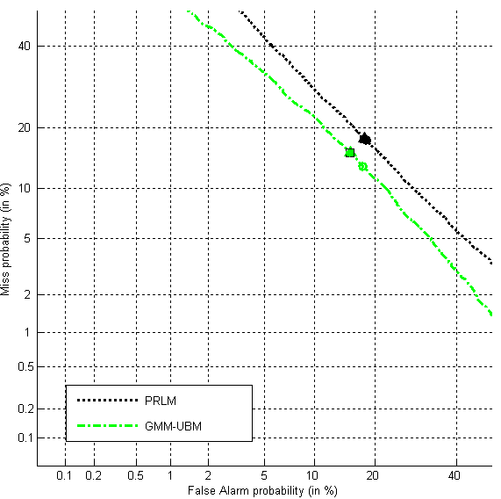
Results (DET curves of PRLM and GMM-UBM) – 30s Cuts (Data II)
Approach | EER (%)
PRLM | 17.7
GMM-UBM | 15.3

Slide 27
Our GMM-UBM Improved with fMLLR
Motivation: VTLN and channel compensation improve GMM-UBM for speaker and language recognition
Our approach: Feature space Maximum Likelihood Linear Regression (fMLLR) adaptation
Idea: Use a phone recognizer to obtain phone sequence: transform the features “towards” the corresponding acoustic model GMMs (a matrix for each speaker)
Intuition: consequently produce more compact models
Same as GMM-UBM approach, but use transformed acoustic vectors instead
[Vowel]-/r/-[Consonant]
fMLLR

Slide 28
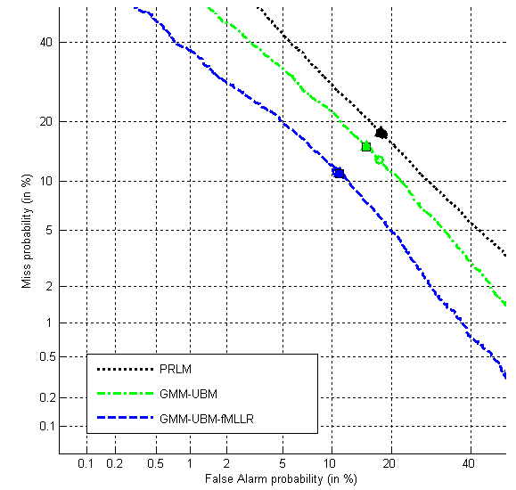
Results – GMM-UBM-fMLLR – 30s Utterances
Approach | EER (%)
PRLM | 17.7
GMM-UBM | 15.3
GMM-UBM-fMLLR | 11.0%

Slide 29
Outline
Problem
Motivation
Corpora
Framework for Language Recognition
Experiments in Dialect Recognition
  Phonotactic Modeling
  Prosodic Modeling
  Acoustic Modeling
  Discriminative Phonotactics
Contributions
Future Work
Research Plan

Slide 30
Discriminative Phonotactics
    Hypothesis: Dialects differ in their allophones (context-dependent phones) and their phonotactics
    Idea: Discriminate dialects first at the level of context-dependent (CD) phones and then phonotactics
    Obtain CD-phones
    Extract acoustic features for each CD-phone
    Discriminate CD-phones across dialects
    Augment the CD-phone sequences and extract phonotactic features
    Train a discriminative classifier to distinguish dialects
/r/ is Approximant in American English [ɹ] and trilled in Scottish in [Consonant] – /r/ – [Vowel]

Slide 31
Obtaining CD-Phones
Context-dependent (CD) phone sequence
...
[Back vowel]-r-[Central Vowel]
[Plosive]-A-[Voiced Consonant]
[VCentral]-b-[High Vowel]
...
...
Run Attila context-dependent phone recognizer (trained on MSA)
* not just /r/ /A/ /b/
Do the above for all training data of all dialects

Slide 32
CD-Phone Universal Background Acoustic Model
Each CD phone type has an acoustic model:
e.g., [Back vowel]-r-[Central Vowel]

Slide 33
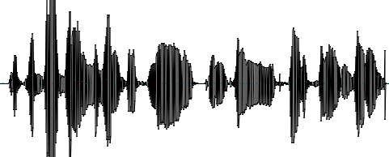
Obtaining CD-Phones + Frame Alignment
Acoustic frames for second state
Front-End
Acoustic frames:
CD-Acoustic Models:
CD-Phone Recognizer
CD-Phones: (e.g.)
[vowel]-b-[glide]
[front-vowel]-r-[sonorant]

Slide 34
MAP Adaptation of each CD-Phone Instance
MAP
MAP
MAP
[Back Vowel]-r-[Central Vowel]
2. MAP adapt the universal background model GMMs to the corresponding frames
Notes:
Capitalize all titles

Slide 35
MAP Adaptation of each CD-Phone Instance
[Back Vowel]-r-[Central Vowel]
2. MAP adapt the universal background model GMMs to the corresponding frames
One Super Vector for each CD phone instance:
Stack all the Gaussian means and phone duration V _{k} =[μ₁, μ₂, …., μ_{N}, duration]
i.e., a sequence of features with unfixed size to fixed-size vector

Slide 36
SVM Classifier for each CD-Phone Type for each Pair of Dialects
[Back Vowel]-r-[Central Vowel]
dialect 1
dialect 2
_{Super vectors of CD} phone instances of all speakers in dialect 2
Super vectors of CD-phone instances of all speakers in dialect 1
Notes:
Color/font

Slide 37
Discriminative Phonotactics – CD-Phone Classification
Acoustic frames for second state
Front-End
Acoustic frames:
CD-Acoustic Models:
CD-Phone Recognizer
CD-Phones: (e.g.)
[vowel]-b-[glide]
[front-vowel]-r-[sonorant]
MAP Adapted Acoustic Models:
MAP Adapt GMMs
Super Vectors:
Super Vector 1
Super Vector N
Super Vectors
Dialects: (e.g.)
Egy
Egy
SVM Classifiers

Slide 38
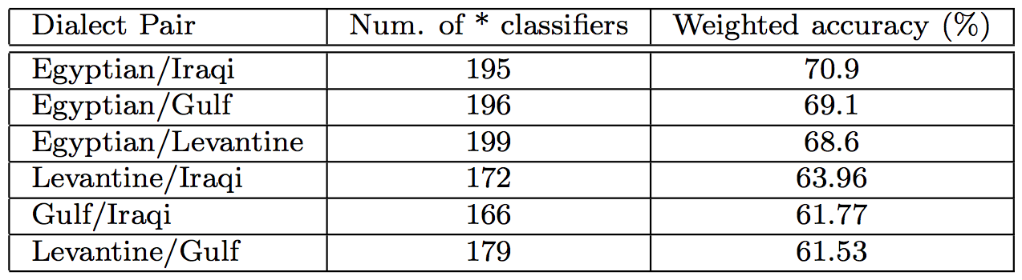
CD-Phone Classifier Results
Split the training data into two halves
Train 227 (one for each CD-phone type) binary classifiers for each pair of dialects on 1st half and test on 2nd

Slide 39
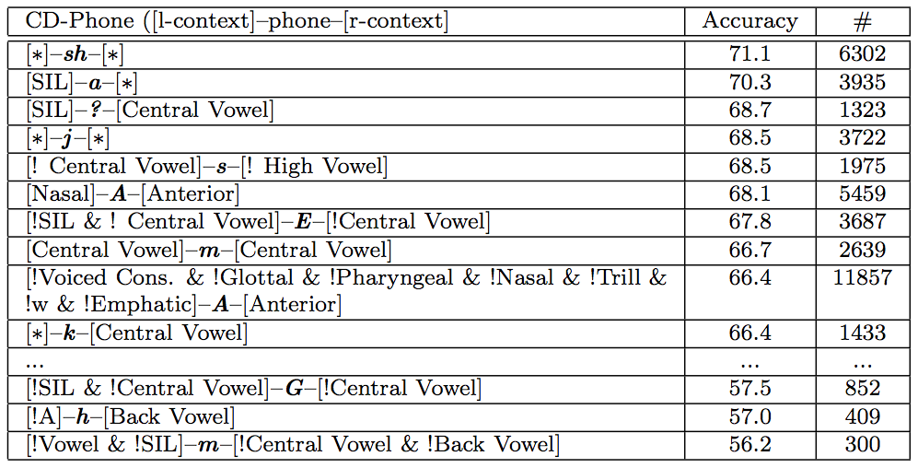
Extraction of Linguistic Knowledge
Use the results of these classifiers to show which phones in what contexts distinguish dialects the most (chance is 50%)
Levantine/Iraqi Dialects

Slide 40
Labeling Phone Sequences with Dialect Hypotheses
Run corresponding SVM classifier to get the dialect of each CD phone
CD-phone recognizer
...
[Back vowel]-r-[Central Vowel]
[Plosive]-A-[Voiced Consonant]
[Central Vowel]-b-[High Vowel]
...
...
...
[Back vowel]-r-[Central Vowel] _{Egyptian}
[Plosive]-A-[Voiced Consonant] _{Egyptian}
[Central Vowel]-b-[High Vowel] _{Levantine}
...
...

Slide 41
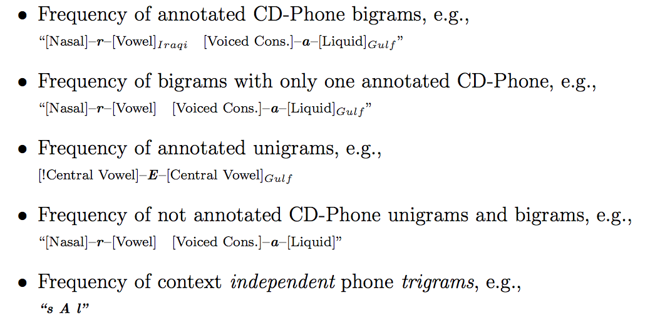
Textual Feature Extraction for Discriminative Phonotactics
Extract the following textual features from each pair of dialects
Normalize vector by its norm
Train a logistic regression with L2 regularizer

Slide 42
Experiments – Training Two Models
Split training data into two halves
Train SVM CD-phone classifiers using the first half
Run these SVM classifiers to annotate the CD phones of the 2nd half
Train the logistic classifier on the annotated sequences

Slide 43
Discriminative Phonotactics – Dialect Recognition
Acoustic frames for second state
Front-End
Acoustic frames:
CD-Acoustic Models:
CD-Phone Recognizer
CD-Phones: (e.g.)
[vowel]-b-[glide]
[front-vowel]-r-[sonorant]
MAP Adapted Acoustic Models:
MAP Adapt GMMs
Super Vectors:
Super Vector 1
Super Vector N
Super Vectors
Dialects: (e.g.)
[vowel]-b-[glide]
[front-vowel]-r-[sonorant]
SVM Classifiers
Egy
Egy
Logistic classifier
Egyptian

Slide 44
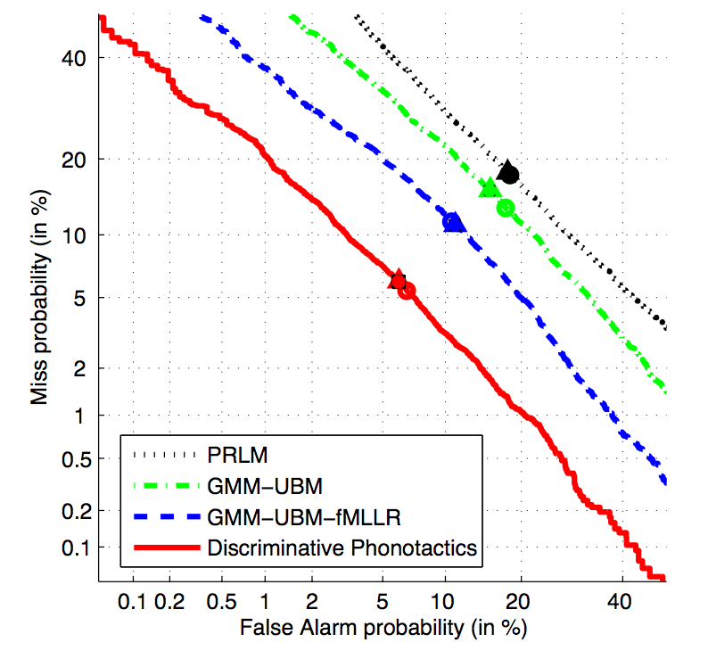
Results – Discriminative Phonotactics
Approach | EER (%)
PRLM | 17.7
GMM-UBM | 15.3
GMM-UBM-fMLLR | 11.0%
Disc. Phonotactics | 6.0%

Slide 45
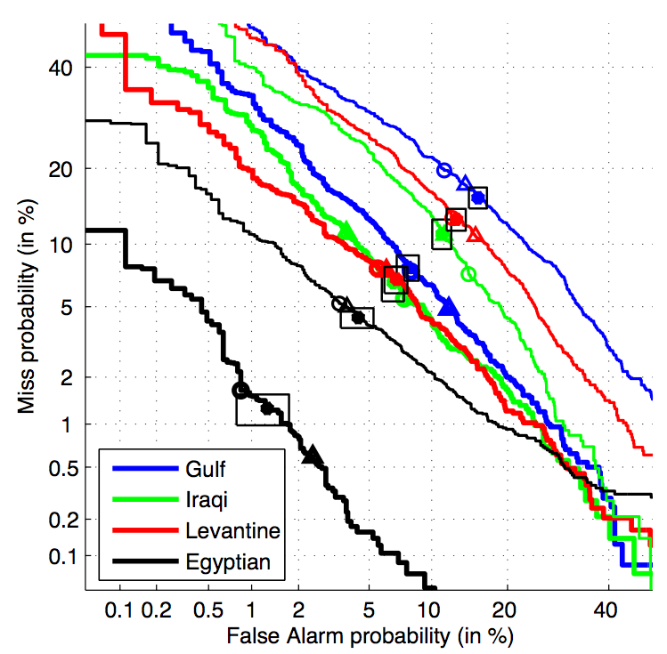
Results per Dialect
Dialect | GMM fMLLR | Disc. Pho.
Egyptian | 4.4% | 1.3%
Iraqi | 11.1% | 6.6%
Levantine | 12.8% | 6.9%
Gulf | 15.6% | 7.8%

Slide 46
Comparison to the State-of-the-Art
State of the art system: (Torres-Carrasquillo et al., 2008)
    Two English accents: EER: 10.6%
    Three Arabic dialects: EER: 7%
    Four Chinese dialects: EER: 7%
NIST Language Recognition 2005: (Mathjka et al., 2006) – fusing multiple approaches:
  7 Languages + 2 accents: EER: 3.1%

Slide 47
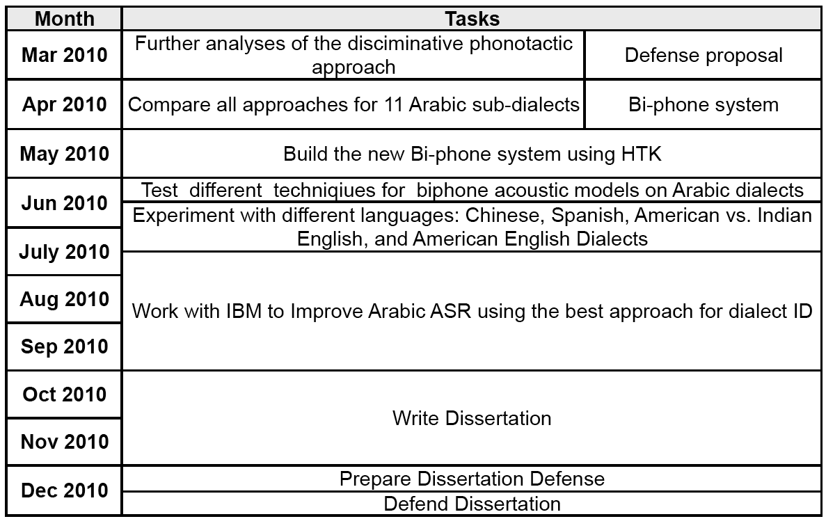
Research Plan

Slide 48
Acknowledgments
Thank You!

Slide 49
Prosodic Differences Across Dialects
F0 differences
  Levantine and Iraqi speakers have higher pitch range and more expanded pitch register than Egyptian and Gulf speakers
  Iraqi and Gulf intonation show more variation than Egyptian and Levantine
  Pitch peaks within pseudo-syllables in Egyptian and Iraqi are shifted significantly later than those in Gulf and Levantine
Durational and Rhythmic differences
  Gulf and Iraqi dialects tend to have more complex syllabic structure
  Egyptian tend to have more vocalic intervals with more variation than other dialects, which may account for vowel reduction and quantity contrasts

Slide 50
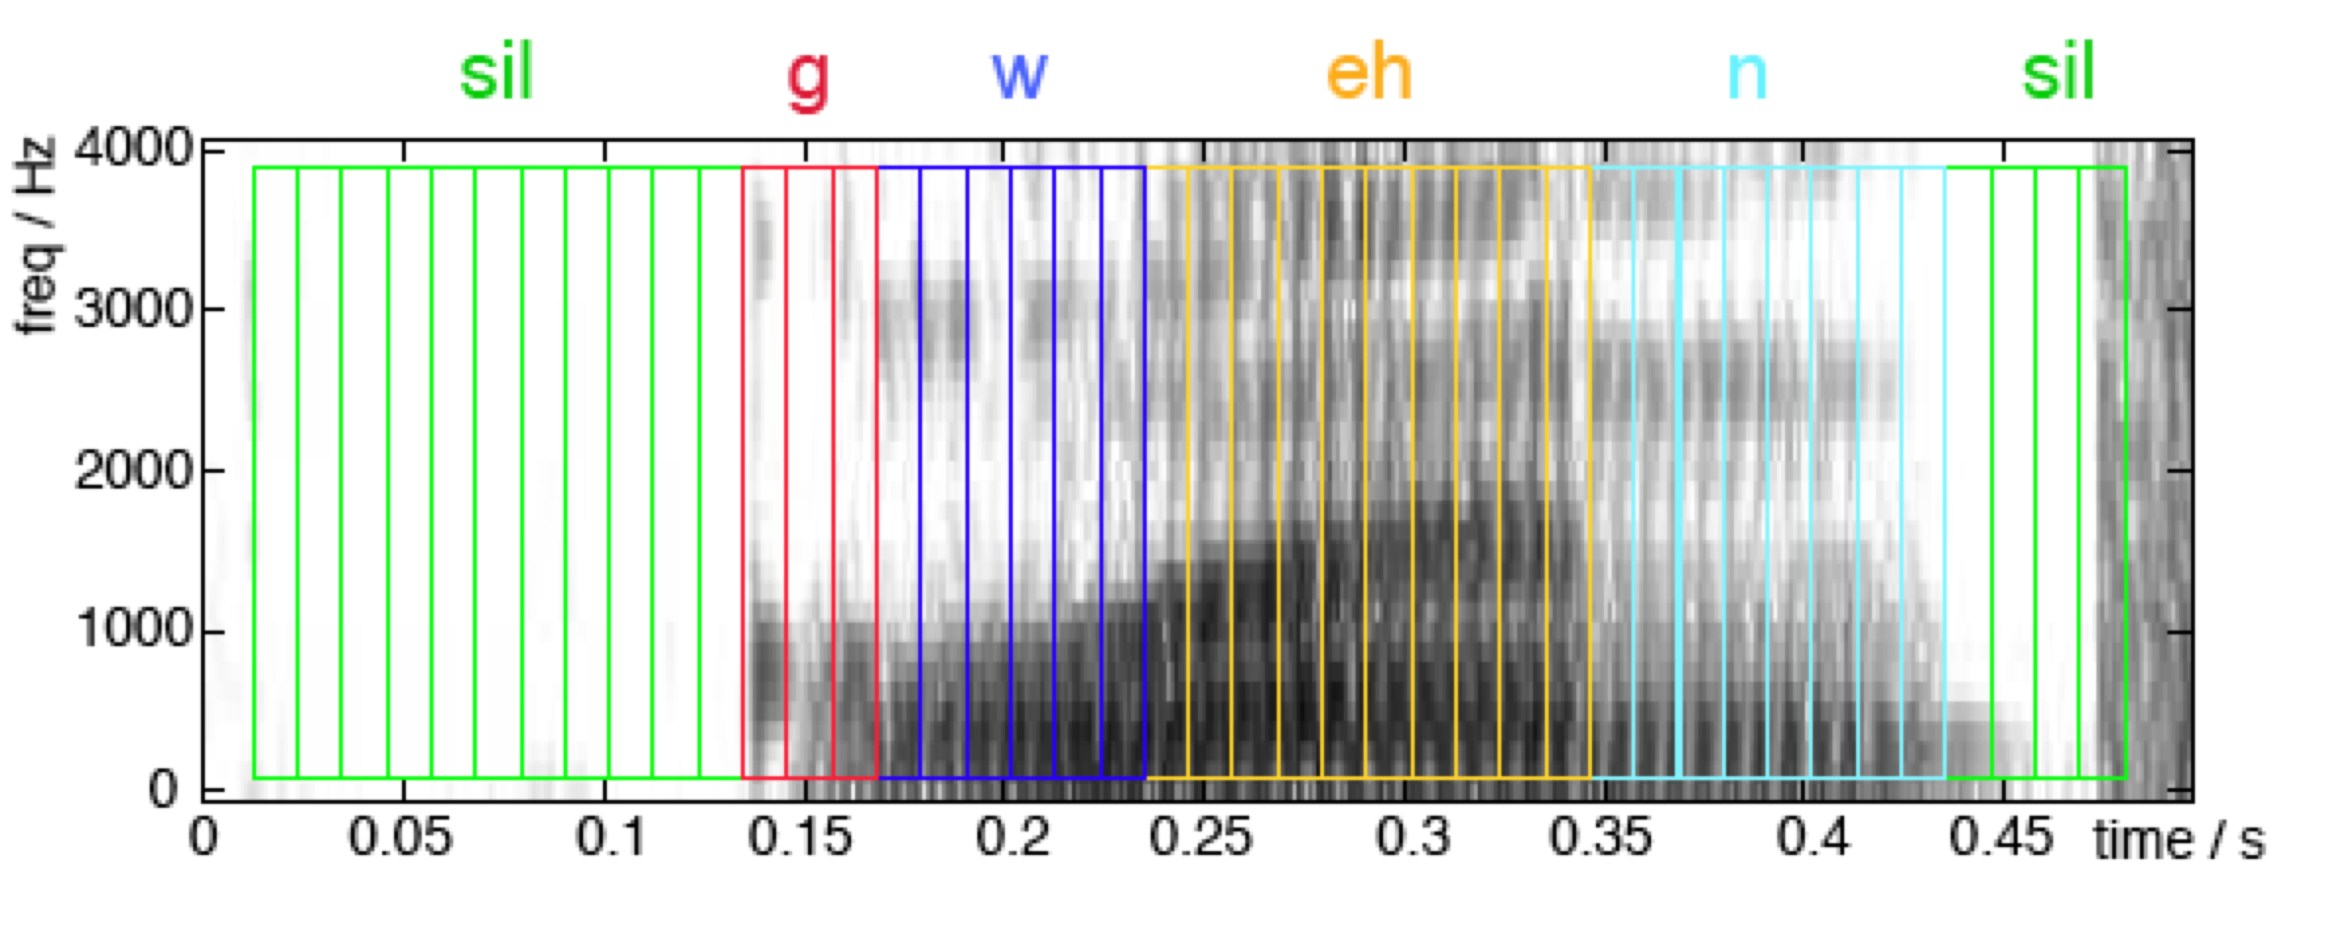
Frame Alignment
For each CD phone sequence:
Get the frame alignment with the acoustic model’s states

