Slide 1
Acoustics of Speech
Julia Hirschberg
CS 4706

Slide 2
Goal 1: Distinguishing One Phoneme from Another, Automatically
ASR: Did the caller say ‘I want to fly to Newark’ or ‘I want to fly to New York’?
Forensic Linguistics: Did the accused say ‘Kill him’ or ‘Bill him’?
What evidence is there in the speech signal?
  How accurately and reliably can we extract it?

Slide 3
Goal 2: Determining How things are said is sometimes critical to understanding
Intonation
  Forensic Linguistics: ‘Kill him!’ or ‘Kill him?’
  TTS: ‘Are you leaving tomorrow./?’
  What information do we need to extract from/generate in the speech signal?
  What tools do we have to do this?

Slide 4
Today and Next Class
How do we define cues to segments and intonation?
  Fundamental frequency (pitch)
  Amplitude/energy (loudness)
  Spectral features
  Timing (pauses, rate)
  Voice Quality
How do we extract them?
  Praat
  Wavesurfer
  Xwaves…

Slide 5
Sound Production
Pressure fluctuations in the air caused by a musical instrument, a car horn, a voice…
  Sound waves propagate thru e.g. air (marbles, stone-in-lake)
  Cause eardrum (tympanum) to vibrate
  Auditory system translates into neural impulses
  Brain interprets as sound
  Plot sounds as change in air pressure over time
From a speech-centric point of view, sound not produced by the human voice is noise
  Ratio of speech-generated sound to other simultaneous sound: Signal-to-Noise ratio

Slide 6
How ‘Loud’ are Common Sounds – How Much Pressure Generated?
Event Pressure (Pa) Db
Absolute 20 0
Whisper 200 20
Quiet office 2K 40
Conversation 20K 60
Bus 200K 80
Subway 2M 100
Thunder 20M 120
*DAMAGE* 200M 140
Notes:
Pa = Pascal
Db = Decibel

Slide 7
Voiced Sounds are Typically Periodic
Simple Periodic Waves (sine waves) defined by
  Frequency: how often does pattern repeat per time unit
    Cycle: one repetition
    Period: duration of cycle
    Frequency=# cycles per time unit, e.g. sec.
      Frequency in Hz = cycles per second or 1/period
      E.g. 400Hz pitch = 1/.0025 (1 cycle has a period of .0025; 400 cycles complete in 1 sec)
    Zero crossing: where the waveform crosses the x-axis

Slide 8
  Amplitude: peak deviation of pressure from normal atmospheric pressure
  Phase: timing of waveform relative to a reference point

Slide 9
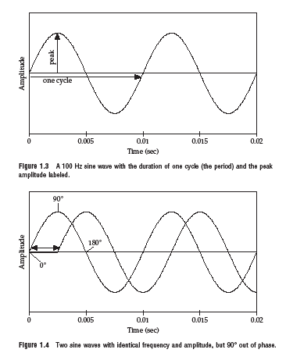

Slide 10
Complex Periodic Waves
Cyclic but composed of multiple sine waves
  Fundamental frequency (F0): rate at which largest pattern repeats (also GCD of component frequencies)
  Harmonics: faster repeating patterns
Any complex waveform can be analyzed into its component sine waves with their frequencies, amplitudes, and phases (Fourier’s theorem)

Slide 11
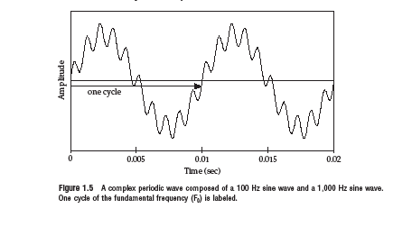
2 Sine Waves → 1 Complex periodic wave

Slide 12
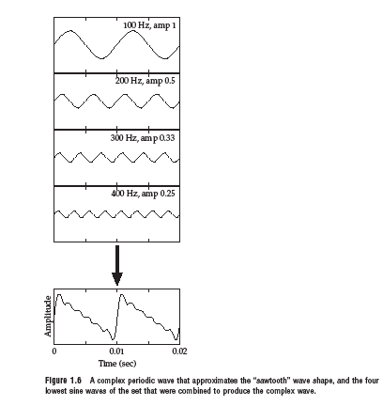
4 Sine Waves→ 1 Complex periodic wave

Slide 13
Power Spectra and Spectrograms
Frequency components of a complex waveform represented in the power spectrum
  Plots frequency and amplitude of each component sine wave
Adding temporal dimension → spectrogram
Obtained via Fast Fourier Transform (FFT), Linear Predicative Coding (LPC),…
  Useful for analysis, coding and synthesis

Slide 14
Examples and Terms
Vowels.wav, speechbeach1.wav, speechbeach2.wav
Spectral slice: plots amplitude at each frequency
Spectrograms: plots changes in amplitude and frequency over time
Harmonics: components of a complex waveform that are multiples of the fundamental frequency (F0)
Formants: frequency bands that are most amplified by the vocal tract

Slide 15
Aperiodic Waveforms
Waveforms with random or non-repeating patterns
  Random aperiodic waveforms: white noise
    Flat spectrum: equal amplitude for all frequency components
  Transients: sudden bursts of pressure (clicks, pops, lip smacks, door slams)
    Flat spectrum with single impulse
  Voiceless consonants

Slide 16
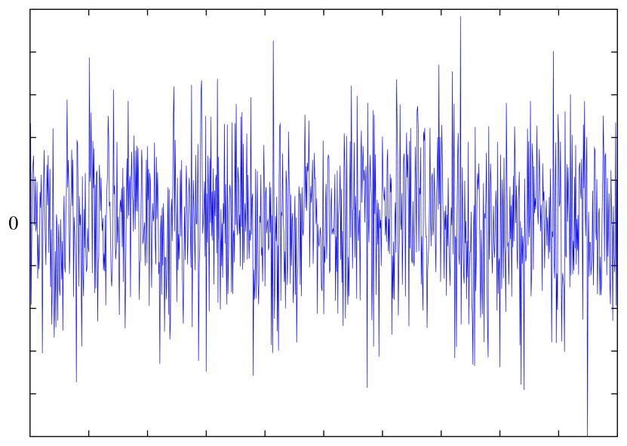
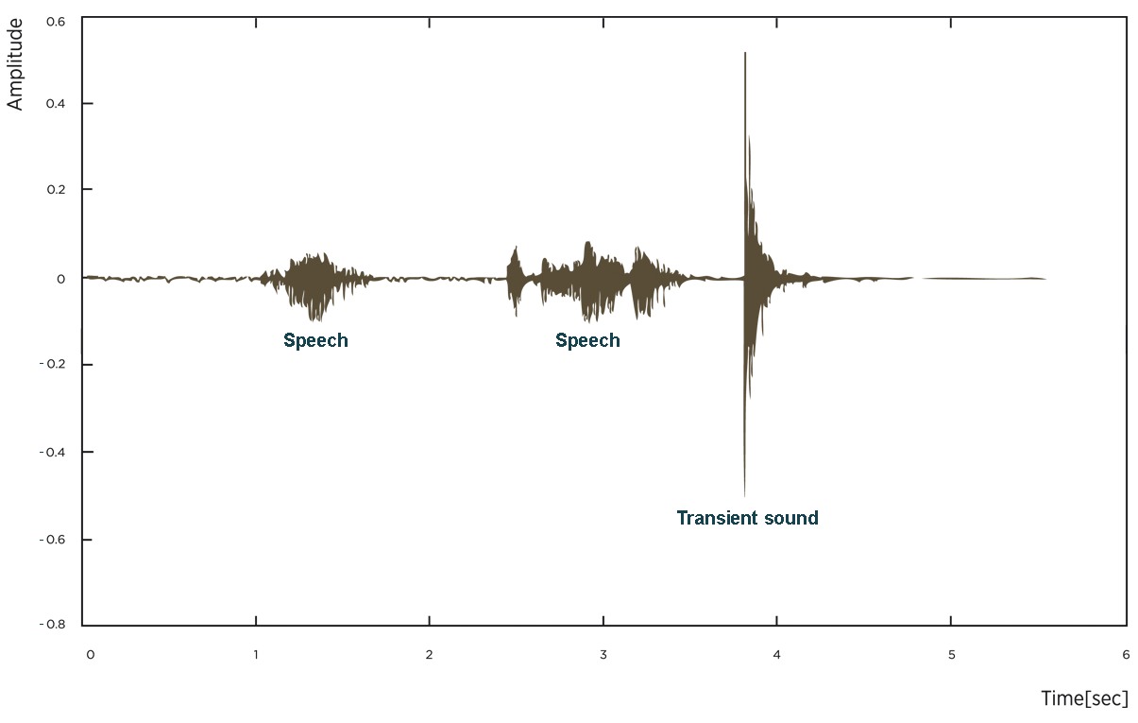

Slide 17
Speech Waveforms in Particular
Lungs plus vocal fold vibration filtered by the resonances of the vocal tract produce complex periodic waveforms
  Pitch range, mean, max: cycles per sec of lowest frequency component of signal = fundamental frequency (F0)
  Loudness:
    RMS amplitude:
    Intensity: in Db, where P₀ is auditory threshold pressure

Slide 18
How do we capture speech for analysis?
Recording conditions
  A quiet office, a sound booth, an anechoic chamber
Microphones convert sounds into electrical current: oscillations of air pressure become oscillations of voltage in an electric circuit
  Analog devices (e.g. tape recorders) store these as a continuous signal
  Digital devices (e.g. computers,DAT) first convert continuous signals into discrete signals (digitizing)

Slide 19
Sampling
Sampling rate: how often do we need to sample?
  At least 2 samples per cycle to capture periodicity of a waveform component at a given frequency
    100 Hz waveform needs 200 samples per sec
    Nyquist frequency: highest-frequency component captured with a given sampling rate (half the sampling rate) – e.g. 8K sampling rate (telephone speech) captures frequencies up to 4K

Slide 20
Sampling/storage tradeoff
Human hearing: ~20K top frequency
  Do we really need to store 40K samples per second of speech?
Telephone speech: 300-4K Hz (8K sampling)
  But some speech sounds (e.g. fricatives, stops) have energy above 4K…
  Peter/teeter/Dieter
44k (CD quality audio) vs.16-22K (usually good enough to study pitch, amplitude, duration, …)
Golden Ears…

Slide 21
Sampling Errors
Aliasing:
  Signal’s frequency higher than the Nyquist frequency
  Solutions:
    Increase the sampling rate
    Filter out frequencies above half the sampling rate (anti-aliasing filter)

Slide 22
Quantization
Measuring the amplitude at sampling points: what resolution to choose?
  Integer representation
  8, 12 or 16 bits per sample
Noise due to quantization steps avoided by higher resolution -- but requires more storage
  How many different amplitude levels do we need to distinguish?
  Choice depends on data and application (44K 16bit stereo requires ~10Mb storage)

Slide 23
  But clipping occurs when input volume (i.e. amplitude of signal) is greater than range that can be represented
  Watch for this when you are recording for TTS!
  Solutions
    Increase the resolution
    Decrease the amplitude
    Example: clipped.wav

Slide 24

Filtering
Acoustic filters block out certain frequencies of sounds
  Low-pass filter blocks high frequency components of a waveform
  High-pass filter blocks low frequencies
  Band-pass filter blocks both around a band
  Reject band (what to block) vs. pass band (what to let through)
But if frequencies of two sounds overlap…. source separation issues
Notes:
Sound from http://cnl.salk.edu/~tewon/Blind/blind_audio.html
Listen for fricatives in 4th file – not quite separated out.

Slide 25
Estimating pitch
Pitch tracking: Estimate F0 over time as a function of vocal fold vibration (vowels.wav)
How? Autocorrelation approach
  A periodic waveform is correlated with itself since one period looks much like another
  Find the period by finding the ‘lag’ (offset) between two windows on the signal for which the correlation of the windows is highest
  Lag duration (T) is 1 period of waveform
  Inverse is F0 (1/T)

Slide 26
Microprosody effects of consonants (e.g. /v/)
Creaky voice → no pitch track
Errors to watch for in reading pitch tracks:
  Halving: shortest lag calculated is too long → estimated cycle too long, too few cycles per sec (underestimate pitch)
  Doubling: shortest lag too short and second half of cycle similar to first → cycle too short, too many cycles per sec (overestimate pitch)

Slide 27
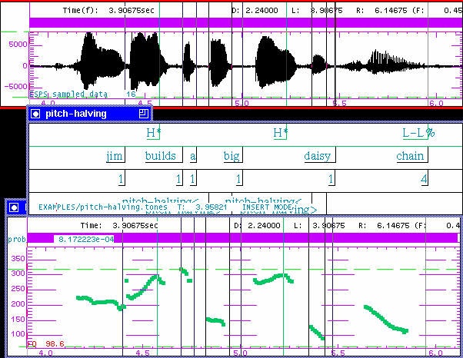
ToBI Labeling Guidelines

Slide 28
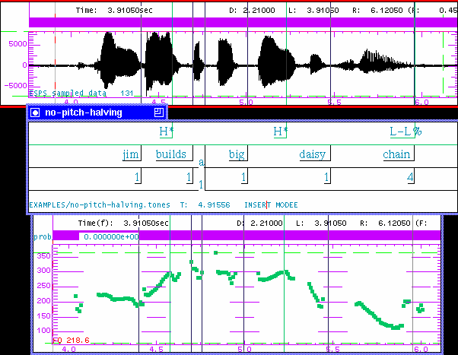

Slide 29
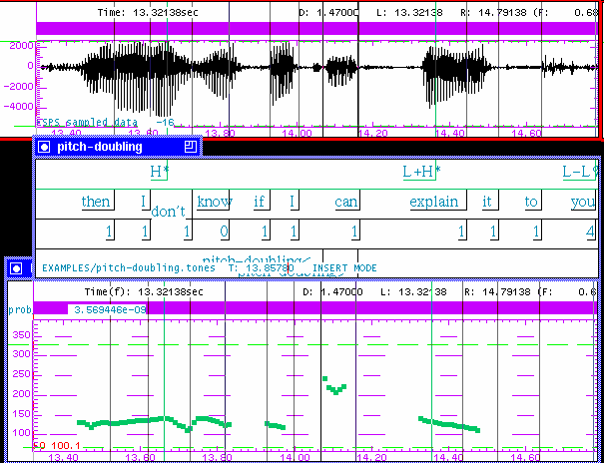

Slide 30
Next Class
Download Praat from the link on the course syllabus page
Read the Praat tutorial linked from the syllabus
Record a file of you saying “My mama lives in Memphis.”
Bring a laptop with the files and headphones to class (if you have – otherwise we’ll share)

