Slide 1
Acoustics of Speech
Julia Hirschberg and Sarah Ita Levitan
CS 6998

Slide 2
Goal 1: Distinguishing One Phoneme from Another, Automatically
ASR: Did the caller say ‘I want to fly to Newark’ or ‘I want to fly to New York’?
Forensic Linguistics: Did the accused say ‘Kill him’ or ‘Bill him’?
What evidence is there in the speech signal?
  How accurately and reliably can we extract it?

Slide 3
Goal 2: Determining How things are said is sometimes critical to understanding
Intonation
  Forensic Linguistics: ‘Kill him!’ or ‘Kill him?’
  TTS: ‘Are you leaving tomorrow./?’
  What information do we need to extract from/generate in the speech signal?
  What tools do we have to do this?

Slide 4
Today and Next Class
How do we define cues to segments and intonation?
  Fundamental frequency (pitch)
  Amplitude/energy (loudness)
  Spectral features
  Timing (pauses, rate)
  Voice Quality
How do we extract them?
  Praat
  openSMILE
  libROSA

Slide 5
Outline
Sound production
Capturing speech for analysis
Feature extraction
Spectrograms

Slide 6
Sound Production
Pressure fluctuations in the air caused by a musical instrument, a car horn, a voice…
  Sound waves propagate thru e.g. air (marbles, stone-in-lake)
  Cause eardrum (tympanum) to vibrate
  Auditory system translates into neural impulses
  Brain interprets as sound
  Plot sounds as change in air pressure over time
From a speech-centric point of view, sound not produced by the human voice is noise
  Ratio of speech-generated sound to other simultaneous sound: Signal-to-Noise ratio

Slide 7
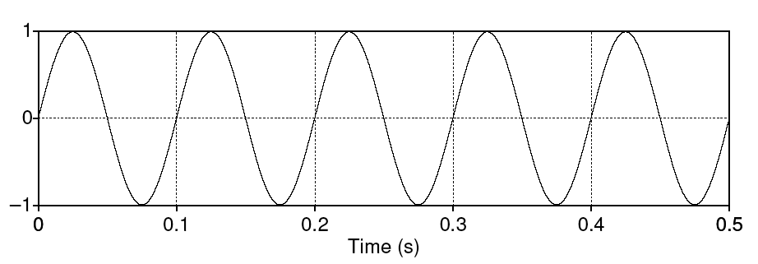
Simple periodic waves
Characterized by frequency and amplitude
Frequency (f) – cycles per second
Amplitude – maximum value in y axis
Period (T) – time it takes for one cycle to complete

Slide 8
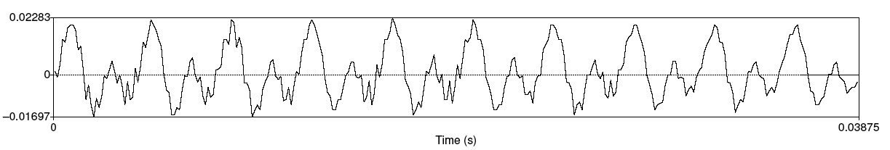
Speech sound waves
+ compression
0 normal air pressure
- rarefaction (decompression)

Slide 9
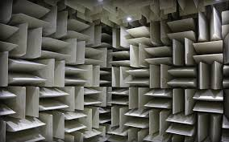
How do we capture speech for analysis?
Recording conditions
  Quiet office, sound booth, anechoic chamber

Slide 10
How do we capture speech for analysis?
Recording conditions
Microphones convert sounds into electrical current: oscillations of air pressure become oscillations of voltage in an electric circuit
  Analog devices (e.g. tape recorders) store these as a continuous signal
  Digital devices (e.g. computers, DAT) first convert continuous signals into discrete signals (digitizing)

Slide 11
Sampling
Sampling rate: how often do we need to sample?
  At least 2 samples per cycle to capture periodicity of a waveform component at a given frequency
    100 Hz waveform needs 200 samples per sec
    Nyquist frequency: highest-frequency component captured with a given sampling rate (half the sampling rate) – e.g. 8K sampling rate (telephone speech) captures frequencies up to 4K

Slide 12
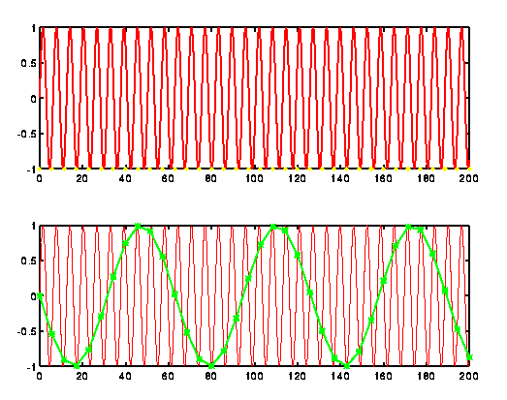
Sampling

Slide 13
Sampling/storage tradeoff
Human hearing: ~20K top frequency
  Do we really need to store 40K samples per second of speech?
Telephone speech: 300-4K Hz (8K sampling)
  But some speech sounds (e.g. fricatives, stops) have energy above 4K…
44k (CD quality audio) vs.16-22K (usually good enough to study pitch, amplitude, duration, …)
Golden Ears…

Slide 14
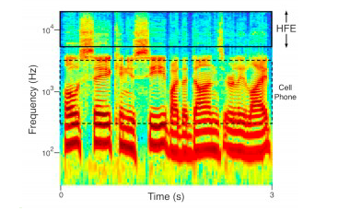
What your phone is not telling you
High frequency samples

Slide 15
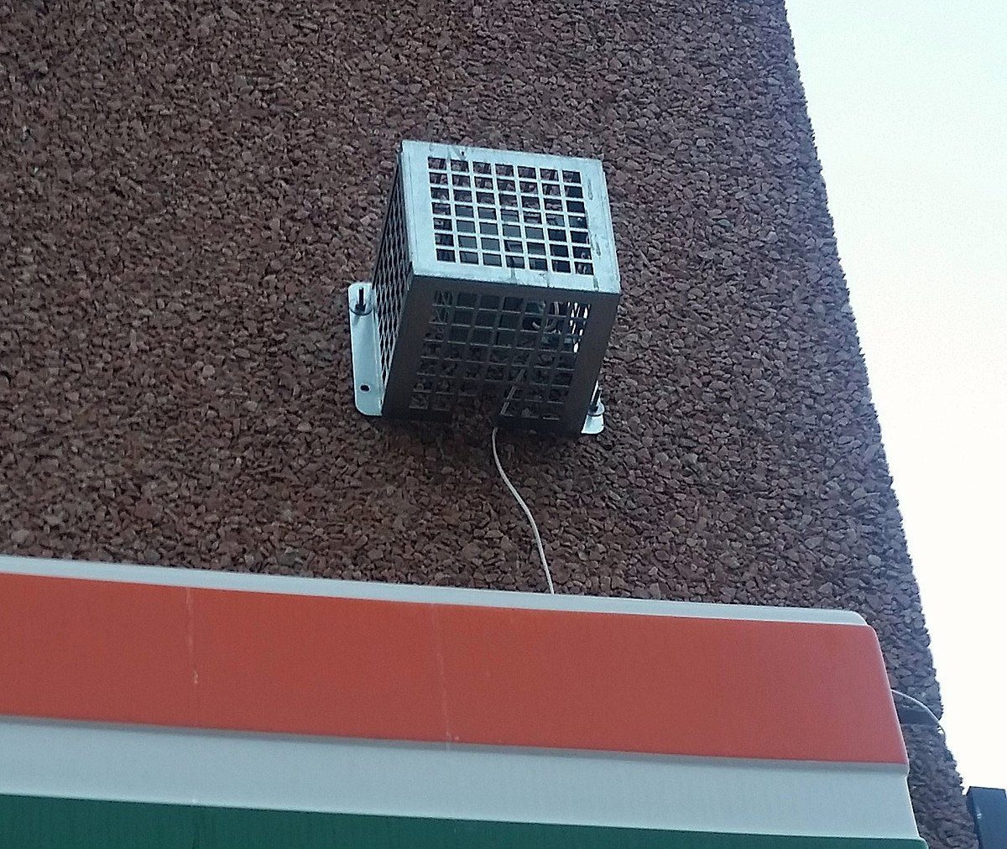
The Mosquito
Listen (at your own risk)

Slide 16
Sampling Errors
Aliasing:
  Signals frequency higher than the Nyquist frequency
  Solutions:
    Increase the sampling rate
    Filter out frequencies above half the sampling rate (anti-aliasing filter)

Slide 17
Quantization
Measuring the amplitude at sampling points: what resolution to choose?
  Integer representation
  8, 12 or 16 bits per sample
Noise due to quantization steps avoided by higher resolution -- but requires more storage
  How many different amplitude levels do we need to distinguish?
  Choice depends on data and application (44K 16bit stereo requires ~10Mb storage)

Slide 18
  But clipping occurs when input volume (i.e. amplitude of signal) is greater than range that can be represented
  Watch for this when you are recording for TTS!
  Solutions
    Increase the resolution
    Decrease the amplitude

Slide 19
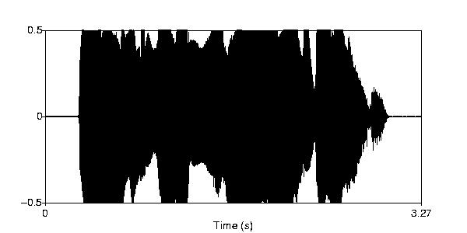

Clipping

Slide 20
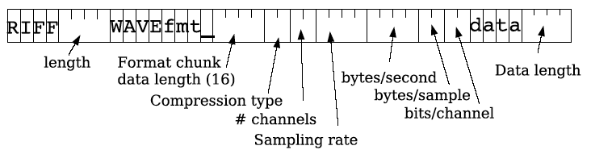
WAV format
Many formats, trade-offs in compression, quality
  Sox can be used to convert speech formats

Slide 21
Frequency
How fast are the vocal folds vibrating?
  Vocal folds vibrate for voiced sounds, causing regular peaks in amplitude
F₀ – Fundamental frequency of the waveform
Pitch track – plot F₀ over time

Slide 22
Estimating pitch
Frequency = cycles per second
Simple approach: zero crossings

Slide 23
Autocorrelation
Idea: figure out the period between successive cycles of the wave
F₀ = 1/period
Where does one cycle end and another begin?
Find the similarity between the signal and a shifted version of itself
Period is the chunk of the segment that matches best with the next chunk

Slide 24
Parameters
Window size (chunk size)
Step size
Frequency range

Slide 25
Microprosody effects of consonants (e.g. /v/)
Creaky voice → no pitch track
Errors to watch for in reading pitch tracks:
  Halving: shortest lag calculated is too long → estimated cycle too long, too few cycles per sec (underestimate pitch)
  Doubling: shortest lag too short and second half of cycle similar to first → cycle too short, too many cycles per sec (overestimate pitch)

Slide 26
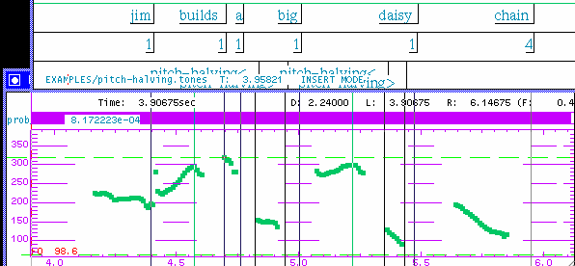

Pitch Halving
pitch is halved

Slide 27
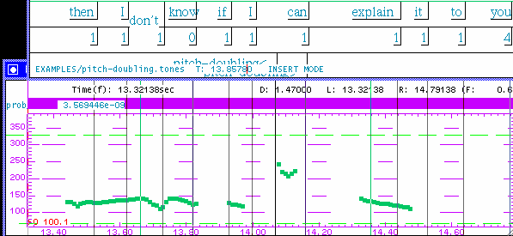
Pitch Doubling
pitch is doubled

Slide 28
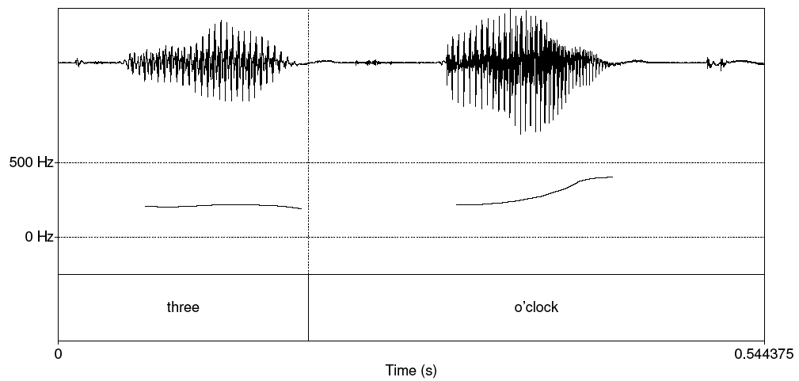
Pitch track

Slide 29
Pitch vs. F₀
Pitch is the perceptual correlate of F0
Relationship between pitch and F0 is not linear;
  human pitch perception is most accurate between 100Hz and 1000Hz.
Mel scale
  Frequency in mels = 1127 ln (1 + f/700)

Slide 30
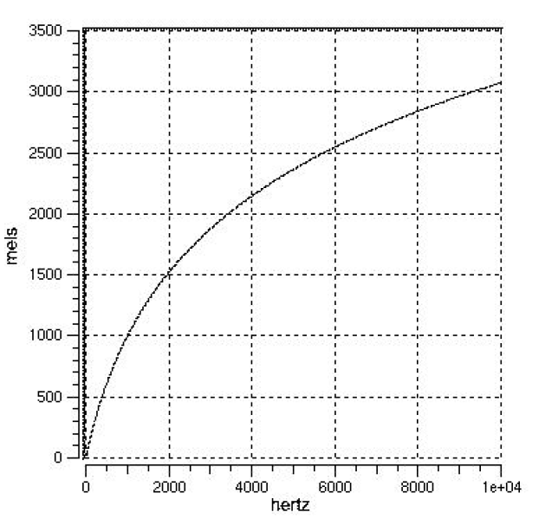
Mel-scale
Human hearing is not equally sensitive to all frequency bands
Less sensitive at higher frequencies, roughly > 1000 Hz
I.e. human perception of frequency is non-linear:

Slide 31
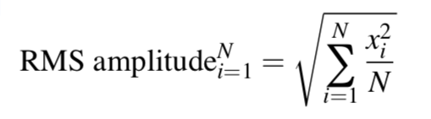
Amplitude
Maximum value on y axis of a waveform
Amount of air pressure variation: + compression, 0 normal, - rarefaction

Slide 32
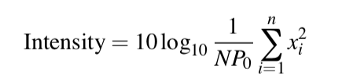

Intensity
Perceived as loudness
Measured in decibels (dB)
P₀ = auditory threshold pressure =

Slide 33
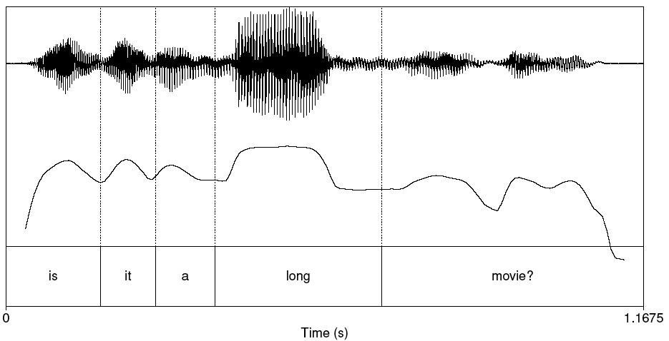
Plot of Intensity

Slide 34
How ‘Loud’ are Common Sounds – How Much Pressure Generated?
Event Pressure (Pa) Db
Absolute 20 0
Whisper 200 20
Quiet office 2K 40
Conversation 20K 60
Bus 200K 80
Subway 2M 100
Thunder 20M 120
*DAMAGE* 200M 140
Notes:
Pa = Pascal
Db = Decibel

Slide 35
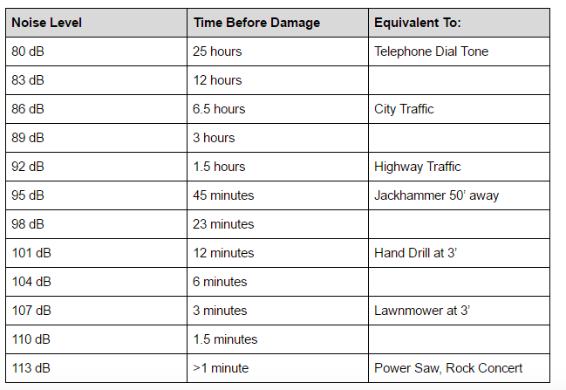

Slide 36
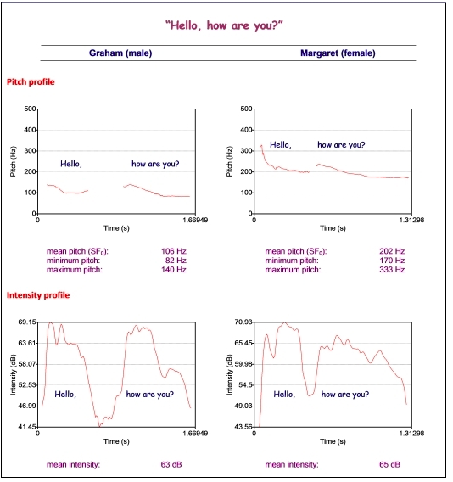

Slide 37
Voice quality
Jitter
Shimmer
HNR

Slide 38
Voice quality
Jitter
  random cycle-to-cycle variability in F₀
  Pitch perturbation
Shimmer
  random cycle-to-cycle variability in amplitude
  Amplitude perturbation

Slide 39
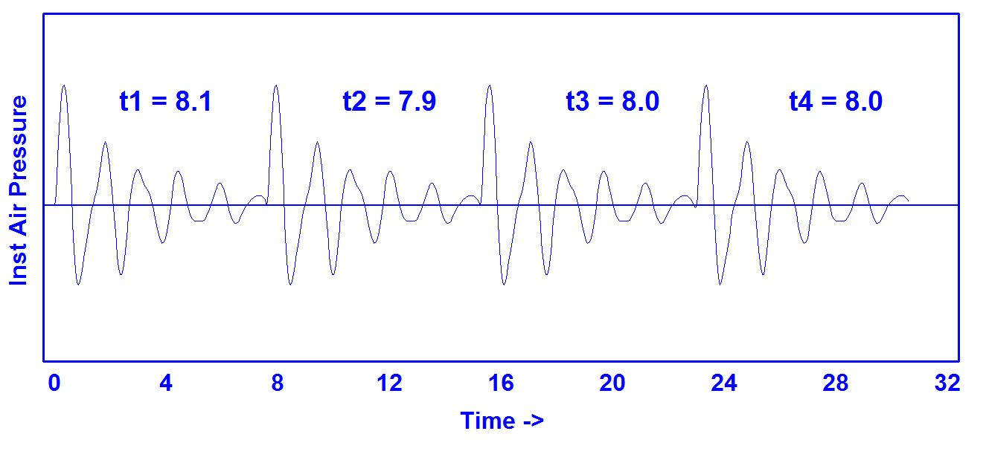
Jitter
https://homepages.wmich.edu/~hillenbr/501.html

Slide 40
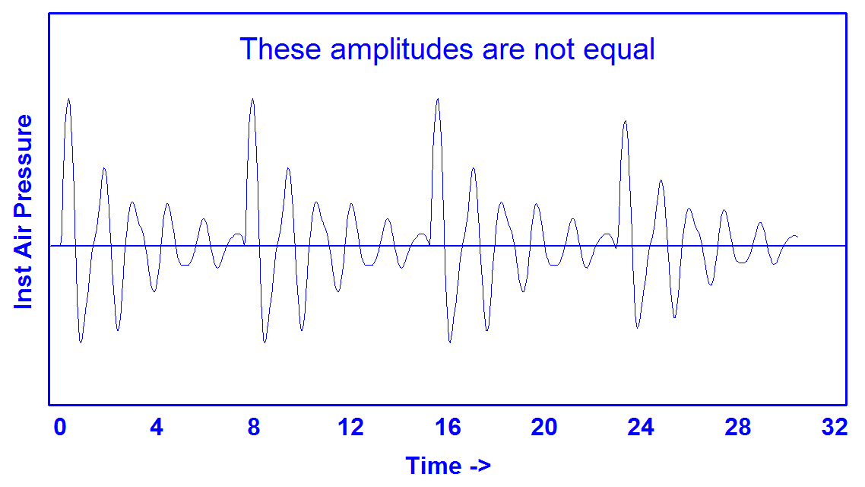
Shimmer
https://homepages.wmich.edu/~hillenbr/501.html

Slide 41
Synthetic Continuum Varying in Jitter
0.0% 2.0%
0.2% 2.5%
0.4% 3.0%
0.6% 4.0%
0.8% 5.0%
1.0% 6.0%
1.5%
https://homepages.wmich.edu/~hillenbr/501.html

Slide 42
Synthetic Continuum Varying in Shimmer
0.00 dB 1.60 dB
0.20 dB 1.80 dB
0.40 dB 2.00 dB
0.60 dB 2.25 dB
0.80 dB 2.50 dB
1.00 dB 2.75 dB
1.20 dB 3.00 dB
1.40 dB
https://homepages.wmich.edu/~hillenbr/501.html

Slide 43
HNR
Harmonics to Noise Ratio
  Ratio between periodic and aperiodic components of a voiced speech segment
Periodic: vocal fold vibration
Non-periodic: glottal noise
Lower HNR -> more noise in signal, perceived as hoarseness, breathiness, roughness

Slide 44
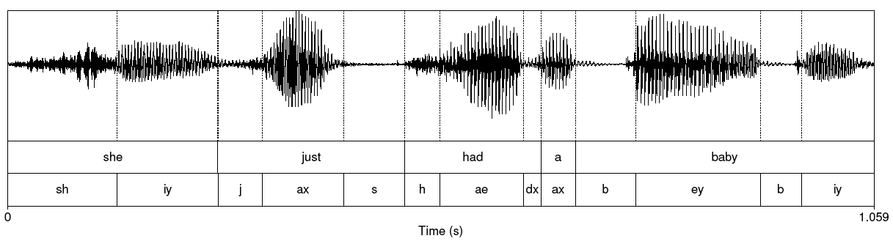
Reading waveforms

Slide 45
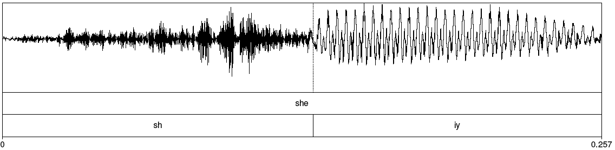
Fricative

Slide 46
Spectrum
Representation of the different frequency components of a wave
  Computed by a Fourier transform
  Linear Predictive Coding (LPC) spectrum – smoothed version

Slide 47
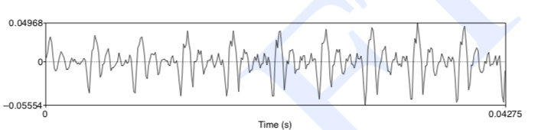
Part of [ae] waveform from “had”
Complex wave repeated 10 times (~234 Hz)
Smaller waves repeated 4 times per large (~936 Hz)
Two tiny waves on the peak of 936 Hz waves (~1872 Hz)

Slide 48
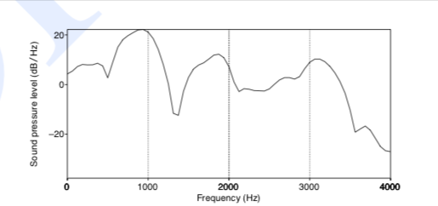
Spectrum
Represents frequency components
Computed by Fourier transform
Peaks at 930 Hz, 1860 Hz, and 3020 Hz

Slide 49
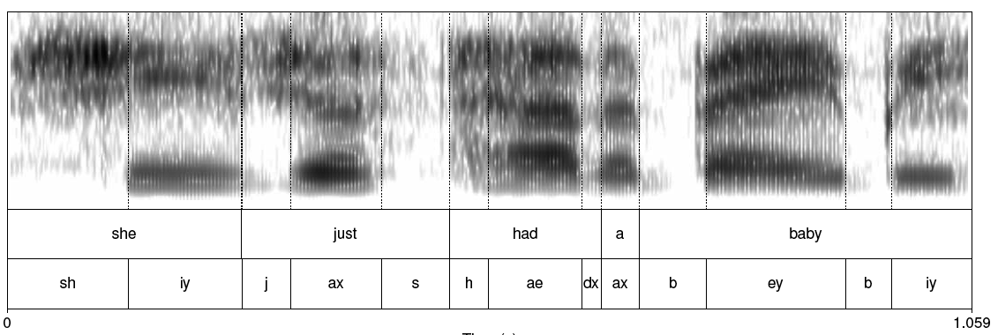
Spectrogram

Slide 50
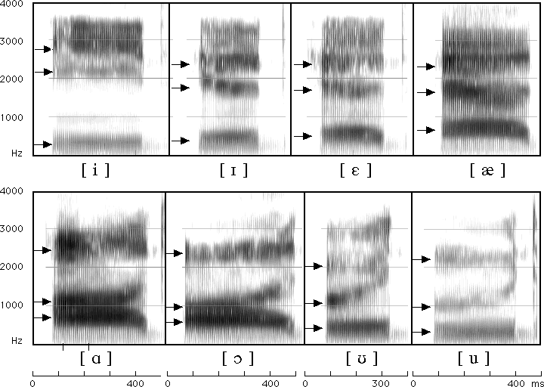
Spectrogram

Slide 51
Source-filter model
Why do different vowels have different spectral signatures?
  Source = glottis
  Filter = vocal tract
When we produce vowels, we change the shape of the vocal tract cavity by placing articulators in particular positions

Slide 52
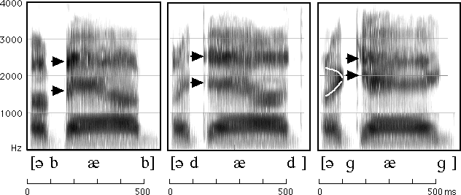
Reading spectrograms

Slide 53
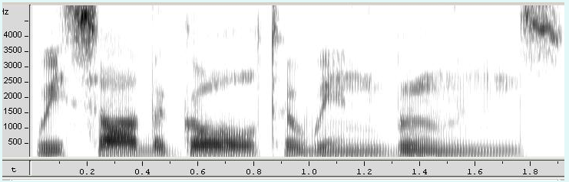
Mystery Spectrogram

Slide 54
MFCC
Sounds that we generate are filtered by the shape of the vocal tract (tongue, teeth etc.)
If we can determine the shape, we can identify the phoneme being produced
Mel Frequency Cepstral Coefficients are widely used features in speech recognition

Slide 55
MFCC calculation
Frame the signal into short frames
Take the Fourier transform of the signal
Apply mel filterbank to power spectra, sum energy in each filter
Take the log of all filterbank energies
Take the DCT of the log filterbank energies
Keep DCT coefficients 2-13

Slide 56
Next class
Download Praat from the link on the course syllabus page
Read the Praat tutorial linked from the syllabus
Bring a laptop and headphones to class

