Slide 1





Computational Models of Modeling Sarcasm in Text
Smaranda Muresan
smara@columbia.edu
Joint work with: Debanjan Ghosh, Alexander Fabrri, Elena Musi, Weiwei-Guo

Slide 2

Understanding People’s Attitudes
(sentiment, beliefs)
News Item
Discussion Forum
User1: A shooting in Oakland? That NEVER happens.
User2: Shootings happen in Oakland all the time and it had nothing to do with the Occupy movement. […]
User3: This shooting does have something to do with the Occupy movement because many of the witnesses are the Occupiers and it happened only a few yards away from the encampment.
Very sad news, regardless of if this young man was w/ #OO or not URL… via @sfgate
Oh yay. Another shooting #sarcasm
Missed Sarcasm will lead to erroneous belief and sentiment detection

Slide 3
Verbal Irony/Sarcasm
Figurative language
Verbal Irony: the use of words to express something other than and especially the opposite of the literal meaning (Mirriam-Webster dictionary)
Sarcasm: the use of words that mean the opposite of what you really want to say especially in order to insult someone, to show irritation, or to be funny” (Mirriam-Webster dictionary)
The market index is falling greatly. What a happy Christmas #sarcasm
Sarcastic
Literal
happy christmas eve ... new haircut ready for new year !!! #christmaseve #enjoy

Slide 4


Verbal Irony/Sarcasm
2. Characteristics:
Irony Markers: “A shooting in Oakland? That NEVER happens”
- typographics, punctuation, hyperbole, interjection
Irony Factors: Incongruence
The market index is falling greatly. What a happy Christmas #sarcasm
prior turn
Plane window shades are open so that people can see fire
@ one more reason to feel really great about flying #sarcasm
current turn

Slide 5
Sarcasm as Figurative Language
Reframed the problem as a word-sense disambiguation problem: Literal vs Sarcastic Sense
The market index is falling greatly. What a happy Christmas #sarcasm
Sarcastic
Literal
happy christmas eve ... new haircut ready for new year !!! #christmaseve #enjoy
(Ghosh, Guo and Muresan, 2015) - EMNLP 2015
3rd prize awarded at the NYC Media Lab Annual Summit, 2015

Slide 6
Key issues that needed to be addressed
  How to collect a set of target words that can have either literal or sarcastic meaning, depending on context?
  Given an utterance and a target word, how to detect whether the target word is used in the literal or the sarcastic sense?

Slide 7

1. Crowdsourcing Experiments
I'm so happy I'm going back to the emergency
room
AMT
SM
IM1: I don't like that I have to go to the emergency room again.
IM2: I'm so unhappy that I am going back to the emergency room.
IM3: I am so upset that I have to return to the emergency room.
IM4: …
IM5: ….
  Use the SM – IM dataset as parallel corpus to identify Semantically Opposite (SO) words (happy <-> upset, …) via monolingual alignment (Barzilay&MkKeown, 2001)
  Use the semantically opposite pairs to extract target words (`happy’, `love’, `yeah’)
Notes:
.

Slide 8
Target and Data Collection
We extracted 70 targets via alignment
Using Twitter APIs we collected training data for each targets
  Sarcastic (#sarcasm, #sarcastic)
  Literal (labeled with sentiment hashtags: e.g., #enjoy, #sad)
Size of training data varies per target word from 427 (`mature’) to 26,802 (`love’)
The market index is falling greatly. What a happy Christmas #sarcasm
happy christmas eve ... new haircut ready for new year !!! #christmaseve #enjoy

Slide 9
Targets and # of Instances per Sense
love(26802), like(14995), great(14495), good(11624), really(9825), right(6771), fun(6603), best(6182), better(5960), glad(5748), yeah(5504), nice(4443), awesome(4196), excited(4027), always(3807), happy(3098), cool(2705), amazing(1952), favorite(1883), perfect(1792), wonderful(1749), wonder(1476), lovely(1424), super(1390), fantastic(1369), joy(1176), cute(1007), beautiful(981), sweet(800), hot(729), proud(703), shocked(645), interested(624), brilliant(576), genius(481), attractive(449), mature(427)
Consider only target with at least 400 trainingg instances
Train-Test split: 80%(Training), 10% (Dev.) and 10% (Test)

Slide 10
Classification Approach
For each target, separate training/testing is done using Support Vector Machines (SVM).
Baseline (BL_SVM):
SVM with Lexical features (unigrams, sentiment lexicons such as LIWC, as well as sarcasm markers such as interjections, All Caps, emoticons).
New Approach:
- SVM with a new kernel using Word Embeddings
  - Alignment to find similarity between two short texts

Slide 11
Details on Word Embedding
Approaches
  Weighted Textual Matrix Factorization (WTMF) [Guo and Diab, 2012]
  GloVe [Pennigton et al., 2014]
  Word2Vec [Mikolov et al., 2013]
    Skip-gram
    CBOW
Use 2.5 Million tweets to build each model
Context window of ± 10 words
100-d vector for each word

Slide 12
Results
Various word embedding models
For some targets (`brilliant’, `mature’, `joy’) the accuracy is higher than other targets (`genius’, `sweet’).
Unlike the Lexical baseline, word embeddings can achieve high accuracy for small training data.

Slide 13
Sarcasm
Modeling Conversation Context
2. Characteristics:
Irony Factors: Incongruence
prior turn
Plane window shades are open so that people can see fire
current turn
@ one more reason to feel really great about flying #sarcasm
(Ghosh, Fabrri and Muresan, 2017;2018)
best paper award at SIGDIAL 2017

Slide 14
Sarcasm Analysis
The vast majority of research on sarcasm/verbal irony detection relies on the content of an utterance in isolation
  Incongruity between positive sentiment and negative situation [Riloff et al. 2013]
  sarcasm as a word sense disambiguation problem [Ghosh, Guo, Muresan; 2015]
  Cognitive features for sarcasm [Mishra et al. 2016]
The market index is falling greatly. What a happy Christmas #sarcasm
Sarcastic
Literal
happy christmas eve ... new haircut ready for new year !!! #christmaseve #enjoy

Slide 15
Sarcasm Analysis
The speaker’s intent is often unclear without additional context:
  conversation context [Bamman and Smith 2015;Oraby et al. 2017]
  Multimodal [Schifanella et al. 2016]
  author’s context [Rajadesingan et al.2015, Khattri et al. 2015, Moreira et al. 2016]
  background knowledge

Slide 16
Modeling Conversation Context
[Ghosh, Fabrri, Muresan 2017; 2018]
Data
RQ1: can conversation context help in sarcasm detection
RQ2: can we identify what part of the context triggers the sarcastic reply?

Slide 17
Twitter
prior turn
Plane window shades are open so that people can see fire
current turn
@ one more reason to feel really great about flying #sarcasm

Slide 18

Discussion Forum
It is entirely premature to be discussing this matter for the purpose of promoting political positions and beliefs. It is also disrespectful to those that died and their families to try and capitalize on their pain for a political agenda. No relevant details have been discovered or released yet meaning all that can be had is pure speculation and hyperbole. The simple fact that authorities were able to apprehend the individual before he could commit suicide places us as a whole in a unique situation.
prior turn
the law abiding responsible gun owner who gunned them down did so respectfully, right? You
current turn

Slide 19
Discussion Forum
his early life, X had a reputation for drinking too much. Whether or not this affected his thinking is a question which should to be considered when asking questions about mormon theology ….. emoticonXBanghead.
prior turn
Wow, that must be some good stuff he was drinking to keep him 'under the influence' for THAT long!! :p
current turn
Perhaps he was stoned on other drugs like the early writers of the bible.
succeeding turn

Slide 20
Data and Annotations
Twitter Corpus
  ``reply_to(@user)’’ to detect reply; collect the full thread
  Self-labeled corpus (provided by the author using hashtags)
    S: #sarcasm, #sarcastic
    NS: #love, #hate, … [González-Ibáñez et al. 2011]
  25K instances (12K S/13K NS; 30% with > 1 context utterance)
Context (prior turn(s))
…
Current turn (S or NS)

Slide 21
Data and Annotations
  IAC_{v2} ([Oraby et al, 2016], Discussion forum)
  Released version from Sarcasm Corpus V2 part of the Internet Argument Corpus
  Annotated by crowdsourcing at comment level: perceived sarcasm!
  4950 Instances
    Balanced between S/NS
    Comments between 3-7 sentences long
    3 types of sarcasm: General, Rhetorical Question, Hyperbole
……………………………….
Prior turn
………………………...
Current turn (S or NS)

Slide 22
Data and Annotations
  IAC⁺_{v2} (Discussion forum)
  Built a subset that includes also succeeding turns
  2900 Instances
    Balanced between S/NS
    Comments between 3-7 sentences long
    3 types of sarcasm: General, Rhetorical Question, Hyperbole
……………………………….
Prior turn
………………………...
Current turn (S or NS)
……………………………….
Succeeding turn

Slide 23
Data and Annotations
  Reddit Corpus ([Khodak et al. 2017], Discussion forum)
  Self-labeled corpus, annotated at comment level (``\s marker added by speaker)
  Collected a subset of 50K instances
    Balanced between S/NS
    Comments between 3-7 sentences long
……………………………….
Prior turn
………………………...
Current turn (S or NS)

Slide 24
Modeling Conversation Context
Data
RQ1: can conversation context help in sarcasm detection
RQ2: can we identify what part of the context triggers the sarcastic reply?

Slide 25
Computational Models
Baseline (SVM with discrete features)
  ngrams
  Sentiment and pragmatic features
    Linguistic Inquiry and Word Count (LIWC) lexicon
    MPQA Subjectivity lexicon
    Change of sentiment [Joshi et al. 2015]
  Sarcasm Markers [Burgers et al. 2012]
    Morpho-syntactic
      (interjections: ``yeah’’; ``uh’’), Tag questions (``is nt it?”), Exclamations
    Typographic
      Capitalization (``NEVER’’), quotation marks, emoticons
    Tropes
      Intensifiers (``greatest’’, ``best’’…)

Slide 26
Computational Models
Long Short-Term Memory (LSTM) Networks [Hochreiter & Schmidhuber 1997]
  Type of RNN; able to learn long-distant dependencies
  one LSTM reads the context and another LSTM reads the response
Attention-based LSTM Networks
  Word and sentence level attention (hierarchical model; Yang et al. 2016)
  Only sentence level (avg. word embeddings)

Slide 27
Final Vector Rep.
Attention
Hidden layers
Sentence Embedding
Fig. inspired by Yang et al. 2016

Slide 28
Computational Models
Long Short-Term Memory (LSTM) Networks [Hochreiter & Schmidhuber 1997]
  Type of RNN; able to learn long-distant dependencies
  one LSTM reads the context and another LSTM reads the response
Attention-based LSTM Networks
  Word and sentence level attention (hierarchical model; Yang et al. 2016)
  Only sentence level (avg. word embeddings)
Conditional LSTM
  introduced for textual entailment [Rocktäschel et al. 2015]
  The LSTM that reads the response is conditioned on the representation that the first LSTM built for the context
Notes:
\

Slide 29
Word embedding
  Discussion forum: Google’s pre-trained Word2Vec model
  Twitter: model trained on tweets [Ghosh et al. 2015]
Data Split: 80/10/10
    Dev data is used for parameter tuning

Slide 30
Results: Prior Turn
Model | Twitter F1 | IAC_{v2} F1 | Reddit F1
SVM^{ct} | 66.5 | 65.8 | 72.54
SVM^{ct+pt} | 67.9 | 63.1 | 67.00
LSTM^{ct} | 67.2 | 67.5 | 68.5
LSTM^{ct+pt} | 68.0 | 69.9 | 74.22
LSTM^{conditional} | 74.5 | 71.8 | 73.03
LSTM_{a}^{ct} | 73.4 | 69.8 | 74.68
LSTM_{a}^{ct+pt} | 75.1 | 71.3 | 75.42
Notes:
Stat significant

Slide 31
Results: Prior Turn
Model | Twitter F1 | IAC_{v2} F1 | Reddit F1
SVM^{ct} | 66.5 | 65.8 | 72.54
SVM^{ct+pt} | 67.9 | 63.1 | 67.00
LSTM^{ct} | 67.2 | 67.5 | 68.5
LSTM^{ct+pt} | 68.0 | 69.9 | 74.22
LSTM^{conditional} | 74.5 | 71.8 | 73.03
LSTM_{a}^{ct} | 73.4 | 69.8 | 74.68
LSTM_{a}^{ct+pt} | 75.1 | 71.3 | 75.42
Notes:
Stat significant

Slide 32
Results: Prior Turn
Model | Twitter F1 | IAC_{v2} F1 | Reddit F1
SVM^{ct} | 66.5 | 65.8 | 72.54
SVM^{ct+pt} | 67.9 | 63.1 | 67.00
LSTM^{ct} | 67.2 | 67.5 | 68.5
LSTM^{ct+pt} | 68.0 | 69.9 | 74.22
LSTM^{conditional} | 74.5 | 71.8 | 73.03
LSTM_{a}^{ct} | 73.4 | 69.8 | 74.68
LSTM_{a}^{ct+pt} | 75.1 | 71.3 | 75.42
Twitter: using only immediate prior turn: LSMT_{a}^{ct+pt_last}: 73.71
Notes:
Stat significant

Slide 33
Results: Cross-corpora training
Reddit data is self labeled and is larger
Train on Reddit and Test on IAC_{v2}
Model | F1
LSTM_{a}^{ct} | 65.11
LSTM_{a}^{ct+pt} | 63.23

Slide 34
Results: Cross-corpora training
Reddit data is self labeled and is larger
Train on Reddit and Test on IAC_{v2}
Model | F1
LSTM_{a}^{ct} | 65.11
LSTM_{a}^{ct+pt} | 63.23
Possible issues:
- self-labeled vs. crowdsourced labeled
- topics

Slide 35
Results: Prior + Succeeding Turn
Model | IAC⁺_{v2} (F1)
SVM^{ct} | 77.89
SVM^{ct+pt} | 76.43
SVM^{ct+st} | 68.83
SVM^{ct+ps+st} | 72.77
LSTM^{ct} | 79.25
LSTM^{ct+pt} | 83.32
LSTM^{ct+st} | 82.60
LSTM^{ct+pt+st} | 83.33
LSTM_{a}^{ct} | 80.05
LSTM_{a}^{ct+pt} | 81.52
LSTM_{a}^{ct+st} | 80.67
LSTM_{a}^{ct+pt+st} | 81.08

Slide 36
Results: Prior + Succeeding Turn
Model | IAC⁺_{v2} (F1)
SVM^{ct} | 77.89
SVM^{ct+pt} | 76.43
SVM^{ct+st} | 68.83
SVM^{ct+ps+st} | 72.77
LSTM^{ct} | 79.25
LSTM^{ct+pt} | 83.32
LSTM^{ct+st} | 82.60
LSTM^{ct+pt+st} | 83.33
LSTM_{a}^{ct} | 80.05
LSTM_{a}^{ct+pt} | 81.52
LSTM_{a}^{ct+st} | 80.67
LSTM_{a}^{ct+pt+st} | 81.08
Even if dataset is smaller the results are higher….
Possible answer: IAC⁺_{v2} contains mostly Generic type of Sarcasm (95%) while IAC_{v2} contains an equal distribution of Generic, Rhetorical Questions and Hyperbole
Notes:
Stat significant

Slide 37
Results: Prior + Succeeding Turn
Model | IAC⁺_{v2} (F1)
SVM^{ct} | 77.89
SVM^{ct+pt} | 76.43
SVM^{ct+st} | 68.83
SVM^{ct+ps+st} | 72.77
LSTM^{ct} | 79.25
LSTM^{ct+pt} | 83.32
LSTM^{ct+st} | 82.60
LSTM^{ct+pt+st} | 83.33
LSTM_{a}^{ct} | 80.05
LSTM_{a}^{ct+pt} | 81.52
LSTM_{a}^{ct+st} | 80.67
LSTM_{a}^{ct+pt+st} | 81.08
Even if dataset is smaller the results are higher….
Possible answer: IAC⁺_{v2} contains mostly Generic type of Sarcasm (95%) while IAC_{v2} contains an equal distribution of Generic, Rhetorical Questions and Hyperbole
Notes:
Stat significant

Slide 38
Error analysis findings
Can capture cases of context incongruity
Misses:
  Use of contextual information outside the text (shared common ground)
  Sarcastic turns with more than 5 sentences
  User of profanity and slang
  Use of rhetorical questions

Slide 39
Modeling Conversation Context
Data
RQ1: can conversation context help in sarcasm detection
RQ2: can we identify what part of the context triggers the sarcastic reply?

Slide 40
Crowdsourcing Experiment
  Given a context and sarcastic reply identify one or more sentences from the context that you think triggered the sarcastic reply
  Use IAC_{v2} data
    85 HITs ( context length between 3-7 sentences)
  Ratings were compared to attention weights (41% matches for the top-ranked sentence)
LHS: attention weights; RHS: Turkers’ selections
40

Slide 41
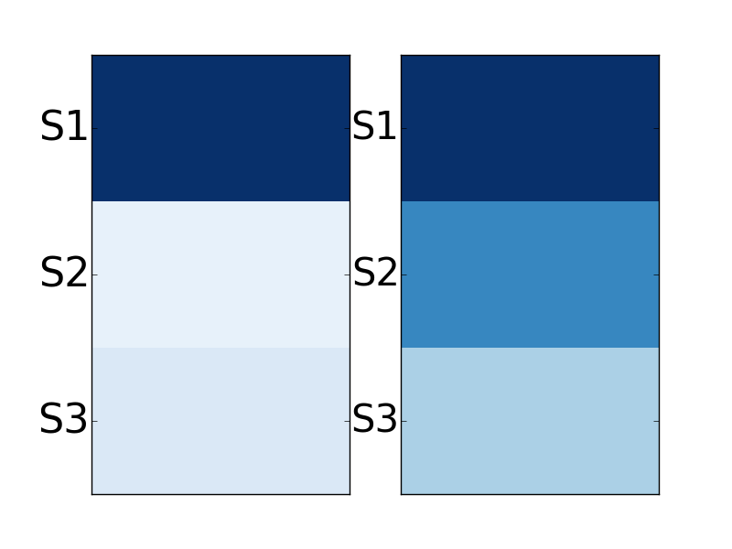
S1. how do we rationally explain these creatures existence so recently in our human history if they were extinct for millions of years?
S2. and if they were the imaginings of bronze age sheep herders as your atheists/evolutionists would have you believe, then how did these ignorant people describe creatures we can now recognize from fossil evidence?
S3. and while your at it, ask yourself if it's reasonable that the bones of dead creatures have survived from 60 million years to some estimated to be more than 200 million years without becoming dust?
LHS: attention weights
RHS: Turkers’ selection
how about this explanation - you're reading waaaaay too much into your precious bible

Slide 42
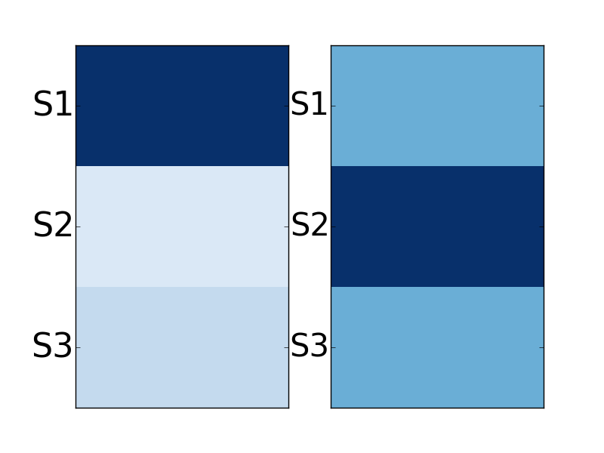
S1. you disguting sickening woman!
S2. how can you tell a man that about his mum??!!!
S3. evil twisted filthy...
you think im evil , how would your mum have felt reading half the %$#%# that comes out of your mouth. oh and i love you.
42

Slide 43
Crowdsourcing 2
Given a pair of sarcastic turn and its previous post
  Indicate what sentence inside the sarcastic turn expresses sarcasm
  Identify what triggered that sarcastic sentence
60 examples from IAC_{v2} and 100 from Reddit
  Ratings were compared to attention weights
    For task 2:
      51% matches the top-ranked sentence for IAC_{v2} data
      30% matches the top-ranked sentence for Reddit data
    For task 1:
      ~25% matches for both IAC and Reddit

Slide 44
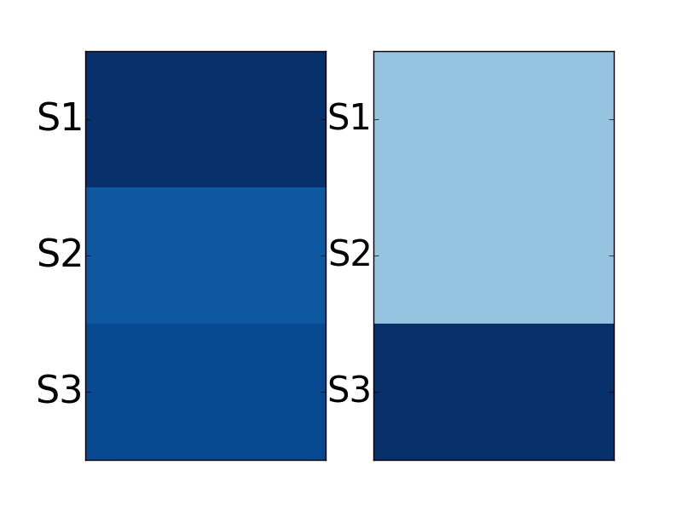
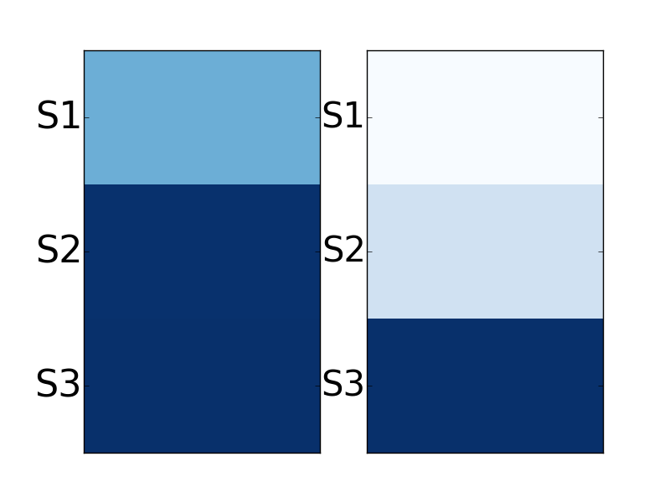
S1. nothing will happen, this is going to die a quiet death like 99.99 \% of other private member motions.
S2. this whole thing is being made into a big ordeal by those that either don't know how our parliament works, or are trying to push an agenda.
S3. feel free to let your mp know how you feel though but i doubt this motion gets more than a few minutes of discussion before it is send to the trashcan.
S1. the usual ``nothing to see here'' response.
S2. whew!
S3. we can sleep at night and ignore this.

Slide 45
Other remarks
Sarcasm markers
  Explicit indicators of sarcasm
  Attention put more weights to markers, such as emoticons (``:p’’) and interjections (``yeah’’, ``hmm’’)
However,
  interpretations based on attentions weights have to be taken with care, classification task is not forced to solely rely on the attentions weights [Rocktäschel et al. 2015]

Slide 46
Conclusion
Conversation context helps, particularly prior context
Preliminary study to understand what part of the prior turn triggers the sarcastic reply
Results might differ depending on corpora
  Twitter vs. Discussion Forums
  Self-labeled vs. Crowdsourcing labeled
  Topics could have an influence
  Size of data

Slide 47
Current/Future Work
Investigate more closely the self-labeled vs. crowdlabeled data
Look at unbalanced datasets (old experiments in twitter data show similar results to balanced conditions) and also the topic of conversation
Consider the entire thread of discussion as context
Look at the role of sarcasm in the unfolding conversation (e.g., agreement/disagreement space; shift in topics, etc)
Use other type of context
  Multimedia (speech & videos)
  Social network (social relations)
  World knowledge

Slide 48
Thank you!

Slide 49
Sarcasm in Spoken Language
Julia Hirschberg and Sarah Ita Levitan
CS6998 2019

Slide 50
Sarcasm in Spoken Language
Is sarcasm detection easier in text or in speech?
In speech there are additional cues
  Prosody
  Timing
  Laughter
But do people compensate in text with more cues?
  Hashtags
  Emojis
  More explicit language

Slide 51
Spoken Sarcasm Corpora
Acted
  Movies
  TV shows
Natural speech: dialogues between strangers
  Switchboard
  Fisher
Similar issues with acted vs. natural emotion corpora: more exaggeration?
Notes:
Same debate as with emotion – acted vs. natural speech
Rakov & Rosenberg argue that TV show is sort of “natural” – do you agree?
Problem with natural – between strangers

Slide 52
Definition
“Speech bearing a semantic interpretation exactly opposite to its literal meaning…[with] no intent to deceive on the speaker’s part”
  Importantly: We are not trying to detect deception ☺
Sarcasm as verbal irony violates a Gricean Maxim of Cooperative Conversation
  “Do not say what you believe to be false”
  But it occurs often in conversation
Very important for spoken dialogue systems and any attempt to transcribe and interpret speech
Notes:
What other cases can you think of in which it would be important to recognize sarcasm in speech: poitical debates?

Slide 53
Yeah right: Sarcasm Recognition for Spoken Dialogue Systems (Tepperman, Traum, & Narayanan (2006))
Goal: Discover reliable cues to sarcasm
Corpora: 131 “yeah right” occurrences in 2 corpora of strangers speaking on assigned topics
  Switchboard, Fisher
  Selected data with and without surrounding context
4 types of cues examined
  Contextual
  Objective
  Prosodic
  Spectral
Notes:
Both corpora collected to elicit data for ASR training

Slide 54
Contextual Cues
Contextual: annotated four kinds of ‘yeah right’ speech acts
  Acknowledgement (sincere): (perhaps a back channel)
    A: that’s right near Piedmont
    B: Yeah right, right…
  Agreement/Disagreement: not used to ground understanding
    A: a thorn in my side: bureaucratics
    B: yeah right, I agree
Notes:
Second could be sarcastic if said in disagreement of course

Slide 55
Indirect Interpretation: anecdotal; not directed at interlocutor
  “…We have too many pets!” I thought, “Yeah right, come tell me about it…”
Phrase internal: When ‘yeah right’ is not functioning as a unit
  A: Park Plaza, Park Suites?
  B: Park Suites, yeah right across the street…

Slide 56
Objective Cues
Was there laughter?
Was it a response to a question?
Where did it occur in a speaker’s turn – beginning or end? Was it an entire turn?
Were there surrounding pauses?
Gender: Men use sarcasm more?

Slide 57
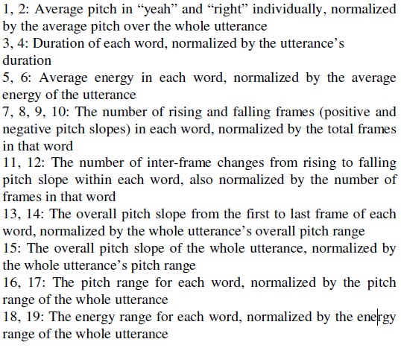
Prosodic Cues
Pitch mean, range, F0 slope
Word duration
Energy

Slide 58
Spectral Features
Mel-frequency cepstrum coefficients- Short term power spectrum of a sound
  Used the first 12 MFCCs and their delta and acceleration coefficients
Used to train Hidden Markov Models which were utilized for sarcasm detection

Slide 59
Methods
Collected 2 versions of “yeah rights”, one with and one without surrounding context
  Hand coded version without context to serve as a human baseline (low agreement)
  Hand annotated the version with context (fair agreement)
Trained the Weka C4.5 decision trees using leave-one-out cross-validation
Compared classification results to human performance on “without context” data

Slide 60
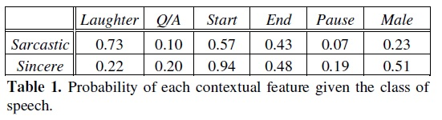
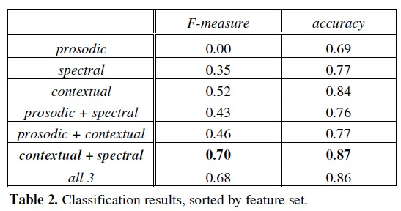
Results

Slide 61
Conclusions
Using contextual and spectral features provides best accuracy and F1
  Prosodic cues alone are not useful
  Prosodic cues do not improve
Laughter and pauses seemed to be good cues for sarcasm
Initial position seemed to be a good cue for sincerity
Gender was not a good cue

Slide 62
Problems and Possibilities
What problems do you see in this work?
  Small dataset
  Requested conversation between strangers
  Prosodic cues alone are not useful
What might they do to improve?
What uses could successful identification of sarcasm provide?
  Train computer-human dialogue systems to recognize sarcasm? To respond to it?? To generate it??

Slide 63
Do you Agree?
“As for handling the sarcasm once it’s detected, a dialogue agent ought to do what real humans do and acknowledge it. Either generate some synthetic laughter or, for more advanced agents, somehow point out that it “ gets” the joke.”
Notes:
What do you do with sarcasm classifier?
Do you agree/disagree with this?
Future work: go beyond “yeah right”, more data…
Rakov and Rosenberg build directly on this paper

Slide 64
“Sure, I did the Right Thing”: A System for Sarcasm Detection in Speech (Rakov and Rosenberg, 2013)
Use a new acted speech corpus annotated for sarcastic vs. sincere speech
Daria Sarcasm Corpus
  Created from Daria, an animated television show that ran on MTV from 1997-2001
  Acted speech but should ‘lead to a more natural expression of sarcasm than traditional acted speech.’
  75 sarcastic sentences and 75 sincere sentences plus context
Notes:
Differences: acted speech, good results even without context
Where "acted speech" implies that a speaker read an utterance with a prescribed emotion, the pragmatic and paralinguistic content of the Daria material is dictated by the character's state and narrative context. We believe this should lead to a more natural expression of sarcasm than traditional "acted speech.” Additionally, since the television show uses a stylized animation style, it is difficult to determine sarcasm from facial expression alone. We predicted that this would result in even more exaggerated acted speech than a live-action sitcom could have yielded. Furthermore, as a scripted sitcom, Daria leans heavily on sarcasm as a comedic device. This causes the source material to be rich in examples that can be used for investigation
Question: included non-native speakers for perception studies (3 years of English) – is that a problem?

Slide 65
Perceptions of Sarcastic Speech Survey
165 speakers listen to the 150 sentences and label them as sarcastic or sincere (forced-choice)
  Anything labled as sarcastic with 30% agreement or less was labeled as sincere
  Anything labeled as sarcastic with 72% agreement or higher was labeled as sarcastic
  Only 112 sentences effectively labeled

Slide 66
Features
Baseline acoustic features:
  Mean pitch
  Pitch range
  Standard deviation of pitch
  Mean intensity
  Intensity range
  Speaking rate
Sequences of pitch and intensity contours over words in utterances were modeled using k-means clustering and used as additional features

Slide 67
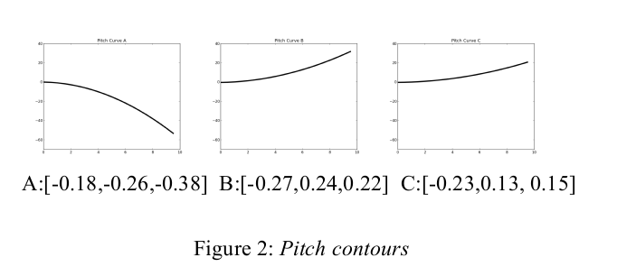
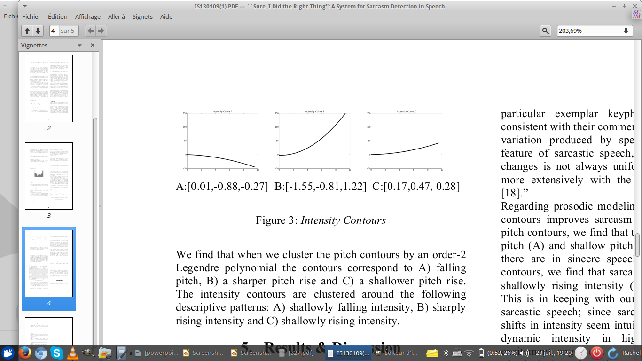

Slide 68
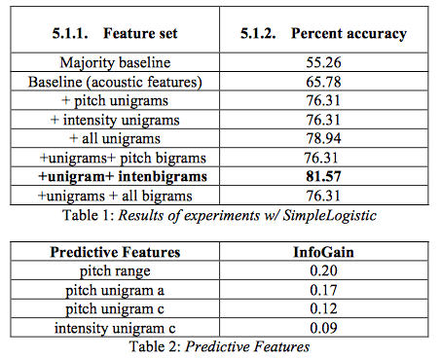
Results
Notes:
Pitch range was most predictive
They argue that prosody is important!
Difference from “Yeah Right”: they use intonational contours and intensity contours

Slide 69
How would you Improve Sarcasm Detection in Speech?
Acted vs. natural corpora?
Single speaker vs. multiple speakers?
How to improve human annotation?
Additional features?

