Slide 1
Intonation and Computation:
Analyzing Speech Prosody
Julia Hirschberg
LSA 2017
julia@cs.columbia.edu

Slide 2

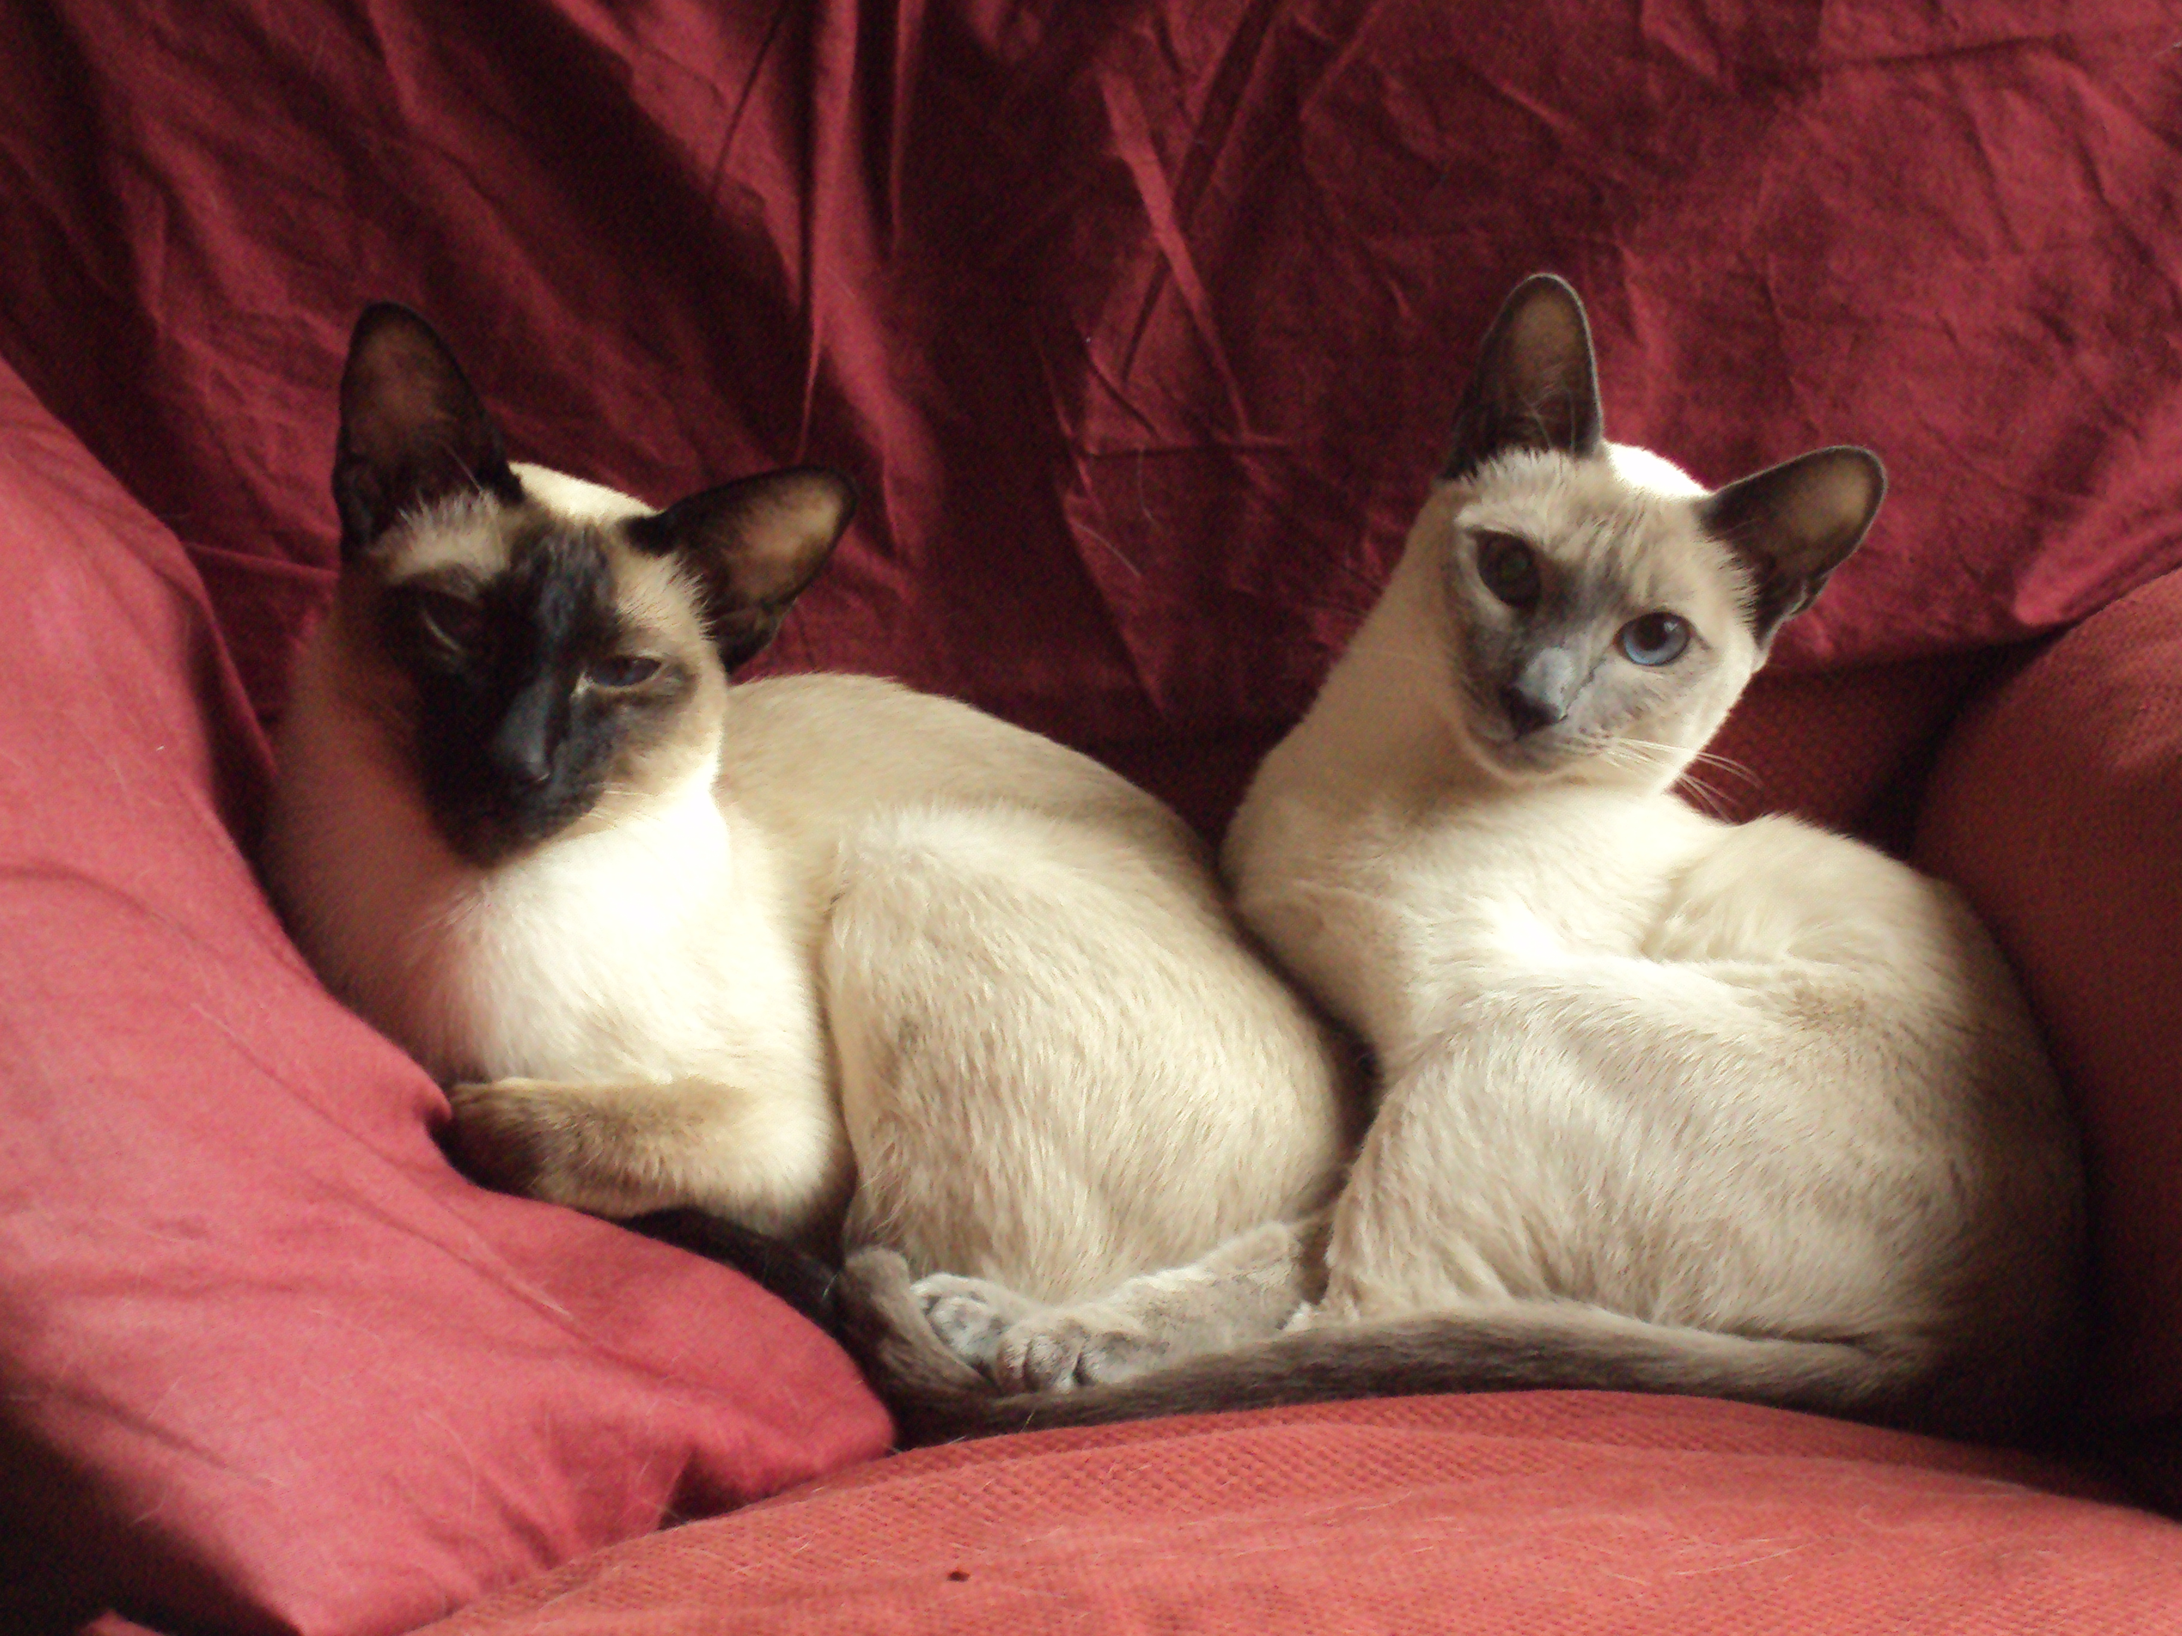
Julia Hirschberg in One Slide
Technical Career
PhD in History, UofM
Asst Prof at Smith
Saw the light: PhD in CS, UPenn
Bell Labs/AT&T Labs: MTS and Dept Head
Move to Columbia CS
CS Chair with 6 PhD students
Family and Fun
Married to Dan Hirschberg
Cats: Oliver and Dahlia
Hobbies: opera, plays and musicals, cooking, travel, Duolingo

Slide 3
Why study speech?
Today speech research most familiar to us in Spoken Dialogue Systems (SDS)
  Siri, Google speech apps, Microsoft Cortana, Amazon’s Echo
  SDS incorporate 2 important speech technologies
    Automatic Speech Recognition (ASR)
    Text-to-Speech synthesis (TTS)
Other applications depend upon these technologies
    Tutoring systems: KTH’s Ville , Rosetta Stone, Carnegie Speech, Duolingo
    Speech to Speech Translation: Military and rescue applications
    Speech Search: Google Voice Search, IARPA Babel project for Low Resource Languages
    Accessibility: Web access for visually challenged, TTS’d audio books

Slide 4
Other Major Speech Applications: Recognizing Speaker State
Recognizing or generating emotion, e.g.
  Recognizing anger/frustration in SDS
  Generating excitement/fear in games
Recognizing other speaker states
  Confidence vs. uncertainty in tutoring systems
  Medical diagnosis e.g. depression, schizophrenia
  Degree of interest e.g. for salespeople
  Sleepiness for drivers
  Drunkenness for drivers
  Deception for police, military, social services

Slide 5
What we’ll learn in this course
How to recognize different types of “speaker state” through spoken cues (as well as lexical information)
  Deceptive speech
  Emotional speech
  Charisma
  Personality
  Sarcasm
  Mental Illness
  Trust

Slide 6
How to design experiments to collect the data we need to do this
How to evaluate our results and draw conclusions from our research

Slide 7
How do we produce speech?
General process of articulation
  Air expelled from lungs through windpipe (trachea) leaving via mouth (mostly) and nose (nasals) (e.g. [m], [n])
  Air passing thru trachea goes thru larynx, which contains vocal folds – space between them is the glottis
  When vocal folds vibrate, we get voiced sounds (e.g. [v]); o.w. voiceless (e.g. [f])
Speech sounds differ in their place and manner of articulation
Notes:
Articulation is the movement of the tongue, lips, jaw, and other speech organs (the articulators) in order to make speech sounds.
The point of maximum obstruction is known as the PLACE of articulation and the WAY the obstruction is formed is called the MANNER. For example, when making a p sound, the two lips come together tightly, blocking the air for a little while and causing a buildup of air pressure. The lips are then released suddenly, leading to a burst of sound. The place of articulation of this sound is therefore called bilabial, and the manner is called stop (also known as a plosive).

Slide 8
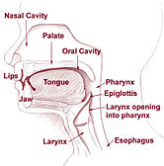
Notes:
https://en.wikipedia.org/wiki/Speech_production

Slide 9
How do we perceive speech?
Speech (like other sounds) causes sound waves, or fluctuations, in the air:
  These propagate (analogy: toss a stone in a lake and watch the circles of ripples), losing amplitude
  Received by outer ear and passed on to
  Middle ear’s auditory canal causing the eardrum (tympanum) to vibrate
  Inner ear translates these vibrations into neural impulses which are passed along the vestibulo-cochlear nerve to the brain
  Brain interprets impulses as sound

Slide 10
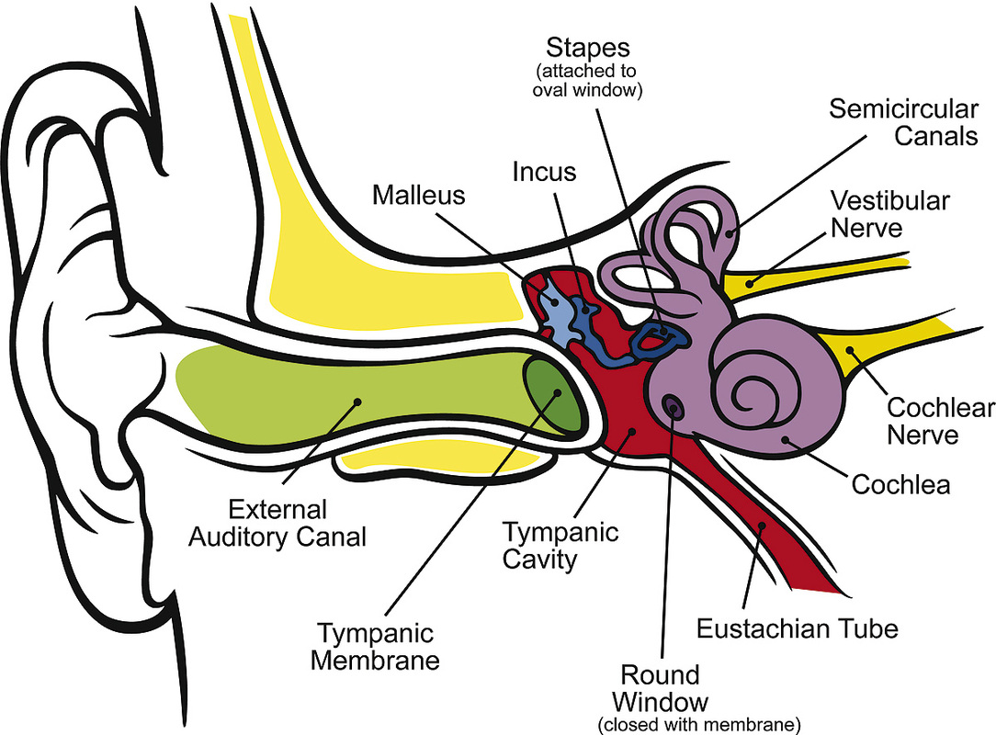
Notes:
https://en.wikipedia.org/wiki/Ear
Inner ear also includes organs of balance, the semicircular canals and the utricle and saccule and connected to the Eustachian Tube which connects to the upper part of the throat.

Slide 11
How do we analyze these sounds?
Speech signals can be visualized as a set of waveforms (check out Praat)
Different patterns in these waveforms represent different speech sounds, such as vowels and consonants
By identifying the different patterns we can identify what is said
Different aspects of these waveforms can also tell us how it is said, which provides cues to speaker state
Notes:
Also looking at brain activation in humans – and ferrets!

Slide 12
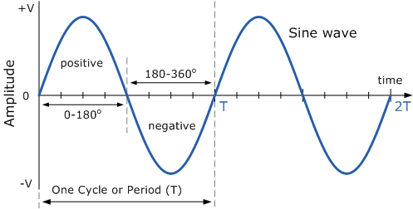
Modeled as Simple Periodic Sine Waves
Notes:
http://innovativeblood.blogspot.com/2011/01/types-of-waveforms.html
The simplest representation of speech sounds are simple periodic sine saves.

Slide 13
Simple Periodic (Sine) Waves
Simple Periodic Waves are defined by
  Frequency: how often does pattern repeat per time unit
    Cycle: one repetition
    Period: duration of cycle
    Frequency = # cycles per time unit, e.g. sec.
      Frequency in Hz = cycles per second or 1/period
      E.g. 400Hz pitch = 1/.0025 (1 cycle has a period of .0025; 400 cycles complete in 1 sec)
    Zero crossing: where the waveform crosses the x-axis

Slide 14
  Amplitude: peak deviation of pressure from normal atmospheric pressure
  Phase: timing of waveform relative to a reference point

Slide 15
Complex Periodic Waveforms
We rarely hear (human) simple periodic sine waves
Most speech sounds are composed of multiple sine waves – periodic or aperiodic
Vowels and voiced consonants (e.g. b,d,v,g) are composed of complex periodic waveforms

Slide 16
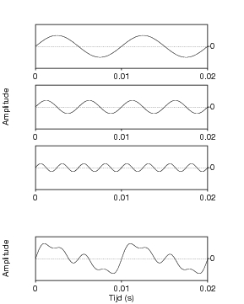
3 Sine Waves = 1 Complex Periodic Wave
Notes:
http://www.hum.uu.nl/uilots/lab/courseware/phonetics/basics_of_acoustics_2/complex_signals.html
Any complex waveform can be analyzed into its component sine waves with their frequencies, amplitudes, and phases using Fast Fourier Analysis or Fourier Transform

Slide 17

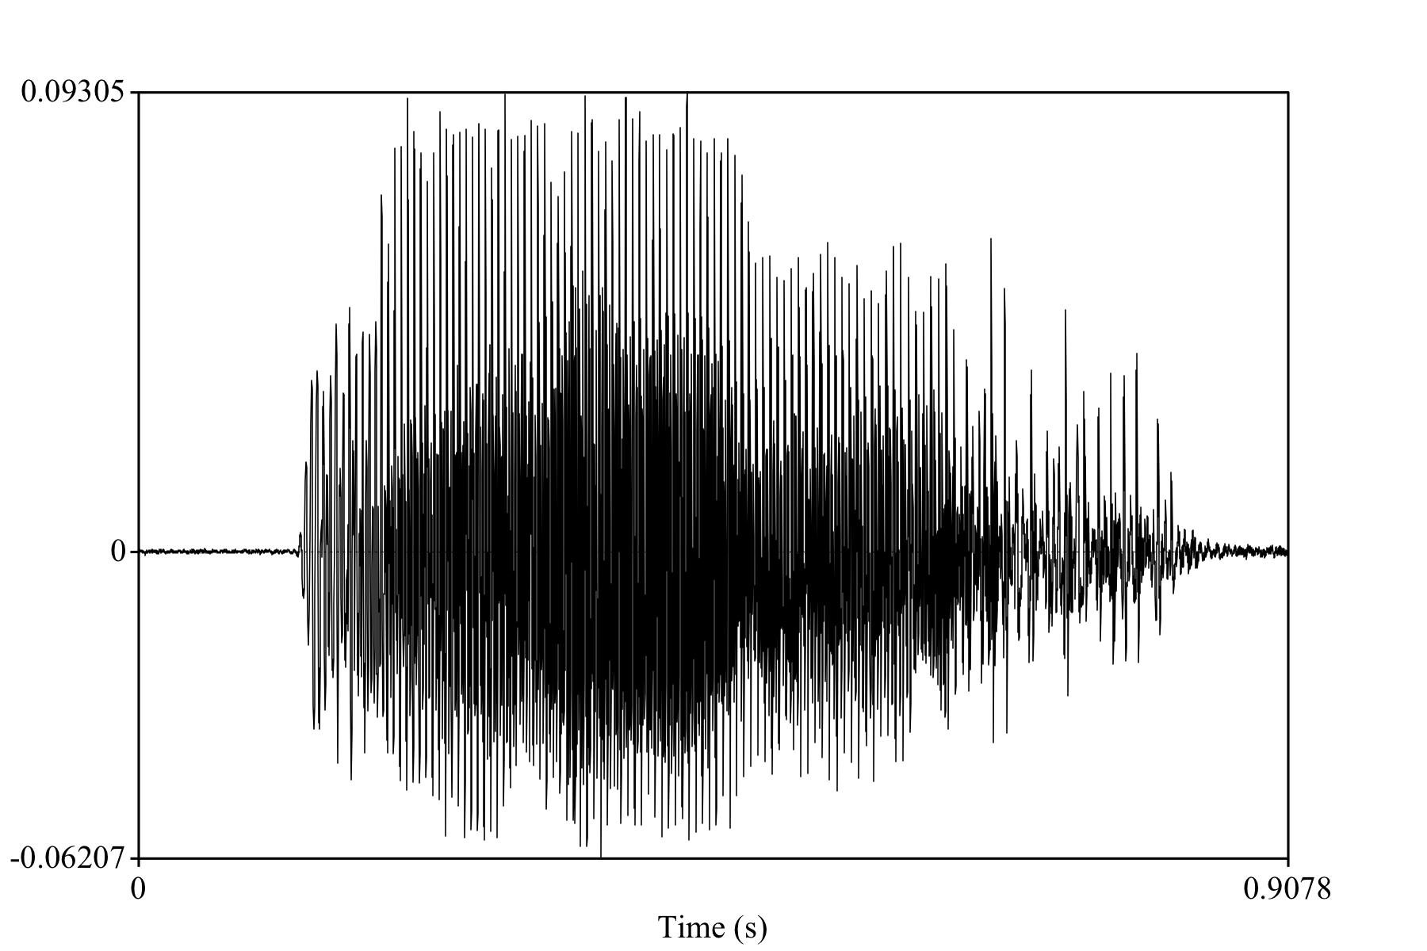
“ma”
Notes:
Periodic sine wave

Slide 18
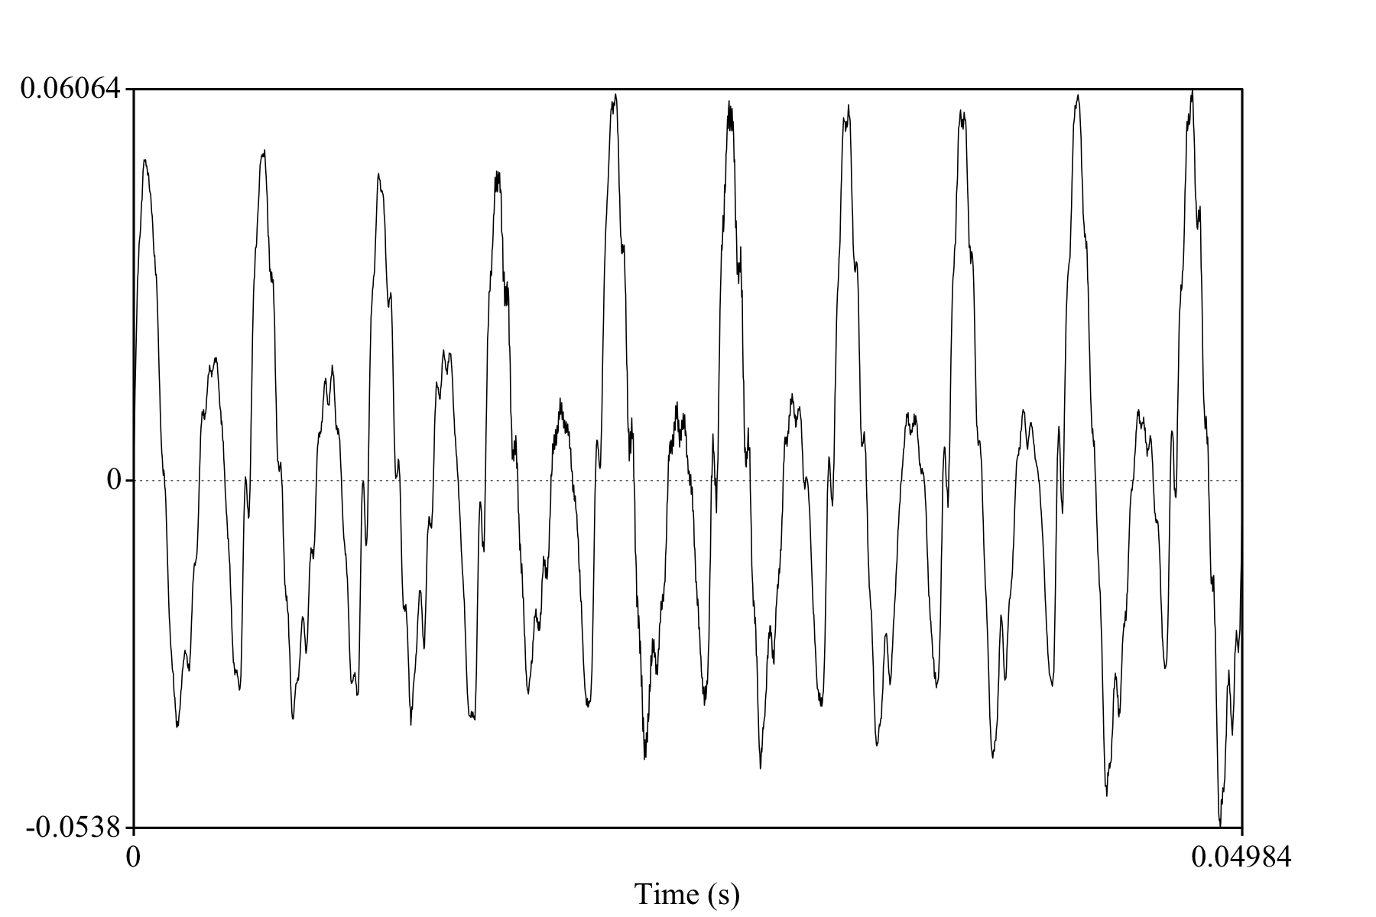
“m”
Notes:
Part of an “m”

Slide 19
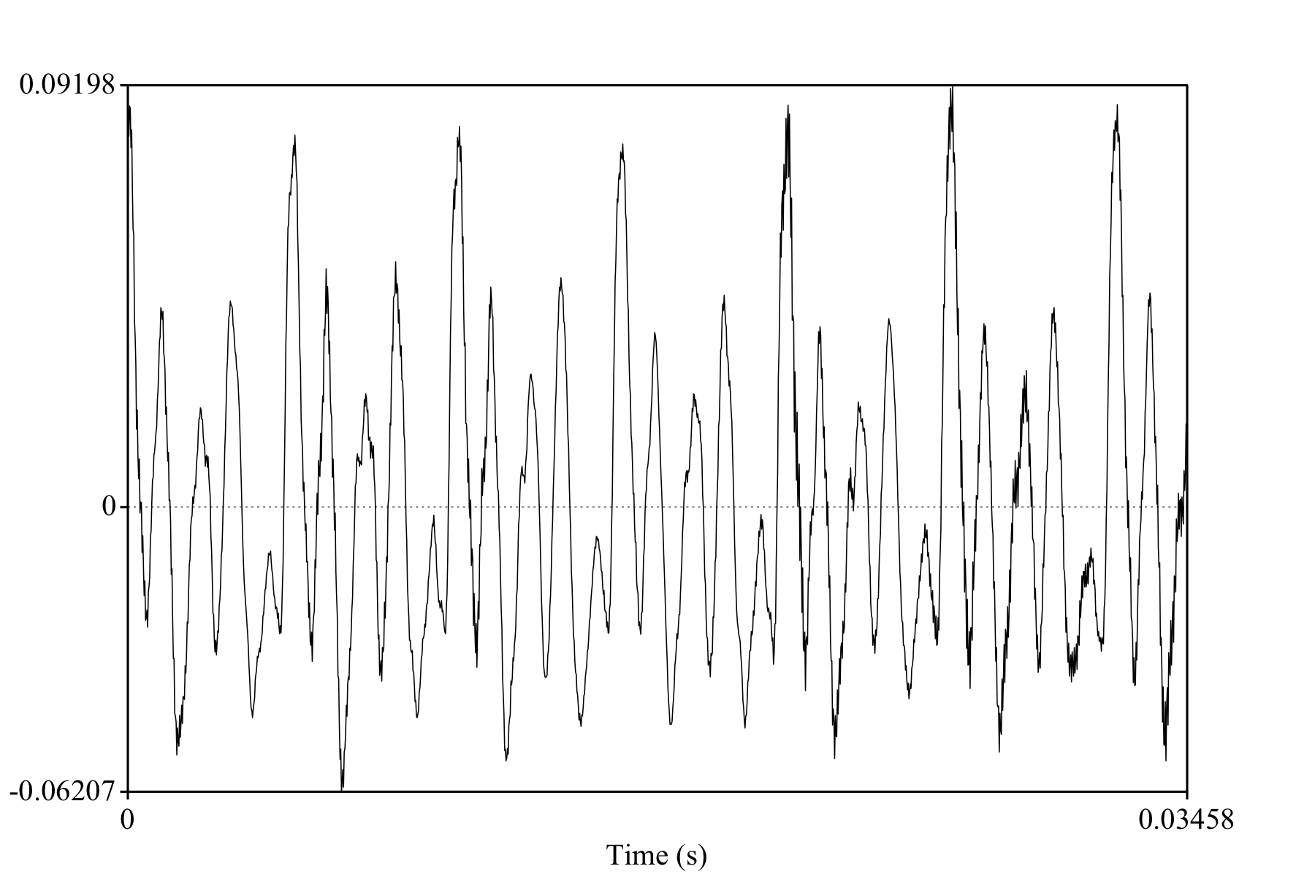
“a”
Notes:
Part of an “a”

Slide 20
Aperiodic Waveforms
Voiceless consonants (e.g. p, t, f, k) are aperiodic
  Waveforms with random or non-repeating patterns
Random aperiodic waveforms: white noise
    Flat spectrum: equal amplitude for all frequency components
Transients: sudden bursts of pressure (clicks, pops, lip smacks, door slams)
    Flat spectrum with single impulse

Slide 21
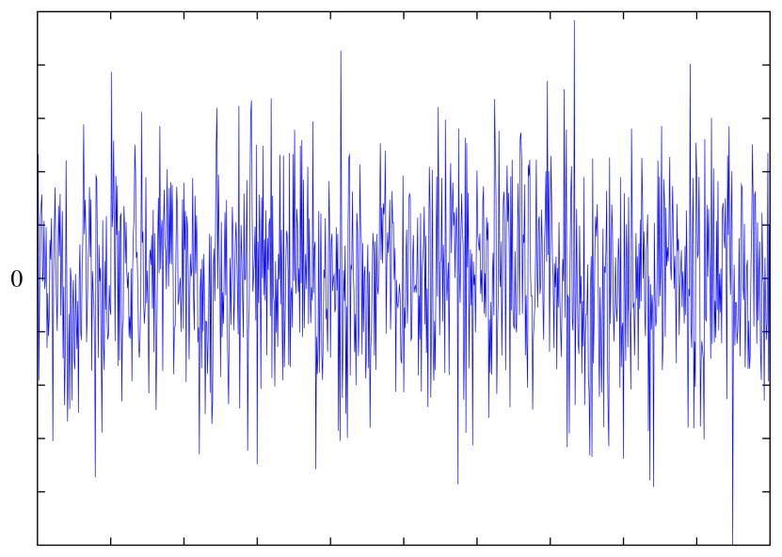
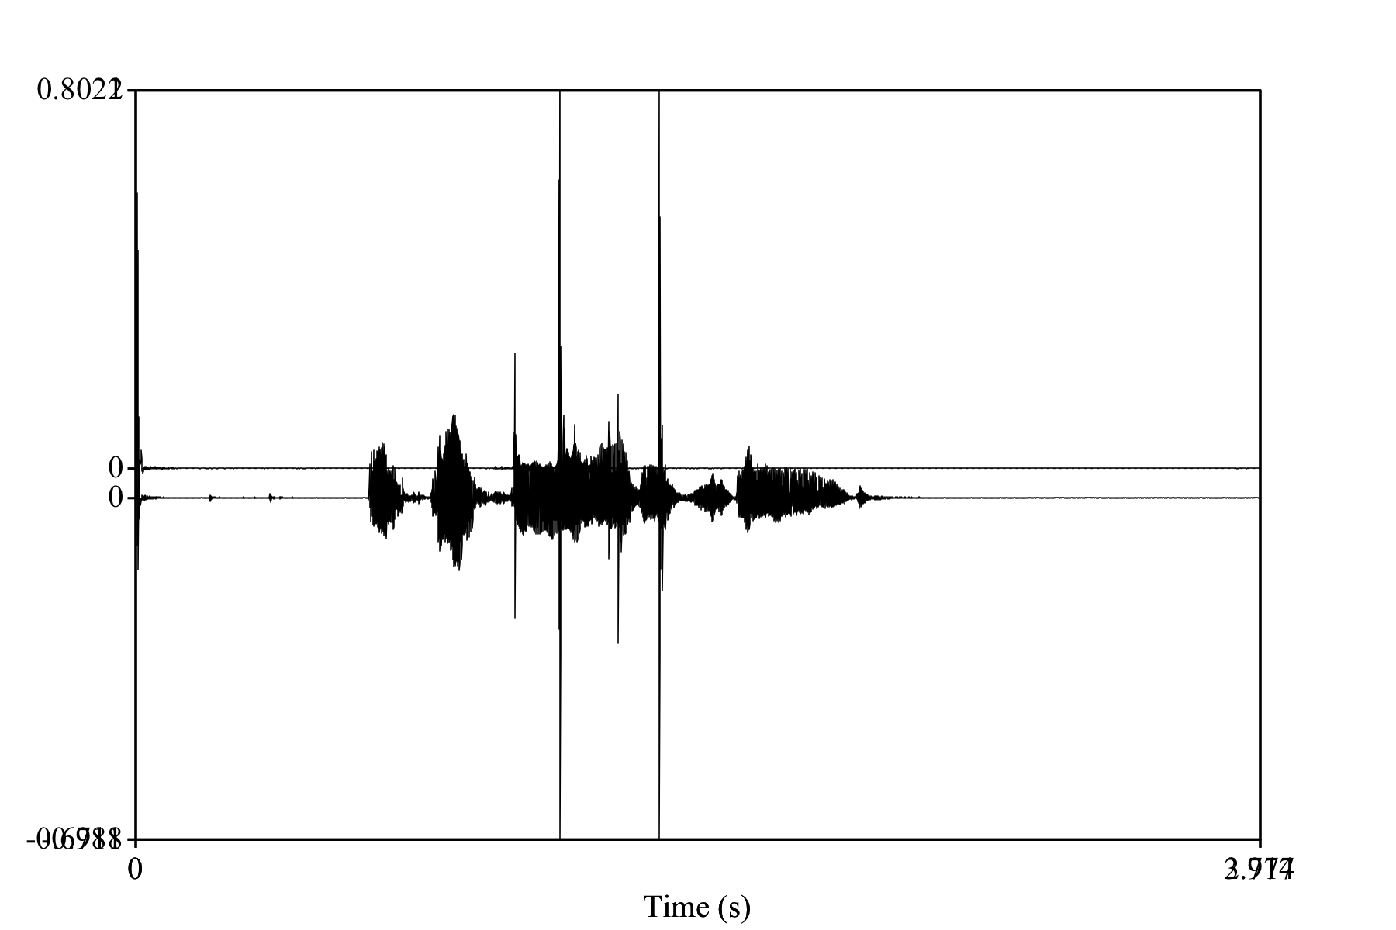

Slide 22
Power Spectra and Spectrograms
Frequency components of a complex waveform are represented in the power spectrum
  Plots frequency and amplitude of each component sine wave
Adding temporal dimension → spectrogram
Obtained via Fast Fourier Transform (FFT), Linear Predicative Coding (LPC),…

Slide 23
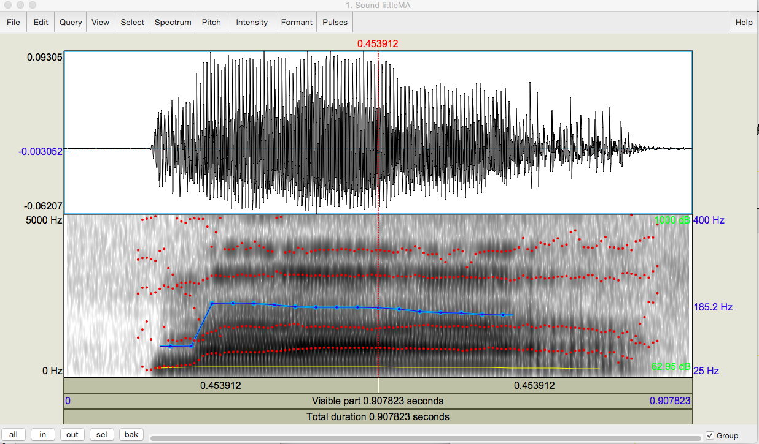
Spectrogram: “ma”

Slide 24
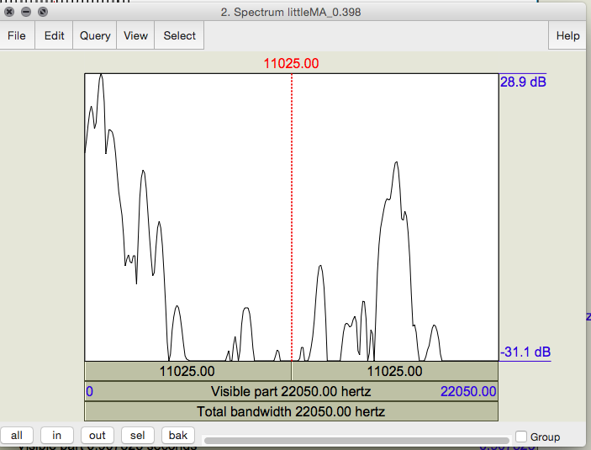
Spectral Slice: A window of “a”

Slide 25
Terms
Spectral slice: plots amplitude at each frequency of a window of the waveform
Spectrogram: plots changes in amplitude and frequency over time over many windows
Harmonics: components of a complex waveform that are integer multiples of the fundamental frequency (F0)
Formants: frequency bands that are most amplified by the vocal tract

Slide 26
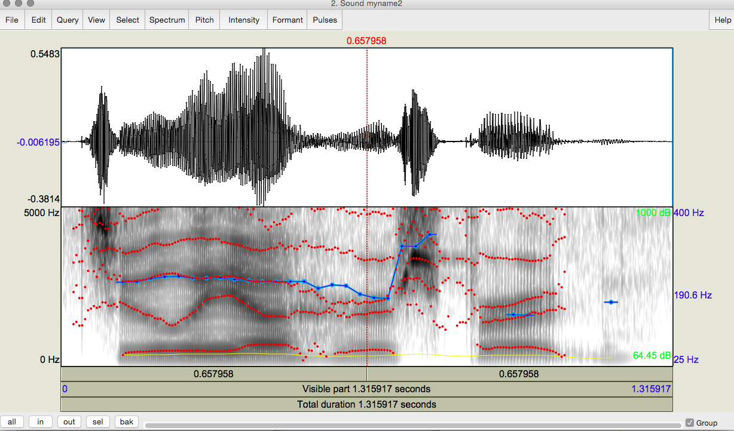
Sample Spectrogram: Any Guesses?

Slide 27
How do we record speech to study it?
Recording conditions depend upon purpose
  A quiet office, a sound booth, an anechoic chamber
Microphones convert sounds into electrical current: oscillations of air pressure become oscillations of voltage in an electric circuit
  Analog devices (e.g. tape recorders) store these as a continuous signal
  Digital devices (e.g. computers, DAT) convert continuous signals into discrete signals by digitizing it

Slide 28
Digitizing Speech
We cannot store every part of the speech signal so we must sample it
  Different sampling rates produce different levels of quality but also different storage requirements
  For many prosodic tasks, 16Khz is sufficient
How often must we sample?
  A minimum of 2 samples per cycle to capture periodicity of a waveform component at a given frequency
    So… 100 Hz waveform requires 200 samples/sec

Slide 29
To Learn More
Read Keith Johnson. Acoustic & Auditory Phonetics (3rd edition). Wiley. 2011.

Slide 30
Trade-offs
Human hearing: ~20K top frequency
  Do we really need to store 40K samples per second of speech?
Telephone speech: 300-4K Hz (8K sampling)
  But some speech sounds (e.g. fricatives, stops) have energy above 4K…
  Peter/teeter/Dieter
44K (CD quality audio) vs.16-22K (usually good enough to study pitch, amplitude, duration, …)
Golden Ears…

Slide 31
Determining Not Just What is Said but How it is Said
Forensic Linguistics: ‘Kill him!’ or ‘Kill him?’
What information do we need to extract to distinguish these different meanings?
Can we extract this information automatically from the waveform?
Tools such as Praat, sox
What kind of information is useful and extractable?

Slide 32
Pitch
  Fundamental frequency (F0): rate at which largest pattern repeats (also GCD of component frequencies)
  Derived pitch features (e.g. min, max, mean, sdev)
  Pitch contour (pitch-tracking plus stylization)
  Pitch range, slope, prominence

Slide 33
Estimating (Tracking) Pitch
Pitch tracking: Estimate F0 over time as a function of vocal fold vibration
How? Autocorrelation approach
  A periodic waveform is correlated with itself since one period looks much like another
  Find the period by finding the ‘lag’ (offset) between two windows on the signal for which the correlation of the windows is highest
  Lag duration (T) is 1 period of waveform
  Inverse is F0 (1/T)

Slide 34
Intensity
Loudness:
  RMS amplitude: Energy features (RMS energy)
  Intensity: in Db, where P(0) is auditory threshold pressure (closer to human perception)
Notes:
Db and other logarithmic methods model human perception of loudness

Slide 35
Rhythm and Pause
Duration features
  Phone / Vowel / Syllable / Phrase Durations
  Normalized by Phone/Vowel Means, Speaker
  Inter-Pausal Units (IPUs)
Speaking rate features (syllables per second)
Pause features (cf Benus et al ‘06)
  Speech to pause ratio, number of long pauses
  Maximum pause length

Slide 36
Voice Quality
Spectral tilt features: shape of the spectral envelope
Jitter:
  Cycle-to-cycle variation in Fundamental Frequency of the signal
  Excessive: Hoarse, harsh, rough
Shimmer:
  Cycle-to-cycle variation in amplitude of the signal
  Excessive: hoarse

Slide 37
Higher-Level Features: Prosody
Prosodic phrasing:
  Indicated by pauses, phrase-final lengthening, pitch
Prosodic prominence:
  Indicated by F0, duration, intensity, voice quality
Pitch contour:
  Meaningful variation in phrasing and prominence
  E.g. a yes-no question vs. a statement vs. ??

Slide 38
How do we represent these differences?
Many representations have been proposed
  Fujisaki’s super-positional, British School, Hirst’s INTSINT, IPO Perception Model, Gussenhoven’s ToDI, and more
American school models make a distinction between accents and boundary tones
  Only two tones, which may be combined
    H = high target
    L = low target

Slide 39
Pierrehumbert 1980
Contours = pitch accents, phrase accents, boundary tones
Pitch Accents*
Phrase Accents*
Boundary Tone
H* L*
L*+H L+H*
H*+L H+L*
L- H-
L% H%
Notes:
Jd

Slide 40
Price, Ostendorf et al
Break indices: degree of juncture between words
0 → 8 (none to ‘a lot’)
  What I’d like is a nice roast beef sandwich.

Slide 41
To(nes and)B(reak)I(ndices)
Developed by prosody researchers in four meetings over 1991-94
Putting Pierrehumbert ’80 and Price, Ostendorf, et al together
Goals:
  devise common labeling scheme for Standard American English that is robust and reliable
  promote collection of large, prosodically labeled, shareable corpora

Slide 42
ToBI standards also proposed for English (multi), German (multi), Greek, Dutch, Portuguese (multi), Spanish (multi), Serbo-Croatian, Slovak, Italian (multi), Swedish, Japanese, Korean, Cantonese, Mandarin, Taiwanese, Chickasaw, Bininj, and more…
Two collected volume on prosodic typology (Jun) and many papers
Courses and tutorials

Slide 43
Minimal ToBI transcription:
  recording of speech
  f0 contour
  ToBI tiers:
    orthographic tier: words
    break-index tier: degrees of junction (Price et al ‘89)
    tonal tier: pitch accents, phrase accents, boundary tones (Pierrehumbert ‘80)
    miscellaneous tier: disfluencies, non-speech sounds, etc.

Slide 44

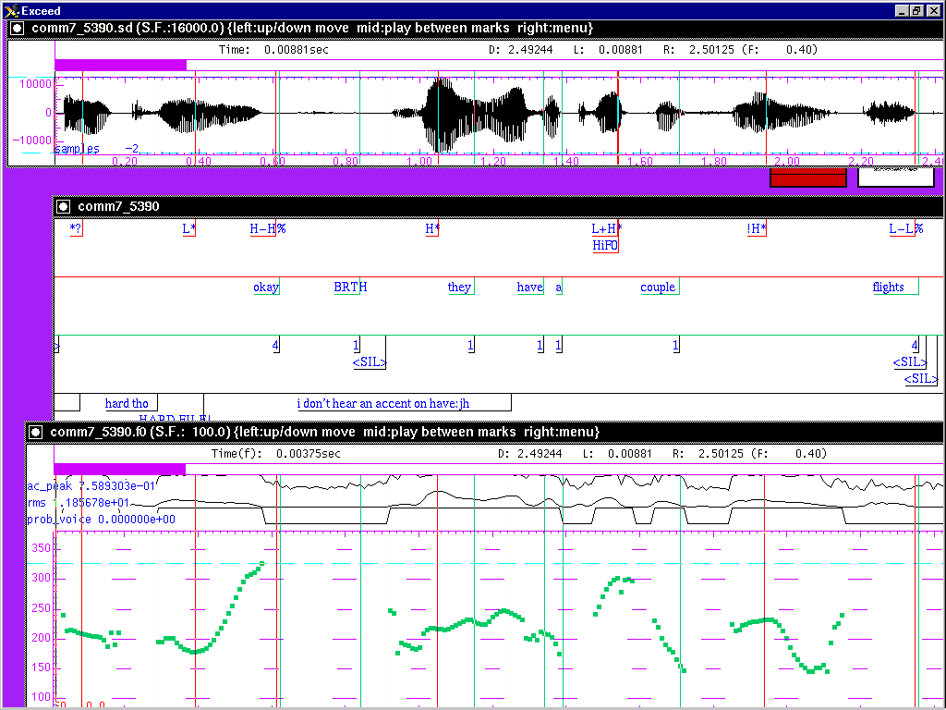
Sample ToBI Labeling

Slide 45
Online training material,available at:
  http://www.ling.ohio-state.edu/~tobi/ame_tobi/ Evaluation
  Good inter-labeler reliability for expert and naive labelers: 88% agreement on presence/absence of tonal category, 81% agreement on category label, 91% agreement on break indices to within 1 level (Silverman et al. ‘92,Pitrelli et al ‘94)

Slide 46
Pitch Accent/Prominence in ToBI
Which items are made intonationally prominent and how: tonal targets/levels not movement
Accent type:
  H* simple high (declarative)
  L* simple low (ynq)
  L*+H scooped, late rise (uncertainty/ incredulity)
  L+H* early rise to stress (contrastive focus)
  H+!H* fall onto stress (implied familiarity)

Slide 47
Downstepped accents:
  !H*
  L+!H*
  L*+!H
Degree of prominence:
  within a phrase: HiF0 (~nuclear accent)
  across phrases ??

Slide 48
Prosodic Phrasing in ToBI
‘Levels’ of phrasing:
  intermediate phrase: one or more pitch accents plus a phrase accent, H- or L-
  intonational phrase: 1 or more intermediate phrases + boundary tone, H% or L%
ToBI break-index tier
  0 no word boundary
  1 word boundary

Slide 49
  2 strong juncture with no tonal markings
  3 intermediate phrase boundary
  4 intonational phrase boundary

Slide 50
L-L%
L-H%
H-L%
H-H%
H*
L*
L*+H

Slide 51
L-L%
L-H%
H-L%
H-H%
L+H*
H+!H*
H* !H*

Slide 52
Contour Examples
http://www.cs.columbia.edu/~julia/cs6998/cards/examples.html

Slide 53
A Compositional Account (Pierrehumbert & Hirschberg ’92)
Contours convey relationships
  Between current, prior, and following utterances
  Between propositional content and mutual beliefs
Contour meanings are composites of the meanings of their pitch accents, phrase accents and boundary tones (hypothesis: intonational lexicon is compositional!)

Slide 54
Pitch Accents
Convey information status about discourse references, modifiers, predicates and their relationship to S and H’s mutual beliefs
  H*: X is new and predicated
    My name is H* Mark H* Liberman H-H%
  L*: X is salient but not part of the speaker’s predication
    Trotsky: …L* Stalin was L* right H-H%
  H*+L: X is inferable from S and H’s mutual beliefs and part of the predication
    H*+L Don’t H*+L forget to H*+L take your H* lunch L-L%

Slide 55
  H+L* (H+!H*): X is inferable from S and H’s mutual beliefs but not part of predication
    She’s H+L* teething L-L%
  L*+H: X is part of a scale but not part of the predication
    …I fed the L*+H goldfish L-H%
  L+H*: X is part of a scale and in S and H’s mutual beliefs (narrow focus)
    I don’t L+H* want L+H* shrimp L-H% I want L+H* lobster L-L%

Slide 56
Phrase Accents
Convey relationships among intermediate phrases, such as which form part of larger interpretive units
  L-: X L- Y means X and Y are interpreted separately from one another
    Do you want a sandwich L- or would you like a soda
  H-: X H- Y means X and Y should be interpreted together
    Do you want apple juice H- or orange juice

Slide 57
Boundary Tones
Signal the directionality of interpretation of intonational phrases
  H%: X H% Y means interpret X wrt Y
    You made seven errors L-H%
    What a shame L-L%
    We don’t have time to continue today.
  L%: X L% Y means no directionality of interpretation suggested
    You made seven errors L-L%
    What a shame L-H%
    We don’t have time to continue today.

Slide 58
Unresolved Questions
How do the meanings of pitch accents in a single phrase combine?
  The L* blackboard’s painted H* orange L-L%
How do we distinguish the meaning of a phrase accent from that of a boundary tone – especially in intonational phrases with a single intermediate phrase?
  E.g. H* H-L% (plateau) vs. H*H-H% (high-rise question) vs. H*L-L% (declarative)
Is this framework useful for investigating contour meaning? E.g. downstepped contours, H+L*

Slide 59
How are these features useful?
Expanded vs. compressed pitch range?
  Happiness vs. boredom
Louder vs. softer speech?
  Anger vs. contentment
Faster vs. slower speech?
  Certainty vs. uncertainty
Differences in intonational prominence?
  New vs. old information
Differences in intonational phrasing?
  1 thought vs. 2 thoughts
Differences in pitch contours?
  Question vs. statement

Slide 60
Next Class
Deception detection and experimental design

