Slide 1
Automatic Speech Recognition
Sarah Ita Levitan
COMS 6998
Spring 2022

Slide 2
Announcements
Google cloud credits: $50 per person
Project proposals due next week, October 24, 1pm

Slide 3
Proposals
Make sure to include:
- goal of the project
- problem you intend to solve
- 2-3 references of prior work that relates to your topic
- data you plan to use
- overview of proposed approach
- evaluation plan (how you will measure the success of your work?)
- timeline for project completion
- names of all team members, and each member’s role in the project

Slide 4
What is ASR?
Automatic process of translating a speech waveform into its corresponding transcription by computer (Rabiner & Juang, 193)
  Transcription can be in words, phones, syllables, or other units

Slide 5
ASR applications
Closed captioning
Voicemail transcription
Dictation system
Dialogue system front end

Slide 6
Challenges
Speaking style
Environment
Speaker characteristics
Domain specific challenges

Slide 7
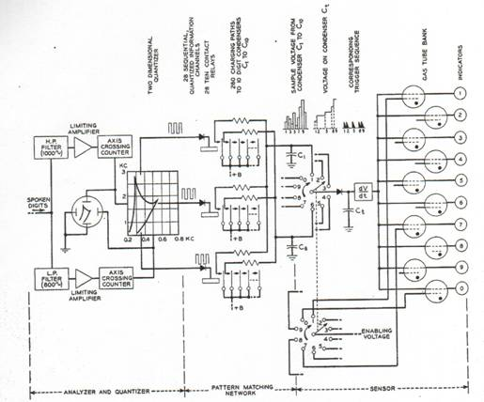
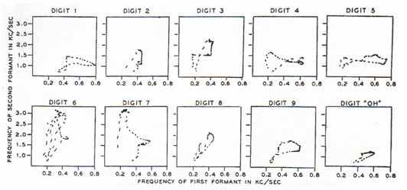
Speech Recognition: the Early Years
1952 – Automatic Digit Recognition (AUDREY)
  Davis, Biddulph, Balashek (Bell Laboratories)

Slide 8
IBM Shoebox, 1961
Digit recognition and arithmetic operations
Could compute and print the solution

Slide 9
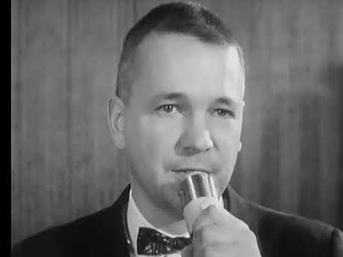

Slide 10
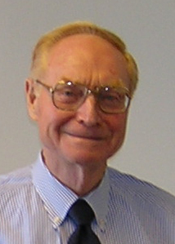
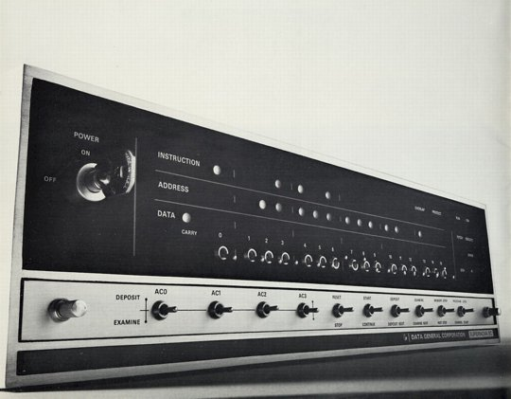
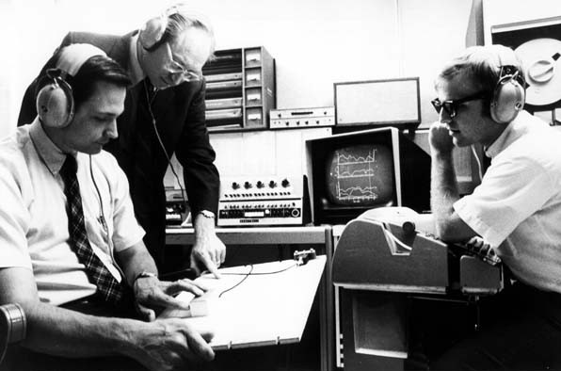
1960’s – Speech Processing and Digital Computers
AD/DA converters and digital computers start appearing in the labs
James Flanagan
Bell Laboratories

Slide 11
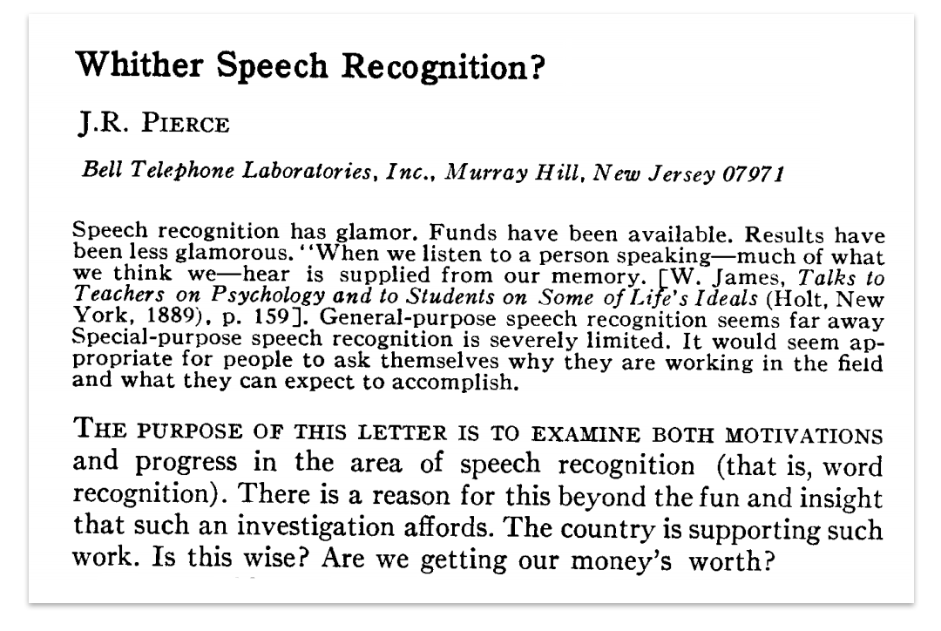

Slide 12
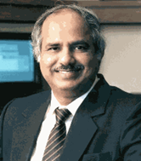
1971-1976: The ARPA SUR project
Despite anti-speech recognition campaign led by Pierce Commission ARPA launches 5 year Spoken Understanding Research program
Goal: 1000-word vocabulary, 90% understanding rate, near real time on 100 mips machine
4 Systems built by the end of the program
  SDC (24%)
  BBN’s HWIM (44%)
  CMU’s Hearsay II (74%)
  CMU’s HARPY (95% -- but 80 times real time!)
Rule-based systems except for Harpy
  Engineering approach: search network of all the possible utterances
Raj Reddy -- CMU

Slide 13
Lack of clear evaluation criteria
  ARPA felt systems had failed
  Project not extended
Speech Understanding: too early for its time
Need a standard evaluation method so that progress within and across systems could be measured

Slide 14
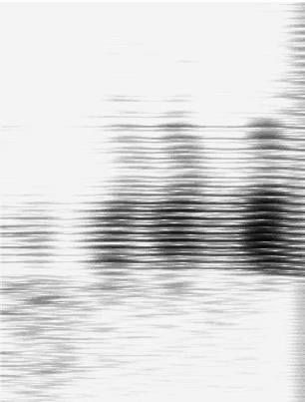
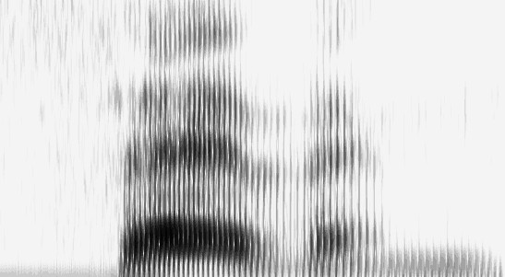
1970’s – Dynamic Time Warping
The Brute Force of the Engineering Approach
T.K. Vyntsyuk (1968)
H. Sakoe,
S. Chiba (1970)
TEMPLATE (WORD 7)
Isolated Words
Speaker Dependent
Connected Words
Speaker Independent
Sub-Word Units
UNKNOWN WORD

Slide 15
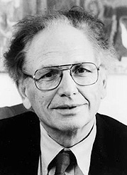

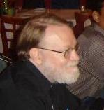
1980s -- The Statistical Approach
Based on work on Hidden Markov Models done by Leonard Baum at IDA, Princeton in the late 1960s
Purely statistical approach pursued by Fred Jelinek and Jim Baker, IBM T.J.Watson Research
Fred Jelinek
Acoustic HMMs
Word Tri-grams
a11
a22
a33
Jim Baker
a12
a23
S1
S2
S3

Slide 16
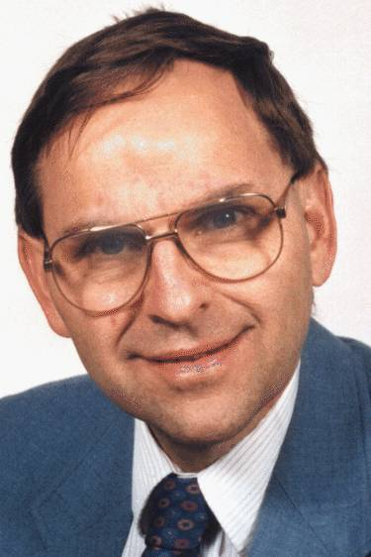
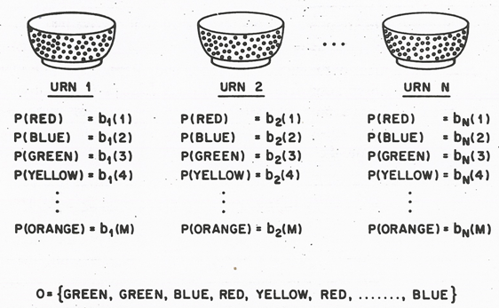
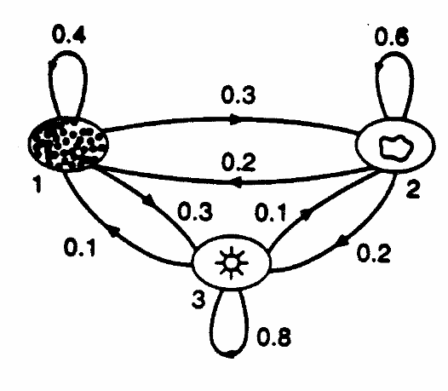
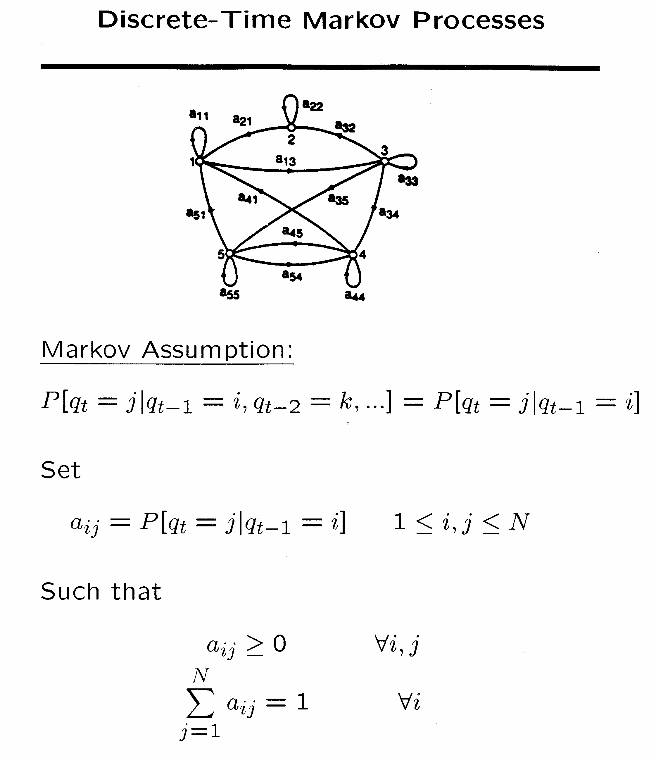
1980-1990 – Statistical approach becomes ubiquitous
Lawrence Rabiner, A Tutorial on Hidden Markov Models and Selected Applications in Speech Recognition, Proceeding of the IEEE, Vol. 77, No. 2, February 1989.

Slide 17
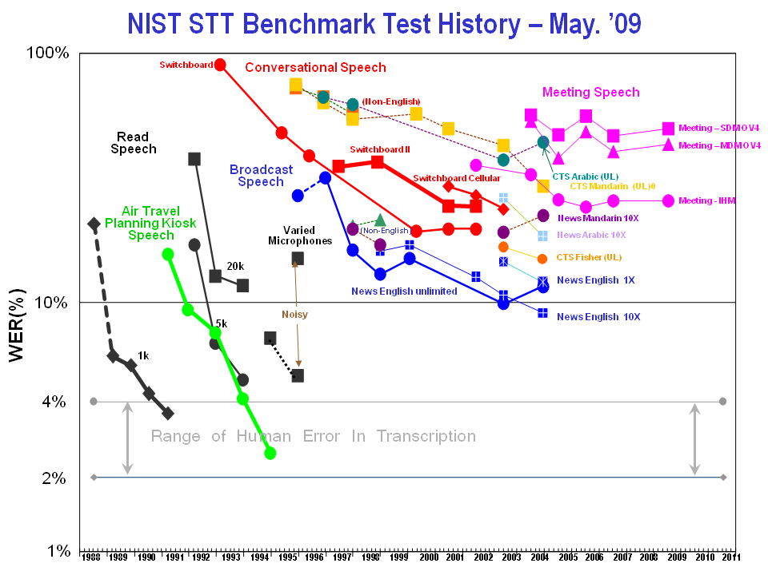

Slide 18
Large Vocabulary Continuous Speech Recognition (LVCSR)
~20,000-64,000 words
Speaker independent (vs. speaker-dependent)
Continuous speech (vs isolated-word)
Conversational speech, dialogue (vs. dictation)
Many languages (vs. English, Japanese, Swedish, French)
Notes:
18

Slide 19
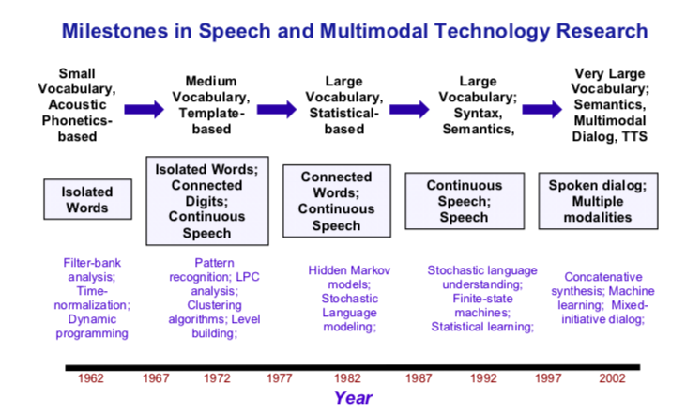
Juang & Rabiner, 1995

Slide 20
Current error rates
Ballpark numbers; exact numbers depend very much on the specific corpus
Task | Vocabulary | Word Error Rate %
Digits | 11 | 0.5
WSJ read speech | 5K | 1
WSJ read speech | 20K | 1
Broadcast news | 64,000+ | 4
Conversational Telephone | 64,000+ | 6

Slide 21
HSR versus ASR
Task | Vocab | ASR | Hum SR
Continuous digits | 11 | .5 | .009
WSJ 1995 clean | 5K | 3 | 0.9
WSJ 1995 w/noise | 5K | 9 | 1.1
SWBD 2004 | 65K | ~6 | 3-4?

Slide 22
How to Build an ASR System
Build a statistical model of the speech-to-text process
  Collect lots of speech and transcribe all the words
  Train the acoustic model on the labeled speech
  Train a language model on the transcription + lots more text
Paradigms:
  Supervised Machine Learning + Search
  The Noisy Channel Model

Slide 23
ASR Paradigm
Given an acoustic observation:
  What is the most likely sequence of words to explain the input?
    Using an
      Acoustic Model and a
      Language Model
Two problems:
  How to score hypotheses (Modeling)
  How to pick hypotheses to score (Search)

Slide 24
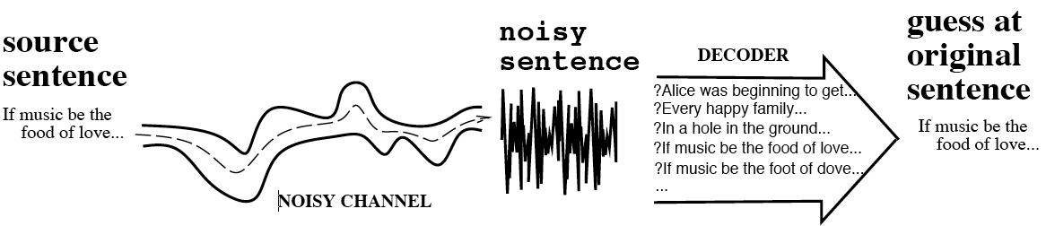
The Noisy Channel Model
Search through space of all possible sentences.
Pick the one that is most probable given the waveform
Decoding

Slide 25
The Noisy Channel Model: Assumptions
What is the most likely sentence out of all sentences in the language L, given some acoustic input O?
Treat acoustic input O as sequence of individual acoustic observations or frames
  O = o₁,o₂,o₃,…,o_{t}
Define a sentence W as a sequence of words:
  W = w₁,w₂,w₃,…,w_{n}

Slide 26
Noisy Channel Model
Probabilistic implication: Pick the highest probable sequence:
We can use Bayes rule to rewrite this:
Since denominator is the same for each candidate sentence W, we can ignore it for the argmax:

Slide 27
Speech Recognition Architecture

Slide 28
Noisy channel model
likelihood
prior

Slide 29
The noisy channel model
Ignoring the denominator leaves us with two factors: P(Source) and P(Signal|Source)

Slide 30
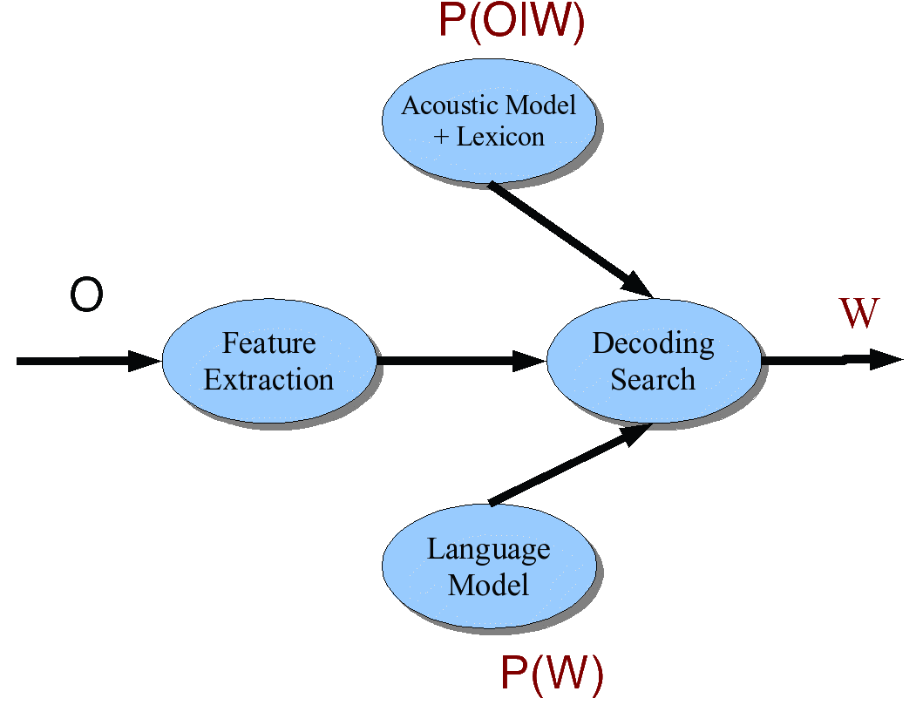
Speech Architecture meets Noisy Channel

Slide 31
Components of an ASR System
Corpora for training and testing of components
Representation for input and method of extracting features
Pronunciation Model (a lexicon)
Acoustic Model (acoustic characteristics of subword units)
Language Model (word sequence probabilities)
Algorithms to search hypothesis space efficiently

Slide 32
Training and Test Corpora
Collect corpora appropriate for recognition task at hand
  Small speech + phonetic transcription to associate sounds with symbols (Acoustic Model)
  Large (>= 60 hrs) speech + orthographic transcription to associate words with sounds (Acoustic Model+)
  Very large text corpus to identify ngram probabilities or build a grammar (Language Model)

Slide 33
Building the Acoustic Model
Goal: Model likelihood of sounds given spectral features, pronunciation models, and prior context
Usually represented as Hidden Markov Model
  States represent phones or other subword units for each word in the lexicon
  Transition probabilities (a) on states: how likely to transition from one unit to itself? To the next?
  Observation likelihoods (b): how likely is spectral feature vector (the acoustic information) to be observed at state i?

Slide 34
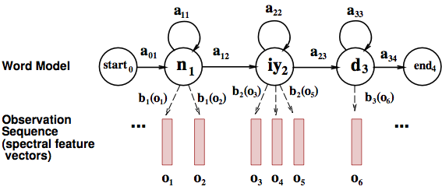
Training a Word HMM

Slide 35
Initial estimates of acoustic models from phonetically transcribed corpus or flat start
  Transition probabilities between phone states
  Observation probabilities associating phone states with acoustic features of windows of waveform
Embedded training:
  Re-estimate probabilities using initial phone HMMs + orthographically transcribed corpus + pronunciation lexicon to create whole sentence HMMs for each sentence in training corpus
  Iteratively retrain transition and observation probabilities by running the training data through the model until convergence

Slide 36
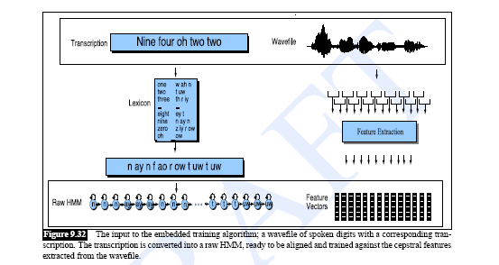
Training the Acoustic Model
Iteratively sum over all possible segmentations of words and phones – given the transcript -- re-estimating HMM parameters accordingly until convergence

Slide 37
Building the Pronunciation Model
Models likelihood of word given network of candidate phone hypotheses
  Multiple pronunciations for each word
  May be weighted automaton or simple dictionary
Words come from all corpora (including text)
Pronunciations come from pronouncing dictionary or TTS system

Slide 38
Lexicon
A list of words
Each one with a pronunciation in terms of phones
We get these from on-line pronunciation dictionary
CMU dictionary: 127K words
  http://www.speech.cs.cmu.edu/cgi-bin/cmudict
We’ll represent the lexicon as an HMM

Slide 39
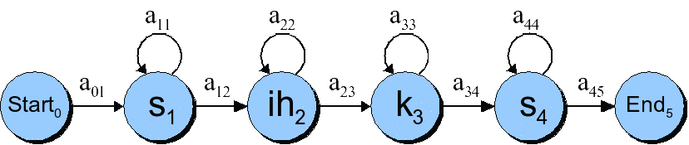
HMMs for speech

Slide 40
Each phone has 3 subphones

Slide 41
Resulting HMM word model for “six”

Slide 42
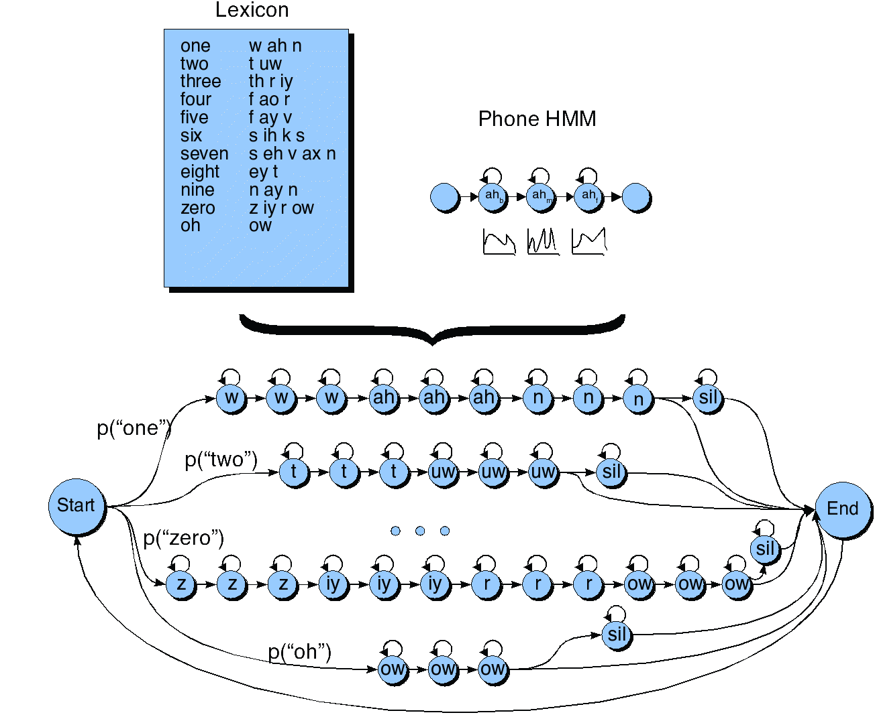
HMM for the digit recognition task

Slide 43
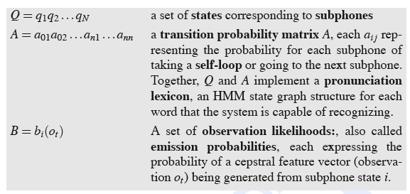

Slide 44
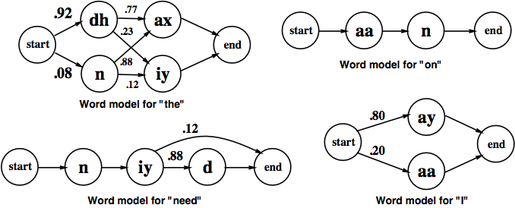
ASR Lexicon: Markov Models for Pronunciation

Slide 45
Building the Language Model
Models likelihood of word given previous word(s)
Ngram models:
  Build the LM by calculating bigram or trigram probabilities from text training corpus: how likely is one word to follow another? To follow the two previous words?
  Smoothing issues: sparse data
Grammars
  Finite state grammar or Context Free Grammar (CFG) or semantic grammar
Out of Vocabulary (OOV) problem

Slide 46
Search/Decoding
Find the best hypothesis Ŵ (P(O|W) P(W)) given
  A sequence of acoustic feature vectors (O)
  A trained HMM (Acoustic Model)
  Lexicon (Pronunciation Model)
  Probabilities of word sequences (Language Model)
For O
  Calculate most likely state sequences in HMM given transition and observation probabilities → lattice w/AM probabilities
  Trace backward thru lattice to assign words to states using AM and LM probabilities (decoding)
  N best vs. 1-best vs. lattice output
Limiting search
  Lattice minimization and determinization
  Pruning: beam search

Slide 47
Evaluating Success
Transcription
  Goal: Low Word Error Rate (Subst+Ins+Del)/N * 100
  This is a test
    Thesis test. (1subst+2del)/4*100=75% WER
    That was the dentist calling. (4 subst+1ins)/4words * 100=125% WER
Understanding
  Goal: High Concept Accuracy
  How many domain concepts were correctly recognized?
  I want to go from Boston to Washington on September 29

Slide 48
  Domain concepts Values
  source city Boston
  target city Washington
  travel month September
  travel day 29
  Ref: Go from Boston to Washington on September 29 vs. ASR: Go to Boston from Washington on December 29
  3concepts/4concepts * 100 = 25% Concept Error Rate or 75% Concept Accuracy
  3subst/8words * 100 = 37.5% WER or 62.5% Word Accuracy
  Which is better?

Slide 49
Summary: ASR Architecture
ASR Noisy Channel architecture
  Feature Extraction:
    39 “MFCC” features
  Acoustic Model:
    Gaussians for computing p(o|q)
  Lexicon/Pronunciation Model
    HMM: what phones can follow each other
  Language Model
    N-grams for computing p(w_{i}|w_{i-1})
  Decoder
    Viterbi algorithm: dynamic programming for combining all these to get word sequence from speech

Slide 50
Neural networks
Hybrid approach
End-to-end models

Slide 51
End-to-End Speech Recognition
Direct transcription of speech to text, without an intermediate phonetic representation
Baidu: Deep Speech RNN, 5,000 hours
https://arxiv.org/pdf/1412.5567.pdf
Google: LSTM, 12,500 hours
https://arxiv.org/pdf/1712.01769.pdf

Slide 52
Evaluation
How to evaluate the ‘goodness’ of a word string output by a speech recognizer?
Terms:
  ASR hypothesis: ASR output
  Reference transcription: ground truth – what was actually said

Slide 53
Transcription Accuracy
Word Error Rate (WER)
  Minimum Edit Distance: Distance in words between the ASR hypothesis and the reference transcription
    Edit Distance: = (Substitutions+Insertions+Deletions)/N
    For ASR, usually all weighted equally but different weights can be used to minimize difference types of errors
  WER = Edit Distance * 100

Slide 54
WER Calculation
Word Error Rate =
100 (Insertions+Substitutions + Deletions)
------------------------------
Total Word in Correct Transcript
Alignment example:
REF: portable **** PHONE UPSTAIRS last night so
HYP: portable FORM OF STORES last night so
Eval I S S
WER = 100 (1+2+0)/6 = 50%
54
Notes:
54

Slide 55
Word Error Rate =
100 (Insertions+Substitutions + Deletions)
------------------------------
Total Word in Correct Transcript
Alignment example:
REF: portable **** phone upstairs last night so ***
HYP: preferable form of stores next light so far
Eval S I S S S S I
WER = 100 (1+5+1)/6 = 117%

Slide 56
NIST sctk-1.3 scoring softare:
Computing WER with sclite
https://github.com/usnistgov/SCTK
Sclite aligns a hypothesized text (HYP) (from the recognizer) with a correct or reference text (REF) (human transcribed)
id: (2347-b-013)
Scores: (#C #S #D #I) 9 3 1 2
REF: was an engineer SO I i was always with **** **** MEN UM and they
HYP: was an engineer ** AND i was always with THEM THEY ALL THAT and they
Eval: D S I I S S
Notes:
56

Slide 57
Sclite output for error analysis
CONFUSION PAIRS Total (972)
With >= 1 occurances (972)
1: 6 -> (%hesitation) ==> on
2: 6 -> the ==> that
3: 5 -> but ==> that
4: 4 -> a ==> the
5: 4 -> four ==> for
6: 4 -> in ==> and
7: 4 -> there ==> that
8: 3 -> (%hesitation) ==> and
9: 3 -> (%hesitation) ==> the
10: 3 -> (a-) ==> i
11: 3 -> and ==> i
12: 3 -> and ==> in
13: 3 -> are ==> there
14: 3 -> as ==> is
15: 3 -> have ==> that
16: 3 -> is ==> this
Notes:
57

Slide 58
Sclite output for error analysis
17: 3 -> it ==> that
18: 3 -> mouse ==> most
19: 3 -> was ==> is
20: 3 -> was ==> this
21: 3 -> you ==> we
22: 2 -> (%hesitation) ==> it
23: 2 -> (%hesitation) ==> that
24: 2 -> (%hesitation) ==> to
25: 2 -> (%hesitation) ==> yeah
26: 2 -> a ==> all
27: 2 -> a ==> know
28: 2 -> a ==> you
29: 2 -> along ==> well
30: 2 -> and ==> it
31: 2 -> and ==> we
32: 2 -> and ==> you
33: 2 -> are ==> i
34: 2 -> are ==> were
Notes:
58

Slide 59
Other Types of Error Analysis
What speakers are most often misrecognized (Doddington ’98)
  Sheep: speakers who are easily recognized
  Goats: speakers who are really hard to recognize
  Lambs: speakers who are easily impersonated
  Wolves: speakers who are good at impersonating others

Slide 60
What (context-dependent) phones are least well recognized?
  Can we predict this?
What words are most confusable (confusability matrix)?
  Can we predict this?

Slide 61
Are there better metrics than WER?
WER useful to compute transcription accuracy
But should we be more concerned with meaning (“semantic error rate”)?
  Good idea, but hard to agree on approach
  Applied mostly in spoken dialogue systems, where semantics desired is clear
  What ASR applications will be different?
    Speech-to-speech translation?
    Medical dictation systems?
Notes:
61

Slide 62
Concept Accuracy
Spoken Dialogue Systems often based on recognition of Domain Concepts
Input: I want to go to Boston from Baltimore on September 29.
Goal: Maximize concept accuracy (total number of domain concepts in reference transcription of user input)
Concept | Value
Source City | Baltimore
Target City | Boston
Travel Date | Sept. 29

Slide 63
  CA Score: How many domain concepts were correctly recognized of total N mentioned in reference transcription
    Reference: I want to go from Boston to Baltimore on September 29
    Hypothesis: Go from Boston to Baltimore on December 29
    2 concepts correctly recognized/3 concepts in ref transcription * 100 = 66% Concept Accuracy
  What is the WER?
    3 Ins+2 Subst+0Del/11 * 100 = 45% WER (55% Word Accuracy)

Slide 64
Sentence Error Rate
Percentage of sentences with at least one error
  Transcription error
  Concept error

Slide 65
Which Metric is Better?
Transcription accuracy?
Semantic accuracy?

Slide 66
Is ASR a solved problem?

Slide 67
Semantic Errors
Reference: “let’s meet up Tuesday”
Semantic error: “let’s meet up today”
Word error: “let’s meet Tuesday”

Slide 68
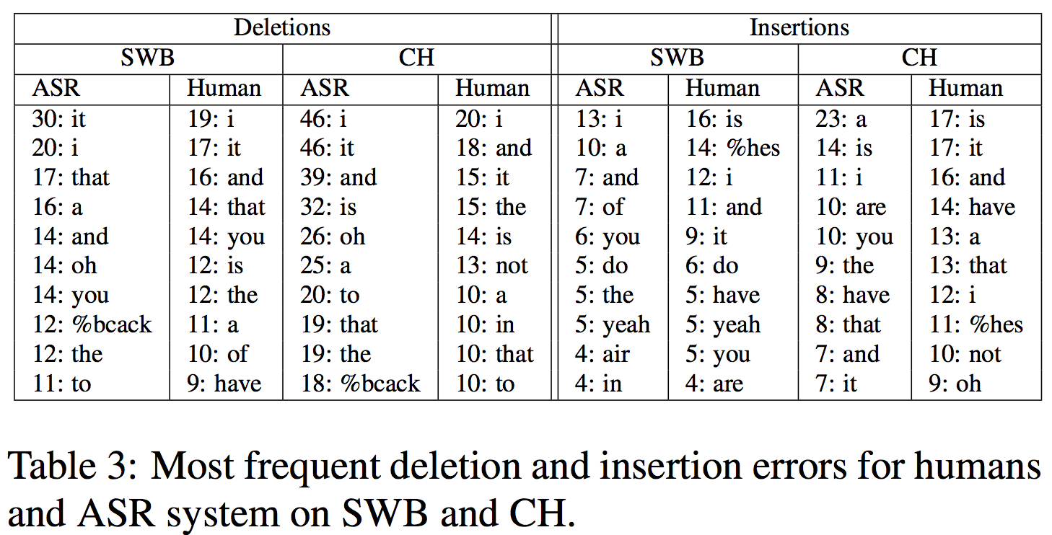
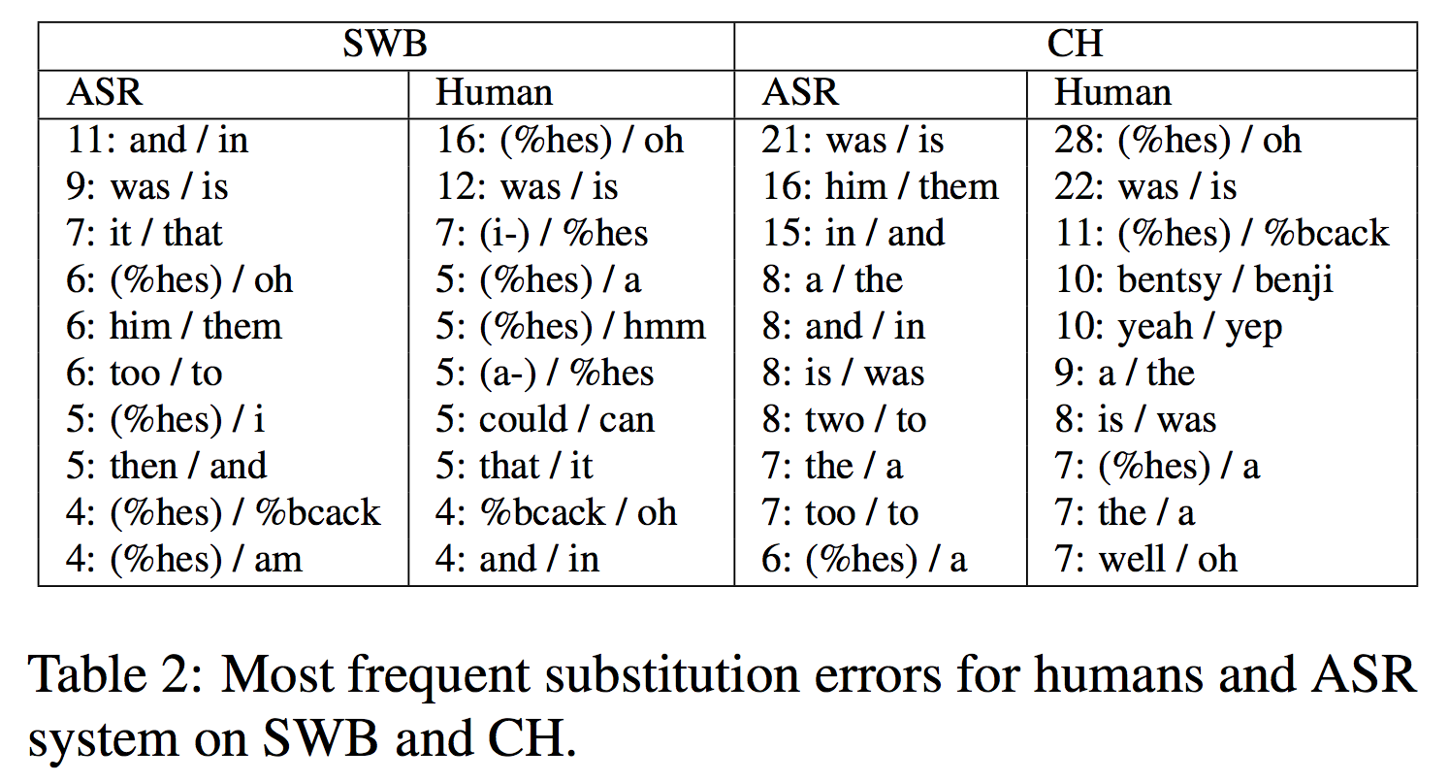
HSR versus ASR
(Saon et al, 2017)

Slide 69
Domain and speaker variation
Noisy environments
Multiple speakers
Speaker dialect, accent
Speaker age

Slide 70
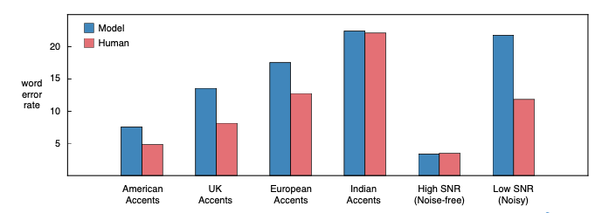
Accents and Noise

Slide 71
Dialects
Variations of the same language, specific to geographic regions or social groups
  E.g. Mexican, Argentine, Castilian are all Spanish dialects
Custom ASR per dialect?
Multi-dialect speech recognition with a single sequence-to-sequence model

Slide 72
Other research areas
Low resource languages
Code switching
ASR

Slide 73
Open source ASR toolkits
CMU Sphinx (CMU)
Kaldi (orig. Johns Hopkins University workshop)
HTK (Cambridge University)
Julius (orig. Kyoto Univeristy)
DeepSpeech (Mozilla)
Wav2Letter++ (Facebook AI)
DeepSpeech2 (Baidu)

Slide 74
Next week
Project proposals due
Weekly research topics

