Slide 1
ASR Feature Extraction, Training, Search and Evaluation
Julia Hirschberg
COMS 4706

Slide 2
Noisy Channel Model
likelihood
prior

Slide 3
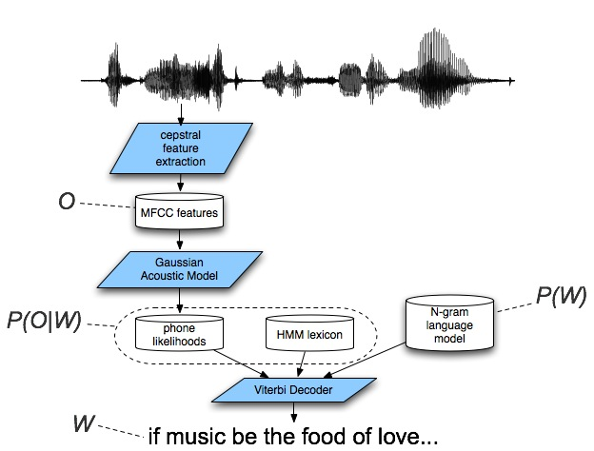
Speech Recognition Architecture

Slide 4
ASR Components
ASR Architecture
  Feature Extraction procedure
  Lexicon/Pronunciation Model
  Acoustic Model
  Language Model (Ngrams)
  Decoder
  Evaluation

Slide 5
ASR Components
ASR Architecture
  Feature Extraction procedure
  Lexicon/Pronunciation Model
  Acoustic Model
  Language Model (Ngrams)
  Decoding
  Evaluation

Slide 6
ASR Process
Choose a method to extract acoustic information
Create an Acoustic Model (AM) to compute P(O|W)
  Build an HMM for each word in lexicon
  Expand word HMMs to phone HMMs
  Build a ‘whole sentence’ HMM for each sentence in the training data (embedded training)
  Compute transition probabilities (A) and observation likelihoods (B)
Create a Language Model (LM) to compute P(W)

Slide 7
  Compute ngram log probabilities from very large text corpus and store in lookup table
Choose a Decoding strategy
  Use AM and LM to recognize new data
Choose an evaluation strategy to measure success

Slide 8
Today
Feature extraction
Embedded training using Baum-Welch
Decoding using Viterbi
Evaluation methods

Slide 9
Feature Extraction
Digitize the signal (A/D)
  Sample at : 16KHz (wideband) or 8KHz (telephone)
  Convert real amplitude values to integer
Boost energy in higher frequencies (pre-emphasis)
  Balancing spectral tilt improves phone recognition
Divide signal into overlapping frames (windowing)
  Capture stationary parts of spectrum
  Hamming windowing avoids discontinuities between windows
Perform Discrete Fourier Transform (DFT) to extract spectral data (energy) for each frequency band

Slide 10
Compute Mel Frequency Cepstral Coefficients (MFCCs) to convert DFT output to the mel scale
  Log scale above 1000 Hz to mimic human hearing
  Compute log of mel spectrum to reduce sensitivity to power variation
Compute cepstrum (spectrum of log of spectrum) to separate source (from vocal folds) from filter (vocal tract) to better identify phones
  Cepstral coefficients represent f0 and harmonics information, so we can use only harmonics
  Include delta and delta-delta cepstrum to capture change
Compute energy

Slide 11
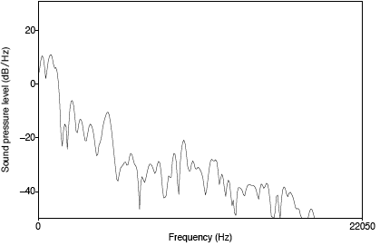
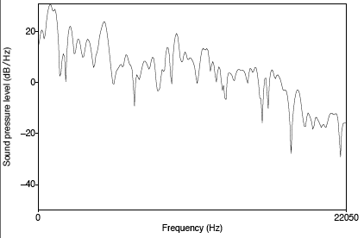
Pre-emphasis
Before and after pre-emphasis
  Spectral slice from the vowel [aa]
Notes:
Boost energy in higher frequencies (pre-emphasis)
Balancing spectral tilt improves phone recognition

Slide 12
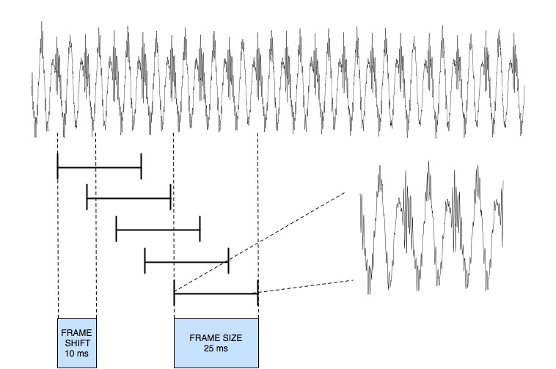
MFCC process: windowing
Notes:
Divide signal into overlapping frames (windowing)
Capture stationary parts of spectrum
Hamming windowing avoids discontinuities between windows

Slide 13
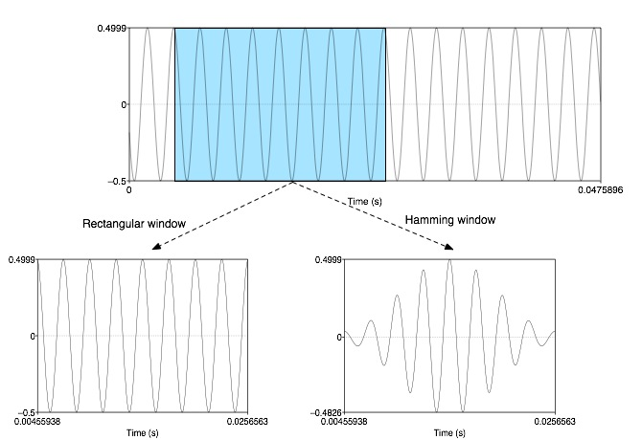
MFCC process: windowing

Slide 14
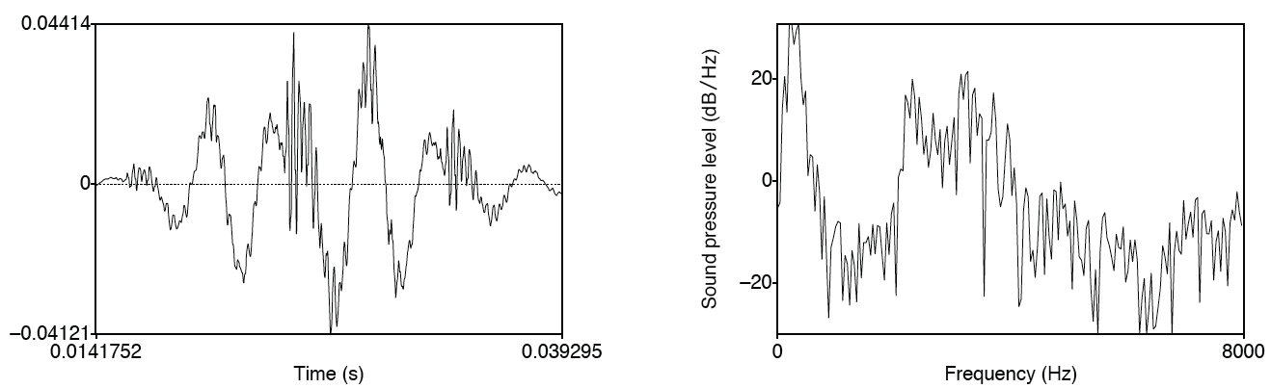
Discrete Fourier Transform computing a spectrum
A 25 ms Hamming-windowed signal from [iy]
  And its spectrum as computed by DFT (plus other smoothing)
Notes:
Perform Discrete Fourier Transform (DFT) to extract spectral data (energy) for each frequency band

Slide 15
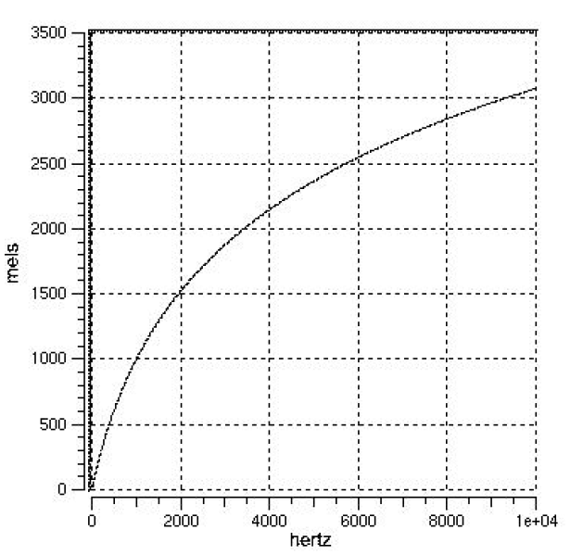
Mel-scale
Human hearing is not equally sensitive to all frequency bands
Less sensitive at higher frequencies, roughly > 1000 Hz
I.e. human perception of frequency is non-linear:
Notes:
Compute Mel Frequency Cepstral Coefficients (MFCCs) to convert DFT output to the mel scale
Log scale above 1000 Hz to mimic human hearing

Slide 16
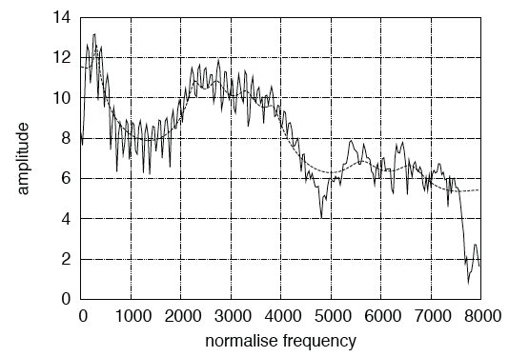
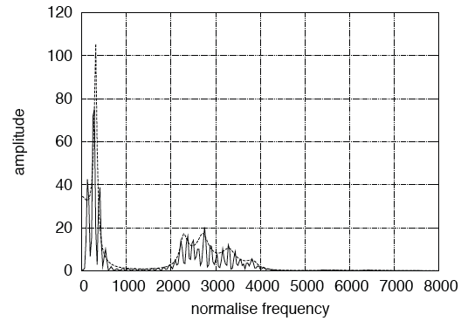
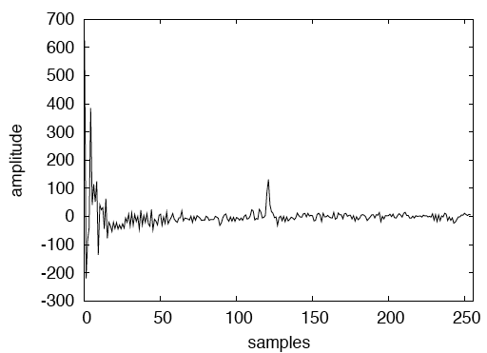
Cepstrum: Spectrum of the log of the Spectrum
Spectrum
Log spectrum
Spectrum of log spectrum
Notes:
Compute log of mel spectrum to reduce sensitivity to power variation
Compute cepstrum (spectrum of log of spectrum) to separate source (from vocal folds) from filter (vocal tract) to better identify phones
Cepstral coefficients represent f0 and harmonics information, so we can use only harmonics

Slide 17
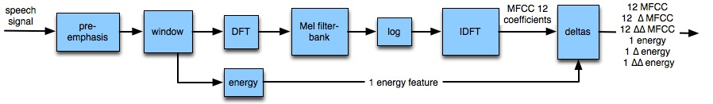
MFCC: Mel-Frequency Cepstral Coefficients
Notes:
Cepstral coefficients represent f0 and harmonics information, so we can use only harmonics
Include delta and delta-delta cepstrum to capture change
Compute energy

Slide 18
Typical MFCC features
Window size: 25ms
Window shift: 10ms
Pre-emphasis coefficient: 0.97
MFCC:
  12 MFCC (mel frequency cepstral coefficients)
  1 energy feature
  12 delta MFCC features
  12 double-delta MFCC features
  1 delta energy feature
  1 double-delta energy feature
Total 39-dimensional features
Notes:
Cepstral coefficients represent f0 and harmonics information, so we can use only harmonics
Include delta and delta-delta cepstrum to capture change
Compute energy

Slide 19
Speech Recognition Architecture

Slide 20
Embedded Training
Given a training corpus, with sentences segmented and orthographically transcribed and a pronouncing lexicon
Build HMMs for each sentence
Initialize transition probabilities (A) and observation likelihoods (B) to neutral weights
Re-estimate A and B by iterating Baum-Welch or Viterbi algorithm over corpus until convergence
Notes:
Training B likelihoods using CD phones modeled as GMMs is described in J&M 10.3 – we’ll just talk about the first stage of this training

Slide 21
Baum-Welch (Forward-Backward) Algorithm
Goal: Learn HMM parameters: transition probabilities A between the states and emission probabilities B for each state
  How likely are we to transition from state i to state j?
  How likely are we to be in state j if we observe observation o?
We’d like to just count the # of times a transition from i to j occurs and normalize by the total # of transitions from i
But -- for a given observation sequence, if we are now in state j, we have no record of how we got here
Notes:
Special case of Expectation-Maximization (EM) algorithm

Slide 22
BW intuition:
  Estimate transition counts iteratively
  Get estimates by computing the forward probability for an observation and dividing the probability mass among all the paths that might have gotten us there
Forward probability: the likelihood of being in a state j in an HMM after seeing t observations
Backward probability: the probability of seeing the observations from t+1 to the end, given that we are at state j at time t in an HMM
Together these estimate a path from start to end going through j

Slide 23
BW: Forward Algorithm
Dynamic programming algorithm
  Fills cells in trellis recursively
  Each cell α_{i}(j) represents the probability of being in state q_{j} of the HMM after seeing the first t observations
  Calculated by multiplying, for all previous paths
    α_{t-1}(i): the previous forward path probability
    α_{ij} : the transition probability from previous state q_{i} to current state q_{j}
    b_{j}(o_{t}): the observation likelihood of o_{t} at state q_{j}
  Add them up
  O(N²T) time, where T is the length of the observation sequence

Slide 24
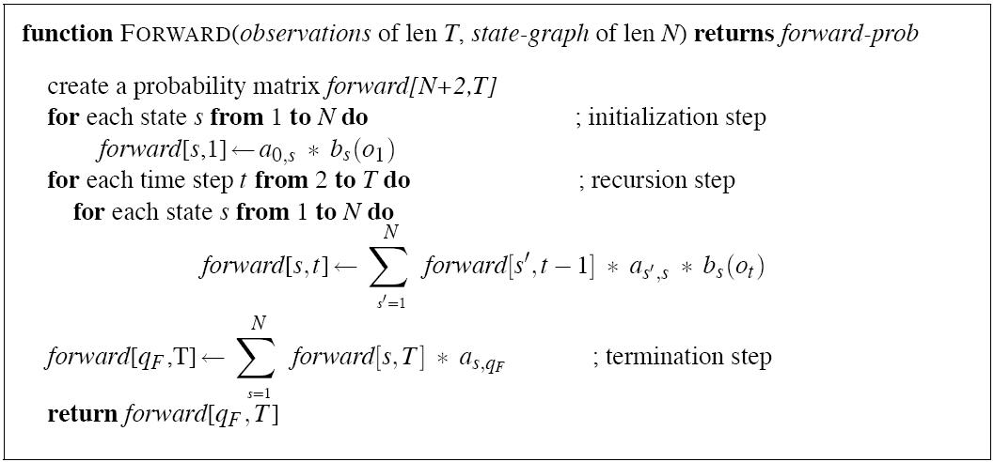
Notes:
# observations x # states
Initialize first cell of all states with likelihood of starting an utterance * observation likelihood at the state
For each subsequent observation, for each next state in the HMM, take all the preceding states and multiply the forward value of the state, the transition probability from the state, and the acoustic likelihood at the new state

Slide 25
Forward Algorithm: Summing over all possible sequences of states
A simple example: “five”
  f ay ay ay ay v v v v
  f f ay ay ay ay v v v
  f f f f ay ay ay ay v
  f f ay ay ay ay ay ay v
  f f ay ay ay ay ay ay ay ay v
  f f ay v v v v v v v

Slide 26
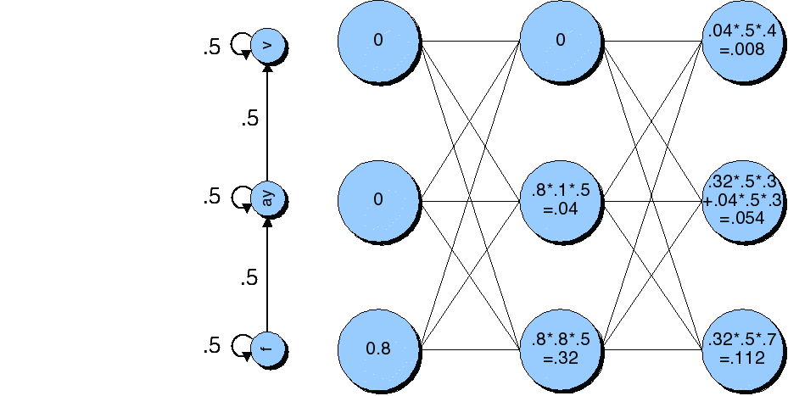
First 3 Time Steps of Forward Lattice for “five”
Notes:
Transition probabilities on left. Where do the probabilities come from? Initialization.
For each
From trellis:
At time t=1, each state is initialized with its transition probability from the start state – which is 1 only for F -- * its observation likelihood, which is .8 for F
At time t=2, there are transitions to F and AY. Each next state inherits .8 from t=1, multiplied by the transition probability from the previous state (.5 in both cases) multiplied by the observation likelihood (.8 for F and .1 for AY).
And so on.

Slide 27
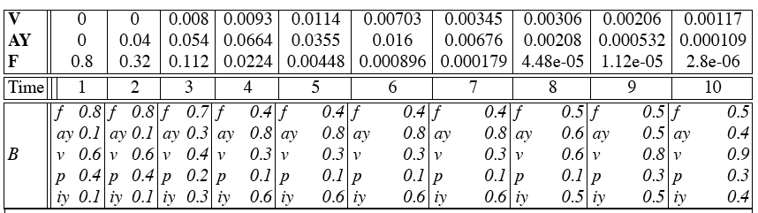
The Forward Trellis for “five”
Notes:
Top: A transition probabilities; Bottom: B observation likelihoods
At time t=1, each state is initialized with its transition probability from the start state – which is 1 only for F -- * its observation likelihood, which is .8 for F
At time t=2, there are transitions to F and AY. Each next state inherits .8 from t=1, multiplied by the transition probability from the previous state (.5 in both cases) multiplied by the observation likelihood (.8 for F and .1 for AY).
And so one.

Slide 28
BW: The Backward Probability
Initialization
Recursion
Termination
Notes:
Like Forward, but working backward
Starting from the (almost) final states, initialize their cells with the transition probability to the final state qf
For each state i, find its backward probability by summing for each next state j, all β_{t+1}(j) weighted by their transition probabilities to that state a_{iij} and observation likelihoods b_{j} (o_{t+1})

Slide 29
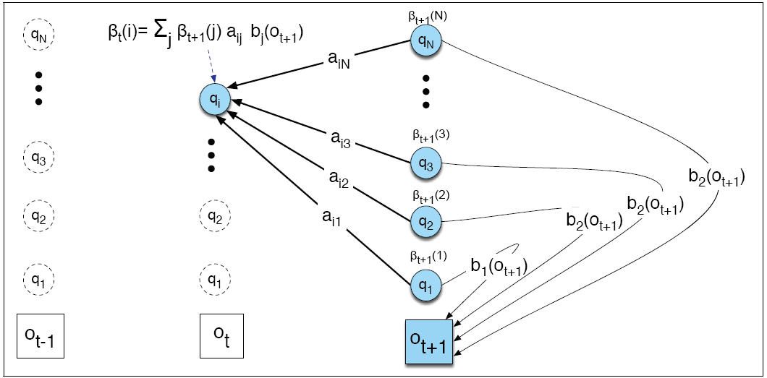
Computing β_{t}(i)

Slide 30
Finishing Baum-Welch
So how do we estimate how likely a transition is from i to j given an input O and an HMM λ?
We need to compute â_{ij}=expected transitions from i to j/expected number of transitions from i
The Forward (α) and Backward (β) probabilities get us close to estimating â_{ij} if we think of the numerator as a joint probability ξ_{t} (i,j)=P(q_{t}=i, q_{t+1}=j|O, λ)
  Now, we include O in the joint probability -- ~ξ_{t}(i,j)=P(q_{t}=i, q_{t+1}=j,O| λ)
  Next, we define the probabilities that go into computing ~ξ_{t} (i,j) in terms of α and β
Notes:
ξ is Xi (ksai)

Slide 31
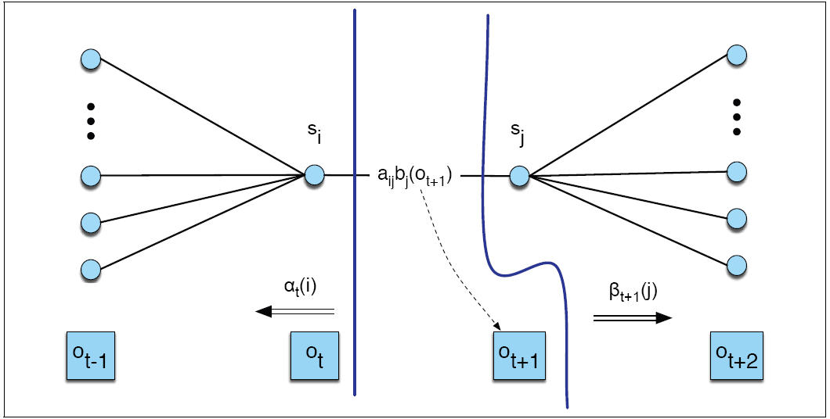
Figure 6.14
Notes:
We’re going to use the transition probability for the arc itself from i to j, the forward probability α before the arc, the backward probability β after the arc and the observation probability for the observation at j – after the arc

Slide 32
Now we have ~ξ_{t}(i,j)=α_{t}(i)*a_{ij}*b_{j}(o_{t+1})*β_{t+1}(j)
We divide by the probability of O given λ, which turns out to be just the Forward (or Backward) probability of the whole utterance
So, ξ_{t}(i,j)=α_{t}(i)*a_{ij}*b_{j}(o_{t+1})*β_{t+1}(j) / α_{T}(q_{F}) is our estimate of the transitions from i to j given O and λ at time t
We must sum over all times t in O to get the expected number of transitions from i to j at any point when O is being processed
We also need to compute our denominator – what are the total # of transitions from state i – but we can use the same equation
Notes:
The forward probability of I * the transition probability of i->j * the observation probability of the next o at state j * the backward probability of j at t+1

Slide 33
So we have
We must also compute the observation probabilities b’_{j}(v_{k}) = How often are we in state j when we observe observation o/how often are we in j at all, given O and λ
  We use ϒ_{t}(j), the probability of being in state j at time t, which we can compute using α and β
Now, given an initial estimation of the A and B probabilities, we do the following:
  E-step: estimate ξ_{t} (i,j) and ϒ_{t}(j)
  M-step: use these to compute â_{ij} and b’_{j}(v_{k}) and update the A and B tables of our HMM λ
Notes:
ϒ is upsilon
Numerator: sum estimates over all times t of transition from i to j
Denominator: sum all transitions from i to any state

Slide 34
So, How do we do Recognition?
Given: A wave file (no transcription)
Goal: output a string of words
What we have:
  A feature extraction module that extracts MFCC vectors for each 10ms window of the input
  An acoustic model with trained transition probabilities and observation likelihoods
  A language model with trained ngram probabilities
How do we put this together?

Slide 35
Why is ASR decoding hard?
Decoder must segment the utterance and identify the words at the same time

Slide 36
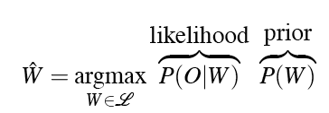
Decoding
In principle:
In practice:
  We need to give the acoustic model more weight and correct for the LM’s tendency to prefer longer words
  So….
Notes:
LMSF: Language Model Scaling factor used to offset the underestimation of acoustic word probabilities (multiplying probabilities for each frame to get word probabilities when actually if we took context into account we would get higher probabilities per frame)
WIP: Word Insertion Penalty corrects for the resulting decrease in the weight of the LM, which causes it to prefer fewer, longer words
Finally, use log probabilities to prevent underflow

Slide 37
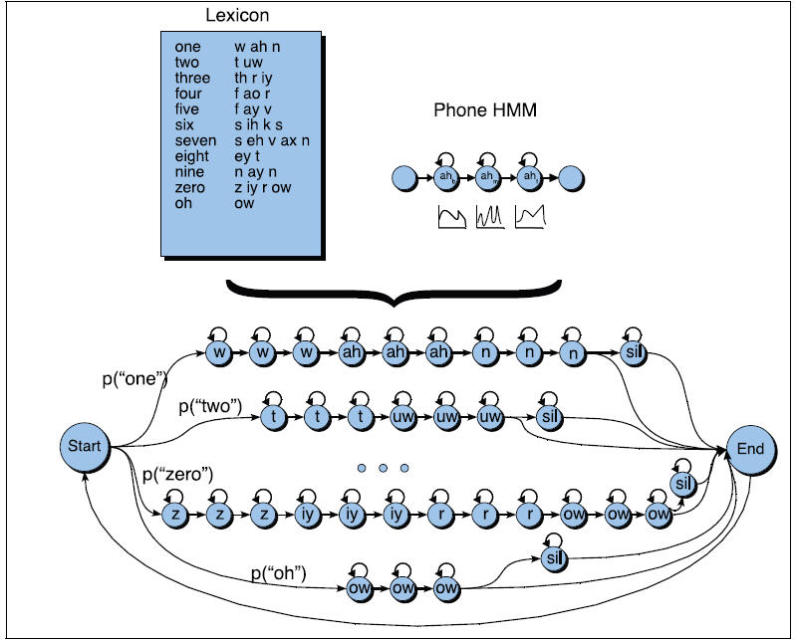

Slide 38
Decoding: Finding the Best Sequence of (Hidden) Phones
How do we find the most likely sequence of (hidden) states that generated the acoustic observations?
  For each possible (hidden) state sequence, we could run the Forward Algorithm and compute the likelihood of the observation sequence to find the state sequence with the maximum observation likelihood
  But there are an exponentially large number of state sequences
So we use a more efficient algorithm that looks a lot like the Forward Algorithm -- the Viterbi Algorithm

Slide 39
The Viterbi Algorithm
Dynamic Programming Algorithm
  Each cell in trellis represents the probability that the HMM is in state q_{i} after seeing t observations and passing thru the most probable state sequence in the HMM
  Cell v_{t}(j) computed by multiplying
    the Viterbi path probability v_{t-1}(i) from the most probable previous state q_{i}
    the transition probability from that state q_{i}
    the state observation likelihood of the input o_{t} in q_{j}

Slide 40
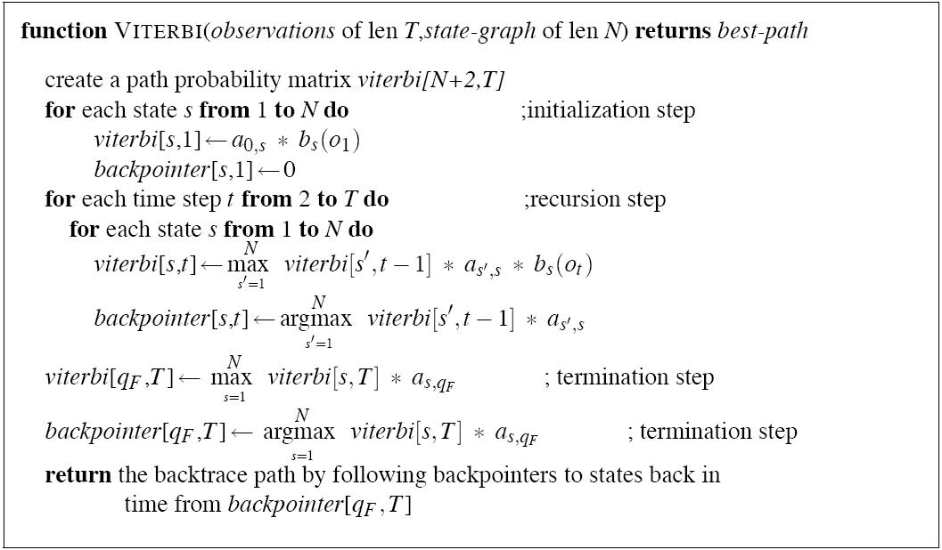
Notes:
Initialize the first column of the trellis with transition probabilities from start * observation likelihoods
For each subsequent state, multiply the best prior state times the transitions prob * the obs likelihood – choose from all possible prior states
Keep a ptr back to the prior best state

Slide 41
Like the Forward Algorithm except
  It takes the max over the previous path probabilities rather than the sum
  It maintains backpointers so the best path can be backtraced to the start state at the end of the computation
  Probabilities are different, since they come from a single path

Slide 42
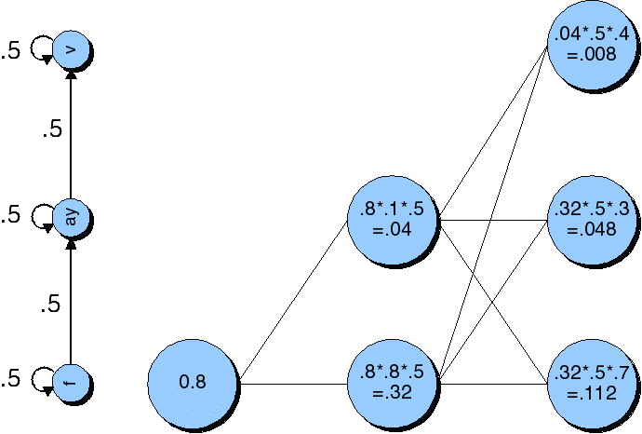
Viterbi Trellis for “five”
Notes:
Only follow best path for each subsequent state: compare the probability at t3

Slide 43
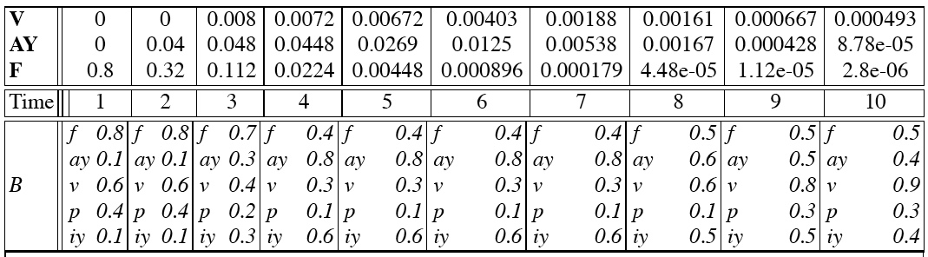
Viterbi Trellis for “five”

Slide 44
Decoding Word Sequences from HMM States
We have a path thru HMM states, so how do we figure out the words?
Augment transition matrix (A) with interword probability of transitioning from end of w₁ to beginning of w₂
Use ngram LM priors (P(W)) to model transitions between words in HMM
Once Viterbi trellis computed
  Start from most probable state at t_{n}
  Follow backtrace ptrs to get most probable string of states: most probable string of words

Slide 45
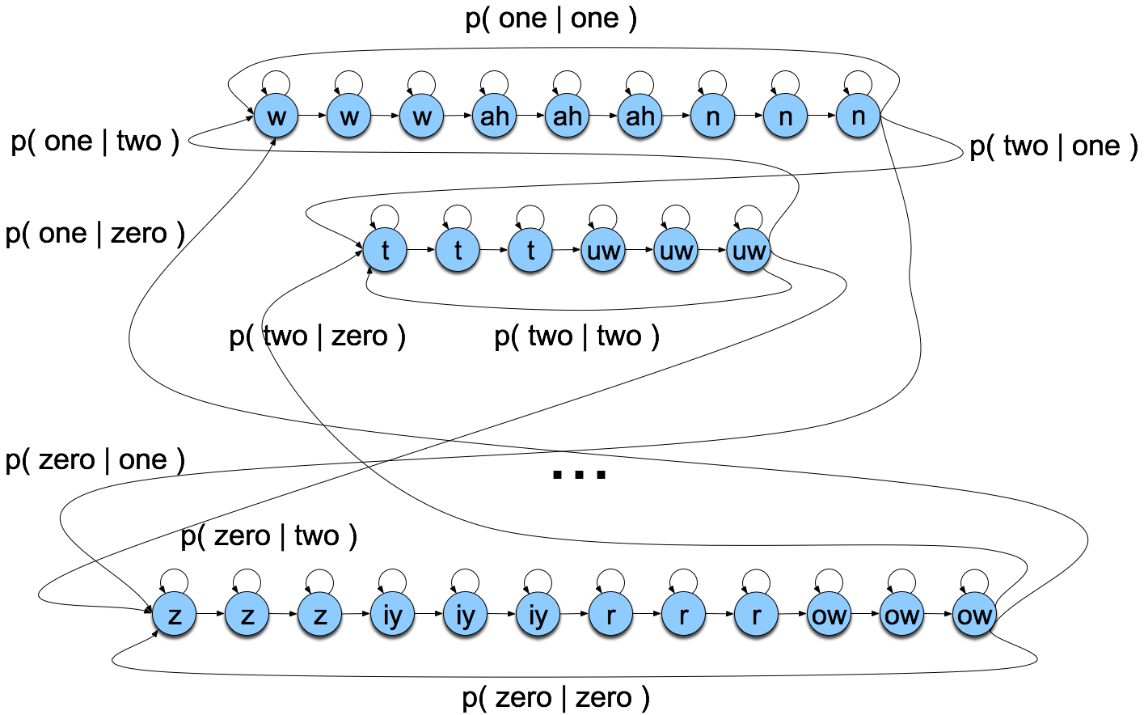
Search Space with Bigrams
Notes:
Bigrams provide probability of transitioning from one word to another

Slide 46
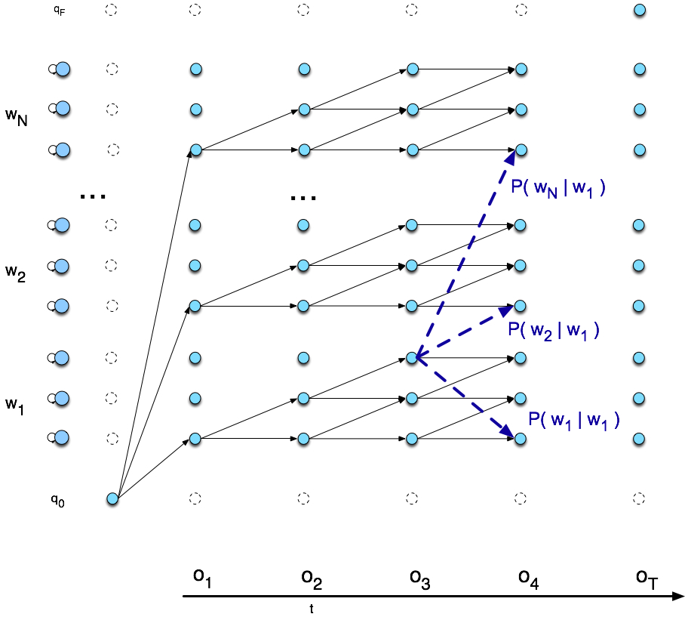
Viterbi trellis
Notes:
Potential transitions are added between states endings and beginning words

Slide 47
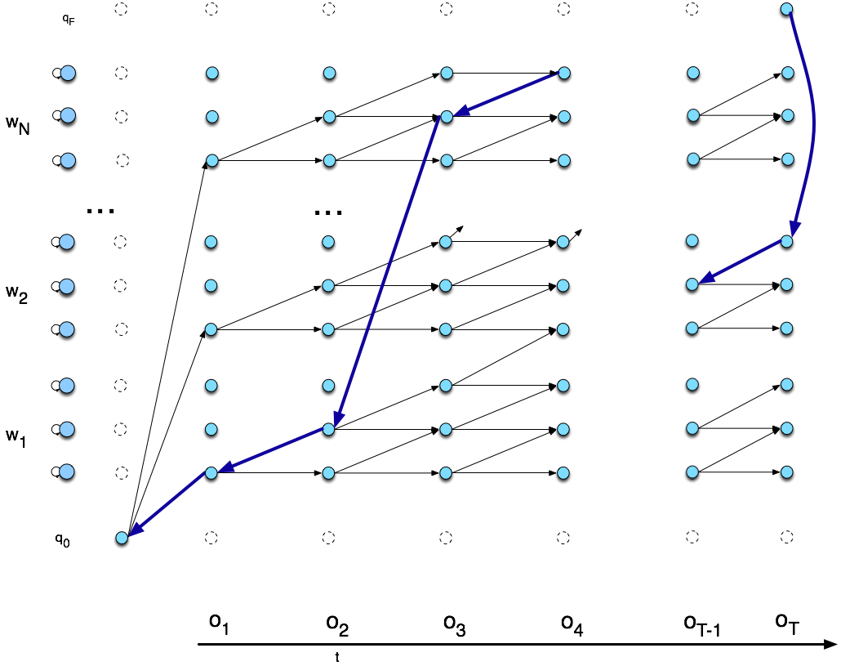
Viterbi Backtrace
Notes:
Result: best phone string which derives a word string: here, 2 words

Slide 48
Pruning and Beam Search
Viterbi better than Forward Algorithm but still slow – what can we do?
Prune low probability paths at each time step
Beam Search:
  At each time t, compute probability of best state/path D
  Prune any state worse than D by a threshold (beam width) θ
  Improves performance significantly

Slide 49
Evaluation
How do we evaluate the word string output by a speech recognizer?

Slide 50
Word Error Rate
Word Error Rate =
100 (Insertions+Substitutions + Deletions)
------------------------------
Total Word in Correct Transcript
Aligment example:
REF: portable **** PHONE UPSTAIRS last night so
HYP: portable FORM OF STORES last night so
Eval I S S
WER = 100 (1+2+0)/6 = 50%

Slide 51
NIST sctk-1.3 scoring softare:
Computing WER with sclite
http://www.nist.gov/speech/tools/
Sclite aligns a hypothesized text (HYP) (from the recognizer) with a correct or reference text (REF) (human transcribed)
id: (2347-b-013)
Scores: (#C #S #D #I) 9 3 1 2
REF: was an engineer SO I i was always with **** **** MEN UM and they
HYP: was an engineer ** AND i was always with THEM THEY ALL THAT and they
Eval: D S I I S S

Slide 52
Sclite output for error analysis
CONFUSION PAIRS Total (972)
With >= 1 occurances (972)
1: 6 -> (%hesitation) ==> on
2: 6 -> the ==> that
3: 5 -> but ==> that
4: 4 -> a ==> the
5: 4 -> four ==> for
6: 4 -> in ==> and
7: 4 -> there ==> that
8: 3 -> (%hesitation) ==> and
9: 3 -> (%hesitation) ==> the
10: 3 -> (a-) ==> i
11: 3 -> and ==> i
12: 3 -> and ==> in
13: 3 -> are ==> there
14: 3 -> as ==> is
15: 3 -> have ==> that
16: 3 -> is ==> this

Slide 53
Sclite output for error analysis
17: 3 -> it ==> that
18: 3 -> mouse ==> most
19: 3 -> was ==> is
20: 3 -> was ==> this
21: 3 -> you ==> we
22: 2 -> (%hesitation) ==> it
23: 2 -> (%hesitation) ==> that
24: 2 -> (%hesitation) ==> to
25: 2 -> (%hesitation) ==> yeah
26: 2 -> a ==> all
27: 2 -> a ==> know
28: 2 -> a ==> you
29: 2 -> along ==> well
30: 2 -> and ==> it
31: 2 -> and ==> we
32: 2 -> and ==> you
33: 2 -> are ==> i
34: 2 -> are ==> were

Slide 54
Better Metrics than WER?
WER has been useful
But should we be more concerned with meaning (“semantic error rate”)?
  Good idea, but hard to agree on domain concepts
  Has been applied in dialogue systems, where desired semantic output may be more clear
  Just like WER but defined in terms of concepts, not words

Slide 55
Summary: ASR Architecture
ASR Noisy Channel architecture
  Feature Extraction:
    39 “MFCC” features
  Acoustic Model:
    Gaussians for computing p(o|w)
  Lexicon/Pronunciation Model
    HMM: what CD phones can follow each other for computing p(o|w)
  Language Model for computing p(w)
    Probability of N-grams in context, e.g. p(w_{i}|w_{i-1})
  Decoder
    Viterbi algorithm: dynamic programming for combining all these to get best word sequence from speech
  6) Evaluation
    Metric for determining success, improvement

Slide 56

Accents: An experiment
A word by itself
The word in context

Slide 57
Next Class
Spoken Dialogue Systems
Proj 2 due 4/11 at 11:59pm

