Slide 1
Spoken Dialogue System Architecture
Joshua Gordon
CS4706

Slide 2
Outline
Goals of an SDS architecture
Research challenges
Practical considerations
An end-to-end tour of a real world SDS

Slide 3
SDS Architectures
Software abstractions that tie together orchestrate the many NLP components required for human-computer dialogue
Conduct task-oriented, limited-domain conversations
Manage the many levels of information processing (e.g., utterance interpretation, turn taking) necessary for dialogue
  In real-time, under uncertainty

Slide 4
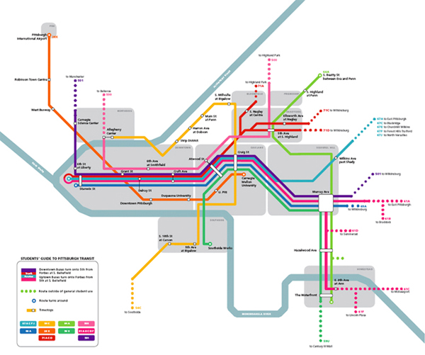

Examples
Information seeking, transactional
Most common
CMU – Bus route information
Columbia – Virtual Librarian
Google – Directory service
Let’s Go Public

Slide 5

Examples
Virtual Humans
Multimodal input / output
Prosody and facial expression
Auditory and visual clues assist turn taking
Many limitations
  Scripting
  Constrained domain
http://ict.usc.edu/projects/virtual_humans

Slide 6
Examples
Interactive Kiosks
Multi-participant conversations!
Surprises and challenges passersby to trivia games
[Bohus and Horvitz, 2009]

Slide 7
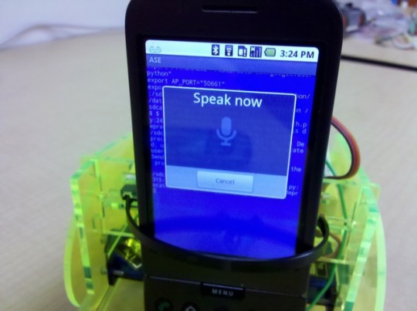
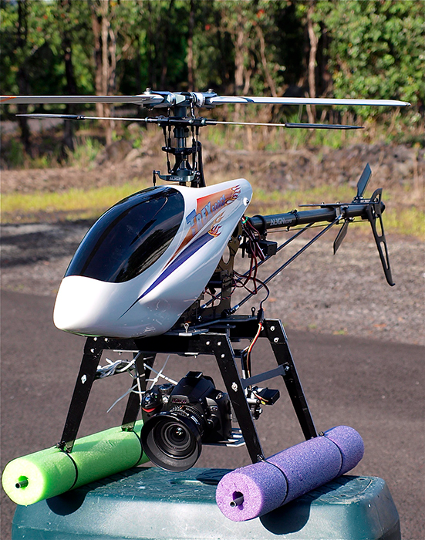
Examples
Robotic Interfaces
www.cellbots.com
Speech interface to a UAV
[Eliasson, 2007]

Slide 8
Conversational skills
SDS Architectures tie together:
  Speech recognition
  Turn taking
  Dialogue management
  Utterance interpretation
  Grounding
  Natural language generation
And increasingly include
  Multimodal input / output
  Gesture recognition

Slide 9
Research Challenges in every area
Speech recognition
  Accuracy in interactive settings, detecting emotion.
Turn taking
  Fluidly handling overlap, backchannels.
Dialogue management
  Increasingly complex domains, better generalization, multi-party conversations.
Utterance interpretation
  Reducing constraints on what the user can say, and how they can say it. Attending to prosody, emphasis, speech rate.

Slide 10
A tour of a real-world SDS
CMU Olympus
  Open source collection of dialogue system components
  Research platform used to investigate dialogue management, turn taking, spoken language interpretation
  Actively developed
Many implementations
  Let’s go public, Team Talk, CheckItOut
www.speech.cs.cmu.edu

Slide 11
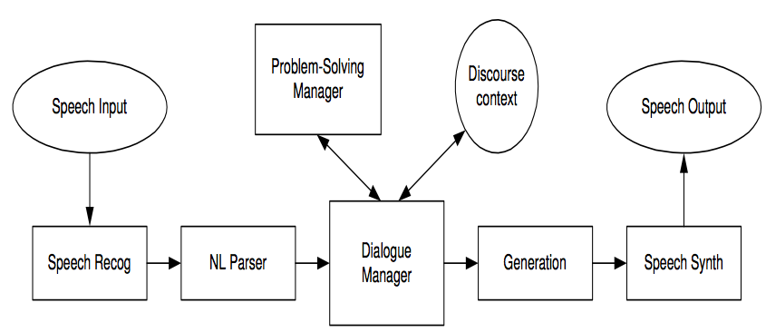
Conventional SDS Pipeline
Speech signals to words. Words to domain concepts. Concepts to system intentions. Intentions to utterances (represented as text). Text to speech.

Slide 12
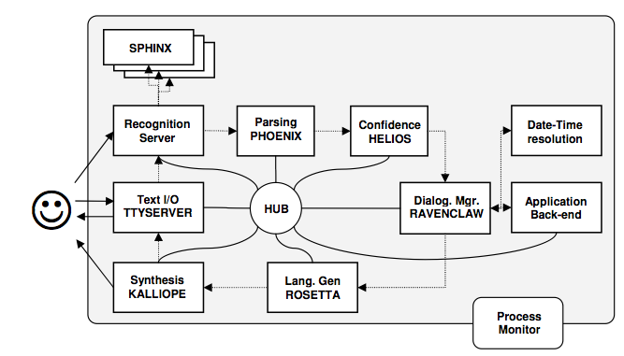
Olympus under the hood: provider pattern

Slide 13
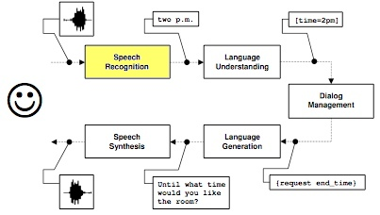
Speech recognition

Slide 14
The Sphinx Open Source Recognition Toolkit
Pocket-sphinx
  Continuous speech, speaker independent recognition system
  Includes tools for language model compilation, pronunciation, and acoustic model adaptation
  Provides word level confidence annotation, n-best lists
  Efficient – runs on embedded devices (including an iPhone SDK)
Olympus supports parallel decoding engines / models
  Typically runs parallel acoustic models for male and female speech
http://cmusphinx.sourceforge.net/

Slide 15
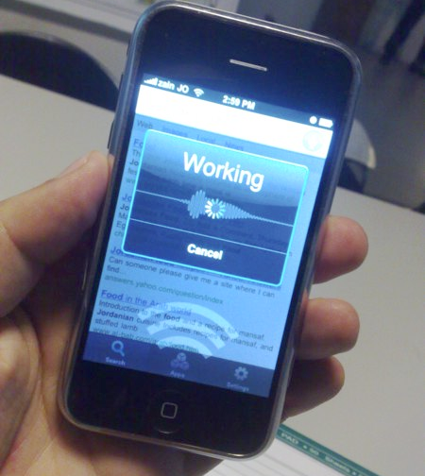
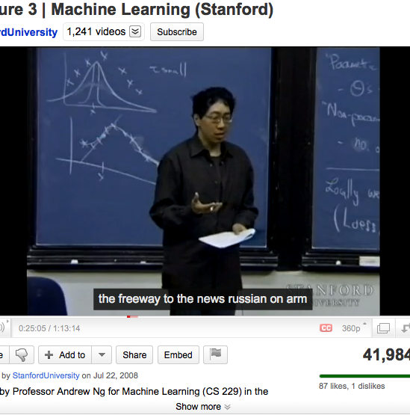
Speech recognition challenge in interactive settings

Slide 16
Spontaneous dialogue is difficult for speech recognizers
Poor in interactive settings compared to one-off applications like voice search and dictation
Performance phenomena: backchannels, pause-fillers, false-starts…
OOV words
Interaction with an SDS is cognitively demanding for users
  What can I say and when? Will the system understand me?
  Uncertainty increases disfluency, resulting in further recognition errors

Slide 17
WER (Word Error Rate)
Non-interactive settings
  Google Voice Search: 17% deployed (0.57% OOV over 10k queries randomly sampled from Sept-Dec, 2008)
Interactive settings:
  Let’s Go Public: 17% in controlled conditions vs. 68% in the field
  CheckItOut: Used to investigate task-oriented performance under worst case ASR - 30% to 70% depending on experiment
  Virtual Humans: 37% in laboratory conditions

Slide 18
Examples of (worst-case) recognizer noise
S: What book would you like?
U: The Language of Sycamores
ASR: THE LANGUAGE OF IS .A. COMING WARS
S: Hi Scott, welcome back!
U: Not Scott, Sarah! Sarah Lopez.
ASR: SCOTT SARAH SCOUT LAW

Slide 19
Error Propagation
Recognizer noise injects uncertainty into the pipeline
Information loss occurs when moving from an acoustic signal to a lexical representation
  Most SDSs ignore prosody, amplitude, emphasis
Information provided to downstream components includes
    An n-best list, or word lattice
    Low level features: speech rate, speech energy…

Slide 20
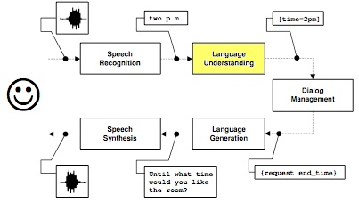
Spoken Language Understanding

Slide 21
SLU maps from words to concepts
Dialog acts (the overall intent of an utterance)
Domain specific concepts (like a book, or bus route)
Single utterances vs. across turns
Challenging in noisy settings
Ex. “Does the library have Hitchhikers Guide to the Galaxy by Douglas Adams on audio cassette?”
Dialog Act | Book Request
Title | The Hitchhikers Guide to the Galaxy
Author | Douglas Adams
Media | Audio Cassette

Slide 22
Semantic grammars
Domain independent concepts
  [Yes], [No], [Help], [Repeat], [Number]
Domain specific concepts
  [Book], [Author]
[Quit]
(*THANKS *good bye)
(*THANKS goodbye)
(*THANKS +bye)
;
THANKS
(thanks *VERY_MUCH)
(thank you *VERY_MUCH)
VERY_MUCH
(very much)
(a lot)
;

Slide 23
Grammars generalize poorly
Useful for extracting fine-grained concepts, but…
Hand engineered
  Time consuming to develop and tune
  Requires expert linguistic knowledge to construct
Difficult to maintain over complex domains
Lack robustness to OOV words, novel phrasing
Sensitive to recognizer noise

Slide 24
SLU in Olympus: the Phoenix Parser
Phoenix is a semantic parser, indented to be robust to recognition noise
Phoenix parses the incoming stream of recognition hypotheses
Maps words in ASR hypotheses to semantic frames
  Each frame has an associated CFG Grammar, specifying word patterns that match the slot
  Multiple parses may be produced for a single utterance
  The frame is forward to the next component in the pipeline

Slide 25
Statistical methods
Supervised learning is commonly used for single utterance interpretation
  Given word sequence W, find the semantic representation of meaning M that has maximum a posteriori probability P(M|W)
Useful for dialog act identification, determining broad intent
Like all supervised techniques…
  Requires a training corpus
  Often is domain and recognizer dependent

Slide 26
Belief updating

Slide 27

Cross-utterance SLU
U: Get my coffee cup and put it on my desk. The one at the back.
Difficult in noisy settings
Mostly new territory for SDS
[Zuckerman, 2009]

Slide 28
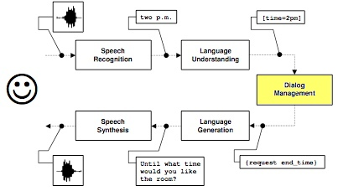
Dialogue Management

Slide 29
The Dialogue Manager
Represents the system’s agenda
  Many techniques
  Hierarchal plans, state / transaction tables, Markov processes
System initiative vs. mixed initiative
  System initiative has less uncertainty about the dialog state, but is clunky
Required to manage uncertainty and error handing
  Belief updating, domain independent error handling strategies

Slide 30
Task Specification, Agenda, and Execution
[Bohus, 2007]

Slide 31
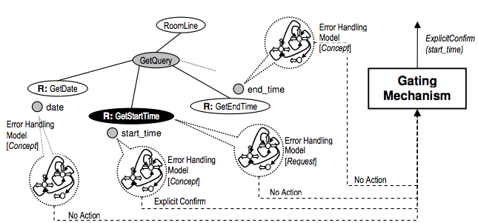
Domain independent error handling
[Bohus, 2007]

Slide 32
Error recovery strategies
Error Handling Strategy (misunderstanding) | Example
Explicit confirmation | Did you say you wanted a room starting at 10 a.m.?
Implicit confirmation | Starting at 10 a.m. ... until what time?
Error Handling Strategy (non-understanding) | Example
Notify that a non-understanding occurred | Sorry, I didn’t catch that .
Ask user to repeat | Can you please repeat that?
Ask user to rephrase | Can you please rephrase that?
Repeat prompt | Would you like a small room or a large one?

Slide 33
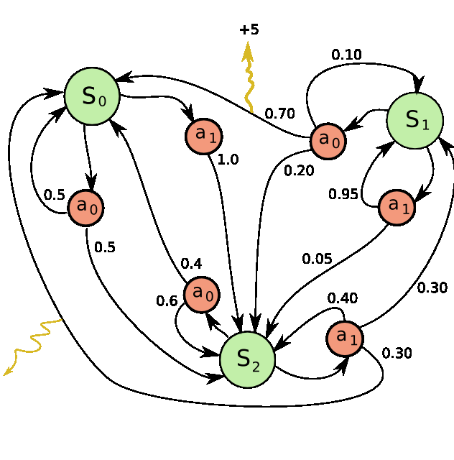
Statistical Approaches to Dialogue Management
Learning management policy from a corpus
Dialogue can be modeled as Partially Observable Markov Decision Processes (POMDP)
Reinforcement learning is applied (either to existing corpora or through user simulation studies) to learn an optimal strategy
Evaluation functions typically reference the PARADISE framework

Slide 34
Interaction management

Slide 35
The Interaction Manager
Mediates between the discrete, symbolic reasoning of the dialog manager, and the continuous real-time nature of user interaction
Manages timing, turn-taking, and barge-in
  Yields the turn to the user on interruption
  Prevents the system from speaking over the user
Notifies the dialog manager of
  Interruptions and incomplete utterances

Slide 36
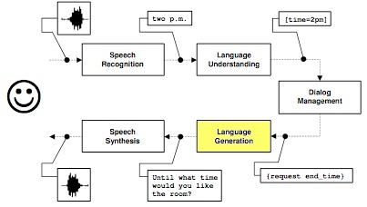
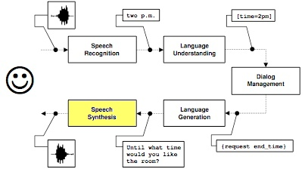
Natural Language Generation and Speech Synthesis

Slide 37
NLG and Speech Synthesis
Template based, e.g., for explicit error handling strategies
  Did you say <concept>?
  More interesting cases in disambiguation dialogs
A TTS synthesizes the NLG output
  The audio server allows interruption mid utterance
Production systems incorporate
  Prosody, intonation contours to indicate degree of certainty
Open source TTS frameworks
  Festival - http://www.cstr.ed.ac.uk/projects/festival/
  Flite - http://www.speech.cs.cmu.edu/flite/

Slide 38
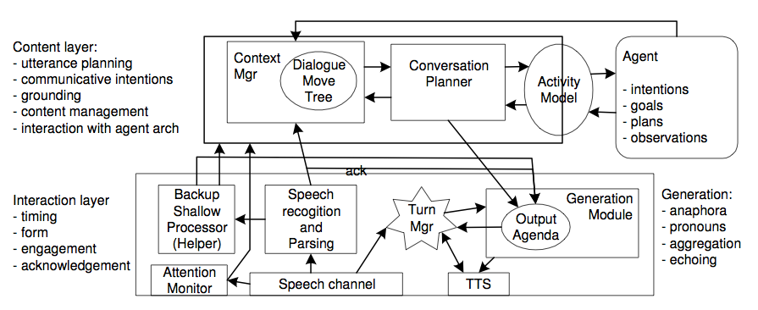
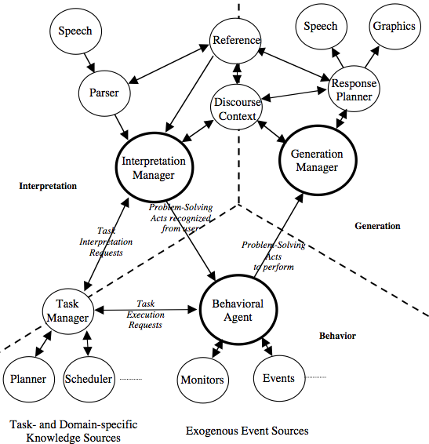
Asynchronous architectures
Lemon, 2003
Backup recognition pass enables better
discussion of OOV utterances
Blaylock, 2002
An asynchronous modification of TRIPS,
most work is directed toward best-case speech recognition

Slide 39
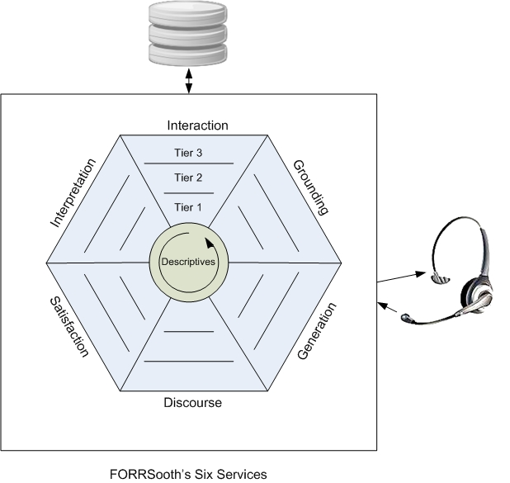
Problem-solving architectures
FORRSooth models task-oriented dialogue as cooperative decision making
Six FORR-based services operating in parallel
  Interpretation
  Grounding
  Generation
  Discourse
  Satisfaction
  Interaction
Each service has access to the same knowledge in the form of descriptives

Slide 40
Thanks! Questions?

