Slide 1
Spoken Dialogue Systems: Human and Machine
Julia Hirschberg
CS 4706

Slide 2
Today
Introduction to Spoken Dialogue Systems (SDS)
  Automatic Speech Recognition (ASR)
  Natural Language Understand (NLU)
  Natural Language Generation (NLG) and Text-to-Speech Synthesis (TTS)
Cooperative Question-Answering
Dialogue Representations
Issues to consider in designing your dialogue systems

Slide 3
Spoken Dialogue Systems
AKA:
  Interactive Voice Response Systems
  Dialogue Systems
  Spoken Dialogue Systems
  Conversational Agents
Applications:
  Travel arrangements (Amtrak, United airlines)
  Telephone call routing
  Tutoring
  Communicating with robots
  Anything with limited screen/keyboard

Slide 4
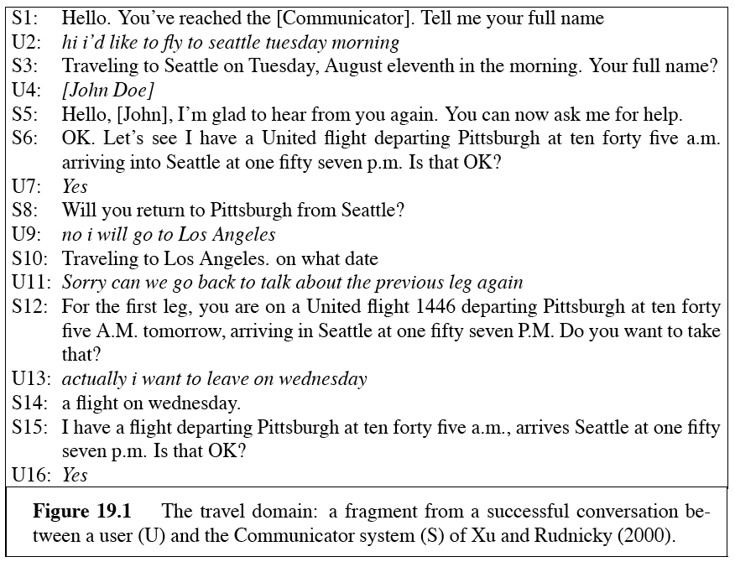
A Travel Dialogue: Communicator

Slide 5
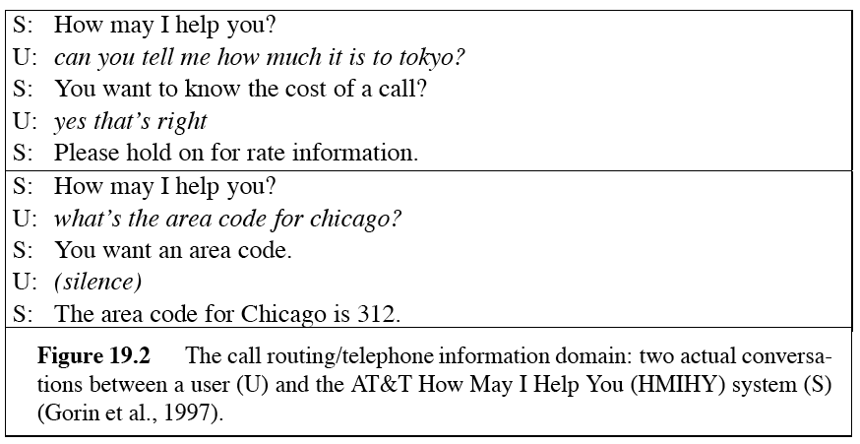
Call routing: ATT HMIHY

Slide 6
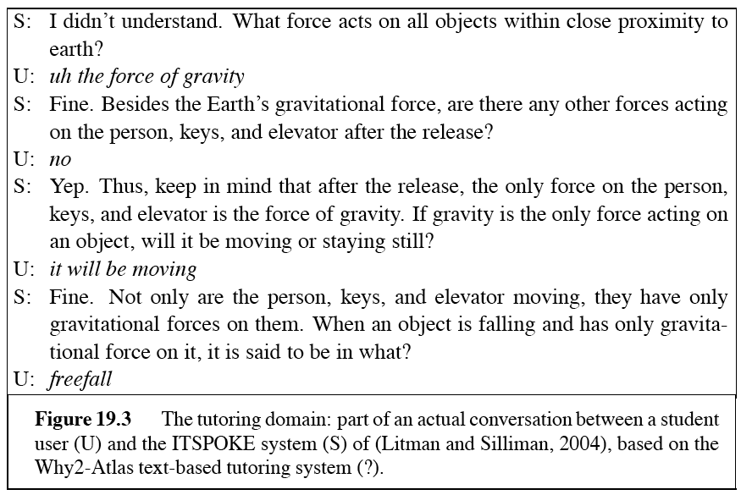
A tutorial dialogue: ITSPOKE

Slide 7
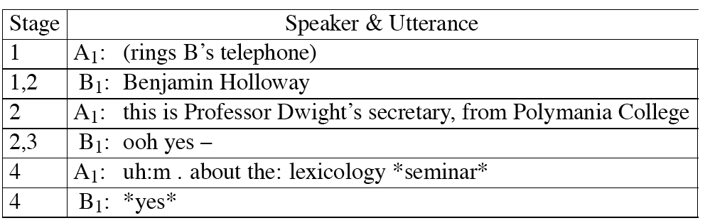
Conversational Structure
Telephone conversations
  Stage 1: Enter a conversation
  Stage 2: Identification
  Stage 3: Establish joint willingness to converse
  Stage 4: First topic is raised, usually by caller

Slide 8
Is this a simple conversation?
Customer: (rings)
Operator: Directory Enquiries, for which town please?
Customer: Could you give me the phone number of um: Mrs. um: Smithson?
Operator: Yes, which town is this at please?
Customer: Huddleston.
Operator: Yes. And the name again?
Customer: Mrs. Smithson

Slide 9
Is this?
A: And, what day in May did you want to travel?
C: OK, uh, I need to be there for a meeting that’s from the 12th to the 15th.
Client did not answer question.
Meaning of client’s sentence:
  Meeting
    Start-of-meeting: 12th
    End-of-meeting: 15th
  Doesn’t say anything about flying!
How does the agent infer client is informing him/her of travel dates?

Slide 10
Is this?
B: I want a non-stop flight from New York La Guardia to Tucson.
A: … there’s 3 non-stops today.
  True if, in fact, there are 7 non-stops today.
  But agent means: 3 and only 3.
  How can client infer that agent means:
    only 3

Slide 11
Grice: Conversational Implicature
Implicature: a particular class of licensed inferences
Grice (1975): how do conversational participants draw inferences beyond what is actually asserted?
Cooperative Principle
  "Make your contribution such as it is required, at the stage at which it occurs, by the accepted purpose or direction of the talk exchange in which you are engaged."
  A tacit agreement by speakers and listeners to cooperate in communication

Slide 12
4 Gricean Maxims
Relevance: Be relevant
Quantity: Do not make your contribution more or less informative than required
Quality: Try to make your contribution one that is true (don’t say things that are false or for which you lack adequate evidence)
Manner: Avoid ambiguity and obscurity; be brief and orderly

Slide 13
Maxim of Relevance
A: Is Regina here?
B: Her car is outside.
Implicature: yes
  Hearer thinks: Why would B mention the car? It must be relevant. How could it be relevant? It could since if her car is here she is probably here.
Client: I need to be there for a meeting that’s from the 12th to the 15th
  Hearer thinks: Speaker is following maxims, would only have mentioned meeting if it was relevant. How could meeting be relevant? If client meant me to understand that he had to depart in time to attend the meeting.

Slide 14
Maxim of Quantity
A: How much money do you have on you?
B: I have 5 dollars
  Implicature: not 6 dollars
Similarly, 3 non-stops means ‘only 3’
  Hearer thinks: If speaker meant 7 non-stops she would have said 7 non-stops
A: Did you do the reading for today’s class?
B: I meant to
  Implicature: No
  B’s answer would be true if B intended to do the reading AND in fact did do the reading, but would then violate Maxim of Quantity

Slide 15
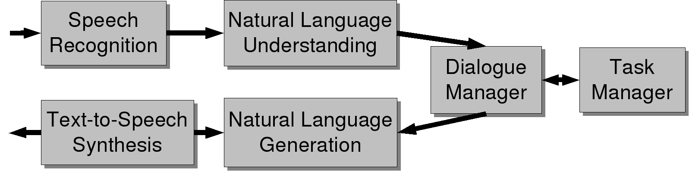
Dialogue System Architecture

Slide 16
Speech Recognition
Input: acoustic waveform
Output: string of words
  Basic components:
    A recognizer for phones, small sound units like [k] or [ae].
    A pronunciation dictionary mapping orthography to sounds, e.g. can = [k ae n]
    A language model or grammar telling us what words are likely to follow what words
      I {want|need|would like} to {leave|fly} from {La Guardia|JFK|Newark}
    A search algorithm to find the best string of words

Slide 17
Natural Language Understanding
Or “NLU”
Or “Computational Semantics”
Many ways to represent the meaning of sentences
For speech dialogue systems, most common is Frame and Slot Semantics

Slide 18
A Sample Frame
Show me morning flights from Boston to SF on Tuesday.
SHOW:
FLIGHTS:
ORIGIN:
CITY: Boston
DATE: Tuesday
TIME: morning
DEST:
CITY: San Francisco

Slide 19
How do we Generate this Semantics?
Many methods
  Simplest: “semantic grammars”
  E.g. a simple Context Free Grammar
LHS of rules defining semantic categories:
  LIST -> show me | I want | can I see|…
  DEPARTTIME -> (after|around|before) HOUR | morning | afternoon | evening
  HOUR -> one|two|three…|twelve (am|pm)
  FLIGHTS -> (a) flight|flights
  ORIGIN -> from CITY
  DESTINATION -> to CITY
  CITY -> Boston | San Francisco | Denver | Washington

Slide 20
Semantics for a sentence
LIST FLIGHTS ORIGIN
Show me flights from Boston
DESTINATION DEPARTDATE
to San Francisco on Tuesday
DEPARTTIME
morning

Slide 21
Generation and TTS
Generation component
  Chooses concepts to express to user
  Plans how to express these concepts in words
  Assigns appropriate prosody to the words
TTS component
  Takes words and prosodic annotations
  Synthesizes a waveform

Slide 22
Generation Component
Content Planner
  Decides what information to express to user
    (ask a question, present an answer, etc.)
  Often merged with dialogue manager
Language Generation
  Chooses syntactic structures and words to express meaning.
  Simplest method
    Pre-specify basic sentences and fill in the blanks as appropriate
    Template-based generation
    Can have variables:
      What time do you want to leave CITY-ORIG?
      Will you return to CITY-ORIG from CITY-DEST?

Slide 23
More sophisticated language generation component
Natural Language Generation
Approach:
  Dialogue manager builds representation of meaning of utterance to be expressed
  Passes this to a “generator”
  Generators have three components
    Sentence planner
    Surface realizer
    Prosody assigner

Slide 24
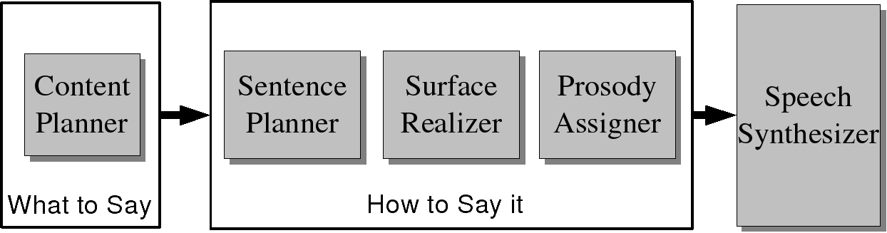
Architecture of a generator for a dialogue system
(after Walker and Rambow 2002)

Slide 25
HCI constraints on generation for dialogue: Coherence
Discourse markers and pronouns (Coherence”):
  Please say the date.…
  Please say the start time.…
  Please say the duration…
  Please say the subject…
  First, tell me the date.…
  Next, I’ll need the time it starts.…
  Thanks. <pause> Now, how long is it supposed to last?…
  Last of all, I just need a brief description
Bad!
Good!

Slide 26
HCI Constraints on Dialogue Generation Coherence: Tapered Prompts
Prompts which get incrementally shorter:
  System: Now, what’s the first company to add to your watch list?
  Caller: Cisco
  System: What’s the next company name? (Or, you can say, “Finished”)
  Caller: IBM
  System: Tell me the next company name, or say, “Finished.”
  Caller: Intel
  System: Next one?
  Caller: America Online.
  System: Next?
  Caller: …

Slide 27
Issues in Building SDS
Which architecture to use?
How much discourse history to collect?
What type of dialogue strategy to follow?
What type of confirmation strategy to use?
What kind of help to provide?
How to recover from errors?

Slide 28
Discourse History
What information to keep track of?
  What you need to find out from the user
  What you think the user knows
  What the user has told you
  What else?

Slide 29
Dialogue Strategy
System initiative
  Please tell me your destination city.
User initiative
  How may I help you?
  I’d like to go from Boston to Baltimore on Monday, January 24th.
Mixed initiative
  May I give you flight information?
  Yes, I’d like to go to Boston.
  Where would you be leaving from?

Slide 30
Confirmation Strategy
Explicit
  I want to transfer $500.
  Did you say you want to transfer $500?
Implicit
  I want to transfer $500
  What account do you want to transfer $500 to?
None at all
  I want to transfer $500.
  Okay.

Slide 31
Providing Help
General help module
  What kinds of things can I do in this SDS?
  What kinds of things can I say?
  What do I do when I get totally stuck?
    Can I back up without starting over?
    Can I start over from the beginning?
    Can I talk to a person?
Context-dependent help
  Make help specific to where the user is in the dialogue

Slide 32
How can users recover from errors?
Clarification subdialogues
  Did you say you need 47 lettuces shipped to Kandajar?
  No! That’s not what I said.
  What do you want shipped to Kandajar?
  Ladders, not lettuce!
  Did you say ‘ladders’?
  Yes.
  You want ladders shipped to Kandajar?
  Yes, 47 ladders.

Slide 33
Next Class
Speech sounds → phonetics and phonology
Make appointments with me or your TAs to discuss your project
  Bring a one-paragraph description
  At least one team member present
  Project descriptions now due February 6

