Slide 1
Building an ASR using HTK
CS4706
Fadi Biadsy
Mar 24th, 2010

Slide 2
Outline
Speech Recognition
Feature Extraction
Modeling Speech
  Hidden Markov Models (HMM): 3 basic problems
HMM Toolkit (HTK)
  Steps for building an ASR using HTK

Slide 3
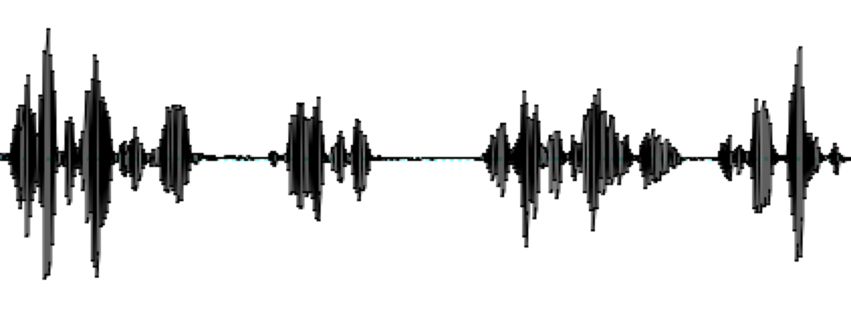
Automatic Speech Recognition (ASR)
Speech signal to text
ASR
There’s something happening when Americans…

Slide 4
It’s hard to recognize speech
Contextual effects
  Speech sounds vary within contexts
    “How do you do?”
    Half and half
    /t/ in butter vs. bat
Within-speaker variability
  Speaking rate, Intensity, F0 contour
  Voice quality
  Speaking Style
    Formal vs. spontaneous register
    Speaker State: Emotion, Sleepy, Drunk,…
Between-speaker variability
  Gender and age
  Accents, Dialects, native vs. non-native
    Scottish vs. American /r/ in some contexts
Environment variability
  Background noise
  Microphone type

Slide 5
Outline
Speech Recognition
Feature Extraction
Modeling Speech
  Hidden Markov Models (HMM): 3 basic problems
HMM Toolkit (HTK)
  Steps for building an ASR using HTK

Slide 6
Feature Extraction
Wave form?
Spectrogram?
Need representation of speech signal that is robust to acoustic variation but sensitive to linguistic content

Slide 7
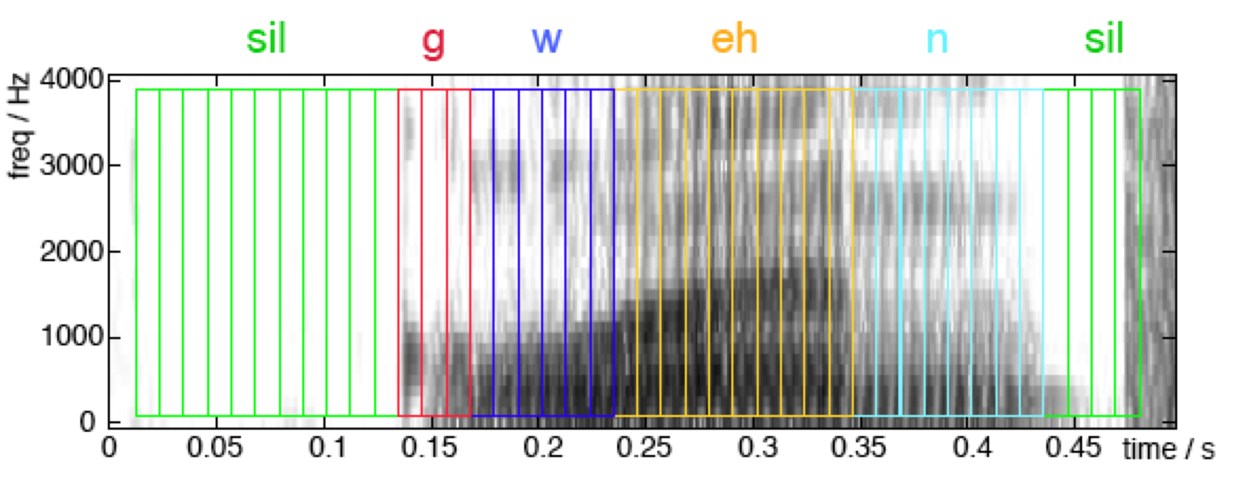
Feature Extraction
Extract features from short frames (frame period 10ms, 25ms frame size) – a sequence of features

Slide 8
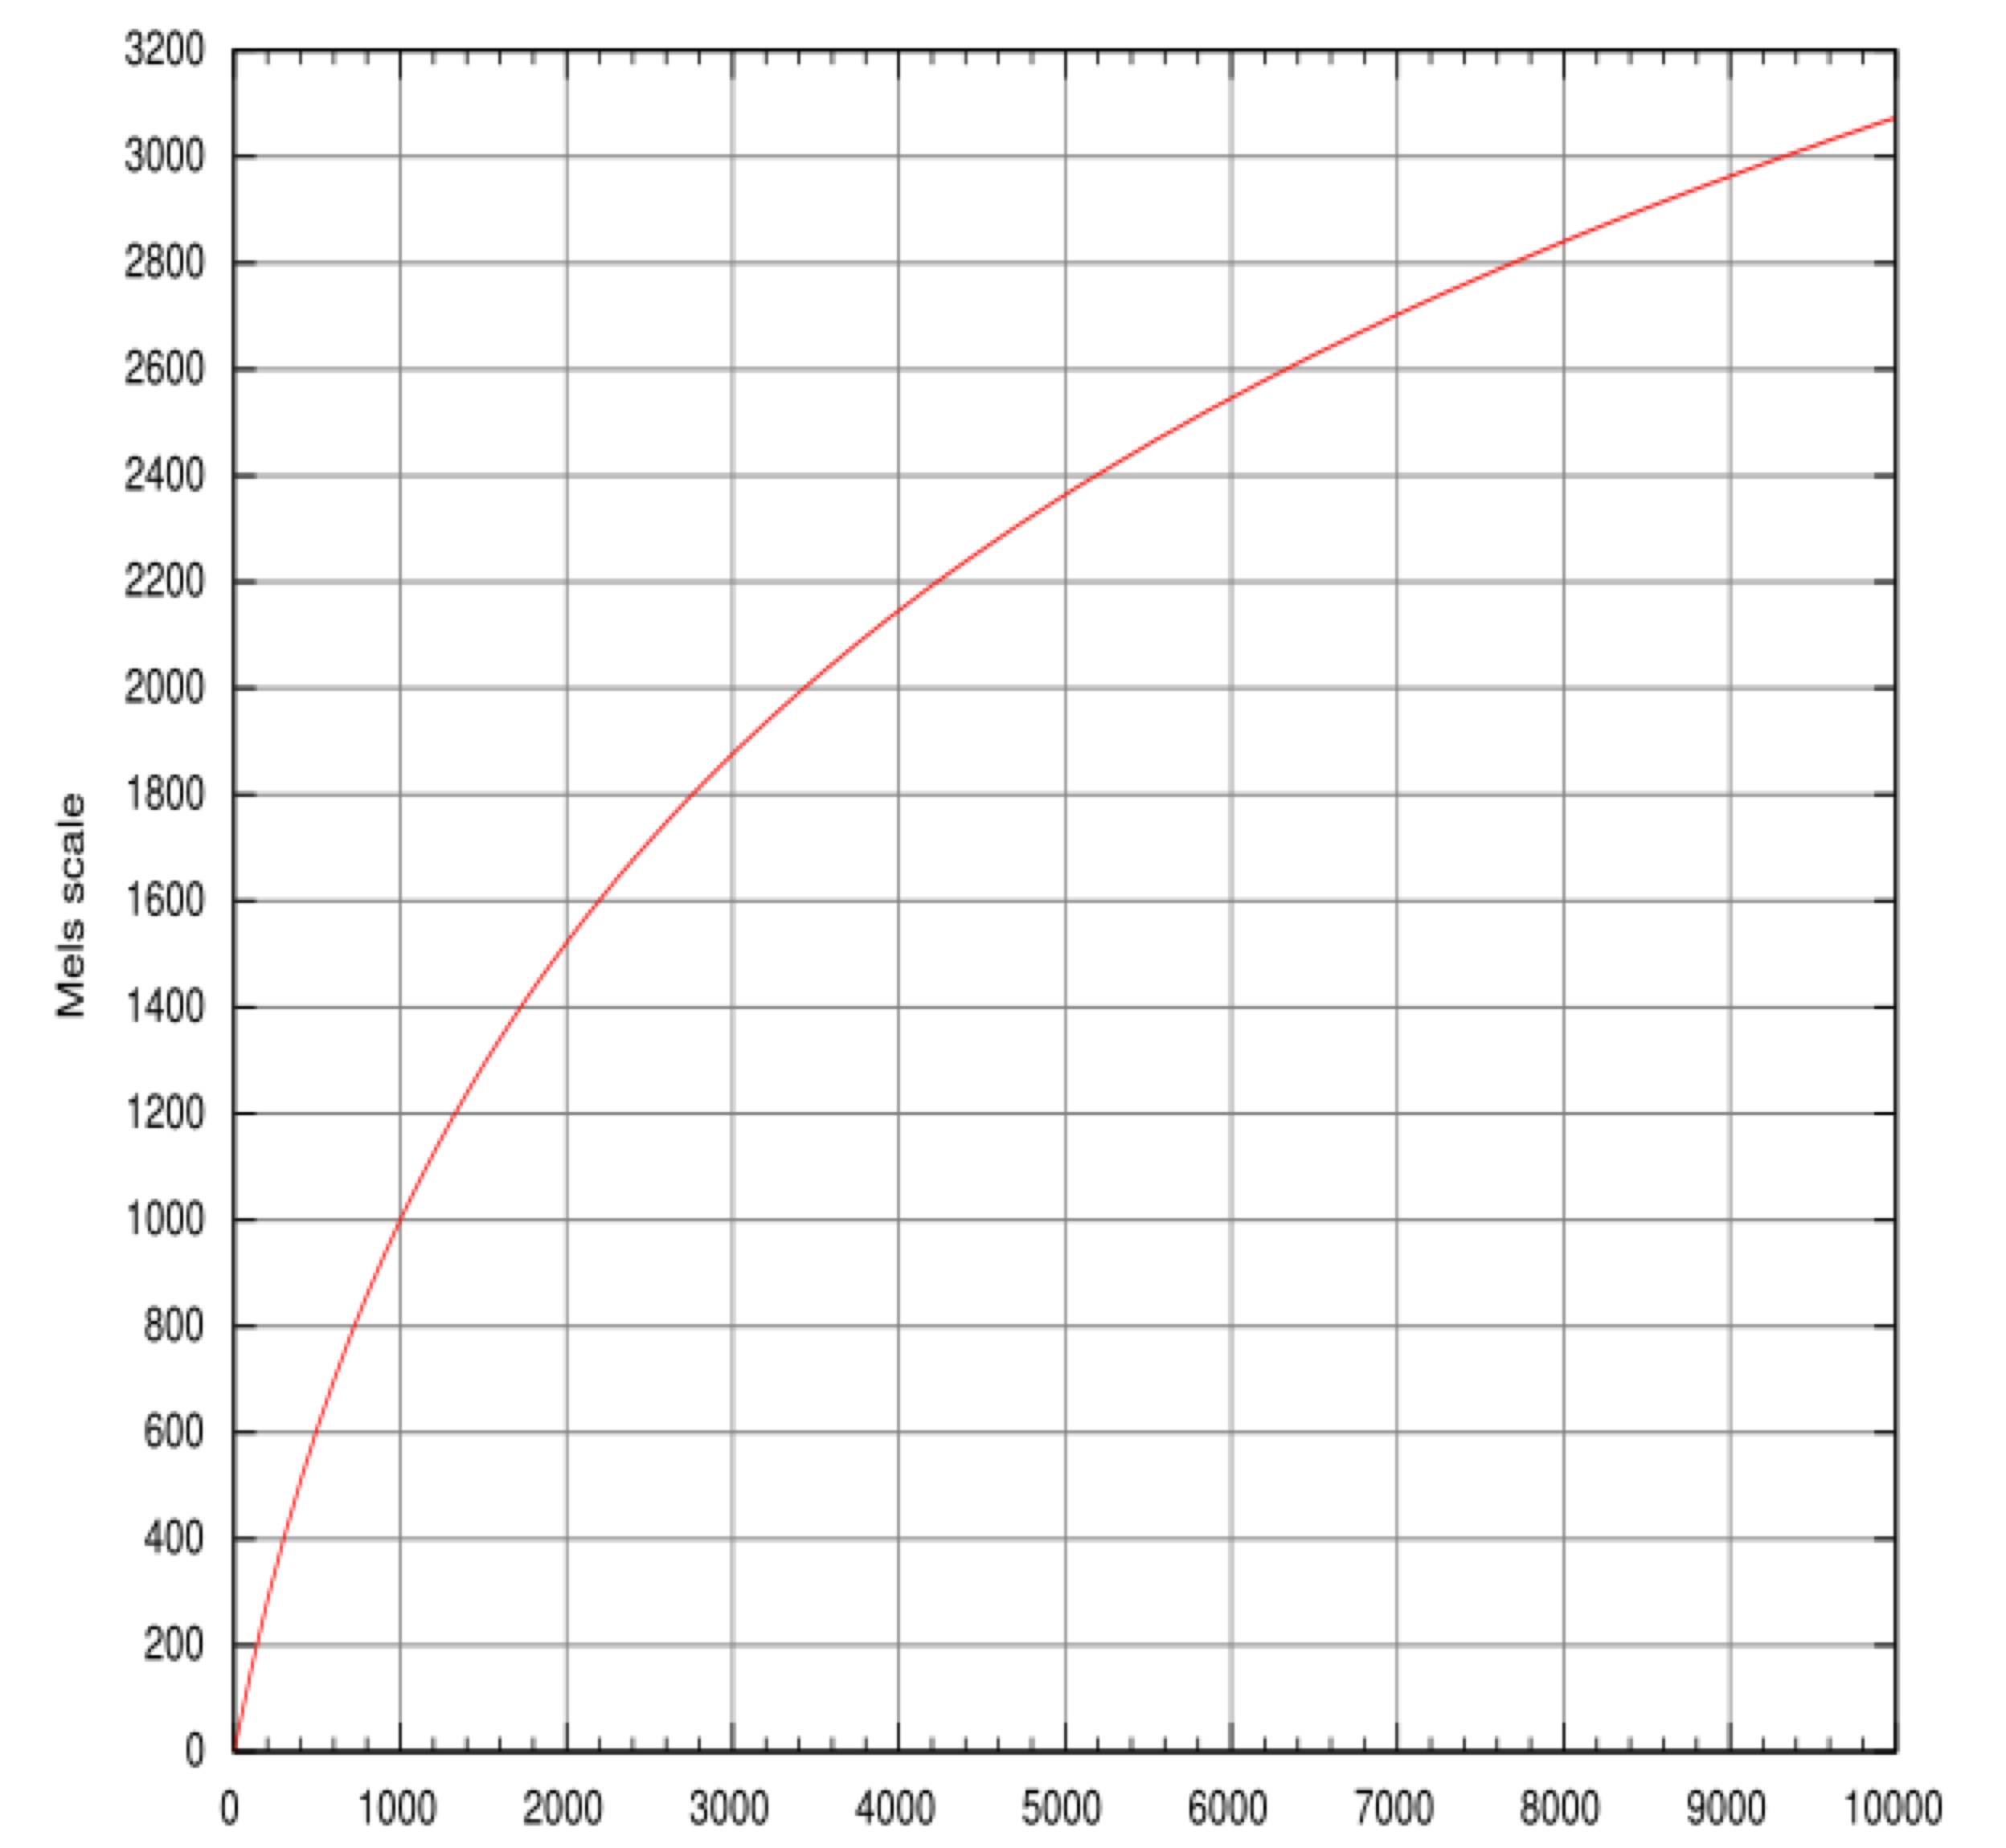
Feature Extraction - MFCC
Mel Scale: Approximate the unequal sensitivity of human hearing at different frequencies
Based on pitch perception

Slide 9

Feature Extraction - MFCC
MFCC (Mel frequency cepstral coefficient)
  Widely used in speech recognition
  Take the Fourier transform of the signal ➔ spectrum
  Map the powers of the spectrum to the mel scale and take the log
  Discrete cosine transform of the mel log-amplitudes
  The MFCCs are the amplitudes of the resulting spectrum

Slide 10
Feature Extraction - MFCC
Extract a feature vector from each frame
    12 MFCC coefficients + 1 normalized energy = 13 features
    Delta MFCC = 13
    Delta-Delta MCC = 13
  Total: 39 features
Inverted MFCCs:
39D Feature vector

Slide 11
Outline
Speech Recognition
Feature Extraction
Modeling Speech
  Hidden Markov Models (HMM): 3 basic problems
HMM Toolkit (HTK)
  Steps for building an ASR using HTK

Slide 12
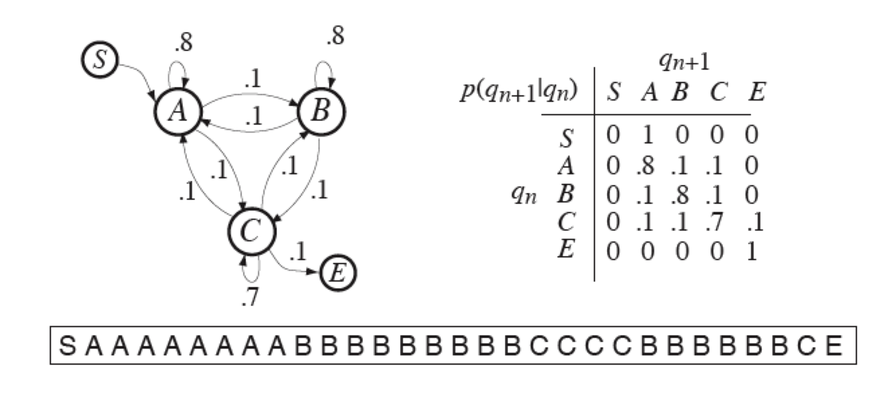
Markov Chain
Weighted finite state acceptor: Future is independent of the past given the present

Slide 13
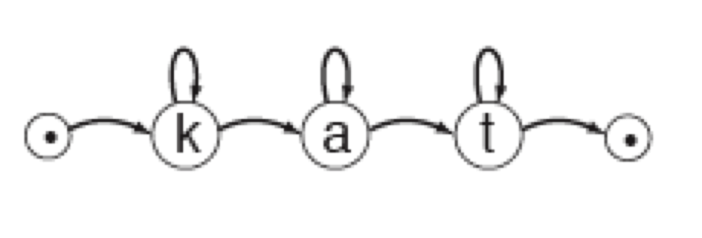
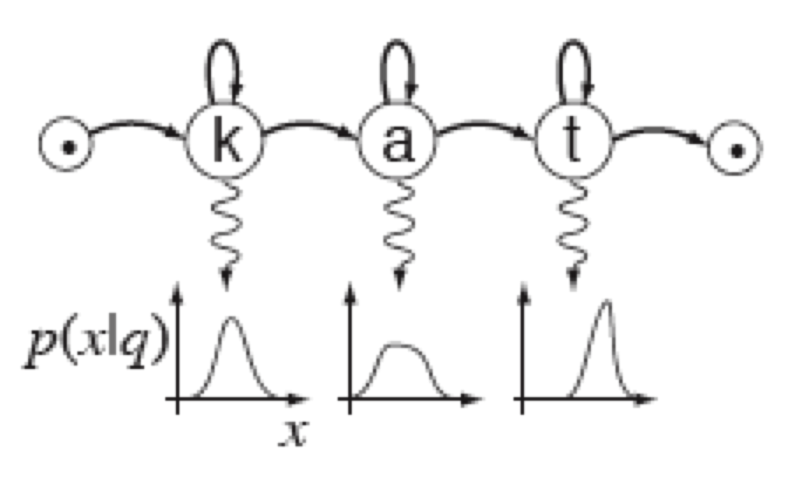
Hidden Markov Model (HMM)
HMM is a Markov chain + emission probability function for each state
Markov Chain
HMM M=(A, B, Pi)
A = Transition Matrix
B = Observation Distributions
Pi = Initial state probabilities

Slide 14
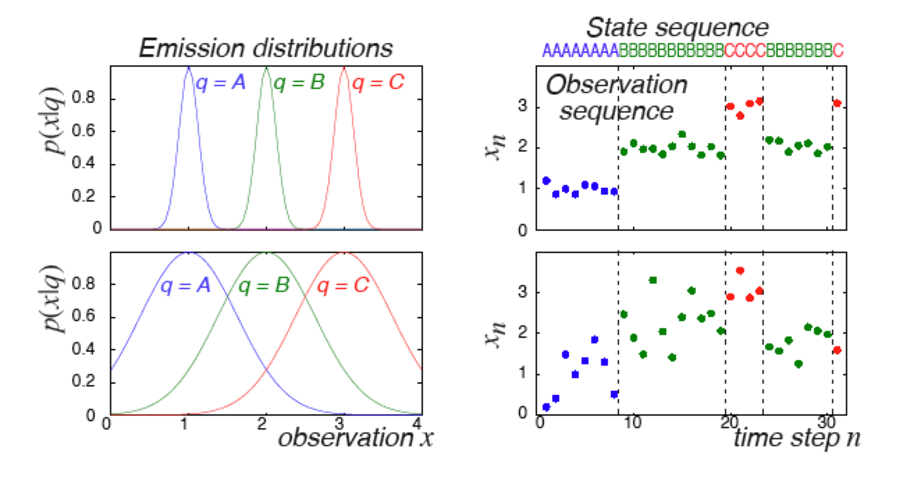
HMM Example
/d/
/aa/
/n/
/aa/

Slide 15
HMM – 3 Basic Problems
Evaluation
Decoding
Training

Slide 16
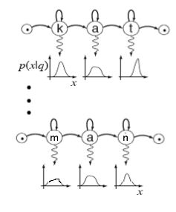

HMM – I. Evaluation
Given an observation sequence O and a model M, how can we efficiently compute:
P(O | M) = the likelihood of O given the model?
argmax_{i} P(λ_{i}|O)
⬄
argmax_{i} P(O|λ_{i}) P(λ_{i})
λ₁
λ_{N}

Slide 17
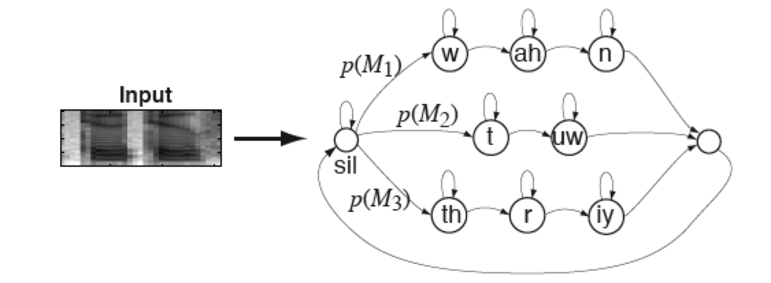
HMM – II. Decoding
Given an observation sequence O and a model M:
How can we obtain the most likely state sequence Q = {q1, q2,…,qt}?

Slide 18
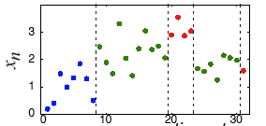
Viterbi Algorithm
Efficient algorithm for decoding O(TN^2)
/d/
/aa/
/n/
/aa/
Start
End
/uw/
/d/ /aa/ /n/ /aa/ => dana

Slide 19
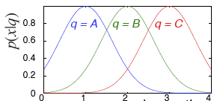
HMM – III. Training
How do we estimate the model parameters M=(A, B, Pi) to maximize P(O|M)?
  Baum-Welch algorithm
/d/
/aa/
/n/
/aa/
dana => /d/ /aa/ /n/ /aa/
1) Transition Matrix: A
2) Emission probability distribution:
Estimate

Slide 20
Outline
Speech Recognition
Feature Extraction
Modeling Speech
  Hidden Markov Models (HMM): 3 basic problems
HMM Toolkit (HTK)
  Steps for building an ASR using HTK

Slide 21
Hidden Markov Model Toolkit (HTK)
HTK is a research toolkit for building and manipulating HMMs
Primarily designed for building HMM-based ASR systems
Tools, for examples:
  Extracting MFCC features
  HMM algorithms
  Grammar networks
  Speaker Adaptation
  …

Slide 22
Steps for building ASR: Voice-operated interface for phone dialing
Examples:
  Dial three three two six five four
  Phone Woodland
  Call Steve Young
Grammar:
  $digit = ONE | TWO | THREE | FOUR | FIVE | SIX | SEVEN | EIGHT | NINE | OH | ZERO;
  $name = [ JOOP ] JANSEN | [ JULIAN ] ODELL | [ DAVE ] OLLASON | [ PHIL ] WOODLAN
  ( SENT-START ( DIAL <$digit> | (PHONE|CALL) $name) SENT-END )

Slide 23
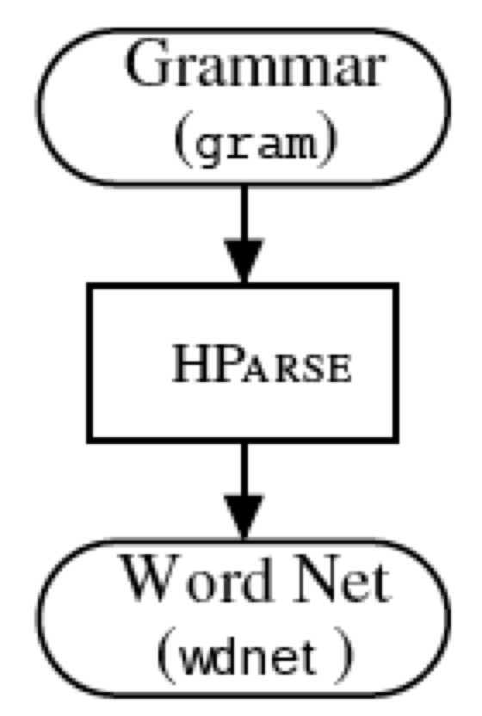
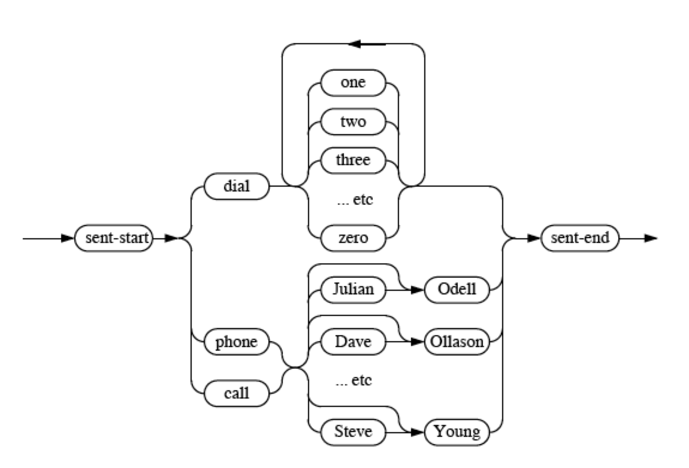
Convert Grammar to Network (HParse)

Slide 24
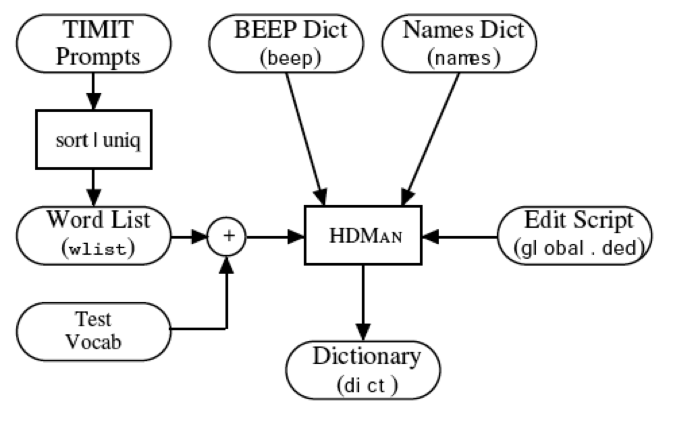
Training the system
Lab files:
Wave files
A ah sp
A ax sp
A ey sp
CALL k ao l sp
DIAL d ay ax l sp
EIGHT ey t sp
PHONE f ow n sp
…
S0001 ONE VALIDATED ACTS OF SCHOOL DISTRICTS
S0002 TWO OTHER CASES ALSO WERE UNDER ADVISEMENT
S0003 BOTH FIGURES WOULD GO HIGHER IN LATER YEARS

Slide 25
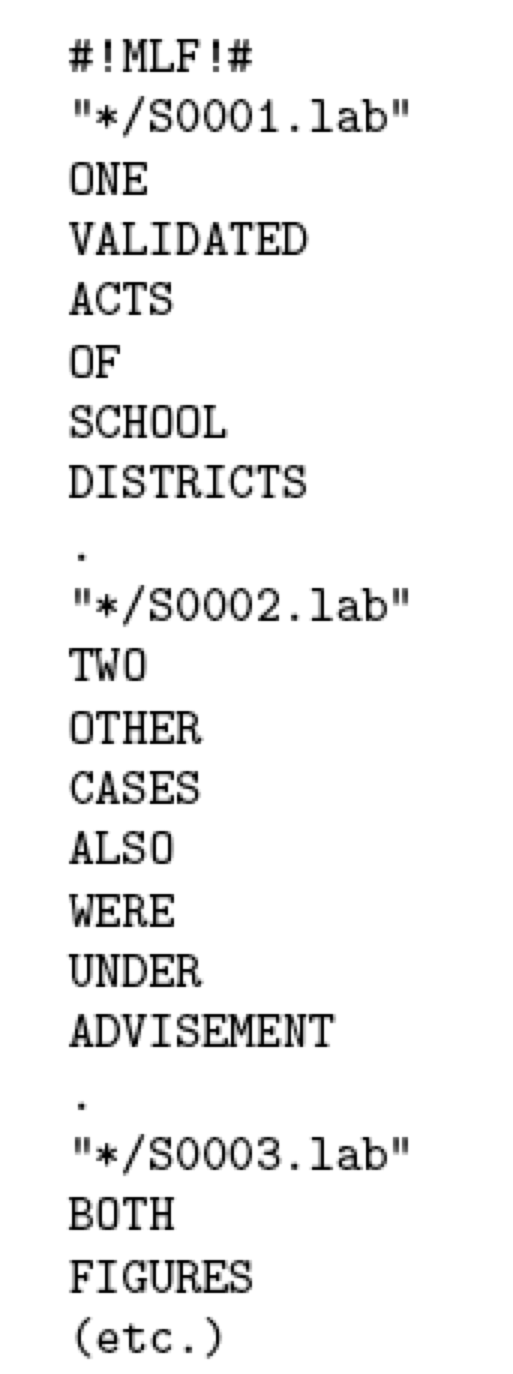
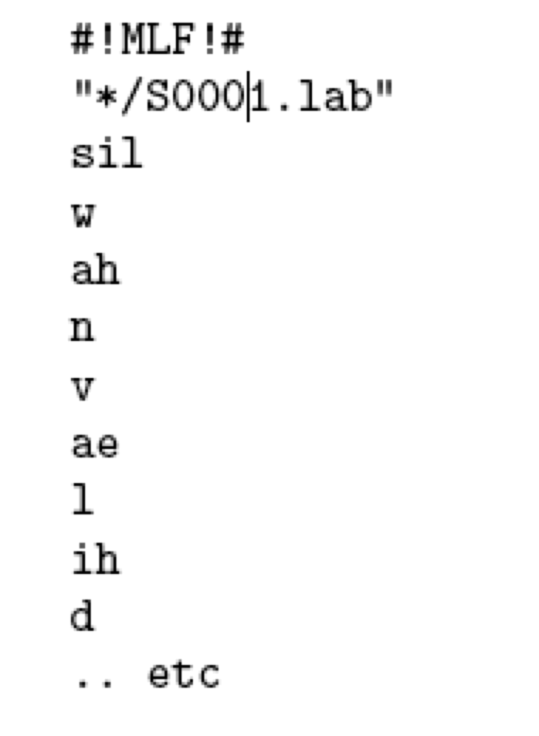
Words to Phones (using HLEd)
HTK scripting language is used to generate phonetic transcription for all training data

Slide 26
Extracting MFCC (using HCopy)
For each wave file, extract MFCC features.
.wav ➔ .mfc files

Slide 27

Specifying Monophone HMM Topology
5 states: 3 emitting states
Flat Start: Mean and Variance are initialized as the global mean and variance of all the data
/r/
S1
S2
S3
S4
S5

Slide 28
Training (HERest)
For each training pair of files (mfc+lab):
1. Concatenate the corresponding monophone HMMs
2. Use the Baum-Welch Algorithm to train the
HMMs given the MFC features
One validated acts of school districts…
/w/
/ah/
/n/
S1
S2
S3
S4
S5
S1
S2
S3
S4
S5
S1
S2
S3
S4
S5

Slide 29
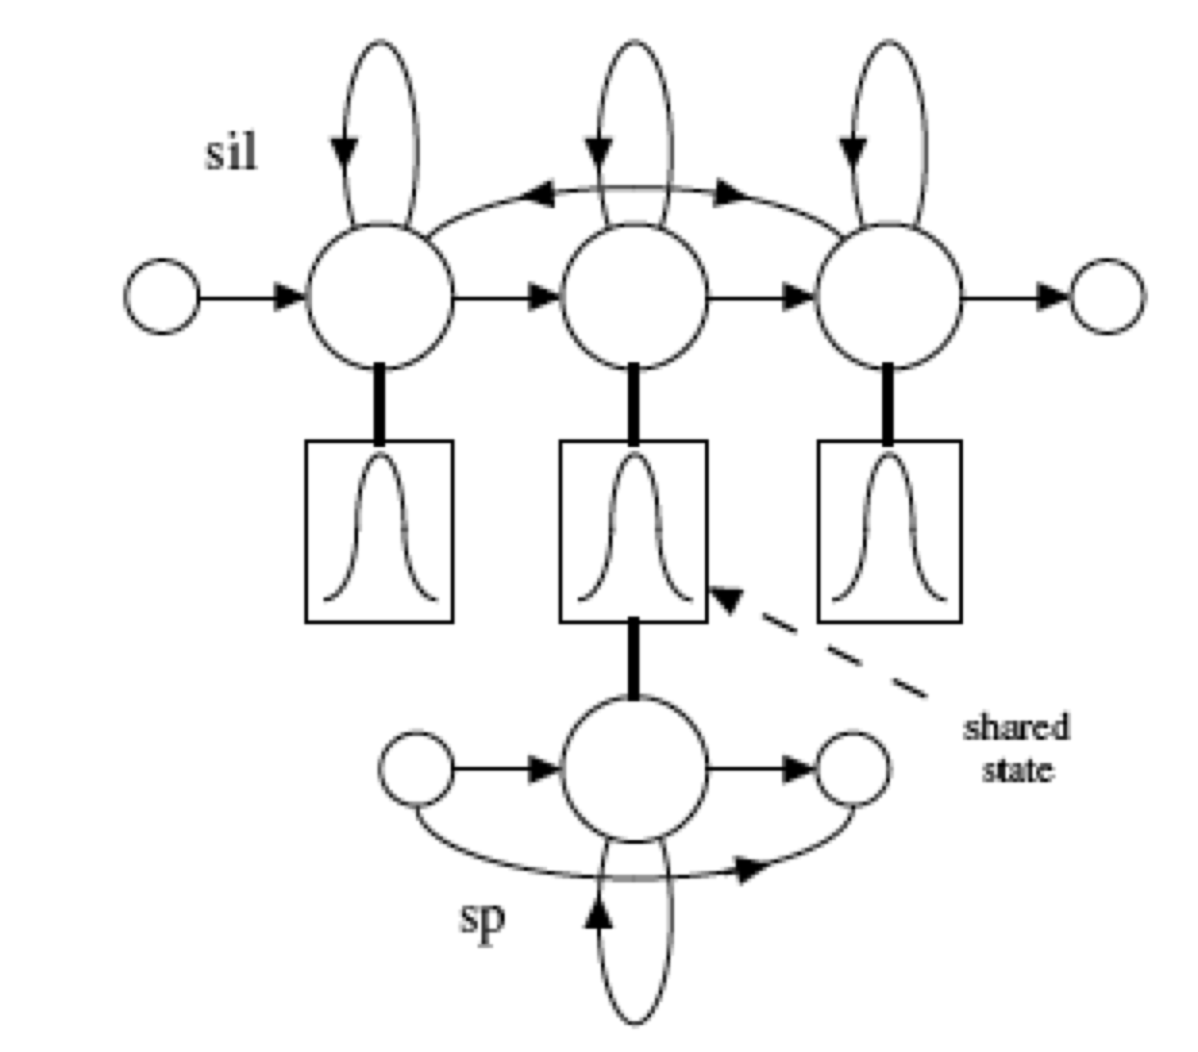
Training
So far, we have all monophone models trained
Train the short pause (sp) model

Slide 30
Handling Multiple Pronunciations (HVite)
The dictionary contains multiple pronunciations for some words.
Forced alignment
/d/
/ey/
/t/
/ax/
Run Viterbi to get the best pronunciation that matches the acoustics
/ae/
/dx/

Slide 31
Handling Multiple Pronunciations
The dictionary contains multiple pronunciations for some words.
Forced alignment
/d/
/ey/
/t/
/ax/
Run Viterbi to get the best pronunciation that matches the acoustics
/ae/
/dx/

Slide 32
Retrain
After getting the best pronunciation
  => Train again using Baum-Welch algorithm using the best pronunciations

Slide 33
Creating Triphone Models (using HLEd)
Phones may be realized differently in some contexts
➔ Build context-dependent acoustic models (HMMs)
Triphones: One preceding and succeeding phone
Make triphones from monophones
  Generate a list of all the triphones for which there is at least one example in the training data
  s-l+ow
  b-l+aa
  p-l+aa
  jh-oy+s
  f-iy+t
  …

Slide 34
Tie Triphone (HDMan)
Clustering by growing decision trees
All states in the same leaf will be tied
t+ih t+ae
t+iy t+ae
ao-r+ax r
t+oh t+ae
ao-r+iy
t+uh t+ae
t+uw t+ae
sh-n+t
sh-n+z sh-n+t
ch-ih+l
ay-oh+l
ay-oh+r ay-oh+l
L = Class-Stop ?
n
y
R = Nasal ?
L = Nasal ?
n
y
n
y
R = Glide?
n
y

Slide 35
After Tying
Train the acoustic models again using Baum-Welch algorithm (HERest)
Increase the number of Gaussians for each state
  HHEd followed by HERest

Slide 36
Decoding (HVite)
Using the compiled grammar network (WNET)
Given a new speech file:
  Extract the mfcc features (.mfc file)
  Run Viterbi on the WNET given the .(mfc file) to get the most likely word sequence

Slide 37
Summary
MFCC Features
HMM 3 basic problems
Steps for Building an ASR using using HTK:
  Features and data preparation
  Monophone topology
  Flat Start
  Training monophones
  Handling multiple pronunciations
  Context-dependent acoustic models (triphones) + Tying
  Final Training
  Decoding

Slide 38
Thanks!

Slide 39
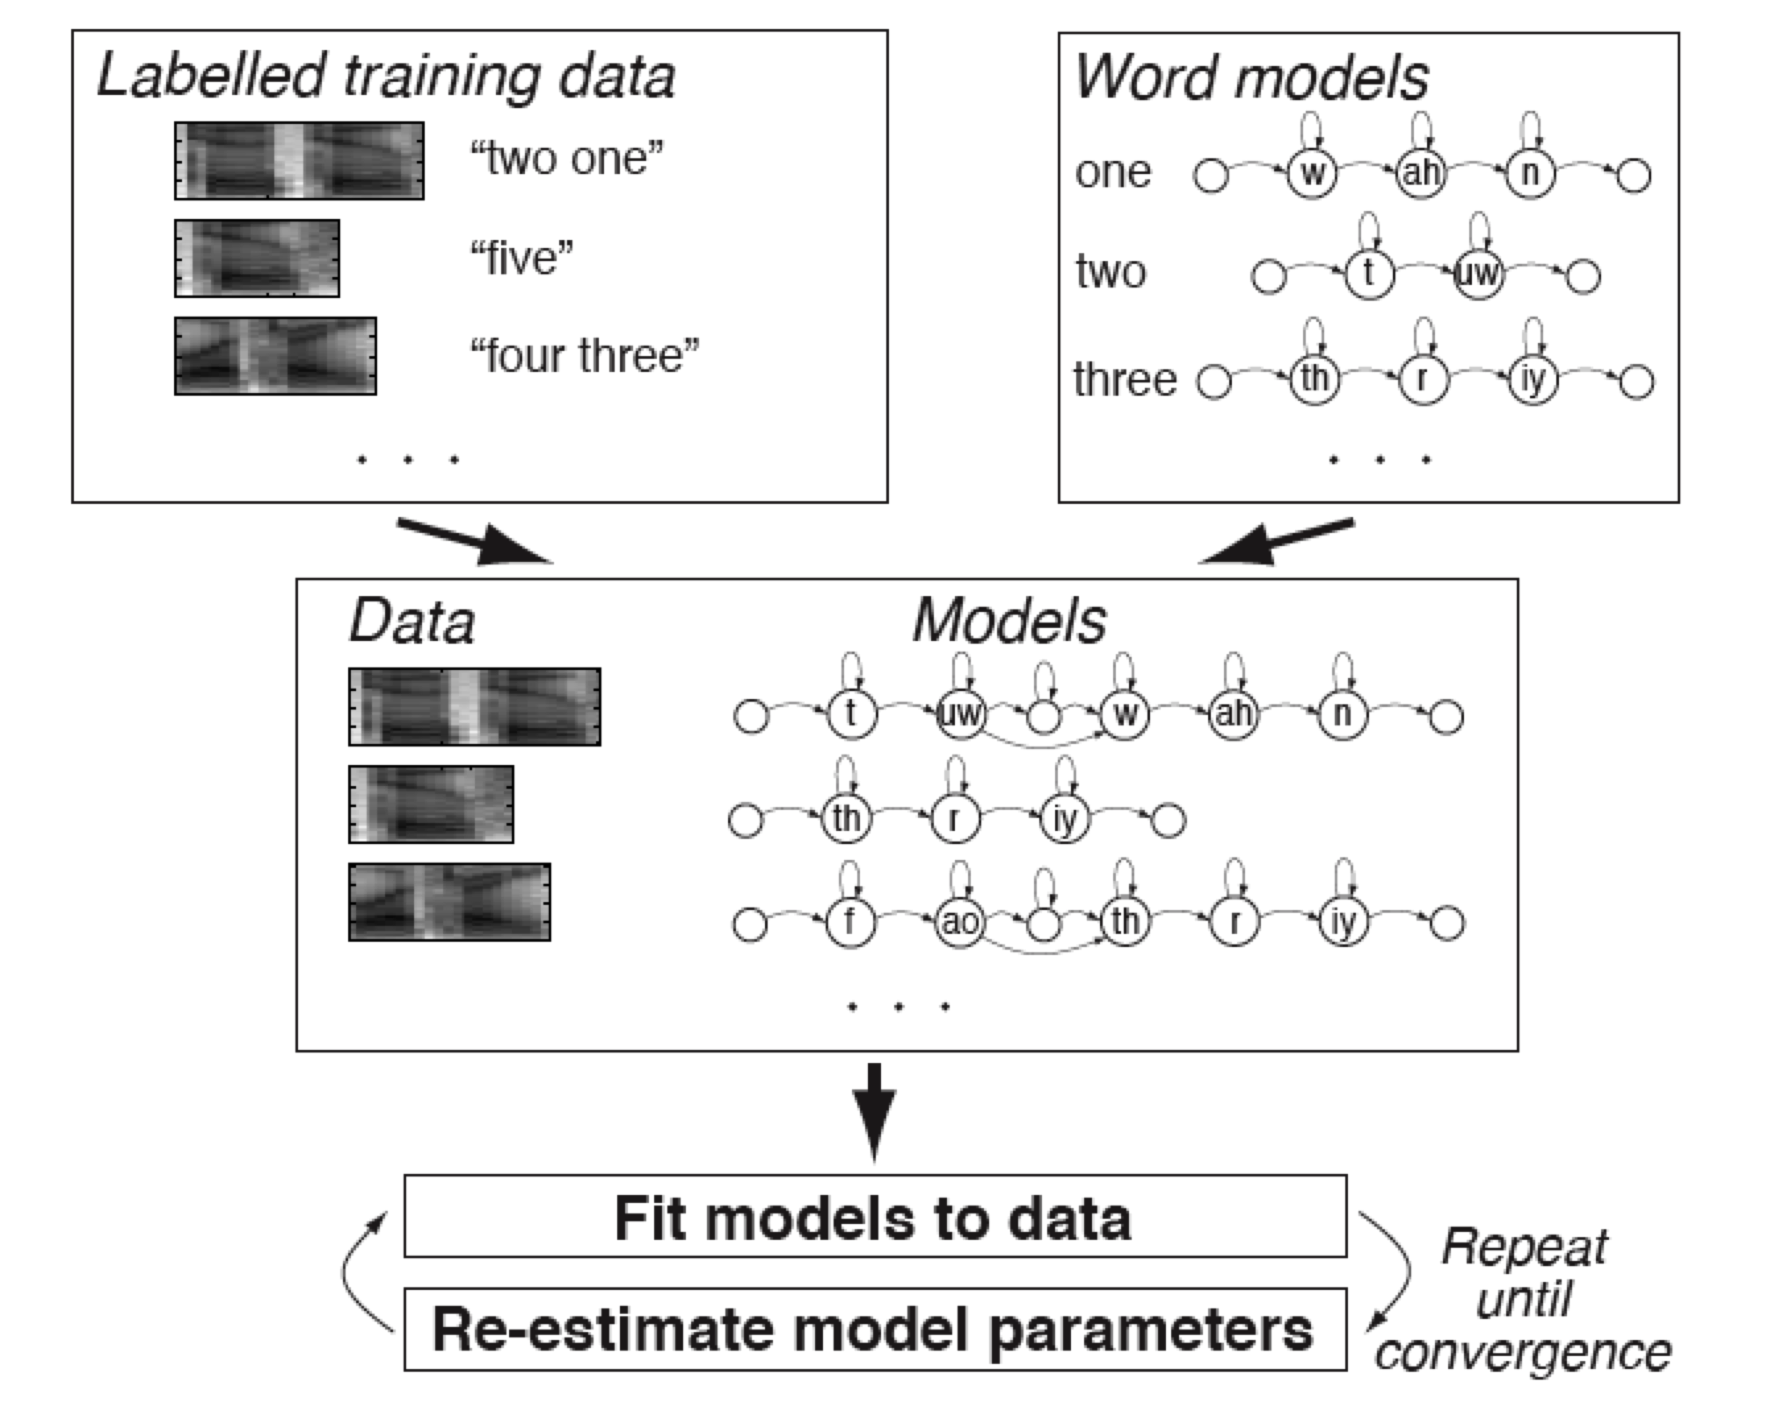
HMM – III. Training
Pronunciation Dictionary
A ah sp
A ax sp
CALL k ao l sp
DIAL d ay ax l sp
EIGHT ey t sp
PHONE f ow n sp
TWO t uw sp
…

