Slide 1
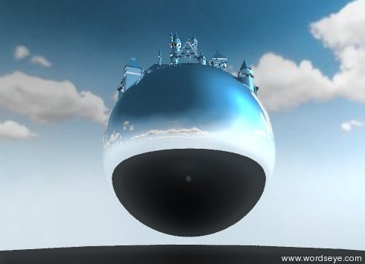
Semantics in Text-to-Scene Generation
Bob Coyne (coyne@cs.columbia.edu)
Owen Rambow (rambow@ccls.columbia.edu)
Richard Sproat (rws@xoba.com)
Julia Hirschberg (julia@columbia.edu)

Slide 2
Outline
Motivation and system overview
Background and functionality
Under the hood
Semantics on Objects
Lexical Semantics (WordNet and FrameNet)
Semantics on Scenes (SBLR - Scenario-Based Lexical Resource)
Computational flow
Applications
Education pilot at HEAF (Harlem Educational Activities Fund)
Conclusions
Notes:
Introducing the idea of lexical frames in mtt

Slide 3
Why is it hard to create 3D graphics?

Slide 4
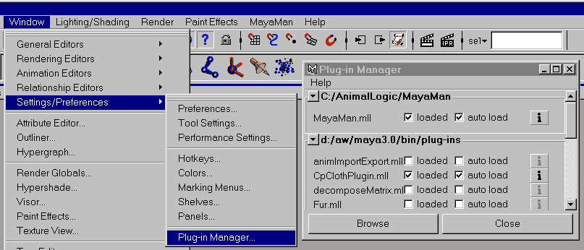
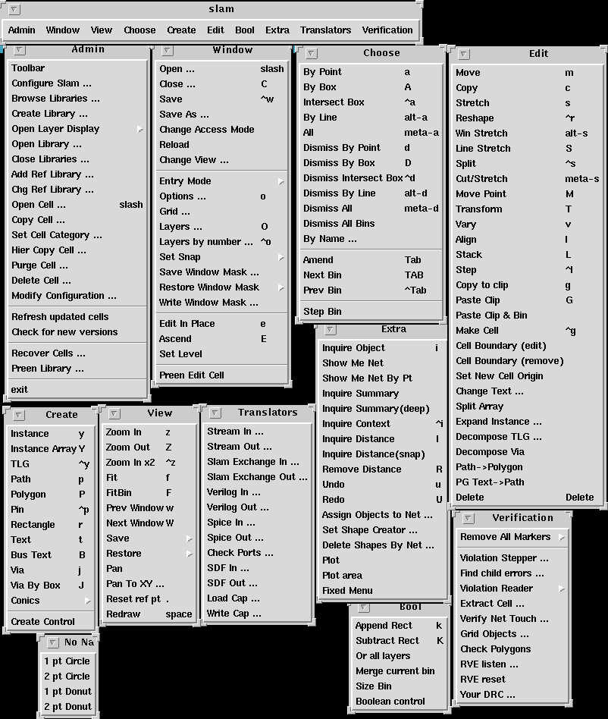
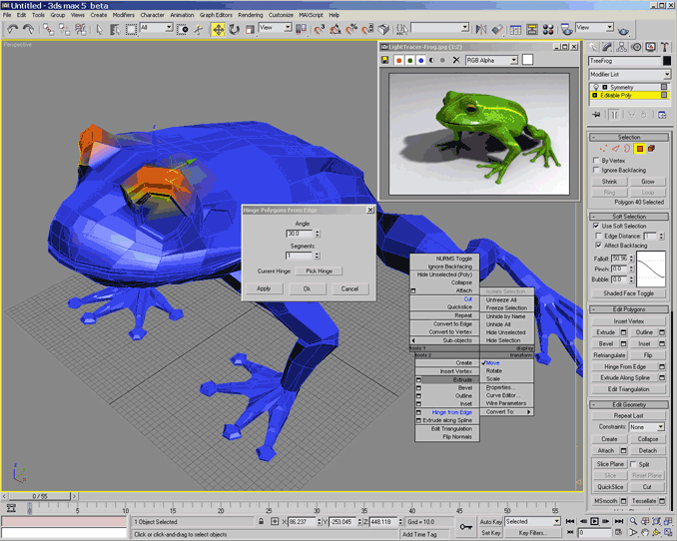
Complex tools

Slide 5
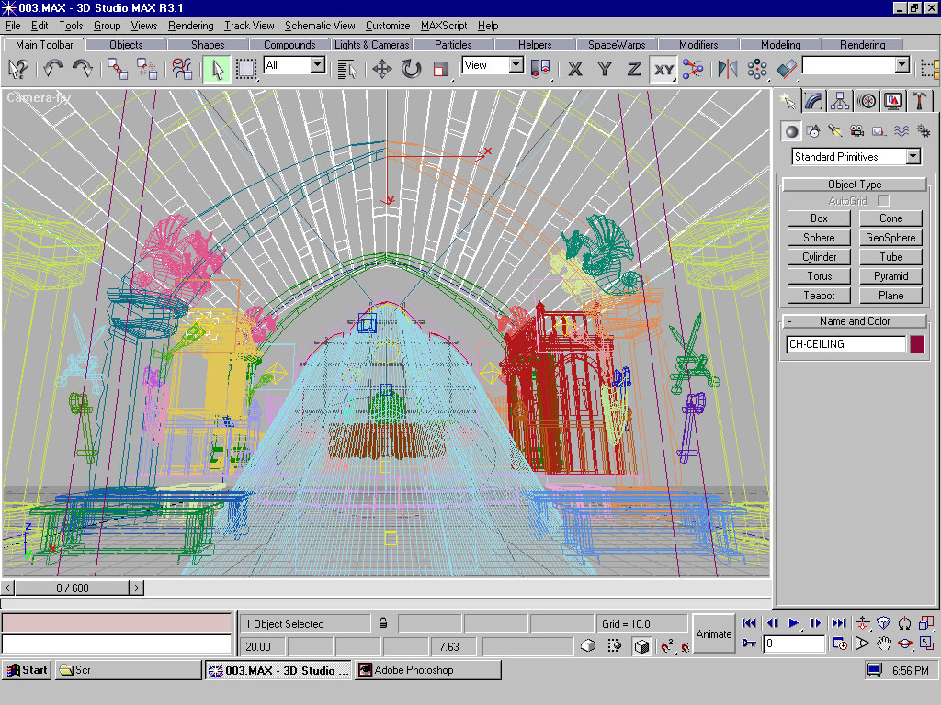
Work at low level of detail

Slide 6
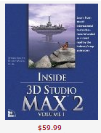
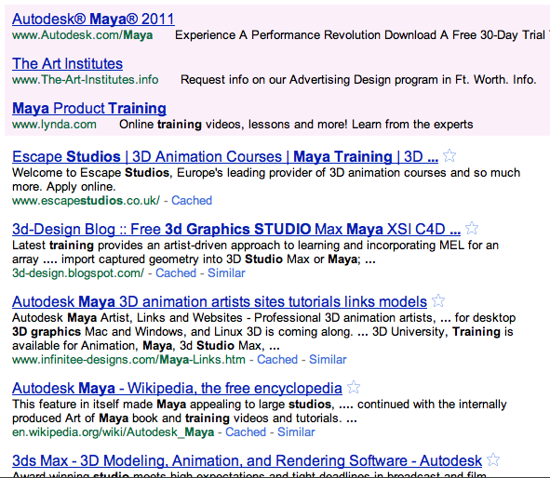
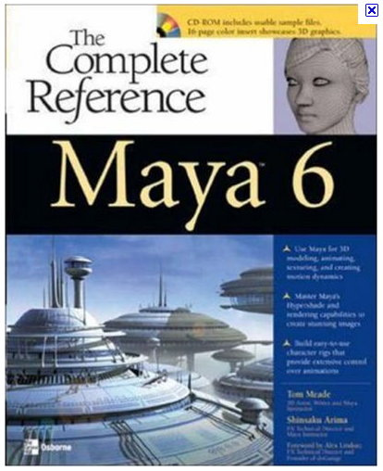
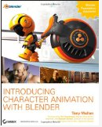
Requires training – time, skill, expense
Notes:
Investment of time, money

Slide 7
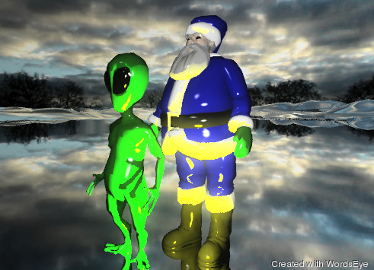
New Approach - Create 3D scenes with language
Santa Claus is on the white mountain range. he is blue. it is cloudy. the large yellow illuminator is in front of him. the alien is in front of him. the mountain range is silver.

Slide 8
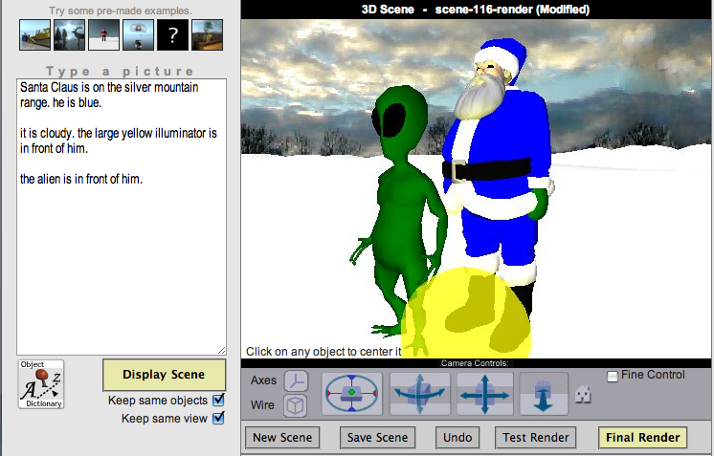
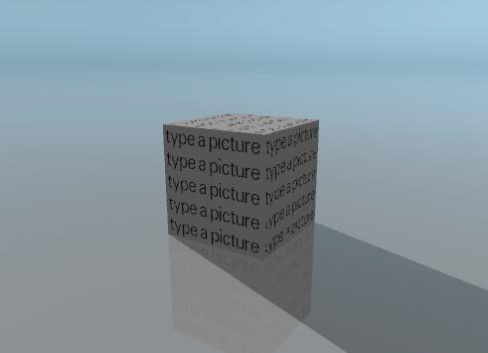
WordsEye: Create 3D scenes with language

Slide 9
WordsEye: Create 3D scenes with language
1
Describe a scene

Slide 10
WordsEye: Create 3D scenes with language
1
Describe a scene

Slide 11
WordsEye: Create 3D scenes with language
2
Click Display

Slide 12
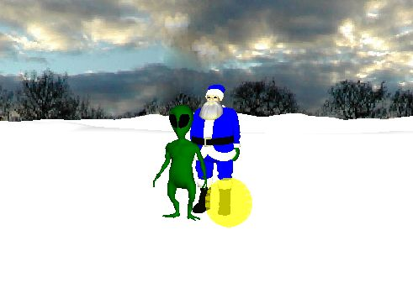
WordsEye: Create 3D scenes with language
2
click Display

Slide 13
WordsEye: Create 3D scenes with language
3
Change 3D viewpoint
using camera controls

Slide 14
WordsEye: Create 3D scenes with language
3
Change 3D viewpoint
using camera controls

Slide 15
WordsEye: Create 3D scenes with language
4
Perform final render to add reflections, shadows, etc.

Slide 16
WordsEye: Create 3D scenes with language
4
Perform final render to add reflections, shadows, etc.

Slide 17
WordsEye: Create 3D scenes with language
5
Final Rendering can be given a title and put in online Gallery.
Or linked with other pictures to form a Picturebook

Slide 18
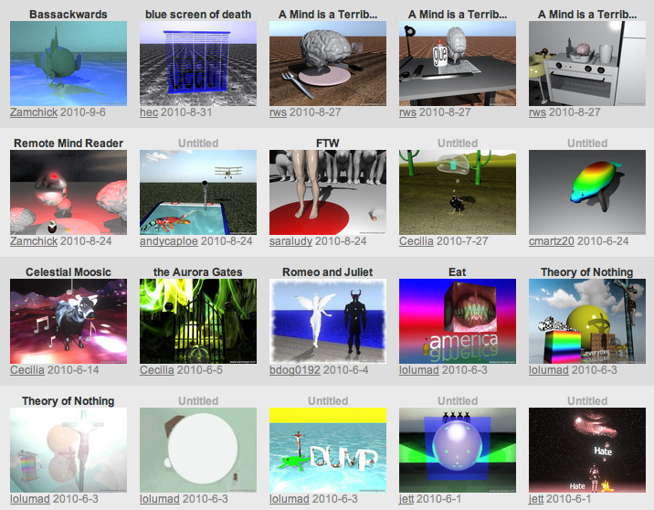
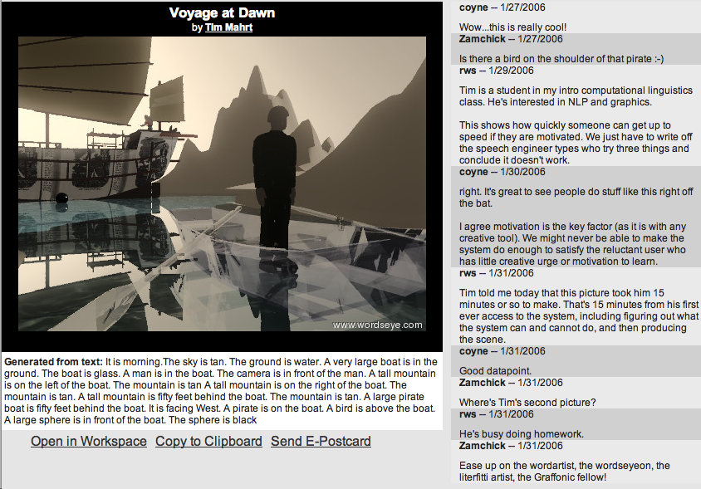
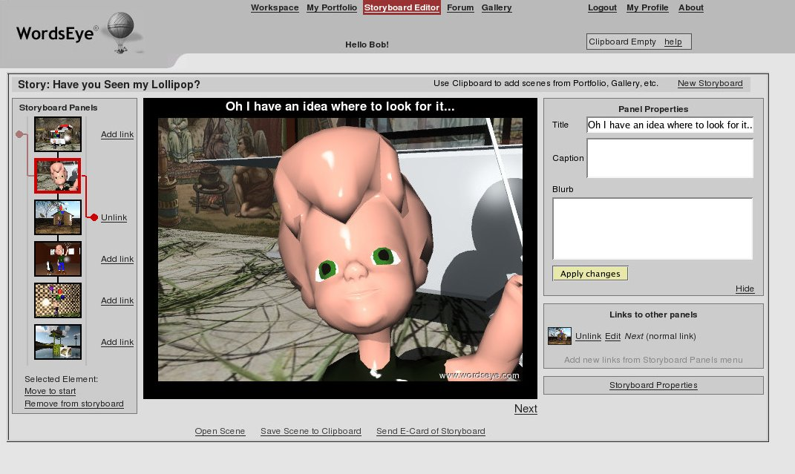
Online gallery and picturebooks
Gallery
User comments
Picturebook editor

Slide 19
Greeting cards

Slide 20
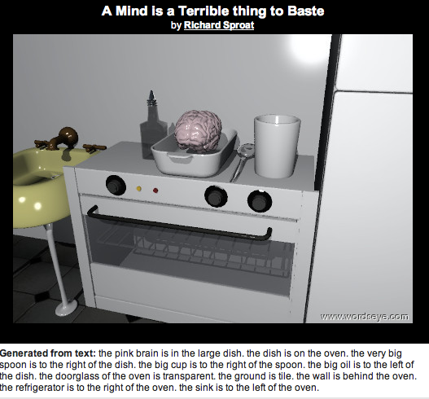
Visual Puns

Slide 21
Lighting
the extremely tall mountain range is 300 feet wide. it is 300 feet deep. it is partly cloudy. the unreflective good is in front of the white picket fence. The good is 7 feet tall. The unreflective cowboy is next to the good. the cowboy is 6 feet tall. The good is facing the biplane. The cowboy is facing the good. The fence is 50 feet long. the fence is on the mountain range. The camera light is yellow. The cyan illuminator is 2 feet above the cowboy. the pink illuminator is 2 feet above the good. The ground is white. the biplane is 30 feet behind the good. it is 2 feet above the cowboy.

Slide 22
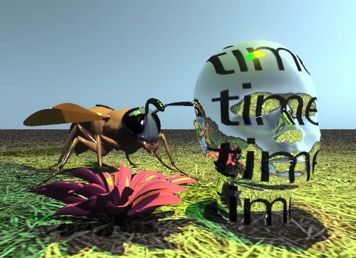
A silver head of time is on the grassy ground. The blossom is next to the head. the blossom is in the ground. the green light is three feet above the blossom. the yellow light is 3 feet above the head. The large wasp is behind the blossom. the wasp is facing the head.
Reflections

Slide 23
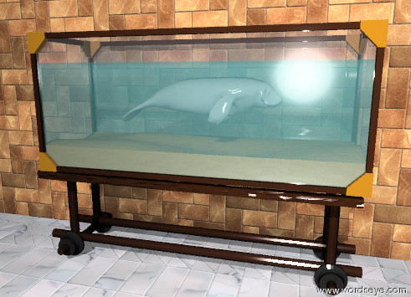
A tiny grey manatee is in the aquarium. It is facing right. The manatee is six inches below the top of the aquarium. The ground is tile. There is a large brick wall behind the aquarium.
Transparency

Slide 24
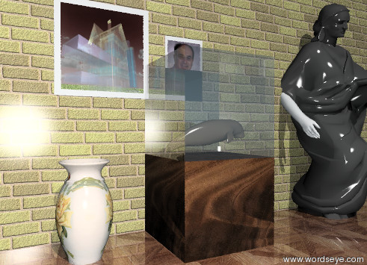
Scenes within scenes . . .

Slide 25
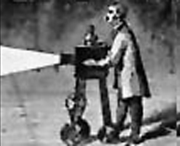
Creating 3D Scenes with language
No GUI bottlenecks - Just describe it!
Low entry barrier - no special skill or training required
Trade-off detailed direct manipulation for speed and economy of expression
Language directly expresses constraints
Bypass rigid, pre-defined paths of expression (dialogs, menus, etc)
Objects vs Polygons – automatically utilizes pre-made 2D/3D objects
Enable novel applications
Using language is fun and stimulates imagination
in education, gaming, social media, . . .

Slide 26
Outline
Motivation and system overview
Background and functionality
Under the hood
Semantics on Objects
Lexical Semantics (WordNet and FrameNet)
Semantics on Scenes (SBLR - Scenario-Based Lexical Resource)
Computational flow
Applications
Education pilot at HEAF (Harlem Educational Activities Fund)
Conclusions
Notes:
Introducing the idea of lexical frames in mtt

Slide 27
WordsEye Background
Original version
Coyne and Sproat: “WordsEye: An Automatic Text-to-Scene Conversion System.” In SIGGRAPH 2001
Web version (2004-2007)
3,000 users, 15,000 final rendered scenes in online gallery
No verbs or poses
New version (2010) in development
Verb semantics (FrameNet, etc) and poses to handle wider range of language
FaceGen to create facial expressions
Contextual knowledge to help depict environments, actions/poses
Tested in middle-school summer school program in Harlem

Slide 28
Related Work - Natural language and 3D graphics systems
Some variations
Directed text (eg control virtual character) versus descriptions
Domain specific (eg car accident reports) versus open domain
Animation/motion versus static scene generation
Output storyboards (time segmenting) versus single scene
Batch (real-world text input) versus interactive (user adjusts text and adapts to graphics interactively)
Some systems
SHRDLU: Winograd, 1972
Adorni, Di Manzo, Giunchiglia, 1984
Put: Clay and Wilhelms, 1996
PAR: Badler et al., 2000
CarSim: Dupuy et al., 2000
WordsEye – Coyne, Sproat (2001)
CONFUCIUS – Ma (2006)
Automatic Animated Storyboarding: Ye, Baldwin, 2008
Notes:
28

Slide 29
Text-to-Scene conversion: resolve linguistic descriptions to spatial relations and attributes on 3D objects:
Objects
2000 different 3D objects and 10,000 textures/images
Spatial Relations (positions/orientation/distance/size)
the cat is on the chair
the dog is facing the cat
the table is 2 feet tall. The television is one foot from the couch
Groupings and cardinality
The stack of 10 plates is on the table.
Surface properties: Colors, textures, reflectivity, and transparency
The shiny, blue vase; the grassy mountain; the transparent wall
Reference resolution
The vase is on the table. It is blue.
Currently working on:
Poses for action verbs and facial expressions (the angry man ate the hamburger)
Settings (the boy is in the living room)

Slide 30
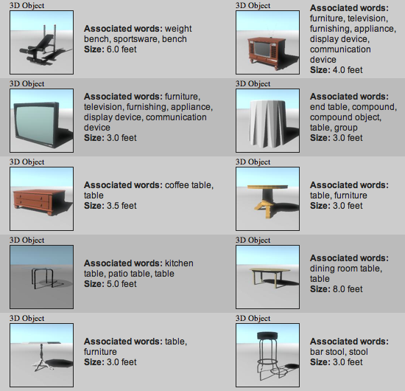
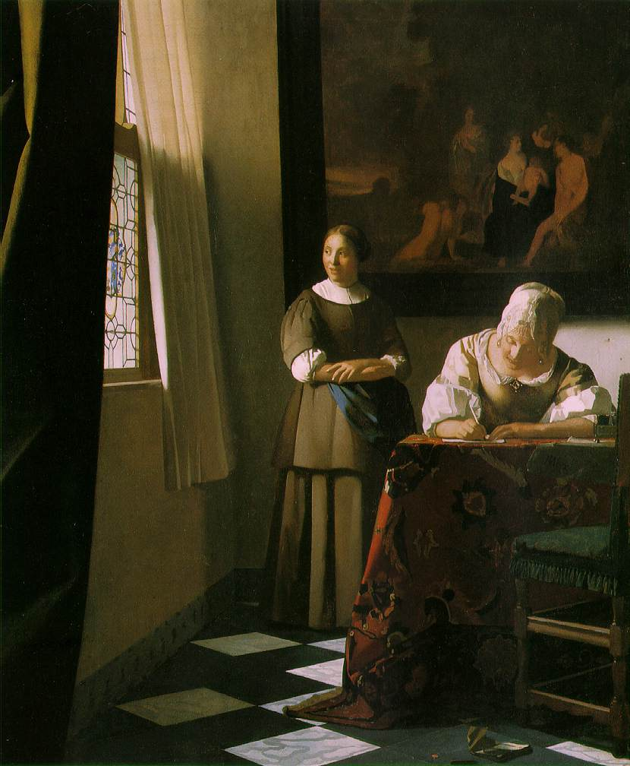
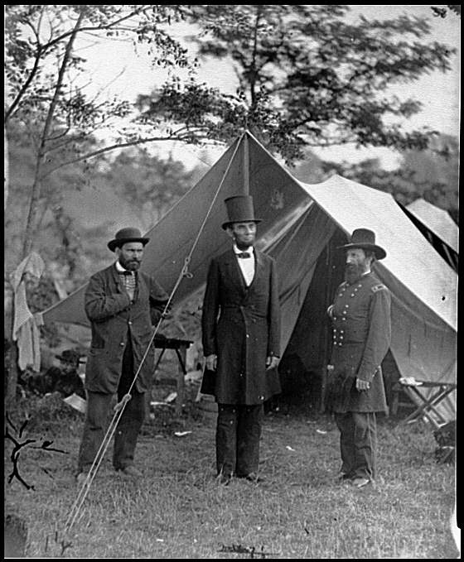
Graphical library: 2,000 3D objects and 10,000 images, all semantically tagged
3D objects
2D Images and textures
B&W drawings Texture Maps
Artwork Photographs

Slide 31
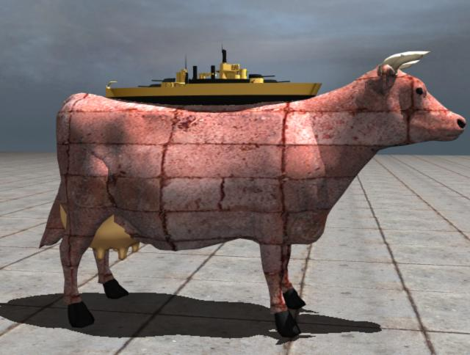
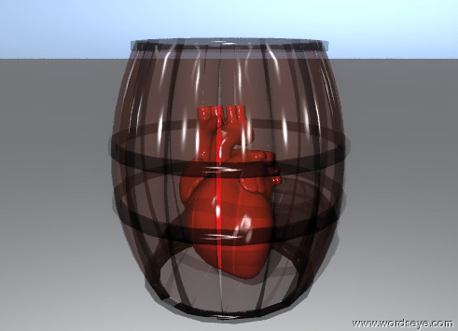
Spatial relations and Attributes (size, color, transparency, texture)
The orange battleship is on the brick cow. The battleship is 3 feet long
The red heart is in the tiny transparent barrel.

Slide 32
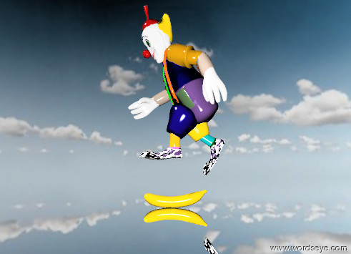
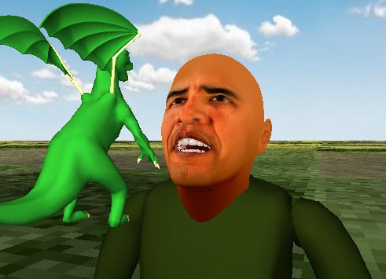
Poses and facial expressions
The clown is running. the clown is 1 foot above the ground. the big banana is under the clown. the banana is on the ground. it is partly cloudy. the ground is blue silver.
Obama is afraid and angry. The sky is cloudy. A dragon is 8 inches in front of him. It is 5 feet above the ground. It is 9 inches tall. It is facing him. The ground has a grass texture.

Slide 33
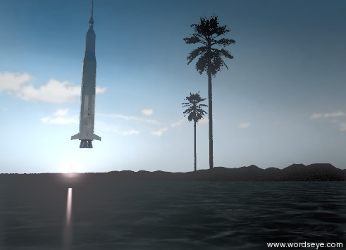
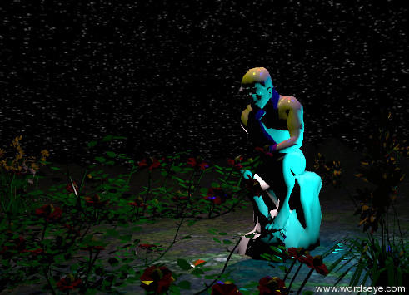
Environmental attributes: Time of day, cloudiness, lighting
the big palm tree is on the very large white sandy island. a palm tree is next to the big palm tree. the island is on the sea. The sun is pink. it is dawn. it is partly cloudy. The huge silver rocket is 20 feet above the sea…
The 7 enormous flowers are in front of the statue. It is midnight. The statue is 40 feet tall. The statue is on the mountain range. The 5 huge bushes are behind the mushroom. . . .

Slide 34
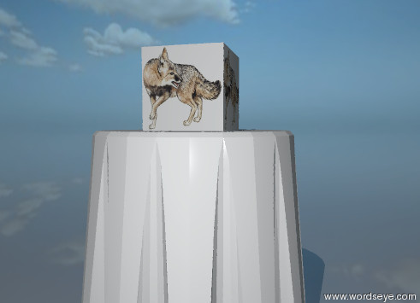
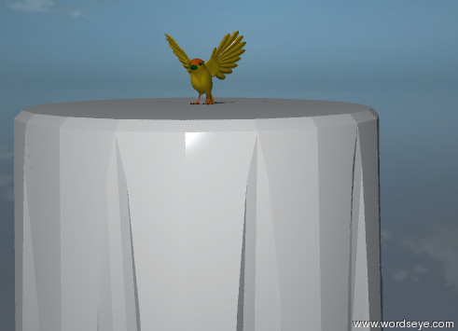
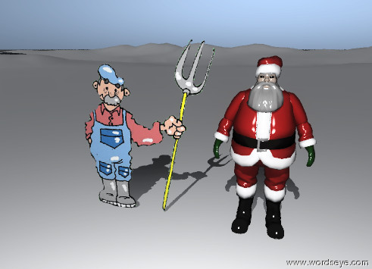
Depiction strategies: When 3D object doesn’t exist…
Text object: “Foo on table”
Substitute image: “Fox on table”
Related object: “Robin on table”
2D cutout: “Farmer left of santa”

Slide 35
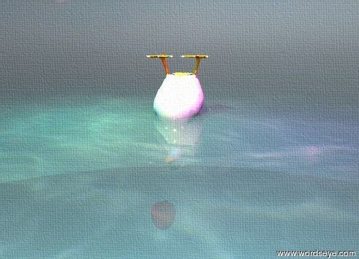
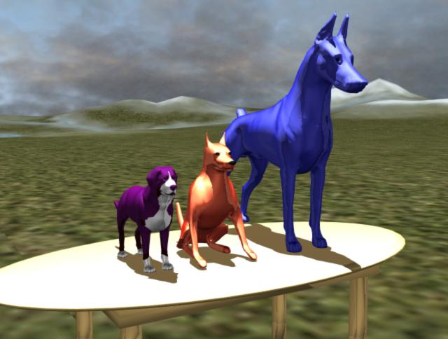
Reference resolution
Anaphora
Attribute reference
The duck is in the sea. It is upside down. The sea is shiny and transparent. The apple is 3 inches below the duck. It is in front of the duck. It is partly cloudy.
Three dogs are on the table. The first dog is blue. The first dog is 5 feet tall. The second dog is red. The third dog is purple.

Slide 36
Outline
Motivation and system overview
Background and functionality
Under the hood
Semantics on Objects
Lexical Semantics (WordNet and FrameNet)
Semantics on Scenes (SBLR - Scenario-Based Lexical Resource)
Computational flow
Applications
Education pilot at HEAF (Harlem Educational Activities Fund)
Conclusions
Notes:
Introducing the idea of lexical frames in mtt

Slide 37
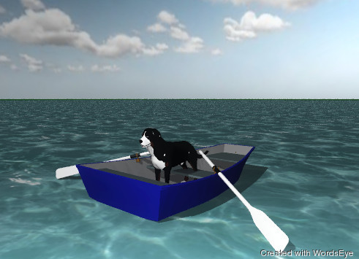
Semantics on Objects
The boat is in the ocean. The dog is in the boat.
Boat in water ➔ Embedded-in
Dog in boat ➔ In cupped region
Requires knowledge of shapes and function of objects

Slide 38
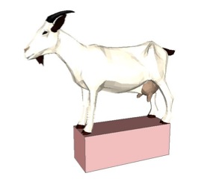
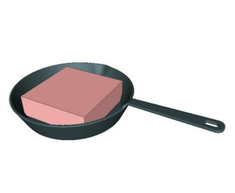
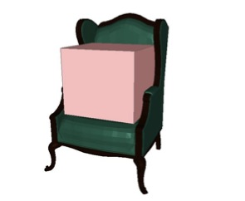
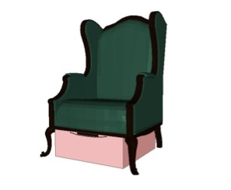
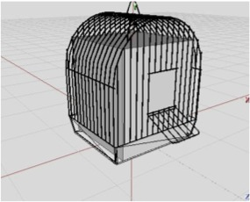
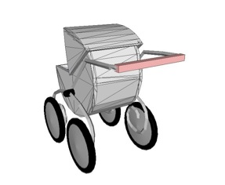
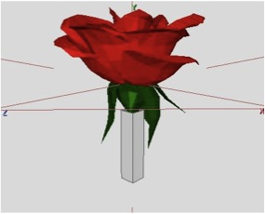
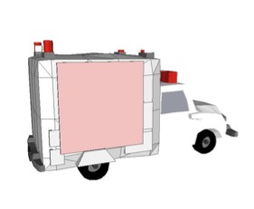
Spatial Tags
Base
Cup
On
Canopy
Enclosure
Handle
Stem
Wall
Notes:
All objects in database given spatial tags

Slide 39
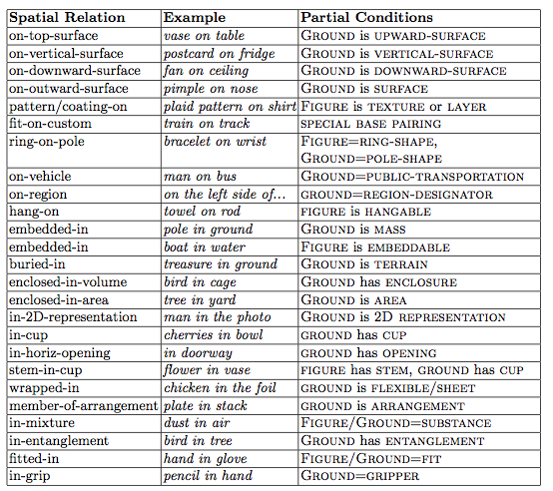
Mapping prepositions to spatial relations with spatial tags

Slide 40
Other 3D Object Features
Object Feature | Description
Is-A | What is this object (can be multiple)
Spatial Tags
Canopy | Canopy-like area under an object (under a tree)
Cup | Hollow area, open above forming interior of object
Enclosure | Interior region, bounded on all sides (holes allowed)
Top/side/bottom/front/back | For both inner and outer surfaces
Named-part | Specific part (e.g. hood of car)
Stem | A long thin vertical base
Opening | Opening to object’s interior (e.g. doorway to a room)
Hole-through | Hole through an object (e.g. a ring or nut for a bolt)
Touch-point | Handles and other functional parts (e.g. doorknob)
Base | Region of an object where it supports itself
Overall Shape | Dominant overall shape (sheet, block, ribbon, disk, …)
Forward/Up direction | Object’s default orientation
Size | Object’s default size
Length axis | Axis for lengthening object (e.g. the long axis of a pencil)
Segmented/stretchable | Some objects
Embeddable | Distance this object is embedded, if any. (eg boat, fireplace,…)
Wall-item/Ceiling-item | Object normally attached to wall or ceiling
Flexible | Flexible objects like cloth and paper that can wrap or drape over
Surface element | Part of flat surface (e.g. crack, smudge, decal, texture)
Semantic Properties | Functional properties such as PATH, SEAT, AIRBORNE

Slide 41
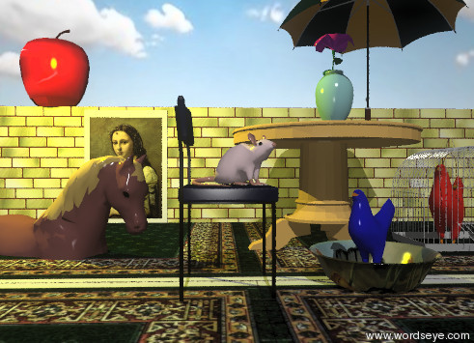
Spatial relations in a scene
Spatial relation | Scene elements
Enclosed-in | Chicken in cage
Embedded-in | Horse in ground
In-cup | Chicken in bowl
On-top-surface | Apple on wall
On-vertical-surface | Picture on wall
Pattern-on | Brick-texture on wall
Under-canopy | Vase under umbrella
Under-base | Rug under table
Stem-in-cup | Flower in vase
Laterally related | Wall behind table
Length axis | Wall
Default size/orientation | All objects
Region | Right side of
Distance | 2 feet behind
Size | Small and 16 ft long
Orientation | facing
Input text: A large magenta flower is in a small vase. The vase is under an umbrella. The umbrella is on the right side of a table. A picture of a woman is on the left side of a 16 foot long wall. A brick texture is on the wall. The wall is 2 feet behind the table. A small brown horse is in the ground. It is a foot to the left of the table. A red chicken is in a birdcage. The cage is to the right of the table. A huge apple is on the wall. It is to the left of the picture. A large rug is under the table. A small blue chicken is in a large flower cereal bowl. A pink mouse is on a small chair. The chair is 5 inches to the left of the bowl. The bowl is in front of the table. The red chicken is facing the blue chicken. . .

Slide 42
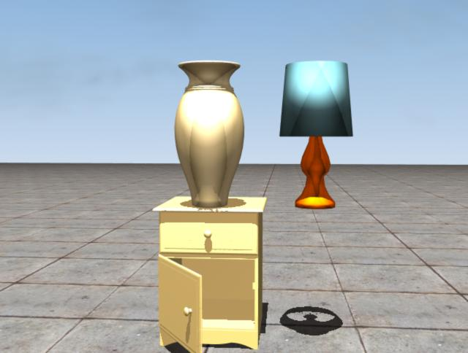
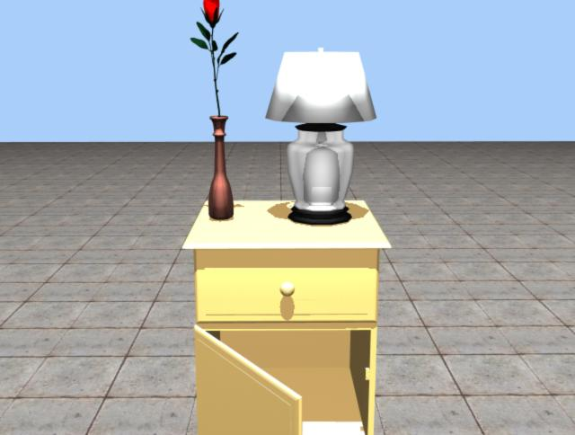
Implicit spatial constraints: objects on surface
Without constraint
With constraint
The vase is on the nightstand. The lamp is next to the vase.

Slide 43
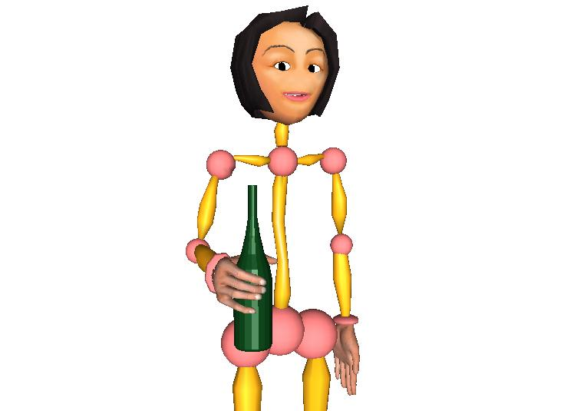
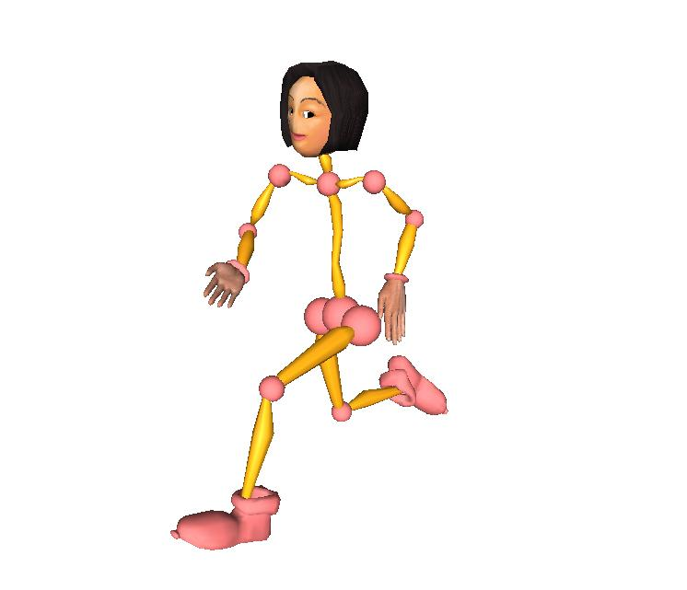
Poses Types (from original system -- not implemented yet in new system)
Grasp: wine_bottle-vp0014
Standalone body pose: Run
43
Body pose + grasp
Use object: bicycle_10-speed-vp8300

Slide 44
Combined poses
Mary rides the bicycle. She plays the trumpet.

Slide 45
Outline
Motivation and system overview
Background and functionality
Under the hood
Semantics on Objects
Lexical Semantics (WordNet and FrameNet)
Semantics on Scenes (SBLR - Scenario-Based Lexical Resource)
Computational flow
Applications
Education pilot at HEAF (Harlem Educational Activities Fund)
Conclusions
Notes:
Introducing the idea of lexical frames in mtt

Slide 46
WordNet: Semantics of synsets
http://wordnet.princeton.edu
120,000 word senses (synsets)
Relations between synsets
Hypernym/hyponym (IS-A)
Meronym/holonym (parts)
Derived forms (e.g. inherit➔inheritance)
Synset example: <dog|domestic dog|canis familiarus>
Hypernyms: <canine>, <domestic animal>
Hyponyms: <poodle>, <hunting dog>, etc.
Part-meronym: <tail> (other parts inherited via hypernyms)

Slide 47
WordNet Limitations
Often only single inheritance.
E.g., princess has hypernym aristocrat but not female
Word sense - No differentiation between polysemy & completely different meanings
Lexical use versus functional use inconsistent. E.g., “spoon” is hyponym of “container”, even though it wouldn’t be called that.
Part-whole and substance-whole very sparse and inconsistent
Doesn’t know that snowball is made-of snow.
Has shoelace as part-of shoe -- but loafer is hyponym of shoe
Lack of specificity in derivationally-related forms. E.g. inheritance is what is inherited, while Inheritor is one who inherits.
Lack of functional roles. E.g. that mop is instrument in cleaning floors

Slide 48
Semantics on events and relations
How to represent overall meaning of sentences?
Eg John quickly walked out of the house
Action=walk.
agent=john, source=house, manner=quickly
Account for syntactic constraints and alternation patterns
Mary told Bill that she was bored
*Mary told to Bill that she was bored
Mary said to Bill that she was bored
*Mary said Bill that she was bored
Represent both verbs and event/relational nouns
John’s search for gold took hours
John searched for gold for hours

Slide 49
Thematic Roles
http://en.wikipedia.org/wiki/Thematic_relation
Agent: deliberately performs the action (Bill ate his soup quietly).
Experiencer: the entity that receives sensory or emotional input (Jennifer heard the music)
Theme: undergoes the action but does not change its state (We believe in many gods.)
Patient: undergoes the action and changes its state ( The falling rocks crushed the car)
Instrument: used to carry out the action (Jamie cut the ribbon with a pair of scissors).
Force or Natural Cause: mindlessly performs the action (An avalanche destroyed the ancient temple).
Location: where the action occurs (Johnny and Linda played carelessly in the park).
Direction or Goal: where the action is directed towards (The caravan headed toward the distant oasis.)
Recipient: a special kind of goal associated with verbs expressing a change in ownership, possession. (I sent John the letter).
Source or Origin: where the action originated (The rocket was launched from Central Command).
Time: the time at which the action occurs (The rocket was launched yesterday).
Beneficiary: the entity for whose benefit the action occurs (I baked Reggie a cake).
Manner: the way in which an action is carried out (With great urgency, Tabatha phoned 911).
Purpose: the reason for which an action is performed (Tabatha phoned 911 right away in order to get some help).
Cause: what caused the action to occur in the first place; not for what, rather because of what (Since Clyde was hungry, he ate the cake).

Slide 50
FrameNet – Digital lexical resource http://framenet.icsi.berkeley.edu/
Frame semantics as generalization of thematic roles
Frame
Schematic representation of a situation, object, or event that provides the background and motivation for the existence and everyday use of words in a language. i.e. grouping of words with common semantics.
947 frames with associated lexical units (LUs)
10,000 LUs (Verbs, nouns, adjectives)
Frame Elements (FEs): frame-based roles
E.g. COMMERCE_SELL (sell, vend)
Core FEs (BUYER, GOODS, SELLER) ,
Peripheral FEs (TIME, LOCATION, MANNER, …)
Annotated sentences and valence patterns mapping LU syntactic patterns to frame roles.
Relations between frames (inheritance, perspective, subframe, using, …)
Notes:
Frames have N,V,A but we’re only looking at verbs in this talk
Fes are what defines the frame
Fes for buy/sell similar
Relations between buy and sell. They’re not just independent! Instead they’re related by a frame relsion.

Slide 51
Example: REVENGE Frame
Frame Element | Core Type
Avenger | Core
Degree | Peripheral
Depictive | Extra_thematic
Offender | Core
Instrument | Peripheral
Manner | Peripheral
Punishment | Core
Place | Core
Purpose | Peripheral
Injury | Core
Result | Extra_thematic
Time | Peripheral
Injured_party | Core
This frame concerns the infliction of punishment in return for a wrong suffered. An AVENGER performs a PUNISHMENT on a OFFENDER as a consequence of an earlier action by the Offender, the INJURY. The Avenger inflicting the Punishment need not be the same as the INJURED_PARTY who suffered the Injury, but the Avenger does have to share the judgment that the Offender's action was wrong. The judgment that the Offender had inflicted an Injury is made without regard to the law.

Slide 52
Lexical Units in REVENGE Frame
Lexical Unit | Annotated sentences
avenge.v | 32
avenger.n | 4
vengeance.a | 28
retaliate.v | 31
revenge.v | 8
revenge.n | 30
vengeful.a | 9
vindictive.a | 0
retribution.n | 15
retaliation.n | 29
revenger.n | 0
revengeful.a | 3
retributive.a | 0
get_even.v | 10
retributory.a | 0
get_back.v | 6
payback.n | 0
sanction.n | 0

Slide 53
Annotations for avenge.v (REVENGE frame)

Slide 54
Annotations for get_even.v (REVENGE frame)
Notes:
Offender explicit, in “with” pp.

Slide 55
Valence patterns for give
Valence pattern | Example sentence
Donor=subj, recipient=obj, theme=Dep/NP | John gave Mary the book
Donor=subj, theme=obj, recipient=dep/to | John gave the book to Mary
Donor=subj, theme=dep/of, recipient=dep/to | John gave of his time to people like Mary
Donor=subj, recipient=dep/to | John gave to the church
Giving frame
LUs: give.v, gift.n, donate.v, contribute.v, …
Core FEs: Donor, Recipient, Theme

Slide 56
Frame-to-frame relations and FE mappings
Related via INHERITANCE and USING
frame relations
Assist, help, aid,
Cater, abet, . . .
Do, act, perform,
Carry out, conduct,…
Notes:
So when we have these frame reations, how do we associate the Fes? Peripherals keep same name here.

Slide 57
Frame-to-frame Relations
pay, payment, disburse,
disbursement
Collect, charge bill
Buy, purchase
Retail, retailer, sell, vend,
Vendor, sale

Slide 58
FrameNet limitations
Missing frames (especially for spatial relations) and lexical units.
Sparse and noisy valence patterns.
Incomplete set of relations between frames
Can’t map He followed her to the store in his car (COTHEME with mode_of_transportation) to He drove to the store (OPERATE_VEHICLE)
No semantics to differentiate between elements in frame. Eg, swim and run are in same frame (self_motion).
Very general semantic type mechanism (few selectional restrictions on FE values)
No default values for FEs

Slide 59
Outline
Motivation and system overview
Background and functionality
Under the hood
Semantics on Objects
Lexical Semantics (WordNet and FrameNet)
Semantics on Scenes (SBLR - Scenario-Based Lexical Resource)
Computational flow
Applications
Education pilot at HEAF (Harlem Educational Activities Fund)
Conclusions
Notes:
Introducing the idea of lexical frames in mtt

Slide 60
Semantics of Scenes: SBLR (Scenario-Based Lexical Resource)
Semantic relation classes
Seeded from FrameNet frames. Others added as needed (eg. Spatial relations)
Valence patterns mapping syntactic patterns to semantic roles with selectional preferences for semantic roles.
Ontology of lexical items and semantic nodes
Seeded from 3D object library and WordNet
Rich set of lexical and contextual relations between semantic nodes represented by semantic relation instances.
(CONTAINING.R (:container bookcase.e) (:contents book.e))
Vignettes to represent mapping from frame semantics to prototypical situations and resulting graphical relations. Eg “wash car” takes place in driveway with hose, while “wash dishes” takes place in kitchen at sink.

Slide 61
Using the SBLR: Valence patterns for “Of” based on semantic preferences
Text (A of B) | Conditions | Resulting Semantic Relation
Bowl of cherries | A=container, B=plurality-or-mass | CONTAINER-OF (bowl, cherries)
Slab of concrete | A=entity, B=substance | MADE-OF (slab, concrete)
picture of girl | A=representing-entity, B=entity | REPRESENTS (picture, girl)
Arm of the chair | A=part-of(B), B=entity | PART-OF (chair, arm)
Height of the tree | A=size-property, B=physical-entity | DIMENSION-OF (height, tree)
Stack of plates | A=arrangement, B=plurality | GROUPING-OF (stack,plates)
Semantic types, functional properties, and spatial tags used to resolve semantic relation for “of”

Slide 62
Mapping “of” to graphical relations
Containment: bowl of cats
Part: head of the cow
Dimension: height of horse is..
Grouping: stack of cats
Substance: horse of stone
Representation: Picture of girl

Slide 63
Using Mechanical Turk to acquire default locations and parts for the SBLR
Present Turkers with pictures of WordsEye 3D objects
They provide parts and default locations for that object
These locations and parts manually normalized to SBRL relations
CONTAINING, RESIDENCE, EMBEDDED-IN, HABITAT-OF, IN-SURFACE, NEXT-TO, ON-SURFACE, PART, REPRESENTING, SUBSTANCE-OF, TEMPORAL-LOCATION, UNDER, WEARING
Sample instances:
(:CONTAINING.R (:CONTAINER SCHOOLHOUSE.E) (:CONTENTS STUDENT.E))
(:CONTAINING.R (:CONTAINER SCHOOLHOUSE.E) (:CONTENTS LOCKER.E))
(:CONTAINING.R (:CONTAINER SCHOOLHOUSE.E) (:CONTENTS DESK.E))
(:CONTAINING.R (:CONTAINER SCHOOLHOUSE.E) (:CONTENTS BLACKBOARD.E))
(HABITAT-OF.R (:habitat MOUNTAIN.E) (:inhabitant BUSH.E))
(HABITAT-OF.R (:habitat MOUNTAIN.E) (:inhabitant BIRD.E))
(HABITAT-OF.R (:habitat MOUNTAIN.E) (:inhabitant ANIMAL.E))
(HABITAT-OF.R (:habitat MEADOW.E) (:inhabitant WILDFLOWER-PLANT.E))
(HABITAT-OF.R (:habitat MEADOW.E) (:inhabitant WEED-PLANT.E))
(HABITAT-OF.R (:habitat MEADOW.E) (:inhabitant GRAIN.E))

Slide 64
Using Mechanical Turk to acquire high/low level descriptions of existing scenes
Low-level:
A man is using the telephone. The man is wearing a yellow vest. The man has blonde hair. The man has white skin. A white rodent is inside a cage. The cage is on a table. The phone is on the table. The cage has a handle. A safe is in the background of the room. #High-level: The man is a scientist working with white rodents. #High-level: The man is talking to another scientist. #High-level: The man feels guilt at imprisoning a white rodent.
Acquire typical language (hi/low) for scenes
100 scenes, each described by 5 different Turkers
Phase 2: Use these sentences for Turkers to do semantic role labeling (in progress)

Slide 65
Outline
Motivation and system overview
Background and functionality
Under the hood
Semantics on Objects
Lexical Semantics (WordNet and FrameNet)
Semantics on Scenes (SBLR - Scenario-Based Lexical Resource)
Computational flow
Applications
Education pilot at HEAF (Harlem Educational Activities Fund)
Conclusions
Notes:
Introducing the idea of lexical frames in mtt

Slide 66
WordsEye: Computational flow (and resources)

Slide 67
Example: Start with input text
Example:
The truck chased the man down the road.
The road is very long.

Slide 68
Parse into phrase structure
1a
Parse into phrase structure
Output
Hand-crafted parser and grammar
Will also use MICA parser for wider coverage
(SS
(S (NP (DT "the") (NN "truck"))
(VP (VBD "chased") (NP (DT "the") (NN "man"))
(PREPP (IN2 (IN "down")) (NP (DT "the") (NN "road")))))
(ENDPUNC "."))
(SS
(S (NP (DT "the") (NN "road"))
(VP (VBZ-BE "is") (PRED-ADJP (INT "very") (JJ "long"))))
(ENDPUNC "."))
For input text:
The truck chased the man down the road. The road is very long.

Slide 69
Convert to dependency structure
1b
Convert to dependency links
Output
Grammar contains head nodes and syntactic roles of constituents
((#<lex-3: "chase">
(:SUBJECT #<lex-2: ”truck">)
(:DIRECT-OBJECT #<lex-5: ”man">)
(:DEP #<lex-6: "down">))
(#<lex-6: "down">
(:DEP #<lex-11: "road">))
(#<lex-8: ”road">
(:ATTRIBUTE-NEW #<lex-13: ”long">)))

Slide 70
Reference resolution
1c
Resolve lexical references
Output
Anaphora and other coreference
Use lexical and semantic features (gender, animacy, definiteness, hypernyms, etc)
Handle references to collections and their elements
((#<lex-3: "chase">
(:SUBJECT #<lex-2: ”truck">)
(:DIRECT-OBJECT #<lex-5: ”man">)
( :DEP #<lex-6: "down">))
(#<lex-6: "down">
(:DEP #<lex-8: "road">))
(#<lex-8: ”road">
(:ATTRIBUTE-NEW #<lex-13: ”long">)))

Slide 71
Assign semantic roles
2
Semantic analysis
Output
Convert syntactic dependency links to semantic role links
Convert lexical items to semantic nodes (only shown for verb)
((#<lex-3: cotheme.chase.v>
(:THEME #<lex-2: ”truck">)
(:COTHEME #<lex-5: ”man">)
(:PATH #<lex-6: "down">))
(#<lex-6: "down">
(:DEP #<lex-8: "road">))
(#<lex-8: ”road">
(:ATTRIBUTE-NEW #<lex-13: ”long">)))

Slide 72
Infer context and other defaults
3
Infer unstated context
Output: add contextual objects and relations
Infer background setting. Currently just adding sky, sun, ground.
Infer default roles for actions. E.g. “he drove to the store” requires vehicle (which is unstated). Not doing this yet.
[1] #<Ent-1 "obj-global_ground" [3D-OBJECT] >
[2] #<Ent-2 "sky" [3D-OBJECT] >
[3] #<Ent-4 "sun" [BACKGROUND-OBJECT] >

Slide 73
Convert semantics to graphical constraints
4
Create scene-level semantics
Output
SBLR vignettes map semantics to prototypical scene relations and primitive graphical relations
Assign actual 2D/3D objects to semantic nodes
Add default relations (e.g. objects on ground)
((#<lex-8: ”road"> (:ATTRIBUTE #<lex-13: ”long">))
(#<Relation: IN-POSE> (:OBJECT #<lex-5: "man">) (:POSE "running"))
(#<Relation: ORIENTATION-WITH>
(:FIGURE #<lex-2: ”truck">)
(:GROUND #<lex-8: "road">))
(#<Relation: BEHIND>
(:FIGURE #<lex-2: ”truck">)
(:GROUND #<lex-5: ”man">)
(:REFERENCE-FRAME #<lex-8: "road">))
(#<Relation: ON-HORIZONTAL-SURFACE>
(:FIGURE #<lex-5: "man">)
(:GROUND #<lex-8: "road">))
(#<Relation: ON-HORIZONTAL-SURFACE>
(:FIGURE #<lex-2: ”truck">)
(:GROUND #<lex-8: "road">)))

Slide 74
Convert graphical constraints to rendered 3D scene
5
Apply graphical constraints and render scene
Final Output
Resolve spatial relations using spatial tags and other knowledge about objects
Handle object vs global reference frame constraints
Preview inOpenGL
Raytrace in Radiance

Slide 75
Outline
Motivation and system overview
Background and functionality
Under the hood
Semantics on Objects
Lexical Semantics (WordNet and FrameNet)
Semantics on Scenes (SBLR - Scenario-Based Lexical Resource)
Computational flow
Applications
Education pilot at HEAF (Harlem Educational Activities Fund)
Conclusions
Notes:
Introducing the idea of lexical frames in mtt

Slide 76
Applications
Education: Pilot study in Harlem summer school
Graphics authoring and online social media
Speed enables social interaction with pictures and promotes “visual banter”. Many examples in WordsEye gallery
3D games: (e.g. WordsEye adventure game to construct environment as part of the gameplay)
Most 3D game content is painstakingly designed by 3D artists
Newer trend toward malleable environments and interfaces
Variable graphical elements: Spore
Spoken language interfaces (Tom Clancy’s End War)
Scribblenauts: textual input/words invoke graphical objects

Slide 77
Application: Use in education to help improve literacy skills
Used with fourteen 6th graders at HEAF (Harlem Educational Activities Fund)
Five once-a-week 90 minute sessions
Students made storyboards for scenes in Animal Farm and Aesop’s Fables
System helped imagine and visualize stories
Made scenes with their own 3D faces. They enjoyed putting each other in scenes, leading to social interaction and motivation.

Slide 78
Pre- post- test results
 | Pre-test | Post-test | Growth
Group 1 (WordsEye) | 15.82 | 23.17 | 7.35
Group 2 (control) | 18.05 | 20.59 | 2.54
Evaluated by three independent qualified judges
Using the evaluation instrument, each scorer assigned a score 1 (Strongly Disagree) through 5 (Strongly Agree) for each of the 8 questions about character and the students’ story descriptions.
The results showed a statistically significant difference in the growth scores between Group 1 and Group 2. We can conclude that WordsEye had a positive impact on the literacy skills of Group 1 (treatment)—specifically in regard to writing and literary response.

Slide 79
HEAF pictures from Aesop’s Fables and Animal Farm
The pig is running away.
Humans facing the pigs in cards
Alfred Simmonds: Horse Slaughterer
Tortoise and the Hare

Slide 80
Outline
Motivation and system overview
Background and functionality
Under the hood
Semantics on Objects
Lexical Semantics (WordNet and FrameNet)
Semantics on Scenes (SBLR - Scenario-Based Lexical Resource)
Computational flow
Applications
Education pilot at HEAF (Harlem Educational Activities Fund)
Conclusions
Notes:
Introducing the idea of lexical frames in mtt

Slide 81
Conclusion
Object semantics, lexical semantics and real-world knowledge can be used to support visualization of natural language.
We are acquiring this knowledge through Mechanical Turk, existing resources, and other means.
Also working to infer emotion for different actions. Eg. “John threatened Bill” ➔ Bill is scared, John is angry
Language-generated scenes have application in education and have shown in a pilot study in a Harlem school to improve literacy skills.
Other potential applications in gaming and online social media
System online at:
http://lucky.cs.columbia.edu:2001 (research system)
www.wordseye.com (old system)

Slide 82
Thank You
http://lucky.cs.columbia.edu:2001 (research system)
www.wordseye.com (old system)
Bob Coyne (coyne@cs.columbia.edu)
Julia Hirschberg, Owen Rambow, Richard Sproat,, Daniel Bauer,
Margit Bowler, Kenny Harvey, Masoud Rouhizadeh, Cecilia Schudel
This work was supported in part by the NSF IIS- 0904361

