Slide 1
Syntax and Context-Free Grammars
Julia Hirschberg
CS 4705
Slides with contributions from Owen Rambow, Kathy McKeown, Dan Jurafsky and James Martin

Slide 2
What is Syntax?
Structure of language
How words are arranged together and related to one another
Goal of syntactic analysis: relate surface form (what someone says or writes) to underlying structure, to support semantic analysis (what the utterance or text means)
Syntactic representation: typically a tree structure

Slide 3
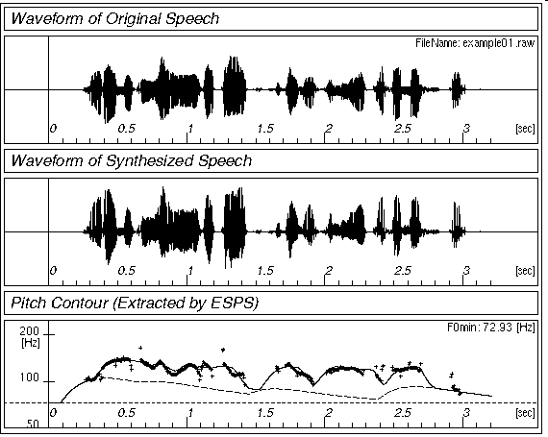
Simple View of Linguistic Analysis
Phonology
⇔ /waddyasai/
Morphology
/waddyasai/ ⇔ what did you say
say
Syntax
what did you say ⇔
obj
subj
say
you
what
Semantics
subj
obj
⇔ P[ λx. say(you, x) ]
you
what

Slide 4
The Big Picture
Empirical Data
?
Formalisms
Data structures
Formalisms (e.g., CFG)
Algorithms
Distributional Models
?
Maud expects there to be a riot
*Teri promised there to be a riot
Maud expects the shit to hit the fan
*Teri promised the shit to hit the fan
?
?
Linguistic Theory

Slide 5
Chomskyan Approach
Thesis: syntax is cognitive reality
Humans can learn languages quickly, but not any arbitrary language ⇒ universal grammar is biological
Goal of syntactic study: find universal principles and language-specific parameters
Specific Chomskyan theories change regularly
General ideas adopted by most contemporary syntactic theories (“principles-and-parameters-type theories”)

Slide 6
Types of Linguistic Theories
Prescriptive theories: how people ought to talk
Descriptive theories: how people actually talk
Most appropriate for NLP applications
Explanatory theories: provide principles-and-parameters style account of syntax that apply to multiple languages

Slide 7
Why is Syntax Important?
Grammar checkers
Question answering
Information extraction (and maybe information retrieval)
Machine translation
Any NLP task, potentially

Slide 8
Main Ideas
Constituency
Subcategorization
Grammatical relations
Movement/long-distance dependency
Grammaticality

Slide 9
Structure in Strings
A set of words, or, a lexicon: the a small nice big very boy girl sees likes
Some `good’ (grammatical) sentences:
the boy likes a girl
the small girl likes the big girl
a very small nice boy sees a very nice boy
Some bad (ungrammatical) sentences:
*the boy the girl
*small boy likes nice girl
Can we find a way of distinguishing between the two kinds of sequences?
Can we identify similarities among grammatical subsequences?

Slide 10
One Version of Constituent Structure
Lexicon: the a small nice big very boy girl sees likes
Grammatical sentences:
(the) boy (likes a girl)
(the small) girl (likes the big girl)
(a very small nice) boy (sees a very nice boy)
Ungrammatical sentences:
*(the) boy (the girl)
*(small) boy (likes the nice girl)

Slide 11
Another Constituency Hypothesis
Lexicon: the a small nice big very boy girl sees likes
Grammatical sentences:
(the boy) likes (a girl)
(the small girl) likes (the big girl)
(a very small nice boy) sees (a very nice boy)
Ungrammatical sentences:
*(the boy) (the girl)
*(small boy) likes (the nice girl)
Better: fewer types of constituents (blue and red are of same type)

Slide 12
Even More Structures
Lexicon: the a small nice big very boy girl sees likes
Grammatical sentences:
((the) boy) likes ((a) girl)
((the) (small) girl) likes ((the) (big) girl)
((a) ((very) small) (nice) boy) sees ((a) ((very) nice) girl)
Ungrammatical sentences:
*((the) boy) ((the) girl)
*((small) boy) likes ((the) (nice) girl)

Slide 13
From Substrings to Trees
(((the) boy) likes ((a) girl))
likes
boy
girl
the
a

Slide 14
How do we Label the Nodes?
( ((the) boy) likes ((a) girl) )
Choose constituents so each one has one non-bracketed word: the head
Group words by distribution of constituents they head (POS)
Noun (N), verb (V), adjective (Adj), adverb (Adv), determiner (Det)
Category of constituent: XP, where X is POS
NP, S, AdjP, AdvP, DetP

Slide 15
Labeling Tree Structures
(((the/Det) boy/N) likes/V ((a/Det) girl/N))
S
NP
likes
NP
boy
DetP
DetP
girl
the
a

Slide 16
Types of Nodes
(((the/Det) boy/N) likes/V ((a/Det) girl/N))
S
nonterminal
symbols
= constituents
Phrase-structure
tree
NP
likes
NP
boy
DetP
DetP
girl
the
a
terminal symbols = words

Slide 17
Determining Part-of-Speech
A blue seat/a child seat: noun or adjective?
Syntax:
a blue seat a child seat
a very blue seat *a very child seat
this seat is blue *this seat is child
Morphology:
bluer *childer
blue and child are not the same POS
blue is Adj, child is Noun

Slide 18
Determining Part-of-Speech
Preposition or particle?
A he threw out the garbage
B he threw the garbage out the door
A he threw the garbage out
B *he threw the garbage the door out
The two out are not same POS
A is particle, B is Preposition

Slide 19
Constituency
Some Noun phrases (NPs)
A red dog on a blue tree
A blue dog on a red tree
Some big dogs and some little dogs
A dog
I
Big dogs, little dogs, red dogs, blue dogs, yellow dogs, green dogs, black dogs, and white dogs
How do we know these form a constituent?

Slide 20
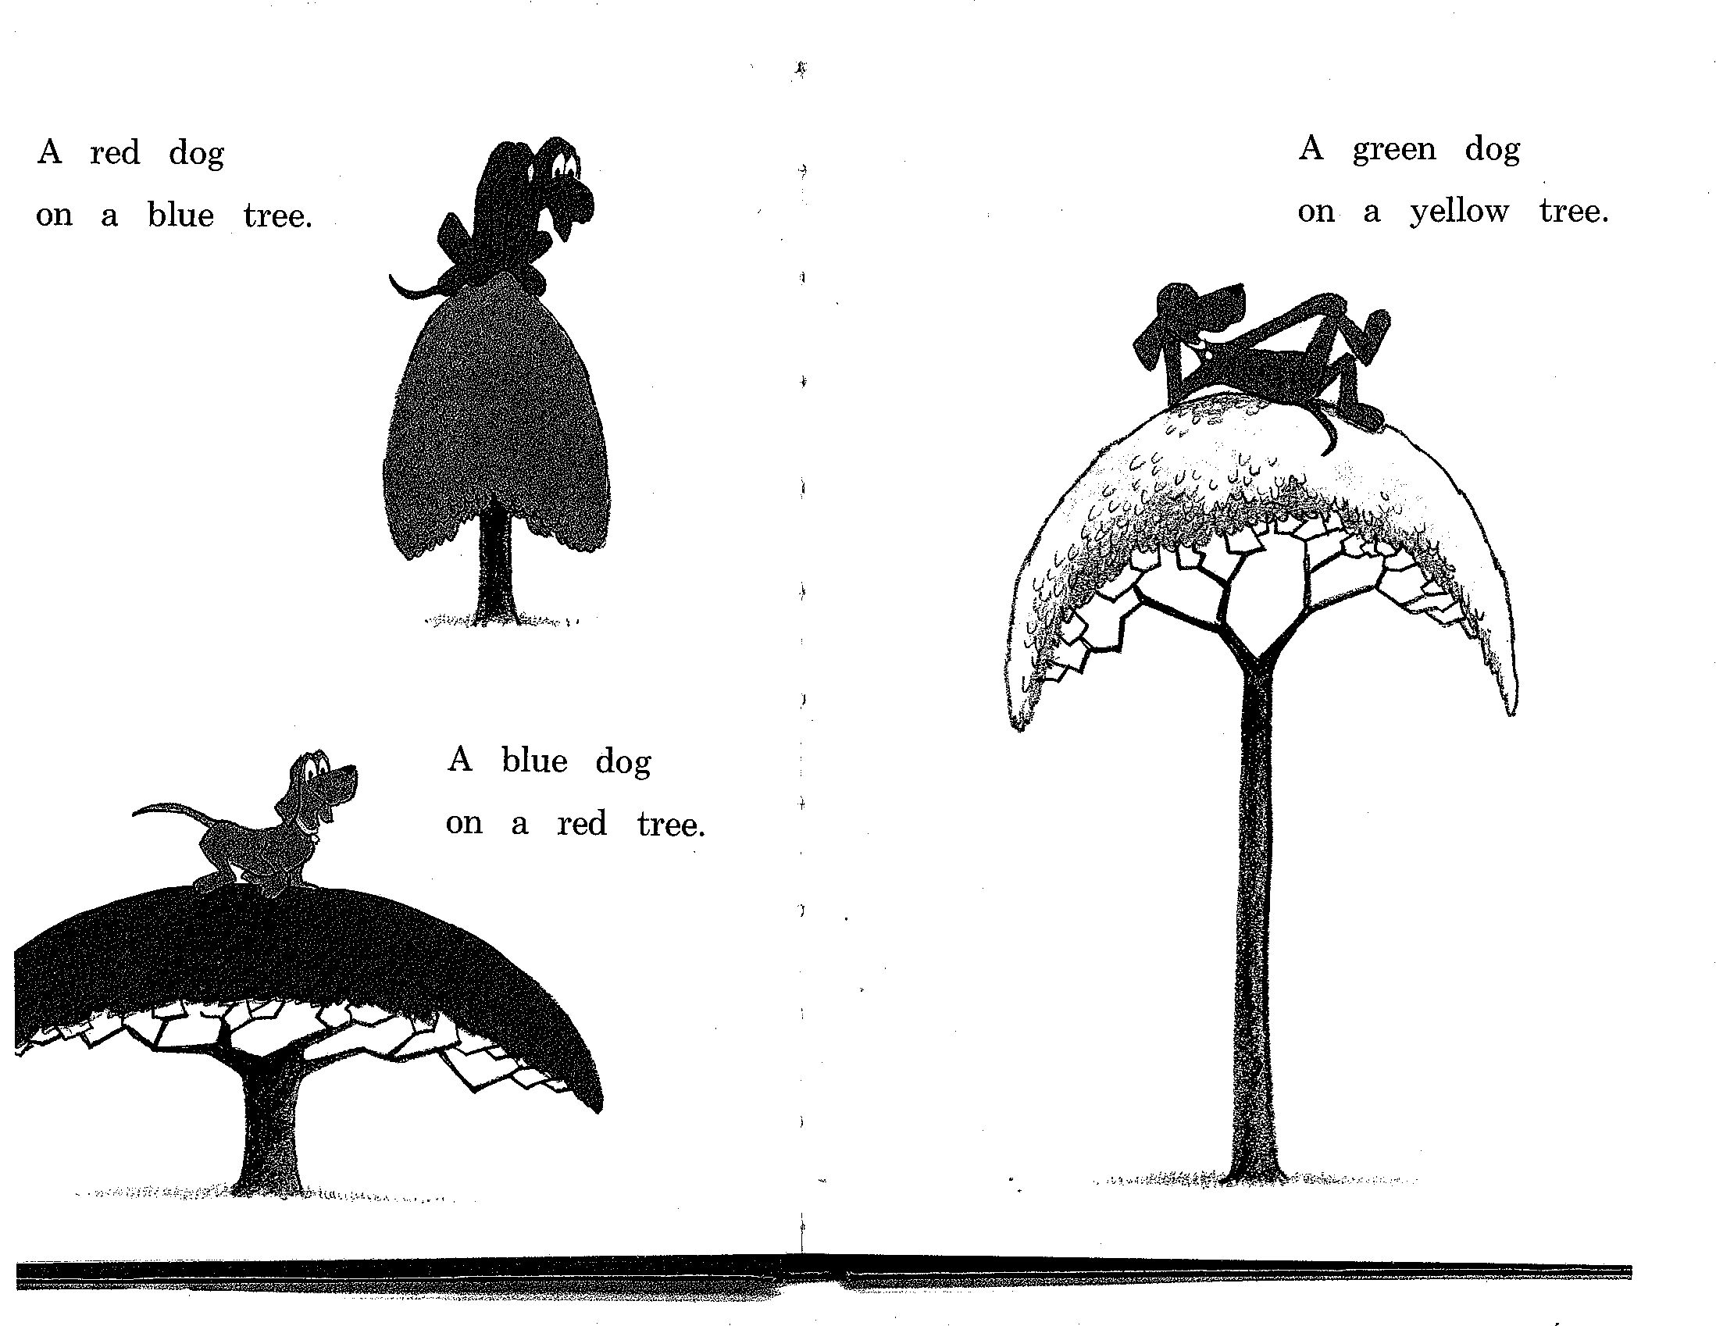

Slide 21
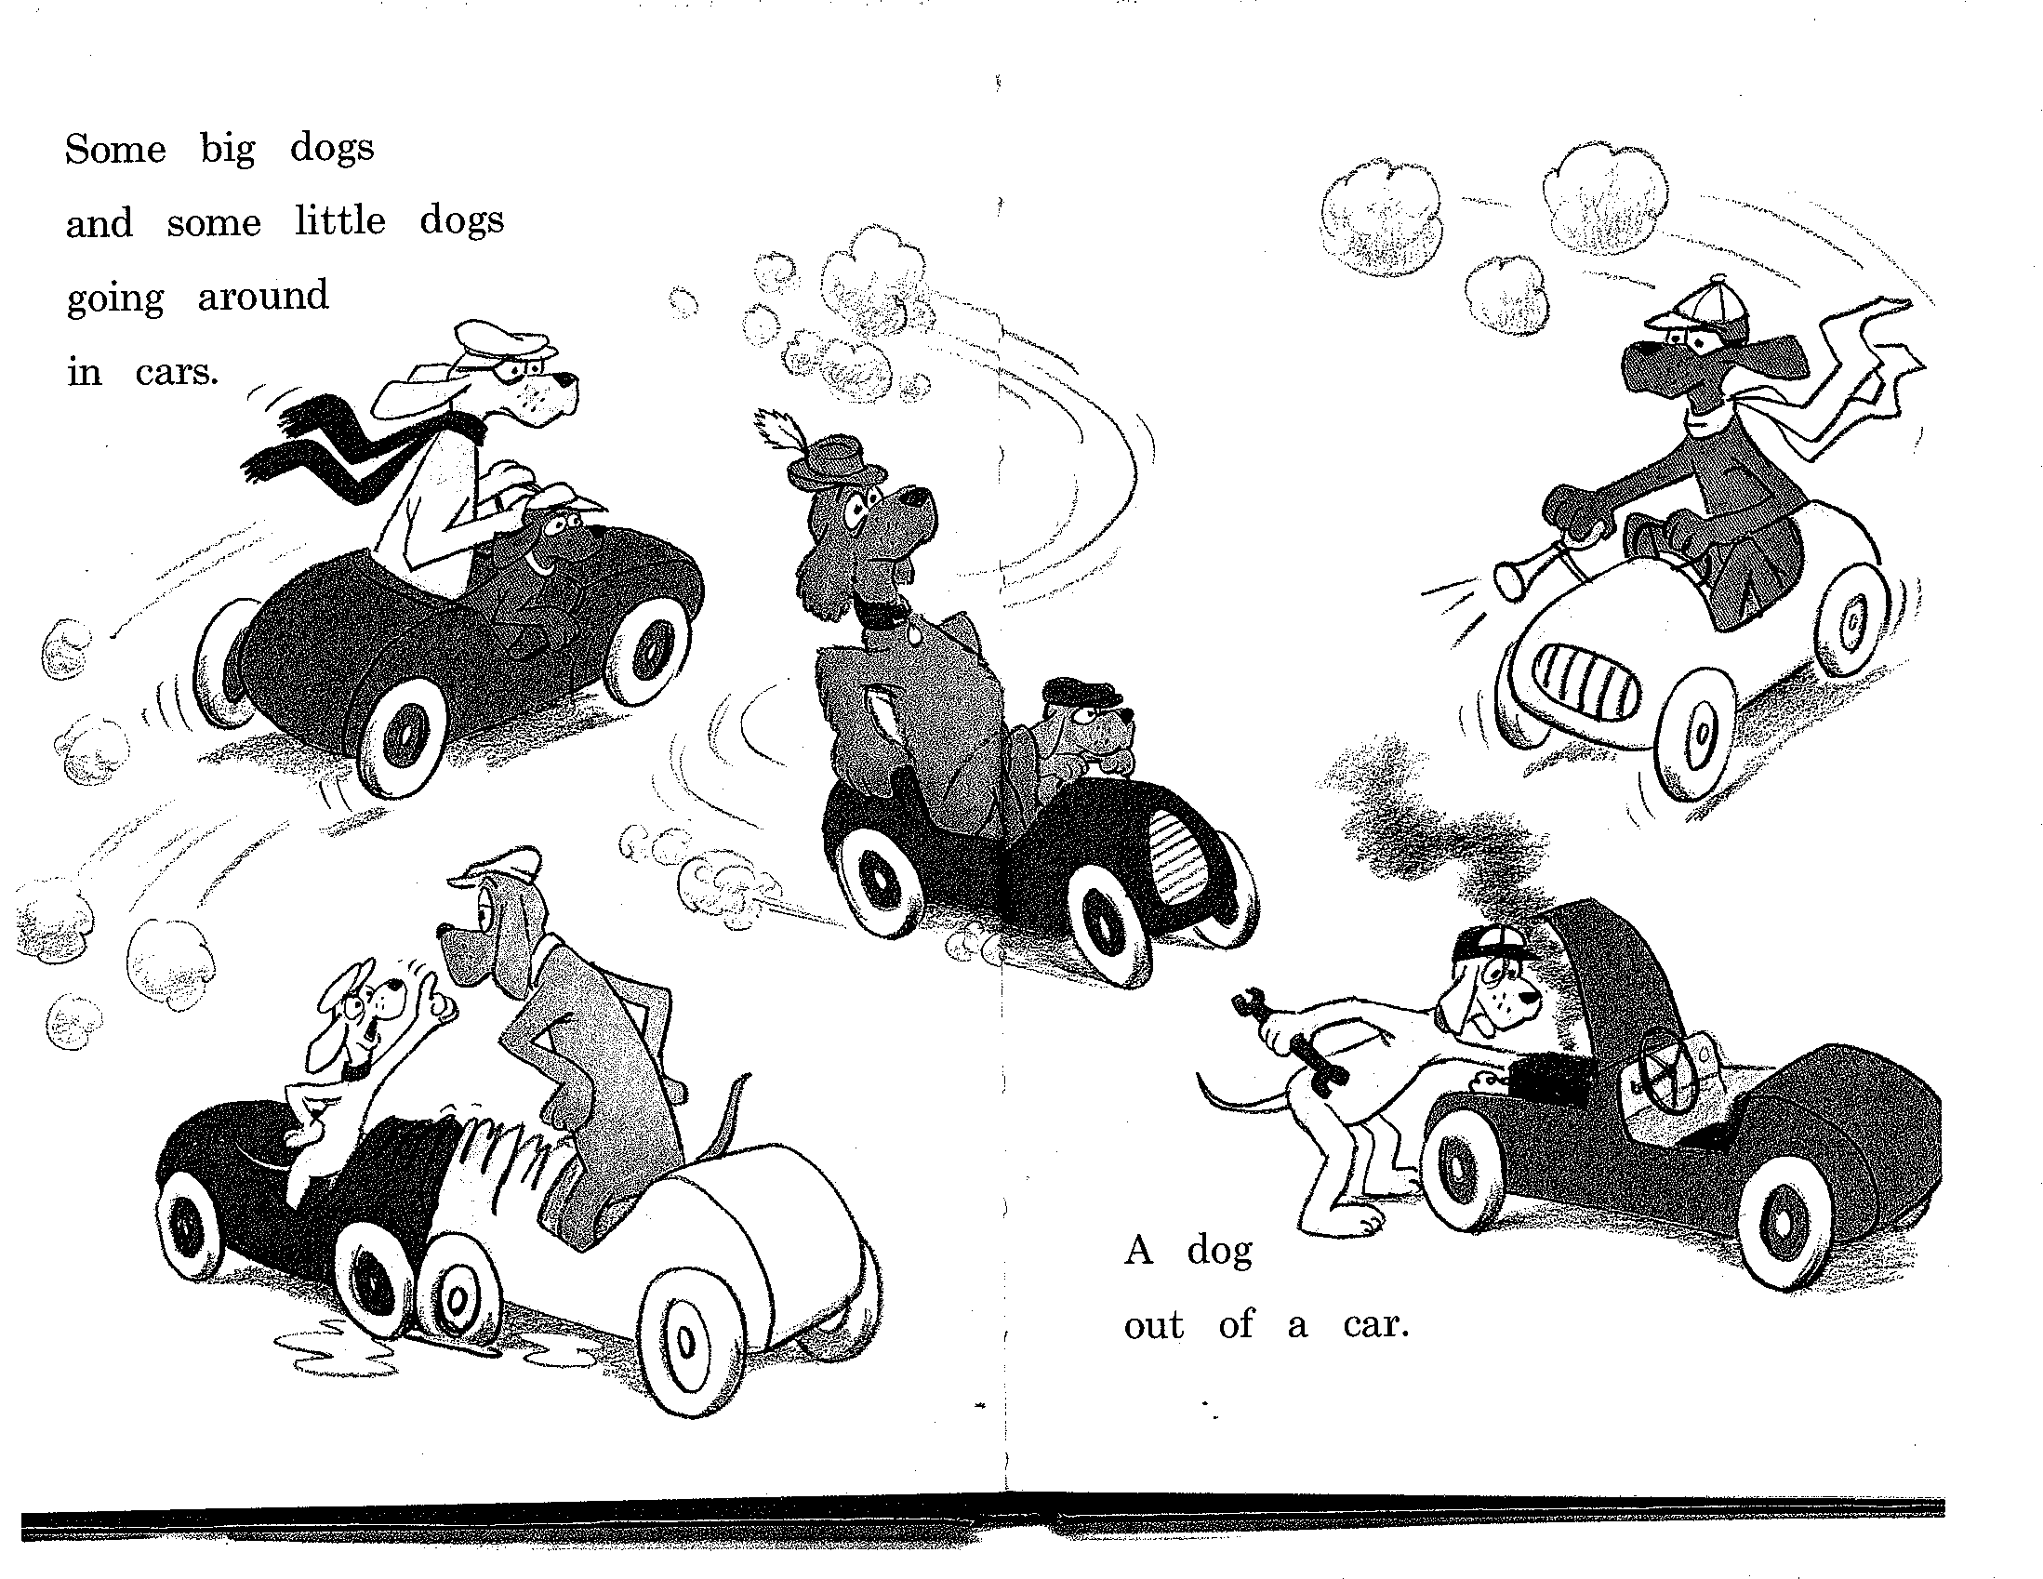

Slide 22
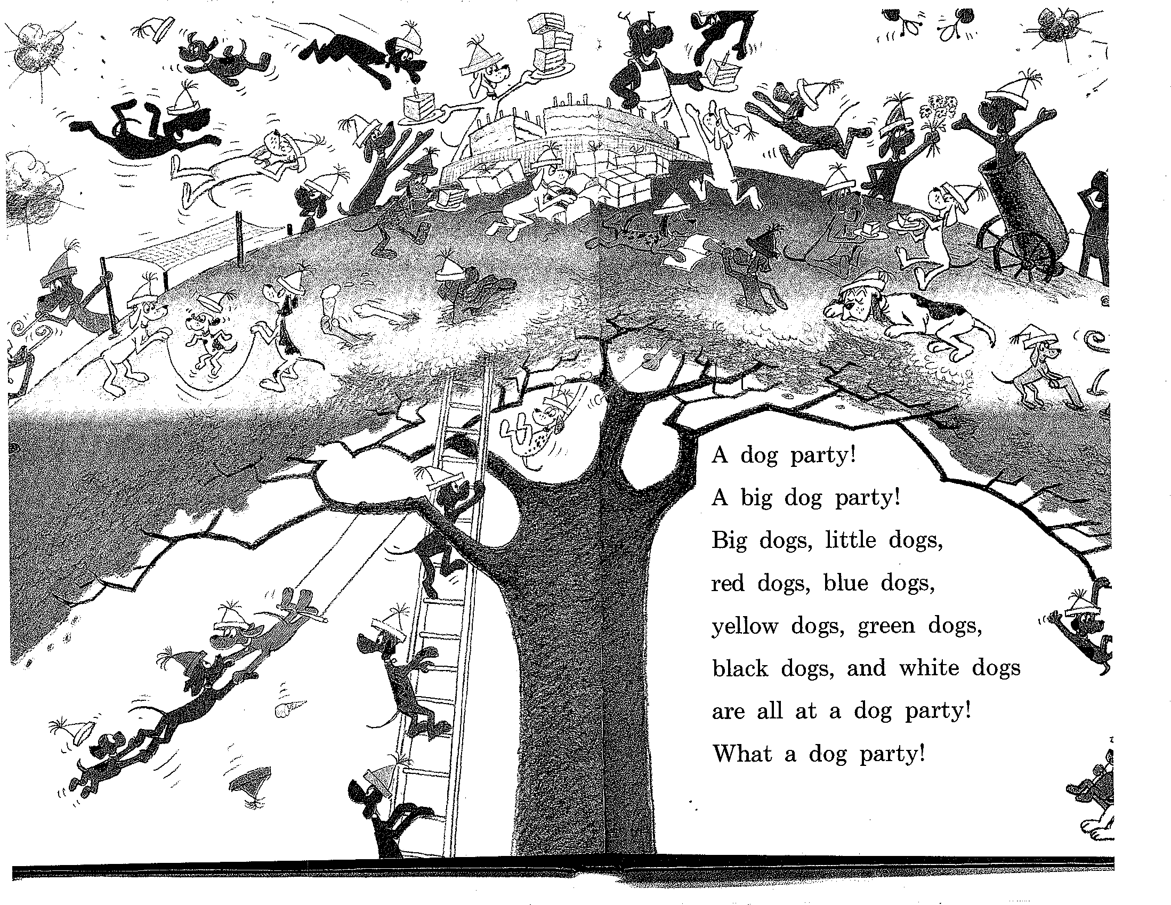

Slide 23
NP Constituency
NPs can all appear before a verb:
Some big dogs and some little dogs are going around in cars…
Big dogs, little dogs, red dogs, blue dogs, yellow dogs, green dogs, black dogs, and white dogs are all at a dog party!
I do not
But individual words can’t always appear before verbs:
*little are going…
*blue are…
*and are
Must be able to state generalizations like:
Noun phrases occur before verbs

Slide 24
PP Constituency
Preposing and postposing:
Under a tree is a yellow dog.
A yellow dog is under a tree.
But not:
*Under, is a yellow dog a tree.
*Under a is a yellow dog tree.
Prepositional phrases notable for ambiguity in attachment
I saw a man on a hill with a telescope.

Slide 25
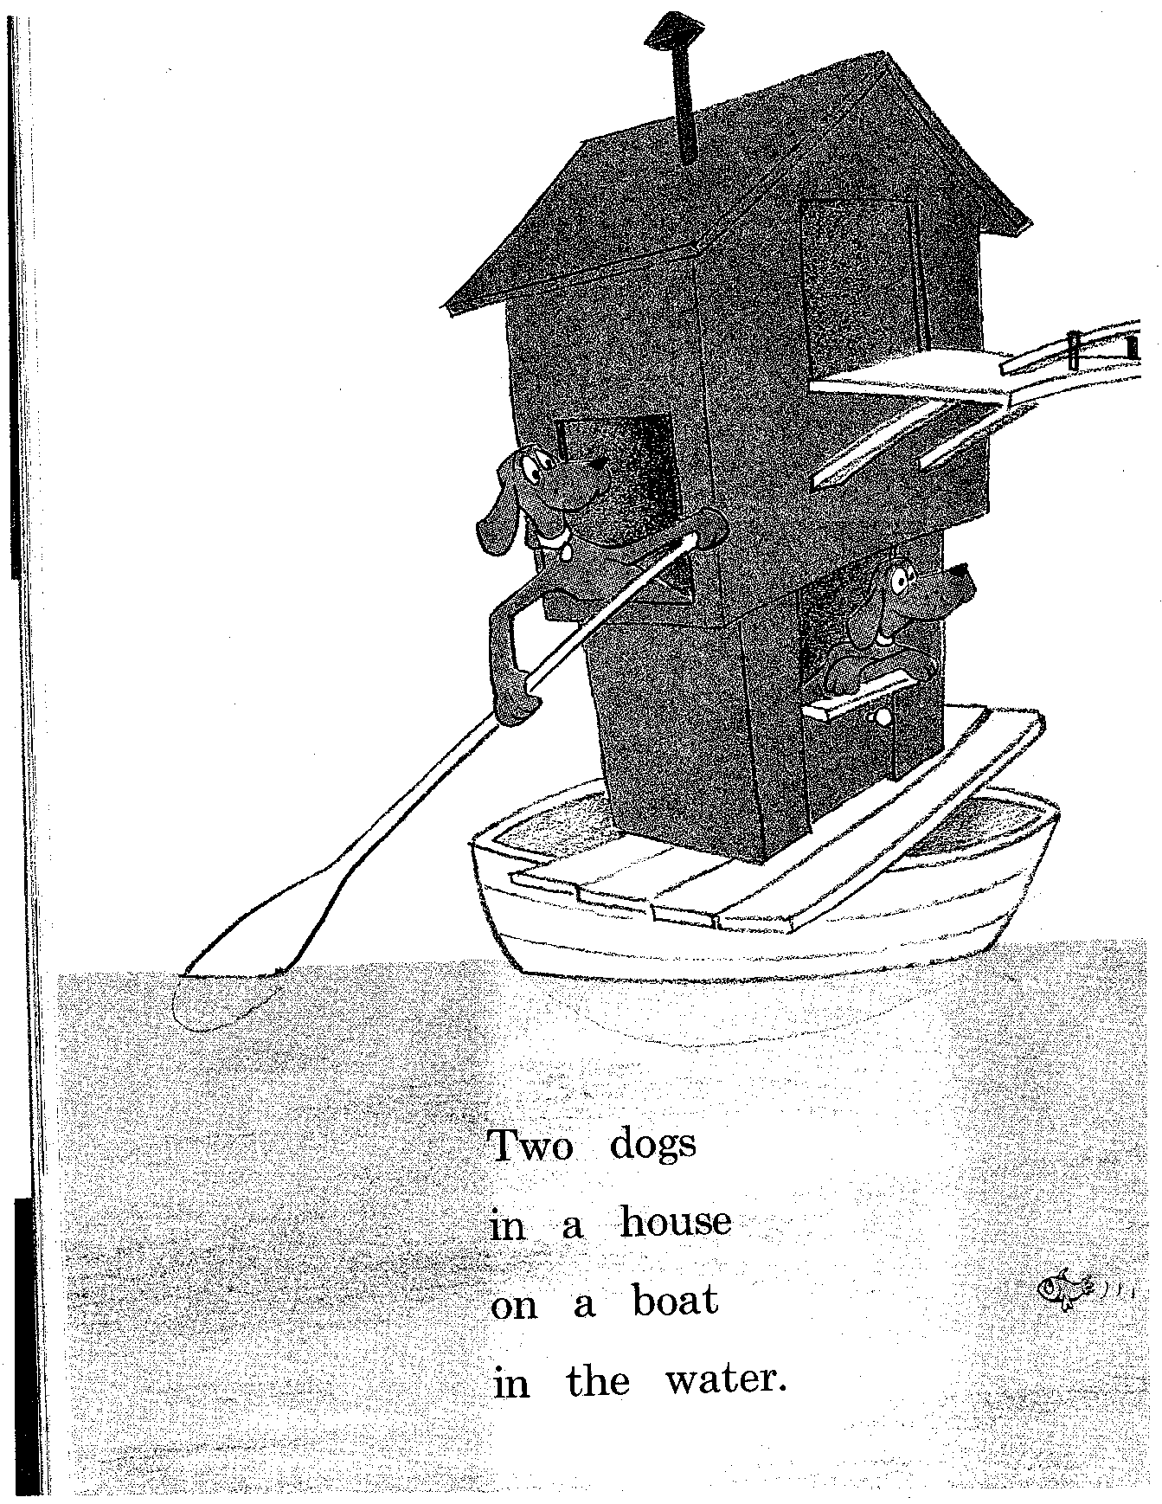

Slide 26
Phrase Structure and Dependency Structure
S
likes/V
NP
likes
NP
boy/N
girl/N
boy
DetP
DetP
girl
the/Det
a/Det
the
a
All nodes are labeled
with words!
Only leaf nodes labeled with words!

Slide 27
Phrase Structure and Dependency Structure
likes/V
S
boy/N
girl/N
NP
likes
NP
boy
the/Det
a/Det
DetP
DetP
girl
the
a
Representationally equivalent if each nonterminal
node has one lexical daughter (its head)

Slide 28
Types of Dependency
likes/V
Adj(unct)
Obj
Subj
sometimes/Adv
boy/N
girl/N
Fw
Adj
Fw
the/Det
small/Adj
a/Det
Adj
very/Adv

Slide 29
Grammatical Relations
Types of relations between words
Arguments: subject, object, indirect object, prepositional object
Adjuncts: temporal, locative, causal, manner, …
Function Words

Slide 30
Subcategorization
List of arguments of a word (typically, a verb), with features about realization (POS, perhaps case, verb form etc)
In canonical order Subject-Object-IndObj
Example:
like: N-N, N-V(to-inf)
see: N, N-N, N-N-V(inf)
NB: J&M talk about subcategorization only within VP

Slide 31
VP Constituency
S
S
NP
VP
NP
likes
NP
boy
boy
DetP
DetP
girl
DetP
likes
NP
the
a
the
girl
DetP
a

Slide 32
VP Constituency
Existence of VP is a linguistic (i.e., empirical) claim, not a methodological claim
Syntactic evidence
VP-fronting (and quickly clean the carpet he did! )
VP-ellipsis (He cleaned the carpet quickly, and so did she )
Adjuncts can occur before and after VP, but not in VP (He often eats beans, *he eats often beans )
NB: VP cannot be represented in a dependency representation

Slide 33
Summary
Goals of syntactic analysis
Forms of syntactic representation
Issues in syntax
Constituency
Subcategorization
Grammatical relations
Movement/long-distance dependency
Grammaticality
Next class: Context Free Grammars

Slide 34
Tips on HW2
No HW in this course can be completed in one day ☺
Start early – much earlier than you think will be required – at least two weeks before the HW is due
Read the HW spec right now and ask questions about anything you don’t understand
HW2 requires you to perform a number of different tasks, so be sure you understand all of them before you start

