Slide 1
Text Summarization: News and Beyond
Kathleen McKeown
Department of Computer Science
Columbia University

Slide 2
What is Summarization?
Data as input (database, software trace, expert system), text summary as output
Text as input (one or more articles), paragraph summary as output
Multimedia in input or output
Summaries must convey maximal information in minimal space

Slide 3
Types of Summaries
Informative vs. Indicative
Replacing a document vs. describing the contents of a document
Extractive vs. Generative (abstractive)
Choosing bits of the source vs. generating something new
Single document vs. Multi Document
Generic vs. user-focused

Slide 4
Types of Summaries
Informative vs. Indicative
Replacing a document vs. describing the contents of a document
Extractive vs. Generative
Choosing bits of the source vs. generating something new
Single document vs. Multi Document
Generic vs user-focused

Slide 5
Questions (from Sparck Jones)
Should we take the reader into account and how?
“Similarly, the notion of a basic summary, i.e., one reflective of the source, makes hidden fact assumptions, for example that the subject knowledge of the output’s readers will be on a par with that of the readers for whom the source was intended. (p. 5)”
Is the state of the art sufficiently mature to allow summarization from intermediate representations and still allow robust processing of domain independent material?

Slide 6
Foundations of Summarization – Luhn; Edmunson
Text as input
Single document
Content selection
Methods
Sentence selection
Criteria

Slide 7
Sentence extraction
Sparck Jones:
`what you see is what you get’, some of what is on view in the source text is transferred to constitute the summary

Slide 8
Luhn 58
Summarization as sentence extraction
http://newsblaster.cs.columbia.edu
Term frequency determines sentence importance
TF*IDF
Stop word filtering
Similar words count as one
Cluster of frequent words indicates a good sentence

Slide 9
TF*IDF
Intuition: Important terms are those that are frequent in this document but not frequent across all documents

Slide 10
Term Weights
Local weights
Generally, some function of the frequency of terms in documents is used
Global weights
The standard technique is known as inverse document frequency
N= number of documents; ni = number of documents with term i

Slide 11
TFxIDF Weighting
To get the weight for a term in a document, multiply the term’s frequency derived weight by its inverse document frequency. TF*IDF

Slide 12
Edmunson 69
Sentence extraction using 4 weighted features:
Cue words (“In this paper..”, “The worst thing was ..”)
Title and heading words
Sentence location
Frequent key words

Slide 13
Sentence extraction variants
Lexical Chains
Barzilay and Elhadad
Silber and McCoy
Discourse coherence
Baldwin
Topic signatures
Lin and Hovy

Slide 14
Lexical Chains
“Dr.Kenny has invented an anesthetic machine. This device controls the rate at which an anesthetic is pumped into the blood.“
“Dr.Kenny has invented an anesthetic machine. The doctor spent two years on this research.“
Algorithm: Measure strength of a chain by its length and its homogeneity
Select the first sentence from each strong chain until length limit reached
Semantics needed?

Slide 15
Discourse Coherence
Saudi Arabia on Tuesday decided to sign…
The official Saudi Press Agency reported that King Fahd made the decision during a cabinet meeting in Riyadh, the Saudi capital.
The meeting was called in response to … the Saudi foreign minister, that the Kingdom…
An account of the Cabinet discussions and decisions at the meeting…
The agency...
It

Slide 16
Topic Signature Words
Uses the log ratio test to find words that are highly descriptive of the input
the log-likelihood ratio test provides a way of setting a threshold to divide all words in the input into either descriptive or not
the probability of a word in the input is the same as in the background
the word has a different, higher probability, in the input than in the background
Binomial distribution used to compute the ratio of the two likelihoods
The sentences containing the highest proportion of topic signatures are extracted.

Slide 17
Summarization as a Noisy Channel Model
Summary/text pairs
Machine learning model
Identify which features help most

Slide 18
Julian Kupiec SIGIR 95 Paper Abstract
To summarize is to reduce in complexity, and hence in length while retaining some of the essential qualities of the original.
This paper focusses on document extracts, a particular kind of computed document summary.
Document extracts consisting of roughly 20% of the original can be as informative as the full text of a document, which suggests that even shorter extracts may be useful indicative summaries.
The trends in our results are in agreement with those of Edmundson who used a subjectively weighted combination of features as opposed to training the feature weights with a corpus.
We have developed a trainable summarization program that is grounded in a sound statistical framework.

Slide 19
Statistical Classification Framework
A training set of documents with hand-selected abstracts
Engineering Information Co provides technical article abstracts
188 document/summary pairs
21 journals
Bayesian classifier estimates probability of a given sentence appearing in abstract
Direct matches (79%)
Direct Joins (3%)
Incomplete matches (4%)
Incomplete joins (5%)
New extracts generated by ranking document sentences according to this probability

Slide 20
Features
Sentence length cutoff
Fixed phrase feature (26 indicator phrases)
Paragraph feature
First 10 paragraphs and last 5
Is sentence paragraph-initial, paragraph-final, paragraph medial
Thematic word feature
Most frequent content words in document
Upper case Word Feature
Proper names are important

Slide 21
Evaluation
Precision and recall
Strict match has 83% upper bound
Trained summarizer: 35% correct
Limit to the fraction of matchable sentences
Trained summarizer: 42% correct
Best feature combination
Paragraph, fixed phrase, sentence length
Thematic and Uppercase Word give slight decrease in performance

Slide 22
Questions (from Sparck Jones)
Should we take the reader into account and how?
“Similarly, the notion of a basic summary, i.e., one reflective of the source, makes hidden fact assumptions, for example that the subject knowledge of the output’s readers will be on a par with that of the readers for whom the source was intended. (p. 5)”
Is the state of the art sufficiently mature to allow summarization from intermediate representations and still allow robust processing of domain independent material?

Slide 23
Questions (from Sparck Jones)
Should we take the reader into account and how?
“Similarly, the notion of a basic summary, i.e., one reflective of the source, makes hidden fact assumptions, for example that the subject knowledge of the output’s readers will be on a par with that of the readers for whom the source was intended. (p. 5)”
Is the state of the art sufficiently mature to allow summarization from intermediate representations and still allow robust processing of domain independent material?

Slide 24
Text Summarization at Columbia
Shallow analysis instead of information extraction
Extraction of phrases rather than sentences
Generation from surface representations in place of semantics

Slide 25
Problems with Sentence Extraction
Extraneous phrases
“The five were apprehended along Interstate 95, heading south in vehicles containing an array of gear including … ... authorities said.”
Dangling noun phrases and pronouns
“The five”
Misleading
Why would the media use this specific word (fundamentalists), so often with relation to Muslims? *Most of them are radical Baptists, Lutheran and Presbyterian groups.

Slide 26
Multi-Document Summarization Research Focus
Monitor variety of online information sources
News, multilingual
Email
Gather information on events across source and time
Same day, multiple sources
Across time
Summarize
Highlighting similarities, new information, different perspectives, user specified interests in real-time

Slide 27
Our Approach
Use a hybrid of statistical and linguistic knowledge
Statistical analysis of multiple documents
Identify important new, contradictory information
Information fusion and rule-driven content selection
Generation of summary sentences
By re-using phrases
Automatic editing/rewriting summary

Slide 28
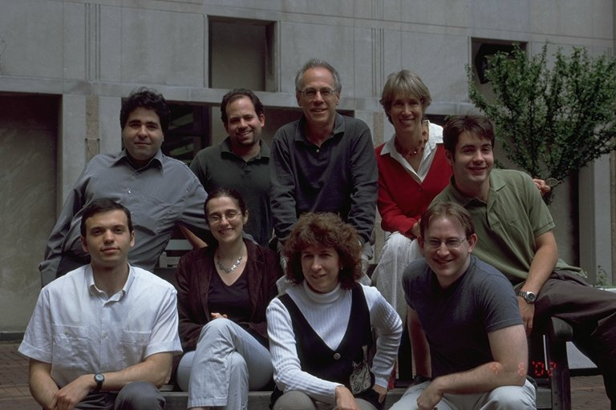
Newsblaster Integrated in online environment for daily news updates http://newsblaster.cs.columbia.edu/
Ani Nenkova
David Elson

Slide 29
Newsblaster
http://newsblaster.cs.columbia.edu/
Clustering articles into events
Categorization by broad topic
Multi-document summarization
Generation of summary sentences
Fusion
Editing of references

Slide 30
Newsblaster Architecture
Crawl News Sites
Form Clusters
Categorize
Title
Clusters
Summary
Router
Select
Images
Event
Summary
Biography
Summary
Multi-
Event
Convert Output to HTML

Slide 31
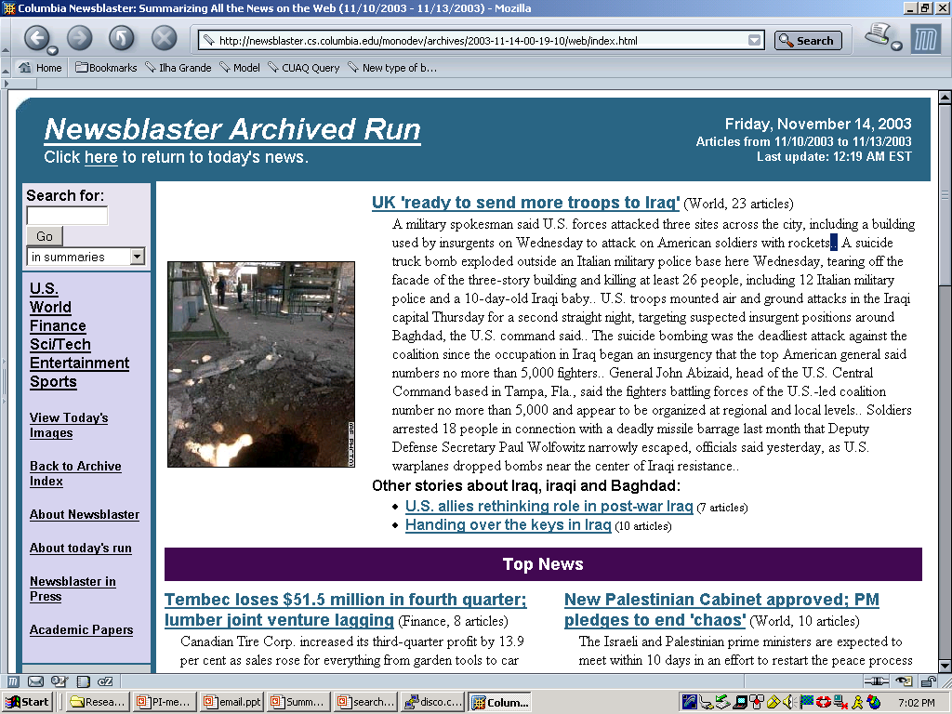

Slide 32
Fusion

Slide 33
Theme Computation
Input: A set of related documents
Output: Sets of sentences that “mean” the same thing
Algorithm
Compute similarity across sentences using the Cosine Metric
Can compare word overlap or phrase overlap
(PLACEHOLDER: IR vector space model)

Slide 34
Sentence Fusion Computation
Common information identification
Alignment of constituents in parsed theme sentences: only some subtrees match
Bottom-up local multi-sequence alignment
Similarity depends on
Word/paraphrase similarity
Tree structure similarity
Fusion lattice computation
Choose a basis sentence
Add subtrees from fusion not present in basis
Add alternative verbalizations
Remove subtrees from basis not present in fusion
Lattice linearization
Generate all possible sentences from the fusion lattice
Score sentences using statistical language model

Slide 36
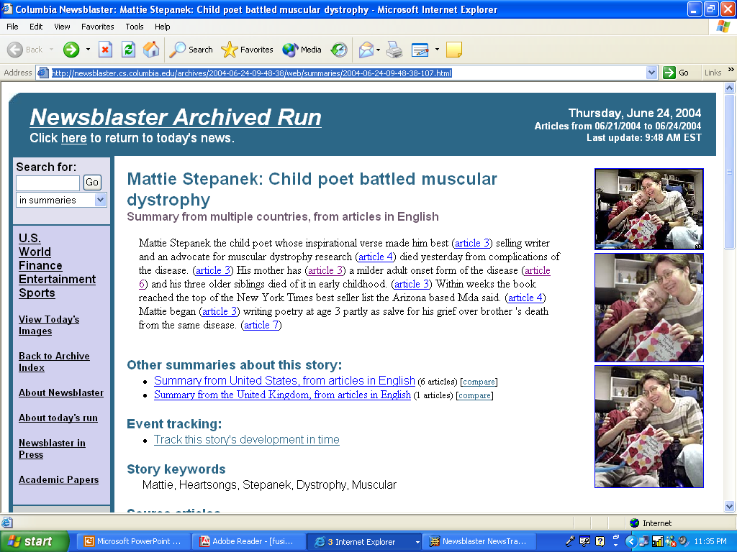

Slide 37
Tracking Across Days
Users want to follow a story across time and watch it unfold
Network model for connecting clusters across days
Separately cluster events from today’s news
Connect new clusters with yesterday’s news
Allows for forking and merging of stories
Interface for viewing connections
Summaries that update a user on what’s new
Statistical metrics to identify differences between article pairs
Uses learned model of features
Identifies differences at clause and paragraph levels

Slide 40
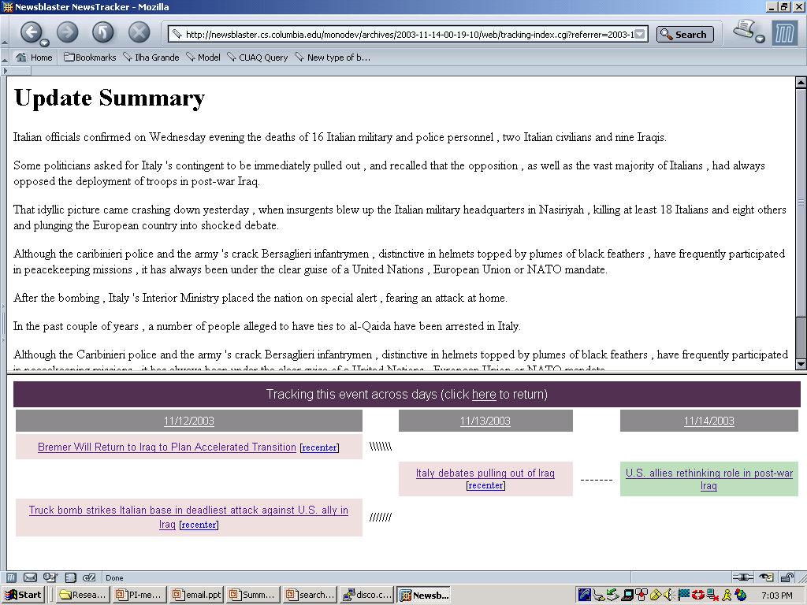

Slide 41
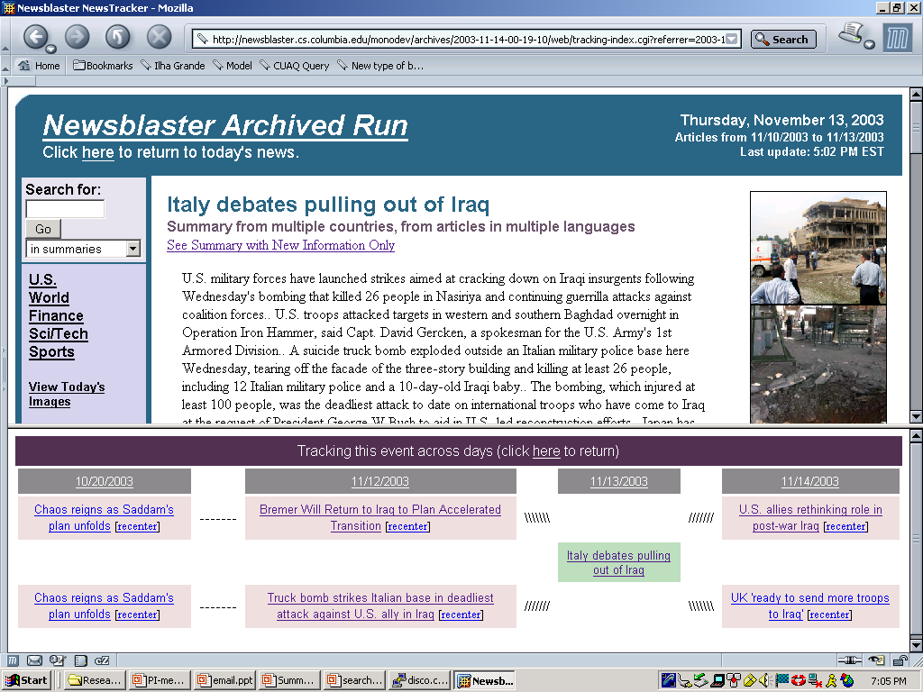

Slide 42
Different Perspectives
Hierarchical clustering
Each event cluster is divided into clusters by country
Different perspectives can be viewed side by side
Experimenting with update summarizer to identify key differences between sets of stories

Slide 43
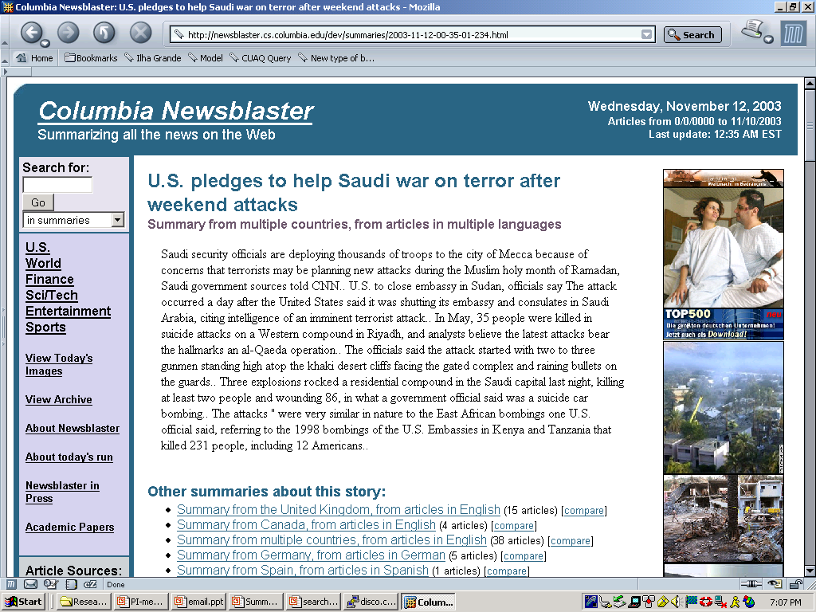

Slide 44
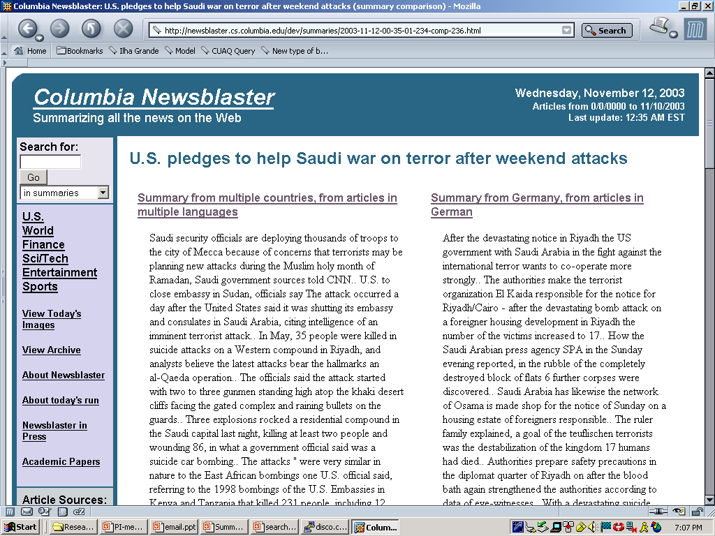

Slide 46
Questions (from Sparck Jones)
Should we take the reader into account and how?
“Similarly, the notion of a basic summary, i.e., one reflective of the source, makes hidden fact assumptions, for example that the subject knowledge of the output’s readers will be on a par with that of the readers for whom the source was intended. (p. 5)”
Is the state of the art sufficiently mature to allow summarization from intermediate representations and still allow robust processing of domain independent material?

