Slide 1
Shallow Parsing
CS 4705
Julia Hirschberg

Slide 2
Shallow or Partial Parsing
Sometimes we don’t need a complete parse tree
Information extraction
Question answering
But we would like more than simple POS sequences

Slide 3
Chunking
Find major but unembedded constituents like NPs, VPs, AdjPs, PPs
Most common task: NP chunking of base NPs
[NP I] saw [NP the man] on [NP the hill] with [NP a telescope]
No attempt to identify full NPs – no recursion, no post-head words
No overlapping constituents
E.g., if we add PPs or VPs, they may consist only of their heads, e.g. [PP on]

Slide 4
Approaches: FST Chunking
Use regexps to identify constituents, e.g.
NP → (DT) NN* NN
Find longest matching chunk
Hand-built rules
No recursion but can cascade FSTs to approximate true CF parser, aggregating larger and larger constituents
E.g. Steve Abney’s Cass chunker

Slide 5
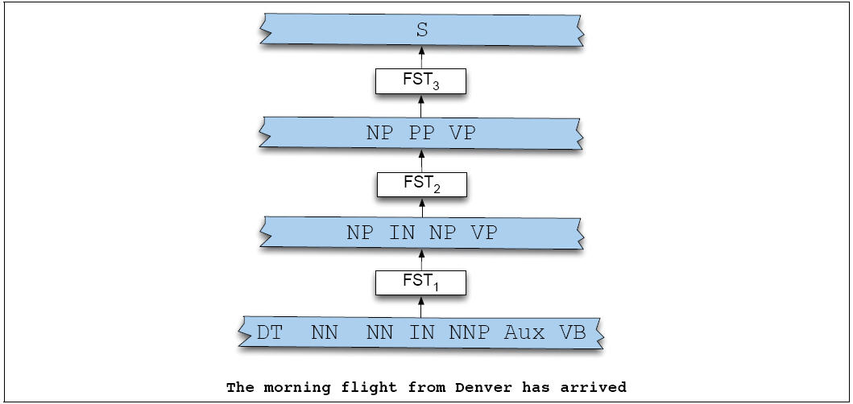
Figure 13.18

Slide 6
Approaches: ML Chunking
Require annotated corpus
Train classifier to classify each element of input in sequence (e.g. IOB Tagging)
B (beginning of sequence)
I (internal to sequence)
O (outside of any sequence)
No end-of-chunk coding – it’s implicit
Easier to detect the beginning than the end
Book/B_VP that/B_NP flight/I_NP quickly/O

Slide 7
Train classifier using features from context and current word such as word identity, POS, chunk tags
Penn Treebank provides a good training corpus, since it has hand-labeled full parses which can be converted to chunks

Slide 8
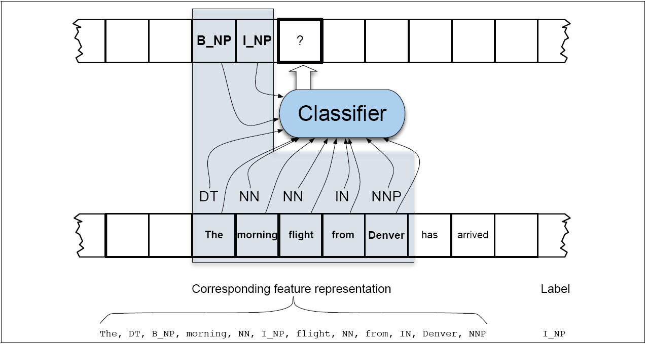
Figure 13.19

Slide 9
Chunk Evaluation
Compare system output with Gold Standard using
Precision: # correct chunks retrieved/total hypothesized chunks retrieved by system
Recall: # correct chunks retrieved/total actual chunks in test corpus
F-measure: (weighted) Harmonic Mean of Precision and Recall
Best: F₁=.96 for NP chunking

Slide 10
Limitations
POS tagging accuracy
Ambiguities and errors in labels of training corpus

Slide 11
Distribution of Chunks in CONLL Shared Task

Slide 12
Summary
Sometimes shallow parsing is enough for task
Performance quite accurate
Next: Midterm

