Slide 1
Pronouns and Reference Resolution
CS 4705
Julia Hirschberg

Slide 2
A Reference Joke
Gracie: Oh yeah ... and then Mr. and Mrs. Jones were having matrimonial trouble, and my brother was hired to watch Mrs. Jones.
George: Well, I imagine she was a very attractive woman.
Gracie: She was, and my brother watched her day and night for six months.
George: Well, what happened?
Gracie: She finally got a divorce.
George: Mrs. Jones?
Gracie: No, my brother's wife.

Slide 3
Terminology
Discourse: anything longer than a single utterance or sentence
  Monologue
  Dialogue:
    May be multi-party
    May be human-machine

Slide 4
Reference Resolution
Process of associating Bloomberg/he/his with particular person and big budget problem/it with a concept
  Guiliani left Bloomberg to be mayor of a city with a big budget problem. It’s unclear how he’ll be able to handle it during his term.
Referring exprs.: Guilani, Bloomberg, he, it, his
Presentational it, there: non-referential
Referents: the person named Bloomberg, the concept of a big budget problem

Slide 5
Co-referring referring expressions: Bloomberg, he, his
Antecedent: Bloomberg
Anaphors: he, his

Slide 6
Discourse Models
Needed to model reference because referring expressions (e.g. Guiliani, Bloomberg, he, it budget problem) encode information about beliefs about the referent
When a referent is first mentioned in a discourse, a representation is evoked in the model
  Information predicated of it is stored also in the model
  On subsequent mention, it is accessed from the model

Slide 7
Types of Referring Expressions
Entities, concepts, places, propositions, events, ...
  According to John, Bob bought Sue an Integra, and Sue bought Fred a Legend.
  But that turned out to be a lie. (a speech act)
  But that was false. (proposition)
  That struck me as a funny way to describe the situation. (manner of description)
  That caused Sue to become rather poor. (event)
  That caused them both to become rather poor. (combination of multiple events)

Slide 8
Reference Phenomena
Indefinite NPs
  A homeless man hit up Bloomberg for a dollar.
  Some homeless guy hit up Bloomberg for a dollar.
  This homeless man hit up Bloomberg for a dollar.
Definite NPs
  The poor fellow only got a lecture.
Demonstratives
  This homeless man got a lecture but that one got carted off to jail.

Slide 9
One-anaphora
  Clinton used to have a dog called Buddy. Now he’s got another one

Slide 10
Pronouns
A large tiger escaped from the Central Park zoo chasing a tiny sparrow. It was recaptured by a brave policeman.
  Referents of pronouns usually require some degree of salience in the discourse (as opposed to definite and indefinite NPs, e.g.)
  How do items become salient in discourse?

Slide 11
Salience vs. Recency: The Rule of 2 Sentences
  He had dodged the press for 36 hours, but yesterday the Buck House Butler came out of the cocoon of his room at the Millennium Hotel in New York and shoveled some morsels the way of the panting press. First there was a brief, if obviously self-serving, statement, and then, in good royal tradition, a walkabout.
  Dapper in a suit and colourfully striped tie, Paul Burrell was stinging from a weekend of salacious accusations in the British media. He wanted us to know: he had decided after his acquittal at his theft to trial to sell his story to the Daily Mirror because he needed the money to stave off "financial ruination". And he was here in America further to spill the beans to the ABC TV network simply to tell "my side of the story".

Slide 12
  If he wanted attention in America, he was getting it. His lawyer in the States, Richard Greene, implored us to leave alone him, his wife, Maria, and their two sons, Alex and Nicholas, as they spent three more days in Manhattan. Just as quickly he then invited us outside to take pictures and told us where else the besieged family would be heading: Central Park, the Empire State Building and ground zero. The "blabbermouth", as The Sun – doubtless doubled up with envy at the Mirror's coup – has taken to calling Mr Burrell, said not a word during the 10-minute outing to Times Square. But he and his wife, in pinstripe jacket and trousers, wore fixed smiles even as they struggled to keep their footing against a surging scrum of cameramen and reporters. Only the two boys looked resolutely miserable.

Slide 13
Salience vs. Structural Recency
E: So you have the engine assembly finished. Now attach the rope. By the way, did you buy the gas can today?
A: Yes.
E: Did it cost much?
A: No.
E: OK, good. Have you got it attached yet?

Slide 14
Inferables
I almost bought an Acura Integra today, but a door had a dent and the engine seemed noisy.
Mix the flour, butter, and water. Knead the dough until smooth and shiny.

Slide 15
Discontinuous Sets
Entities evoked together but mentioned in different sentence or phrases
  John has a St. Bernard and Mary has a Yorkie. They arouse some comment when they walk them in the park.

Slide 16
Generics
I saw two Corgis and their seven puppies today. They are the funniest dogs

Slide 17
Constraints on Coreference
Number agreement
  John’s parents like opera. John hates it/John hates them.
Person and case agreement
  Nominative: I, we, you, he, she, they
  Accusative: me,us,you,him,her,them
  Genitive: my,our,your,his,her,their
  George and Edward brought bread and cheese. They shared them.

Slide 18
Gender agreement
  John has a Porsche. He/it/she is attractive.
Syntactic constraints: binding theory
  John bought himself a new Volvo. (himself = John)
  John bought him a new Volvo (him = not John)
Selectional restrictions
  John left his plane in the hangar.
  He had flown it from Memphis this morning.

Slide 19
Interpretation of Pronouns
Recency
  John bought a new boat. Bill bought a bigger one. Mary likes to sail it.
But…grammatical role raises its ugly head…
  John went to the Acura dealership with Bill. He bought an Integra.
  Bill went to the Acura dealership with John. He bought an Integra.
  ?John and Bill went to the Acura dealership. He bought an Integra.

Slide 20
And so does…repeated mention
  John needed a car to go to his new job. He decided that he wanted something sporty. Bill went to the dealership with him. He bought a Miata.
  Who bought the Miata?
  What about grammatical role preference?
Parallel constructions
  Saturday, Mary went with Sue to the farmer’s market.
  Sally went with her to the bookstore.
  Sunday, Mary went with Sue to the mall.
  Sally told her she should get over her shopping obsession.

Slide 21
Verb semantics/thematic roles
  John telephoned Bill. He’d lost the directions to his house.
  John criticized Bill. He’d lost the directions to his house.

Slide 22
Pragmatics
Context-dependent meaning
  Jeb Bush was helped by his brother and so was Frank Lautenberg. (Strict vs. Sloppy)
  Mike Bloomberg bet George Pataki a baseball cap that he could/couldn’t run the marathon in under 3 hours.
  Mike Bloomberg bet George Pataki a baseball cap that he could/couldn’t be hypnotized in under 1 minute.

Slide 23
What Affects Reference Resolution?
Lexical factors
  Reference type: Inferrability, discontinuous set, generics, one anaphora, pronouns,…
Discourse factors:
  Recency
  Focus/topic structure, digression
  Repeated mention
Syntactic factors:
  Agreement: gender, number, person, case
  Parallel construction
  Grammatical role

Slide 24
  Selectional restrictions
Semantic/lexical factors
  Verb semantics, thematic role
Pragmatic factors
Notes:
Stopped here

Slide 25
Reference Resolution Algorithms
Given these types of constraints, can we construct an algorithm that will apply them such that we can identify the correct referents of anaphors and other referring expressions?

Slide 26
Reference Resolution Task
Finding in a text all the referring expressions that have one and the same denotation
  Pronominal anaphora resolution
  Anaphora resolution between named entities
  Full noun phrase anaphora resolution

Slide 27
Issues
Which constraints/features can/should we make use of?
How should we order them? I.e. which override which?
What should be stored in our discourse model? I.e., what types of information do we need to keep track of?
How to evaluate?

Slide 28
Some Algorithms
Lappin & Leas ‘94: weighting via recency and syntactic preferences
Hobbs ‘78: syntax tree-based referential search
Supervised approaches

Slide 29
Hobbs: Syntax-Based Approach
Search for antecedent in parse tree of current sentence, then prior sentences in order of recency
  For current S, search for NP nodes to the left of a path p from the pronoun up to the first NP or S node (X) above it in L2R, breadth-first
    Propose as pronoun’s antecedent any NP you find as long as it has an NP or S node between itself and X
    If X is highest node in sentence, search prior sentences, L2R breadth-first, for candidate NPs
    O.w., continue searching current tree by going to next S or NP above X before going to prior sentences

Slide 30
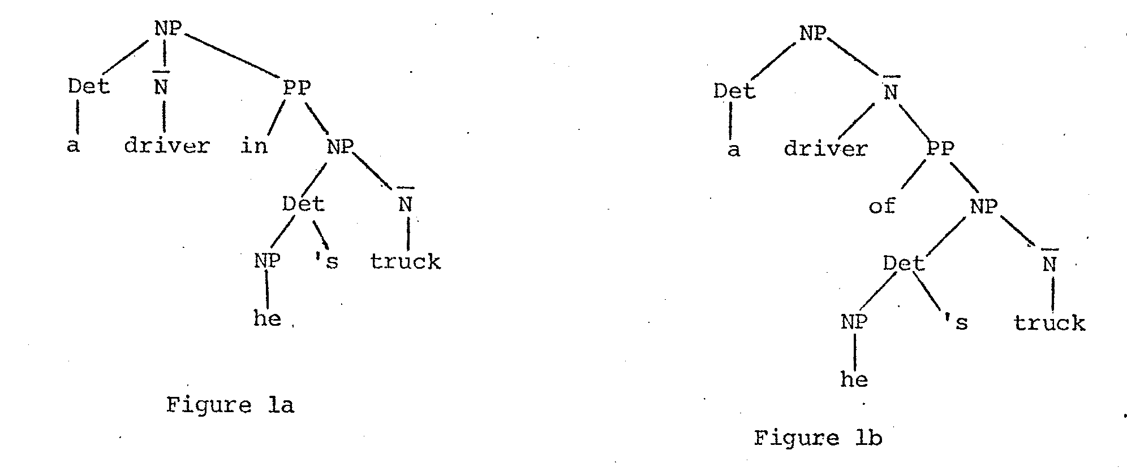
Hobbs’ Example

Slide 31
Lappin & Leas: Salience
Weights candidate antecedents by recency and syntactic preference (86% accuracy)
Two major functions to perform:
  Update the discourse model when an NP that evokes a new entity is found in the text, computing the salience of this entity for future anaphora resolution
  Find most likely referent for current anaphor by considering possible antecedents and their salience values

Slide 32
Saliency Factor Weights
Sentence recency (in current sentence?) 100
Subject emphasis (is it the subject?) 80
Existential emphasis (existential prednom?) 70
Accusative emphasis (is it the dir obj?) 50
Indirect object/oblique comp emphasis 40
Non-adverbial emphasis (not in PP) 50
Head noun emphasis (is head noun) 80
Notes:
Existential emphasis: There is snow on the ground.
Non-adverbial emphasis: not in adv PP
Head noun emphasis: not in another NP

Slide 33
Implicit ordering of arguments:
subj/exist pred/obj/indobj-oblique/dem.advPP
On the sofa, the cat was eating candy. It….
Computing Salience scores
sofa: 100+80=180
cat: 100+80+50+80=310
candy: 100+50+50+80=280
Update:
  Weights accumulate over time
  Cut in half after each sentence processed
  Salience values for subsequent referents accumulate for equivalence class of co-referential items (exceptions, e.g. multiple references in same sentence)

Slide 34
Evaluation
Walker ‘89 manual comparison of Centering vs. Hobbs ‘78
  Only 281 examples from 3 genres
  Assumed correct features given as input to each
  Centering 77.6% vs. Hobbs 81.8%
  Lappin and Leass’ 86% accuracy on test set from computer training manuals
Type of text used for the evaluation
  Lappin and Leass’ computer manual texts (86% accuracy)
  Statistical approach on WSJ articles (83% accuracy)
  Syntactic approach on different genres (75% accuracy)

Slide 35
Supervised Anaphora Resolution
Input: pronoun plus current and preceding sentences
Training: hand-labeled corpus of positive examples plus inferred negative examples
Features
    Strict number
    Compatible number
    Strict gender
    Compatible gender
    Sentence distance

Slide 36
    Hobbs distance (noun groups between pronoun and candidate antecedent
    Grammatical role
    Linguistic form (proper name, definite, indefinite, pronominal antecedent)

Slide 37
Newer Approaches
Reason over all possible coreference relations as sets (within-doc)‏
  Culotta, Hall and McCallum '07, First-Order Probabilistic Models for Coreference Resolution
Reasoning over proper probabalistic models of clustering (across doc)‏
  Haghighi and Klein '07, Unsupervised coreference resolution in a nonparametric bayesian model

Slide 38
Summary
Many approaches to reference resolution
Use similar information/features but different methods
  Lappin & Leas’ Saliency
  Hobbs’ Syntax
  Centering’s Grammatical Function
  Supervised and shallow methods use simple techniques with reasonable success

