Slide 1
Catching Up and Getting into Semantics

Slide 2
Announcements
My office hours will be Wednesday 2-3 this week instead of Wednesday 4-5 (Oct. 7th)

Slide 3
Today
The homework
NLTK demo
Finishing up probabilistic parsing
Getting into semantics

Slide 4
Getting the Probabilities
From an annotated database (a treebank)
  So for example, to get the probability for a particular VP rule just count all the times the rule is used and divide by the number of VPs overall.

Slide 5
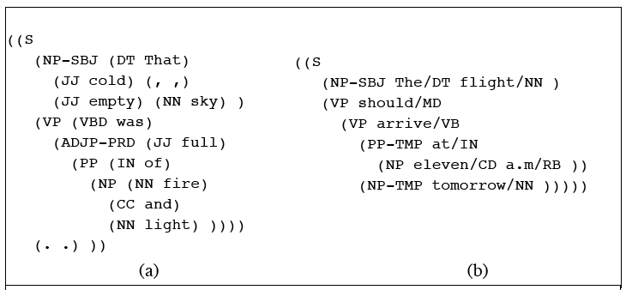
TreeBanks

Slide 6
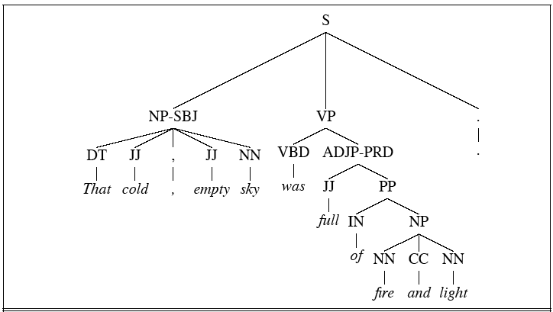
Treebanks

Slide 7
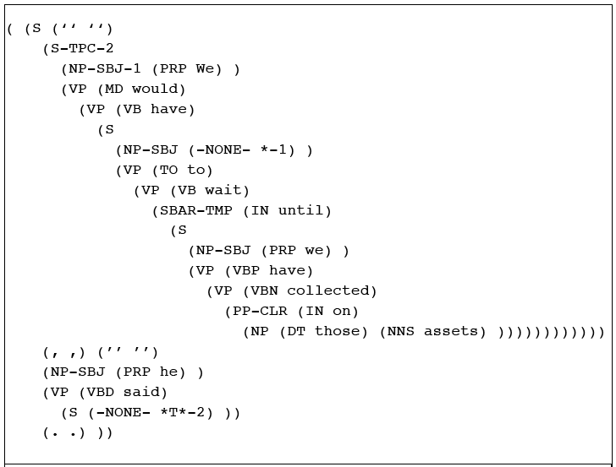
Treebanks

Slide 8
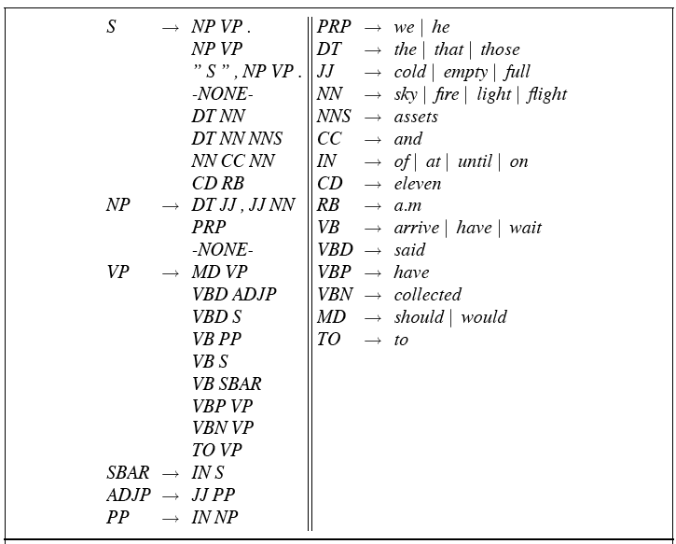
Treebank Grammars

Slide 9
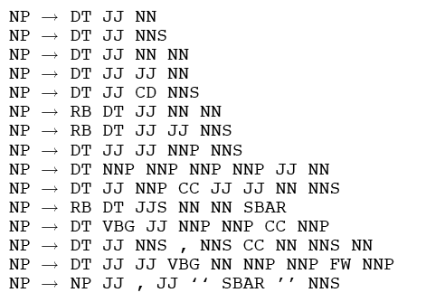
Lots of flat rules

Slide 10
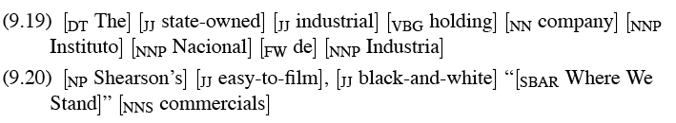
Example sentences from those rules
Total: over 17,000 different grammar rules in the 1-million word Treebank corpus

Slide 11
Probabilistic Grammar Assumptions
We’re assuming that there is a grammar to be used to parse with.
We’re assuming the existence of a large robust dictionary with parts of speech
We’re assuming the ability to parse (i.e. a parser)
Given all that… we can parse probabilistically

Slide 12
Typical Approach
Bottom-up (CKY) dynamic programming approach
Assign probabilities to constituents as they are completed and placed in the table
Use the max probability for each constituent going up

Slide 13
What’s that last bullet mean?
Say we’re talking about a final part of a parse
  S->₀NP_{i}VP_{j}
  The probability of the S is…
  P(S->NP VP)*P(NP)*P(VP)
  The green stuff is already known. We’re doing bottom-up parsing

Slide 14
Max
I said the P(NP) is known.
What if there are multiple NPs for the span of text in question (0 to i)?
Take the max (where?)

Slide 15
Problems with PCFGs
The probability model we’re using is just based on the rules in the derivation…
  Doesn’t use the words in any real way
  Doesn’t take into account where in the derivation a rule is used

Slide 16
Solution
Add lexical dependencies to the scheme…
  Infiltrate the predilections of particular words into the probabilities in the derivation
  I.e. Condition the rule probabilities on the actual words

Slide 17
Heads
To do that we’re going to make use of the notion of the head of a phrase
  The head of an NP is its noun
  The head of a VP is its verb
  The head of a PP is its preposition
  (It’s really more complicated than that but this will do.)

Slide 18
Example (right)
Attribute grammar

Slide 19
Example (wrong)

Slide 20
How?
We used to have
  VP -> V NP PP P(rule|VP)
    That’s the count of this rule divided by the number of VPs in a treebank
Now we have
  VP(dumped)-> V(dumped) NP(sacks)PP(in)
  P(r|VP ^ dumped is the verb ^ sacks is the head of the NP ^ in is the head of the PP)
  Not likely to have significant counts in any treebank

Slide 21
Declare Independence
When stuck, exploit independence and collect the statistics you can…
We’ll focus on capturing two things
  Verb subcategorization
    Particular verbs have affinities for particular VPs
  Objects affinities for their predicates (mostly their mothers and grandmothers)
    Some objects fit better with some predicates than others

Slide 22
Subcategorization
Condition particular VP rules on their head… so
  r: VP -> V NP PP P(r|VP)
  Becomes
  P(r | VP ^ dumped)
  What’s the count?
  How many times was this rule used with (head) dump, divided by the number of VPs that dump appears (as head) in total
  Think of left and right modifiers to the head

Slide 23
Example (right)
Attribute grammar

Slide 24
Probability model
P(T,S) = S-> NP VP (.5)*
VP(dumped) -> V NP PP (.5) (T1)
VP(ate) -> V NP PP (.03)
VP(dumped) -> V NP (.2) (T2)
What about VP -> VP PP?

Slide 25
Preferences
Subcategorization captures the affinity between VP heads (verbs) and the VP rules they go with.
What about the affinity between VP heads and the heads of the other daughters of the VP
Back to our examples…

Slide 26
Example (right)

Slide 27
Example (wrong)

Slide 28
Preferences
The issue here is the attachment of the PP. So the affinities we care about are the ones between dumped and into vs. sacks and into.
So count the places where dumped is the head of a constituent that has a PP daughter with into as its head and normalize
Vs. the situation where sacks is a constituent with into as the head of a PP daughter.

Slide 29
Probability model
P(T,S) = S-> NP VP (.5)*
VP(dumped) -> V NP PP(into) (.7) (T1)
NOM(sacks) -> NOM PP(into) (.01) (T2)

Slide 30
Preferences (2)
Consider the VPs
  Ate spaghetti with gusto
  Ate spaghetti with marinara
The affinity of gusto for eat is much larger than its affinity for spaghetti
On the other hand, the affinity of marinara for spaghetti is much higher than its affinity for ate

Slide 31
Preferences (2)
Note the relationship here is more distant and doesn’t involve a headword since gusto and marinara aren’t the heads of the PPs.
Vp (ate)
Vp(ate)
Vp(ate)
Np(spag)
Pp(with)
np
Pp(with)
v
np
v
Ate spaghetti with gusto
Ate spaghetti with marinara

Slide 32
Summary
Context-Free Grammars
Parsing
  Top Down, Bottom Up Metaphors
  Dynamic Programming Parsers: CKY. Earley
Disambiguation:
  PCFG
  Probabilistic Augmentations to Parsers
  Tradeoffs: accuracy vs. data sparcity
  Treebanks

Slide 33
Semantics: Representations and Analyses
Slides adapted from Julia Hirschberg, Dan Jurafsky, Chris Manning

Slide 34
Question-Answering/Dialog

Slide 35
Where does the information come from?
One possibility:
  http://newyork.citysearch.com

Slide 36
NL Architecture
Morphology
Syntax
Semantics
Knowledge Representation/
Meaning Representation

Slide 37
Semantic Considerations
Meaning Representation
Translation from syntax into the meaning representation
Word meaning disambiguation
Relations between words

Slide 38
Meaning Representation
To represent questions
To represent knowledge drawn from text

Slide 39
What Can Serve as a Meaning Representation?
Anything that allows us to
  Answer questions (What is the best French restaurant in the East Village?)
  Determine truth (Is The Terrace in the Sky on 118th?)
  Draw inferences (If The Terrace is in Butler Hall and Butler Hall is the tallest building on the West Side, then The Terrace is in the tallest building on the West Side.)

Slide 40
What kinds of meaning do we want to capture?
Categories/entities
  Tau, Jane, Asian cuisine, vegetarian
Events
  taking a taxi, nomination of Obama as Democratic candidate
Time
  Oct 30, next week, in 2 months
Aspect
  Kathy knows how to run. Kathy is running. Kathy ran to the restaurant in 5 min.
Beliefs, Desires and Intentions (BDI)

Slide 41
Meaning Representations
All represent ‘linguistic meaning’ of
I have a car
and state of affairs in some world
All consist of structures, composed of symbols representing objects and relations among them
  FOPC:

Slide 42
Semantic Net:
having
haver had-thing
speaker car
Conceptual Dependency Diagram:
  Physical-object
  ⇑
  Car
  ⇑ Poss-By
  Speaker
Frame
  Having
  Haver: S
  HadThing: Car

Slide 43
A Standard Representation: Predicate-Argument Structure
Represents concepts and relationships among them
  Nouns as concepts or arguments (red(ball))
  Adjectives, adverbs, verbs as predicates (red(ball))
Subcategorization (or, argument) frames specify number, position, and syntactic category of arguments
  NP likes NP
  NP likes Inf-VP
  NP likes NP Inf-VP

Slide 44
Semantic (Thematic) Roles
Subcat frames link arguments in surface structure with their semantic roles
  Agent: George hit Bill. Bill was hit by George.
  Patient: George hit Bill. Bill was hit by George.
The claim of a theory of semantic roles is that these arguments of predicates can be usefully classified into a small set of semantically contentful classes
  And that these classes are useful for explaining lots of things

Slide 45
Common semantic roles
Agent: initiator or doer in the event
Patient: affected entity in the event; undergoes the action
  Sue killed the rat.
Theme: object in the event undergoing a change of state or location, or of which location is predicated
  The ice melted
Experiencer: feels or perceive the event
  Bill likes pizza.
Stimulus: the thing that is felt or perceived

Slide 46
Common semantic roles
Goal:
  Bill ran to Copley Square.
Recipient (may or may not be distinguished from Goal):
  Bill gave the book to Mary.
Benefactive (may be grouped with Recipient):
  Bill cooked dinner for Mary.
Source:
  Bill took a pencil from the pile.
Instrument:
  Bill ate the burrito with a plastic spork.
Location:
  Bill sits under the tree on Wednesdays

Slide 47
Common semantic roles
Try for yourself!
The submarine sank a troop ship.
Doris hid the money in the flowerpot.
Emma noticed the stain.
We crossed the street.
The boys climbed the wall.
The chef cooked a great meal.
The computer pinpointed the error.
A mad bull damaged the fence on Jack’s farm.
The company wrote me a letter.
Jack opened the lock with a paper clip.

Slide 48
Linking of thematic roles to syntactic positions
John opened the door
AGENT THEME
The door was opened by John
THEME AGENT
The door opened
THEME
John opened the door with the key
AGENT THEME INSTRUMENT

Slide 49
Deeper Semantics
From the WSJ…
  He melted her reserve with a husky-voiced paean to her eyes.
  If we label the constituents He and her reserve as the Melter and Melted, then those labels lose any meaning they might have had.
  If we make them Agent and Theme then we can do more inference.

Slide 50
Selectional Restrictions
Selectional Restrictions: constraints on the types of arguments verbs take
  George assassinated the senator.
  *The spider assassinated the fly.
  assassinate: intentional (political?) killing
The astronaut married the star.

Slide 51
Problems
What exactly is a role?
What’s the right set of roles?
Are such roles universals?
Are these roles atomic?
  I.e. Agents
      Animate, Volitional, Direct causers, etc
Can we automatically label syntactic constituents with thematic roles?

Slide 52
First Order Predicate Calculus
Not ideal as a meaning representation and doesn't do everything we want -- but better than many…
  Supports the determination of truth
  Supports compositionality of meaning
  Supports question-answering (via variables)
  Supports inference

Slide 53
NL Mapping to FOPC
Terms: constants, functions, variables
  Constants: objects in the world, e.g. Huey
  Functions: concepts, e.g. sisterof(Huey)
  Variables: x, e.g. sisterof(x)
Predicates: symbols that refer to relations that hold among objects in some domain or properties that hold of some object in a domain
  likes(Kathy, pasta)
  female(Kathy) person(Kathy)

Slide 54
Logical connectives permit compositionality of meaning
  pasta(x) → likes(Kathy,x) “Kathy likes pasta”
  cat(Vera) ^ odd(Vera) “Vera is an odd cat”
  sleeping(Huey) v eating(Huey) “Huey either is sleeping or eating”
Sentences in FOPC can be assigned truth values
  Atomic formulae are T or F based on their presence or absence in a DB (Closed World Assumption?)
  Composed meanings are inferred from DB and meaning of logical connectives

Slide 55
  cat(Huey)
  sibling(Huey,Vera)
  cat(Huey) ^ sibling(Huey,Vera) → cat(Vera)
Limitations:
  Do ‘and’ and ‘or’ in natural language really mean ‘^’ and ‘v’?
    Mary got married and had a baby. And then…
    Your money or your life!
  Does ‘→’ mean ‘if’?
    If you go, I’ll meet you there.
  How do we represent other connectives?
    She was happy but ignorant.

Slide 56
Quantifiers:
  Existential quantification: There is a unicorn in my garden. Some unicorn is in my garden.
  Universal quantification: The unicorn is a mythical beast. Unicorns are mythical beasts.
  Many? A few? Several? A couple?

Slide 57
Temporal Representations
How do we represent time and temporal relationships between events?
  It seems only yesterday that Martha Stewart was in prison but now she has a popular TV show. There is no justice.
Where do we get temporal information?
  Verb tense
  Temporal expressions
  Sequence of presentation
Linear representations: Reichenbach ‘47

Slide 58
  Utterance time (U): when the utterance occurs
  Reference time (R): the temporal point-of-view of the utterance
  Event time (E): when events described in the utterance occur
  George is eating a sandwich.
  -- E,R,U →
  George had eaten a sandwich (when he realized…)
  E – R – U →
  George will eat a sandwich.
  --U,R – E →
  While George was eating a sandwich, his mother arrived.

Slide 59
Verbs and Event Types: Aspect
Statives: states or properties of objects at a particular point in time
    I am hungry.
Activities: events with no clear endpoint
    I am eating.
Accomplishments: events with durations and endpoints that result in some change of state
    I ate dinner.
Achievements: events that change state but have no particular duration – they occur in an instant
    I got the bill.

Slide 60
Beliefs, Desires and Intentions
Very hard to represent internal speaker states like believing, knowing, wanting, assuming, imagining
  Not well modeled by a simple DB lookup approach so..
  Truth in the world vs. truth in some possible world
  George imagined that he could dance.
  George believed that he could dance.
Augment FOPC with special modal operators that take logical formulae as arguments, e.g. believe, know

Slide 61
  Believes(George, dance(George))
  Knows(Bill,Believes(George,dance(George)))
Mutual belief: I believe you believe I believe….
  Practical importance: modeling belief in dialogue
  Clark’s grounding

Slide 62
Sum
Many hard problems in full semantic representation:
  Temporal relations: tense, aspect
  BDI
Current representations impoverished in many respects
Read Ch 17.2-17.4, 18.1-18.7 (cover material through today)

