Slide 1
Final Review and Wrap Up
CS4705
Natural Language Processing

Slide 2
Announcements
Final: December 17th 1:10-4, 1024 Mudd
  Closed book, notes, electronics
Don’t forget courseworks evaluation: only 4% so far have done it.
Office hours as usual next week

Slide 3
What’s Next?
Natural Language for the Web (Spring 10)
  TIME CHANGE: Thursdays 6-8pm
Spoken Language Processing (Spring 10)
Statistical natural language (Spring 10)
Machine translation (Fall 10)

Slide 4
Natural Language for the Web
Seminar style class
Reading original papers
  Presentation and discussion
Semester long project
The web contains huge amounts of unstructured documents, both written and spoken, in many languages. This class will study applications of natural language processing to the web. We will study search techniques that incorporate language, cross-lingual search, advanced summarization and question answering particularly for new media such as blogs, social networking, sentiment analysis and entailment. For many of these, we will look at multi-lingual approaches.

Slide 5
CS 4706: Spoken Language Processing
Speech phenomena
  Acoustics, intonation, disfluencies, laughter
  Tools for speech annotation and analysis
Speech technologies
  Text-to-Speech
  Automatic Speech Recognition
  Speaker Identification
  Dialogue Systems

Slide 6
Challenges for speech technologies
  Pronunciation modeling
  Modeling accent, phrasing and contour
  Spoken cues to
    Discourse segmentation
    Information status
    Topic detection
    Speech acts
    Turn-taking
Fun stuff: emotional speech, charismatic speech, deceptive speech….

Slide 7
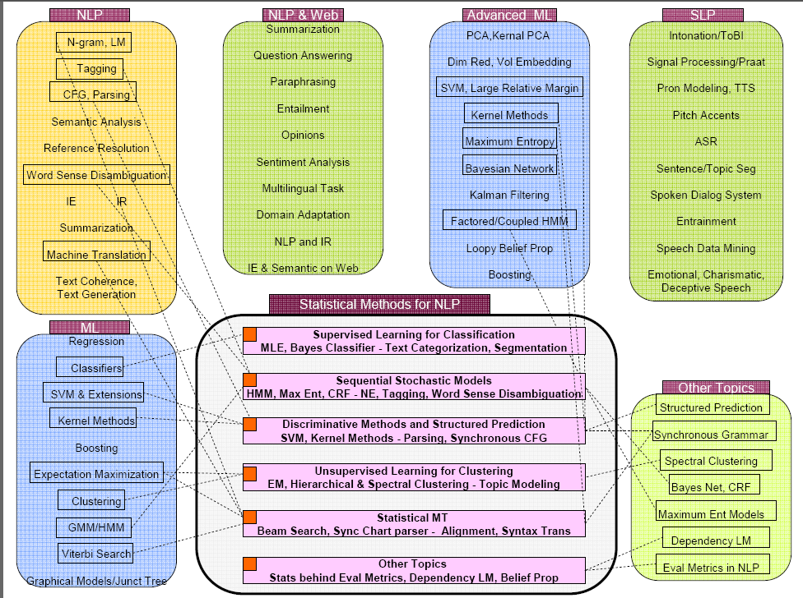

Slide 8
Stop by and visit
CS Advising
Recommendation letters
Research project
Advice on applying to graduate school

Slide 9
What is Computational Linguistics? (NLP)
An experiment done by outgoing ACL President Bonnie Dorr
http://www.youtube.com/v/k4cyBuIsdy4
http://www.youtube.com/v/CUSxWsj7y0w
http://www.youtube.com/v/Nz_sSvXBdfk

Slide 10
Form of Final Exam
Fill-in-the-blank/multiple choice
Short answer
Problem solving
Essay
Comprehensive (Will cover the full semester)

Slide 11
Semantics
Meaning Representations
  Predicate/argument structure and FOPC
Thematic roles and selectional restrictions
  Agent/ Patient: George hit Bill. Bill was hit by George
  George assassinated the senator. *The spider assassinated the fly

Slide 12
Compositional semantics
  Rule 2 rule hypothesis
  E.g. λx λy E(e) (Isa(e,Serving) ^ Server(e,y) ^ Served(e,x))
  Lambda notation
    λ x P(x): λ + variable(s) + FOPC expression in those variables
Non-compositional semantics
  Metaphor: You’re the cream in my coffee.
  Idiom: The old man finally kicked the bucket.
  Deferred reference: The ham sandwich wants his check.

Slide 13
Sample questions
Give the FOPC meaning representation for:
  John showed each girl an apple.
  All students at Columbia University are tall.
Given a sentence and a syntactic grammar, give the semantic representation for each word and the semantic annotations for the grammar. Derive the meaning representation for the sentence.

Slide 14
Representing time:
  Reichenbach ’47
    Utterance time (U): when the utterance occurs
    Reference time (R): the temporal point-of-view of the utterance
    Event time (E): when events described in the utterance occur
    George is eating a sandwich.
    -- E,R,U →
    George will eat a sandwich?
Verb aspect
  Statives, activities, accomplishments, achievements
Notes:
Statives: states or properties of objects at a particular point in time
I am hungry.
Activities: events with no clear endpoint
I am eating.
Accomplishments: events with durations and endpoints that result in some change of state
I ate dinner.
Achievements: events that change state but have no particular duration – they occur in an instant
I got the bill.

Slide 15
Word Relations
Wordnet: pros and cons
Types of word relations
  Homonymy: bank/bank
  Homophones: red/read
  Homographs: bass/bass
  Polysemy: Citibank/ The bank on 59th street
  Synonymy: big/large
  Hyponym/hypernym: poodle/dog
  Metonymy: waitress: the man who ordered the ham sandwich wants dessert./the ham sandwich wants dessert.
  The White House announced the bailout plan.

Slide 16
WordsEye
What were some problems with WordNet that required creating their own dictionary?
What are considerations about objects have to be taken into account when generating a picture that depicts an “on” relation?

Slide 17


Implicit Constraint. The vase is on the nightstand. The lamp is next to the vase.

Slide 18
Word Sense Disambiguation
Time flies like an arrow.
Supervised methods
  Collocational
  Bag of words
    What features are used?
    Evaluation
Semi-supervised
  Use bootstrapping: how?
Baselines
  Lesk method
  Most frequent meaning

Slide 19
Robust semantics
Information Extraction
  Three types of IE: NER, relation detection, QA
  Three approaches: statistical sequence labeling, supervised, semi-supervised
  Learning patterns:
      Using Wikipedia
      Using Google
      Language modeling approach
Information Retrieval
  TF/IDF and vector-space model
  Precision, recall, F-measure

Slide 20
IE Question
What are the advantages and disadvantages of using exact pattern matching versus using flexible pattern matching for relation detection?
Given a Wikipedia page for a famous person, show how you would derive the patterns for place of birth.
If we wanted to use a language modeler to answer definition questions (e.g., “What is a quark?”), how would we do it?

Slide 21
Reference
Referring expressions, anaphora, coreference, antecedents
Types of NPs, e.g. pronouns, one-anaphora, definite NPs, ….
Constraints on anaphoric reference
  Salience
  Recency of mention
  Discourse structure
  Agreement
  Grammatical function

Slide 22
  Repeated mention
  Parallel construction
  Verb semantics/thematic roles
  Pragmatics
Algorithms for reference resolution
  Hobbes – most recent mention
  Lappin and Leas
  Centering

Slide 23
MT
Challenges for MT
  Orthographical
  Lexical ambiguity
  Morphological
  Translational divergences
MT Pyramid
  Surface, transfer, interlingua
  Statistical?
      Word alignment
      Phrase alignment
Evaluation strategies
  Bleu
  Human levels of grading criteria

Slide 24
MT Questions
How does lexical ambiguity affect MT?
Compute the Bleu score for the following example, using unigrams and bigrams:
  Translation: One moment later Alice went down the hole.
  References: In another moment down went Alice after it,
  In another minute Alice went into the hole.
  In one moment Alice went down after it.
  [never once considering how in the world she was to get out again.]

Slide 25
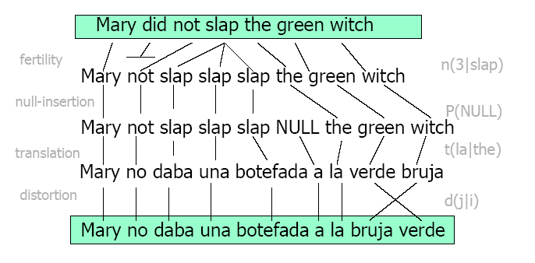

Slide 26
Generation
Architecture
Why is generation different from interpretation?
What are some constraints on syntactic choice? Lexical choice?
Functional unification grammar
Statistical language generation
  Overgenerate and prune
  Input: abstract meaning representation
  How are meaning representations linked to English?
  What kinds of rules generate different forms?

Slide 27
An example grammar
((alt GSIMPLE (
;; a grammar always has the same form: an alternative
;; with one branch for each constituent category.
;; First branch of the alternative
;; Describe the category clause.
((cat clause)
(agent ((cat np)))
(patient ((cat np)))
(pred ((cat verb-group)
(number {agent number})))
(cset (pred agent patient))
(pattern (agent pred patient))
;; Second branch: NP
((cat np)
(head ((cat noun) (lex {^ ^ lex})))
(number ((alt np-number (singular plural))))
(alt ( ;; Proper names don't need an article
((proper yes)
(pattern (head)))
;; Common names do
((proper no)
(pattern (det head))
(det ((cat article) (lex "the")))))))
;; Third branch: Verb
((cat verb-group)
(pattern (v))
(aux none)
(v ((cat verb) (lex {^ ^ lex}))))
))

Slide 28
A simple input
Input to generate: The system advises John.
I1 = ((cat np)
(head ((lex “cat")))
(number plural))
Show unification with grammar.
What would be generated?
Suppose we wanted to change the grammar so that we could generate “a cat” or “cats”?

Slide 29
Discourse
Structure
  Topic segmentation
  Lexical Cues for topic shift
    Lexical repetition
    Introduction of new words
    Lexical chains
    Possible question: given a discourse, compute the lexical repetition score between each block of 2 sentences
Coherence
  Rhetorical Structure
    Rhetorical relations
    Nucleus and satellite

Slide 30
Discourse Structure for Generation and Summarization
Supervised method to learn rhetorical labels
  Scientific articles
  Improved summarization
Content Modeling
  Learn discourse structures for different topics
  Domain specific
  What was the algorithm?
  How was it used for information ordering and summarization?

Slide 31
Thank you and good luck on the exam!
Stop by!

Slide 32
Another take: What is Computational Linguistics?

