Slide 1
Discourse Applications
Slides were adapted from Regina Barzilay

Slide 2
Homework questions
Testing an hypothesis
Pyramid: use one document set from the training data that you had
Can you use your late days?
  Yes
HW 2: If you think you were penalized for sentences that run, see me.

Slide 3
What is text?
A product of cohesive ties (cohesion)
ATHENS, Greece (Ap) A strong earthquake shook the Aegean Sea island of Crete on Sunday but caused no injuries or damage. The quake had a preliminary magnitude of 5.2 and occurred at 5:28 am (0328 MT) on the sea floor 70 kilometers (44 miles) south of the Cretan port of Chania. The Athens seismological institute said the temblor's epicenter was located 380 kilometers (238 miles) south of the capital. No injuries or damage were reported.

Slide 4
What is text?
A product of structural relations (coherence)
S1: | A strong earthquake shook the Aegean Sea island of Crete on Sunday
S2: | but caused no injuries or damage.
S3: | The quake had a preliminary magnitude of 5.2

Slide 5
Content based structure
Describe the strength and the impact of an earthquake
Specify its magnitude
Specify its location
…

Slide 6
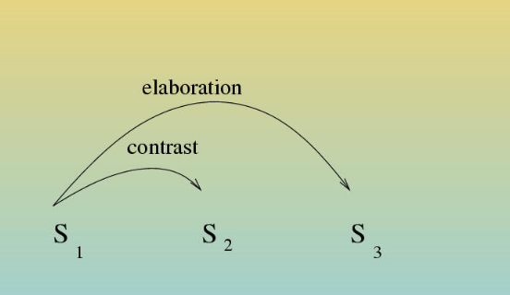
Rhetorical Structure

Slide 7
Analogy with syntax
Domain-independent Theory of Sentence Structure
Fixed set of word categories (nouns, verbs, …)
Fixed set of relations (subject, object, …)
P(A is sentence this weird.)

Slide 8
Two Approaches to text structure
Domain-dependent models (Today)
  Content-based models
  Rhetorical models
Domain-independent mode
  Rhetorical Structure Theory

Slide 9
Motivation
Summarization
  Extract a representative subsequence from a set of sentences
Question-Answering
  Find an answer to a question in natural language
Text Ordering
  Order a set of information-bearing items into a coherent text
Machine Translation
  Find the best translation taking context into account

Slide 10
Domain Specific Models
Rhetorical Model:
  Argumentative Zoning of Scientic Articles (Teufel, 1999)
Content-based Model:
  Unsupervised (Barzilay&Lee, 2004)

Slide 11
Argumentative Zoning
Many of the recent advances in Question Answering have followed from the insight that systems can benefit from by exploiting the redundancy in large corpora. Brill et al. (2001) describe using the vast amount of data available on the WWW to achieve impressive performance …The Web, while nearly infinite in content, is not a completerepository of useful information … In order to combat these inadequacies, we propose a strategy in which in information is extracted from …

Slide 12
Argumentative Zoning
BACKGROUND
Many of the recent advances in Question Answering have followed from the insight that systems can benefit from by exploiting the redundancy …
OTHER WORK
Brill et al. (2001) describe using the vast amount of data available on the WWW to achieve impressive performance …
WEAKNESS
The Web, while nearly infinite in content, is not a complete repository of useful information …
OWN CONTRIBUTION
In order to combat these inadequacies, we propose a strategy in which in information is extracted from : :

Slide 13
Motivation
Scientic articles exhibit (consistent across domains) similarity in structure
  BACKGROUND
  OWN CONTRIBUTION
  RELATION TO OTHER WORK
Automatic structure analysis can benefit:
  Q&A
  Summarization
  citation analysis

Slide 14
Approach
Goal: Rhetorical segmentation with labeling
Annotation Scheme:
  Own work: aim, own, textual
  Background
  Other Work: contrast, basis, other
Implementation: Classification

Slide 15
Examples
Category | Realization
Aim | We have proposed a method of clustering words based on large corpus data
Textual | Section 2 describes three parsers which are …
Contrast | However, no method for extracting the relationship from supercial linguistic expressions was described in their paper.

Slide 16
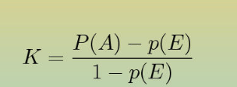
Kappa Statistics
(Siegal&Castellan, 1998; Carletta, 1999)
Kappa controls agreement P(A) for chance agreement P(E)
Kappa from Argumentative Zoning:
    Stability: 0.83
    Reproducibility: 0.79

Slide 17
Features
Position
Verb Tense and Voice
History
Lexical Features (“other researchers claim that”)

Slide 18
Results
Classification accuracy is above 70%
Zoning improves classification

Slide 19
Content Models
(Barzilay&Lee, 2004)
Content models represent topics and their ordering in text.
Domain: newspaper articles on earthquake
Topics: “strength”, “location”, “casualties”, . . .
Order: “casualties” prior to “rescue efforts”.
Assumption: Patterns in content organization are recurrent

Slide 20
Similarity in domain texts
TOKYO (AP) A moderately strong earthquake with a preliminary magnitude reading of 5.1 rattled northern Japan early Wednesday, the Central Meteorological Agency said. There were no immediate reports of casualties or damage. The quake struck at 6:06 am (2106 GMT) 60 kilometers (36 miles) beneath the Pacic Ocean near the northern tip of the main island of Honshu. . . .
ATHENS, Greece (AP) A strong earthquake shook the Aegean Sea island of Crete on Sunday but caused no injuries or damage. The quake had a preliminary magnitude of 5.2 and occurred at 5:28 am (0328 GMT) on the sea floor 70 kilometers (44 miles) south of the Cretan port of Chania. The Athens seismological institute said the temblor's epicenter was located 380 k ilometers (238 miles) south of the capital. No injuries or damage were reported.

Slide 21
Similarity in domain texts
TOKYO (AP) A moderately strong earthquake with a preliminary magnitude reading of 5.1 rattled northern Japan early Wednesday, the Central Meteorological Agency said. There were no immediate reports of casualties or damage. The quake struck at 6:06 am (2106 GMT) 60 kilometers (36 miles) beneath the Pacic Ocean near the northern tip of the main island of Honshu. . . .
ATHENS, Greece (AP) A strong earthquake shook the Aegean Sea island of Crete on Sunday but caused no injuries or damage. The quake had a preliminary magnitude of 5.2 and occurred at 5:28 am (0328 GMT) on the sea floor 70 kilometers (44 miles) south of the Cretan port of Chania. The Athens seismological institute said the temblor's epicenter was located 380 k ilometers (238 miles) south of the capital. No injuries or damage were reported.

Slide 22
Narrative Grammars
Propp (1928): fairy tales follow a “story grammar”.
Barlett (1932): formulaic text structure facilities reader's comprehension
Wray (2002): texts in multiple domains exhibit significant structural similarity

Slide 23
Computing Content Models
Implementation: Hidden Markov Model
  States represent topics
  State-transitions represent ordering constraints
Casualties
Rescue
Efforts
Location
Strength
History

Slide 24
Model Construction
Initial topic induction
Determining states, emission and transition probabilities
Viterbi re-estimation

Slide 25
Initial Topic Construction
Agglomerative clustering with cosine similarity measure
(Iyer&Ostendorf:1996,Florian&Yarowsky:1999, Barzilay&Elhadad:2003)
The Athens seismological institute said the temblor's epicenter was located 380 kilometers (238 miles) south of the capital.
Seismologists in Pakistan's Northwest Frontier Province said the temblor's epicenter was about 250 kilometers (155 miles) north of the provincial capital Peshawar.
The temblor was centered 60 kilometers (35 miles) northwest of the provincial capital of Kunming, about 2,200 kilometers (1,300 miles) southwest of Beijing, a bureau seismologist said.

Slide 26
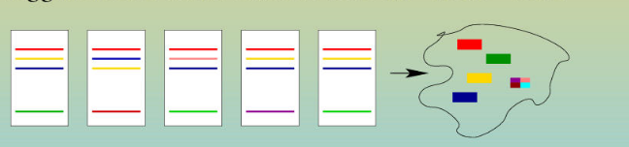
From clusters to states
Each large cluster constitutes a state
Agglomerate small clusters into an insert state

Slide 27
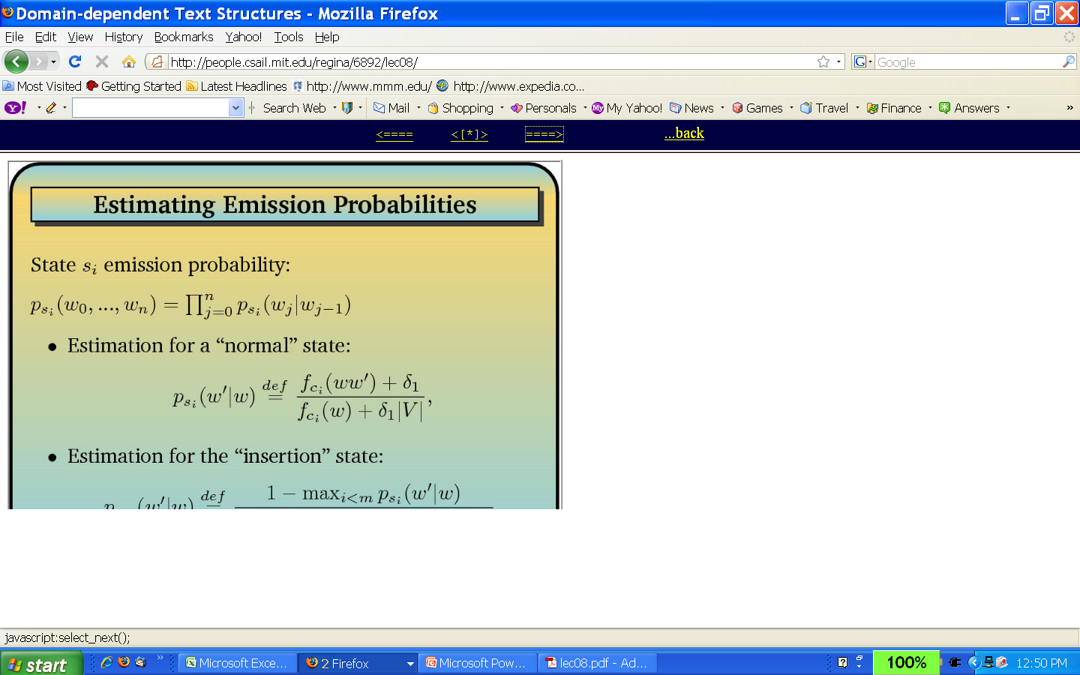
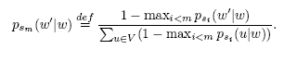
Estimating Emission Probabilities
State s-I emission probability:
Estimation for a normal state:
Estimation for the insertion state:

Slide 28
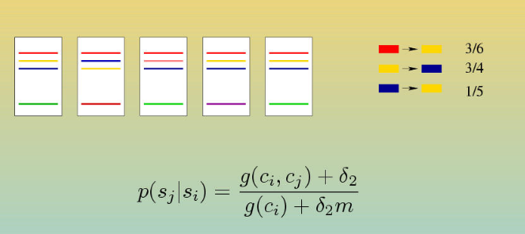
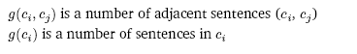
Estimating Transition Probabilities

Slide 29
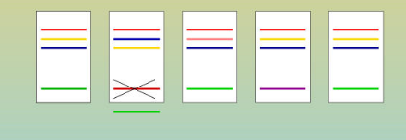
Viterbi Re-estimation
Goal: incorporate ordering information
Decode the training data with Viterbi decoding
Use the new clustering as the input to the parameter estimation procedure

Slide 30
Application: Information Ordering
Input: set of sentences
Applications:
  Text summarization
  Natural Language Generation
Goal: Recover most likely sequences
“get marry” prior to “give birth” (in some domains)

Slide 31
Information Ordering: Algorithm
Input: set of sentences
  Produce all permutations of the set
  Rank them based on the content model

Slide 32
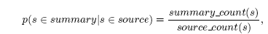
Summarization: Algorithm
Input: source text
Training data: parallel corpus of summaries and source texts (aligned)
Employ Viterbi on source texts and summaries
Compute state likelihood to generate summary sentences:
Given a new text, decode it and extract sentences corresponding to “summary” states

Slide 33

Evaluation: Data

Slide 34
Baselines
“Straw” baseline: Bigram Language model
“State-of-the-art” baseline: (Lapata:2003)
  represent a sentence using lexico-syntactic features
  compute pairwise ordering preferences
  find optimally global order

Slide 35
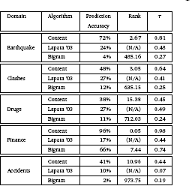
Results: Ordering

Slide 36
Baselines for Summarization
“Straw” baseline: n leading sentences
“State-of-the-art”Kupiec-style classier
    Sentence representation: lexical features and location
    Classifier: BoosTexter

Slide 37
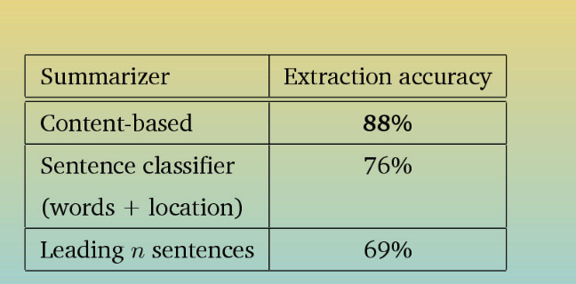
Results: Summarization

Slide 38
Next Class
Final exam review (Dec. 17th 1-4pm, 1024 Mudd)
Future

