Slide 1
Language Generation
Some slides adapted from

Slide 2
Today
Linguistic Generation
Statistical Generation

Slide 3
Two Types of Problems
Conceptual:
  What to say
  How to organize
Linguistic
  How to say it
    Words?
    Syntactic structure

Slide 4
A Language Generator
Content
Planner
Presentation
Plan
Data
Ontology
Micro
Planner
Lexicon
Sentence
Generator
Grammar
Sentences

Slide 5
Why isn’t generation the reverse of parsing?
Parsing
    Input = sentence
    Output = parse tree
Generation
    Output = sentence
    Input = parse tree?

Slide 6
Generation = Decision making under constraints
Syntactic
    Agent = The President
    Pred = pass
    Patient = tax bailout plain
    When = yesterday
  The President passed the tax bailout plan
  The tax bailout plan was passed by the President
  The tax bailout plan was passed
  It was the President who passed the tax bailout plan
  It was the tax bailout plan the President passed.
Constraints?

Slide 7
Lexical Choice
Bought vs sell
    Kathy bought the book from Joshua.
    Joshua sold the book to Kathy.
Erudite vs. wise
    The erudite old man taught us ancient history.
    The wise old man taught us ancient history.
Polarity vs. “plus/minus”
    Insert the battery and check the polarity.
    Insert the battery and make sure the plus lines up with the plus.
Edged out vs. beat
    The Denver Nuggets edged out the Boston Celtics 102-101
    The Denver Nuggets beat the Boston Celtics with a narrow margin 102-101.
Constraints?

Slide 8
Lexical Choice
Syntax
    Allow one to select
    Allow the selection
Semantics
    Rebound vs. point in basketball
Lexical
    “grab a rebound” vs. “score a point” and not vice versa
Domain
    IBM rebounded from a 3 day loss.
    Magic grabbed 20 rebounds.
Pragmatics
    A glass half-full
    A glass half-empty

Slide 9
Floating Constraints
Inter-lexical (e.g., collocations)
Cross-ranking (content units are not isomorphic with linguistic units)

Slide 10
Constraints on Lexical Choice Float
Wall Street indexes opened strongly. (time in verb, manner as adverb)
Stock indexes surged at the start of the trading day. (time as PP, manner in verb)
The Denver Nuggets beat the Boston Celtics with a narrow margin, 102-101. (game result in verb, manner in PP)
The Denver Nuggets edged out the Boston Celtics 102-101. (game result and manner in verb)

Slide 11
A Language Generator
Content
Planner
Presentation
Plan
Data
Ontology
Micro
Planner
Lexical
choice
Lexicon
Sentence
Generator
Grammar
Sentences

Slide 12
Functional Unification Grammar
Function plays as important a role as syntax
    Pragmatics, semantics are represented equally with syntactic features, constitutents
Unification is used to enrich the input with constraints from the grammar
    Input is recursively unified with grammar
    Top-down process

Slide 13
Functional Unification
Functional Descriptions (FDs) as a feature structure
    Data structure that is partial and structured
Input and grammar are both specified as functional descriptions

Slide 14
An example grammar
((alt GSIMPLE (
;; a grammar always has the same form: an alternative
;; with one branch for each constituent category.
;; First branch of the alternative
;; Describe the category clause.
((cat clause)
(agent ((cat np)))
(patient ((cat np)))
(pred ((cat verb-group)
(number {agent number})))
(cset (pred agent patient))
(pattern (agent pred patient))
;; Second branch: NP
((cat np)
(head ((cat noun) (lex {^ ^ lex})))
(number ((alt np-number (singular plural))))
(alt ( ;; Proper names don't need an article
((proper yes)
(pattern (head)))
;; Common names do
((proper no)
(pattern (det head))
(det ((cat article) (lex "the")))))))
;; Third branch: Verb
((cat verb-group)
(pattern (v))
(aux none)
(v ((cat verb) (lex {^ ^ lex}))))
))

Slide 15
A simple input
Input to generate: The system advises John.
I1 = ((cat clause)
(tense present)
(pred ((lex "advise")))
(agent ((lex "system") (proper no)))
(patient ((lex "John"))))

Slide 16
Unification Output
((cat clause)
(tense present)
(pred ((lex "advise")
(cat verb-group)
(number {agent number})
(PATTERN (V))
(AUX NONE)
(V ((CAT VERB) (LEX {^ ^ LEX})))))
(agent ((lex "system") (proper no)
(cat np)
(HEAD ((CAT NOUN) (LEX {^ ^ LEX})))
(NUMBER SINGULAR)
(PATTERN (DET HEAD))
(DET ((CAT ARTICLE) (LEX "the")))))
(patient ((lex "John")
(cat np)
(HEAD ((CAT NOUN) (LEX {^ ^ LEX})))
(NUMBER SINGULAR)
(PROPER YES)
(CSET (HEAD))
(PATTERN (HEAD))))
(cset (pred agent patient))
(pattern (agent pred patient)))

Slide 17
Linearization
Identify the pattern feature in the top level: for I1, it is (pattern (agent action affected)).
If a pattern is found:
  For each constituent of the pattern, recursively linearize the constituent. (That means linearize agent, pred and patient).
  The linearization of the FD is the concatenation of the linearizations of the constituents in the order prescribed by the pattern feature.
If no pattern is found:
  Find the lex feature of the FD, and depending on the category of the constituent, the morphological features needed. For example, if the FD is of (cat verb), the features needed are: person, number, tense.
  Send the lexical item and the appropriate morphological features to the morphology module. The linearization of the fd is the resulting string. For example, for (lex="advise") when the features are the default values (as they are in I1), the result is advises. When the FD does not contain a morphological feature, the morphology module provides reasonable defaults.

Slide 18
Encoding Function
((cat clause)
(agent ((cat np)))
(patient ((cat np)))
(alt (
((focus {agent})
(voice active)
(pred ((cat verb-group)
(number {agent number})
(cset (action agent affected))
(pattern (agent action affected)))
((focus {patient})
(voice passive)
(verbs ((cat verb-group)
(aux ((lex “be”)
(number {patient number}))
(pastp ({pred}
(tense pastp)))
(pattern (aux pastp))))
(by-agent {agent})
(pattern (patient verbs by-agent))))

Slide 19
Realization with Statistics
Problem: What does the input to realization look like?
Wouldn’t it be easier to automatically learn output?
    What does it take to scale up linguistic grammars?

Slide 20
Implicit Linguistic Knowledge - Grammar
Subject-verb agreement
I am vs. I are vs. I is
Corpus counts (Langkilde-Geary, 2002)
    I am 2797
    I are 47
    I is 14

Slide 21
Implicit Linguistic Knowledge - Grammar
Choice of determininer
a trust vs. an trust vs. the trust
Corpus counts (Langkilde-Geary, 2002)
    A trust 394
    An trust 0
    The trust 1356
    A trusts 2
    An trusts 0
    The trusts 115

Slide 22
Realization with statistics:
Key Techniques
Over-generate and prune
Automatically acquire grammar from a corpus (if a phrase structure grammar is needed)
Exploit general-purpose tools and resources when possible & appropriate
    Tokenizers
    Part-of-speech taggers
    Parsers, Penn Treebank
    WordNet, VerbNet

Slide 23
Overgenerate and prune
General strategy:
  Generate multiple candidate sentences with some permissive strategy
Some sentences may be very ungrammatical!
Very many sentences (millions) may be generated
  Assign scores to the candidate sentences using a corpus-based language model
  Output the highest-ranking sentence(s)

Slide 24
Generate multiple candidates with permissive strategy
I is not able to betray their trust .
I cannot betray trust of them .
I cannot betray the trust of them .
I am not able to betray their trust .
I will not be able to betray the trust of them .
I will not be able to betray their trust .
I cannot betray their trust .
I cannot betray trusts of them .
I are not able to betray their trust .
I cannot betray a trust of them .s

Slide 25
Assign scores using language model
1. I cannot betray their trust .
2. I will not be able to betray their trust .
3. I am not able to betray their trust .
4. I are not able to betray their trust .
5. I is not able to betray their trust .
6. I cannot betray the trust of them .
7. I cannot betray trust of them .
8. I cannot betray a trust of them .
9. I cannot betray trusts of them .
10.I will not be able to betray the trust

Slide 26
Output highest ranking sentence
1. I cannot betray their trust .
2. I will not be able to betray their trust .
3. I am not able to betray their trust .
4. I are not able to betray their trust .
5. I is not able to betray their trust .
6. I cannot betray the trust of them .
7. I cannot betray trust of them .
8. I cannot betray a trust of them .
9. I cannot betray trusts of them .
10.I will not be able to betray the trust

Slide 27
NITROGEN
Early, influential statistical realization algorithm
  Langkilde & Knight (1998)
  Hatzivassiloglou & Knight (1995)
Uses an overgenerate and prune strategy

Slide 28
NITROGEN input format
Input: Abstract Meaning Representation (AMR)
    Based on Penman Sentence Plan Language (See Kasper 1989, Langkilde & Knight 1998)
Example AMR: (m1 / |dog<canid|)
    m1 is an instance of |dog<canid| -- derived from WordNet
    Might be realized “ the dog” , “ the dogs” , “ a dog” , “ dog” ,...
Another example AMR:
  (m3 / |eat, take in|
:agent (m4 / |dog<canid| :quant plural)
:patient (m5 / |os,bone|))
  Might be realized as “ the dogs ate the bone” , “Dogs will eat a bone” , “ The dogs eat bones” , “Dogs eat bone” ,...

Slide 29
NITROGEN Lattices
In practice, overgeneration can produce millions of sentences for a single input
  So need very compact representations or prune aggressively
Nitrogen uses a lattice representation
  Lattice is an acyclic graph where each arc is labeled with a word.
  A complete path from the left-most node to rightmost node through the lattice represents a possible expression/sentence.

Slide 30
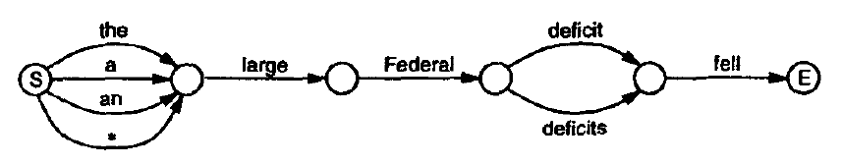
NITROGEN Lattices: idea
Suppose realizer, looking at an AMR input, is uncertain about definiteness and number. Can generate a lattice fragment like this:
Generates:
The large Federal deficit fell.
A large Federal deficit fell.
An large Federal deficit fell large.
Federal deficit fell.
A large Federal deficits fell.

Slide 31
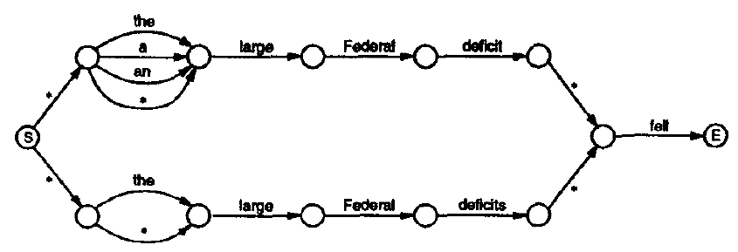
Perhaps a better lattice

Slide 32
NITROGEN lattices: generation
Set of hand-built rules link AMR patterns to lattice fragments
Each AMR pattern is deliberately mapped to many different realizations (overgeneration)
A lexicon describes alternative words that can express AMR concepts.

Slide 33
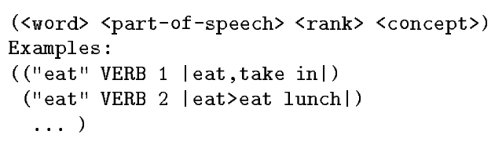
NITROGEN Lexicon
A lexicon of 110,000 entries connects concepts to alternative English words. Format:
Important note: no features like transitivity, subcategorization, gradability (for adjectives), or countability (for nouns).
  This is a substantial advantage for development.

Slide 34
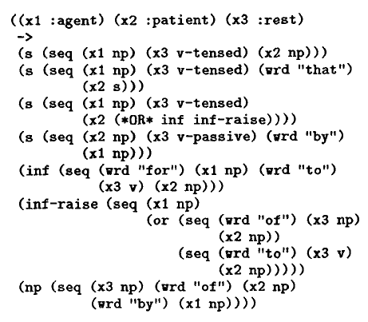
NITROGEN: Example rule

Slide 35
Generation algorithm
Algorithm sketch: Traverse input AMR bottomup, building lattices for the leaves (innermost nested levels of the input) first, to be combined at outer levels according to relations between the leaves
    (see Langkilde & Knight 1998 for details)
Result is a large lattice like...

Slide 36
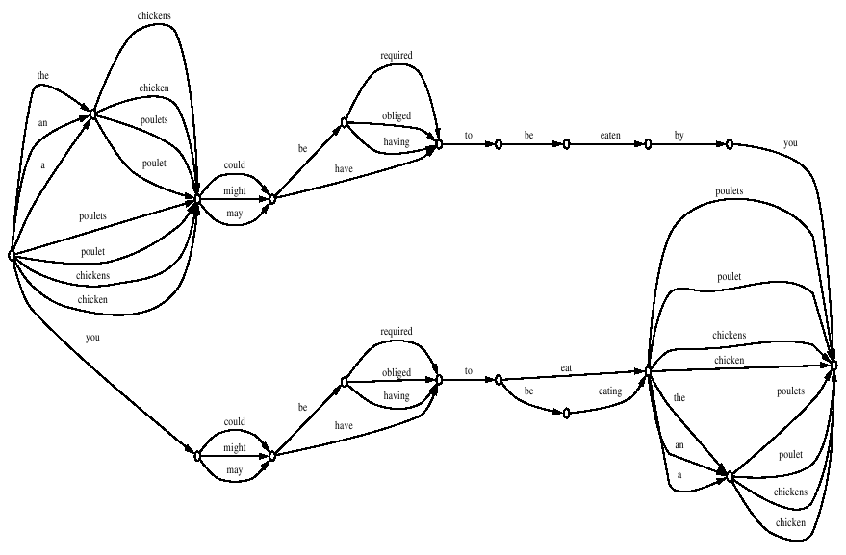
This lattice represents 576 different sentences

Slide 37
Extracting high-probability sentences from a lattice
Nitrogen uses a bigram/trigram language model built from 46 million words of Wall Street Journal text from 1987 and 1988.
As visit each state s, maintain list of most probable sequences of words from start to s:
    Extend all word sequences to predecessors of s,recompute scores, prune down to 1000 most probable sequences per state.
At end state, emit most probable sequence.

Slide 38
Questions
Do the two approaches handle the same phenomena?
Could they be integrated?

Slide 39
References
1989 Kasper, A flexible interface for linking applications to Penman's sentence generator
1995 Hatzivassiloglou & Knight, Unification Based Glossing
1995 Knight & Hatzivassiloglou, Two Level Many Paths Generation
1998 Langkilde & Knight, Generation that Exploits Corpus Based Statistical Knowledge
2000 Langkilde, Forest Based Statistical Sentence Generation
2002 Langkilde-Geary, An Empirical Verification of Coverage and Correctness for a General Purpose Sentence Generator
1998 Langkilde & Knight, The practical value of n grams in generation
2002 Langkilde & Geary, A foundation for general purpose natural language generation sentence realization using probabilistic models of language
2002 Oh & Rudnicky, Stochastic natural language generation for spoken dialog systems
2000 Ratnaparkhi, Trainable methods for surface natural language generation

