Slide 1
CS4705: Natural Language Processing
Discourse: Structure and Coherence
Kathy McKeown
Thanks to Dan Jurafsky, Diane Litman, Andy Kehler, Jim Martin

Slide 2
Homework questions?
HW4:
  For HW3 you experiment with different features (at least 3) and different learning algorithms (at least 2) but you turn in your best model
  For HW4 you are asked to write up your findings from your experiments in HW3
      What features did you experiment with and why?
      How did each individual feature contribute to success vs. the combination? (show the evaluation results)
        Why do you think the features worked this way?
      How do the different machine learning algorithms compare?
      What features did you try but throw out?
      You should provide charts with numbers both comparison of feature impact and learning algorithm impact

Slide 3
  Evaluation: How would your system fare if you used the pyramid method rather than precision and recall? Show how this would work on one of the test document sets. That is, for the first 3 summary sentences in the four human models, show the SCUs, the weights for each SCU, and which of the SCUs your system got.
  If you could do just one thing to improve your system, what would that be? Show an example of where things went wrong and say whether you think there is any NL technology that could help you address this.
  Your paper should be between 5-7 pages.
  Professor McKeown will grade the paper

Slide 4
Class Wrap-Up
Final exam: December 17th, 1:10-4:00 here
Pick up your work: midterms, past assignments from me in my office hours or after class
HW2 grades will be returned the Thurs after Thanksgiving
Interim class participation grades will be posted on courseworks the week after Thanksgiving

Slide 5
What is a coherent/cohesive discourse?

Slide 6
Summarization, question answering, information extraction, generation
Which are more useful where?
    Discourse structure: subtopics
    Discourse coherence: relations between sentences
    Discourse structure: rhetorical relations

Slide 7
Outline
Discourse Structure
  Textiling
Coherence
  Hobbs coherence relations
  Rhetorical Structure Theory

Slide 8
Part I: Discourse Structure
Conventional structures for different genres
  Academic articles:
    Abstract, Introduction, Methodology, Results, Conclusion
  Newspaper story:
    inverted pyramid structure (lead followed by expansion)

Slide 9
Discourse Segmentation
Simpler task
  Discourse segmentation
    Separating document into linear sequence of subtopics

Slide 10
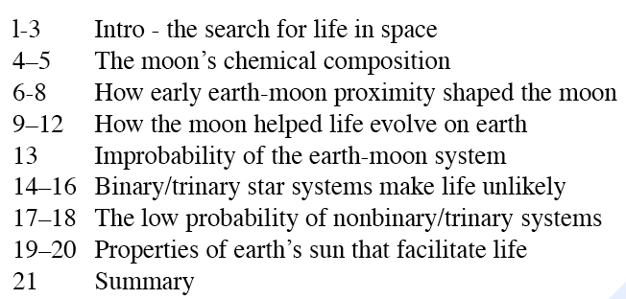
Unsupervised Discourse Segmentation
Hearst (1997): 21-pgraph science news article called “Stargazers”
Goal: produce the following subtopic segments:

Slide 11
Applications
Information retrieval:
    automatically segmenting a TV news broadcast or a long news story into sequence of stories
Text summarization: ?
Information extraction:
    Extract info from inside a single discourse segment
Question Answering?

Slide 12
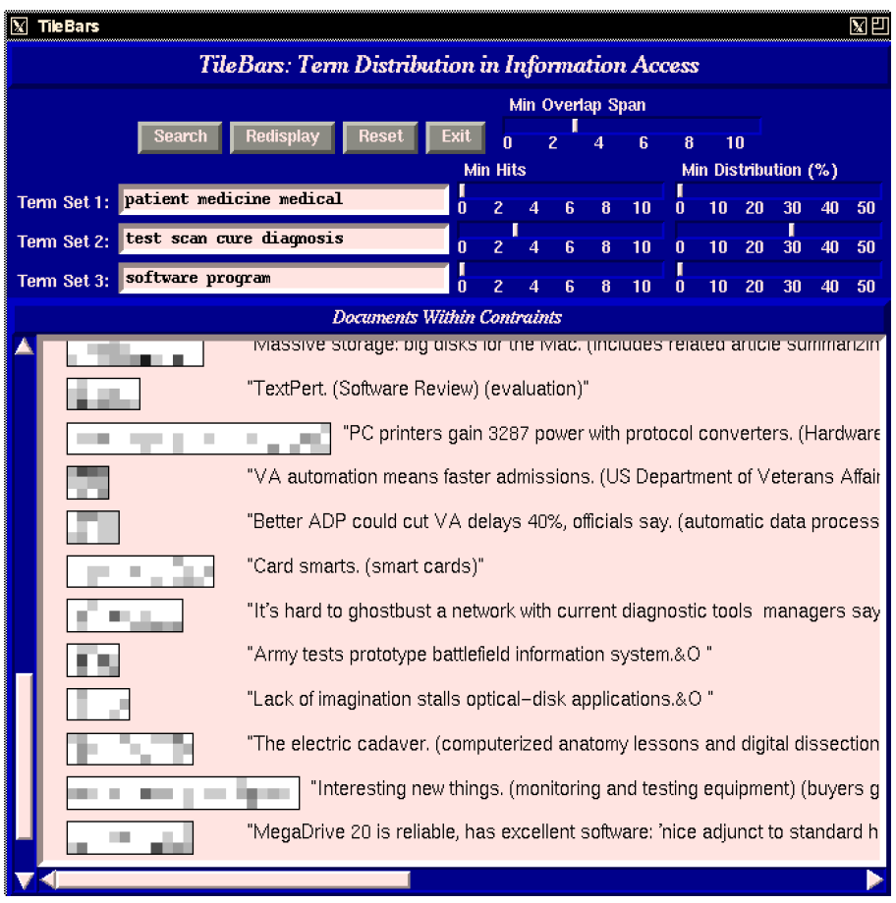

Slide 13
Key intuition: cohesion
Halliday and Hasan (1976): “The use of certain linguistic devices to link or tie together textual units”
Lexical cohesion:
  Indicated by relations between words in the two units (identical word, synonym, hypernym)
    Before winter I built a chimney, and shingled the sides of my house.
    I thus have a tight shingled and plastered house.
    Peel, core and slice the pears and the apples. Add the fruit to the skillet.

Slide 14
Key intuition: cohesion
Non-lexical: anaphora
  The Woodhouses were first in consequence there. All looked up to them.
Cohesion chain:
  Peel, core and slice the pears and the apples. Add the fruit to the skillet. When they are soft…

Slide 15
Intuition of cohesion-based segmentation
Sentences or paragraphs in a subtopic are cohesive with each other
But not with paragraphs in a neighboring subtopic
Thus if we measured the cohesion between every neighboring sentences
  We might expect a ‘dip’ in cohesion at subtopic boundaries.

Slide 16
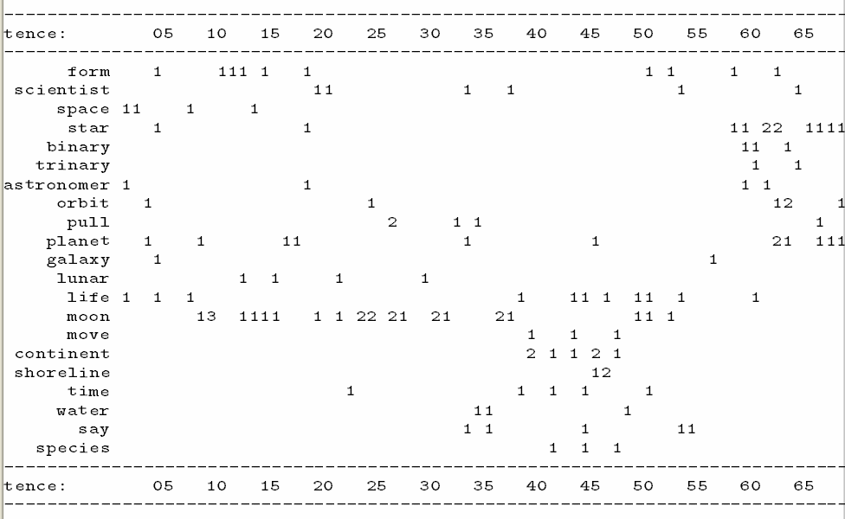

Slide 17
TextTiling (Hearst 1997)
Tokenization
  Each space-deliminated word
  Converted to lower case
  Throw out stop list words
  Stem the rest
  Group into pseudo-sentences of length w=20
Lexical Score Determination: cohesion score
  Three part score including
  Average similarity (cosine measure) between gaps
  Introduction of new terms
  Lexical chains
Boundary Identification

Slide 18
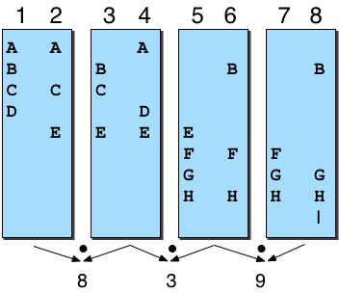
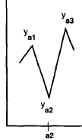
TextTiling algorithm

Slide 19
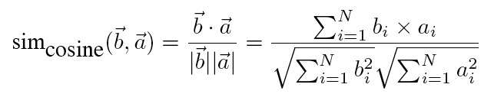
Cosine

Slide 20
Vector Space Model
In the vector space model, both documents and queries are represented as vectors of numbers.
    For textiling: both segments are represented as vectors
    For categorization, both documents are represented as vectors
The numbers are derived from the words that occur in the collection

Slide 21
Representation
Start with bit vectors
This says that there are N word types in the collection and that the representation of a document consists of a 1 for each corresponding word type that occurs in the document.
We can compare two docs or a query and a doc by summing the bits they have in common

Slide 22
Term Weighting
Bit vector idea treats all terms that occur in the query and the document equally.
Its better to give the more important terms greater weight.
    Why?
    How would we decide what is more important?

Slide 23
Term Weighting
Two measures are used
  Local weight
    How important is this term to the meaning of this document
    Usually based on the frequency of the term in the document
  Global weight
    How well does this term discriminate among the documents in the collection
    The more documents a term occurs in the less important it is; The fewer the better.

Slide 24
Term Weights
Local weights
  Generally, some function of the frequency of terms in documents is used
Global weights
  The standard technique is known as inverse document frequency
N= number of documents; ni = number of documents with term i

Slide 25
TFxIDF Weighting
To get the weight for a term in a document, multiply the term’s frequency derived weight by its inverse document frequency.

Slide 26
Back to Similarity
We were counting bits to get similarity
Now we have weights
But that favors long documents over shorter ones

Slide 27
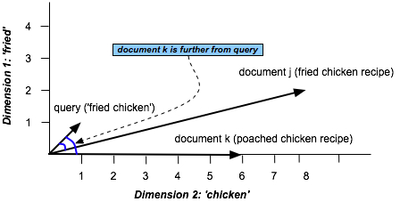
Similarity in Space
(Vector Space Model)

Slide 28
Similarity
View the document as a vector from the origin to a point in the space, rather than as the point.
In this view it’s the direction the vector is pointing that matters rather than the exact position
We can capture this by normalizing the comparison to factor out the length of the vectors

Slide 29
Similarity
The cosine measure

Slide 30
TextTiling algorithm

Slide 31
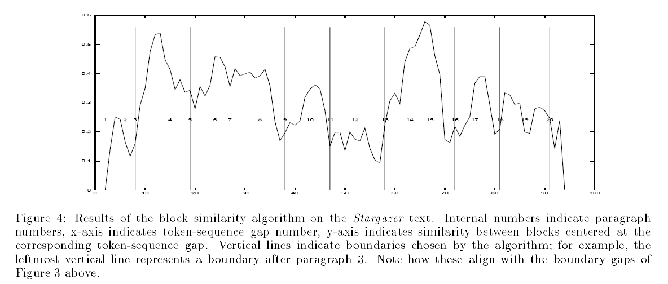

Slide 32
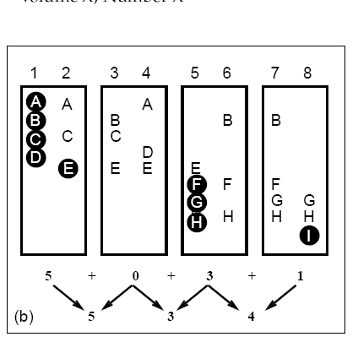
Lexical Score Part 2: Introduction of New Terms

Slide 33
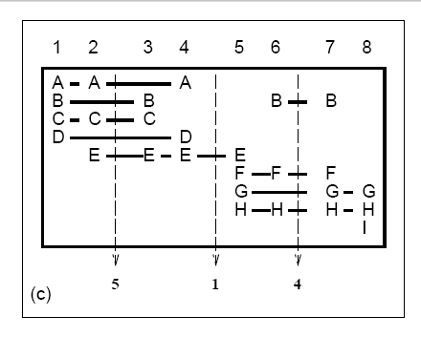
Lexical Score Part 3: Lexical Chains

Slide 34
Supervised Discourse segmentation
Discourse markers or cue words
  Broadcast news
    Good evening, I’m <PERSON>
    …coming up….
  Science articles
    “First,….”
    “The next topic….”

Slide 35
Supervised discourse segmentation
Supervised machine learning
  Label segment boundaries in training and test set
  Extract features in training
  Learn a classifier
  In testing, apply features to predict boundaries

Slide 36
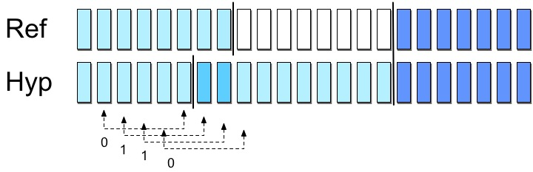
Supervised discourse segmentation
Evaluation: WindowDiff (Pevzner and Hearst 2000)
assign partial credit

Slide 37
Summarization, Question answering, Information extraction, generation
Which are more useful where?
    Discourse structure: subtopics
    Discourse coherence: relations between sentences
    Discourse structure: rhetorical relations

Slide 38
Part II: Text Coherence
What makes a discourse coherent?
The reason is that these utterances, when juxtaposed, will not exhibit coherence. Almost certainly not. Do you have a discourse? Assume that you have collected an arbitrary set of well-formed and independently interpretable utterances, for instance, by randomly selecting one sentence from each of the previous chapters of this book.

Slide 39
Better?
Assume that you have collected an arbitrary set of well-formed and independently interpretable utterances, for instance, by randomly selecting one sentence from each of the previous chapters of this book. Do you have a discourse? Almost certainly not. The reason is that these utterances, when juxtaposed, will not exhibit coherence.

Slide 40
Coherence
John hid Bill’s car keys. He was drunk.
??John hid Bill’s car keys. He likes spinach.

Slide 41
What makes a text coherent?
Appropriate use of coherence relations between subparts of the discourse -- rhetorical structure
Appropriate sequencing of subparts of the discourse -- discourse/topic structure
Appropriate use of referring expressions

Slide 42
Hobbs 1979 Coherence Relations
“ Result ” :
Infer that the state or event asserted by S0 causes or could cause the state or event asserted by S1.
  The Tin Woodman was caught in the rain. His joints rusted.

Slide 43
Hobbs: “Explanation”
Infer that the state or event asserted by S1 causes or could cause the state or event asserted by S0.
  John hid Bill’s car keys. He was drunk.

Slide 44
Hobbs: “Parallel”
Infer p(a1, a2..) from the assertion of S0 and p(b1,b2…) from the assertion of S1, where ai and bi are similar, for all I.
  The Scarecrow wanted some brains. The Tin Woodman wanted a heart.

Slide 45
Hobbs “Elaboration”
Infer the same proposition P from the assertions of S0 and S1.
  Dorothy was from Kansas. She lived in the midst of the great Kansas prairies.

Slide 46
Summarization, question answering, information extraction, generation
Which are more useful where?
    Discourse structure: subtopics
    Discourse coherence: relations between sentences
    Discourse structure: rhetorical relations

Slide 47
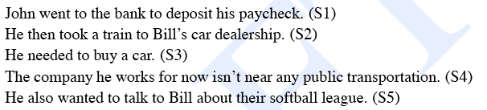
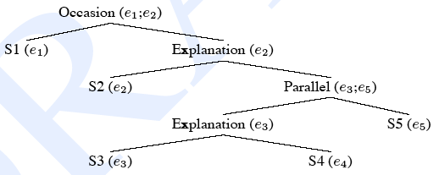
Coherence relations impose a discourse structure

Slide 48
Rhetorical Structure Theory
Another theory of discourse structure, based on identifying relations between segments of the text
  Nucleus/satellite notion encodes asymmetry
    Nucleus is thing that if you deleted it, text wouldn’t make sense.
  Some rhetorical relations:
    Elaboration: (set/member, class/instance, whole/part…)
    Contrast: multinuclear
    Condition: Sat presents precondition for N
    Purpose: Sat presents goal of the activity in N

Slide 49
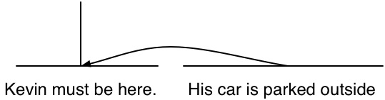
One example of rhetorical relation
A sample definition
  Relation: Evidence
  Constraints on N: H might not believe N as much as S think s/he should
  Constraints on Sat: H already believes or will believe Sat
  Effect: H’s belief in N is increased
An example:
  Kevin must be here.
  His car is parked outside.
Nucleus
Satellite

Slide 50
Automatic Rhetorical Structure Labeling
Supervised machine learning
  Get a group of annotators to assign a set of RST relations to a text
  Extract a set of surface features from the text that might signal the presence of the rhetorical relations in that text
  Train a supervised ML system based on the training set

Slide 51
Features: cue phrases
Explicit markers: because, however, therefore, then, etc.
Tendency of certain syntactic structures to signal certain relations:
Infinitives are often used to signal purpose relations: Use rm to delete files.
Ordering
Tense/aspect
Intonation

Slide 52
Some Problems with RST
How many Rhetorical Relations are there?
How can we use RST in dialogue as well as monologue?
RST does not model overall structure of the discourse.
Difficult to get annotators to agree on labeling the same texts

Slide 53
Summarization, Question answering, Information Extraction, generation
Which are more useful where?
    Discourse structure: subtopics
    Discourse coherence: relations between sentences
    Discourse structure: rhetorical relations

