Slide 1
Web-based Factoid Question Answering
(including a sketch of Information Retrieval)
Slides adapted from Dan Jurafsky, Jim Martin and Ed Hovy

Slide 2
Today
Web-based Question Answering
Information Retrieval (briefly)

Slide 3
II. Question-Answering
The notion of getting computers to give reasonable answers to questions has been around for quite awhile
Three kinds of systems
Finding answers in text collections
Interfaces to relational databases
Mixed initiative dialog systems

Slide 4
People do ask questions…
Examples from various query logs
Which english translation of the bible is used in official Catholic liturgies?
How tall is the sears tower?
How can i find someone in texas
Where can i find information on puritan religion?
What are the 7 wonders of the world
How can i eliminate stress
What vacuum cleaner does Consumers Guide recommend

Slide 5
Factoid Question Answering
Today
Introduction to Factoid QA
A typical full-fledged factoid QA system
A simpler alternative from MSR
TREC: A Conference where many simultaneous evaluations are carried out
IR
QA

Slide 6
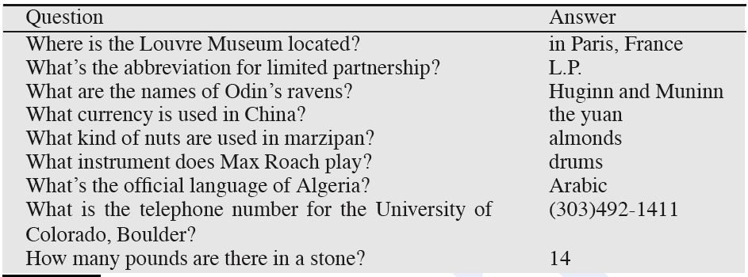
Factoid questions

Slide 7
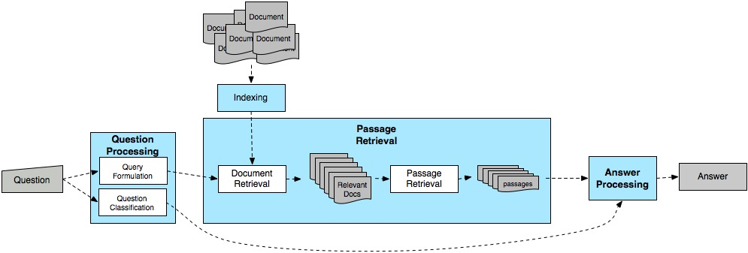
Factoid QA architecture

Slide 8
UT Dallas Q/A Systems
This system contains many components used by other systems, but more complex in some ways
Most work completed in 2001; there have been advances by this group and others since then.
Next slides based mainly on:
Paşca and Harabagiu, High-Performance Question Answering from Large Text Collections, SIGIR’01.
Paşca and Harabagiu, Answer Mining from Online Documents, ACL’01.
Harabagiu, Paşca, Maiorano: Experiments with Open-Domain Textual Question Answering. COLING’00

Slide 9
QA Block Architecture
Extracts and ranks passages
using surface-text techniques
Captures the semantics of the question
Selects keywords for PR
Extracts and ranks answers
using NL techniques
Question Semantics
Q
Question
Processing
Passage
Retrieval
Answer
Extraction
A
Keywords
Passages
WordNet
WordNet
Document
Retrieval
Parser
Parser
NER
NER

Slide 10
Question Processing
Two main tasks
Question classification: Determining the type of the answer
Query formulation: Extract keywords from the question and formulate a query

Slide 11
Answer Types
Factoid questions…
Who, where, when, how many…
The answers fall into a limited and somewhat predictable set of categories
Who questions are going to be answered by…
Where questions…
Generally, systems select answer types from a set of Named Entities, augmented with other types that are relatively easy to extract

Slide 12
Answer Types
Of course, it isn’t that easy…
Who questions can have organizations as answers
Who sells the most hybrid cars?
Which questions can have people as answers
Which president went to war with Mexico?

Slide 13
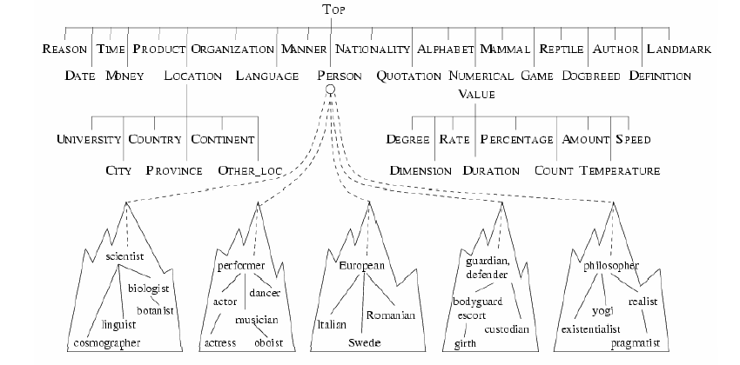
Answer Type Taxonomy
Contains ~9000 concepts reflecting expected answer types
Merges named entities with the WordNet hierarchy

Slide 14
Answer Type Detection
Most systems use a combination of hand-crafted rules and supervised machine learning to determine the right answer type for a question.
But how do we use the answer type?

Slide 15
Query Formulation: Lexical Terms Extraction
Questions approximated by sets of unrelated words (lexical terms)
Similar to bag-of-word IR models
Question (from TREC QA track) | Lexical terms
Q002: What was the monetary value of the Nobel Peace Prize in 1989? | monetary, value, Nobel, Peace, Prize
Q003: What does the Peugeot company manufacture? | Peugeot, company, manufacture
Q004: How much did Mercury spend on advertising in 1993? | Mercury, spend, advertising, 1993
Q005: What is the name of the managing director of Apricot Computer? | name, managing, director, Apricot, Computer

Slide 16
Passage Retrieval
Extracts and ranks passages
using surface-text techniques
Captures the semantics of the question
Selects keywords for PR
Extracts and ranks answers
using NL techniques
Question Semantics
Q
Question
Processing
Passage
Retrieval
Answer
Extraction
A
Keywords
Passages
WordNet
WordNet
Document
Retrieval
Parser
Parser
NER
NER

Slide 17
Passage Extraction Loop
Passage Extraction Component
Extracts passages that contain all selected keywords
Passage size dynamic
Start position dynamic
Passage quality and keyword adjustment
In the first iteration use the first 6 keyword selection heuristics
If the number of passages is lower than a threshold ⇒ query is too strict ⇒ drop a keyword
If the number of passages is higher than a threshold ⇒ query is too relaxed ⇒ add a keyword

Slide 18
Passage Scoring
Passages are scored based on keyword windows
For example, if a question has a set of keywords: {k1, k2, k3, k4}, and in a passage k1 and k2 are matched twice, k3 is matched once, and k4 is not matched, the following windows are built:
Window 1
Window 2
k1 k2
k3
k2
k1
k1 k2
k3
k2
k1
Window 3
Window 4
k1 k2
k3
k2
k1
k1 k2
k3
k2
k1

Slide 19
Passage Scoring
Passage ordering is performed using a sort that involves three scores:
The number of words from the question that are recognized in the same sequence in the window
The number of words that separate the most distant keywords in the window
The number of unmatched keywords in the window

Slide 20
Answer Extraction
Extracts and ranks passages
using surface-text techniques
Captures the semantics of the question
Selects keywords for PR
Extracts and ranks answers
using NL techniques
Question Semantics
Q
Question
Processing
Passage
Retrieval
Answer
Extraction
A
Keywords
Passages
WordNet
WordNet
Document
Retrieval
Parser
Parser
NER
NER

Slide 21
Ranking Candidate Answers
Q066: Name the first private citizen to fly in space.
Answer type: Person
Text passage:
“Among them was Christa McAuliffe, the first private citizen to fly in space. Karen Allen, best known for her starring role in “Raiders of the Lost Ark”, plays McAuliffe. Brian Kerwin is featured as shuttle pilot Mike Smith...”

Slide 22
Ranking Candidate Answers
Q066: Name the first private citizen to fly in space.
Answer type: Person
Text passage:
“Among them was Christa McAuliffe, the first private citizen to fly in space. Karen Allen, best known for her starring role in “Raiders of the Lost Ark”, plays McAuliffe. Brian Kerwin is featured as shuttle pilot Mike Smith...”
Best candidate answer: Christa McAuliffe

Slide 23
Features for Answer Ranking
Number of question terms matched in the answer passage
Number of question terms matched in the same phrase as the candidate answer
Number of question terms matched in the same sentence as the candidate answer
Flag set to 1 if the candidate answer is followed by a punctuation sign
Number of question terms matched, separated from the candidate answer by at most three words and one comma
Number of terms occurring in the same order in the answer passage as in the question
Average distance from candidate answer to question term matches
SIGIR ‘01

Slide 24
Other Methods? Other Questions?
When was Barack Obama born?
Where was George Bush born?
What college did John McCain attend?
When did John F Kennedy die?

Slide 25
How does IE figure in?

Slide 26
Some examples
Q: What is the population of Venezuela?
Patterns (with Precision score):
0.60 <NAME> ' s <C-QUANTITY> population
0.37 of <NAME> ' s <C-QUANTITY> people
0.33 <C-QUANTITY> people in <NAME>
0.28 <NAME> has <C-QUANTITY> people
3.2 Q: What is the population of New York?
S1. The mayor is held in high regards by the 8 million New Yorkers.
S2. The mayor is held in high regards by the two New Yorkers.

Slide 27
Where to find the answer?
Wikipedia, WordNet often more reliable
Wikipedia:
Q: What is the Milky Way?
Candidate 1: outer regions
Candidate 2: the galaxy that contains the Earth
WordNet
Wordnet: Milky Way—the galaxy containing the solar system

Slide 28
An Online QA System
http://tangra.si.umich.edu/clair/NSIR/html/nsir.cgi

Slide 29
Is the Web Different?
In TREC (and most commercial applications), retrieval is performed against a smallish closed collection of texts.
The diversity/creativity in how people express themselves necessitates all that work to bring the question and the answer texts together.
But…

Slide 30
The Web is Different
On the Web popular factoids are likely to be expressed in a gazzilion different ways.
At least a few of which will likely match the way the question was asked.
So why not just grep (or agrep) the Web using all or pieces of the original question.

Slide 31
AskMSR
Process the question by…
Simple rewrite rules to rewriting the original question into a statement
Involves detecting the answer type
Get some results
Extract answers of the right type based on
How often they occur

Slide 32
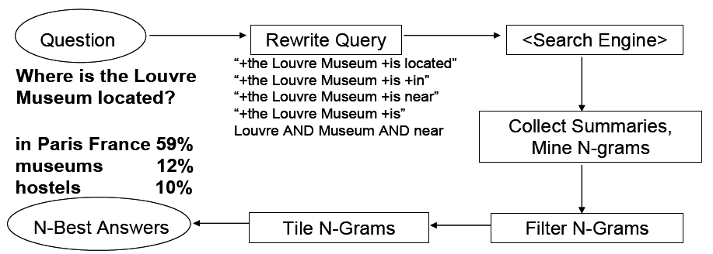
AskMSR

Slide 33
Step 1: Rewrite the questions
Intuition: The user’s question is often syntactically quite close to sentences that contain the answer
Where is the Louvre Museum located?
The Louvre Museum is located in Paris
Who created the character of Scrooge?
Charles Dickens created the character of Scrooge.

Slide 34
Query rewriting
Classify question into seven categories
Who is/was/are/were…?
When is/did/will/are/were …?
Where is/are/were …?
a. Hand-crafted category-specific transformation rules
e.g.: For where questions, move ‘is’ to all possible locations
Look to the right of the query terms for the answer.
“Where is the Louvre Museum located?”
→ “is the Louvre Museum located”
→ “the is Louvre Museum located”
→ “the Louvre is Museum located”
→ “the Louvre Museum is located”
→ “the Louvre Museum located is”

Slide 35
Step 2: Query search engine
Send all rewrites to a Web search engine
Retrieve top N answers (100-200)
For speed, rely just on search engine’s “snippets”, not the full text of the actual document

Slide 36
Step 3: Gathering N-Grams
Enumerate all N-grams (N=1,2,3) in all retrieved snippets
Weight of an n-gram: occurrence count, each weighted by “reliability” (weight) of rewrite rule that fetched the document
Example: “Who created the character of Scrooge?”
Dickens 117
Christmas Carol 78
Charles Dickens 75
Disney 72
Carl Banks 54
A Christmas 41
Christmas Carol 45
Uncle 31

Slide 37
Step 4: Filtering N-Grams
Each question type is associated with one or more “data-type filters” = regular expressions for answer types
Boost score of n-grams that match the expected answer type.
Lower score of n-grams that don’t match.
For example
The filter for
How many dogs pull a sled in the Iditarod?
prefers a number
So disprefer candidate n-grams like
Dog race, run, Alaskan, dog racing
Prefer canddiate n-grams like
Pool of 16 dogs

Slide 38
Step 5: Tiling the Answers
Scores
20
15
10
merged, discard old n-grams
Charles Dickens
Dickens
Mr Charles
Score 45
Mr Charles Dickens

Slide 39
Evaluation
Evaluation of this kind of system is usually based on some kind of TREC-like metric.
In Q/A the most frequent metric is
Mean reciprocal rank
You’re allowed to return N answers. Your score is based on 1/Rank of the first right answer.
Averaged over all the questions you answer.

Slide 40
Results
Standard TREC contest test-bed (TREC 2001): 1M documents; 900 questions
Technique does ok, not great (would have placed in top 9 of ~30 participants)
MRR = 0.507
But with access to the Web… They do much better, would have come in second on TREC 2001
Be suspicious of any after the bake-off is over metrics

Slide 41
Which approach is better?

Slide 42
Harder Questions
A more interesting task is one where the answers are fluid and depend on the fusion of material from disparate texts over time.
Who is Condoleezza Rice?
Who is Stephen Harper?
Why did San Francisco have to hand-count ballots in the last election?

Slide 43
Summary
Information Retrieval
Web-based Question Answering

Slide 44
Information Retrieval
Basic assumption: meanings of documents can be captured by analyzing (counting) the words that occur in them.
This is known as the bag of words approach.

Slide 45
Inverted Index
The fundamental operation we need is the ability to map from words to documents in a collection that contain those words
An inverted index is just a list of words along with the document ids of the documents that contain them
Dog: 1,2,8,100,119,210,400
Dog: 1:4,7:11,13:15,17

Slide 46
Stop Lists and Stemming
IR systems use them
Stop List
List of frequent largely content-free words that are not stored in the index (of, the, a, etc)
The primary benefit is in the reduction of the size of the inverted index
Stemming
Are dog and dogs separate entries or are they collapsed to dog?

Slide 47
Phrases
Google et al allow users to perform phrasal searches “big red dog”.
Hint: they don’t grep the collection
Add locational information to the index
dog: 1{104}, 2{10}, etc
red: 1{103},…
big: 1{102},…
Phrasal searches can operate incrementally by piecing the phrases together.

Slide 48
Ranked Retrieval
The inverted index is just the start
Given a query we want to know how relevant all the documents in the collection are to that query

Slide 49
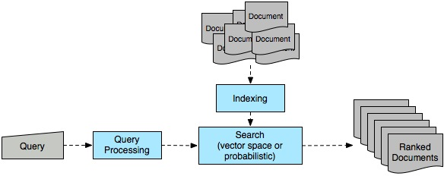
Ad hoc retrieval

Slide 50
Vector Space Model
In the vector space model, both documents and queries are represented as vectors of numbers.
The numbers are derived from the words that occur in the collection

Slide 51
Representation
Start with bit vectors
This says that there are N word types in the collection and that the representation of a document consists of a 1 for each corresponding word type that occurs in the document.
We can compare two docs or a query and a doc by summing the bits they have in common

Slide 52
Term Weighting
Bit vector idea treats all terms that occur in the query and the document equally.
Its better to give the more important terms greater weight.
Why?
How would we decide what is more important?

Slide 53
Term Weighting
Two measures are used
Local weight
How important is this term to the meaning of this document
Usually based on the frequency of the term in the document
Global weight
How well does this term discriminate among the documents in the collection
The more documents a term occurs in the less important it is; The fewer the better.

Slide 54
Term Weights
Local weights
Generally, some function of the frequency of terms in documents is used
Global weights
The standard technique is known as inverse document frequency
N= number of documents; ni = number of documents with term i

Slide 55
TFxIDF Weighting
To get the weight for a term in a document, multiply the term’s frequency derived weight by its inverse document frequency.

Slide 56
Back to Similarity
We were counting bits to get similarity
Now we have weights
But that favors long documents over shorter ones

Slide 57
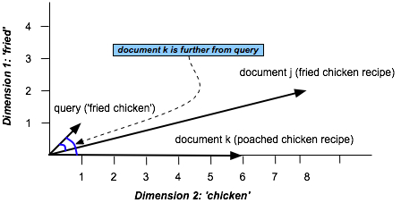
Similarity in Space (Vector Space Model)

Slide 58
Similarity
View the document as a vector from the origin to a point in the space, rather than as the point.
In this view it’s the direction the vector is pointing that matters rather than the exact position
We can capture this by normalizing the comparison to factor out the length of the vectors

Slide 59
Similarity
The cosine measure

Slide 60
Ad Hoc Retrieval
Take a user’s query and find all the documents that contain any of the terms in the query
Convert the query to a vector using the same weighting scheme that was used to represent the documents
Compute the cosine between the query vector and all the candidate documents and sort

