Slide 1
Information Extraction
CS4705

Slide 2
Information Extraction (IE) - Task
Idea: ‘extract’ or tag particular types of information from arbitrary text or transcribed speech

Slide 3
Named Entity Tagger
Identify types and boundaries of named entity
  For example:
    Alexander Mackenzie , (January 28, 1822 ‐ April 17, 1892), a building contractor and writer, was the second Prime Minister of Canada from ….
    -> <PERSON>Alexander Mackenzie</PERSON> , (<TIMEX >January 28, 1822 <TIMEX> ‐ <TIMEX>April 17, 1892</TIMEX>), a building contractor and writer, was the second Prime Minister of <GPE>Canada</GPE> from ….

Slide 4
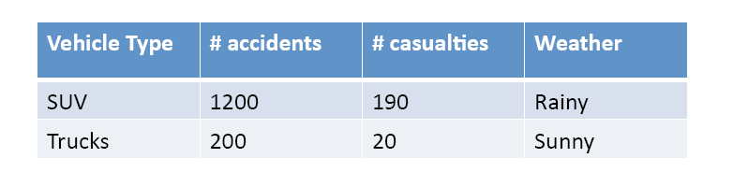
IE for Template Filling
Relation Detection
Given a set of documents and a domain of interest, fill a table of required fields.
• For example:
Number of car accidents per vehicle type and number of casualties in the accidents.

Slide 5
IE for Question Answering
Q: When was Gandhi born?
A: October 2, 1869
Q: Where was Bill Clinton educated?
A: Georgetown University in Washington, D.C.
Q: What was the education of Yassir Arafat?
A: Civil Engineering
Q: What is the religion of Noam Chomsky?
A: Jewish

Slide 6
Approaches
Statistical sequence labeling
Supervised
Semi-supervised and bootstrapping

Slide 7
Approach for NER
<PERSON>Alexander Mackenzie</PERSON> , (<TIMEX >January 28, 1822 <TIMEX> ‐ <TIMEX>April 17, 1892</TIMEX>), a building contractor and writer, was the second Prime Minister of <GPE>Canada</GPE> from ….
Statistical sequence labeling techniques can be used – similar to POS tagging
  Word-by-word sequence labeling
  Example of features
    POS tags
    Syntactic constituents
    Shape features
    Presence in a named entity list

Slide 8
Supervised Approach for relation detection
Given a corpus of annotated relations between entities, train two classifiers:
  A binary classifier
      Given a span of text and two entities -> decide if there is a relationship between these two entities
Features
  Types of two named entities
  Bag of words
  POS of words in between
Example:
  A rented SUV went out of control on Sunday, causing the death of seven people in Brooklyn
  Relation: Type = Accident, Vehicle Type = SUV, casualty = 7, weather = ?
Pros and Cons?

Slide 9
Pattern Matching
How can we come up with these patterns?
Manually?
  Task and domain-specific
  Tedious, time consuming, not scalable

Slide 10
Semi-supervised approach
AutoSlog-TS (Riloff 1996)
MUC-4 task: extract information about terrorist events in Latin America
Two corpora:
  Domain-dependent corpus that contains relevant information
  A set of irrelevant documents
Algorithm:
    Using heuristics, all patterns are extracted from both corpora. For example:
        Rule: <Subj> passive-verb
          <Subj> was murdered
          <Subj> was called
    Pattern Ranking: The output patterns are then ranked by the frequency of their occurrences in corpus1/corpus2
    Filter out the patterns by hand

Slide 11
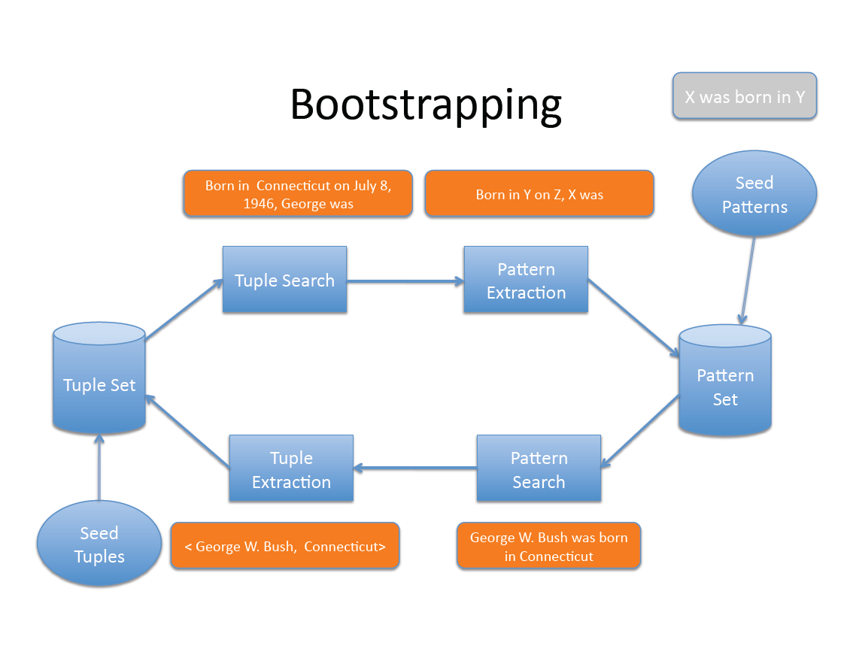

Slide 12
Task 12: (DARPA – GALE year2)
Produce a biography of [person]
1. Name(s), aliases:
2. *Date of Birth or Current Age:
3. *Date of Death:
4. *Place of Birth:
5. *Place of Death:
6. Cause of Death:
7. Religion (Affiliations):
8. Known loca(ons and dates:
9. Last known address:
10. Previous domiciles:
11. Ethnic or tribal affiliations:
12. Immediate family members
13. Na(ve Language spoken:
14. Secondary Languages spoken:
15. Physical Characteristics
16. Passport number and country of issue:
17. Professional positions:
18. Education
19. Party or other organization affiliations:
20. Publica(ons (titles and dates):

Slide 13
Biography – two approaches
To obtain high precision, we handle each slot independently using bootstrapping to learn IE patterns.
To improve the recall, we utilize a biographical sentence classifier

Slide 14
Pattern Matching for Relation Detection
Patterns:
  “[CAR_TYPE] went out of control on [TIMEX], causing the death of [NUM] people”
  “[PERSON] was born in [GPE]”
  “[PERSON] was graduated from [FAC]”
  “[PERSON] was killed by <X>”
Matching Techniques
  Exact matching
    Pros and Cons?
  Flexible matching (e.g., [X] was .* killed .* by [Y])
    Pros and Cons?

