Slide 1
Text Summarization:
News and Beyond
Kathleen McKeown
Department of Computer Science
Columbia University

Slide 2
Homework questions and information
Data sets
  Additional summary/document pairs added
  Not homogeneous

Slide 3
Midterm Curve
A: 72-93
    A- 72-73
    A+ 91-93
B: 58-71
    B- 58-19
    B+ 70-71
C: 47-57
    C- 47-50
    C+ 56-57
D: 39-46
Solutions are posted on the syllabus

Slide 4
Questions (from Sparck Jones)
Should we take the reader into account and how?
“Similarly, the notion of a basic summary, i.e., one reflective of the source, makes hidden fact assumptions, for example that the subject knowledge of the output’s readers will be on a par with that of the readers for whom the source was intended. (p. 5)”
Is the state of the art sufficiently mature to allow summarization from intermediate representations and still allow robust processing of domain independent material?

Slide 5
Text Summarization at Columbia
Shallow analysis instead of information extraction
Extraction of phrases rather than sentences
Generation from surface representations in place of semantics

Slide 6
Problems with Sentence Extraction
Extraneous phrases
    “The five were apprehended along Interstate 95, heading south in vehicles containing an array of gear including … ... authorities said.”
Dangling noun phrases and pronouns
    “The five”
Misleading
    Why would the media use this specific word (fundamentalists), so often with relation to Muslims? *Most of them are radical Baptists, Lutheran and Presbyterian groups.

Slide 7
Cut and Paste in Professional Summarization
Humans also reuse the input text to produce summaries
But they “cut and paste” the input rather than simply extract
  our automatic corpus analysis
    300 summaries, 1,642 sentences
    81% sentences were constructed by cutting and pasting
  linguistic studies

Slide 8
Major Cut and Paste Operations
(1) Sentence reduction
~~~~~~~~~~~~

Slide 9
Major Cut and Paste Operations
(1) Sentence reduction
~~~~~~~~~~~~

Slide 10
Major Cut and Paste Operations
(1) Sentence reduction
(2) Sentence Combination
~~~~~~~~~~~~
~~~~~~~
~~~~~~
~~~~~~~

Slide 11
Major Cut and Paste Operations
(3) Syntactic Transformation
(4) Lexical paraphrasing
~~~~~
~~~~~
~~~~~~~~~~~
~~~

Slide 12
Summarization at Columbia
News
Email
Meetings
Journal articles
Open-ended question-answering
    What is a Loya Jurga?
    Who is Mohammed Naeem Noor Khan?
    What do people think of welfare reform?

Slide 13
Summarization at Columbia
News
    Single Document
    Multi-document
Email
Meetings
Journal articles
Open-ended question-answering
    What is a Loya Jurga?
    Who is Al Sadr?
    What do people think of welfare reform?

Slide 14
Cut and Paste Based Single Document Summarization -- System Architecture
Input: single document
Extraction
Extracted sentences
Corpus
Generation
Parser
Sentence reduction
Decomposition
Co-reference
Sentence combination
Lexicon
Output: summary

Slide 15
(1) Decomposition of Human-written Summary Sentences
Input:
  a human-written summary sentence
  the original document
Decomposition analyzes how the summary sentence was constructed
The need for decomposition
  provide training and testing data for studying cut and paste operations

Slide 16
Sample Decomposition Output
Summary sentence:
Arthur B. Sackler, vice president for law and public policy of Time Warner Cable Inc. and a member of the direct marketing association told the Communications Subcommittee of the Senate Commerce Committee that legislation to protect children’s privacy on-line could destroy the spondtaneous nature that makes the Internet unique.
Document sentences:
S1: A proposed new law that would require web publishers to obtain parental consent before collecting personal information from children could destroy the spontaneous nature that makes the internet unique, a member of the Direct Marketing Association told a Senate panel Thursday.
S2: Arthur B. Sackler, vice president for law and public policy of Time Warner Cable Inc., said the association supported efforts to protect
children on-line, but he…
S3: “For example, a child’s e-mail address is necessary …,” Sackler said in testimony to the Communications subcommittee of the Senate
Commerce Committee.
S5: The subcommittee is considering the Children’s Online Privacy Act, which was drafted…

Slide 17
Decomposition of human-written summaries
A Sample Decomposition Output
Summary sentence:
Arthur B. Sackler, vice president for law and public policy of Time Warner Cable Inc. and a member of the direct marketing association told the Communications Subcommittee of the Senate Commerce Committee that legislation to protect children’s privacy on-line could destroy the spondtaneous nature that makes the Internet unique.
Document sentences:
S1: A proposed new law that would require web publishers to obtain parental consent before collecting personal information from children could destroy the spontaneous nature that makes the internet unique, a member of the Direct Marketing Association told a Senate panel Thursday.
S2: Arthur B. Sackler, vice president for law and public policy of Time Warner Cable Inc., said the association supported efforts to protect
children on-line, but he…
S3: “For example, a child’s e-mail address is necessary …,” Sackler said in testimony to the Communications subcommittee of the Senate
Commerce Committee.
S5: The subcommittee is considering the Children’s Online Privacy Act, which was drafted…

Slide 18
Decomposition of human-written summaries
A Sample Decomposition Output
Summary sentence:
Arthur B. Sackler, vice president for law and public policy of Time Warner Cable Inc. and a member of the direct marketing association told the Communications Subcommittee of the Senate Commerce Committee that legislation to protect children’s privacy on-line could destroy the spondtaneous nature that makes the Internet unique.
Document sentences:
S1: A proposed new law that would require web publishers to obtain parental consent before collecting personal information from children could destroy the spontaneous nature that makes the internet unique, a member of the Direct Marketing Association told a Senate panel Thursday.
S2: Arthur B. Sackler, vice president for law and public policy of Time Warner Cable Inc., said the association supported efforts to protect
children on-line, but he…
S3: “For example, a child’s e-mail address is necessary …,” Sackler said in testimony to the Communications subcommittee of the Senate
Commerce Committee.
S5: The subcommittee is considering the Children’s Online Privacy Act, which was drafted…

Slide 19
Decomposition of human-written summaries
A Sample Decomposition Output
Summary sentence:
Arthur B. Sackler, vice president for law and public policy of Time Warner Cable Inc. and a member of the direct marketing association told the Communications Subcommittee of the Senate Commerce Committee that legislation to protect children’s privacy on-line could destroy the spondtaneous nature that makes the Internet unique.
Document sentences:
S1: A proposed new law that would require web publishers to obtain parental consent before collecting personal information from children could destroy the spontaneous nature that makes the internet unique, a member of the Direct Marketing Association told a Senate panel Thursday.
S2: Arthur B. Sackler, vice president for law and public policy of Time Warner Cable Inc., said the association supported efforts to protect
children on-line, but he…
S3: “For example, a child’s e-mail address is necessary …,” Sackler said in testimony to the Communications subcommittee of the Senate
Commerce Committee.
S5: The subcommittee is considering the Children’s Online Privacy Act, which was drafted…

Slide 20
The Algorithm for Decomposition
A Hidden Markov Model based solution
Evaluations:
  Human judgements
    50 summaries, 305 sentences
    93.8% of the sentences were decomposed correctly
  Summary sentence alignment
  Tested in a legal domain
Details in (Jing&McKeown-SIGIR99)

Slide 21
(2) Sentence Reduction
An example:
  Original Sentence: When it arrives sometime next year in new TV sets, the V-chip will give parents a new and potentially revolutionary device to block out programs they don’t want their children to see.
  Reduction Program: The V-chip will give parents a new and potentially revolutionary device to block out programs they don’t want their children to see.
  Professional: The V-chip will give parents a device to block out programs they don’t want their children to see.

Slide 22
The Algorithm for Sentence Reduction
Preprocess: syntactic parsing
Step 1: Use linguistic knowledge to decide what phrases MUST NOT be removed
Step 2: Determine what phrases are most important in the local context
Step 3: Compute the probabilities of humans removing a certain type of phrase
Step 4: Make the final decision

Slide 23
Step 1: Use linguistic knowledge to decide what MUST NOT be removed
Syntactic knowledge from a large-scale, reusable lexicon we have constructed
  convince:
  meaning 1: NP-PP :PVAL (“of”)
  (E.g., “He convinced me of his innocence”)
  NP-TO-INF-OC
  (E.g., “He convinced me to go to the party”)
  meaning 2: ...
Required syntactic arguments are not removed

Slide 24
Step 2: Determining context importance based on lexical links
Saudi Arabia on Tuesday decided to sign…
The official Saudi Press Agency reported that King Fahd made the decision during a cabinet meeting in Riyadh, the Saudi capital.
The meeting was called in response to … the Saudi foreign minister, that the Kingdom…
An account of the Cabinet discussions and decisions at the meeting…
The agency...

Slide 25
Step 2: Determining context importance based on lexical links
Saudi Arabia on Tuesday decided to sign…
The official Saudi Press Agency reported that King Fahd made the decision during a cabinet meeting in Riyadh, the Saudi capital.
The meeting was called in response to … the Saudi foreign minister, that the Kingdom…
An account of the Cabinet discussions and decisions at the meeting…
The agency...

Slide 26
Step 2: Determining context importance based on lexical links
Saudi Arabia on Tuesday decided to sign…
The official Saudi Press Agency reported that King Fahd made the decision during a cabinet meeting in Riyadh, the Saudi capital.
The meeting was called in response to … the Saudi foreign minister, that the Kingdom…
An account of the Cabinet discussions and decisions at the meeting…
The agency...

Slide 27
Step 3: Compute probabilities of humans removing a phrase
verb
(will give)
vsubc
(when)
subj
(V-chip)
iobj
(parents)
obj
(device)
ndet
(a)
adjp
(and)
lconj
(new)
rconj
(revolutionary)
Prob(“when_clause is removed”| “v=give”)
Prob (“to_infinitive modifier is removed” | “n=device”)

Slide 28
Step 4: Make the final decision
verb
(will give)
L
Cn
Pr
vsubc
(when)
obj
(device)
L
Cn
Pr
subj
(V-chip)
L
Cn
Pr
iobj
(parents)
L
Cn
Pr
L
Cn
Pr
L
Cn
Pr
ndet
(a)
adjp
(and)
L
Cn
Pr
L -- linguistic
Cn -- context
Pr -- probabilities
lconj
(new)
rconj
(revolutionary)
L
Cn
Pr
L
Cn
Pr

Slide 29
Evaluation of Reduction
Success rate: 81.3%
  500 sentences reduced by humans
  Baseline: 43.2% (remove all the clauses, prepositional phrases, to-infinitives,…)
Reduction rate: 32.7%
  Professionals: 41.8%
Details in (Jing-ANLP00)

Slide 30
Multi-Document Summarization Research Focus
Monitor variety of online information sources
    News, multilingual
    Email
Gather information on events across source and time
    Same day, multiple sources
    Across time
Summarize
    Highlighting similarities, new information, different perspectives, user specified interests in real-time

Slide 31
Our Approach
Use a hybrid of statistical and linguistic knowledge
Statistical analysis of multiple documents
    Identify important new, contradictory information
Information fusion and rule-driven content selection
Generation of summary sentences
    By re-using phrases
    Automatic editing/rewriting summary

Slide 32
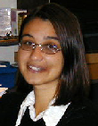
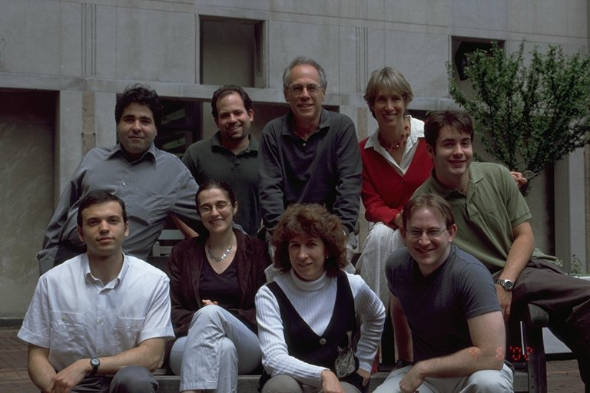

Newsblaster
Integrated in online environment for daily news updates http://newsblaster.cs.columbia.edu/
Ani Nenkova
David Elson

Slide 33
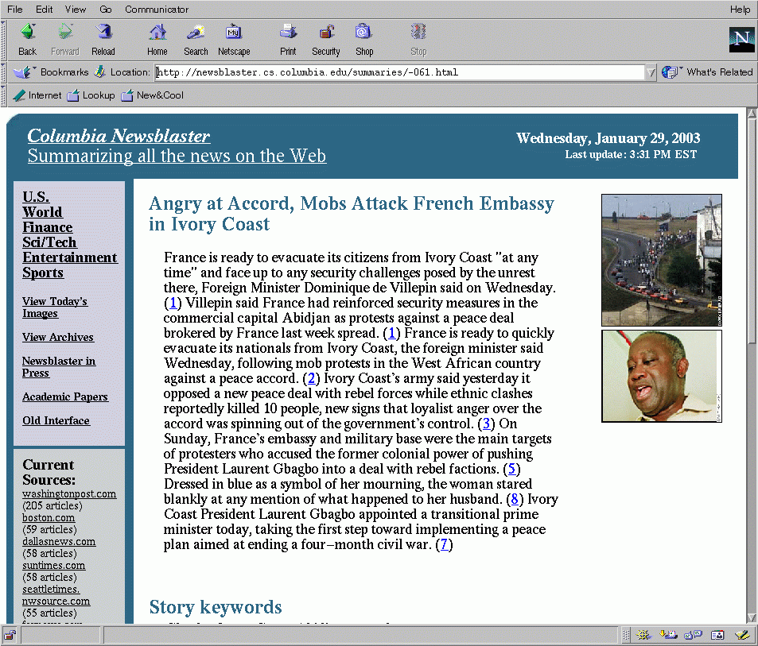
Newsblaster
  http://newsblaster.cs.columbia.edu/
Clustering articles into events
Categorization by broad topic
Multi-document summarization
Generation of summary sentences
    Fusion
    Editing of references

Slide 34
Newsblaster
Architecture
Crawl News Sites
Form Clusters
Categorize
Title
Clusters
Summary
Router
Select
Images
Event
Summary
Biography
Summary
Multi-
Event
Convert Output to HTML

Slide 35
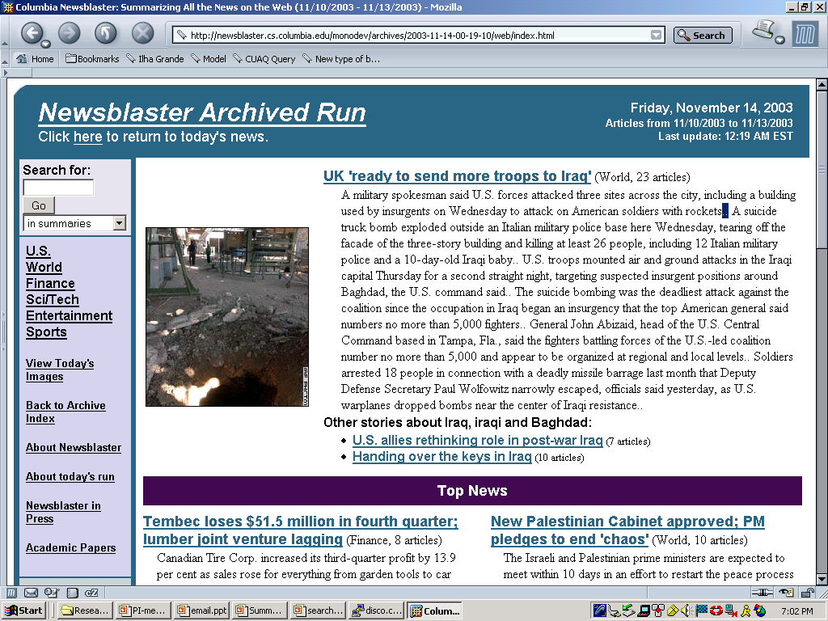

Slide 36
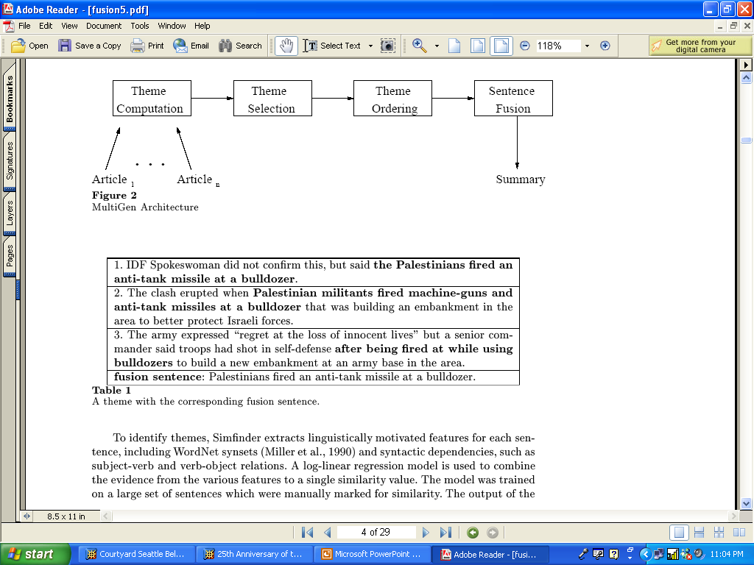
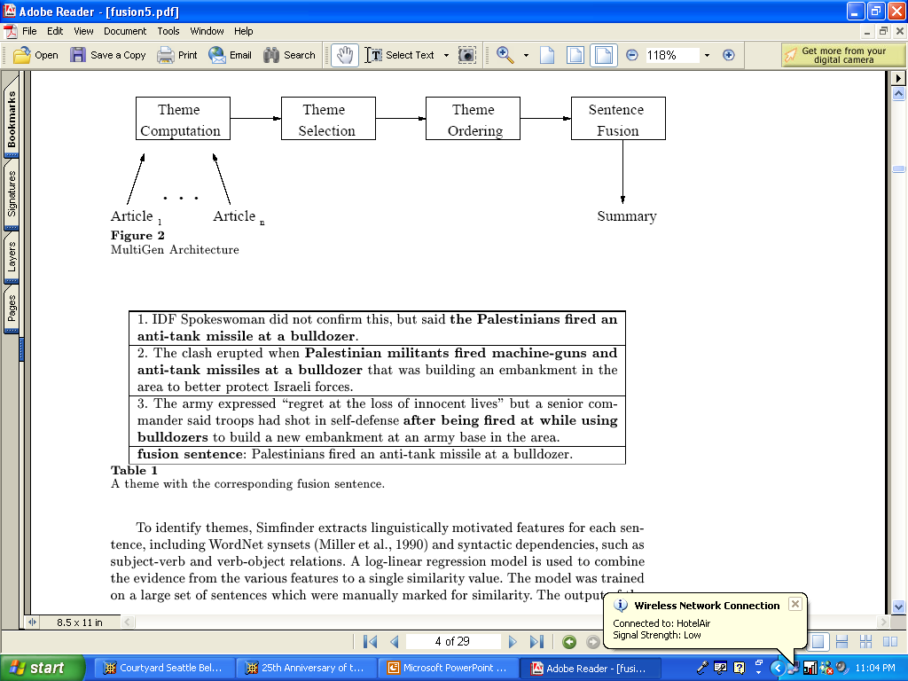
Fusion

Slide 37
Theme Computation
Input: A set of related documents
Output: Sets of sentences that “mean” the same thing
Algorithm
    Compute similarity across sentences using the Cosine Metric
    Can compare word overlap or phrase overlap
    (PLACEHOLDER: IR vector space model)

Slide 38
Sentence Fusion Computation
Common information identification
    Alignment of constituents in parsed theme sentences: only some subtrees match
    Bottom-up local multi-sequence alignment
    Similarity depends on
        Word/paraphrase similarity
        Tree structure similarity
Fusion lattice computation
    Choose a basis sentence
    Add subtrees from fusion not present in basis
    Add alternative verbalizations
    Remove subtrees from basis not present in fusion
Lattice linearization
    Generate all possible sentences from the fusion lattice
    Score sentences using statistical language model

Slide 39
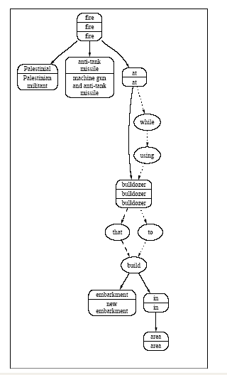

Slide 40
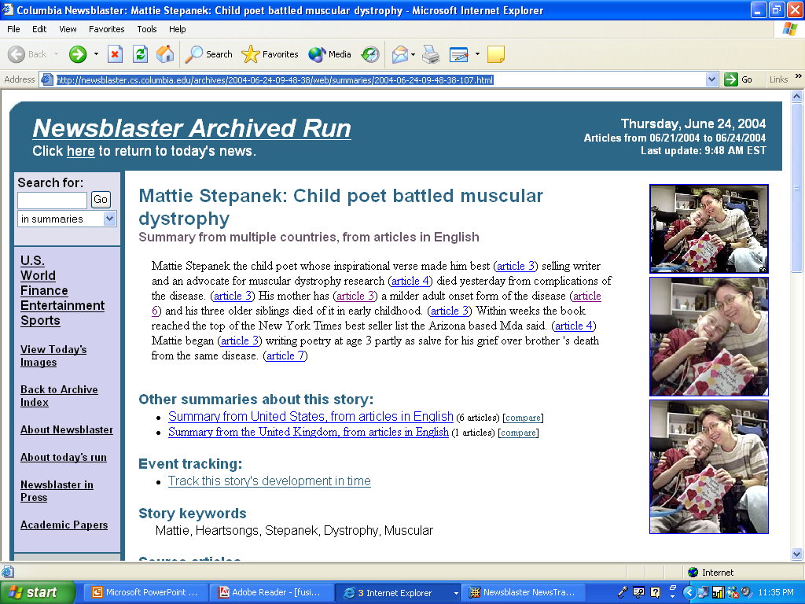

Slide 41
Tracking Across Days
Users want to follow a story across time and watch it unfold
Network model for connecting clusters across days
    Separately cluster events from today’s news
    Connect new clusters with yesterday’s news
    Allows for forking and merging of stories
Interface for viewing connections
Summaries that update a user on what’s new
    Statistical metrics to identify differences between article pairs
    Uses learned model of features
    Identifies differences at clause and paragraph levels

Slide 43
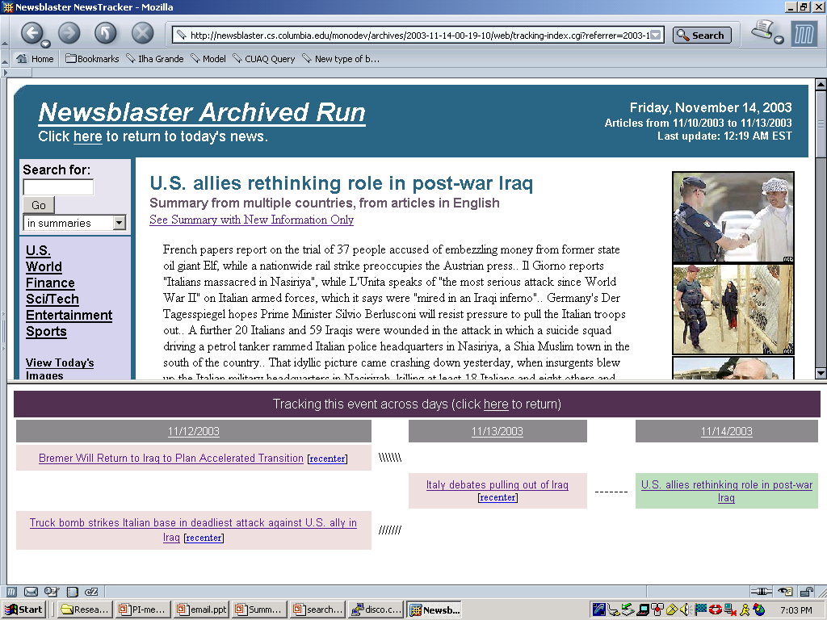

Slide 44
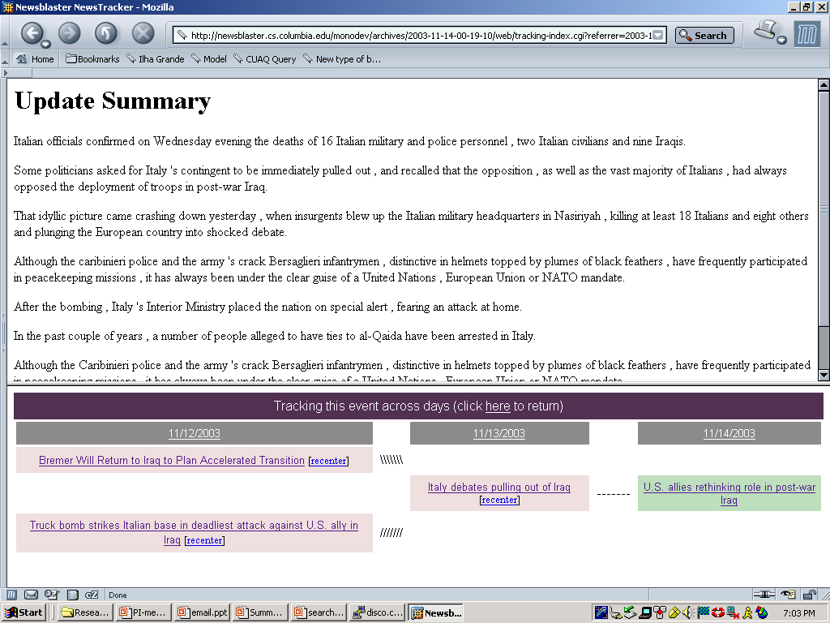

Slide 45
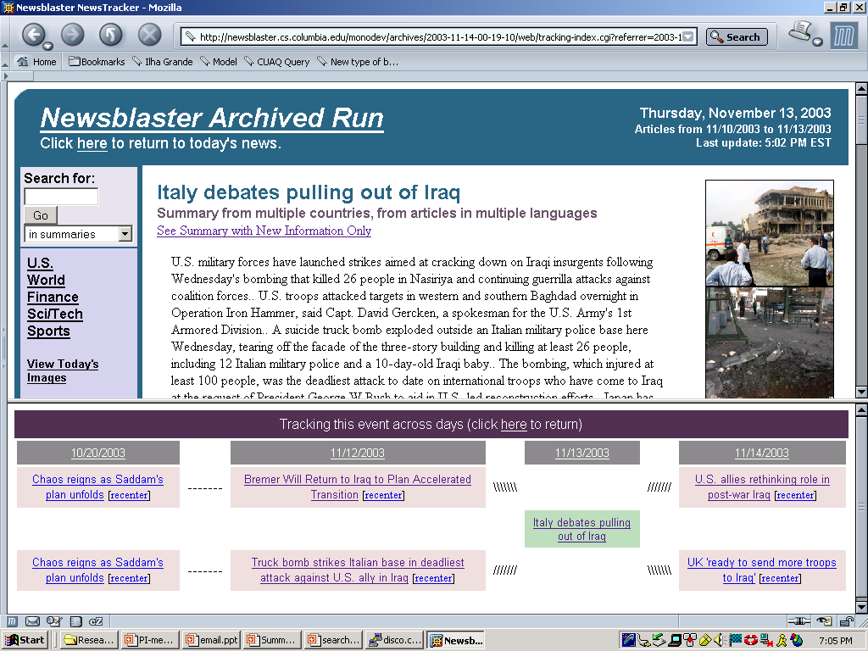

Slide 46
Different Perspectives
Hierarchical clustering
    Each event cluster is divided into clusters by country
Different perspectives can be viewed side by side
Experimenting with update summarizer to identify key differences between sets of stories

Slide 47
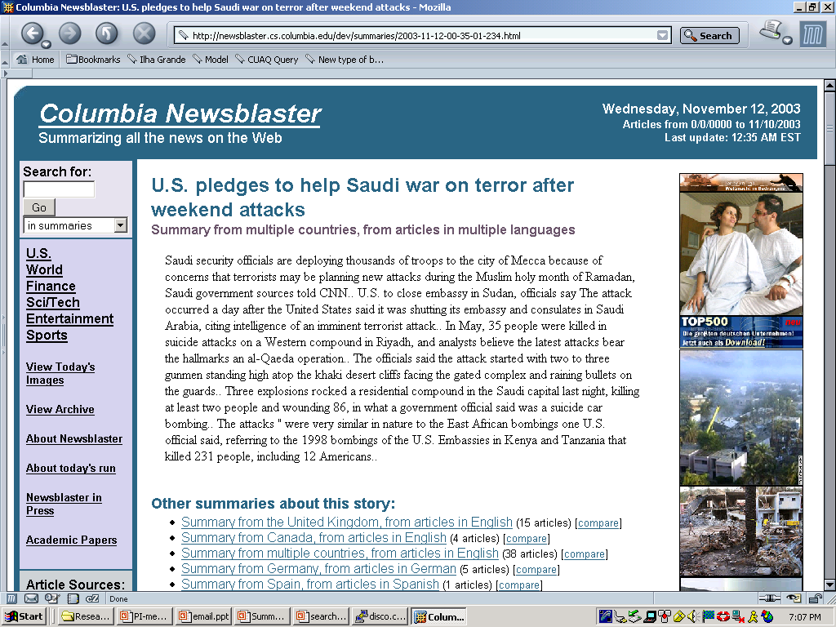

Slide 48
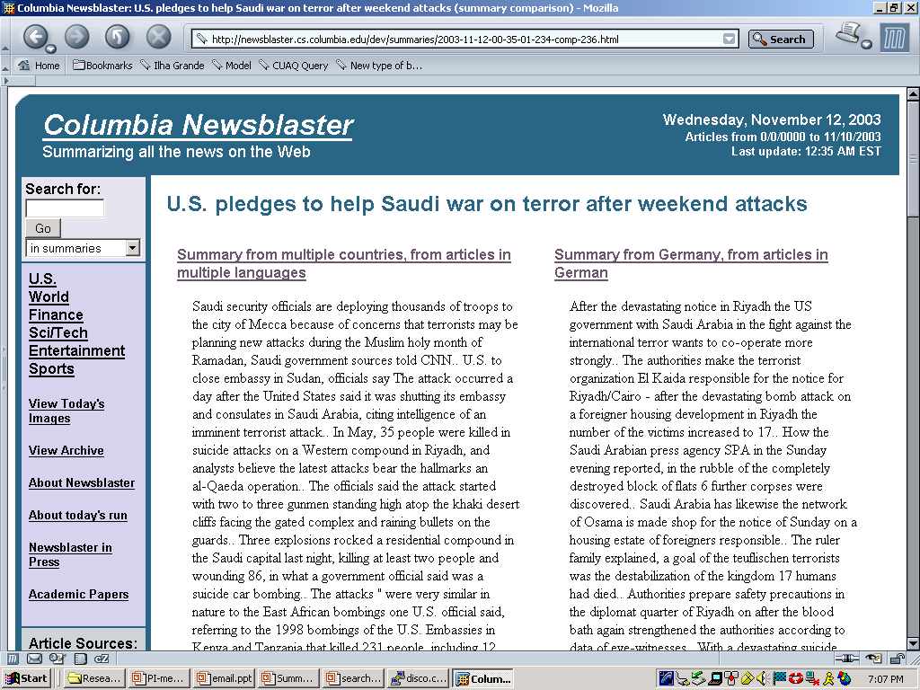

Slide 49
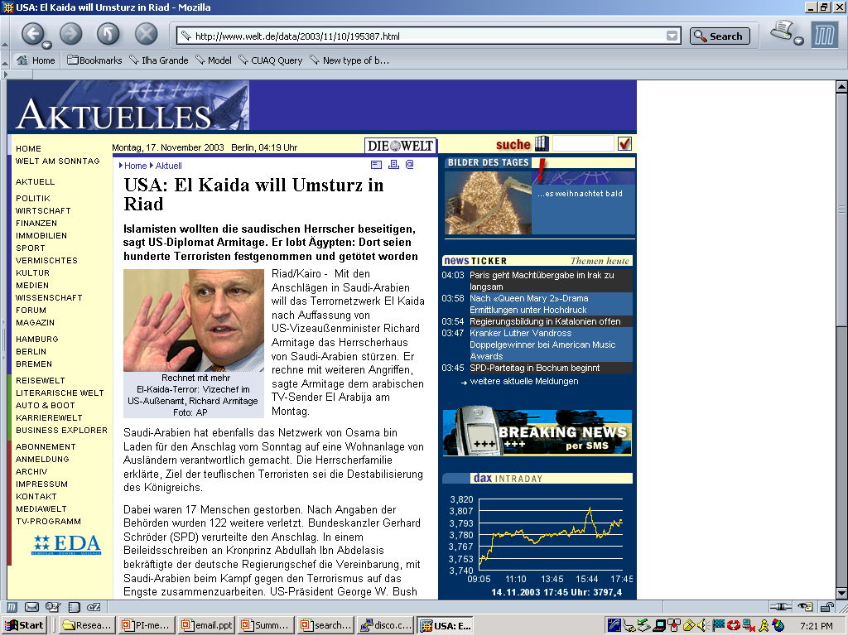

Slide 50
Multilingual Summarization
Given a set of documents on the same event
Some documents are in English
Some documents are translated from other languages

Slide 51
Issues for Multilingual Summarization
Problem: Translated text is errorful
Exploit information available during summarization
    Similar documents in cluster
Replace translated sentences with similar English
Edit translated text
    Replace named entities with extractions from similar English

Slide 52
Multilingual Redundancy
BAGDAD. - A total of 21 prisoners has been died and a hundred more hurt by firings from mortar in the jail of Abu Gharib (to 20 kilometers to the west of Bagdad), according to has informed general into the U.S.A. Marco Kimmitt.
Spanish
Bagdad in the Iraqi capital Aufstaendi attacked Bagdad on Tuesday a prison with mortars and killed after USA gifts 22 prisoners. Further 92 passengers of the Abu Ghraib prison were hurt, communicated a spokeswoman of the American armed forces.
German
The Iraqi being stationed US military shot on the 20th, the same day to the allied forces detention facility which is in アブグレイブ of the Baghdad west approximately 20 kilometers, mortar 12 shot and you were packed, 22 Iraqi human prisoners died, it announced that nearly 100 people were injured.
Japanese
BAGHDAD, Iraq – Insurgents fired 12 mortars into Baghdad's Abu Ghraib prison Tuesday, killing 22 detainees and injuring 92, U.S. military officials said.
English

Slide 53
Multilingual Redundancy
BAGDAD. - A total of 21 prisoners has been died and a hundred more hurt by firings from mortar in the jail of Abu Gharib (to 20 kilometers to the west of Bagdad), according to has informed general into the U.S.A. Marco Kimmitt.
Spanish
Bagdad in the Iraqi capital Aufstaendi attacked Bagdad on Tuesday a prison with mortars and killed after USA gifts 22 prisoners. Further 92 passengers of the Abu Ghraib prison were hurt, communicated a spokeswoman of the American armed forces.
German
The Iraqi being stationed US military shot on the 20th, the same day to the allied forces detention facility which is in アブグレイブ of the Baghdad west approximately 20 kilometers, mortar 12 shot and you were packed, 22 Iraqi human prisoners died, it announced that nearly 100 people were injured.
Japanese
BAGHDAD, Iraq – Insurgents fired 12 mortars into Baghdad's Abu Ghraib prison Tuesday, killing 22 detainees and injuring 92, U.S. military officials said.
English

Slide 54


Multilingual Similarity-based Summarization
Arabic
Text
Japanese
Text
Select summary sentences
ستجواب
القلاف
日本語
テキ
スト
Machine
Translation
German
Text
Deutscher
Text
Documents on the same
Event
Simplify English Sentences
Replace / rewrite MT sentences
English
Text
Detect
Similar
Sentences
English
Text
English
Text
English
Summary
Related English Documents

Slide 55
Sentence 1
  Iraqi President Saddam Hussein that the government of Iraq over 24 years in a "black" near the port of the northern Iraq after nearly eight months of pursuit was considered the largest in history .
  Similarity 0.27: Ousted Iraqi President Saddam Hussein is in custody following his dramatic capture by US forces in Iraq.
  Similarity 0.07: Saddam Hussein, the former president of Iraq, has been captured and is being held by US forces in the country.
  Similarity 0.04: Coalition authorities have said that the former Iraqi president could be tried at a war crimes tribunal, with Iraqi judges presiding and international legal experts acting as advisers.
Notes:
Importance of a good similarity measure!!

Slide 56
Sentence Simplification
Machine translated sentences long and ungrammatical
Use sentence simplification on English sentences to reduce to approximately “one fact” per sentence
Use Arabic sentences to find most similar simple sentences
Present multiple high similarity sentences

Slide 57
Simplification Examples
'Operation Red Dawn', which led to the capture of Saddam Hussein, followed crucial information from a member of a family close to the former Iraqi leader.
  ' Operation Red Dawn' followed crucial information from a member of a family close to the former Iraqi leader.
  Operation Red Dawn led to the capture of Saddam Hussein.
Saddam Hussein had been the object of intensive searches by US-led forces in Iraq but previous attempts to locate him had proved unsuccessful.
  Saddam Hussein had been the object of intensive searches by US-led forces in Iraq.
  But previous attempts to locate him had proved unsuccessful.

Slide 58
Rewrite proper and common nouns to remove MT errors
(Siddharthan and McKeown 05)
Use redundancy in input to summarization and multiple translations to build attribute value matrices (AVMs)
    Record country, role, description for all people
    Record name variants
Use generation grammar with semantic categories (role, organization, location) to re-order phrases for fluent output

Slide 59
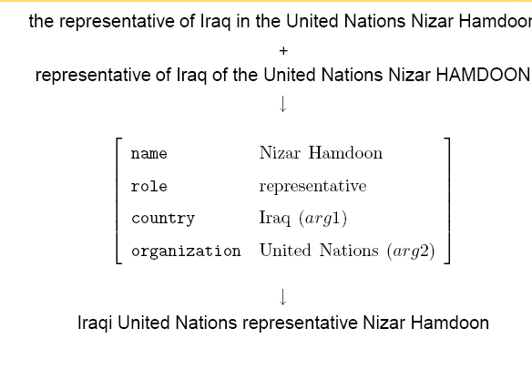

Slide 60
Evaluation
DUC (Document Understanding Conference): run by NIST yearly
Manual creation of topics (sets of documents)
2-7 human written summaries per topic
How well does a system generated summary cover the information in a human summary?
Metrics
  Rouge
  Pyramid

Slide 61
Rouge
ROUGE version 1.2.1:
  Publicly available at: http://www.isi.edu/~cyl/ROUGE
  Version 1.2.1 includes:
    ROUGE-N - n-gram-based co-occurrence statistics
    ROUGE-L - longest common subsequence-based (LCS) co-occurrence statistics
    ROUGE-W - LCS-based co-occurrence statistics favoring consecutive LCSes
Measures recall
    Rouge-1: How many unigrams in the human summary did the system summary find?
    Rouge-2: How many bigrams?

Slide 62
Pyramids
Uses multiple human summaries
    Previous data indicated 5 needed for score stability
Information is ranked by its importance
Allows for multiple good summaries
A pyramid is created from the human summaries
    Elements of the pyramid are content units
    System summaries are scored by comparison with the pyramid

Slide 63
Summarization Content Units
Near-paraphrases from different human summaries
Clause or less
Avoids explicit semantic representation
Emerges from analysis of human summaries

Slide 64
SCU: A cable car caught fire (Weight = 4)
A. The cause of the fire was unknown.
B. A cable car caught fire just after entering a mountainside tunnel in an alpine resort in Kaprun, Austria on the morning of November 11, 2000.
C. A cable car pulling skiers and snowboarders to the Kitzsteinhorn resort, located 60 miles south of Salzburg in the Austrian Alps, caught fire inside a mountain tunnel, killing approximately 170 people.
D. On November 10, 2000, a cable car filled to capacity caught on fire, trapping 180 passengers inside the Kitzsteinhorn mountain, located in the town of Kaprun, 50 miles south of Salzburg in the central Austrian Alps.

Slide 65
SCU: The cause of the fire is unknown (Weight = 1)
A. The cause of the fire was unknown.
B. A cable car caught fire just after entering a mountainside tunnel in an alpine resort in Kaprun, Austria on the morning of November 11, 2000.
C. A cable car pulling skiers and snowboarders to the Kitzsteinhorn resort, located 60 miles south of Salzburg in the Austrian Alps, caught fire inside a mountain tunnel, killing approximately 170 people.
D. On November 10, 2000, a cable car filled to capacity caught on fire, trapping 180 passengers inside the Kitzsteinhorn mountain, located in the town of Kaprun, 50 miles south of Salzburg in the central Austrian Alps.

Slide 66
SCU: The accident happened in the Austrian Alps (Weight = 3)
A. The cause of the fire was unknown.
B. A cable car caught fire just after entering a mountainside tunnel in an alpine resort in Kaprun, Austria on the morning of November 11, 2000.
C. A cable car pulling skiers and snowboarders to the Kitzsteinhorn resort, located 60 miles south of Salzburg in the Austrian Alps, caught fire inside a mountain tunnel, killing approximately 170 people.
D. On November 10, 2000, a cable car filled to capacity caught on fire, trapping 180 passengers inside the Kitzsteinhorn mountain, located in the town of Kaprun, 50 miles south of Salzburg in the central Austrian Alps.

Slide 67
Idealized representation
Tiers of differentially weighted SCUs
Top: few SCUs, high weight
Bottom: many SCUs, low weight
W=3
W=2
W=1

Slide 68
Pyramid Score
SCORE = D/MAX
D: Sum of the weights of the SCUs in a summary
MAX: Sum of the weights of the SCUs in a ideally informative summary
Measures the proportion of good information in the summary: precision

Slide 69
User Study: Objectives
Does multi-document summarization help?
    Do summaries help the user find information needed to perform a report writing task?
    Do users use information from summaries in gathering their facts?
    Do summaries increase user satisfaction with the online news system?
    Do users create better quality reports with summaries?
    How do full multi-document summaries compare with minimal 1-sentence summaries such as Google News?

Slide 70
User Study: Design
Four parallel news systems
  Source documents only; no summaries
  Minimal single sentence summaries (Google News)
  Newsblaster summaries
  Human summaries
All groups write reports given four scenarios
  A task similar to analysts
  Can only use Newsblaster for research
  Time-restricted

Slide 71
User Study: Execution
4 scenarios
  4 event clusters each
  2 directly relevant, 2 peripherally relevant
  Average 10 documents/cluster
45 participants
  Balance between liberal arts, engineering
  138 reports
Exit survey
  Multiple-choice and open-ended questions
Usage tracking
  Each click logged, on or off-site

Slide 72
“Geneva” Prompt
The conflict between Israel and the Palestinians has been difficult for government negotiators to settle. Most recently, implementation of the “road map for peace”, a diplomatic effort sponsored by ……
    Who participated in the negotiations that produced the Geneva Accord?
    Apart from direct participants, who supported the Geneva Accord preparations and how?
    What has the response been to the Geneva Accord by the Palestinians?

Slide 73
Measuring Effectiveness
Score report content and compare across summary conditions
Compare user satisfaction per summary condition
Comparing where subjects took report content from

Slide 74
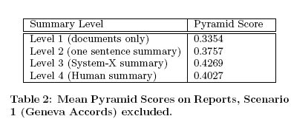

Slide 75
User Satisfaction
More effective than a web search with Newsblaster
    Not true with documents only or single-sentence summaries
Easier to complete the task with summaries than with documents only
Enough time with summaries than documents only
Summaries helped most
    5% single sentence summaries
    24% Newsblaster summaries
    43% human summaries

Slide 76
User Study: Conclusions
Summaries measurably improve a news browswer’s effectiveness for research
Users are more satisfied with Newsblaster summaries are better than single-sentence summaries like those of Google News
Users want search
  Not included in evaluation

Slide 77
Questions (from Sparck Jones)
Should we take the reader into account and how?
Need more power than text extraction and more flexibility than fact extraction (p. 4)
“Similarly, the notion of a basic summary, i.e., one reflective of the source, makes hidden fact assumptions, for example that the subject knowledge of the output’s readers will be on a par with that of the readers for whom the source was intended. (p. 5)”
Is the state of the art sufficiently mature to allow summarization from intermediate representations and still allow robust processing of domain independent material?
Evaluation: gold standard vs. user study? Difficulty of evaluation?

