Slide 1
WordsEye – An automatic text-to-scene conversion system
Bob Coyne
Columbia University
New York City
Email: coyne@cs.columbia.edu,
Notes:
9:45 start -> 10:07
1:32 -> 2:12
6:58 -> 7:20 slide 24
11:14 -> 11:35 slide 24 (stuck on mapping of third example) → 11:43

Slide 2
Outline
Introduction
Motivation
Project Overview/History/Examples
How it works
Linguistic analysis
Semantic interpretation
Depiction and graphics
New directions
Lexical Semantics and FrameNet
Other issues (ambiguity, 3D content, . . .)
Demo
Notes:
Introducing the idea of lexical frames in mtt

Slide 3
Why is it hard to create 3D graphics?

Slide 4
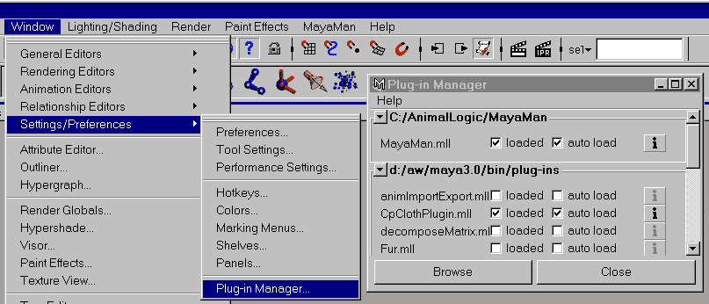
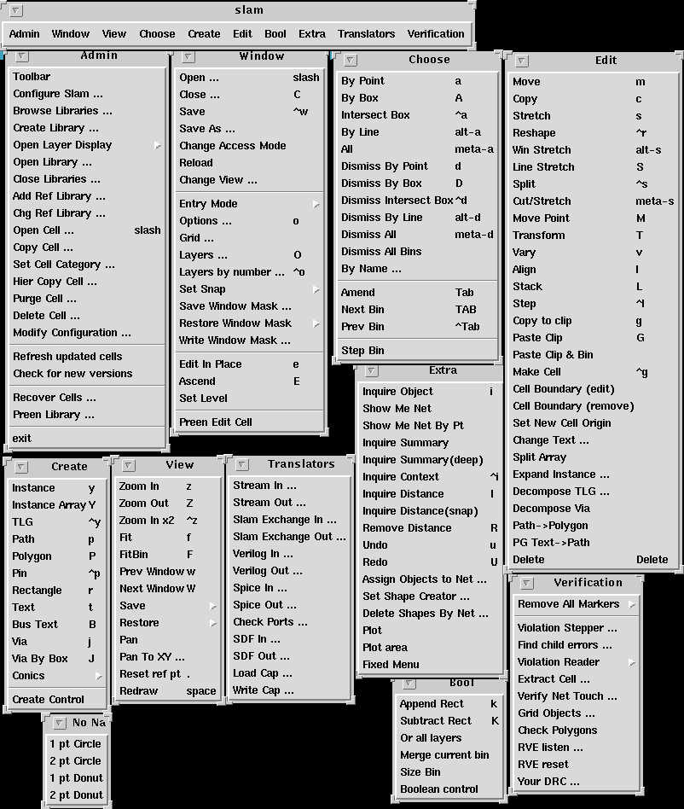
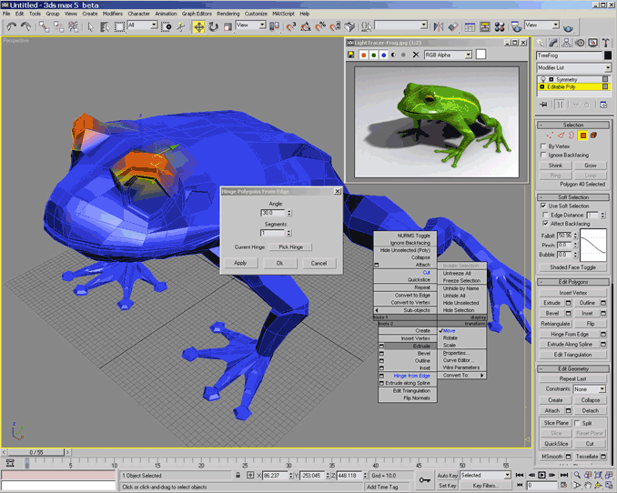
The tools are complex

Slide 5
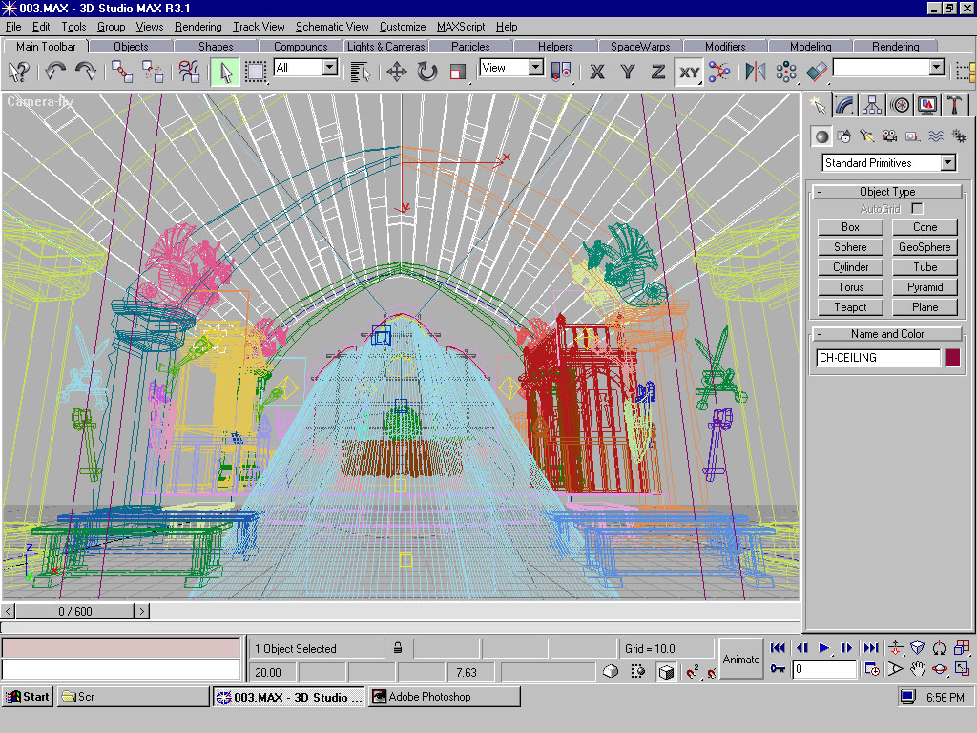
Too much detail

Slide 6
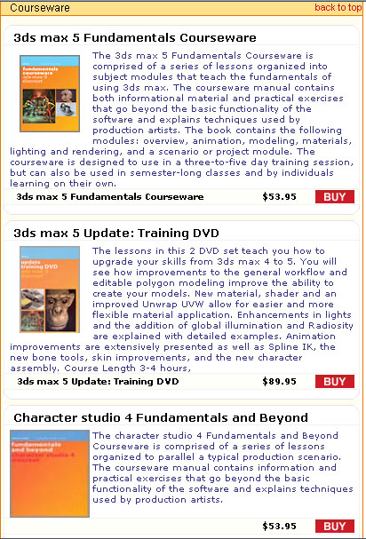
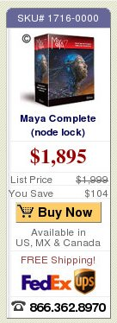
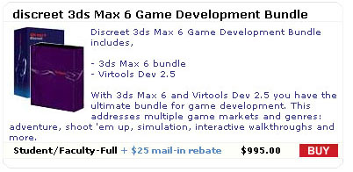
Involves training, artistic skill, and expense

Slide 7
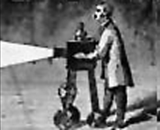
Why Pictures from Language?
No GUI bottlenecks - Just describe it!
Low entry barrier - no special skill or training required
Give up detailed direct manipulation for speed and economy of expression
Language expresses constraints
Bypass rigid, pre-defined paths of expression (dialogs, menus, etc) as defined by GUI
Objects vs Polygons – draw upon objects in pre-made 3D and 2D libraries
Enable novel applications in education, gaming, online communication, . . .
Using language is fun and stimulates imagination
A window into semantics
3D scenes provide an intuitive representation of meaning by making explicit the contextual elements implicit in our mental models.

Slide 8
WordsEye Initial Version (with Richard Sproat)
Developed at AT&T Research Labs
Church Tagger, Collins Parser on Linux
WordNet (http://wordnet.princeton.edu/)
Viewpoint 3D model library
Graphics: Mirai 3D animation system on Windows NT
NLP (linux) and depiction/graphics (Linux) communicate via sockets
WordsEye code in Common Lisp
Siggraph paper (August 2001)
http://www1.cs.columbia.edu/~coyne/images/wordseye_siggraph.pdf

Slide 9
Web Version (with Richard Sproat)
Rewrote software from scratch
Runs on Linux in CMUCL
Custom Parser/Tagger
OpenGL for 3D preview display
Radiance Renderer
ImageMagic, Gimp for 2D post-effects
Different subset of functionality
Minimal verbs/poses
Web interface (www.wordseye.com)
Webserver and multiple backend text-to-scene servers
Gallery/Forum/E-Cards/PIctureBooks/2D effects
Several thousand users have tried it

Slide 10
New Version (with Richard Sproat, Owen Rambow, Julia Hirschberg, …)
Started 7/2009
Build on top of web version
Goals
Verb semantics (FrameNet, etc) and lexical functions to handle wider range of language
Use Contextual knowledge
Depict environments, actions/poses, facial expressions
Test in middle-school afterschool program in Harlem

Slide 11
Related Work
Adorni, Di Manzo, Giunchiglia, 1984
Put: Clay and Wilhelms, 1996
PAR: Badler et al., 2000
CarSim: Dupuy et al., 2000
SHRDLU: Winograd, 1972
Automatic Animated Storyboarding : Ye, Baldwin, 2008
Inferring the Environment in a text-to-scene conversion system: Sproat, 2002
Notes:
11

Slide 12
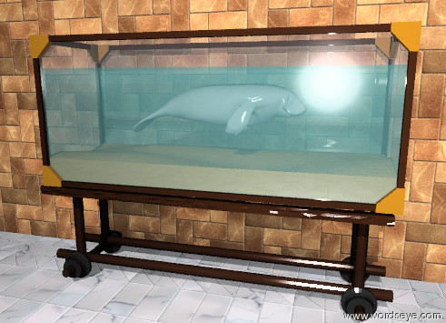
A tiny grey manatee is in the aquarium. It is facing right. The manatee is six inches below the top of the aquarium. The ground is tile. There is a large brick wall behind the aquarium.
Example

Slide 13
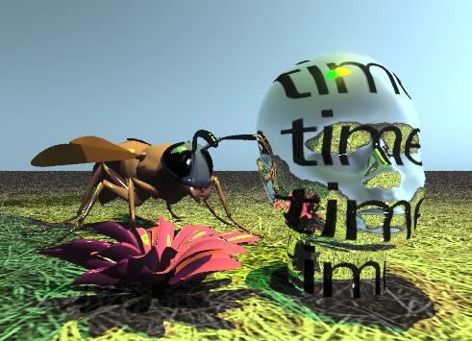
A silver head of time is on the grassy ground. The blossom is next to the head. the blossom is in the ground. the green light is three feet above the blossom. the yellow light is 3 feet above the head. The large wasp is behind the blossom. the wasp is facing the head.
Example

Slide 14
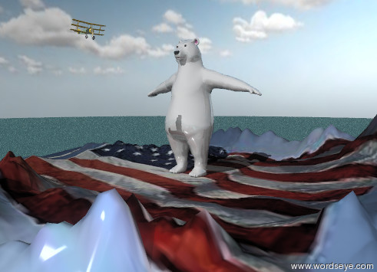
The humongous white shiny bear is on the American mountain range. The mountain range is 100 feet tall. The ground is water. The sky is partly cloudy. The airplane is 90 feet in front of the nose of the bear. The airplane is facing right.
Example

Slide 15
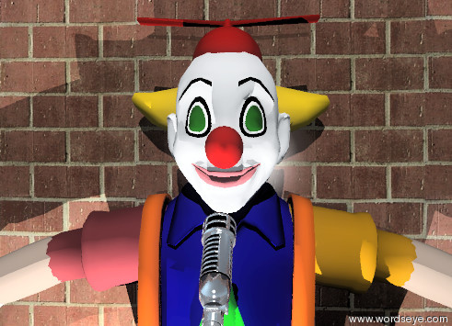
A microphone is in front of a clown. The microphone is three feet above the ground. The microphone is facing the clown. A brick wall is behind the clown. The light is on the ground and in front of the clown.
Example

Slide 16
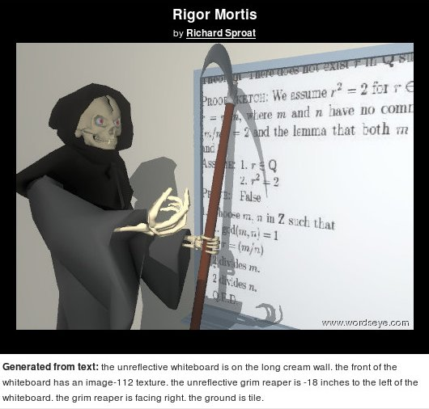
Example
Using user-uploaded
image

Slide 17
Outline
Introduction
Motivation
Project Overview/History/Examples
How it works
Linguistic analysis
Semantic interpretation
Depiction and graphics
New directions
Lexical Semantics and FrameNet
Other issues (ambiguity, 3D, . . .)
Demo
Notes:
Introducing the idea of lexical frames in mtt

Slide 18
Linguistic Analysis
Tag part-of-speech
Parse
Generate semantic representation
Dependency tree
WordNet-like dictionary for nouns
Anaphora resolution
Notes:
18

Slide 19
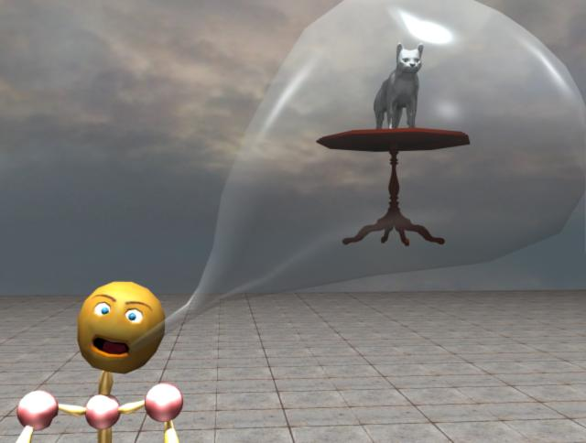
John said that the cat is on the table.

Slide 20
Parse tree for: John said that the cat was on the table.
Said (Verb)
John (Noun)
That (Comp)
Was (Verb)
Cat (Noun)
On (Prep)
Table (Noun)

Slide 21
Nouns: Hierarchical Dictionary
Physical Object
Living thing
Inanimate Object
Animal
Plant
Cat
Dog
. . .
cat-vp2842
dog-vp23283
cat-vp2843
dog_standing-vp5041

Slide 22
WordNet problems
Lack of multiple inheritance between synsets
“Princess” is an aristocrat, but not a female
"ceramic-ware" is grouped under "utensil" and has "earthenware", etc under it. But there are no dishes, plates, under it because those are categorized elsewhere under "tableware"
Inheritance conflates functional and lexical relations
“Terrace” is a “plateau”
“Spoon’ is a “container”
“Bellybutton” is a “point”
Lacks relations other than IS-A. Thesaurus vs dictionary.
Snowball “made-of” snow
Italian “resident-of” Italy
Synsets make no distincton between truly different word senses and mere polysemy
Cluttered with obscure words and word senses
“Spoon” as a type of golf club
Create our own dictionary to address these problems

Slide 23
Semantic Representation for: John said that the blue cat was on the table.
1. Object: “mr-happy” (John)
2. Object: “cat-vp39798” (cat)
3. Object: “table-vp6204” (table)
4. Action: “say”
:subject <element 1>
:direct-object <elements 6>
5. Attribute: “blue”
:object <element 2>
6. Spatial-Relation “on”
:figure <element 2>
:ground <element 3>

Slide 24
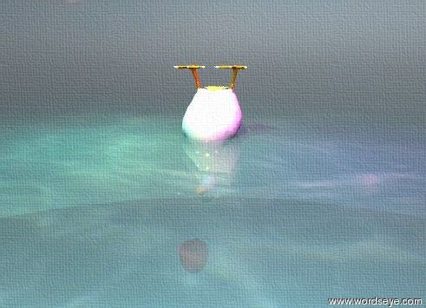
Anaphora resolution: The duck is in the sea. It is upside down. The sea is shiny and transparent. The apple is 3 inches below the duck. It is in front of the duck. It is partly cloudy.

Slide 25
Implicit objects & references
Mary rode by the store. Her motorcycle was red.
Verb resolution: Identify implicit vehicle
Functional properties of objects
Reference
Motorcycle matches the vehicle
Her matches with Mary
Notes:
25

Slide 26
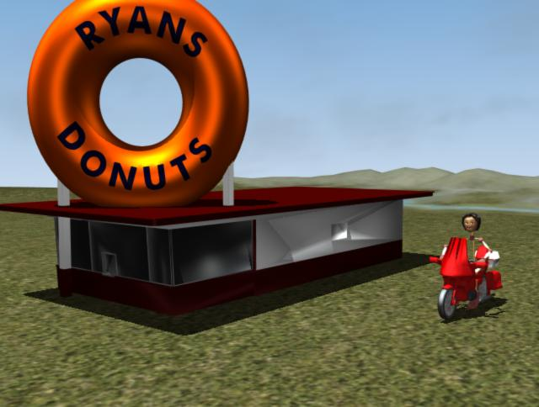
Implicit Reference: Mary rode by the store. Her motorcycle was red.

Slide 27
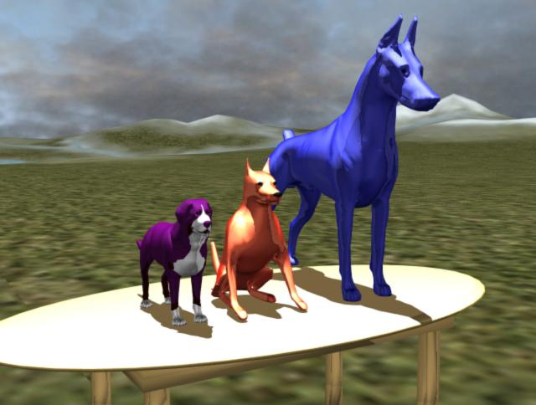
Indexical Reference: Three dogs are on the table. The first dog is blue. The first dog is 5 feet tall. The second dog is red. The third dog is purple.

Slide 28
Interpretation
Interpret semantic representation
Object selection
Resolve semantic relations/properties based on object types
Answer Who? What? When? Where? How?
Disambiguate/normalize relations and actions
Identify and resolve references to implicit objects

Slide 29
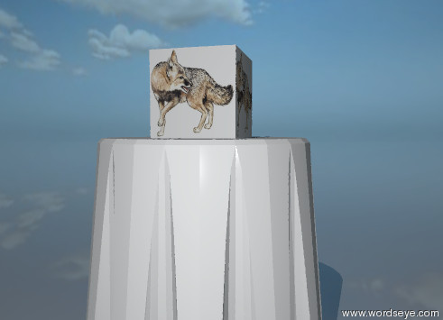
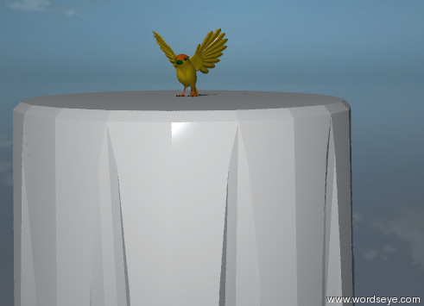
Object Selection: When object is missing or doesn't exist . . .
Text object: “Foo on table”
Substitute image: “Fox on table”
Related object: “Robin on table”

Slide 30
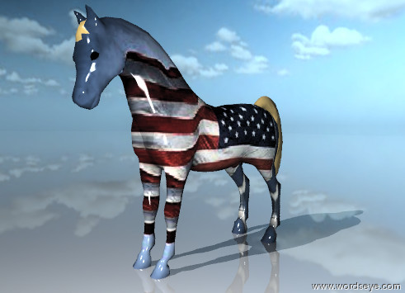
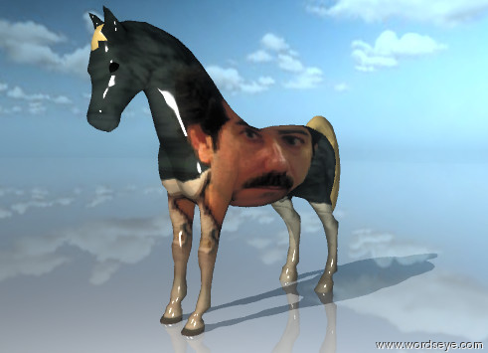
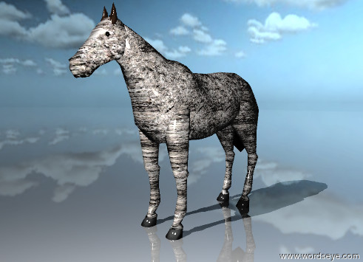
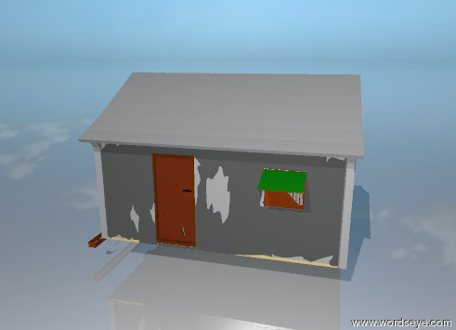
Object attribute interpretation (modify versus selection)
Conventional: “American horse”
Unconventional: “Richard Sproat horse”
Substance: “Stone horse”
Selection: “Chinese house”

Slide 31
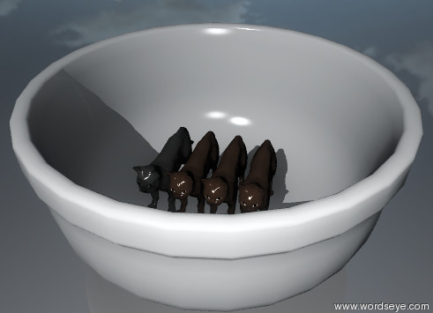
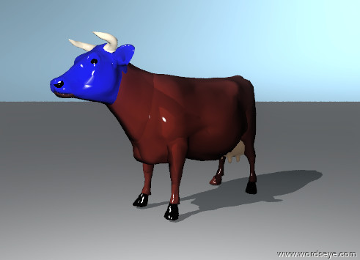
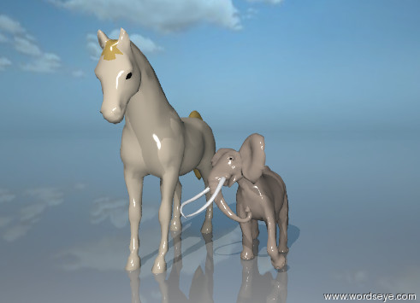
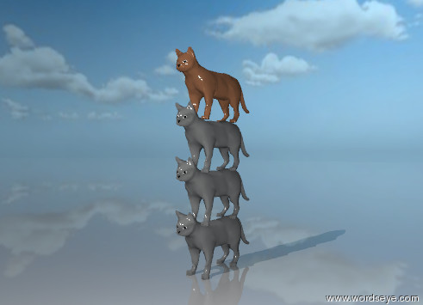
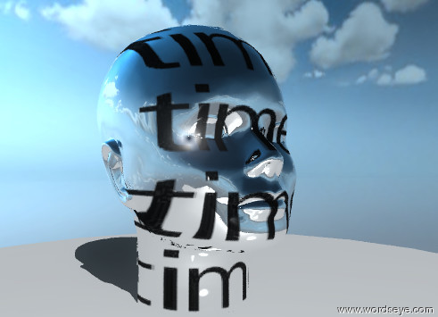
Semantic Interpretation of “Of”
Containment: “bowl of cats”
Part: “head of the cow”
Property: “height of horse is..”
Grouping: “stack of cats”
Substance: “horse of stone”
Abstraction: “head of time”

Slide 32
Depiction
3D object and image database
Graphical constraints
Spatial relations
Attributes
Posing
Shape/Topology changes
Depiction process

Slide 33
2000+ 3D Objects

Slide 34
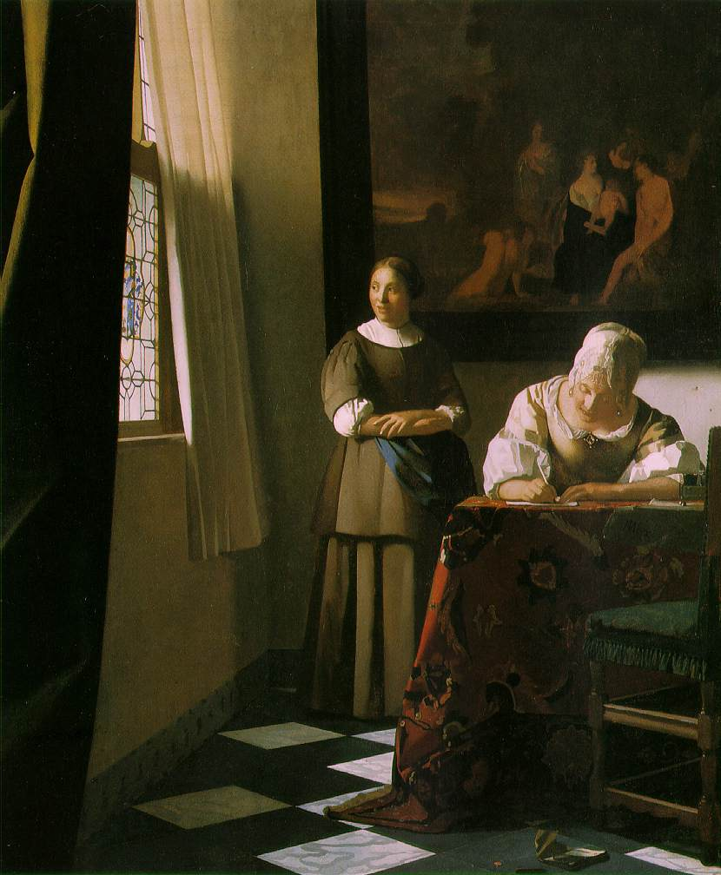
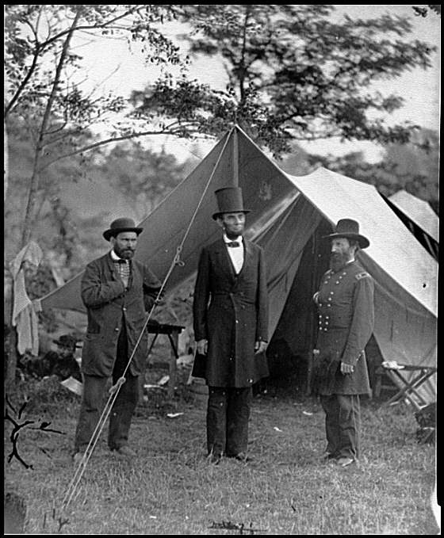
10,000 images and textures
B&W drawings Texture Maps Artwork Photographs

Slide 35
Semantics on Objects
What do we need to know in order to depict the sentences like: The cat is on the chair. The bird is in the cage. The picture is on the wall. The vase is on the shelf.

Slide 36
3D Object Database
2,000+ 3D polygonal objects
Augmented with:
Spatial tags (top surface, base, cup, push handle, wall, stem, enclosure)
Skeletons
Default size, orientation
Lexical category (car, elephant, table, . . .)
Placement/attribute conventions
Compound object constituents, style, subparts, etc.
10,000 images with semantic annotations

Slide 37
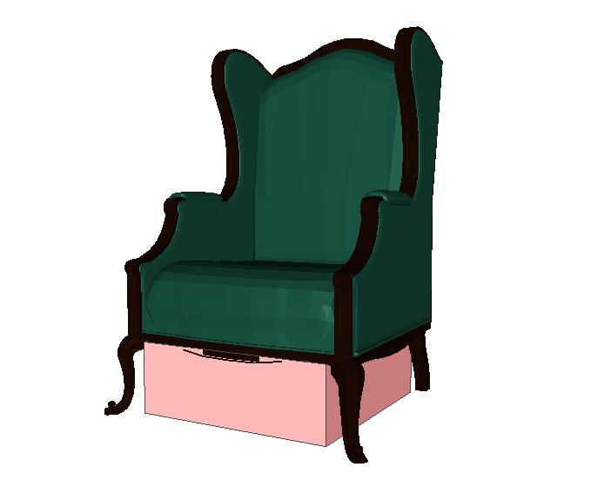
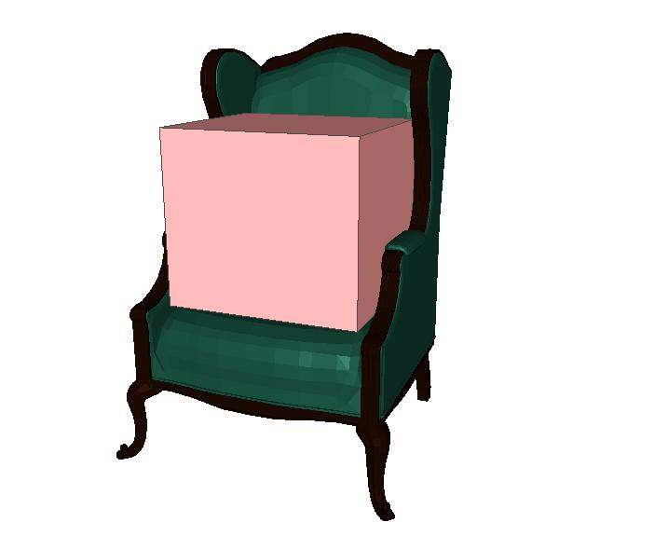
Spatial Tags
Canopy (under, beneath)
Top Surface (on, in)

Slide 38
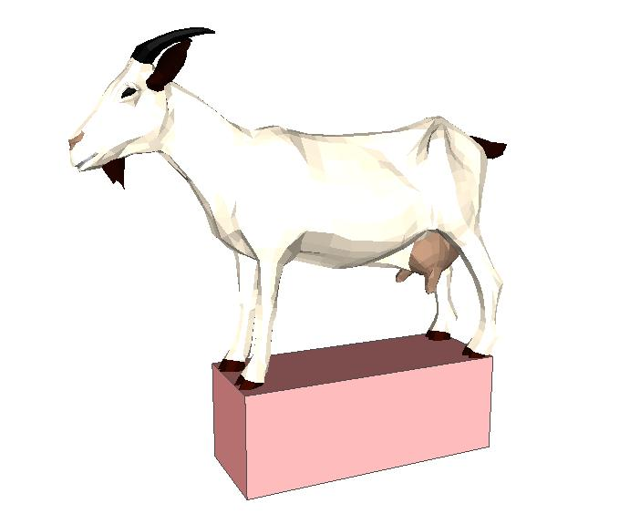
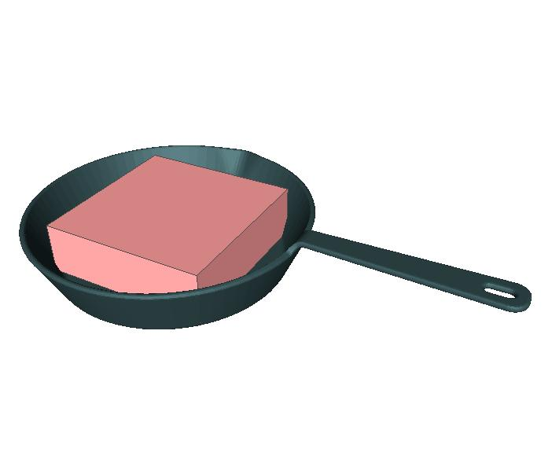
Spatial Tags
Base (under, below, on)
Cup (in, on)

Slide 39
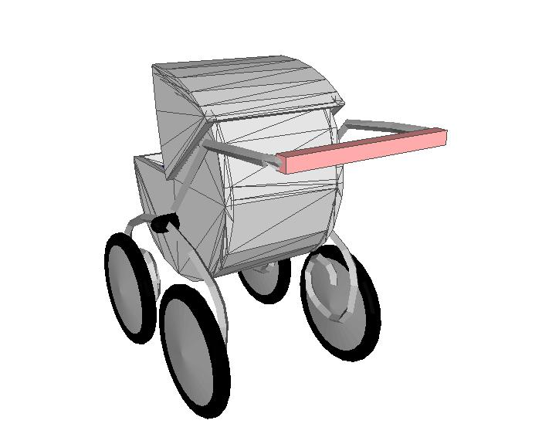
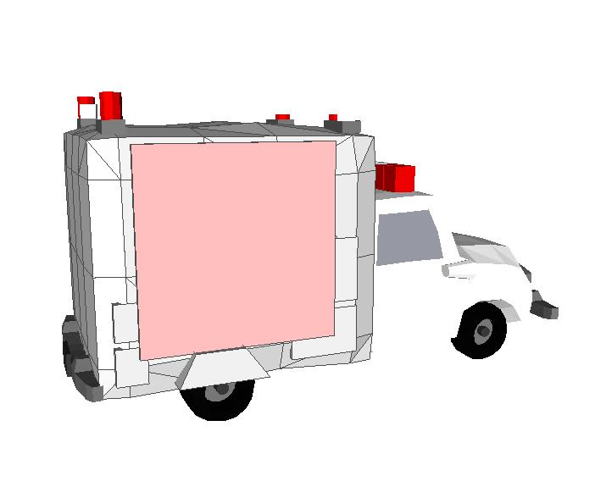
Spatial Tags
Push Handle (actions)
Wall (on, against)

Slide 40
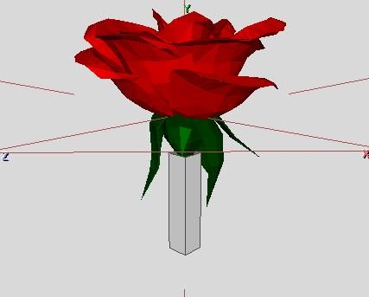
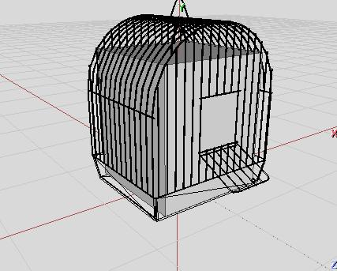
Spatial Tags
Stem (in)
Enclosure (in)

Slide 41
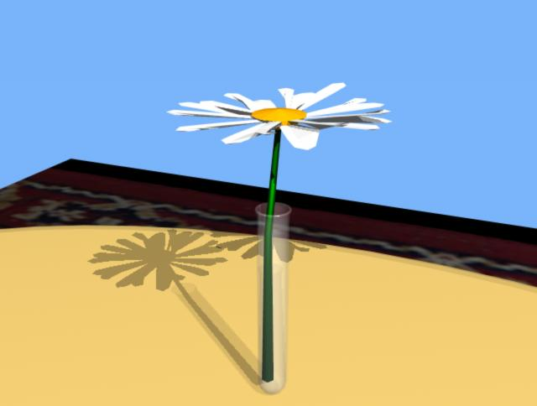
Using stem and cup tags: The daisy is in the test tube.

Slide 42
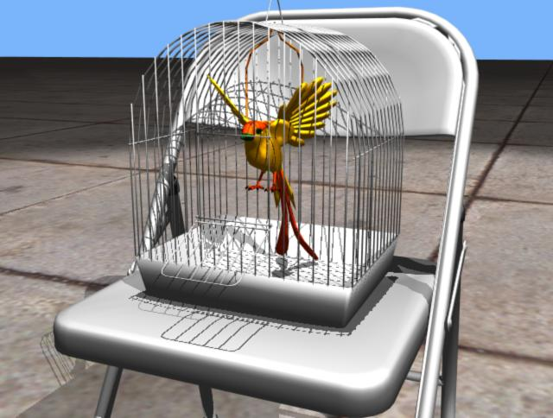
Using enclosure and top surface tags: The bird is in the bird cage. The bird cage is on the chair.

Slide 43
Spatial Relations
Relative positions
On, under, in, below, off, onto, over, above . . .
Distance
Sub-region positioning
Left, middle, corner,right, center, top, front, back
Orientation
facing (object, left, right, front, back, east, west . . .)
Time-of-day relations

Slide 44
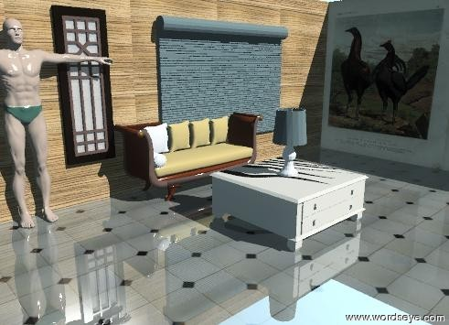
Vertical vs Horizontal “on”, distances, directions: The couch is against the wood wall. The window is on the wall. The window is next to the couch. the door is 2 feet to the right of the window. the man is next to the couch. The animal wall is to the right of the wood wall. The animal wall is in front of the wood wall. The animal wall is facing left. The walls are on the huge floor. The zebra skin coffee table is two feet in front of the couch. The lamp is on the table. The floor is shiny.

Slide 45
Attributes
Size
height, width, depth
Aspect ratio (flat, wide, thin . . .)
Surface attributes
Texture database
Color, texture, opacity, reflectivity
Applied to objects or textures themselves
Brightness (for lights)

Slide 46
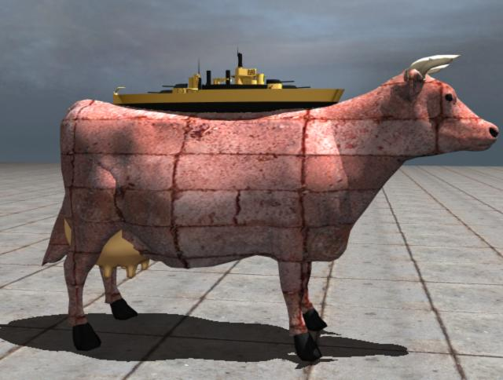
Attributes: The orange battleship is on the brick cow. The battleship is 3 feet long.

Slide 47
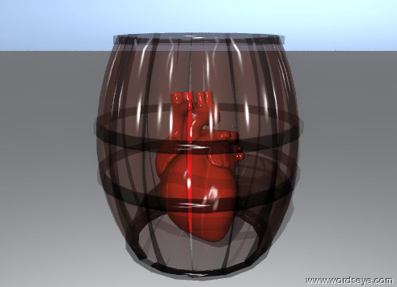
Transparency and color
The red heart is in the tiny transparent barrel.

Slide 48
Time of day & cloudiness

Slide 49
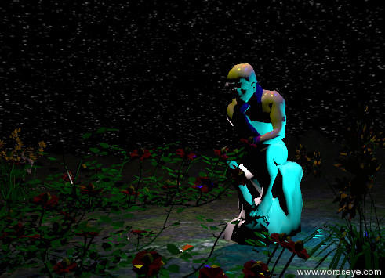
Time of day & lighting
The 7 enormous flowers are in front of the statue. It is midnight. The statue is 40 feet tall. The statue is on the mountain range. The 5 huge bushes are behind the mushroom. . . .

Slide 50
Poses (original version only -- not yet implemented in newer versions)
Represent actions
Database of 500+ human poses
Grips
Usage (specialized/generic)
Standalone
Merge poses (upper/lower body, hands)
Gives wide variety by mix’n’match
Dynamic posing/IK

Slide 51
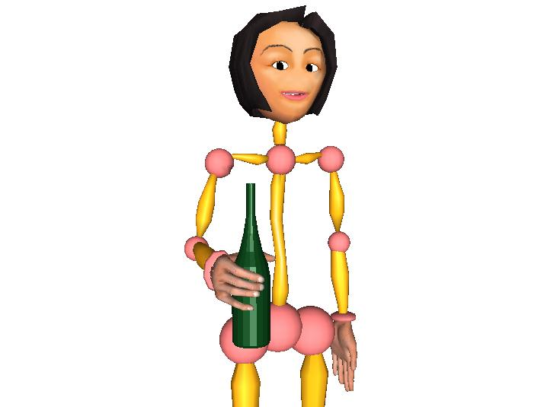
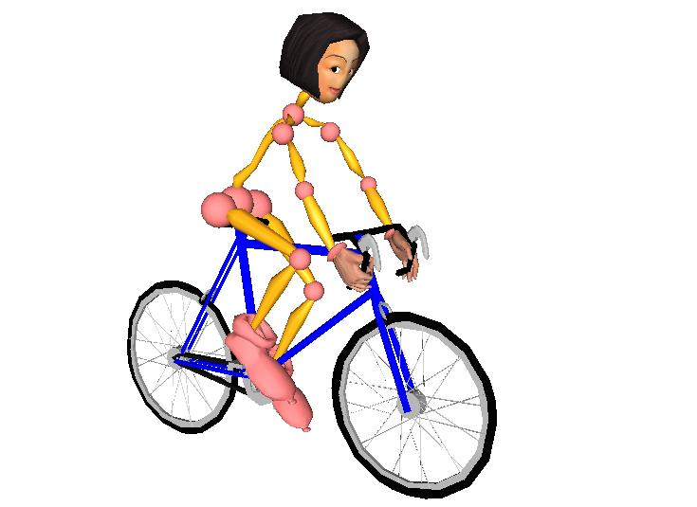
Poses
Grip wine_bottle-bc0014
Use bicycle_10-speed-vp8300
51

Slide 52
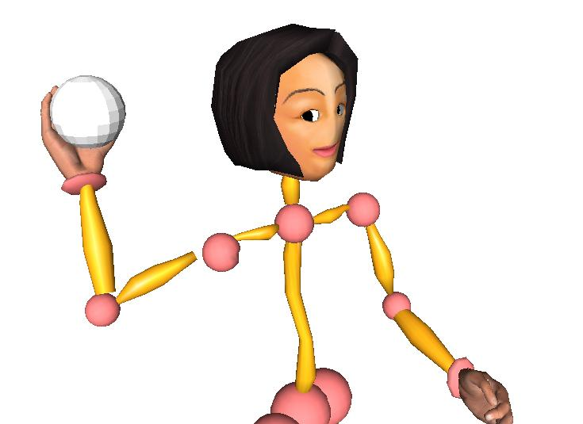
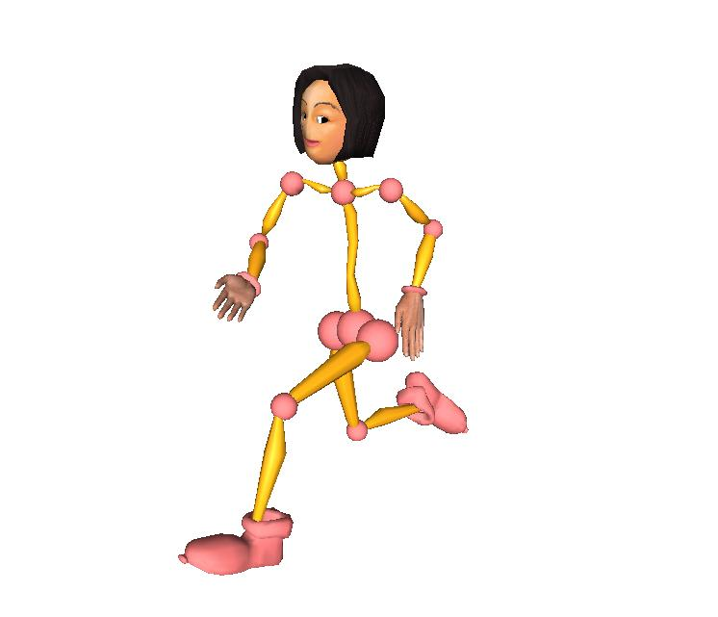
Poses
Throw “round object”
Run

Slide 53
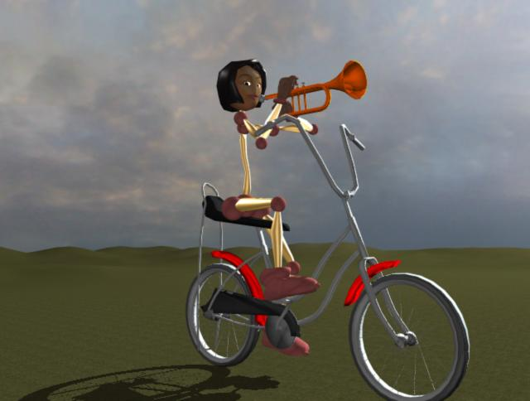
Combined poses
Mary rides the bicycle. She plays the trumpet.

Slide 54
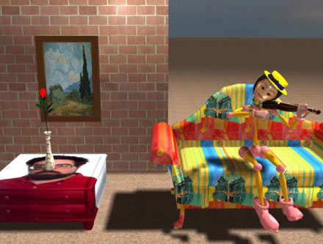
The Broadway Boogie Woogie vase is on the Richard Sproat coffee table. The table is in front of the brick wall. The van Gogh picture is on the wall. The Matisse sofa is next to the table. Mary is sitting on the sofa. She is playing the violin. She is wearing a straw hat.
Combined poses

Slide 55
Mary pushes the lawn mower. The lawnmower is 5 feet tall. The cat is 5 feet behind Mary. The cat is 10 feet tall.
Dynamically defined poses using Inverse Kinematics (IK)

Slide 56
Shape Changes (not implemented yet in newer versions)
Deformations
Facial expressions
Happy, angry, sad, confused . . . mixtures
Combined with poses
Topological changes
Slicing

Slide 57
Facial Expressions
Edward runs. He is happy.
Edward is shocked.

Slide 58
Topological Changes
The rose is in the vase. The vase is on the half dog.

Slide 59
Depiction Process
Given a semantic representation
Generate graphical constraints
Handle implicit and conflicting constraints.
Generate 3d scene from constraints
Add environment, lights, camera
Render scene

Slide 60
Example: cases of kick
Case1: John kicked the pickup truck
Case3: John kicked the ball to the cat on the skateboard
Case2:John kicked the football

Slide 61
Generate constraints for kick
Case1: No path or recipient; Direct object is large
Pose: Actor in kick pose
Position: Actor directly behind direct object
Orientation: Actor facing direct object
Case2: No path or recipient; Direct object is small
Pose: Actor in kick pose
Position: Direct object above foot
Case3: Path and Recipient
Pose+relations . . . (some tentative)

Slide 62
Implicit Constraint: objects must be on a surface.
Without constraint
With constraint
The vase is on the nightstand. The lamp is next to the vase.

Slide 63
Figurative & Metaphorical Depiction (not yet implemented in newer versions)
Textualization
Conventional Icons and emblems
Literalization
Characterization
Personification
Functionalization

Slide 64
Textualization: The cat is facing the wall.

Slide 65
Conventional Icons: The blue daisy is not in the army boot.

Slide 66
Literalization: Life is a bowl of cherries.

Slide 67
Characterization: The policeman ran by the parking meter

Slide 68
Functionalization: The hippo flies over the church

Slide 69
Outline
Introduction
Motivation
Project Overview/History/Examples
How it works
Linguistic analysis
Semantic interpretation
Depiction and graphics
New directions
Lexical Semantics and FrameNet
Other issues (ambiguity, 3D, . . .)
Demo
Notes:
Introducing the idea of lexical frames in mtt

Slide 70
FrameNet – Digital lexical resource http://framenet.icsi.berkeley.edu/
Frame
is a structured schematic representation of a situation, object, or event that provides the background and motivation for the existence and everyday use of words in a language. i.e. grouping of words with common semantics.
947 hierarchically defined frames with associated lexical units (LUs)
10,000 LUs (Verbs, nouns, adjectives)
Frame Elements (FEs): frame-based roles
E.g. COMMERCE_SELL
Core FEs (BUYER, GOODS, SELLER)
Peripheral FEs (TIME, LOCATION, MANNER, …)
Annotated sentences for each LU and corresponding valence patterns
Relations between frames (perspective-on, subframe, using, …)
Notes:
Frames have N,V,A but we’re only looking at verbs in this talk
Fes are what defines the frame
Fes for buy/sell similar
Relations between buy and sell. They’re not just independent! Instead they’re related by a frame relsion.

Slide 71
Lexical Units in REVENGE Frame
Lexical Unit | Annotated sentences
avenge.v | 32
avenger.n | 4
vengeance.a | 28
retaliate.v | 31
revenge.v | 8
revenge.n | 30
vengeful.a | 9
vindictive.a | 0
retribution.n | 15
retaliation.n | 29
revenger.n | 0
revengeful.a | 3
retributive.a | 0
get_even.v | 10
retributory.a | 0
get_back.v | 6
payback.n | 0
sanction.n | 0

Slide 72
Frame Elements for REVENGE Frame
Frame Element | Core Type
Avenger | Core
Degree | Peripheral
Depictive | Extra_thematic
Offender | Core
Instrument | Peripheral
Manner | Peripheral
Punishment | Core
Place | Core
Purpose | Peripheral
Injury | Core
Result | Extra_thematic
Time | Peripheral
Injured_party | Core
This frame concerns the infliction of punishment in return for a wrong suffered. An AVENGER performs a PUNISHMENT on a OFFENDER as a consequence of an earlier action by the Offender, the INJURY. The Avenger inflicting the Punishment need not be the same as the INJURED_PARTY who suffered the Injury, but the Avenger does have to share the judgment that the Offender's action was wrong. The judgment that the Offender had inflicted an Injury is made without regard to the law.

Slide 73
Annotations for avenge.v (REVENGE frame)

Slide 74
Valence patterns for give
Valence pattern | Example sentence
((donor subj)(recipient obj)(theme Dep/NP)) | John gave Mary the book
((donor subj)(theme obj)(recipient dep/to)) | John gave the book to Mary
((donor subj)(theme dep/of)(recipient dep/to)) | John gave of his time to people like Mary
((donor subj)(recipient dep/to)) | John gave to the church

Slide 75
Valence patterns for sell.v, buy.v, and cost.v in three related frames
<LU-2986 "sell.v" Commerce_sell> patterns:
(15 ((Seller Subj) (Goods Obj)))
(8 ((Seller Subj) (Goods Obj) (Buyer Dep/to)))
(7 ((Seller Subj) (Goods Obj) (Money Dep/for)))
(3 ((Seller Subj)))
(3 ((Goods Subj) (Money Dep/for)))
(2 ((Seller Subj) (Buyer Obj) (Goods Dep/NP)))
(2 ((Seller Subj) (Goods Obj) (Manner Dep/by)))
(2 ((Goods Subj) (Money Dep/at)))
(2 ((Goods Subj) (Manner Dep/AVP))
<LU-2966 "buy.v" Commerce_buy > patterns:
(19 ((Buyer Subj) (Goods Obj)))
(9 ((Buyer Subj) (Goods Obj) (Seller Dep/from)))
(8 ((Buyer Subj) (Goods Obj) (Recipient Dep/for)))
(7 ((Buyer Subj) (Goods Obj) (Money Dep/for)))
(5 ((Buyer Subj) (Money Dep/at)))
(4 ((Buyer Subj) (Goods Obj) (Money Dep/with))
<LU-9190 "cost.v" Expensiveness>
(17 ((Goods Subj) (Asset Dep/NP)))
(7 ((Goods Subj) (Rate Dep/NP)))
(4 ((Goods Subj) (Payer Obj) (Asset Dep/NP)))
(4 ((Goods Subj) (Asset Dep/between)))
(4 ((Goods Subj) (Asset Dep/from)))
(2 ((Goods Subj) (Payer Obj) (Rate Dep/NP)))
(2 ((Goods Subj) (Asset Dep/under))
Notes:
Same underlying situation w/ diff valence patterns. Each diff valence patterns (goods are subject
Thes are the VPs that can easilty be exztracted from FN

Slide 76
Frame Relations
pay, payment, disburse,
disbursement
Collect, charge bill
Buy, purchase
Retail, retailer, sell, vend,
Vendor, sale

Slide 77
Frame element mappings between frames
Related via INHERITANCE and USING
frame relations
Assist, help, aid,
Cater, abet, . . .
Do, act, perform,
Carry out, conduct,…
Notes:
So when we have these frame reations, how do we associate the Fes? Peripherals keep same name here.

Slide 78
Use frame semantics in dependency tree
Input: The cat swam to the dangerous island.
Parse
(S (NP (DT "the") (NN2 (NN "cat")))
(VP (VP1 (VBD "swam"))
(PREPP (TO "to")
(NP (DT "the") (ADJP (JJ "dangerous")) (NN2 (NN "island"))))))
Lexical-based dependency representation
((<verb: "swim"> (:SUBJECT <noun: "cat">) (:DEP <preposition: "to">))
(<preposition: "to"> (:DEP <noun: "island">))
(<noun: "island"> (:ATTRIBUTE <adjective: "dangerous">)))
Frame-based dependency representation
((<frame:SelfMotion/swim> (:self-mover <noun: "cat">) (:goal <preposition: "to">))
(<preposition: "to"> (:DEP <noun-7: "island">))
(<noun: "island"> (:ATTRIBUTE <adjective: "dangerous">)))

Slide 79
Outline
Introduction
Motivation
Project Overview/History/Examples
How it works
Linguistic analysis
Semantic interpretation
Depiction and graphics
New directions
Lexical Semantics and FrameNet
Other issues (ambiguity, 3D, . . .)
Demo
Notes:
Introducing the idea of lexical frames in mtt

Slide 80
Pragmatic Ambiguity
The lamp is next to the vase on the nightstand . . .

Slide 81
Syntactic Ambiguity: Prepositional phrase attachment
John looks at the cat on the skateboard.
John draws the man in the moon.

Slide 82
Expand 3D library with facial expressions - angry

Slide 83
Expand 3D library with facial expressions - happy

Slide 84
Potential Applications
Online communications: Electronic postcards, visual chat/IM, social networks
Gaming, virtual environments
Storytelling/comic books/art
Education (ESL, reading, disabled learning, graphics arts)
Graphics authoring/prototyping tool
Visual summarization and/or “translation” of text
Embedded in toys

Slide 85
Education: 1st grade homework:
The duck sat on a hen; the hen sat on
a pig;...

Slide 86
Greeting cards

Slide 87
Greeting cards

Slide 88
Scenes within scenes . . .

Slide 89
Bloopers
These images are clearly not “what is meant” although they’re often literally compatible with the textual input . . . Illustrating how strongly meaning depends on context and other implicit assumptions.

Slide 90
Bloopers – John said the cat is on the table

Slide 91
Mary says the cat is blue.

Slide 92
John wears the axe. He plays the violin.

Slide 93
Happy John holds the red shark

Slide 94
Jack carried the television

Slide 95
Conclusion
New approach to scene generation
Low overhead (skill, training . . .)
Immediacy
Usable with minimal hardware: text or speech input device and display screen.
Opens up new applications areas
Work is ongoing
New functionality in the works
Will be testing in middle-school classroom environment

Slide 96
Demo

Slide 97
Thank You
Bob Coyne
Columbia University
New York City
coyne at cs dot columbia dot edu

