Slide 1
Word Relations and
Word Sense Disambiguation
Slides adapted from Dan Jurafsky, Jim Martin and Chris Manning

Slide 2
Homework Questions?
Schedule
This week
    Finish semantics
    Begin machine learning for NLP
    Review for midterm
Midterm
  October 27^{th,}
  Where: 1024 Mudd (here)
  When: Class time, 2:40-4:00
  Will cover everything through semantics
  A sample midterm will be posted
  Includes multiple choice, short answer, problem solving
October 29th
  Bob Coyne and Words Eye: Not to be missed!
TBD: Class outing to Where the Wild Things Are

Slide 3
Recap on WSD
A subset of WordNet sense representation commonly used
WordNet provides many relations that capture meaning
To do WSD, need a training corpus tagged with senses
Naïve Bayes approach to learning the correct sense
  Probability of a specific sense given a set of features
  Collocational features
  Bag of words

Slide 4
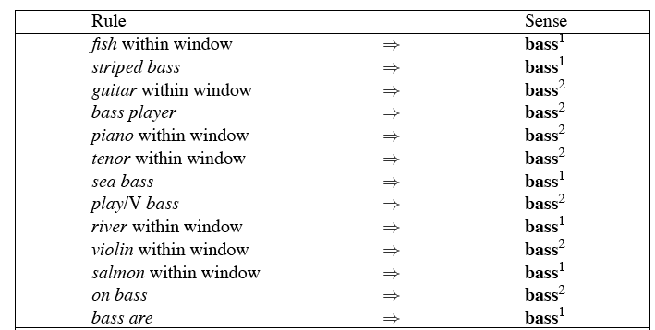
Decision Lists: another popular method
A case statement….

Slide 5
Learning Decision Lists
Restrict the lists to rules that test a single feature (1-decisionlist rules)
Evaluate each possible test and rank them based on how well they work.
Glue the top-N tests together and call that your decision list.

Slide 6
Yarowsky
On a binary (homonymy) distinction used the following metric to rank the tests
This gives about 95% on this test…

Slide 7
WSD Evaluations and baselines
In vivo versus in vitro evaluation
In vitro evaluation is most common now
  Exact match accuracy
    % of words tagged identically with manual sense tags
  Usually evaluate using held-out data from same labeled corpus
    Problems?
    Why do we do it anyhow?
Baselines
  Most frequent sense
  The Lesk algorithm

Slide 8
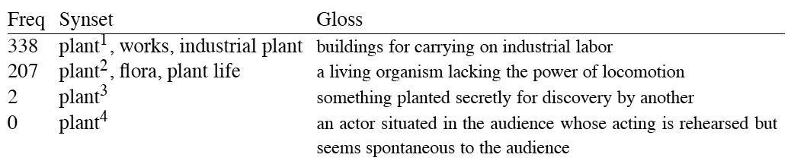
Most Frequent Sense
Wordnet senses are ordered in frequency order
So “most frequent sense” in wordnet = “take the first sense”
Sense frequencies come from SemCor

Slide 9
Ceiling
Human inter-annotator agreement
  Compare annotations of two humans
  On same data
  Given same tagging guidelines
Human agreements on all-words corpora with Wordnet style senses
  75%-80%

Slide 10
Unsupervised Methods
WSD: Dictionary/Thesaurus methods
The Lesk Algorithm
Selectional Restrictions

Slide 11
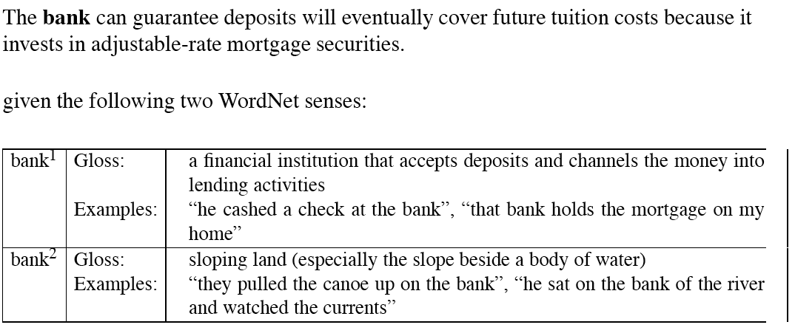
Simplified Lesk

Slide 12
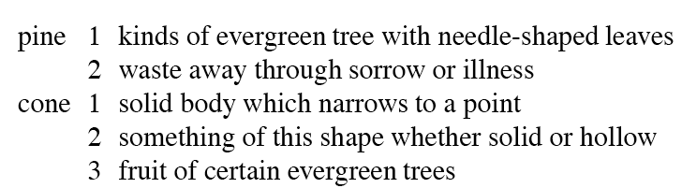
Original Lesk: pine cone

Slide 13
Corpus Lesk
Add corpus examples to glosses and examples
The best performing variant

Slide 14
Disambiguation via Selectional Restrictions
“Verbs are known by the company they keep”
  Different verbs select for different thematic roles
    wash the dishes (takes washable-thing as patient)
    serve delicious dishes (takes food-type as patient)
Method: another semantic attachment in grammar
  Semantic attachment rules are applied as sentences are syntactically parsed, e.g.
    VP --> V NP
    V→ serve <theme> {theme:food-type}
  Selectional restriction violation: no parse

Slide 15
But this means we must:
  Write selectional restrictions for each sense of each predicate – or use FrameNet
    Serve alone has 15 verb senses
  Obtain hierarchical type information about each argument (using WordNet)
    How many hypernyms does dish have?
    How many words are hyponyms of dish?
But also:
  Sometimes selectional restrictions don’t restrict enough (Which dishes do you like?)
  Sometimes they restrict too much (Eat dirt, worm! I’ll eat my hat!)
Can we take a statistical approach?

Slide 16
Semi-supervised
Bootstrapping
What if you don’t have enough data to train a system…
Bootstrap
  Pick a word that you as an analyst think will co-occur with your target word in particular sense
  Grep through your corpus for your target word and the hypothesized word
  Assume that the target tag is the right one

Slide 17
Bootstrapping
For bass
  Assume play occurs with the music sense and fish occurs with the fish sense

Slide 18
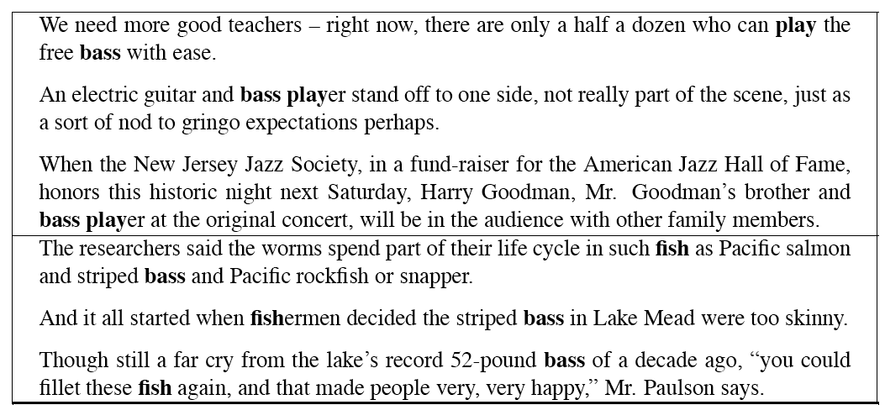
Sentences extracting using “fish” and “play”

Slide 19
Where do the seeds come from?
Hand labeling
“One sense per discourse”:
  The sense of a word is highly consistent within a document - Yarowsky (1995)
  True for topic dependent words
  Not so true for other POS like adjectives and verbs, e.g. make, take
  Krovetz (1998) “More than one sense per discourse” argues it isn’t true at all once you move to fine-grained senses
One sense per collocation:
  A word reoccurring in collocation with the same word will almost surely have the same sense.
Slide adapted from Chris Manning

Slide 20
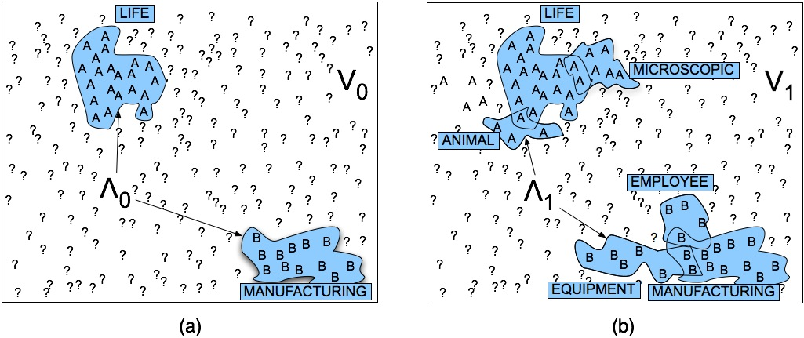
Stages in the Yarowsky bootstrapping algorithm

Slide 21
Problems
Given these general ML approaches, how many classifiers do I need to perform WSD robustly
  One for each ambiguous word in the language
How do you decide what set of tags/labels/senses to use for a given word?
  Depends on the application

Slide 22
WordNet Bass
Tagging with this set of senses is an impossibly hard task that’s probably overkill for any realistic application
bass - (the lowest part of the musical range)
bass, bass part - (the lowest part in polyphonic music)
bass, basso - (an adult male singer with the lowest voice)
sea bass, bass - (flesh of lean-fleshed saltwater fish of the family Serranidae)
freshwater bass, bass - (any of various North American lean-fleshed freshwater fishes especially of the genus Micropterus)
bass, bass voice, basso - (the lowest adult male singing voice)
bass - (the member with the lowest range of a family of musical instruments)
bass -(nontechnical name for any of numerous edible marine and
freshwater spiny-finned fishes)

Slide 23
Senseval History
ACL-SIGLEX workshop (1997)
  Yarowsky and Resnik paper
SENSEVAL-I (1998)
  Lexical Sample for English, French, and Italian
SENSEVAL-II (Toulouse, 2001)
  Lexical Sample and All Words
  Organization: Kilkgarriff (Brighton)
SENSEVAL-III (2004)
SENSEVAL-IV -> SEMEVAL (2007)
SLIDE FROM CHRIS MANNING

Slide 24
WSD Performance
Varies widely depending on how difficult the disambiguation task is
Accuracies of over 90% are commonly reported on some of the classic, often fairly easy, WSD tasks (pike, star, interest)
Senseval brought careful evaluation of difficult WSD (many senses, different POS)
Senseval 1: more fine grained senses, wider range of types:
  Overall: about 75% accuracy
  Nouns: about 80% accuracy
  Verbs: about 70% accuracy

Slide 25
Summary
Lexical Semantics
  Homonymy, Polysemy, Synonymy
  Thematic roles
Computational resource for lexical semantics
  WordNet
Task
  Word sense disambiguation

Slide 26
Statistical NLP
Machine Learning for NL Tasks
    Some form of classification
Experiment with the impact of different kinds of NLP knowledge

Slide 27
What useful things can we do with this knowledge?
Find sentence boundaries, abbreviations
Sense disambiguation
Find Named Entities (person names, company names, telephone numbers, addresses,…)
Find topic boundaries and classify articles into topics
Identify a document’s author and their opinion on the topic, pro or con
Answer simple questions (factoids)
Do simple summarization

Slide 28
Corpus
Find or annotate a corpus
Divide into training and test

Slide 29
Next, we pose a question…the dependent variable
Binary questions:
  Is this word followed by a sentence boundary or not?
  A topic boundary?
  Does this word begin a person name? End one?
  Should this word or sentence be included in a summary?
Classification:
  Is this document about medical issues? Politics? Religion? Sports? …
Predicting continuous variables:
  How loud or high should this utterance be produced?

Slide 30
Finding a suitable corpus and preparing it for analysis
Which corpora can answer my question?
  Do I need to get them labeled to do so?
Dividing the corpus into training and test corpora
  To develop a model, we need a training corpus
    overly narrow corpus: doesn’t generalize
    overly general corpus: don't reflect task or domain
  To demonstrate how general our model is, we need a test corpus to evaluate the model
    Development test set vs. held out test set
  To evaluate our model we must choose an evaluation metric
    Accuracy
    Precision, recall, F-measure,…
    Cross validation

Slide 31
Then we build the model…
Identify the dependent variable: what do we want to predict or classify?
  Does this word begin a person name? Is this word within a person name?
  Is this document about sports? stocks? Health? International news? ???
Identify the independent variables: what features might help to predict the dependent variable?
  What words are used in the document?
  Does ‘hockey’ appear in this document?
  What is this word’s POS? What is the POS of the word before it? After it?
  Is this word capitalized? Is it followed by a ‘.’?
  Do terms play a role? (e.g., “myocardial infarction”, “stock market,” “live stock”)
  How far is this word from the beginning of its sentence?
Extract the values of each variable from the corpus by some automatic means

Slide 32
A Sample Feature Vector for Sentence-Ending Detection
WordID | POS | Cap? | , After? | Dist/Sbeg | End?
Clinton | N | y | n | 1 | n
won | V | n | n | 2 | n
easily | Adv | n | y | 3 | n
but | Conj | n | n | 4 | n

Slide 33
An Example: Genre Identification
Automatically determine
    Short story
      Aesop’s Fable
      Fairy Tale
      Children’s story
    Poetry
    News
    Email

Slide 34
Corpus?
British National Corpus
  Poetry
  Fiction
  Academic Prose
  Non-academic Prose
http://aesopfables.com
Enron corpus: http://www.cs.cmu.edu/~enron/

Slide 35
Features?

Slide 36
The Ant and the Dove
AN ANT went to the bank of a river to quench its thirst, and being carried away by the rush of the stream, was on the point of drowning. A Dove sitting on a tree overhanging the water plucked a leaf and let it fall into the stream close to her. The Ant climbed onto it and floated in safety to the bank. Shortly afterwards a birdcatcher came and stood under the tree, and laid his lime-twigs for the Dove, which sat in the branches. The Ant, perceiving his design, stung him in the foot. In pain the birdcatcher threw down the twigs, and the noise made the Dove take wing.
One good turn deserves another

Slide 37
First Fig
  My candle burns at both ends;
    It will not last the night;
  But ah, my foes, and oh, my friends--
    It gives a lovely light!
    Edna St. Vincent Millay

Slide 38
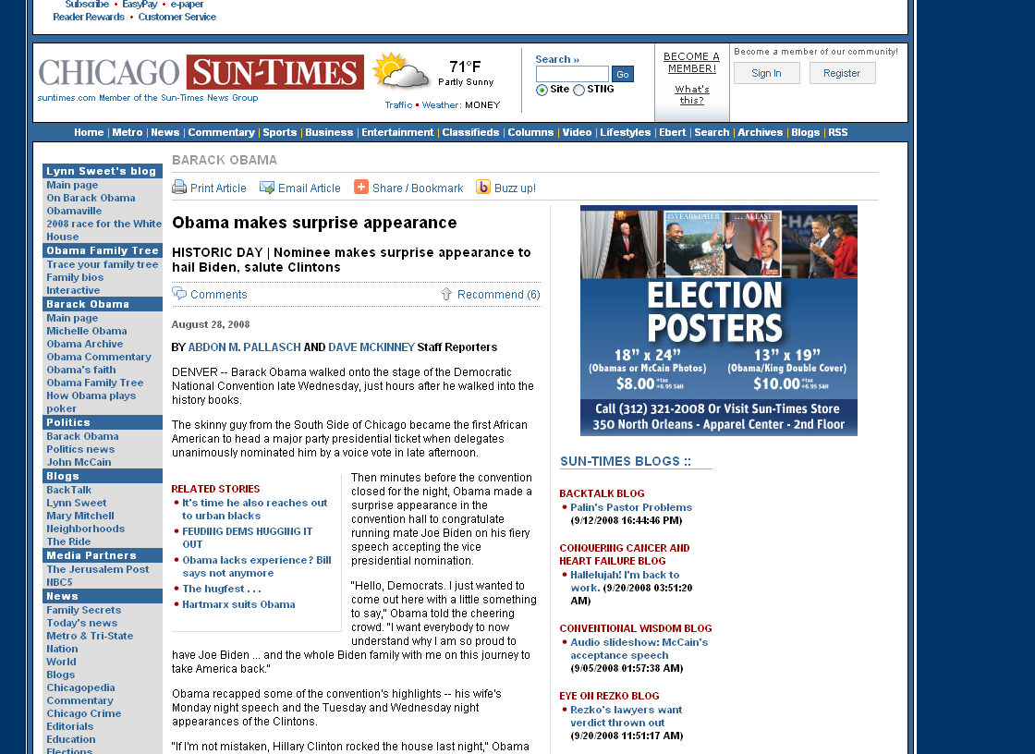

Slide 39
Email
Dear Professor, I'll see you at 6 pm then.
Regards, Madhav
On Wed, Sep 24, 2008 at 12:06 PM, Kathy McKeown <kathy@cs.columbia.edu> wrote:
> I am on the eexamining committee of a candidacy exam from 4-5. That is the
> reason I changed my office hours. If you come right at 6, should be OK. It
> is important that you stop by.
> > Kathy
> > Madhav Krishna wrote:
>> >> Dear Professor,
>> >> Can I come to your office between, say, 4-5 pm today? Google has a
>> >> tech talk on campus today starting at 5 pm -- I would like to attend.
>> >> Regards.

Slide 40
Genre Identification Approaches
Kessler, Nunberg, and Schutze, Automatic Detection of Text Genre, EACL 1997, Madrid, Spain.
Karlgren and Cutting, Recognizing text genres with simple metrics using discriminant analysis. In Proceedings of Coling 94, Kyoto, Japan.

Slide 41
Why Genre Identification?
Parsing accuracy can be increased
    E.g., recipes
POS tagging accuracy can be increased
    E.g., “trend” as a verb
Word sense disambiguation
    E.g., “pretty” in informal genres
Information retrieval
    Allow users to more easily sort through results

Slide 42
What is genre?
Is genre a single property or a multi-dimensional space of properties?
Class of text
    Common function
    Function characterized by formal features
    Class is extensible
      Editorial vs. persuasive text
Genre facets
    BROW
      Popular, middle, upper-middle, high
    NARRATIVE
      Yes, no
    GENRE
      Reportage, editorial, scitech, legal, non-fiction, fiction

Slide 43
Corpus
499 texts from the Brown corpus
    Randomly selected
Training: 402 texts
Test: 97 texts
    Selected so that equal representation of each facet

Slide 44
Features
Structural Cues
    Passives, nominalizations, topicalized sentences, frequency of POS tags
    Used in Karlgren and Cutting
Lexical Cues
    Mr., Mrs. (in papers like the NY Times)
    Latinate affixes (should signify high brow as in scientific papers)
    Dates (appear frequently in certain news articles)
Character Cues
    Punctuation, separators, delimiters, acronyms
Derivative Cues
    Ratios and variation metrics derived from lexical, character and structural cues
    Words per sentence, average word length, words per token
    55 in total used
Kessler et al hypothesis: The surface cues will work as well as the structural cues

Slide 45
Machine Learning Techniques
Logistic Regression
Neural Networks
    To avoid overfitting given large number of variables
    Simple perceptron
    Multi-layer perceptron

Slide 46
Baselines
Karlgren and Cutting
    Can they do better or, at least, equivalent, using features that are simpler to compute?
Simple baseline
    Choose the majority class
    Another possibility: random guess among the k categories
      50% for narrative (yes,no)
      1/6 for genre
      ¼ for brow

Slide 47
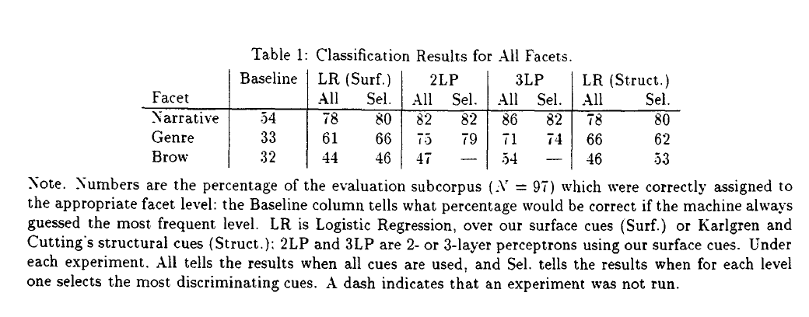

Slide 48
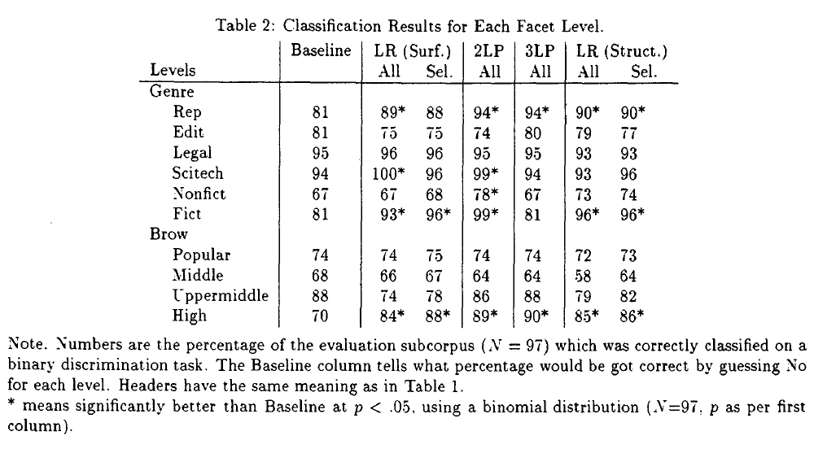

Slide 49
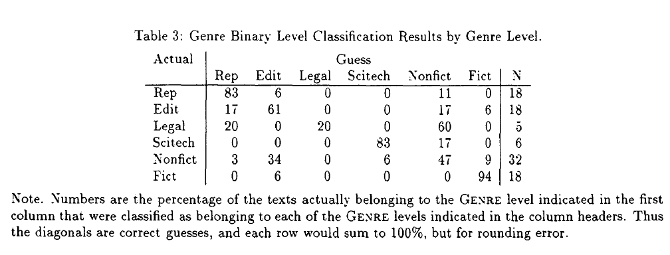
Confusion Matrix

Slide 50
Discussion
All of the facet classifications significantly better than baseline
Component analysis
  Some genres better than other
    Significantly better on reportage and fiction
    Better, but not significantly so on non-fiction and scitech
        Infrequent categories in the Brown corpus
    Less well for editorial and legal
        Genres that are hard to distinguish
Good performance on brow stems from ability to classify in the high brow category
Only a small difference between structural and surface cues

