Slide 1
Word Relations and
Word Sense Disambiguation
Slides adapted from Dan Jurafsky, Jim Martin and Chris Manning

Slide 2
Homework Questions?
Schedule
Next week
    Finish semantics
    Begin machine learning for NLP
    Review for midterm
Midterm
  October 27th
  Will cover everything through semantics
  A sample midterm will be posted
  Includes multiple choice, short answer, problem solving
October 29th
  Bob Coyne and Words Eye: Not to be missed!
Class outing to Where the Wild Things Are
    Either Friday Oct. 23rd or Sunday Oct. 25th. Sign sheet or send email if interested.

Slide 3
Three Perspectives on Meaning
Lexical Semantics
  The meanings of individual words
Formal Semantics (or Compositional Semantics or Sentential Semantics)
  How those meanings combine to make meanings for individual sentences or utterances
Discourse or Pragmatics
  How those meanings combine with each other and with other facts about various kinds of context to make meanings for a text or discourse
  Dialog or Conversation is often lumped together with Discourse

Slide 4
Outline: Comp Lexical Semantics
Intro to Lexical Semantics
  Homonymy, Polysemy, Synonymy
  Online resources: WordNet
Computational Lexical Semantics
  Word Sense Disambiguation
    Supervised
    Semi-supervised
  Word Similarity
    Thesaurus-based
    Distributional

Slide 5
Preliminaries
What’s a word?
  Definitions we’ve used over the class: Types, tokens, stems, roots, inflected forms, etc...
  Lexeme: An entry in a lexicon consisting of a pairing of a form with a single meaning representation
  Lexicon: A collection of lexemes

Slide 6
Relationships between word meanings
Homonymy
Polysemy
Synonymy
Antonymy
Hypernomy
Hyponomy
Meronomy

Slide 7
Homonymy
Lexemes that share a form
    Phonological, orthographic or both
But have unrelated, distinct meanings
Clear example:
    Bat (wooden stick-like thing) vs
    Bat (flying scary mammal thing)
    Or bank (financial institution) versus bank (riverside)
Can be homophones, homographs, or both:
    Homophones:
      Write and right
      Piece and peace

Slide 8
Homonymy causes problems for NLP applications
Text-to-Speech
  Same orthographic form but different phonological form
    bass vs bass
Information retrieval
  Different meanings same orthographic form
    QUERY: bat care
Machine Translation
Speech recognition

Slide 9
Polysemy
The bank is constructed from red brick
I withdrew the money from the bank
Are those the same sense?
Or consider the following WSJ example
  While some banks furnish sperm only to married women, others are less restrictive
  Which sense of bank is this?
    Is it distinct from (homonymous with) the river bank sense?
    How about the savings bank sense?

Slide 10
Polysemy
A single lexeme with multiple related meanings (bank the building, bank the financial institution)
Most non-rare words have multiple meanings
  The number of meanings is related to its frequency
  Verbs tend more to polysemy
  Distinguishing polysemy from homonymy isn’t always easy (or necessary)

Slide 11
Metaphor and Metonymy
Specific types of polysemy
Metaphor:
  Germany will pull Slovenia out of its economic slump.
  I spent 2 hours on that homework.
Metonymy
  The White House announced yesterday.
  This chapter talks about part-of-speech tagging
  Bank (building) and bank (financial institution)

Slide 12
How do we know when a word has more than one sense?
ATIS examples
  Which flights serve breakfast?
  Does America West serve Philadelphia?
The “zeugma” test:
  ?Does United serve breakfast and San Jose?

Slide 13
Synonyms
Word that have the same meaning in some or all contexts.
  filbert / hazelnut
  couch / sofa
  big / large
  automobile / car
  vomit / throw up
  Water / H₂0
Two lexemes are synonyms if they can be successfully substituted for each other in all situations
  If so they have the same propositional meaning

Slide 14
Synonyms
But there are few (or no) examples of perfect synonymy.
  Why should that be?
  Even if many aspects of meaning are identical
  Still may not preserve the acceptability based on notions of politeness, slang, register, genre, etc.
Example:
  Water and H₂0

Slide 15
Some more terminology
Lemmas and wordforms
  A lexeme is an abstract pairing of meaning and form
  A lemma or citation form is the grammatical form that is used to represent a lexeme.
    Carpet is the lemma for carpets
    Dormir is the lemma for duermes.
  Specific surface forms carpets, sung, duermes are called wordforms
The lemma bank has two senses:
  Instead, a bank can hold the investments in a custodial account in the client’s name
  But as agriculture burgeons on the east bank, the river will shrink even more.
A sense is a discrete representation of one aspect of the meaning of a word

Slide 16
Synonymy is a relation between senses rather than words
Consider the words big and large
Are they synonyms?
  How big is that plane?
  Would I be flying on a large or small plane?
How about here:
  Miss Nelson, for instance, became a kind of big sister to Benjamin.
  ?Miss Nelson, for instance, became a kind of large sister to Benjamin.
Why?
  big has a sense that means being older, or grown up
  large lacks this sense

Slide 17
Antonyms
Senses that are opposites with respect to one feature of their meaning
Otherwise, they are very similar!
  dark / light
  short / long
  hot / cold
  up / down
  in / out
More formally: antonyms can
  define a binary opposition or at opposite ends of a scale (long/short, fast/slow)
  Be reversives: rise/fall, up/down

Slide 18
Hyponymy
One sense is a hyponym of another if the first sense is more specific, denoting a subclass of the other
  car is a hyponym of vehicle
  dog is a hyponym of animal
  mango is a hyponym of fruit
Conversely
  vehicle is a hypernym/superordinate of car
  animal is a hypernym of dog
  fruit is a hypernym of mango
superordinate | vehicle | fruit | furniture | mammal
hyponym | car | mango | chair | dog

Slide 19
Hypernymy more formally
Extensional:
  The class denoted by the superordinate
  extensionally includes the class denoted by the hyponym
Entailment:
  A sense A is a hyponym of sense B if being an A entails being a B
Hyponymy is usually transitive
  (A hypo B and B hypo C entails A hypo C)

Slide 20
II. WordNet
A hierarchically organized lexical database
On-line thesaurus + aspects of a dictionary
    Versions for other languages are under development
Category | Unique Forms
Noun | 117,097
Verb | 11,488
Adjective | 22,141
Adverb | 4,601

Slide 21
WordNet
Where it is:
  http://wordnetweb.princeton.edu/perl/webwn

Slide 22
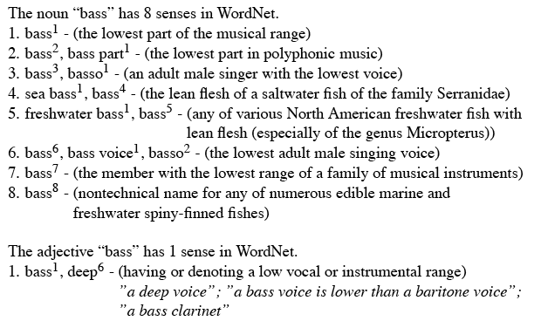
Format of Wordnet Entries

Slide 23
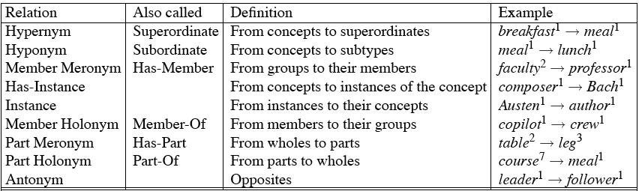
WordNet Noun Relations

Slide 24
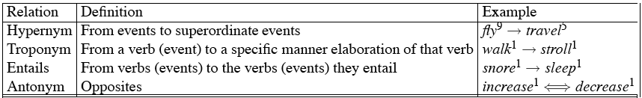
WordNet Verb Relations

Slide 25
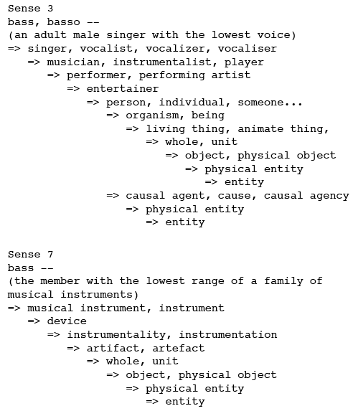
WordNet Hierarchies

Slide 26
How is “sense” defined in WordNet?
The set of near-synonyms for a WordNet sense is called a synset (synonym set); it’s their version of a sense or a concept
Example: chump as a noun to mean
  ‘a person who is gullible and easy to take advantage of’
Each of these senses share this same gloss
Thus for WordNet, the meaning of this sense of chump is this list.

Slide 27
Word Sense Disambiguation (WSD)
Given
  a word in context,
  A fixed inventory of potential word senses
decide which sense of the word this is.
  English-to-Spanish MT
    Inventory is set of Spanish translations
  Speech Synthesis
    Inventory is homographs with different pronunciations like bass and bow
  Automatic indexing of medical articles
    MeSH (Medical Subject Headings) thesaurus entries

Slide 28
Two variants of WSD task
Lexical Sample task
  Small pre-selected set of target words
  And inventory of senses for each word
All-words task
  Every word in an entire text
  A lexicon with senses for each word
  Sort of like part-of-speech tagging
    Except each lemma has its own tagset

Slide 29
Approaches
Supervised
Semi-supervised
  Unsupervised
    Dictionary-based techniques
    Selectional Association
  Lightly supervised
    Bootstrapping
    Preferred Selectional Association

Slide 30
Supervised Machine Learning Approaches
Supervised machine learning approach:
  a training corpus of ?
  used to train a classifier that can tag words in new text
  Just as we saw for part-of-speech tagging, statistical MT.
Summary of what we need:
  the tag set (“sense inventory”)
  the training corpus
  A set of features extracted from the training corpus
  A classifier

Slide 31
Supervised WSD 1: WSD Tags
What’s a tag?

Slide 32
WordNet Bass
The noun ``bass'' has 8 senses in WordNet
bass - (the lowest part of the musical range)
bass, bass part - (the lowest part in polyphonic music)
bass, basso - (an adult male singer with the lowest voice)
sea bass, bass - (flesh of lean-fleshed saltwater fish of the family Serranidae)
freshwater bass, bass - (any of various North American lean-fleshed freshwater fishes especially of the genus Micropterus)
bass, bass voice, basso - (the lowest adult male singing voice)
bass - (the member with the lowest range of a family of musical instruments)
bass -(nontechnical name for any of numerous edible marine and
freshwater spiny-finned fishes)

Slide 33
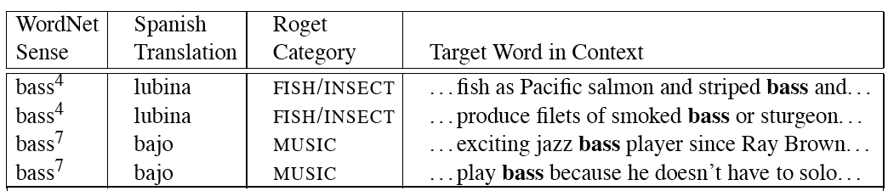
Inventory of sense tags for bass

Slide 34
Supervised WSD 2: Get a corpus
Lexical sample task:
  Line-hard-serve corpus - 4000 examples of each
  Interest corpus - 2369 sense-tagged examples
All words:
  Semantic concordance: a corpus in which each open-class word is labeled with a sense from a specific dictionary/thesaurus.
    SemCor: 234,000 words from Brown Corpus, manually tagged with WordNet senses
    SENSEVAL-3 competition corpora - 2081 tagged word tokens

Slide 35
Supervised WSD 3: Extract feature vectors
Weaver (1955)
If one examines the words in a book, one at a time as through an opaque mask with a hole in it one word wide, then it is obviously impossible to determine, one at a time, the meaning of the words. […] But if one lengthens the slit in the opaque mask, until one can see not only the central word in question but also say N words on either side, then if N is large enough one can unambiguously decide the meaning of the central word. […] The practical question is : ``What minimum value of N will, at least in a tolerable fraction of cases, lead to the correct choice of meaning for the central word?''

Slide 36
dishes
bass

Slide 37
washing dishes.
simple dishes including
convenient dishes to
of dishes and
free bass with
pound bass of
and bass player
his bass while

Slide 38
“In our house, everybody has a career and none of them includes washing dishes,” he says.
In her tiny kitchen at home, Ms. Chen works efficiently, stir-frying several simple dishes, including braised pig’s ears and chcken livers with green peppers.
Post quick and convenient dishes to fix when your in a hurry.
Japanese cuisine offers a great variety of dishes and regional specialties

Slide 39
We need more good teachers – right now, there are only a half a dozen who can play the free bass with ease.
Though still a far cry from the lake’s record 52-pound bass of a decade ago, “you could fillet these fish again, and that made people very, very happy.” Mr. Paulson says.
An electric guitar and bass player stand off to one side, not really part of the scene, just as a sort of nod to gringo expectations again.
Lowe caught his bass while fishing with pro Bill Lee of Killeen, Texas, who is currently in 144th place with two bass weighing 2-09.

Slide 40
Feature vectors
A simple representation for each observation (each instance of a target word)
  Vectors of sets of feature/value pairs
    I.e. files of comma-separated values
  These vectors should represent the window of words around the target
  How big should that window be?

Slide 41
Two kinds of features in the vectors
Collocational features and bag-of-words features
  Collocational
    Features about words at specific positions near target word
      Often limited to just word identity and POS
  Bag-of-words
    Features about words that occur anywhere in the window (regardless of position)
      Typically limited to frequency counts

Slide 42
Examples
Example text (WSJ)
  An electric guitar and bass player stand off to one side not really part of the scene, just as a sort of nod to gringo expectations perhaps
  Assume a window of +/- 2 from the target

Slide 43
Examples
Example text
  An electric guitar and bass player stand off to one side not really part of the scene, just as a sort of nod to gringo expectations perhaps
  Assume a window of +/- 2 from the target

Slide 44
Collocational
Position-specific information about the words in the window
guitar and bass player stand
  [guitar, NN, and, CC, player, NN, stand, VB]
  Word_{n-2,} POS_{n-2,} word_{n-1,} POS_{n-1,} Word_{n+1} POS_{n+1}…
  In other words, a vector consisting of
  [position n word, position n part-of-speech…]

Slide 45
Bag-of-words
Information about the words that occur within the window.
First derive a set of terms to place in the vector.
Then note how often each of those terms occurs in a given window.

Slide 46
Co-Occurrence Example
Assume we’ve settled on a possible vocabulary of 12 words that includes guitar and player but not and and stand
guitar and bass player stand
  [0,0,0,1,0,0,0,0,0,1,0,0]
  Which are the counts of words predefined as e.g.,
  [fish,fishing,viol, guitar, double,cello…

Slide 47
Classifiers
Once we cast the WSD problem as a classification problem, then all sorts of techniques are possible
  Naïve Bayes (the easiest thing to try first)
  Decision lists
  Decision trees
  Neural nets
  Support vector machines
  Nearest neighbor methods…

Slide 48
Classifiers
The choice of technique, in part, depends on the set of features that have been used
  Some techniques work better/worse with features with numerical values
  Some techniques work better/worse with features that have large numbers of possible values
    For example, the feature the word to the left has a fairly large number of possible values

Slide 49
Naïve Bayes
ŝ = p(s|V), or
Where s is one of the senses S possible for a word w and V the input vector of feature values for w
Assume features independent, so probability of V is the product of probabilities of each feature, given s, so
p(V) same for any ŝ
Then

Slide 50
How do we estimate p(s) and p(v_{j}|s)?
  p(s_{i}) is max. likelihood estimate from a sense-tagged corpus (count(s_{i},w_{j})/count(w_{j})) – how likely is bank to mean ‘financial institution’ over all instances of bank?
  P(v_{j}|s) is max. likelihood of each feature given a candidate sense (count(v_{j},s)/count(s)) – how likely is the previous word to be ‘river’ when the sense of bank is ‘financial institution’
Calculate for each possible sense and take the highest scoring sense as the most likely choice

Slide 51
Naïve Bayes Test
On a corpus of examples of uses of the word line, naïve Bayes achieved about 73% correct
Good?

Slide 52
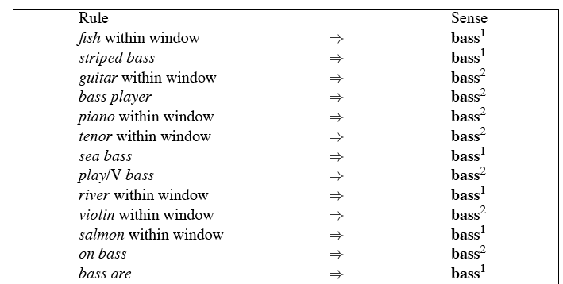
Decision Lists: another popular method
A case statement….

Slide 53
Learning Decision Lists
Restrict the lists to rules that test a single feature (1-decisionlist rules)
Evaluate each possible test and rank them based on how well they work.
Glue the top-N tests together and call that your decision list.

Slide 54
Yarowsky
On a binary (homonymy) distinction used the following metric to rank the tests
This gives about 95% on this test…

Slide 55
WSD Evaluations and baselines
In vivo versus in vitro evaluation
In vitro evaluation is most common now
  Exact match accuracy
    % of words tagged identically with manual sense tags
  Usually evaluate using held-out data from same labeled corpus
    Problems?
    Why do we do it anyhow?
Baselines
  Most frequent sense
  The Lesk algorithm

Slide 56
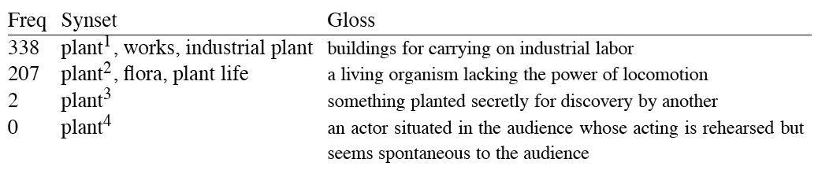
Most Frequent Sense
Wordnet senses are ordered in frequency order
So “most frequent sense” in wordnet = “take the first sense”
Sense frequencies come from SemCor

Slide 57
Ceiling
Human inter-annotator agreement
  Compare annotations of two humans
  On same data
  Given same tagging guidelines
Human agreements on all-words corpora with Wordnet style senses
  75%-80%

Slide 58
Unsupervised Methods
WSD: Dictionary/Thesaurus methods
The Lesk Algorithm
Selectional Restrictions

Slide 59
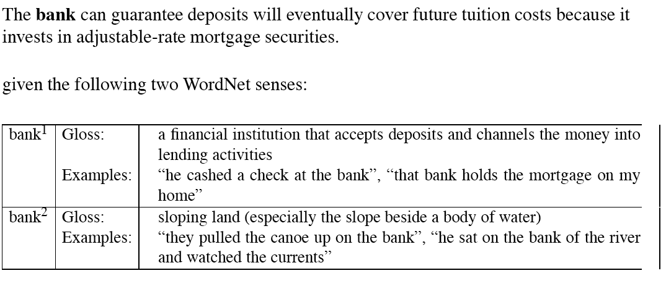
Simplified Lesk

Slide 60
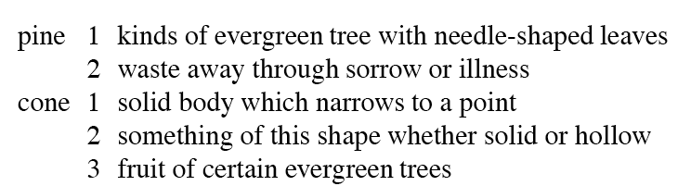
Original Lesk: pine cone

Slide 61
Corpus Lesk
Add corpus examples to glosses and examples
The best performing variant

Slide 62
Disambiguation via Selectional Restrictions
“Verbs are known by the company they keep”
  Different verbs select for different thematic roles
    wash the dishes (takes washable-thing as patient)
    serve delicious dishes (takes food-type as patient)
Method: another semantic attachment in grammar
  Semantic attachment rules are applied as sentences are syntactically parsed, e.g.
    VP --> V NP
    V→ serve <theme> {theme:food-type}
  Selectional restriction violation: no parse

Slide 63
But this means we must:
  Write selectional restrictions for each sense of each predicate – or use FrameNet
    Serve alone has 15 verb senses
  Obtain hierarchical type information about each argument (using WordNet)
    How many hypernyms does dish have?
    How many words are hyponyms of dish?
But also:
  Sometimes selectional restrictions don’t restrict enough (Which dishes do you like?)
  Sometimes they restrict too much (Eat dirt, worm! I’ll eat my hat!)
Can we take a statistical approach?

Slide 64
Semi-supervised
Bootstrapping
What if you don’t have enough data to train a system…
Bootstrap
  Pick a word that you as an analyst think will co-occur with your target word in particular sense
  Grep through your corpus for your target word and the hypothesized word
  Assume that the target tag is the right one

Slide 65
Bootstrapping
For bass
  Assume play occurs with the music sense and fish occurs with the fish sense

Slide 66
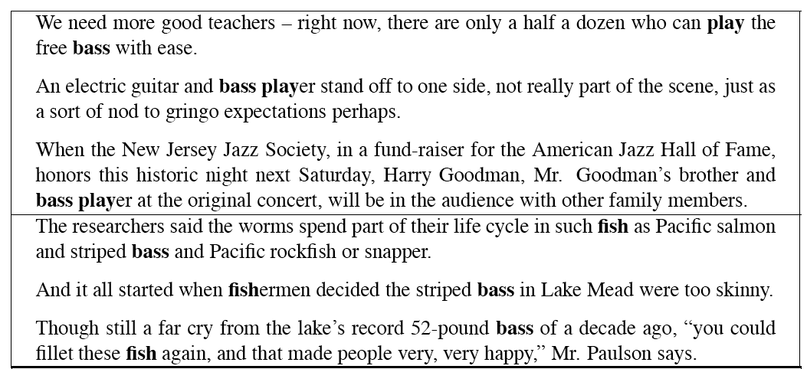
Sentences extracting using “fish” and “play”

Slide 67
Where do the seeds come from?
Hand labeling
“One sense per discourse”:
  The sense of a word is highly consistent within a document - Yarowsky (1995)
  True for topic dependent words
  Not so true for other POS like adjectives and verbs, e.g. make, take
  Krovetz (1998) “More than one sense per discourse” argues it isn’t true at all once you move to fine-grained senses
One sense per collocation:
  A word reoccurring in collocation with the same word will almost surely have the same sense.
Slide adapted from Chris Manning

Slide 68
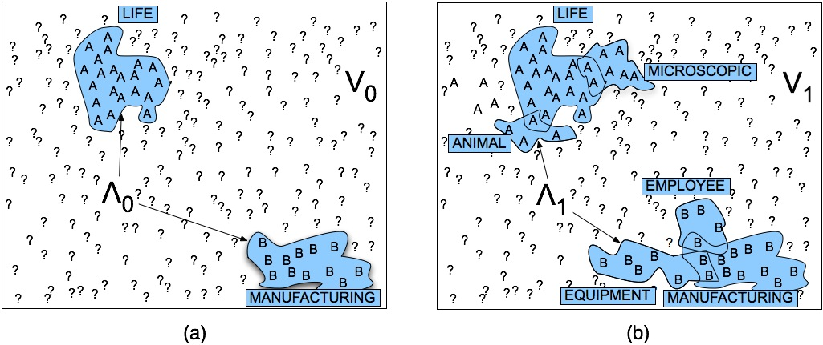
Stages in the Yarowsky bootstrapping algorithm

Slide 69
Problems
Given these general ML approaches, how many classifiers do I need to perform WSD robustly
  One for each ambiguous word in the language
How do you decide what set of tags/labels/senses to use for a given word?
  Depends on the application

Slide 70
WordNet Bass
Tagging with this set of senses is an impossibly hard task that’s probably overkill for any realistic application
bass - (the lowest part of the musical range)
bass, bass part - (the lowest part in polyphonic music)
bass, basso - (an adult male singer with the lowest voice)
sea bass, bass - (flesh of lean-fleshed saltwater fish of the family Serranidae)
freshwater bass, bass - (any of various North American lean-fleshed freshwater fishes especially of the genus Micropterus)
bass, bass voice, basso - (the lowest adult male singing voice)
bass - (the member with the lowest range of a family of musical instruments)
bass -(nontechnical name for any of numerous edible marine and
freshwater spiny-finned fishes)

Slide 71
Senseval History
ACL-SIGLEX workshop (1997)
  Yarowsky and Resnik paper
SENSEVAL-I (1998)
  Lexical Sample for English, French, and Italian
SENSEVAL-II (Toulouse, 2001)
  Lexical Sample and All Words
  Organization: Kilkgarriff (Brighton)
SENSEVAL-III (2004)
SENSEVAL-IV -> SEMEVAL (2007)
SLIDE FROM CHRIS MANNING

Slide 72
WSD Performance
Varies widely depending on how difficult the disambiguation task is
Accuracies of over 90% are commonly reported on some of the classic, often fairly easy, WSD tasks (pike, star, interest)
Senseval brought careful evaluation of difficult WSD (many senses, different POS)
Senseval 1: more fine grained senses, wider range of types:
  Overall: about 75% accuracy
  Nouns: about 80% accuracy
  Verbs: about 70% accuracy

Slide 73
Summary
Lexical Semantics
  Homonymy, Polysemy, Synonymy
  Thematic roles
Computational resource for lexical semantics
  WordNet
Task
  Word sense disambiguation

