Slide 1
Basic Parsing with Context-Free Grammars
Some slides adapted from Julia Hirschberg and Dan Jurafsky

Slide 2
Announcements
To view past videos:
  http://globe.cvn.columbia.edu:8080/oncampus.php?c=133ae14752e27fde909fdbd64c06b337
Usually available only for 1 week. Right now, available for all previous lectures

Slide 3
Earley Parsing
Allows arbitrary CFGs
Fills a table in a single sweep over the input words
  Table is length N+1; N is number of words
  Table entries represent
    Completed constituents and their locations
    In-progress constituents
    Predicted constituents

Slide 4
States/Locations
It would be nice to know where these things are in the input so…
  S -> · VP [0,0] A VP is predicted at the start of the sentence
  NP -> Det · Nominal [1,2] An NP is in progress; the Det goes from 1 to 2
  VP -> V NP · [0,3] A VP has been found starting at 0 and ending at 3

Slide 5
Graphically

Slide 6
Earley Algorithm
March through chart left-to-right.
At each step, apply 1 of 3 operators
  Predictor
    Create new states representing top-down expectations
  Scanner
    Match word predictions (rule with word after dot) to words
  Completer
    When a state is complete, see what rules were looking for that completed constituent
Done when an S spans from 0 to n

Slide 7
Predictor
Given a state
  With a non-terminal to right of dot (not a part-of-speech category)
  Create a new state for each expansion of the non-terminal
  Place these new states into same chart entry as generated state, beginning and ending where generating state ends.
  So predictor looking at
    S -> . VP [0,0]
  results in
    VP -> . Verb [0,0]
    VP -> . Verb NP [0,0]

Slide 8
Scanner
Given a state
  With a non-terminal to right of dot that is a part-of-speech category
  If the next word in the input matches this POS
  Create a new state with dot moved over the non-terminal
  So scanner looking at VP -> . Verb NP [0,0]
  If the next word, “book”, can be a verb, add new state:
    VP -> Verb . NP [0,1]
  Add this state to chart entry following current one
  Note: Earley algorithm uses top-down input to disambiguate POS! Only POS predicted by some state can get added to chart!

Slide 9
Completer
Applied to a state when its dot has reached right end of role.
Parser has discovered a category over some span of input.
Find and advance all previous states that were looking for this category
  copy state, move dot, insert in current chart entry
Given:
  NP -> Det Nominal . [1,3]
  VP -> Verb. NP [0,1]
Add
  VP -> Verb NP . [0,3]

Slide 10
How do we know we are done?
Find an S state in the final column that spans from 0 to n and is complete.
If that’s the case you’re done.
  S –> α · [0,n]

Slide 11
Earley
More specifically…
  Predict all the states you can upfront
  Read a word
    Extend states based on matches
    Add new predictions
    Go to 2
  Look at N to see if you have a winner

Slide 12
Example
Book that flight
We should find… an S from 0 to 3 that is a completed state…

Slide 13
CFG for Fragment of English
S → NP VP | VP → V
S → Aux NP VP | PP -> Prep NP
NP → Det Nom | N → old | dog | footsteps | young
NP →PropN | V → dog | include | prefer
Nom -> Adj Nom | Aux → does
Nom → N | Prep →from | to | on | of
Nom → N Nom | PropN → Bush | McCain | Obama
Nom → Nom PP | Det → that | this | a| the
VP → V NP | Adj -> old | green | red

Slide 14
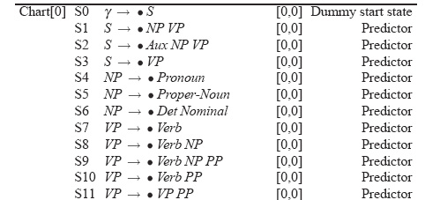
Example

Slide 15
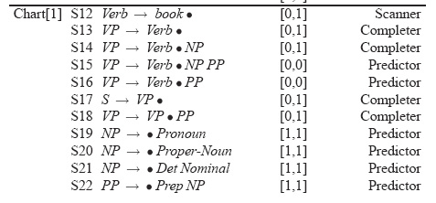
Example

Slide 16
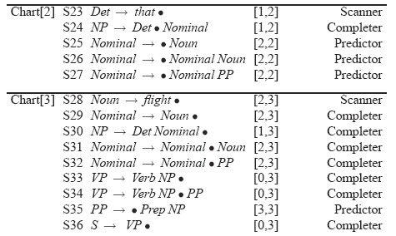
Example

Slide 17
Details
What kind of algorithms did we just describe
  Not parsers – recognizers
    The presence of an S state with the right attributes in the right place indicates a successful recognition.
    But no parse tree… no parser
    That’s how we solve (not) an exponential problem in polynomial time

Slide 18
Converting Earley from Recognizer to Parser
With the addition of a few pointers we have a parser
Augment the “Completer” to point to where we came from.

Slide 19
Augmenting the chart with structural information
S8
S9
S8
S10
S9
S11
S8
S12
S13

Slide 20
Retrieving Parse Trees from Chart
All the possible parses for an input are in the table
We just need to read off all the backpointers from every complete S in the last column of the table
Find all the S -> X . [0,N+1]
Follow the structural traces from the Completer
Of course, this won’t be polynomial time, since there could be an exponential number of trees
We can at least represent ambiguity efficiently

Slide 21
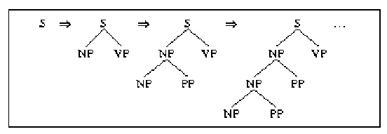
Left Recursion vs. Right Recursion
Depth-first search will never terminate if grammar is left recursive (e.g. NP --> NP PP)

Slide 22
Solutions:
  Rewrite the grammar (automatically?) to a weakly equivalent one which is not left-recursive
    e.g. The man {on the hill with the telescope…}
    NP → NP PP (wanted: Nom plus a sequence of PPs)
    NP → Nom PP
    NP → Nom
    Nom → Det N
    …becomes…
    NP → Nom NP’
    Nom → Det N
    NP’ → PP NP’ (wanted: a sequence of PPs)
    NP’ → e
    Not so obvious what these rules mean…
Notes:
Reordering rules doesn’t work:
you really want to choose the second rule on the first round and the first rule on the second round to handle the input…but...

Slide 23
  Harder to detect and eliminate non-immediate left recursion
      NP --> Nom PP
      Nom --> NP
  Fix depth of search explicitly
  Rule ordering: non-recursive rules first
    NP --> Det Nom
    NP --> NP PP

Slide 24
Another Problem: Structural ambiguity
Multiple legal structures
  Attachment (e.g. I saw a man on a hill with a telescope)
  Coordination (e.g. younger cats and dogs)
  NP bracketing (e.g. Spanish language teachers)

Slide 25
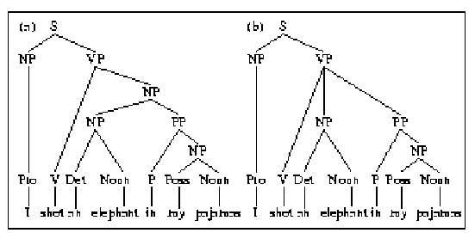
NP vs. VP Attachment

Slide 26
Solution?
  Return all possible parses and disambiguate using “other methods”

Slide 27
Summing Up
Parsing is a search problem which may be implemented with many control strategies
  Top-Down or Bottom-Up approaches each have problems
    Combining the two solves some but not all issues
  Left recursion
  Syntactic ambiguity
Rest of today (and next time): Making use of statistical information about syntactic constituents
  Read Ch 14

Slide 28
Probabilistic Parsing

Slide 29
How to do parse disambiguation
Probabilistic methods
Augment the grammar with probabilities
Then modify the parser to keep only most probable parses
And at the end, return the most probable parse

Slide 30
Probabilistic CFGs
The probabilistic model
  Assigning probabilities to parse trees
Getting the probabilities for the model
Parsing with probabilities
  Slight modification to dynamic programming approach
  Task is to find the max probability tree for an input

Slide 31
Probability Model
Attach probabilities to grammar rules
The expansions for a given non-terminal sum to 1
VP -> Verb .55
VP -> Verb NP .40
VP -> Verb NP NP .05
  Read this as P(Specific rule | LHS)

Slide 32
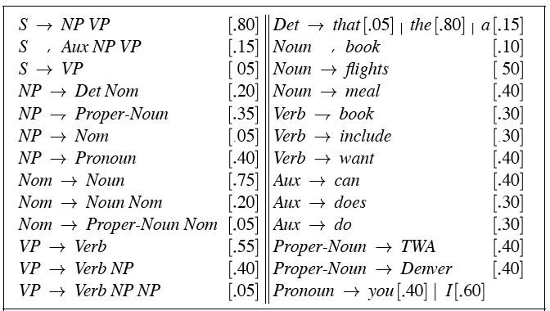
PCFG

Slide 33
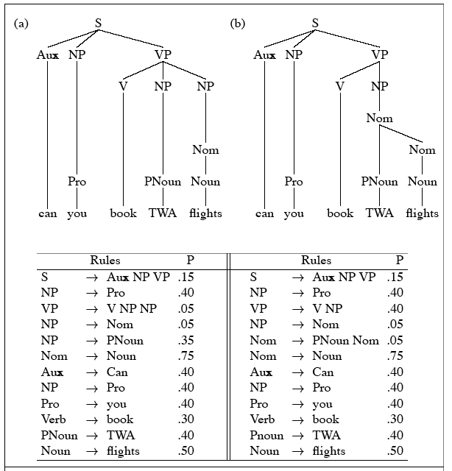
PCFG

Slide 34
Probability Model (1)
A derivation (tree) consists of the set of grammar rules that are in the tree
The probability of a tree is just the product of the probabilities of the rules in the derivation.

Slide 35
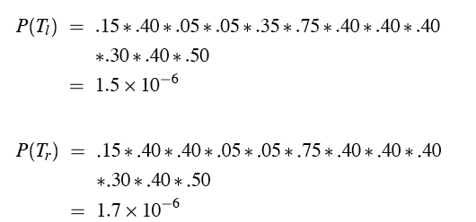
Probability model
P(T,S) = P(T)P(S|T) = P(T); since P(S|T)=1

Slide 36
Probability Model (1.1)
The probability of a word sequence P(S) is the probability of its tree in the unambiguous case.
It’s the sum of the probabilities of the trees in the ambiguous case.

Slide 37
Getting the Probabilities
From an annotated database (a treebank)
  So for example, to get the probability for a particular VP rule just count all the times the rule is used and divide by the number of VPs overall.

Slide 38
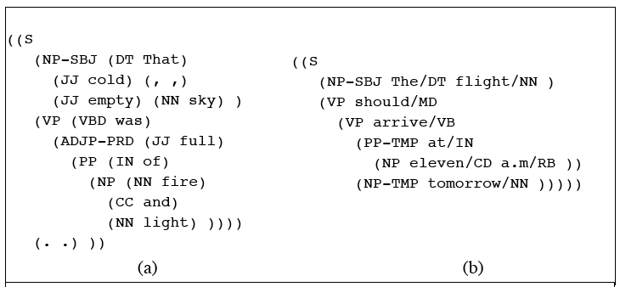
TreeBanks

Slide 39
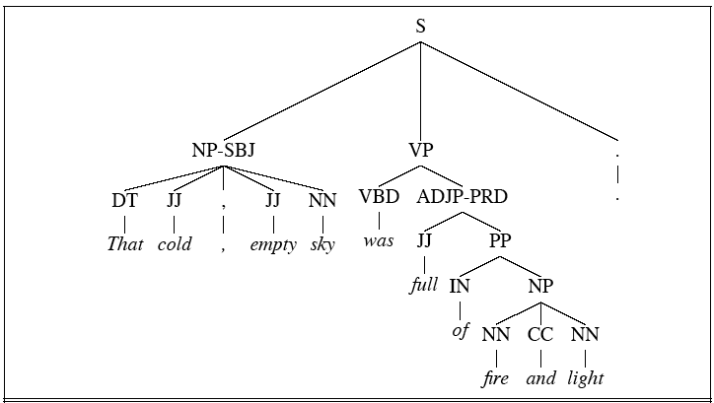
Treebanks

Slide 40
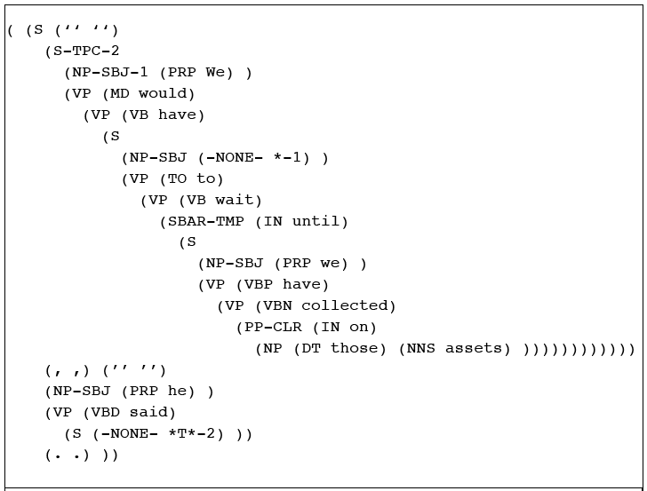
Treebanks

Slide 41
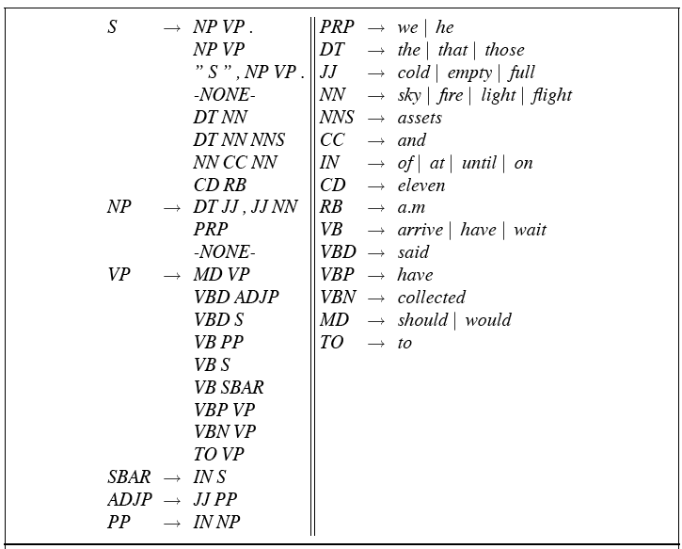
Treebank Grammars

Slide 42
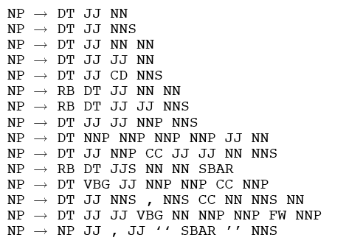
Lots of flat rules

Slide 43
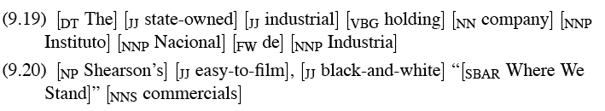
Example sentences from those rules
Total: over 17,000 different grammar rules in the 1-million word Treebank corpus

Slide 44
Probabilistic Grammar Assumptions
We’re assuming that there is a grammar to be used to parse with.
We’re assuming the existence of a large robust dictionary with parts of speech
We’re assuming the ability to parse (i.e. a parser)
Given all that… we can parse probabilistically

Slide 45
Typical Approach
Bottom-up (CKY) dynamic programming approach
Assign probabilities to constituents as they are completed and placed in the table
Use the max probability for each constituent going up

Slide 46
What’s that last bullet mean?
Say we’re talking about a final part of a parse
  S->₀NP_{i}VP_{j}
  The probability of the S is…
  P(S->NP VP)*P(NP)*P(VP)
  The green stuff is already known. We’re doing bottom-up parsing

Slide 47
Max
I said the P(NP) is known.
What if there are multiple NPs for the span of text in question (0 to i)?
Take the max (where?)

Slide 48
Problems with PCFGs
The probability model we’re using is just based on the rules in the derivation…
  Doesn’t use the words in any real way
  Doesn’t take into account where in the derivation a rule is used

Slide 49
Solution
Add lexical dependencies to the scheme…
  Infiltrate the predilections of particular words into the probabilities in the derivation
  I.e. Condition the rule probabilities on the actual words

Slide 50
Heads
To do that we’re going to make use of the notion of the head of a phrase
  The head of an NP is its noun
  The head of a VP is its verb
  The head of a PP is its preposition
  (It’s really more complicated than that but this will do.)

Slide 51
Example (right)
Attribute grammar

Slide 52
Example (wrong)

Slide 53
How?
We used to have
  VP -> V NP PP P(rule|VP)
    That’s the count of this rule divided by the number of VPs in a treebank
Now we have
  VP(dumped)-> V(dumped) NP(sacks)PP(in)
  P(r|VP ^ dumped is the verb ^ sacks is the head of the NP ^ in is the head of the PP)
  Not likely to have significant counts in any treebank

Slide 54
Declare Independence
When stuck, exploit independence and collect the statistics you can…
We’ll focus on capturing two things
  Verb subcategorization
    Particular verbs have affinities for particular VPs
  Objects affinities for their predicates (mostly their mothers and grandmothers)
    Some objects fit better with some predicates than others

Slide 55
Subcategorization
Condition particular VP rules on their head… so
  r: VP -> V NP PP P(r|VP)
  Becomes
  P(r | VP ^ dumped)
  What’s the count?
  How many times was this rule used with (head) dump, divided by the number of VPs that dump appears (as head) in total
  Think of left and right modifiers to the head

Slide 56
Example (right)
Attribute grammar

Slide 57
Probability model
P(T,S) = S-> NP VP (.5)*
VP(dumped) -> V NP PP (.5) (T1)
VP(ate) -> V NP PP (.03)
VP(dumped) -> V NP (.2) (T2)

Slide 58
Preferences
Subcategorization captures the affinity between VP heads (verbs) and the VP rules they go with.
What about the affinity between VP heads and the heads of the other daughters of the VP
Back to our examples…

Slide 59
Example (right)

Slide 60
Example (wrong)

Slide 61
Preferences
The issue here is the attachment of the PP. So the affinities we care about are the ones between dumped and into vs. sacks and into.
So count the places where dumped is the head of a constituent that has a PP daughter with into as its head and normalize
Vs. the situation where sacks is a constituent with into as the head of a PP daughter.

Slide 62
Probability model
P(T,S) = S-> NP VP (.5)*
VP(dumped) -> V NP PP(into) (.7) (T1)
NOM(sacks) -> NOM PP(into) (.01) (T2)

Slide 63
Preferences (2)
Consider the VPs
  Ate spaghetti with gusto
  Ate spaghetti with marinara
The affinity of gusto for eat is much larger than its affinity for spaghetti
On the other hand, the affinity of marinara for spaghetti is much higher than its affinity for ate

Slide 64
Preferences (2)
Note the relationship here is more distant and doesn’t involve a headword since gusto and marinara aren’t the heads of the PPs.
Vp (ate)
Vp(ate)
Vp(ate)
Np(spag)
Pp(with)
np
Pp(with)
v
np
v
Ate spaghetti with gusto
Ate spaghetti with marinara

Slide 65
Summary
Context-Free Grammars
Parsing
  Top Down, Bottom Up Metaphors
  Dynamic Programming Parsers: CKY. Earley
Disambiguation:
  PCFG
  Probabilistic Augmentations to Parsers
  Tradeoffs: accuracy vs. data sparcity
  Treebanks

