Slide 1
Basic Parsing with Context-Free Grammars
Some slides adapted from Julia Hirschberg and Dan Jurafsky

Slide 2
Announcements
To view past videos:
  http://globe.cvn.columbia.edu:8080/oncampus.php?c=133ae14752e27fde909fdbd64c06b337
Usually available only for 1 week. Right now, available for all previous lectures

Slide 3
Homework Questions?

Slide 4
Evaluation

Slide 5
Syntactic Parsing

Slide 6
Syntactic Parsing
Declarative formalisms like CFGs, FSAs define the legal strings of a language -- but only tell you ‘this is a legal string of the language X’
Parsing algorithms specify how to recognize the strings of a language and assign each string one (or more) syntactic analyses

Slide 7
CFG: Example
the small boy likes a girl
Many possible CFGs for English, here is an example (fragment):
  S → NP VP
  VP → V NP
  NP → Det N | Adj NP
  N → boy | girl
  V → sees | likes
  Adj → big | small
  DetP → a | the
  *big the small girl sees a boy
  John likes a girl
  I like a girl
  I sleep
  The old dog the footsteps of the young

Slide 8
Modified CFG
S → NP VP | VP → V
S → Aux NP VP | VP -> V PP
S -> VP | PP -> Prep NP
NP → Det Nom | N → old | dog | footsteps | young | flight
NP →PropN | V → dog | include | prefer | book
NP -> Pronoun
Nom -> Adj Nom | Aux → does
Nom → N | Prep →from | to | on | of
Nom → N Nom | PropN → Bush | McCain | Obama
Nom → Nom PP | Det → that | this | a| the
VP → V NP | Adj -> old | green | red

Slide 9
Parse Tree for ‘The old dog the footsteps of the young’ for Prior CFG
S
NP
VP
V
NP
DET
NOM
NOM
DET
N
The
old
dog
the
N
PP
of the young
footsteps

Slide 10
Parsing as a Form of Search
Searching FSAs
  Finding the right path through the automaton
  Search space defined by structure of FSA
Searching CFGs
  Finding the right parse tree among all possible parse trees
  Search space defined by the grammar
Constraints provided by the input sentence and the automaton or grammar

Slide 11
Top-Down Parser
Builds from the root S node to the leaves
Expectation-based
Common search strategy
  Top-down, left-to-right, backtracking
  Try first rule with LHS = S
  Next expand all constituents in these trees/rules
  Continue until leaves are POS
  Backtrack when candidate POS does not match input string

Slide 12
Rule Expansion
“The old dog the footsteps of the young.”
    Where does backtracking happen?
    What are the computational disadvantages?
    What are the advantages?

Slide 13
Bottom-Up Parsing
Parser begins with words of input and builds up trees, applying grammar rules whose RHS matches
  Det N V Det N Prep Det N
  The old dog the footsteps of the young.
  Det Adj N Det N Prep Det N
  The old dog the footsteps of the young.
  Parse continues until an S root node reached or no further node expansion possible

Slide 14
  Det N V Det N Prep Det N
  The old dog the footsteps of the young.
  Det Adj N Det N Prep Det N

Slide 15
Bottom-up parsing
When does disambiguation occur?
What are the computational advantages and disadvantages?

Slide 16
What’s right/wrong with….
Top-Down parsers – they never explore illegal parses (e.g. which can’t form an S) -- but waste time on trees that can never match the input
Bottom-Up parsers – they never explore trees inconsistent with input -- but waste time exploring illegal parses (with no S root)
For both: find a control strategy -- how explore search space efficiently?
  Pursuing all parses in parallel or backtrack or …?
  Which rule to apply next?
  Which node to expand next?

Slide 17
Some Solutions
Dynamic Programming Approaches – Use a chart to represent partial results
CKY Parsing Algorithm
  Bottom-up
  Grammar must be in Normal Form
  The parse tree might not be consistent with linguistic theory
Early Parsing Algorithm
  Top-down
  Expectations about constituents are confirmed by input
  A POS tag for a word that is not predicted is never added
Chart Parser

Slide 18
Earley Parsing
Allows arbitrary CFGs
Fills a table in a single sweep over the input words
  Table is length N+1; N is number of words
  Table entries represent
    Completed constituents and their locations
    In-progress constituents
    Predicted constituents

Slide 19
States
The table-entries are called states and are represented with dotted-rules.
  S -> · VP A VP is predicted
  NP -> Det · Nominal An NP is in progress
  VP -> V NP · A VP has been found

Slide 20
States/Locations
It would be nice to know where these things are in the input so…
  S -> · VP [0,0] A VP is predicted at the start of the sentence
  NP -> Det · Nominal [1,2] An NP is in progress; the Det goes from 1 to 2
  VP -> V NP · [0,3] A VP has been found starting at 0 and ending at 3

Slide 21
Graphically

Slide 22
Earley
As with most dynamic programming approaches, the answer is found by looking in the table in the right place.
In this case, there should be an S state in the final column that spans from 0 to n+1 and is complete.
If that’s the case you’re done.
  S –> α · [0,n+1]

Slide 23
Earley Algorithm
March through chart left-to-right.
At each step, apply 1 of 3 operators
  Predictor
    Create new states representing top-down expectations
  Scanner
    Match word predictions (rule with word after dot) to words
  Completer
    When a state is complete, see what rules were looking for that completed constituent

Slide 24
Predictor
Given a state
  With a non-terminal to right of dot (not a part-of-speech category)
  Create a new state for each expansion of the non-terminal
  Place these new states into same chart entry as generated state, beginning and ending where generating state ends.
  So predictor looking at
    S -> . VP [0,0]
  results in
    VP -> . Verb [0,0]
    VP -> . Verb NP [0,0]

Slide 25
Scanner
Given a state
  With a non-terminal to right of dot that is a part-of-speech category
  If the next word in the input matches this POS
  Create a new state with dot moved over the non-terminal
  So scanner looking at VP -> . Verb NP [0,0]
  If the next word, “book”, can be a verb, add new state:
    VP -> Verb . NP [0,1]
  Add this state to chart entry following current one
  Note: Earley algorithm uses top-down input to disambiguate POS! Only POS predicted by some state can get added to chart!

Slide 26
Completer
Applied to a state when its dot has reached right end of role.
Parser has discovered a category over some span of input.
Find and advance all previous states that were looking for this category
  copy state, move dot, insert in current chart entry
Given:
  NP -> Det Nominal . [1,3]
  VP -> Verb. NP [0,1]
Add
  VP -> Verb NP . [0,3]

Slide 27
How do we know we are done?
Find an S state in the final column that spans from 0 to n+1 and is complete.
If that’s the case you’re done.
  S –> α · [0,n+1]

Slide 28
Earley
More specifically…
  Predict all the states you can upfront
  Read a word
    Extend states based on matches
    Add new predictions
    Go to 2
  Look at N+1 to see if you have a winner

Slide 29
Example
Book that flight
We should find… an S from 0 to 3 that is a completed state…

Slide 30
CFG for Fragment of English
S → NP VP | VP → V
S → Aux NP VP | PP -> Prep NP
NP → Det Nom | N → old | dog | footsteps | young
NP →PropN | V → dog | include | prefer
Nom -> Adj Nom | Aux → does
Nom → N | Prep →from | to | on | of
Nom → N Nom | PropN → Bush | McCain | Obama
Nom → Nom PP | Det → that | this | a| the
VP → V NP | Adj -> old | green | red

Slide 31
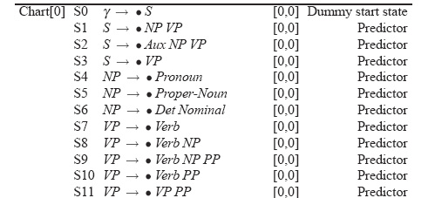
Example

Slide 32
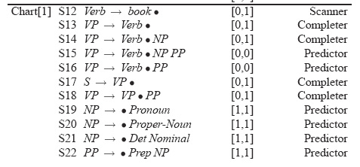
Example

Slide 33
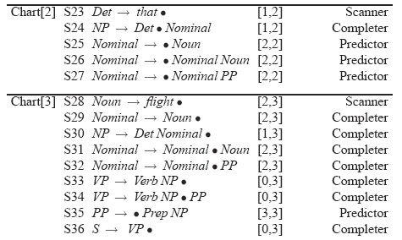
Example

Slide 34
Details
What kind of algorithms did we just describe
  Not parsers – recognizers
    The presence of an S state with the right attributes in the right place indicates a successful recognition.
    But no parse tree… no parser
    That’s how we solve (not) an exponential problem in polynomial time

Slide 35
Converting Earley from Recognizer to Parser
With the addition of a few pointers we have a parser
Augment the “Completer” to point to where we came from.

Slide 36
Augmenting the chart with structural information
S8
S9
S8
S10
S9
S11
S8
S12
S13

Slide 37
Retrieving Parse Trees from Chart
All the possible parses for an input are in the table
We just need to read off all the backpointers from every complete S in the last column of the table
Find all the S -> X . [0,N+1]
Follow the structural traces from the Completer
Of course, this won’t be polynomial time, since there could be an exponential number of trees
We can at least represent ambiguity efficiently

Slide 38
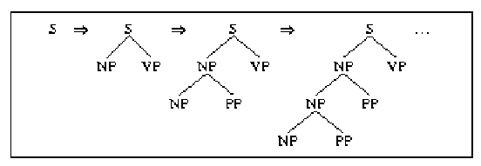
Left Recursion vs. Right Recursion
Depth-first search will never terminate if grammar is left recursive (e.g. NP --> NP PP)

Slide 39
Solutions:
  Rewrite the grammar (automatically?) to a weakly equivalent one which is not left-recursive
    e.g. The man {on the hill with the telescope…}
    NP → NP PP (wanted: Nom plus a sequence of PPs)
    NP → Nom PP
    NP → Nom
    Nom → Det N
    …becomes…
    NP → Nom NP’
    Nom → Det N
    NP’ → PP NP’ (wanted: a sequence of PPs)
    NP’ → e
    Not so obvious what these rules mean…
Notes:
Reordering rules doesn’t work:
you really want to choose the second rule on the first round and the first rule on the second round to handle the input…but...

Slide 40
  Harder to detect and eliminate non-immediate left recursion
      NP --> Nom PP
      Nom --> NP
  Fix depth of search explicitly
  Rule ordering: non-recursive rules first
    NP --> Det Nom
    NP --> NP PP

Slide 41
Another Problem: Structural ambiguity
Multiple legal structures
  Attachment (e.g. I saw a man on a hill with a telescope)
  Coordination (e.g. younger cats and dogs)
  NP bracketing (e.g. Spanish language teachers)

Slide 42
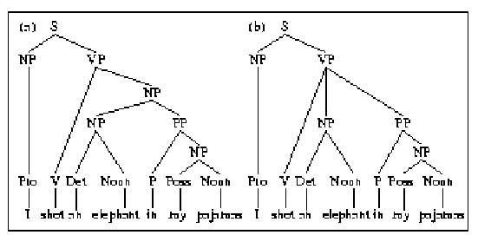
NP vs. VP Attachment

Slide 43
Solution?
  Return all possible parses and disambiguate using “other methods”

Slide 44
Summing Up
Parsing is a search problem which may be implemented with many control strategies
  Top-Down or Bottom-Up approaches each have problems
    Combining the two solves some but not all issues
  Left recursion
  Syntactic ambiguity
Next time: Making use of statistical information about syntactic constituents
  Read Ch 14

