Slide 1
CS 4705 Hidden Markov Models
Slides adapted from Dan Jurafsky, and James Martin

Slide 2
Questions on the Homework?
Paraphrases on major indices not company names
We have limited major indices to three: Dow Jones, NASDAQ S&P 500
Using other tools
Keep your approach simple until you have something working with patterns only
Only then think about extending with other tools and resources. It is not necessary.

Slide 3
Hidden Markov Model Tagging
Using an HMM to do POS tagging
A special case of Bayesian inference
Related to the “noisy channel” model used in MT, ASR and other applications
Notes:
Foundational work in computational linguistics
Bledsoe 1959: OCR
Mosteller and Wallace 1964: authorship identification

Slide 4
POS tagging as a sequence classification task
We are given a sentence (an “observation” or “sequence of observations”)
Secretariat is expected to race tomorrow
What is the best sequence of tags which corresponds to this sequence of observations?
Probabilistic view:
Consider all possible sequences of tags
Choose the tag sequence which is most probable given the observation sequence of n words w1…wn.
Notes:
Out of this universe of sequences, choose the tag sequence which is most probable given the observation sequence of n words w1…wn.

Slide 5
Getting to HMM
Out of all sequences of n tags t₁…t_{n} want the single tag sequence such that P(t₁…t_{n}|w₁…w_{n}) is highest.
Hat ^ means “our estimate of the best one”
Argmax_{x} f(x) means “the x such that f(x) is maximized”

Slide 6
Getting to HMM
This equation is guaranteed to give us the best tag sequence
Intuition of Bayesian classification:
Use Bayes rule to transform into a set of other probabilities that are easier to compute
Notes:
But how to make it operational? How to compute this value?

Slide 7
Using Bayes Rule

Slide 8
Likelihood and prior
n

Slide 9
Two kinds of probabilities (1)
Tag transition probabilities p(t_{i}|t_{i-1})
Determiners likely to precede adjs and nouns
That/DT flight/NN
The/DT yellow/JJ hat/NN
So we expect P(NN|DT) and P(JJ|DT) to be high
But P(DT|JJ) to be:
Compute P(NN|DT) by counting in a labeled corpus:

Slide 10
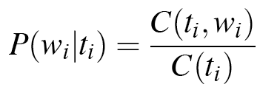
Two kinds of probabilities (2)
Word likelihood probabilities p(w_{i}|t_{i})
VBZ (3sg Pres verb) likely to be “is”
Compute P(is|VBZ) by counting in a labeled corpus:

Slide 11
An Example: the verb “race”
Secretariat/NNP is/VBZ expected/VBN to/TO race/VB tomorrow/NR
People/NNS continue/VB to/TO inquire/VB the/DT reason/NN for/IN the/DT race/NN for/IN outer/JJ space/NN
How do we pick the right tag?

Slide 12
Disambiguating “race”

Slide 13
P(NN|TO) = .00047
P(VB|TO) = .83
P(race|NN) = .00057
P(race|VB) = .00012
P(NR|VB) = .0027
P(NR|NN) = .0012
P(VB|TO)P(NR|VB)P(race|VB) = .00000027
P(NN|TO)P(NR|NN)P(race|NN)=.00000000032
So we (correctly) choose the verb reading,

Slide 14
Hidden Markov Models
What we’ve described with these two kinds of probabilities is a Hidden Markov Model
Now we will tie this approach into the model
Definitions.

Slide 15
Definitions
A weighted finite-state automaton adds probabilities to the arcs
The sum of the probabilities leaving any arc must sum to one
A Markov chain is a special case of a WFST
the input sequence uniquely determines which states the automaton will go through
Markov chains can’t represent inherently ambiguous problems
Assigns probabilities to unambiguous sequences

Slide 16
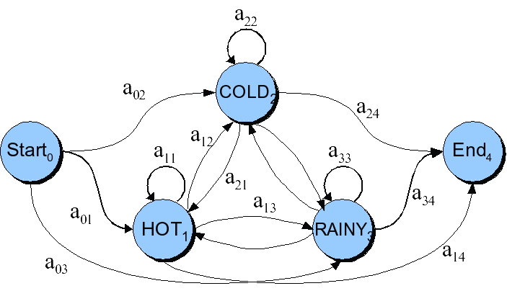
Markov chain for weather

Slide 17
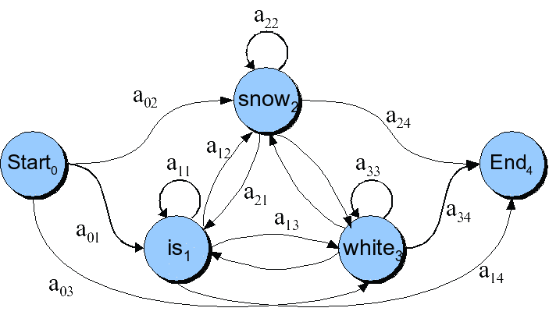
Markov chain for words

Slide 18
Markov chain = “First-order observable Markov Model”
a set of states
Q = q₁, q₂…q_{N;} the state at time t is q_{t}
Transition probabilities:
a set of probabilities A = a₀₁a₀₂…a_{n1}…a_{nn}.
Each a_{ij} represents the probability of transitioning from state i to state j
The set of these is the transition probability matrix A
Distinguished start and end states

Slide 19
Markov chain = “First-order observable Markov Model”
Current state only depends on previous state

Slide 20
Another representation for start state
Instead of start state
Special initial probability vector π
An initial distribution over probability of start states
Constraints:

Slide 21
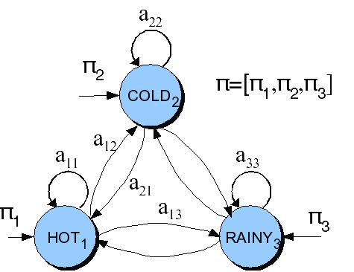
The weather figure using pi

Slide 22
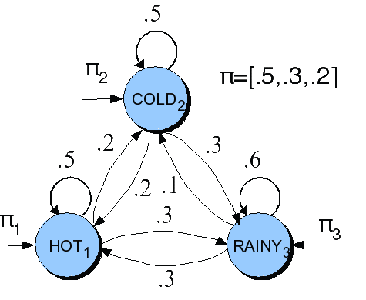
The weather figure: specific example

Slide 23
Markov chain for weather
What is the probability of 4 consecutive rainy days?
Sequence is rainy-rainy-rainy-rainy
I.e., state sequence is 3-3-3-3
P(3,3,3,3) =
π₁a₁₁a₁₁a₁₁a₁₁ = 0.2 x (0.6)³ = 0.0432

Slide 24
Hidden Markov Models
We don’t observe POS tags
We infer them from the words we see
Observed events
Hidden events

Slide 25
HMM for Ice Cream
You are a climatologist in the year 2799
Studying global warming
You can’t find any records of the weather in New York, NY for summer of 2007
But you find Kathy McKeown’s diary
Which lists how many ice-creams Kathy ate every date that summer
Our job: figure out how hot it was

Slide 26
Hidden Markov Model
For Markov chains, the output symbols are the same as the states.
See hot weather: we’re in state hot
But in part-of-speech tagging (and other things)
The output symbols are words
The hidden states are part-of-speech tags
So we need an extension!
A Hidden Markov Model is an extension of a Markov chain in which the input symbols are not the same as the states.
This means we don’t know which state we are in.

Slide 27
Hidden Markov Models
States Q = q₁, q₂…q_{N;}
Observations O= o₁, o₂…o_{N;}
Each observation is a symbol from a vocabulary V = {v₁,v₂,…v_{V}}
Transition probabilities
Transition probability matrix A = {a_{ij}}
Observation likelihoods
Output probability matrix B={b_{i}(k)}
Special initial probability vector π

Slide 28
Hidden Markov Models
Some constraints

Slide 29
Assumptions
Markov assumption:
Output-independence assumption

Slide 30
McKeown task
Given
Ice Cream Observation Sequence: 1,2,3,2,2,2,3…
Produce:
Weather Sequence: H,C,H,H,H,C…

Slide 31
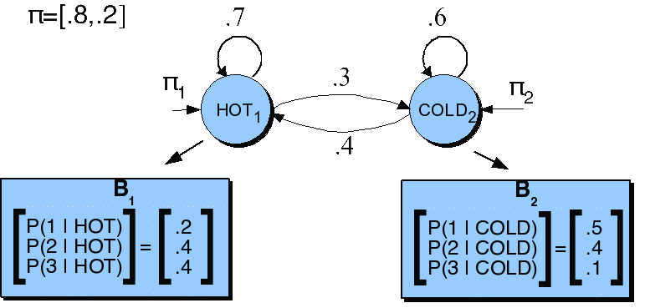
HMM for ice cream

Slide 32
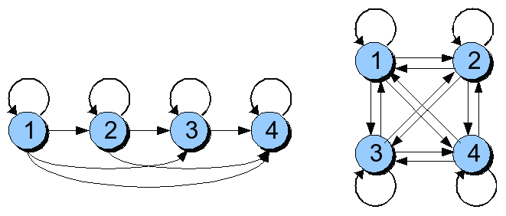
Different types of HMM structure
Ergodic =
fully-connected
Bakis = left-to-right

Slide 33
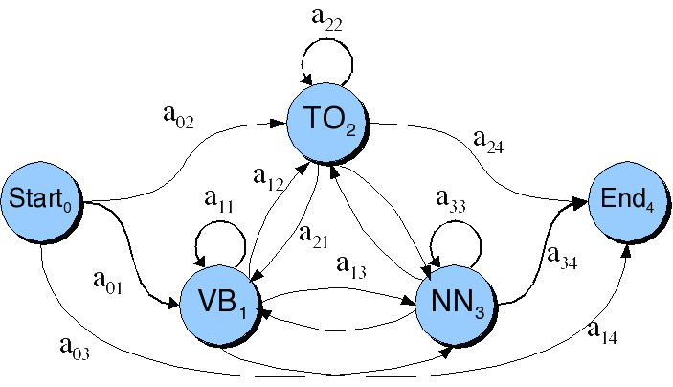
Transitions between the hidden states of HMM, showing A probs

Slide 34
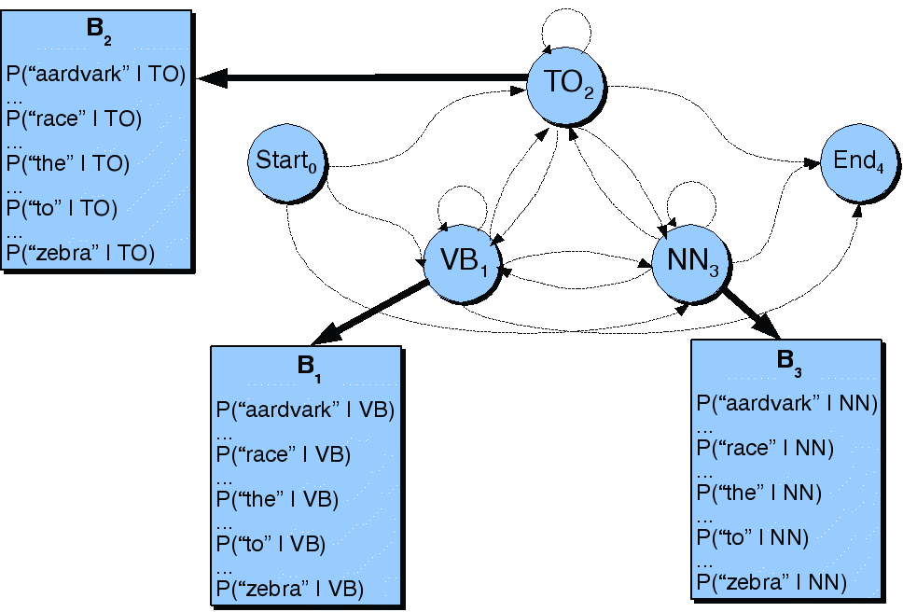
B observation likelihoods for POS HMM

Slide 35
Three fundamental Problems for HMMs
Likelihood: Given an HMM λ = (A,B) and an observation sequence O, determine the likelihood P(O, λ).
Decoding: Given an observation sequence O and an HMM λ = (A,B), discover the best hidden state sequence Q.
Learning: Given an observation sequence O and the set of states in the HMM, learn the HMM parameters A and B.

Slide 36
Decoding
The best hidden sequence
Weather sequence in the ice cream task
POS sequence given an input sentence
We could use argmax over the probability of each possible hidden state sequence
Why not?
Viterbi algorithm
Dynamic programming algorithm
Uses a dynamic programming trellis
Each trellis cell represents, v_{t}(j), represents the probability that the HMM is in state j after seeing the first t observations and passing through the most likely state sequence

Slide 37
Viterbi intuition: we are looking for the best ‘path’
S₁
S₂
S₃
S₄
S₅
Slide from Dekang Lin

Slide 38
Intuition
The value in each cell is computed by taking the MAX over all paths that lead to this cell.
An extension of a path from state i at time t-1 is computed by multiplying:

Slide 39
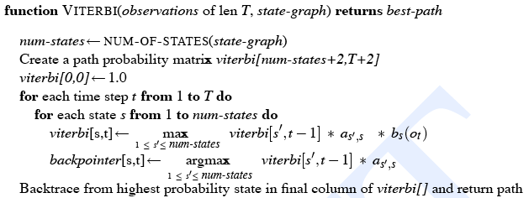
The Viterbi Algorithm

Slide 40
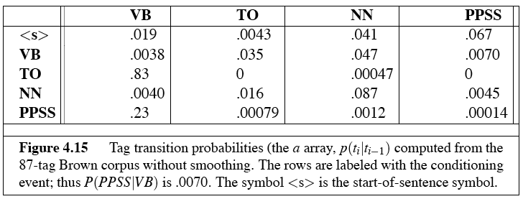
The A matrix for the POS HMM

Slide 41
The B matrix for the POS HMM

Slide 42
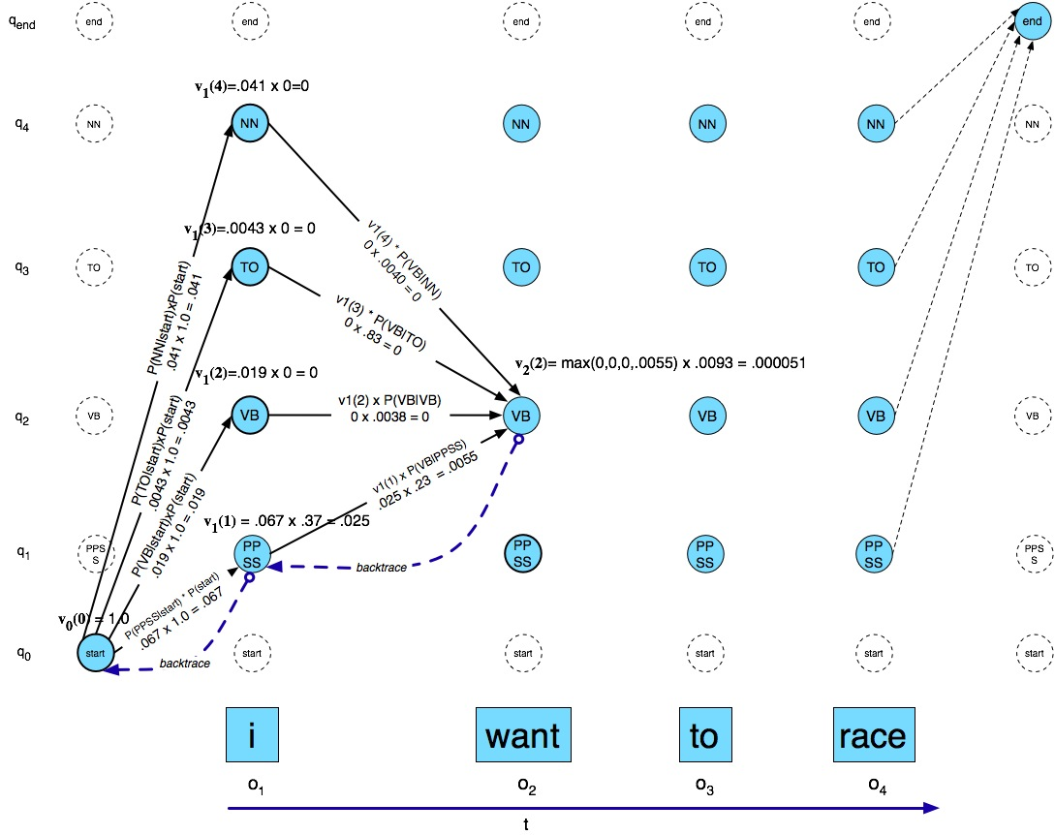
Viterbi example

Slide 43
Computing the Likelihood of an observation
Forward algorithm
Exactly like the viterbi algorithm, except
To compute the probability of a state, sum the probabilities from each path

Slide 44
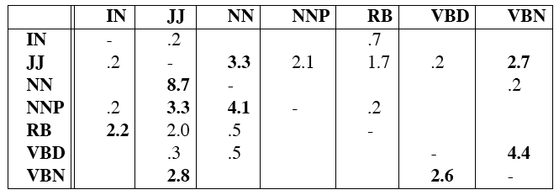
Error Analysis: ESSENTIAL!!!
Look at a confusion matrix
See what errors are causing problems
Noun (NN) vs ProperNoun (NN) vs Adj (JJ)
Adverb (RB) vs Prep (IN) vs Noun (NN)
Preterite (VBD) vs Participle (VBN) vs Adjective (JJ)

