Slide 1
Introduction to Syntax and
Context-Free Grammars http://www1.cs.columbia.edu/~rambow/teaching/lecture-2009-09-22.ppt
Owen Rambow
rambow@ccls.columbia.edu
Slides with contributions from Kathy McKeown, Dan Jurafsky and James Martin

Slide 2
Announcements
Talks
  Information Extraction, Data Mining and Joint Inference, Prof. Andrew McCallum, Univ. of Massachusetts, 11AM Wed. Oct. 1st, Davis Auditorium, Schapiro
  Integrity of Elections, Dr. Peter G. Neumann, SRI International, 11 AM Mon. Oct. 6th, Davis Auditorium, Schapiro

Slide 3
What is Syntax?
Study of structure of language
Refers to the way words are arranged together, and the relationship between them.
Roughly, goal is to relate surface form (what we perceive when someone says something) to semantics (what that utterance means)

Slide 4
What is Syntax Not?
Phonology: study of sound systems and how sounds combine
Morphology: study of how words are formed from smaller parts (morphemes)
Semantics: study of meaning of language

Slide 5
What is Syntax? (2)
Study of structure of language
Specifically, goal is to relate an interface to morphological component to an interface to a semantic component
Note: interface to morphological component may look like written text
Representational device is tree structure

Slide 6
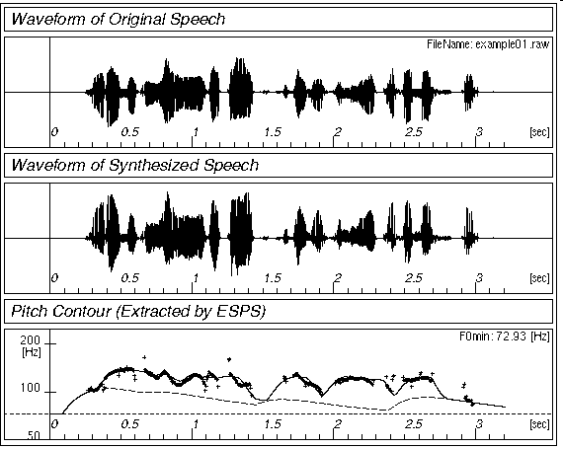
Simplified View of Linguistics
Phonology
⇔ /waddyasai/
Morphology
/waddyasai/ ⇔ what did you say
say
Syntax
what did you say ⇔
obj
subj
say
you
what
Semantics
subj
obj
⇔ P[ λx. say(you, x) ]
you
what

Slide 7



The Big Picture
Empirical Matter
?
Formalisms
Data structures
Formalisms (e.g., CFG)
Algorithms
Distributional Models
?
Maud expects there to be a riot
*Teri promised there to be a riot
Maud expects the shit to hit the fan
*Teri promised the shit to hit the fan
?
?
Linguistic Theory

Slide 8
What About Chomsky?
At birth of formal language theory (comp sci) and formal linguistics
Major contribution: syntax is cognitive reality
Humans able to learn languages quickly, but not all languages ⇒ universal grammar is biological
Goal of syntactic study: find universal principles and language-specific parameters
Specific Chomskyan theories change regularly
General ideas adopted by almost all contemporary syntactic theories (“principles-and-parameters-type theories”)

Slide 9
Types of Linguistic Theories
Prescriptive: “prescriptive linguistics” is an oxymoron
  Prescriptive grammar: how people ought to talk
Descriptive: provide account of syntax of a language
  Descriptive grammar: how people do talk
  often appropriate for NLP engineering work
Explanatory: provide principles-and-parameters style account of syntax of (preferably) several languages

Slide 10
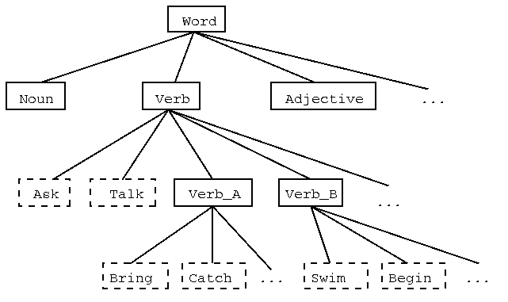
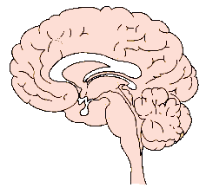
The Big Picture
Empirical Matter
or
Formalisms
Data structures
Formalisms
Algorithms
Distributional Models
?
Maud expects there to be a riot
*Teri promised there to be a riot
Maud expects the shit to hit the fan
*Teri promised the shit to hit the
?
?
Linguistic Theory

Slide 11
Syntax: Why should we care?
Grammar checkers
Question answering
Information extraction
Machine translation

Slide 12
key ideas of syntax
Constituency (we’ll spend most of our time on this)
Subcategorization
Grammatical relations
Movement/long-distance dependency

Slide 13
Structure in Strings
Some words: the a small nice big very boy girl sees likes
Some good sentences:
  the boy likes a girl
  the small girl likes the big girl
  a very small nice boy sees a very nice boy
Some bad sentences:
  *the boy the girl
  *small boy likes nice girl
Can we find subsequences of words (constituents) which in some way behave alike?

Slide 14
Structure in Strings
Proposal 1
Some words: the a small nice big very boy girl sees likes
Some good sentences:
  (the) boy (likes a girl)
  (the small) girl (likes the big girl)
  (a very small nice) boy (sees a very nice boy)
Some bad sentences:
  *(the) boy (the girl)
  *(small) boy (likes the nice girl)

Slide 15
Structure in Strings
Proposal 2
Some words: the a small nice big very boy girl sees likes
Some good sentences:
  (the boy) likes (a girl)
  (the small girl) likes (the big girl)
  (a very small nice boy) sees (a very nice boy)
Some bad sentences:
  *(the boy) (the girl)
  *(small boy) likes (the nice girl)
This is better proposal: fewer types of constituents
(blue and red are of same type)

Slide 16
More Structure in Strings
Proposal 2 -- ctd
Some words: the a small nice big very boy girl sees likes
Some good sentences:
  ((the) boy) likes ((a) girl)
  ((the) (small) girl) likes ((the) (big) girl)
  ((a) ((very) small) (nice) boy) sees ((a) ((very) nice) girl)
Some bad sentences:
  *((the) boy) ((the) girl)
  *((small) boy) likes ((the) (nice) girl)

Slide 17
From Substrings to Trees
(((the) boy) likes ((a) girl))
likes
boy
girl
the
a

Slide 18
Node Labels?
( ((the) boy) likes ((a) girl) )
Choose constituents so each one has one non-bracketed word: the head
Group words by distribution of constituents they head (part-of-speech, POS):
  Noun (N), verb (V), adjective (Adj), adverb (Adv), determiner (Det)
Category of constituent: XP, where X is POS
  NP, S, AdjP, AdvP, DetP

Slide 19
Node Labels
(((the/Det) boy/N) likes/V ((a/Det) girl/N))
S
NP
likes
NP
boy
DetP
DetP
girl
the
a

Slide 20
Types of Nodes
(((the/Det) boy/N) likes/V ((a/Det) girl/N))
S
nonterminal
symbols
= constituents
Phrase-structure
tree
NP
likes
NP
boy
DetP
DetP
girl
the
a
terminal symbols = words

Slide 21
Determining Part-of-Speech
  A blue seat/a child seat: noun or adjective?
  Syntax:
    a blue seat a child seat
    a very blue seat *a very child seat
    this seat is blue *this seat is child
  Morphology:
    bluer *childer
  blue and child are not the same POS
  blue is Adj, child is Noun

Slide 22
Determining
Part-of-Speech (2)
  preposition or particle?
    A he threw out the garbage
    B he threw the garbage out the door
    A he threw the garbage out
    B *he threw the garbage the door out
    The two out are not same POS; A is particle, B is Preposition

Slide 23
Constituency (Review)
E.g., Noun phrases (NPs)
    A red dog on a blue tree
    A blue dog on a red tree
    Some big dogs and some little dogs
    A dog
    I
    Big dogs, little dogs, red dogs, blue dogs, yellow dogs, green dogs, black dogs, and white dogs
How do we know these form a constituent?

Slide 24
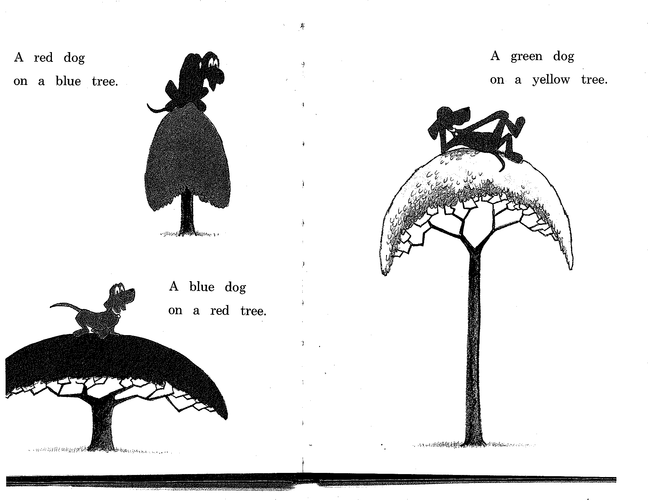

Slide 25
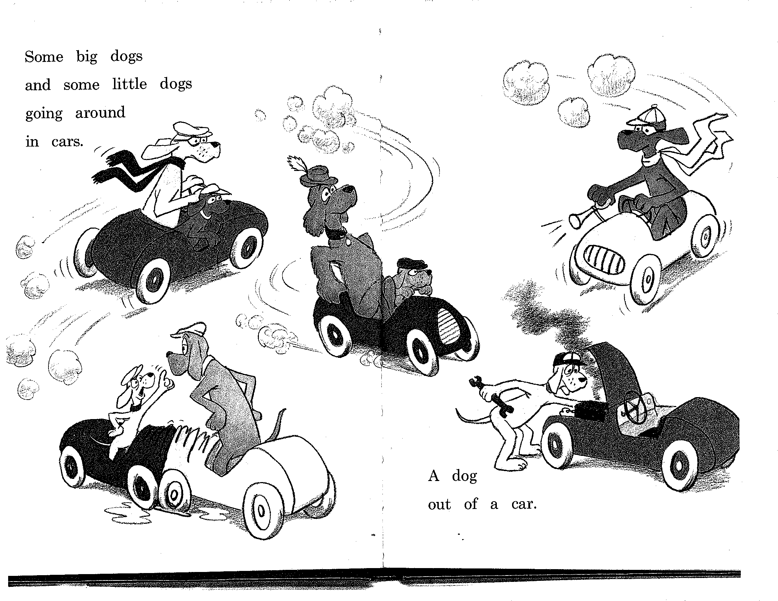

Slide 26
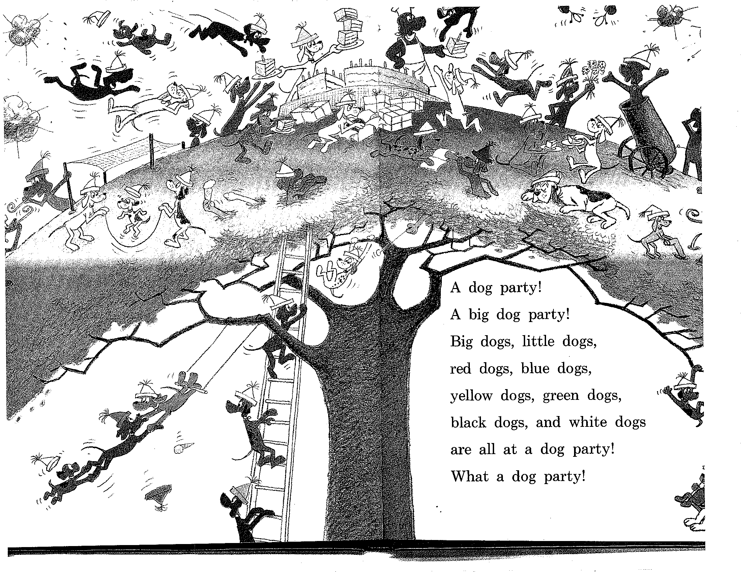

Slide 27
Constituency (II)
They can all appear before a verb:
  Some big dogs and some little dogs are going around in cars…
  Big dogs, little dogs, red dogs, blue dogs, yellow dogs, green dogs, black dogs, and white dogs are all at a dog party!
  I do not
But individual words can’t always appear before verbs:
  *little are going…
  *blue are…
  *and are
Must be able to state generalizations like:
  Noun phrases occur before verbs

Slide 28
Constituency (III)
Preposing and postposing:
  Under a tree is a yellow dog.
  A yellow dog is under a tree.
But not:
  *Under, is a yellow dog a tree.
  *Under a is a yellow dog tree.
Prepositional phrases notable for ambiguity in attachment

Slide 29
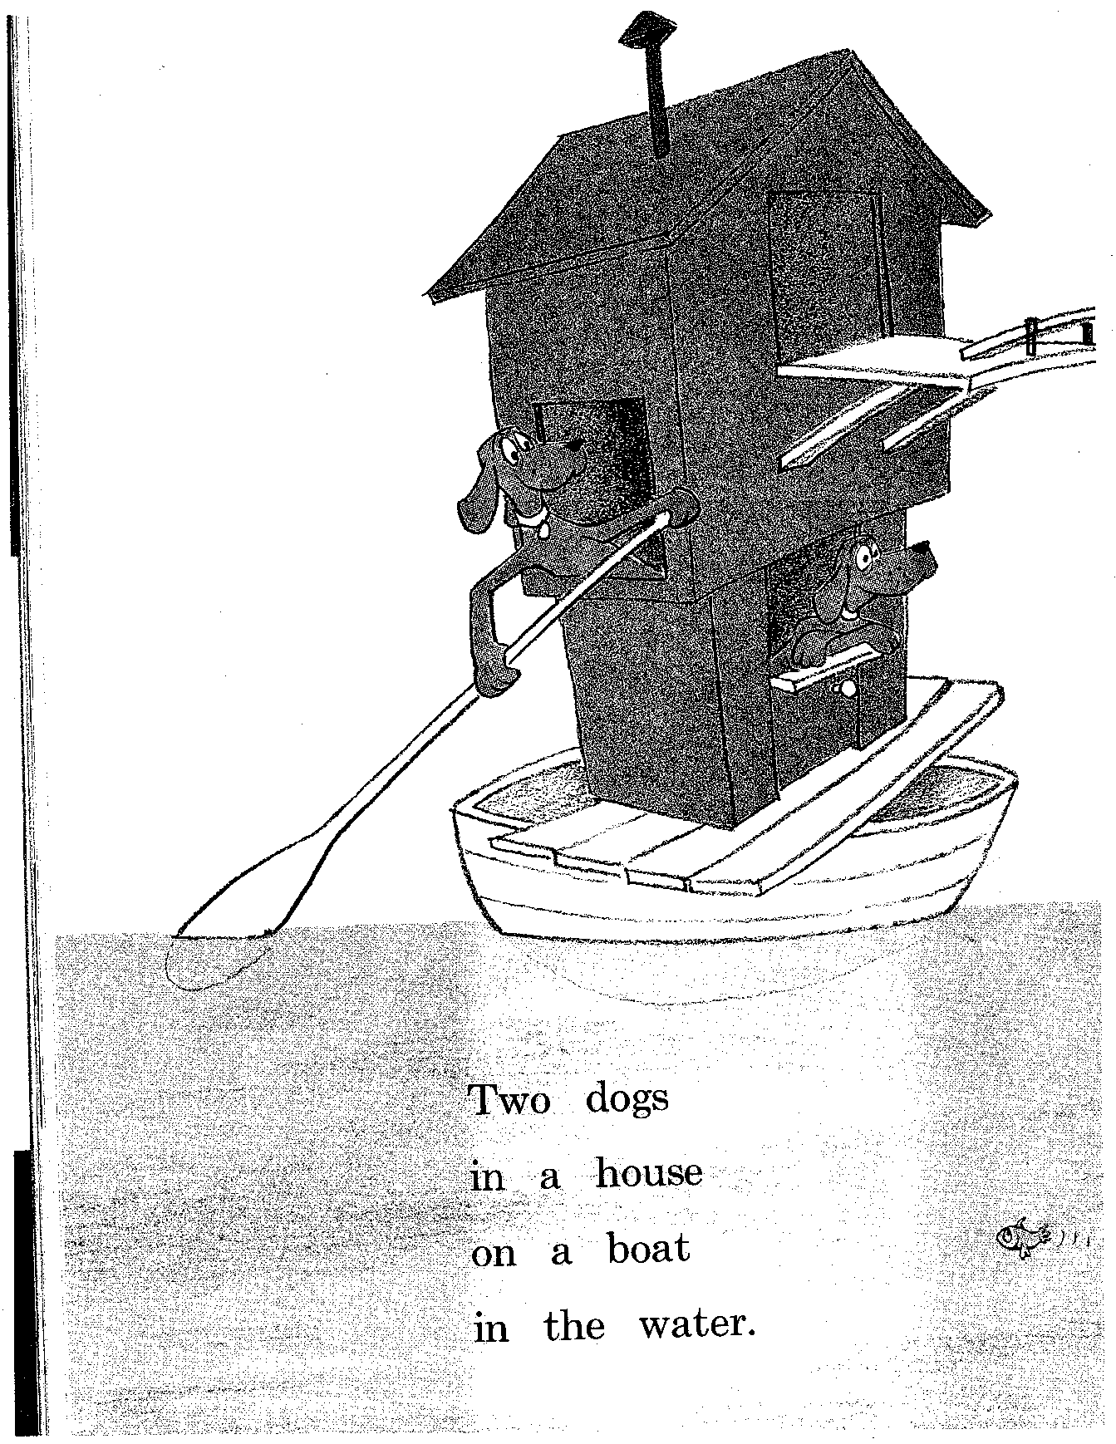

Slide 30
Phrase Structure and Dependency Structure
S
likes/V
NP
likes
NP
boy/N
girl/N
boy
DetP
DetP
girl
the/Det
a/Det
the
a
All nodes are labeled
with words!
Only leaf nodes labeled with words!

Slide 31
Phrase Structure and Dependency Structure (ctd)
likes/V
S
boy/N
girl/N
NP
likes
NP
boy
the/Det
a/Det
DetP
DetP
girl
the
a
Representationally equivalent if each nonterminal
node has one lexical daughter (its head)

Slide 32
Types of Dependency
likes/V
Adj(unct)
Obj
Subj
sometimes/Adv
boy/N
girl/N
Fw
Adj
Fw
the/Det
small/Adj
a/Det
Adj
very/Adv

Slide 33
Grammatical Relations
Types of relations between words
  Arguments: subject, object, indirect object, prepositional object
  Adjuncts: temporal, locative, causal, manner, …
  Function Words

Slide 34
Subcategorization
List of arguments of a word (typically, a verb), with features about realization (POS, perhaps case, verb form etc)
In canonical order Subject-Object-IndObj
Example:
  like: N-N, N-V(to-inf)
  see: N, N-N, N-N-V(inf)
Note: J&M talk about subcategorization only within VP

Slide 35
What About the VP?
S
S
NP
VP
NP
likes
NP
boy
boy
DetP
DetP
girl
DetP
likes
NP
the
a
the
girl
DetP
a

Slide 36
What About the VP?
Existence of VP is a linguistic (i.e., empirical) claim, not a methodological claim
Semantic evidence???
Syntactic evidence
  VP-fronting (and quickly clean the carpet he did! )
  VP-ellipsis (He cleaned the carpets quickly, and so did she )
  Can have adjuncts before and after VP, but not in VP (He often eats beans, *he eats often beans )
Note: VP cannot be represented in a dependency representation

Slide 37
Context-Free Grammars
Defined in formal language theory (comp sci)
Terminals, nonterminals, start symbol, rules
String-rewriting system
Start with start symbol, rewrite using rules, done when only terminals left
NOT A LINGUISTIC THEORY, just a formal device

Slide 38
CFG: Example
Many possible CFGs for English, here is an example (fragment):
  S → NP VP
  VP → V NP
  NP → DetP N | AdjP NP
  AdjP → Adj | Adv AdjP
  N → boy | girl
  V → sees | likes
  Adj → big | small
  Adv → very
  DetP → a | the
the very small boy likes a girl

Slide 39
Derivations in a CFG
S
S → NP VP
VP → V NP
NP → DetP N | AdjP NP
AdjP → Adj | Adv AdjP
N → boy | girl
V → sees | likes
Adj → big | small
Adv → very
DetP → a | the
S

Slide 40
Derivations in a CFG
NP VP
S → NP VP
VP → V NP
NP → DetP N | AdjP NP
AdjP → Adj | Adv AdjP
N → boy | girl
V → sees | likes
Adj → big | small
Adv → very
DetP → a | the
S
NP
VP

Slide 41
Derivations in a CFG
DetP N VP
S → NP VP
VP → V NP
NP → DetP N | AdjP NP
AdjP → Adj | Adv AdjP
N → boy | girl
V → sees | likes
Adj → big | small
Adv → very
DetP → a | the
S
NP
VP
DetP
N

Slide 42
Derivations in a CFG
the boy VP
S → NP VP
VP → V NP
NP → DetP N | AdjP NP
AdjP → Adj | Adv AdjP
N → boy | girl
V → sees | likes
Adj → big | small
Adv → very
DetP → a | the
S
NP
VP
DetP
N
the
boy

Slide 43
Derivations in a CFG
the boy likes NP
S → NP VP
VP → V NP
NP → DetP N | AdjP NP
AdjP → Adj | Adv AdjP
N → boy | girl
V → sees | likes
Adj → big | small
Adv → very
DetP → a | the
S
NP
VP
DetP
N
V
NP
the
boy
likes

Slide 44
Derivations in a CFG
the boy likes a girl
S → NP VP
VP → V NP
NP → DetP N | AdjP NP
AdjP → Adj | Adv AdjP
N → boy | girl
V → sees | likes
Adj → big | small
Adv → very
DetP → a | the
S
NP
VP
DetP
N
V
NP
the
boy
likes
DetP
N
a
girl

Slide 45
Derivations in a CFG;
Order of Derivation Irrelevant
NP likes DetP girl
S → NP VP
VP → V NP
NP → DetP N | AdjP NP
AdjP → Adj | Adv AdjP
N → boy | girl
V → sees | likes
Adj → big | small
Adv → very
DetP → a | the
S
NP
VP
V
NP
likes
DetP
N
girl

Slide 46
Derivations of CFGs
String rewriting system: we derive a string (=derived structure)
But derivation history represented by phrase-structure tree (=derivation structure)!
S
NP
VP
the boy likes a girl
DetP
N
V
NP
the
boy
likes
DetP
N
a
girl

Slide 47
Formal Definition of a CFG
G = (V,T,P,S)
V: finite set of nonterminal symbols
T: finite set of terminal symbols, V and T are disjoint
P: finite set of productions of the form
  A → α, A ∈ V and α ∈ (T ∪ V)*
S ∈ V: start symbol

Slide 48
Context?
The notion of context in CFGs has nothing to do with the ordinary meaning of the word context in language
All it really means is that the non-terminal on the left-hand side of a rule is out there all by itself (free of context)
  A -> B C
  Means that I can rewrite an A as a B followed by a C regardless of the context in which A is found

Slide 49
Key Constituents (English)
Sentences
Noun phrases
Verb phrases
Prepositional phrases

Slide 50
Sentence-Types
Declaratives: I do not.
  S -> NP VP
Imperatives: Go around again!
  S -> VP
Yes-No Questions: Do you like my hat?
S -> Aux NP VP
WH Questions: What are they going to do?
  S -> WH Aux NP VP

Slide 51
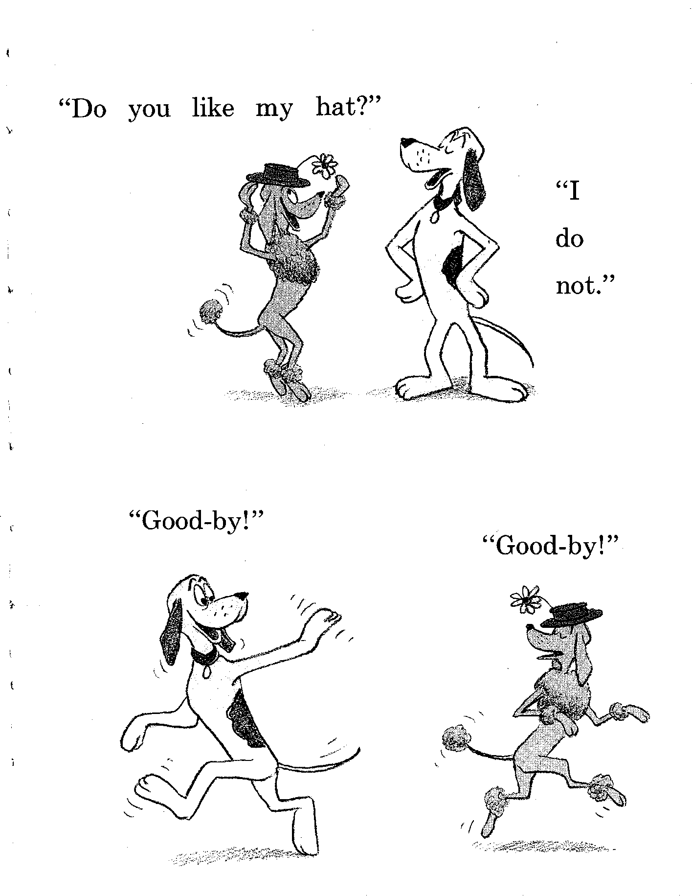

Slide 52
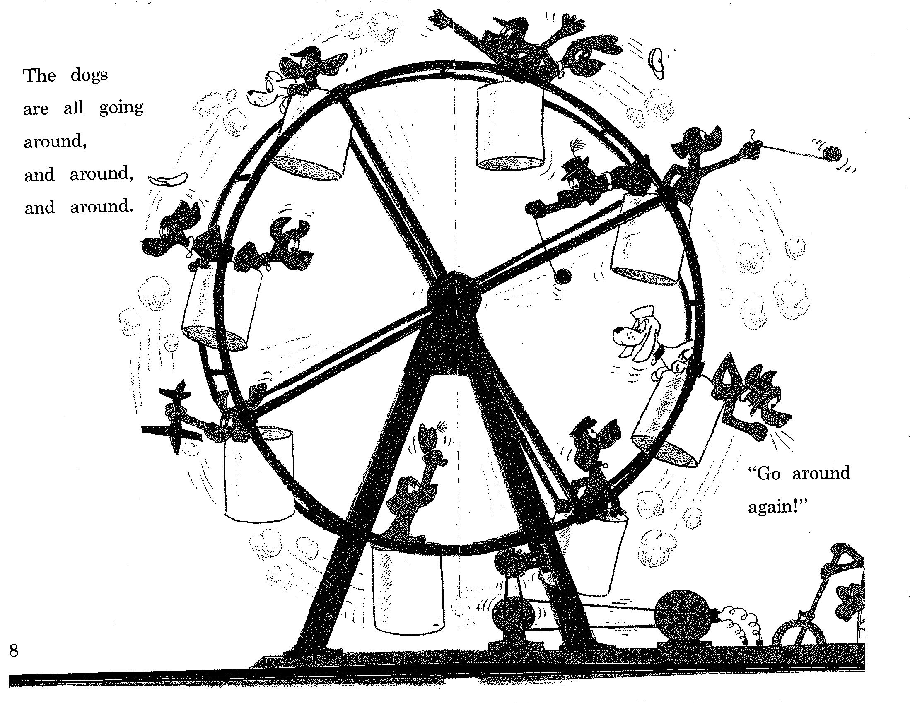

Slide 53
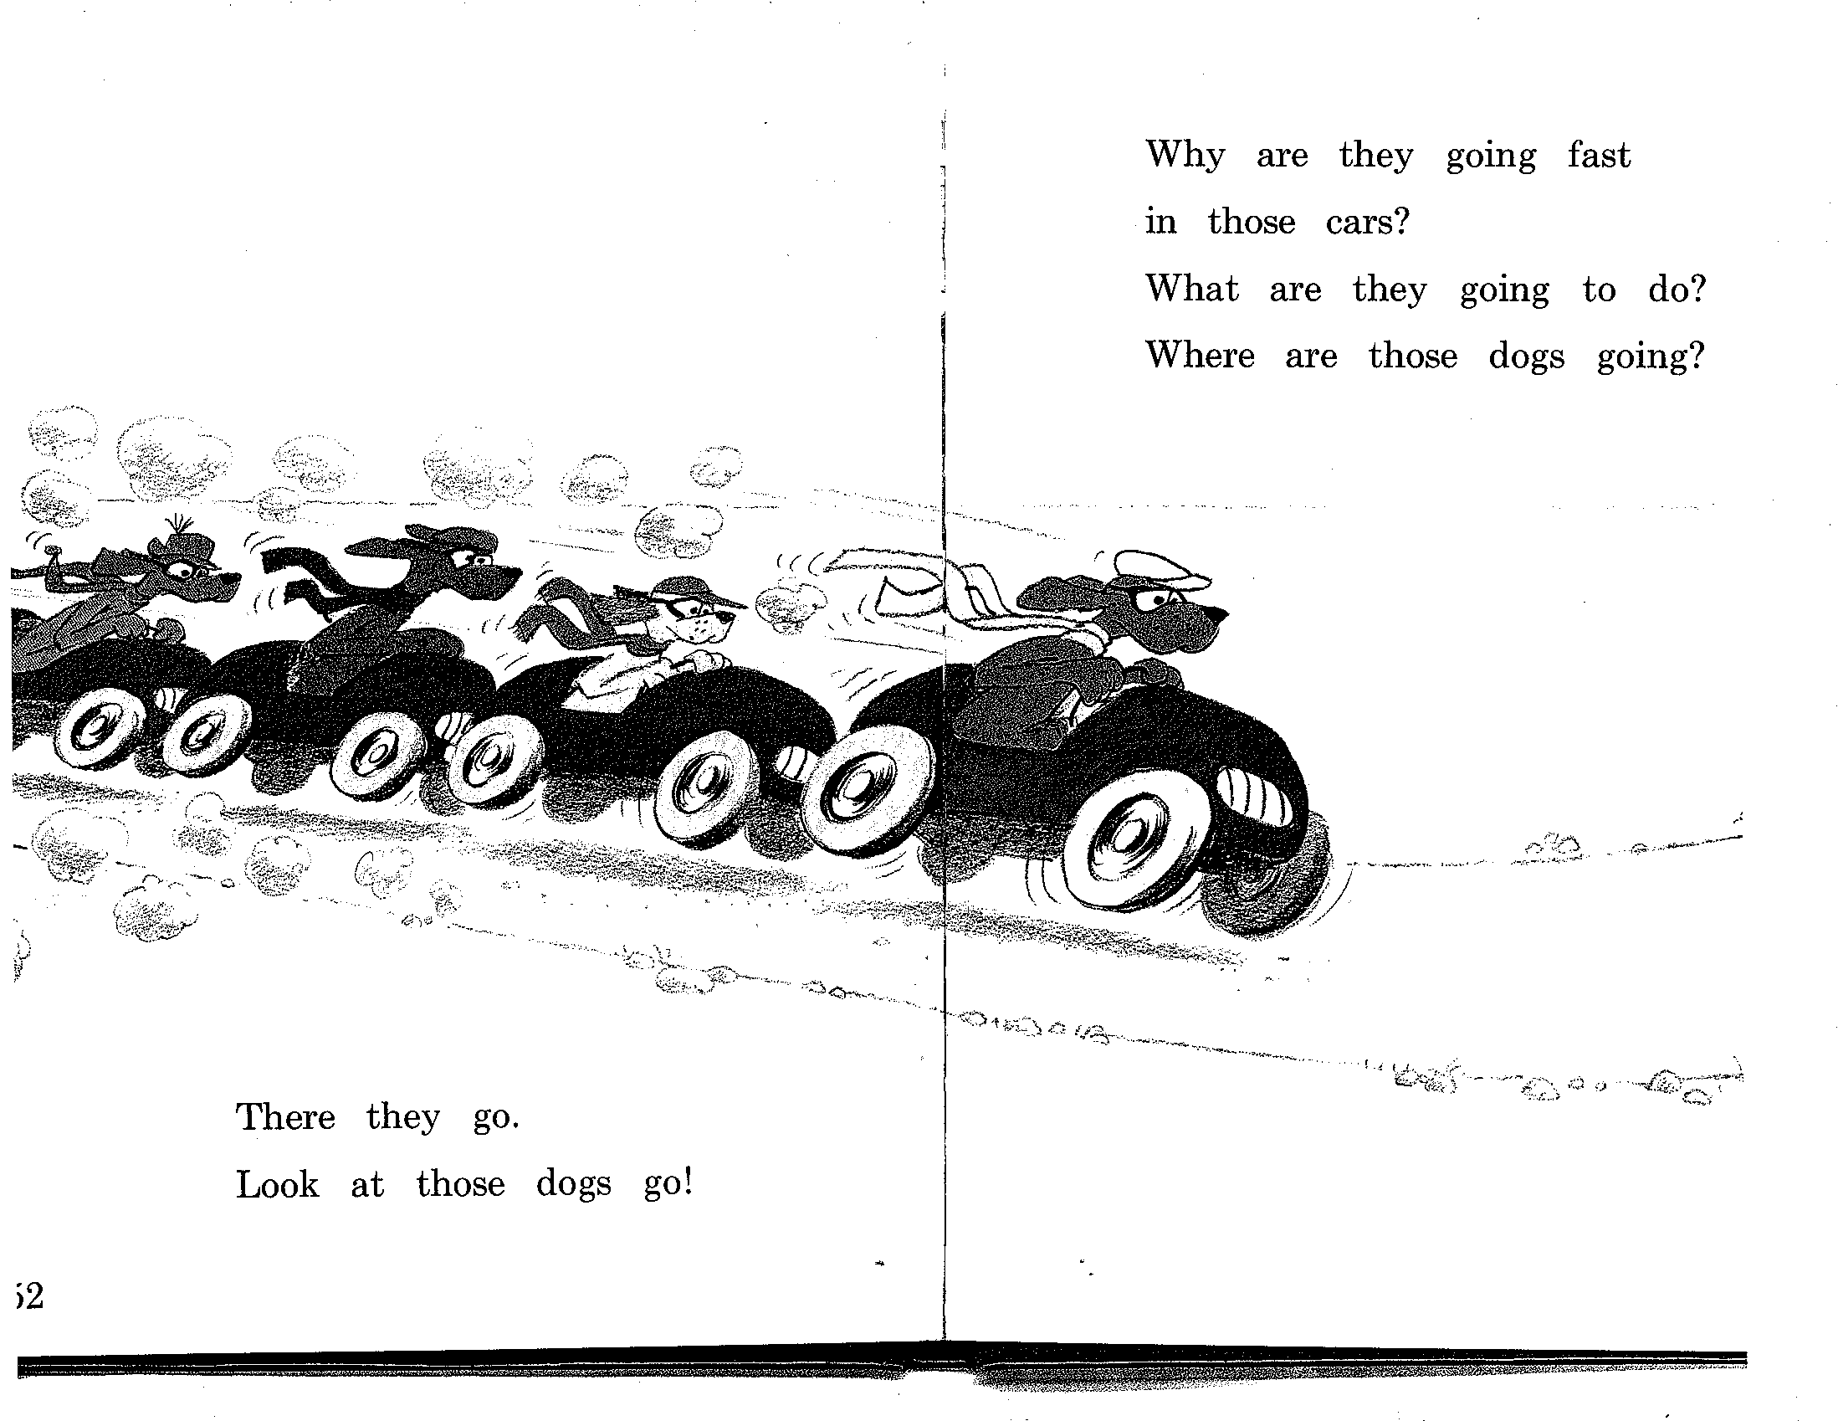

Slide 54
NPs
NP -> Pronoun
  I came, you saw it, they conquered
NP -> Proper-Noun
  New Jersey is west of New York City
  Lee Bollinger is the president of Columbia
NP -> Det Noun
  The president
NP -> Nominal
Nominal -> Noun Noun
  A morning flight to Denver

Slide 55
PPs
PP -> Preposition NP
  Over the house
  Under the house
  To the tree
  At play
  At a party on a boat at night

Slide 56
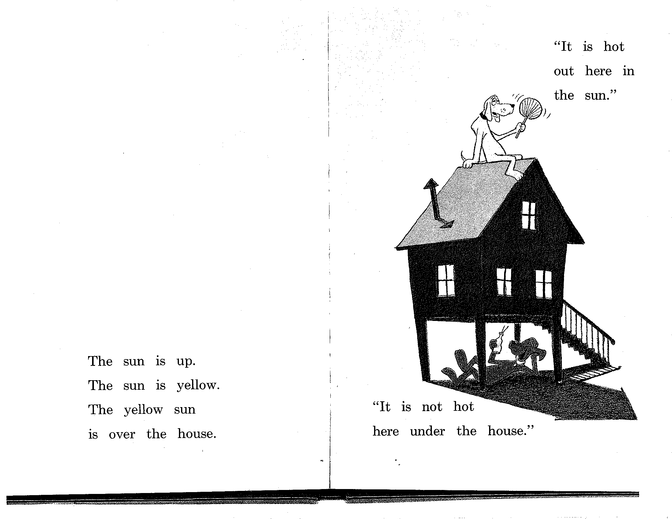

Slide 57
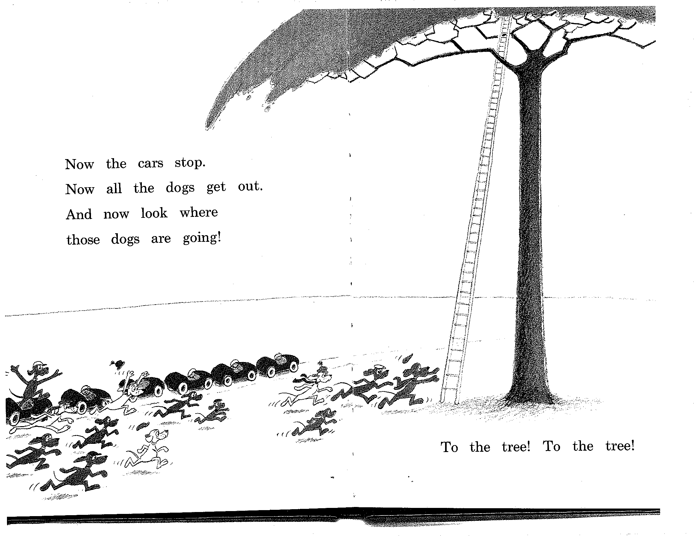

Slide 58
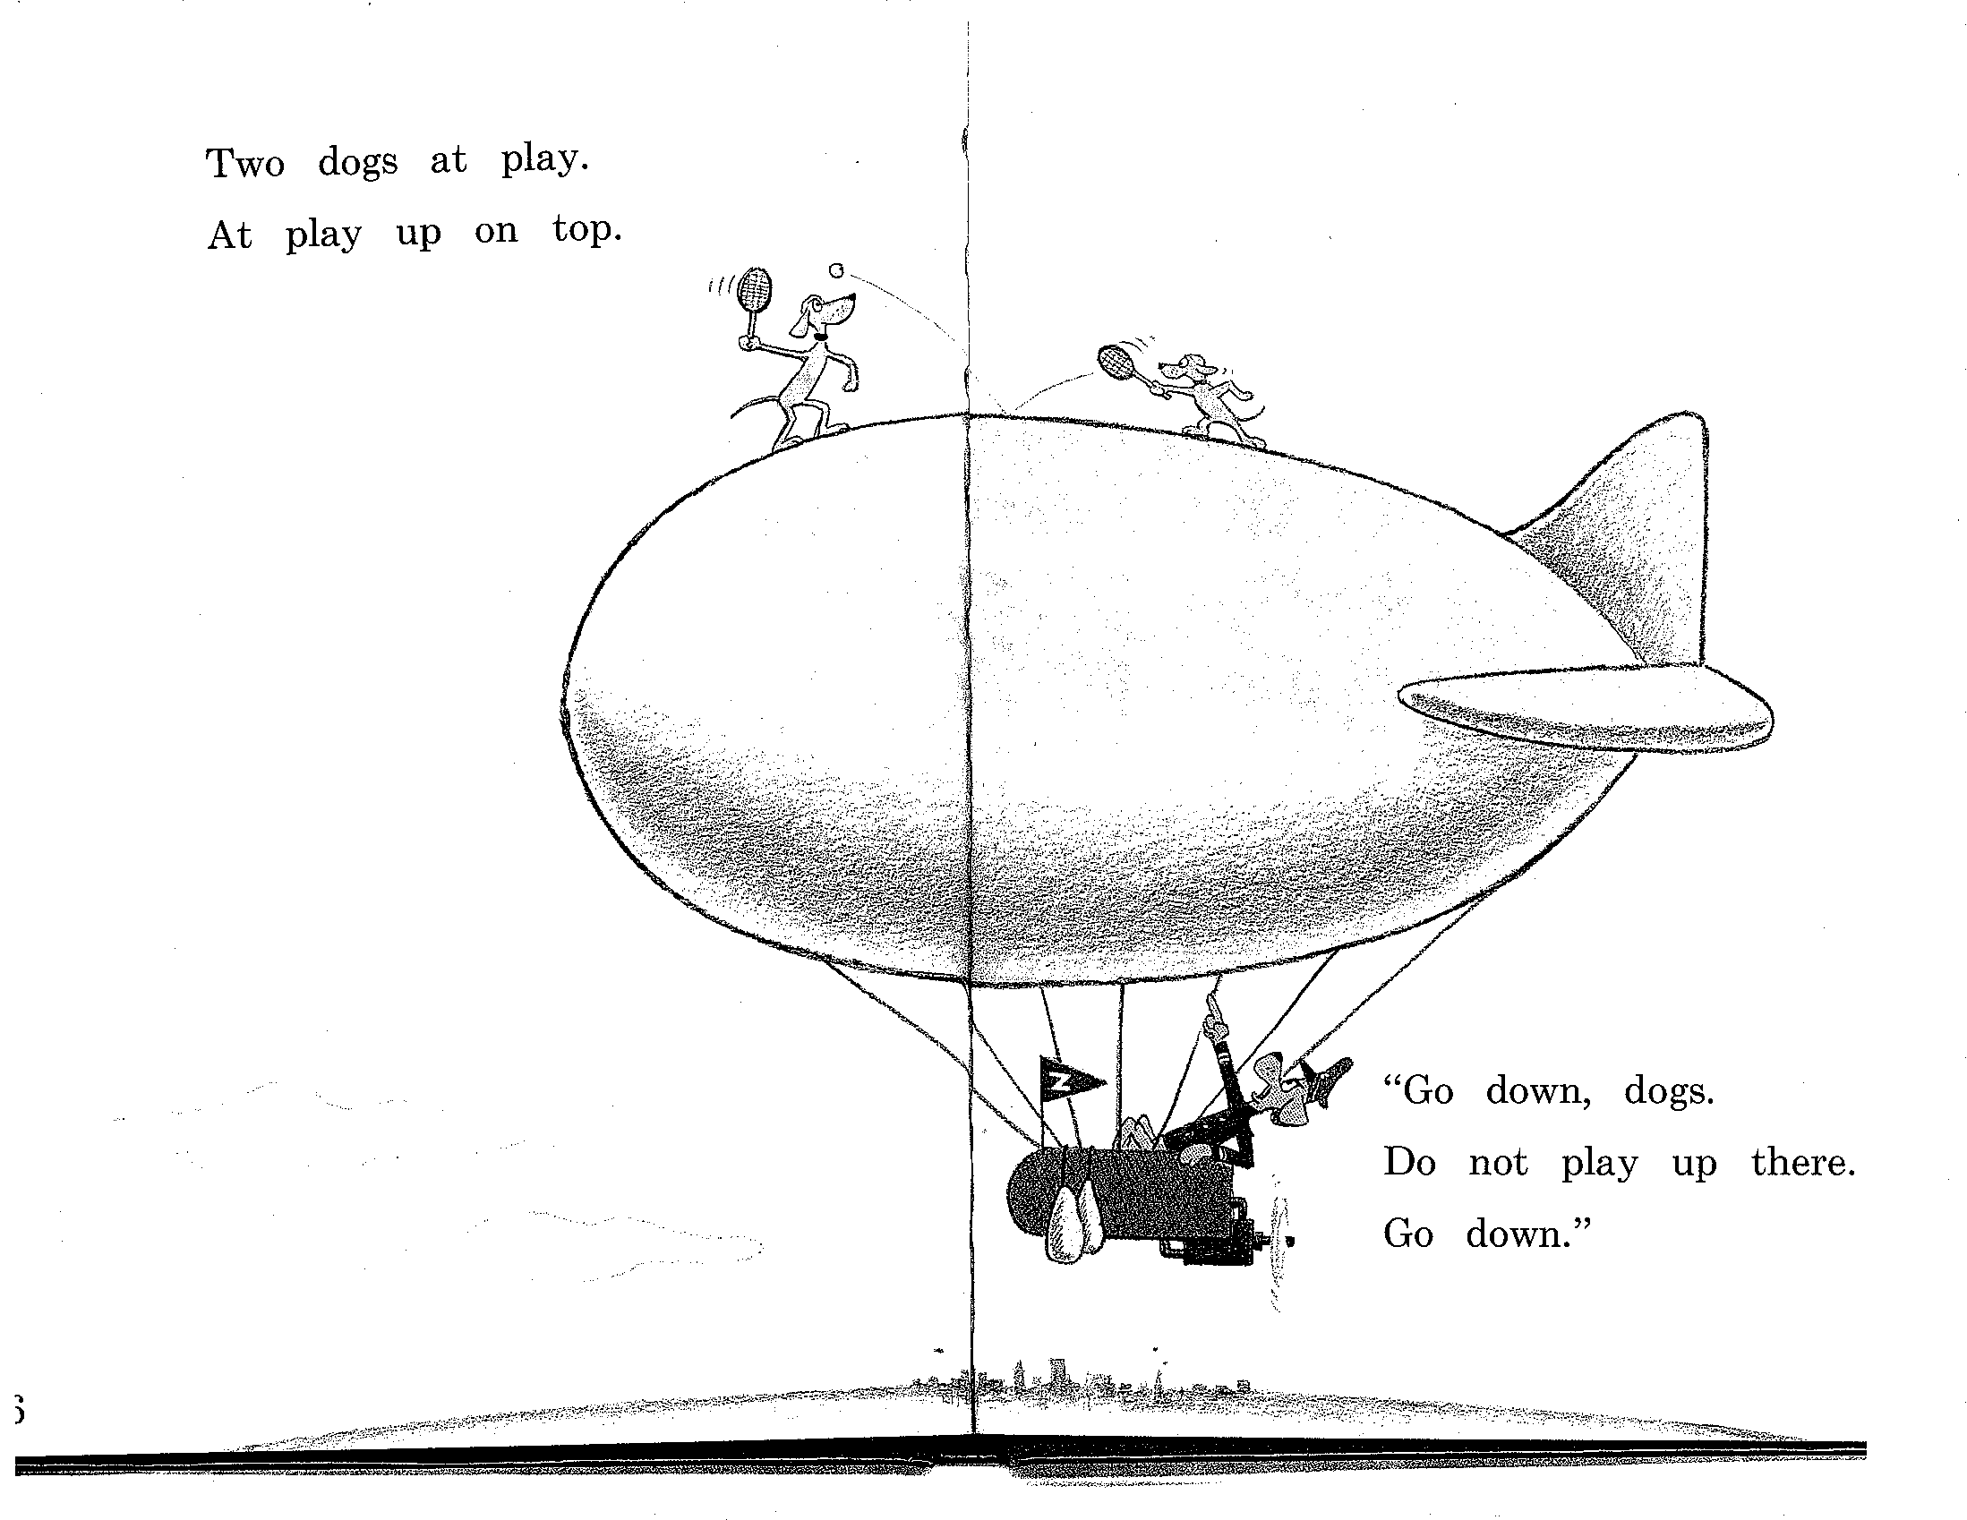

Slide 59
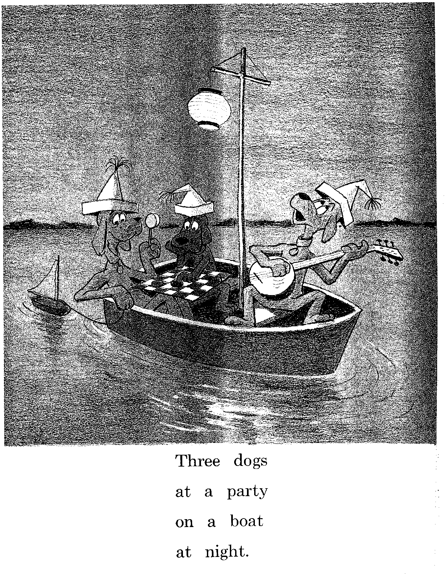

Slide 60
Recursion
We’ll have to deal with rules such as the following where the non-terminal on the left also appears somewhere on the right (directly)
  NP -> NP PP [[The flight] [to Boston]]
  VP -> VP PP [[departed Miami] [at noon]]
  (indirectly)
  NP -> NP Srel
  Srel -> NP VP [ [the dog] [[the cat] likes] ]

Slide 61
Recursion
Of course, this is what makes syntax interesting
  The dog bites
  The dog the mouse bit bites
  The dog the mouse the cat ate bit bites

Slide 62
Recursion
  [[Flights] [from Denver]]
  [[[Flights] [from Denver]] [to Miami]]
  [[[[Flights] [from Denver]] [to Miami]] [in February]]
  [[[[[Flights] [from Denver]] [to Miami]] [in February]] [on a Friday]]
  Etc.
  NP -> NP PP

Slide 63
Implications of Recursion and Context-Freeness
VP -> V NP
(I) hate
  flights from Denver
  flights from Denver to Miami
  flights from Denver to Miami in February
  flights from Denver to Miami in February on a Friday
  flights from Denver to Miami in February on a Friday under $300
  flights from Denver to Miami in February on a Friday under $300 with lunch
This is why context-free grammars are appealing! If you have a rule like
VP -> V NP
  It only cares that the thing after the verb is an NP
  It doesn’t have to know about the internal affairs of that NP

Slide 64
Grammar Equivalence
Can have different grammars that generate same set of strings (weak equivalence)
  Grammar 1: NP → DetP N and DetP → a | the
  Grammar 2: NP → a N | NP → the N
Can have different grammars that have same set of derivation trees (strong equivalence)
  With CFGs, possible only with useless rules
  Grammar 2: NP → a N | NP → the N
  Grammar 3: NP → a N | NP → the N, DetP → many
Strong equivalence implies weak equivalence

Slide 65
Normal Forms &c
There are weakly equivalent normal forms (Chomsky Normal Form, Greibach Normal Form)
There are ways to eliminate useless productions and so on

Slide 66
Chomsky Normal Form
A CFG is in Chomsky Normal Form (CNF) if all productions are of one of two forms:
A → BC with A, B, C nonterminals
A → a, with A a nonterminal and a a terminal
Every CFG has a weakly equivalent CFG in CNF

Slide 67
“Generative Grammar”
Formal languages: formal device to generate a set of strings (such as a CFG)
Linguistics (Chomskyan linguistics in particular): approach in which a linguistic theory enumerates all possible strings/structures in a language (=competence)
Chomskyan theories do not really use formal devices – they use CFG + informally defined transformations

Slide 68
Nobody Uses Simple CFGs (Except Intro NLP Courses)
All major syntactic theories (Chomsky, LFG, HPSG, TAG-based theories) represent both phrase structure and dependency, in one way or another
All successful parsers currently use statistics about phrase structure and about dependency
Derive dependency through “head percolation”: for each rule, say which daughter is head

Slide 69
Massive Ambiguity of Syntax
For a standard sentence, and a grammar with wide coverage, there are 1000s of derivations!
Example:
  The large portrait painter told the delegation that he sent money orders in a letter on Wednesday

Slide 70
Penn Treebank (PTB)
Syntactically annotated corpus of newspaper texts (phrase structure)
The newspaper texts are naturally occurring data, but the PTB is not!
PTB annotation represents a particular linguistic theory (but a fairly “vanilla” one)
Particularities
  Very indirect representation of grammatical relations (need for head percolation tables)
  Completely flat structure in NP (brown bag lunch, pink-and-yellow child seat )
  Has flat Ss, flat VPs

Slide 71
Example from PTB
( (S (NP-SBJ It)
(VP 's
(NP-PRD (NP (NP the latest investment craze)
(VP sweeping
(NP Wall Street)))
:
(NP (NP a rash)
(PP of
(NP (NP new closed-end country funds)
,
(NP (NP those
(ADJP publicly traded)
portfolios)
(SBAR (WHNP-37 that)
(S (NP-SBJ *T*-37)
(VP invest
(PP-CLR in
(NP (NP stocks)
(PP of
(NP a single foreign country)))))))))))

Slide 72
Types of syntactic constructions
Is this the same construction?
  An elf decided to clean the kitchen
  An elf seemed to clean the kitchen
  An elf cleaned the kitchen
Is this the same construction?
  An elf decided to be in the kitchen
  An elf seemed to be in the kitchen
  An elf was in the kitchen

Slide 73
Types of syntactic constructions (ctd)
Is this the same construction?
  There is an elf in the kitchen
  *There decided to be an elf in the kitchen
  There seemed to be an elf in the kitchen
Is this the same construction?
It is raining/it rains
  ??It decided to rain/be raining
  It seemed to rain/be raining

Slide 74
Types of syntactic constructions (ctd)
Is this the same construction?
  An elf decided that he would clean the kitchen
  * An elf seemed that he would clean the kitchen
  An elf cleaned the kitchen

Slide 75
Types of syntactic constructions (ctd)
Conclusion:
to seem: whatever is embedded surface subject can appear in upper clause
to decide: only full nouns that are referential can appear in upper clause
Two types of verbs

Slide 76
Types of syntactic constructions: Analysis
S
S
NP
VP
VP
an elf
S
S
V
V
to decide
NP
VP
to seem
NP
VP
an elf
PP
an elf
PP
V
V
to be
in the
kitchen
to be
in the
kitchen

Slide 77
Types of syntactic constructions: Analysis
S
S
NP
VP
VP
an elf
S
S
V
V
decided
NP
VP
seemed
NP
VP
PRO
PP
an elf
PP
V
V
to be
in the
kitchen
to be
in the
kitchen

Slide 78
Types of syntactic constructions: Analysis
S
S
NP
VP
VP
an elf
S
S
V
V
decided
NP
VP
seemed
NP
VP
PRO
PP
an elf
PP
V
V
to be
in the
kitchen
to be
in the
kitchen

Slide 79
Types of syntactic constructions: Analysis
S
S
NP
VP
NP_{i}
VP
an elf
S
an elf
S
V
V
decided
NP
VP
seemed
NP
VP
PRO
t_{i}
V
PP
V
PP
to be
in the
kitchen
to be
in the
kitchen

Slide 80
Types of syntactic constructions: Analysis
to seem: lower surface subject raises to
upper clause; raising verb
seems (there to be an elf in the kitchen)
there seems (t to be an elf in the kitchen)
it seems (there is an elf in the kitchen)

Slide 81
Types of syntactic constructions: Analysis (ctd)
to decide: subject is in upper clause and co-refers with an empty subject in lower clause; control verb
  an elf decided (an elf to clean the kitchen)
  an elf decided (PRO to clean the kitchen)
  an elf decided (he cleans/should clean the kitchen)
  *it decided (an elf cleans/should clean the kitchen)

Slide 82
Lessons Learned from the Raising/Control Issue
Use distribution of data to group phenomena into classes
Use different underlying structure as basis for explanations
Allow things to “move” around from underlying structure -> transformational grammar
Check whether explanation you give makes predictions

Slide 83
Examples from PTB
(S (NP-SBJ-1 The ropes)
(VP seem
(S (NP-SBJ *-1)
(VP to
(VP make
(NP much sound))))))
(S (NP-SBJ-1 The ancient church vicar)
(VP refuses
(S (NP-SBJ *-1)
(VP to
(VP talk
(PP-CLR about
(NP it)))))

Slide 84
The Big Picture
Empirical Matter
or
Formalisms
Data structures
Formalisms
Algorithms
Distributional Models
descriptive
theory is
about
Maud expects there to be a riot
*Teri promised there to be a riot
Maud expects the shit to hit the fan
*Teri promised the shit to hit the
uses
predicts
explanatory
theory is about
Linguistic Theory
Content: Relate morphology to semantics
Surface representation (eg, ps)
Deep representation (eg, dep)
Correspondence

Slide 85
Introduction to Syntax and
Context-Free Grammars http://www1.cs.columbia.edu/~rambow/teaching/lecture-2009-09-22.ppt
Owen Rambow
rambow@ccls.columbia.edu
Slides with contributions from Kathy McKeown, Dan Jurafsky and James Martin

