Slide 1
CS4705
Part of Speech tagging
Some slides adapted from: Dan Jurafsky, Julia Hirschberg, Jim Martin

Slide 2
HW questions?
Training files, question samples
  /home/cs4705/corpora/wsj
  /home/cs4705/corpora/wsj/wsj_2300questions.txt
  CVN: will post on the CVN web site this afternoon
Question and answer templates
Not expected to use tools that we haven’t gone over (e.g., named entity recognition)
    Must allow paraphrases for indices
    But company names will be provided in question exactly as they appear in article
Any other questions?

Slide 3
Smoothing
Words follow a Zipfian distribution
  Small number of words occur very frequently
  A large number are seen only once
  Zipf’s law: a word’s frequency is approximately inversely proportional to its rank in the word distribution list
Zero probabilities on one bigram cause a zero probability on the entire sentence

Slide 4
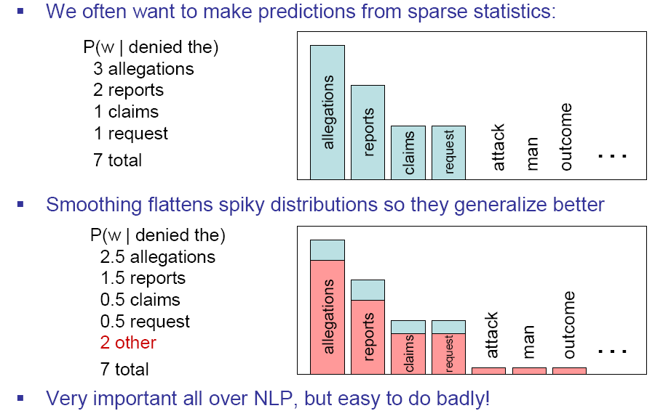
Smoothing is like Robin Hood:
Steal from the rich and give to the poor (in probability mass)
Slide from Dan Klein

Slide 5
Smoothing Methods
Add-one smoothing (easy, but inaccurate)
  Add 1 to every word count (Note: this is type)
  Increment normalization factor by Vocabulary size: N (tokens) + V (types) :
Backoff models
  When a count for an n-gram is 0, back off to the count for the (n-1)-gram
  These can be weighted
Class-based smoothing
  For certain types of n-grams, back off to the count of its syntactic class
  E.g., Count ProperNouns in place of names (e.g., Obama)
Good-Turing
  Re-estimate amount of probability mass for zero (or low count) ngrams by looking at ngrams with higher counts
  Estimate

Slide 6
Garden path sentences
The old dog the footsteps of the young.
The cotton clothing is made of grows in Mississippi.
The horse raced past the barn fell.

Slide 7
What is a word class?
Words that somehow ‘behave’ alike:
  Appear in similar contexts
  Perform similar functions in sentences
  Undergo similar transformations
9 (or so) traditional parts of speech
  Noun, verb, adjective, preposition, adverb, article, interjection, pronoun, conjunction,

Slide 8
POS examples
N noun chair, bandwidth, pacing
V verb study, debate, munch
ADJ adjective purple, tall, ridiculous
ADV adverb unfortunately, slowly,
P preposition of, by, to
PRO pronoun I, me, mine
DET determiner the, a, that, those

Slide 9
POS Tagging: Definition
The process of assigning a part-of-speech or lexical class marker to each word in a corpus:
WORDS
TAGS
the
koala
put
the
keys
on
the
table
N
V
P
DET

Slide 10
What is POS tagging good for?
Is the first step of a vast number of Comp Ling tasks
Speech synthesis:
  How to pronounce “lead”?
  INsult inSULT
  OBject obJECT
  OVERflow overFLOW
  DIScount disCOUNT
  CONtent conTENT
Parsing
  Need to know if a word is an N or V before you can parse
Word prediction in speech recognition
  Possessive pronouns (my, your, her) followed by nouns
  Personal pronouns (I, you, he) likely to be followed by verbs
Machine Translation

Slide 11
Open and closed class words
Closed class: a relatively fixed membership
  Prepositions: of, in, by, …
  Auxiliaries: may, can, will had, been, …
  Pronouns: I, you, she, mine, his, them, …
  Usually function words (short common words which play a role in grammar)
Open class: new ones can be created all the time
  English has 4: Nouns, Verbs, Adjectives, Adverbs
  Many languages have all 4, but not all!
  In Lakhota and possibly Chinese, what English treats as adjectives act more like verbs.

Slide 12
Open class words
Nouns
  Proper nouns (Columbia University, New York City, Arthi Ramachandran, Metropolitan Transit Center). English capitalizes these.
  Common nouns (the rest). German capitalizes these.
  Count nouns and mass nouns
    Count: have plurals, get counted: goat/goats, one goat, two goats
    Mass: don’t get counted (fish, salt, communism) (*two fishes)
Adverbs: tend to modify things
  Unfortunately, John walked home extremely slowly yesterday
  Directional/locative adverbs (here, home, downhill)
  Degree adverbs (extremely, very, somewhat)
  Manner adverbs (slowly, slinkily, delicately)
Verbs:
  In English, have morphological affixes (eat/eats/eaten)
  Actions (walk, ate) and states (be, exude)

Slide 13
Many subclasses, e.g.
  eats/V ⇒ eat/VB, eat/VBP, eats/VBZ, ate/VBD, eaten/VBN, eating/VBG, ...
  Reflect morphological form & syntactic function

Slide 14
How do we decide which words go in which classes?
Nouns denote people, places and things and can be preceded by articles? But…
    My typing is very bad.
    *The Mary loves John.
Verbs are used to refer to actions, processes, states
  But some are closed class and some are open
  I will have emailed everyone by noon.
  Adverbs modify actions
  Is Monday a temporal adverb or a noun? Some others?

Slide 15
Closed Class Words
Idiosyncratic
Closed class words (Prep, Det, Pron, Conj, Aux, Part, Num) are easier, since we can enumerate them….but
  Part vs. Prep
    George eats up his dinner/George eats his dinner up.
    George eats up the street/*George eats the street up.
  Articles come in 2 flavors: definite (the) and indefinite (a, an)

Slide 16
POS tagging: Choosing a tagset
To do POS tagging, need to choose a standard set of tags to work with
Could pick very coarse tagsets
  N, V, Adj, Adv.
Brown Corpus (Francis & Kucera ‘82), 1M words, 87 tags
Penn Treebank: hand-annotated corpus of Wall Street Journal, 1M words, 45-46 tags
  Commonly used
  set is finer grained,
Even more fine-grained tagsets exist

Slide 17
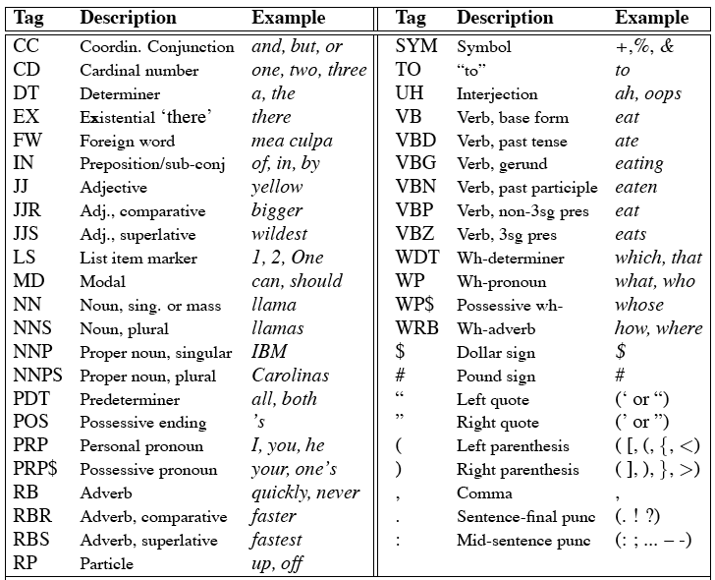
Penn TreeBank POS Tag set

Slide 18
Using the UPenn tagset
The/DT grand/JJ jury/NN commmented/VBD on/IN a/DT number/NN of/IN other/JJ topics/NNS ./.
Prepositions and subordinating conjunctions marked IN (“although/IN I/PRP..”)
Except the preposition/complementizer “to” is just marked “to”.

Slide 19
POS Tagging
Words often have more than one POS: back
  The back door = JJ
  On my back = NN
  Win the voters back = RB
  Promised to back the bill = VB
The POS tagging problem is to determine the POS tag for a particular instance of a word.
These examples from Dekang Lin

Slide 20
How do we assign POS tags to words in a sentence?
  Time flies like an arrow.
  Time/[V,N] flies/[V,N] like/[V,Prep] an/Det arrow/N
  Time/N flies/V like/Prep an/Det arrow/N
  Fruit/N flies/N like/V a/DET banana/N
  Fruit/N flies/V like/Prep a/DET banana/N
  The/Det flies/N like/V a/DET banana/N

Slide 21
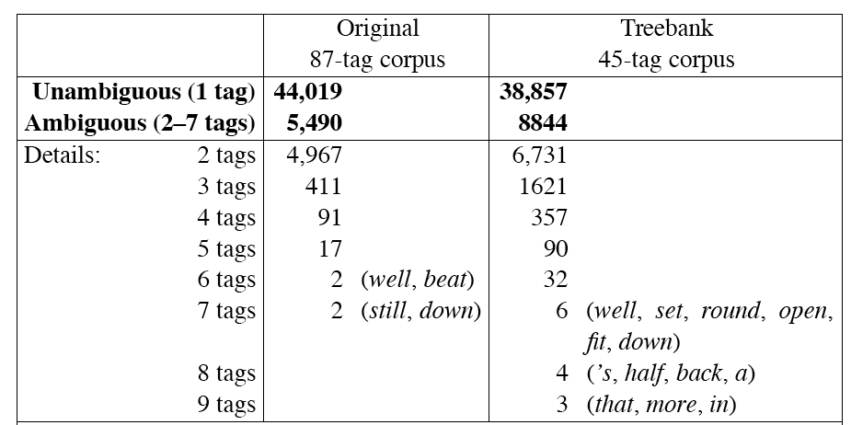
How hard is POS tagging? Measuring ambiguity

Slide 22
Potential Sources of Disambiguation
Many words have only one POS tag (e.g. is, Mary, very, smallest)
Others have a single most likely tag (e.g. a, dog)
But tags also tend to co-occur regularly with other tags (e.g. Det, N)
In addition to conditional probabilities of words P(w₁|w_{n-1}), we can look at POS likelihoods P(t₁|t_{n-1}) to disambiguate sentences and to assess sentence likelihoods

Slide 23
3 methods for POS tagging
Rule-based tagging
  (ENGTWOL)
Transformation-based tagging
    Learned rules (statistic and linguistic)
  Brill tagger
Stochastic (=Probabilistic) tagging
  HMM (Hidden Markov Model) tagging

Slide 24
Rule-based tagging
Start with a dictionary
Assign all possible tags to words from the dictionary
Write rules by hand to selectively remove tags
Leaving the correct tag for each word.

Slide 25
Start with a dictionary
she: PRP
promised: VBN,VBD
to TO
back: VB, JJ, RB, NN
the: DT
bill: NN, VB
Etc… for the ~100,000 words of English

Slide 26
Use the dictionary to assign every possible tag
NN
RB
VBN JJ VB
PRP VBD TO VB DT NN
She promised to back the bill

Slide 27
Write rules to eliminate tags
Eliminate VBN if VBD is an option when VBN|VBD follows “<start> PRP”
NN
RB
JJ VB
PRP VBD TO VB DT NN
She promised to back the bill
VBN

Slide 28
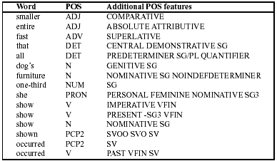
Sample ENGTWOL Lexicon

Slide 29
Stage 1 of ENGTWOL Tagging
First Stage: Run words through FST morphological analyzer to get all parts of speech.
Example: Pavlov had shown that salivation …
Pavlov PAVLOV N NOM SG PROPER
had HAVE V PAST VFIN SVO
HAVE PCP2 SVO
shown SHOW PCP2 SVOO SVO SV
that ADV
PRON DEM SG
DET CENTRAL DEM SG
CS
salivation N NOM SG

Slide 30
Stage 2 of ENGTWOL Tagging
Second Stage: Apply NEGATIVE constraints.
Example: Adverbial “that” rule
  Eliminates all readings of “that” except the one in
    “It isn’t that odd”
Given input: “that”
If
(+1 A/ADV/QUANT) ;if next word is adj/adv/quantifier
(+2 SENT-LIM) ;following which is E-O-S
(NOT -1 SVOC/A) ; and the previous word is not a
; verb like “consider” which
; allows adjective complements
; in “I consider that odd”
Then eliminate non-ADV tags
Else eliminate ADV

Slide 31
Transformation-Based Tagging (Brill Tagging)
Combination of Rule-based and stochastic tagging methodologies
  Like rule-based because rules are used to specify tags in a certain environment
  Like stochastic approach because machine learning is used—with tagged corpus as input
    Rules are learned
Input:
  tagged corpus
  dictionary (with most frequent tags)

Slide 32
Transformation-Based Tagging
Basic Idea:
  Set the most probable tag for each word as a start value
  Change tags according to rules of type “if word-1 is a determiner and word is a verb then change the tag to noun” in a specific order
Training is done on tagged corpus:
  Use a set of rule templates
  Among the set of rules, find one with highest score
  Continue finding rules until lowest score threshold is passed
  Keep the ordered set of rules
Rules make errors that are corrected by later rules

Slide 33
TBL Rule Application
Tagger labels every word with its most-likely tag
  For example: race has the following probabilities in the Brown corpus:
    P(NN|race) = .98
    P(VB|race)= .02
Transformation rules make changes to tags
  “Change NN to VB when previous tag is TO”
  … is/VBZ expected/VBN to/TO race/NN tomorrow/NN
  becomes
  … is/VBZ expected/VBN to/TO race/VB tomorrow/NN

Slide 34
TBL: Rule Learning
2 parts to a rule
  Triggering environment
  Rewrite rule
The range of triggering environments of templates (from Manning & Schutze 1999:363)
Schema t_{i-3} t_{i-2} t_{i-1} t_{i} t_{i+1} t_{i+2} t_{i+3}
1 *
2 *
3 *
4 *
5 *
6 *
7 *
8 *
9 *

Slide 35
TBL: The Tagging Algorithm
Step 1: Label every word with most likely tag (from dictionary)
Step 2: Check every possible transformation & select one which most improves tagging
Step 3: Re-tag corpus applying the rules
Repeat 2-3 until some criterion is reached, e.g., X% correct with respect to training corpus
RESULT: Sequence of transformation rules

Slide 36
TBL: Rule Learning (cont.)
Problem: Could apply transformations ad infinitum!
Constrain the set of transformations with “templates”:
  Replace tag X with tag Y, provided tag Z or word Z’ appears in some position
Rules are learned in ordered sequence
Rules may interact.
Rules are compact and can be inspected by humans

Slide 37
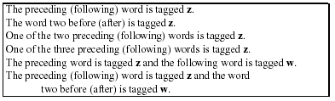
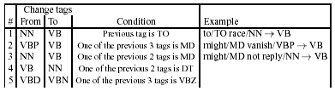
Templates for TBL

Slide 38
Comparison of two approaches
Accuracy
Coverage
Ease of building such a system
    What is needed?
Ease in porting to a new genre/new domain
Baseline?

Slide 39
Summary
Parts of speech
  What’s POS tagging good for anyhow?
  Tag sets
  Rule-based tagging
  Learning rules: statistical and linguistic
  Next time:
    HMM Tagging

