Slide 1
Regular Expressions and Automata in Natural Language Analysis
CS 4705
Some slides adapted from Hirschberg, Dorr/Monz, Jurafsky

Slide 2
Announcements
New Office Hours for Kaushal Lahankar
Usually: Th 4-5; Fri 1-2
THIS WEEK: Fri 1-3
Class participation and CVN

Slide 3
Rule-based vs. Statistical Approaches
Rule-based = linguistic
For what problems is rule-based better suited and when is statistics better
Identifying proper names
Distinguishing a biography from a dictionary entry
Answering questions
How far can a simple method take us?
How much is Google worth?
How much is Microsoft worth?
How much knowledge of language do our algorithms need to do useful NLP?
80/20 Rule:
Claim: 80% of NLP can be done with simple methods
When should we worry about the other 20%?

Slide 4
Rule-based vs. Statistical Approaches
Rule-based = linguistic
For what problems is rule-based better suited and when is statistics better
Identifying proper names
Distinguishing a biography from a dictionary entry
Answering questions
How far can a simple method take us?
How much is Google worth?
How much is Microsoft worth?
How much is IBM worth?
How much knowledge of language do our algorithms need to do useful NLP?
80/20 Rule:
Claim: 80% of NLP can be done with simple methods
When should we worry about the other 20%?

Slide 5
Rule-based vs. Statistical Approaches
Rule-based = linguistic
For what problems is rule-based better suited and when is statistics better
Identifying proper names
Distinguishing a biography from a dictionary entry
Answering questions
How far can a simple method take us?
How much is Google worth?
How much is Microsoft worth?
How much is IBM worth?
How much is Walmart worth?
How much knowledge of language do our algorithms need to do useful NLP?
80/20 Rule:
Claim: 80% of NLP can be done with simple methods
When should we worry about the other 20%?

Slide 6
Rule-based vs. Statistical Approaches
Rule-based = linguistic
For what problems is rule-based better suited and when is statistics better
Identifying proper names
Distinguishing a biography from a dictionary entry
Answering questions
How far can a simple method take us?
How much is Google worth?
How much is Microsoft worth?
How much is a Columbia University education worth?
How much is the Statue of Liberty worth?
How much is your life worth?
How much knowledge of language do our algorithms need to do useful NLP?
80/20 Rule:
Claim: 80% of NLP can be done with simple methods
When should we worry about the other 20%?

Slide 7
Today
Review some simple representations of language and see how far they will take us
Regular Expressions
Finite State Automata
Think about the limits of these simple approaches
When are simple methods good enough?
When do we need something more?

Slide 8
Regular Expression/Pattern Matching in NLP
Simple but powerful tools for ‘shallow’ processing of a document or “corpus”
What word begins a sentence?
What words begin a question?
Identify all noun phrases
Allow us to
Build simple interactive applications (e.g. Eliza)
Morphological analysis
Recognize Named Entities (NE): people names, company names

Slide 9
Review
RE
Matches
Uses
/./
Any character
A non-blank line
/\./, /\?/
A ‘.’, a ‘?’
A statement, a question
/[bckmsr]/
Any char in set
Rhyme:/[bckmrs]ite/
/[a-z]/
Any l.c. letter
Rhyme: /[a-z]ite/
/ [A-Z]/
Capitalized letter
Possible NE
/ [^A-Z]/
Lower case letter
Not an NE

Slide 10
RE | Description | Uses?
/a*/ | Zero or more a’s | /(very[ ])*/
/a+/ | One or more a’s | /(very[ ])+/
/a?/ | Optional single a | /(very[ ])?/
/cat|dog/ | ‘cat’ or ‘dog’ | /[A-Z,a-z]* (cat|dog)/
/^[Nn]o$/ |  | A line with only ‘No’ or ‘no’ in it
/\bun\B/ | Prefixes | Words prefixed by ‘un’ (nb. union)

Slide 11
RE plus
E.G.
/kitt(y|ies|en|ens)/
Morphological variants of ‘kitty’
/ (.+ier) and \1 /
Patterns: happier and happier, fuzzier and fuzzier, classifier and classifier

Slide 12
Question Answering
Eliza

Slide 13
Eliza (Weizenbaum)
Men are all alike.
IN WHAT WAY?
They're always bugging us about something or other.
CAN YOU THINK OF A SPECIFIC EXAMPLE?
Well, my boyfriend made me come here.
YOUR BOYFRIEND MADE YOU COME HERE
He says I'm depressed much of the time.
I AM SORRY TO HEAR YOU ARE DEPRESSED
It's true. I am unhappy
DO YOU THINK COMING HERE WILL HELP YOU NOT TO BE UNHAPPY
I need some help, that much seems certain.
WHAT WOULD IT MEAN TO YOU IF YOU GOT SOME HELP
Perhaps I could learn to get along with my mother.
TELL ME MORE ABOUT YOUR FAMILY
My mother takes care of me.
WHO ELSE IN YOUR FAMILY TAKES CARE OF YOU
My father.
YOUR FATHER
You are like my father in some ways.
Notes:
s/\bI(’m| am)\b /YOU ARE/g
s/\bmy\b /YOUR/g
S/\bmine\b /YOURS/g
s/.* YOU ARE (depressed|sad) .*/I AM SORRY TO HEAR YOU ARE \1/
s/.* YOU ARE (depressed|sad) .*/WHY DO YOU THINK YOU ARE \1/
s/.* all .*/IN WHAT WAY/
s/.* always .*/CAN YOU THINK OF A SPECIFIC EXAMPLE/

Slide 14
Eliza-style regular expressions
Step 1: replace first person with second person references
s/\bI(’m| am)\b /YOU ARE/g
s/\bmy\b /YOUR/g
S/\bmine\b /YOURS/g
Step 2: use additional regular expressions to generate replies
s/.* YOU ARE (depressed|sad) .*/I AM SORRY TO HEAR YOU ARE \1/
s/.* YOU ARE (depressed|sad) .*/WHY DO YOU THINK YOU ARE \1/
s/.* all .*/IN WHAT WAY/
s/.* always .*/CAN YOU THINK OF A SPECIFIC EXAMPLE/
Step 3: use scores to rank possible transformations
Slide from Dorr/Monz

Slide 15
How far does this allow you to go? How much of a question answering system?
Advantages?
Disadvatages?

Slide 16
Three Views
Three equivalent formal ways to look at what we’re up to
Regular Expressions
Regular
Languages
Finite State Automata
Regular Grammars

Slide 17
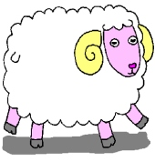
Finite-state Automata (Machines)
baa!
baaa!
baaaa!
baaaaa!
...
/^baa+!$/
a
b
a
a
!
q₀
q₁
q₂
q₃
q₄
state
final state
transition
Slide from Dorr/Monz

Slide 18
Formally
FSA is a 5-tuple consisting of
Q: set of states {q0,q1,q2,q3,q4}
Σ: an alphabet of symbols {a,b,!}
q0: a start state in Q
F: a set of final states in Q {q4}
δ(q,i): a transition function mapping Q x Σ to Q
a
b
a
a
!
q0
q1
q2
q3
q4

Slide 19
Yet Another View
State-transition table

Slide 20
Recognition
Recognition is the process of determining if a string should be accepted by a machine
Or… it’s the process of determining if a string is in the language we’re defining with the machine
Or… it’s the process of determining if a regular expression matches a string

Slide 21
Recognition
Traditionally, (Turing’s idea) this process is depicted with a tape.

Slide 22
Recognition
Start in the start state
Examine the current input
Consult the table
Go to a new state and update the tape pointer.
Until you run out of tape.

Slide 23
Input Tape
q₀
REJECT
a
b
a
!
b
b
a
a
a
!
0
1
2
3
4
Slide from Dorr/Monz

Slide 24
Input Tape
q₀
q₁
q₂
q₃
q₃
q₄
ACCEPT
b
a
a
a
!
b
a
a
a
!
0
1
2
3
4
Slide from Dorr/Monz

Slide 25
Key Points
Deterministic means that at each point in processing there is always one unique thing to do (no choices).
D-recognize is a simple table-driven interpreter
The algorithm is universal for all unambiguous languages.
To change the machine, you change the table.
Slide from Jurafsky

Slide 26
Non-Deterministic FSAs for SheepTalk
a
b
a
a
!
q0
q1
q2
q3
q4
b
a
a
!
q0
q1
q2
q3
q4
ε

Slide 27
Problems of Non-Determinism
At any choice point, we may follow the wrong arc
Potential solutions:
Save backup states at each choice point
Look-ahead in the input before making choice
Pursue alternatives in parallel
Determinize our NFSAs (and then minimize)
FSAs can be useful tools for recognizing – and generating – subsets of natural language
But they cannot represent all NL phenomena (e.g. center embedding: The mouse the cat chased died.)

Slide 28
FSAs as Grammars for Natural Language: Names
dr
the
rev
mr
pat
l.
robinson
q0
q1
q2
q3
q4
q5
q6
hon
ms
ε
mrs
ε

Slide 29
Recognizing Person Names
If we want to extract all the proper names in the news, will this work?
What will it miss?
Will it accept something that is not a proper name?
How would you change it to accept all proper names without false positives?
Precision vs. recall….

Slide 30
English Morphology
Morphology is the study of the ways that words are built up from smaller meaningful units called morphemes
We can usefully divide morphemes into two classes
Stems: The core meaning bearing units
Affixes: Bits and pieces that adhere to stems to change their meanings and grammatical functions

Slide 31
Regular and Irregular Nouns and Verbs
Regulars…
Walk, walks, walking, walked, walked
Table, tables
Irregulars
Eat, eats, eating, ate, eaten
Catch, catches, catching, caught, caught
Cut, cuts, cutting, cut, cut
Goose, geese

Slide 32
What we want
Something to automatically do the following kinds of mappings:
Cats cat +N +PL
Cat cat +N +SG
Cities city +N +PL
Merging merge +V +Present-participle
Caught catch +V +past-participle

Slide 33
Why care about morphology?
Spelling correction: referece
Morphology in machine translation
Spanish words quiero and quieres are both related to querer ‘want’
Hyphenation algorithms: refer-ence
Part-of-speech analysis: google, googler
Text-to-speech: grapheme-to-phoneme conversion
hothouse (/T/ or /D/)
Allows us to guess at meaning
‘Twas brillig and the slithy toves…
Muggles moogled migwiches
Notes:
Gesagt: past tense of said in German (pres: sagen)
Arabic: v: to worship, to build, to enslave
n: religious service, worship, bondage, slavery, servant, slave, worshipper,

Slide 34
Morphology and FSAs
We’d like to use the machinery provided by FSAs to capture facts about morphology
Ie. Accept strings that are in the language
And reject strings that are not
And do it in a way that doesn’t require us to in effect list all the words in the language

Slide 35
What do we need to build a morphological parser?
Lexicon: list of stems and affixes (w/ corresponding part of speech (p.o.s.))
Morphotactics of the language: model of how and which morphemes can be affixed to a stem
Orthographic rules: spelling modifications that may occur when affixation occurs
in → il in context of l (in- + legal)
Most morphological phenomena can be described with regular expressions – so finite state techniques often used to represent morphological processes

Slide 36
Start Simple
Regular singular nouns are ok
Regular plural nouns have an -s on the end
Irregulars are ok as is

Slide 37
Simple Rules

Slide 38
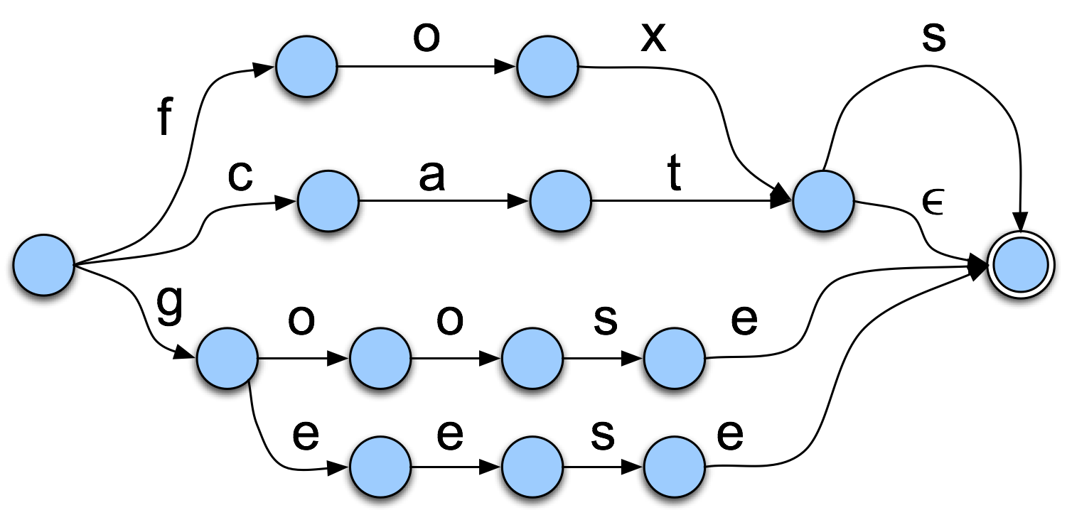
Now Add in the Words

Slide 39
Derivational morphology: adjective fragment
adj-root₁
un-
-er, -ly, -est
q1
q2
q0
adj-root₁
q5
q3
q4
ε
-er, -est
adj-root₂
Adj-root₁: clear, happi, real
Adj-root₂: big, red (*bigly)
Notes:
What will happen if we use only the FSA defined by the purple nodes?
Will allow unbig, unred,…
Solution: define classes of adjective stems
NFSA: easier and more intuitive to define

Slide 40
Parsing/Generation vs. Recognition
We can now run strings through these machines to recognize strings in the language
Accept words that are ok
Reject words that are not
But recognition is usually not quite what we need
Often if we find some string in the language we might like to find the structure in it (parsing)
Or we have some structure and we want to produce a surface form (production/generation)
Example
From “cats” to “cat +N +PL”

Slide 41
Finite State Transducers
The simple story
Add another tape
Add extra symbols to the transitions
On one tape we read “cats”, on the other we write “cat +N +PL”

Slide 42
Applications
The kind of parsing we’re talking about is normally called morphological analysis
It can either be
An important stand-alone component of an application (spelling correction, information retrieval)
Or simply a link in a chain of processing

Slide 43
Generativity
Nothing really privileged about the directions.
We can write from one and read from the other or vice-versa.
One way is generation, the other way is analysis

Slide 44
FSTs
Kimmo Koskenniemi’s two-level morphology
Idea: word is a relationship between lexical level (its morphemes) and surface level (its orthography)

Slide 45
Transitions
c:c
a:a
t:t
+N:ε
+PL:s
c:c means read a c on one tape and write a c on the other
+N:ε means read a +N symbol on one tape and write nothing on the other
+PL:s means read +PL and write an s

Slide 46
The Gory Details
Of course, its not as easy as
“cat +N +PL” <-> “cats”
As we saw earlier there are geese, mice and oxen
But there are also a whole host of spelling/pronunciation changes that go along with inflectional changes
Cats vs Dogs
Fox and Foxes

Slide 47
Multi-Tape Machines
To deal with this we can simply add more tapes and use the output of one tape machine as the input to the next
So to handle irregular spelling changes we’ll add intermediate tapes with intermediate symbols

Slide 48
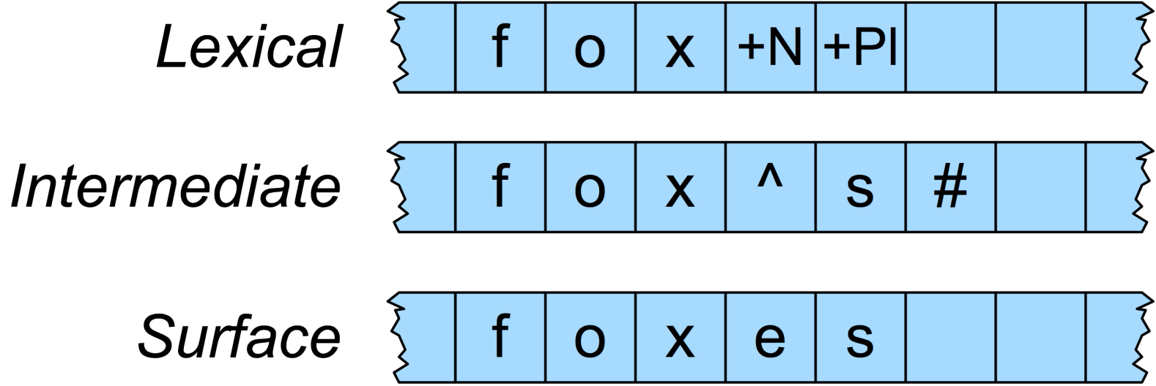
Multi-Level Tape Machines
We use one machine to transduce between the lexical and the intermediate level, and another to handle the spelling changes to the surface tape

Slide 49
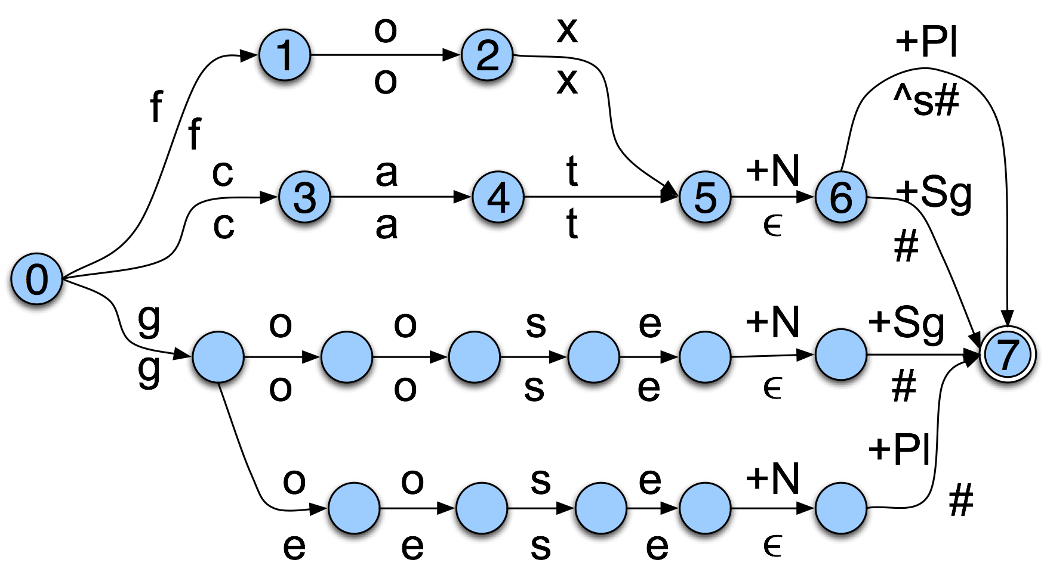
Lexical to Intermediate Level

Slide 50
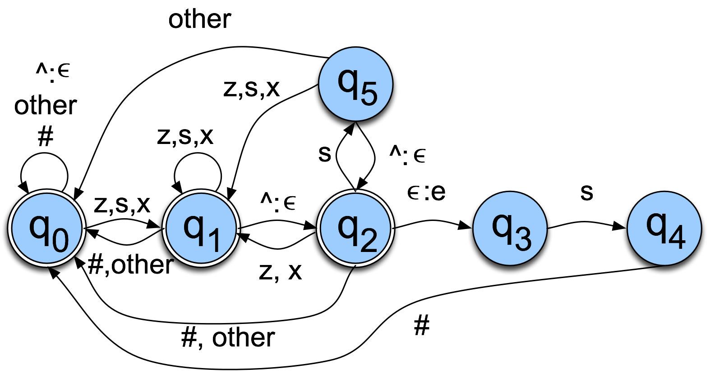
Intermediate to Surface
The add an “e” rule as in fox^s# <-> foxes#

Slide 51
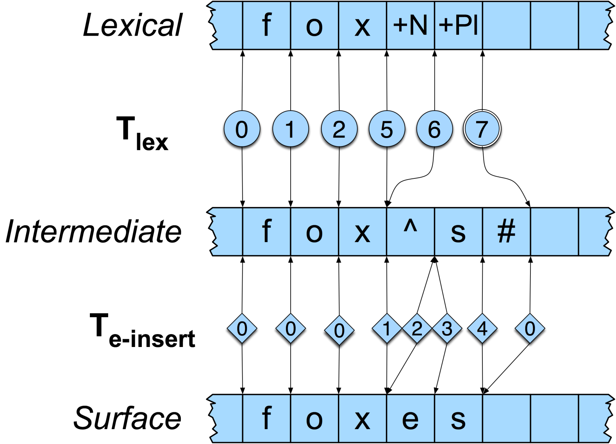
Foxes

Slide 52
Summing Up
Regular expressions and FSAs can represent subsets of natural language as well as regular languages
Both representations may be difficult for humans to understand for any real subset of a language
Can be hard to scale up: e.g., when many choices at any point (e.g. surnames)
But quick, powerful and easy to use for small problems
Next class:
Read Ch 4

