Slide 1
Word Relations
Slides adapted from Dan Jurafsky, Jim Martin and Chris Manning

Slide 2
Three Perspectives on Meaning
Lexical Semantics
  The meanings of individual words
Formal Semantics (or Compositional Semantics or Sentential Semantics)
  How those meanings combine to make meanings for individual sentences or utterances
Discourse or Pragmatics
  How those meanings combine with each other and with other facts about various kinds of context to make meanings for a text or discourse
  Dialog or Conversation is often lumped together with Discourse

Slide 3
Outline: Comp Lexical Semantics
Intro to Lexical Semantics
  Homonymy, Polysemy, Synonymy
  Online resources: WordNet
Computational Lexical Semantics
  Word Sense Disambiguation
    Supervised
    Semi-supervised
  Word Similarity
    Thesaurus-based
    Distributional

Slide 4
Preliminaries
What’s a word?
  Definitions we’ve used over the class: Types, tokens, stems, roots, inflected forms, etc...
  Lexeme: An entry in a lexicon consisting of a pairing of a form with a single meaning representation
  Lexicon: A collection of lexemes

Slide 5
Relationships between word meanings
Homonymy
Polysemy
Synonymy
Antonymy
Hypernomy
Hyponomy
Meronomy

Slide 6
Homonymy
Homonymy:
  Lexemes that share a form
    Phonological, orthographic or both
  But have unrelated, distinct meanings
  Clear example:
    Bat (wooden stick-like thing) vs
    Bat (flying scary mammal thing)
    Or bank (financial institution) versus bank (riverside)
  Can be homophones, homographs, or both:
    Homophones:
      Write and right
      Piece and peace

Slide 7
Homonymy causes problems for NLP applications
Text-to-Speech
  Same orthographic form but different phonological form
    bass vs bass
Information retrieval
  Different meanings same orthographic form
    QUERY: bat care
Machine Translation
Speech recognition
  Why?

Slide 8
Polysemy
The bank is constructed from red brick
I withdrew the money from the bank
Are those the same sense?
Or consider the following WSJ example
  While some banks furnish sperm only to married women, others are less restrictive
  Which sense of bank is this?
    Is it distinct from (homonymous with) the river bank sense?
    How about the savings bank sense?

Slide 9
Polysemy
A single lexeme with multiple related meanings (bank the building, bank the financial institution)
Most non-rare words have multiple meanings
  The number of meanings is related to its frequency
  Verbs tend more to polysemy
  Distinguishing polysemy from homonymy isn’t always easy (or necessary)

Slide 10
Metaphor and Metonymy
Specific types of polysemy
Metaphor:
  Germany will pull Slovenia out of its economic slump.
  I spent 2 hours on that homework.
Metonymy
  The White House announced yesterday.
  This chapter talks about part-of-speech tagging
  Bank (building) and bank (financial institution)

Slide 11
How do we know when a word has more than one sense?
ATIS examples
  Which flights serve breakfast?
  Does America West serve Philadelphia?
The “zeugma” test:
  ?Does United serve breakfast and San Jose?

Slide 12
Synonyms
Word that have the same meaning in some or all contexts.
  filbert / hazelnut
  couch / sofa
  big / large
  automobile / car
  vomit / throw up
  Water / H₂0
Two lexemes are synonyms if they can be successfully substituted for each other in all situations
  If so they have the same propositional meaning

Slide 13
Synonyms
But there are few (or no) examples of perfect synonymy.
  Why should that be?
  Even if many aspects of meaning are identical
  Still may not preserve the acceptability based on notions of politeness, slang, register, genre, etc.
Example:
  Water and H₂0

Slide 14
Some more terminology
Lemmas and wordforms
  A lexeme is an abstract pairing of meaning and form
  A lemma or citation form is the grammatical form that is used to represent a lexeme.
    Carpet is the lemma for carpets
    Dormir is the lemma for duermes.
  Specific surface forms carpets, sung, duermes are called wordforms
The lemma bank has two senses:
  Instead, a bank can hold the investments in a custodial account in the client’s name
  But as agriculture burgeons on the east bank, the river will shrink even more.
A sense is a discrete representation of one aspect of the meaning of a word

Slide 15
Synonymy is a relation between senses rather than words
Consider the words big and large
Are they synonyms?
  How big is that plane?
  Would I be flying on a large or small plane?
How about here:
  Miss Nelson, for instance, became a kind of big sister to Benjamin.
  ?Miss Nelson, for instance, became a kind of large sister to Benjamin.
Why?
  big has a sense that means being older, or grown up
  large lacks this sense

Slide 16
Antonyms
Senses that are opposites with respect to one feature of their meaning
Otherwise, they are very similar!
  dark / light
  short / long
  hot / cold
  up / down
  in / out
More formally: antonyms can
  define a binary opposition or at opposite ends of a scale (long/short, fast/slow)
  Be reversives: rise/fall, up/down

Slide 17
Hyponymy
One sense is a hyponym of another if the first sense is more specific, denoting a subclass of the other
  car is a hyponym of vehicle
  dog is a hyponym of animal
  mango is a hyponym of fruit
Conversely
  vehicle is a hypernym/superordinate of car
  animal is a hypernym of dog
  fruit is a hypernym of mango
superordinate | vehicle | fruit | furniture | mammal
hyponym | car | mango | chair | dog

Slide 18
Hypernymy more formally
Extensional:
  The class denoted by the superordinate
  extensionally includes the class denoted by the hyponym
Entailment:
  A sense A is a hyponym of sense B if being an A entails being a B
Hyponymy is usually transitive
  (A hypo B and B hypo C entails A hypo C)

Slide 19
II. WordNet
A hierarchically organized lexical database
On-line thesaurus + aspects of a dictionary
    Versions for other languages are under development
Category | Unique Forms
Noun | 117,097
Verb | 11,488
Adjective | 22,141
Adverb | 4,601

Slide 20
WordNet
Where it is:
  http://www.cogsci.princeton.edu/cgi-bin/webwn

Slide 21
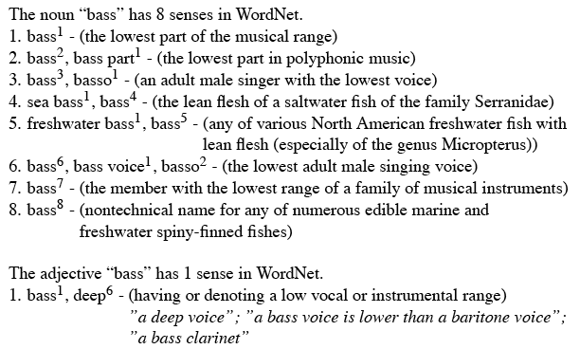
Format of Wordnet Entries

Slide 22
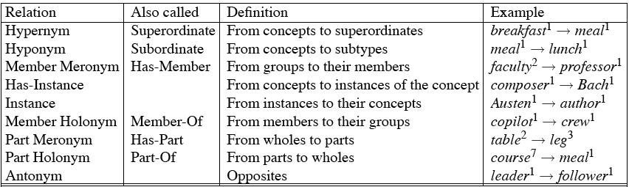
WordNet Noun Relations

Slide 23
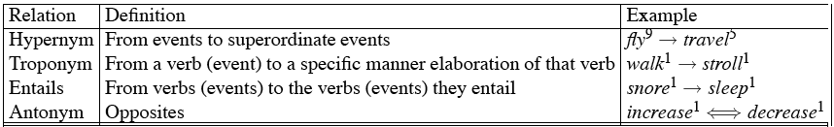
WordNet Verb Relations

Slide 24
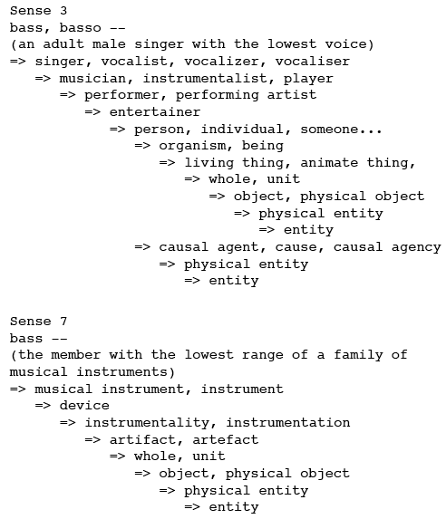
WordNet Hierarchies

Slide 25
How is “sense” defined in WordNet?
The set of near-synonyms for a WordNet sense is called a synset (synonym set); it’s their version of a sense or a concept
Example: chump as a noun to mean
  ‘a person who is gullible and easy to take advantage of’
Each of these senses share this same gloss
Thus for WordNet, the meaning of this sense of chump is this list.

