Slide 1
Word Sense Disambiguation

Slide 2
Midterm
Aim to get back on Tuesday
I grade on a curve
  One for graduate students
  One for undergraduate students
Comments?

Slide 3
HW 1
You should have received email with your grade – if not, let Madhav know
Statistics
  Written
    UNDERGRAD: Mean=22.11, SD =3.79, Max=27, Min=15
    GRAD: Mean=23.15, SD=4.45, Max=33, Min=14.5
  Programming
    UNDERGRAD: Mean=55.96, SD=3.55, Max=60.48, Min=52.68
    GRAD: Mean=59.40, SD =6.06, Max=68.38, Min=45.58

Slide 4
Class Participation
A way to raise your grade
Changing seats

Slide 5
Schedule
This class: last class on semantics
Next classes: primarily applications, some discourse
Tuesday: Bob Coyne, WordsEye
    Graphics plus language
    Illustrates word sense disambiguation
    Undergrads up front
Thursday: Fadi Biadsy, Information Extraction
    Overview
    Demonstration of an approach that uses bootstrapping and multiple methods
        Patterns (regular expressions)
        Language models

Slide 6
Word Sense Disambiguation (WSD)
Given
  a word in context,
  A fixed inventory of potential word senses
decide which sense of the word this is.
  English-to-Spanish MT
    Inventory is set of Spanish translations
  Speech Synthesis
    Inventory is homographs with different pronunciations like bass and bow
  Automatic indexing of medical articles
    MeSH (Medical Subject Headings) thesaurus entries

Slide 7
Two variants of WSD task
Lexical Sample task
  Small pre-selected set of target words
  And inventory of senses for each word
All-words task
  Every word in an entire text
  A lexicon with senses for each word
  Sort of like part-of-speech tagging
    Except each lemma has its own tagset

Slide 8
Approaches
Supervised
Semi-supervised
  Unsupervised
    Dictionary-based techniques
    Selectional Association
  Lightly supervised
    Bootstrapping
    Preferred Selectional Association

Slide 9
Supervised Machine Learning Approaches
Supervised machine learning approach:
  a training corpus of ?
  used to train a classifier that can tag words in new text
  Just as we saw for part-of-speech tagging, statistical MT.
Summary of what we need:
  the tag set (“sense inventory”)
  the training corpus
  A set of features extracted from the training corpus
  A classifier

Slide 10
Supervised WSD 1: WSD Tags
What’s a tag?

Slide 11
WordNet
  http://www.cogsci.princeton.edu/cgi-bin/webwn

Slide 12
WordNet Bass
The noun ``bass'' has 8 senses in WordNet
bass - (the lowest part of the musical range)
bass, bass part - (the lowest part in polyphonic music)
bass, basso - (an adult male singer with the lowest voice)
sea bass, bass - (flesh of lean-fleshed saltwater fish of the family Serranidae)
freshwater bass, bass - (any of various North American lean-fleshed freshwater fishes especially of the genus Micropterus)
bass, bass voice, basso - (the lowest adult male singing voice)
bass - (the member with the lowest range of a family of musical instruments)
bass -(nontechnical name for any of numerous edible marine and
freshwater spiny-finned fishes)

Slide 13
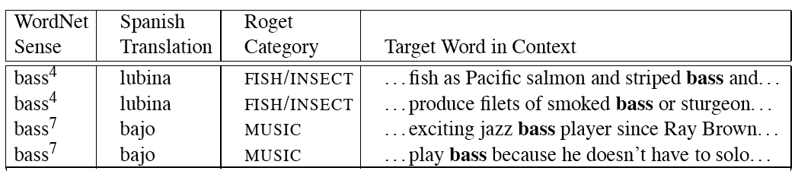
Inventory of sense tags for bass

Slide 14
Supervised WSD 2: Get a corpus
Lexical sample task:
  Line-hard-serve corpus - 4000 examples of each
  Interest corpus - 2369 sense-tagged examples
All words:
  Semantic concordance: a corpus in which each open-class word is labeled with a sense from a specific dictionary/thesaurus.
    SemCor: 234,000 words from Brown Corpus, manually tagged with WordNet senses
    SENSEVAL-3 competition corpora - 2081 tagged word tokens

Slide 15
Supervised WSD 3: Extract feature vectors
Weaver (1955)
If one examines the words in a book, one at a time as through an opaque mask with a hole in it one word wide, then it is obviously impossible to determine, one at a time, the meaning of the words. […] But if one lengthens the slit in the opaque mask, until one can see not only the central word in question but also say N words on either side, then if N is large enough one can unambiguously decide the meaning of the central word. […] The practical question is : ``What minimum value of N will, at least in a tolerable fraction of cases, lead to the correct choice of meaning for the central word?''

Slide 16
dishes
bass

Slide 17
washing dishes.
simple dishes including
convenient dishes to
of dishes and
free bass with
pound bass of
and bass player
his bass while

Slide 18
“In our house, everybody has a career and none of them includes washing dishes,” he says.
In her tiny kitchen at home, Ms. Chen works efficiently, stir-frying several simple dishes, including braised pig’s ears and chcken livers with green peppers.
Post quick and convenient dishes to fix when your in a hurry.
Japanese cuisine offers a great variety of dishes and regional specialties

Slide 19
We need more good teachers – right now, there are only a half a dozen who can play the free bass with ease.
Though still a far cry from the lake’s record 52-pound bass of a decade ago, “you could fillet these fish again, and that made people very, very happy.” Mr. Paulson says.
An electric guitar and bass player stand off to one side, not really part of the scene, just as a sort of nod to gringo expectations again.
Lowe caught his bass while fishing with pro Bill Lee of Killeen, Texas, who is currently in 144th place with two bass weighing 2-09.

Slide 20
Feature vectors
A simple representation for each observation (each instance of a target word)
  Vectors of sets of feature/value pairs
    I.e. files of comma-separated values
  These vectors should represent the window of words around the target
  How big should that window be?

Slide 21
Two kinds of features in the vectors
Collocational features and bag-of-words features
  Collocational
    Features about words at specific positions near target word
      Often limited to just word identity and POS
  Bag-of-words
    Features about words that occur anywhere in the window (regardless of position)
      Typically limited to frequency counts

Slide 22
Examples
Example text (WSJ)
  An electric guitar and bass player stand off to one side not really part of the scene, just as a sort of nod to gringo expectations perhaps
  Assume a window of +/- 2 from the target

Slide 23
Examples
Example text
  An electric guitar and bass player stand off to one side not really part of the scene, just as a sort of nod to gringo expectations perhaps
  Assume a window of +/- 2 from the target

Slide 24
Collocational
Position-specific information about the words in the window
guitar and bass player stand
  [guitar, NN, and, CC, player, NN, stand, VB]
  Word_{n-2,} POS_{n-2,} word_{n-1,} POS_{n-1,} Word_{n+1} POS_{n+1}…
  In other words, a vector consisting of
  [position n word, position n part-of-speech…]

Slide 25
Bag-of-words
Information about the words that occur within the window.
First derive a set of terms to place in the vector.
Then note how often each of those terms occurs in a given window.

Slide 26
Co-Occurrence Example
Assume we’ve settled on a possible vocabulary of 12 words that includes guitar and player but not and and stand
guitar and bass player stand
  [0,0,0,1,0,0,0,0,0,1,0,0]
  Which are the counts of words predefined as e.g.,
  [fish,fishing,viol, guitar, double,cello…

Slide 27
Classifiers
Once we cast the WSD problem as a classification problem, then all sorts of techniques are possible
  Naïve Bayes (the easiest thing to try first)
  Decision lists
  Decision trees
  Neural nets
  Support vector machines
  Nearest neighbor methods…

Slide 28
Classifiers
The choice of technique, in part, depends on the set of features that have been used
  Some techniques work better/worse with features with numerical values
  Some techniques work better/worse with features that have large numbers of possible values
    For example, the feature the word to the left has a fairly large number of possible values

Slide 29
Naïve Bayes
ŝ = p(s|V), or
Where s is one of the senses S possible for a word w and V the input vector of feature values for w
Assume features independent, so probability of V is the product of probabilities of each feature, given s, so
p(V) same for any ŝ
Then

Slide 30
How do we estimate p(s) and p(v_{j}|s)?
  p(s_{i}) is max. likelihood estimate from a sense-tagged corpus (count(s_{i},w_{j})/count(w_{j})) – how likely is bank to mean ‘financial institution’ over all instances of bank?
  P(v_{j}|s) is max. likelihood of each feature given a candidate sense (count(v_{j},s)/count(s)) – how likely is the previous word to be ‘river’ when the sense of bank is ‘financial institution’
Calculate for each possible sense and take the highest scoring sense as the most likely choice

Slide 31
Naïve Bayes Test
On a corpus of examples of uses of the word line, naïve Bayes achieved about 73% correct
Good?

Slide 32
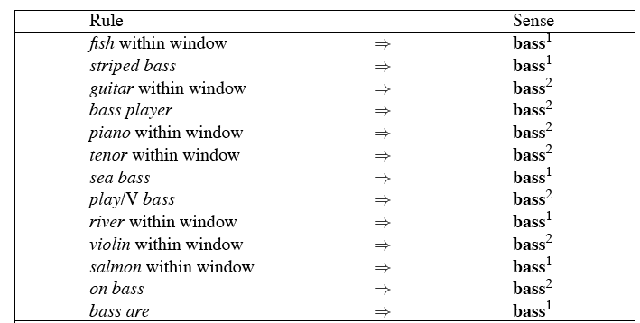
Decision Lists: another popular method
A case statement….

Slide 33
Learning Decision Lists
Restrict the lists to rules that test a single feature (1-decisionlist rules)
Evaluate each possible test and rank them based on how well they work.
Glue the top-N tests together and call that your decision list.

Slide 34
Yarowsky
On a binary (homonymy) distinction used the following metric to rank the tests
This gives about 95% on this test…

Slide 35
WSD Evaluations and baselines
In vivo versus in vitro evaluation
In vitro evaluation is most common now
  Exact match accuracy
    % of words tagged identically with manual sense tags
  Usually evaluate using held-out data from same labeled corpus
    Problems?
    Why do we do it anyhow?
Baselines
  Most frequent sense
  The Lesk algorithm

Slide 36
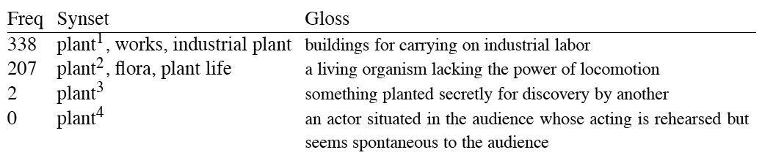
Most Frequent Sense
Wordnet senses are ordered in frequency order
So “most frequent sense” in wordnet = “take the first sense”
Sense frequencies come from SemCor

Slide 37
Ceiling
Human inter-annotator agreement
  Compare annotations of two humans
  On same data
  Given same tagging guidelines
Human agreements on all-words corpora with Wordnet style senses
  75%-80%

Slide 38
Unsupervised Methods
WSD: Dictionary/Thesaurus methods
The Lesk Algorithm
Selectional Restrictions

Slide 39
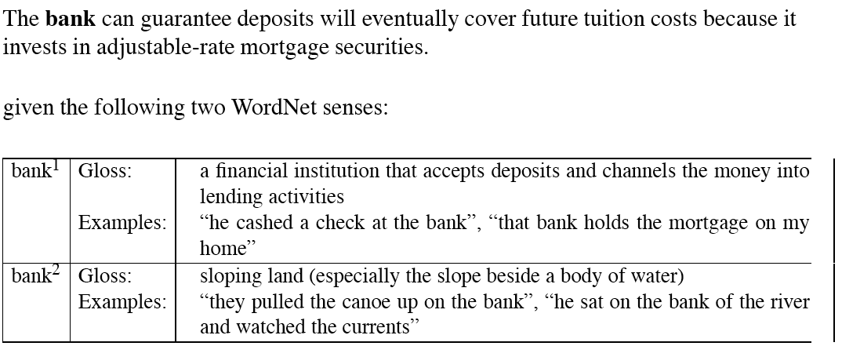
Simplified Lesk

Slide 40
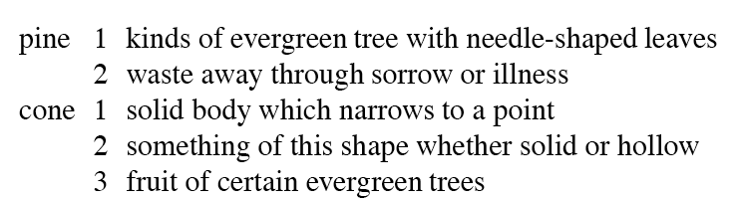
Original Lesk: pine cone

Slide 41
Corpus Lesk
Add corpus examples to glosses and examples
The best performing variant

Slide 42
Disambiguation via Selectional Restrictions
“Verbs are known by the company they keep”
  Different verbs select for different thematic roles
    wash the dishes (takes washable-thing as patient)
    serve delicious dishes (takes food-type as patient)
Method: another semantic attachment in grammar
  Semantic attachment rules are applied as sentences are syntactically parsed, e.g.
    VP --> V NP
    V→ serve <theme> {theme:food-type}
  Selectional restriction violation: no parse

Slide 43
But this means we must:
  Write selectional restrictions for each sense of each predicate – or use FrameNet
    Serve alone has 15 verb senses
  Obtain hierarchical type information about each argument (using WordNet)
    How many hypernyms does dish have?
    How many words are hyponyms of dish?
But also:
  Sometimes selectional restrictions don’t restrict enough (Which dishes do you like?)
  Sometimes they restrict too much (Eat dirt, worm! I’ll eat my hat!)
Can we take a statistical approach?

Slide 44
Semi-supervised
Bootstrapping
What if you don’t have enough data to train a system…
Bootstrap
  Pick a word that you as an analyst think will co-occur with your target word in particular sense
  Grep through your corpus for your target word and the hypothesized word
  Assume that the target tag is the right one

Slide 45
Bootstrapping
For bass
  Assume play occurs with the music sense and fish occurs with the fish sense

Slide 46
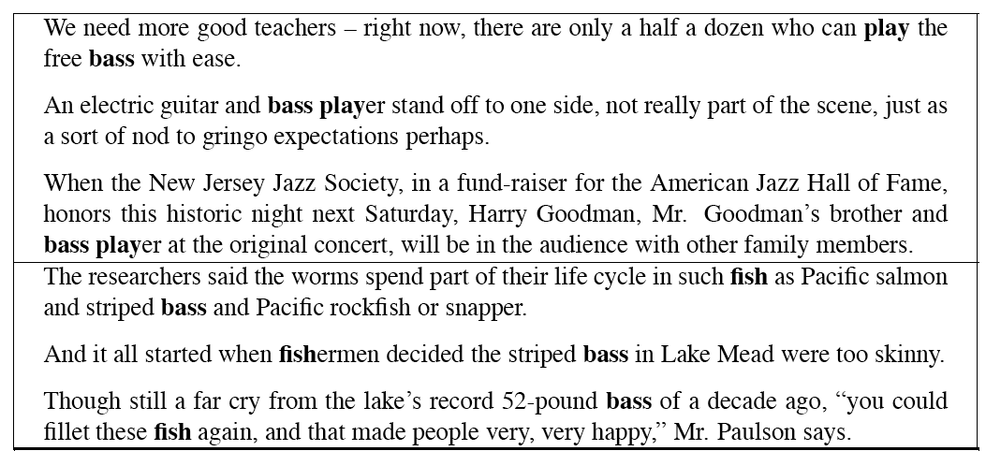
Sentences extracting using “fish” and “play”

Slide 47
Where do the seeds come from?
Hand labeling
“One sense per discourse”:
  The sense of a word is highly consistent within a document - Yarowsky (1995)
  True for topic dependent words
  Not so true for other POS like adjectives and verbs, e.g. make, take
  Krovetz (1998) “More than one sense per discourse” argues it isn’t true at all once you move to fine-grained senses
One sense per collocation:
  A word reoccurring in collocation with the same word will almost surely have the same sense.
Slide adapted from Chris Manning

Slide 48
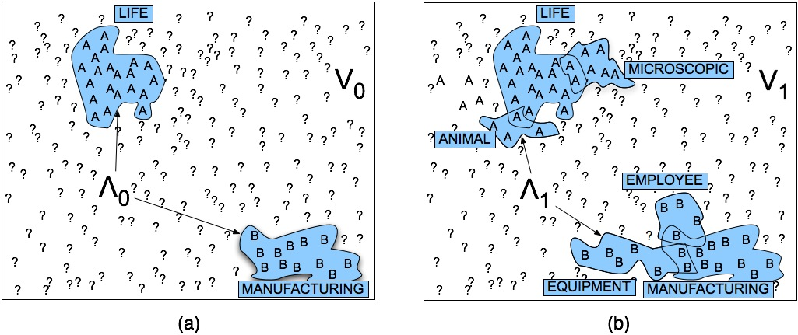
Stages in the Yarowsky bootstrapping algorithm

Slide 49
Problems
Given these general ML approaches, how many classifiers do I need to perform WSD robustly
  One for each ambiguous word in the language
How do you decide what set of tags/labels/senses to use for a given word?
  Depends on the application

Slide 50
WordNet Bass
Tagging with this set of senses is an impossibly hard task that’s probably overkill for any realistic application
bass - (the lowest part of the musical range)
bass, bass part - (the lowest part in polyphonic music)
bass, basso - (an adult male singer with the lowest voice)
sea bass, bass - (flesh of lean-fleshed saltwater fish of the family Serranidae)
freshwater bass, bass - (any of various North American lean-fleshed freshwater fishes especially of the genus Micropterus)
bass, bass voice, basso - (the lowest adult male singing voice)
bass - (the member with the lowest range of a family of musical instruments)
bass -(nontechnical name for any of numerous edible marine and
freshwater spiny-finned fishes)

Slide 51
Senseval History
ACL-SIGLEX workshop (1997)
  Yarowsky and Resnik paper
SENSEVAL-I (1998)
  Lexical Sample for English, French, and Italian
SENSEVAL-II (Toulouse, 2001)
  Lexical Sample and All Words
  Organization: Kilkgarriff (Brighton)
SENSEVAL-III (2004)
SENSEVAL-IV -> SEMEVAL (2007)
SLIDE FROM CHRIS MANNING

Slide 52
WSD Performance
Varies widely depending on how difficult the disambiguation task is
Accuracies of over 90% are commonly reported on some of the classic, often fairly easy, WSD tasks (pike, star, interest)
Senseval brought careful evaluation of difficult WSD (many senses, different POS)
Senseval 1: more fine grained senses, wider range of types:
  Overall: about 75% accuracy
  Nouns: about 80% accuracy
  Verbs: about 70% accuracy

Slide 53
Summary
Lexical Semantics
  Homonymy, Polysemy, Synonymy
  Thematic roles
Computational resource for lexical semantics
  WordNet
Task
  Word sense disambiguation

