Slide 1
Discourse Structure and Discourse Coherence
Julia Hirschberg
CS 4705
Thanks to Dan Jurafsky, Diane Litman, Andy Kehler, Jim Martin

Slide 2
What makes a text or dialogue coherent?
“Consider, for example, the difference between passages (18.71) and (18.72). Almost certainly not. The reason is that these utterances, when juxtaposed, will not exhibit coherence. Do you have a discourse? Assume that you have collected an arbitrary set of well-formed and independently interpretable utterances, for instance, by randomly selecting one sentence from each of the previous chapters of this book.”

Slide 3
Or, this?
“Assume that you have collected an arbitrary set of well-formed and independently interpretable utterances, for instance, by randomly selecting one sentence from each of the previous chapters of this book. Do you have a discourse? Almost certainly not. The reason is that these utterances, when juxtaposed, will not exhibit coherence. Consider, for example, the difference between passages (18.71) and (18.72).”

Slide 4
What makes a text coherent?
Appropriate use of coherence relations between subparts of the discourse -- rhetorical structure
Appropriate sequencing of subparts of the discourse -- discourse/topic structure
Appropriate use of referring expressions

Slide 5
Outline
Discourse Structure
  Textiling
Coherence
  Hobbs coherence relations
  Rhetorical Structure Theory

Slide 6
Conventions of Discourse Structure
Differ for different genres
  Academic articles:
    Abstract, Introduction, Methodology, Results, Conclusion
  Newspaper stories:
    Inverted Pyramid structure:
      Lead followed by expansion, least important last
  Textbook chapters
  News broadcasts
  NB: We can take advantage of this to ‘parse’ discourse structures

Slide 7
Discourse Segmentation
Simpler task: Separating document into linear sequence of subtopics
Applications
  Information retrieval
    Automatically segmenting a TV news broadcast or a long news story into sequence of stories
  Text summarization
  Information extraction
    Extract information from a coherent segment or topic
  Question Answering

Slide 8
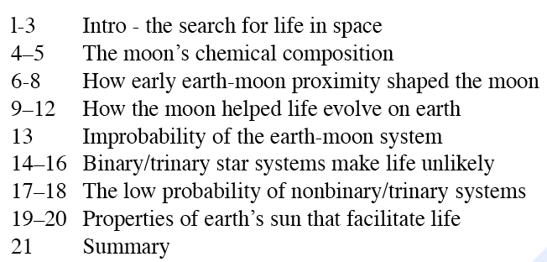
Unsupervised Segmentation
Hearst (1997): 21-paragraph science news article on “Stargazers”
Goal: produce the following subtopic segments:

Slide 9
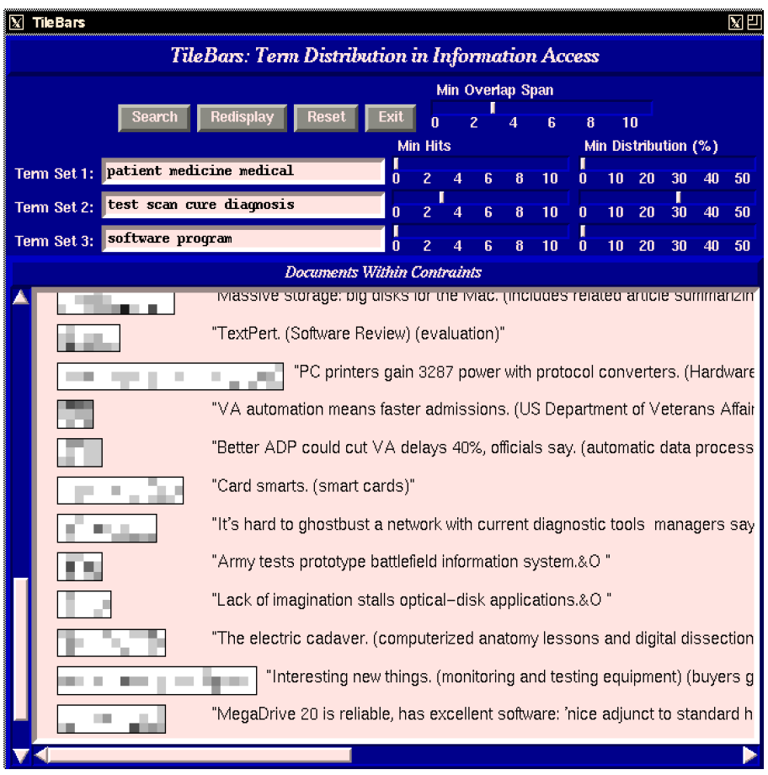

Slide 10
Intuition: Cohesion
Halliday and Hasan (1976): “The use of certain linguistic devices to link or tie together textual units”
Lexical cohesion:
  Indicated by relations between words in the two units (identical word, synonym, hypernym)
    Before winter I built a chimney, and shingled the sides of my house.
    I thus have a tight shingled and plastered house.
    Peel, core and slice the pears and the apples. Add the fruit to the skillet.

Slide 11
Intuition: Cohesion
Non-lexical: anaphora
  The Woodhouses were first in consequence there. All looked up to them.
Cohesion chain:
  Peel, core and slice the pears and the apples. Add the fruit to the skillet. When they are soft…

Slide 12
Cohesion-Based Segmentation
Sentences or paragraphs in a subtopic are cohesive with each other
But not with paragraphs in a neighboring subtopic
So, if we measured the cohesion between every neighboring sentences
  We might expect a ‘dip’ in cohesion at subtopic boundaries.

Slide 13
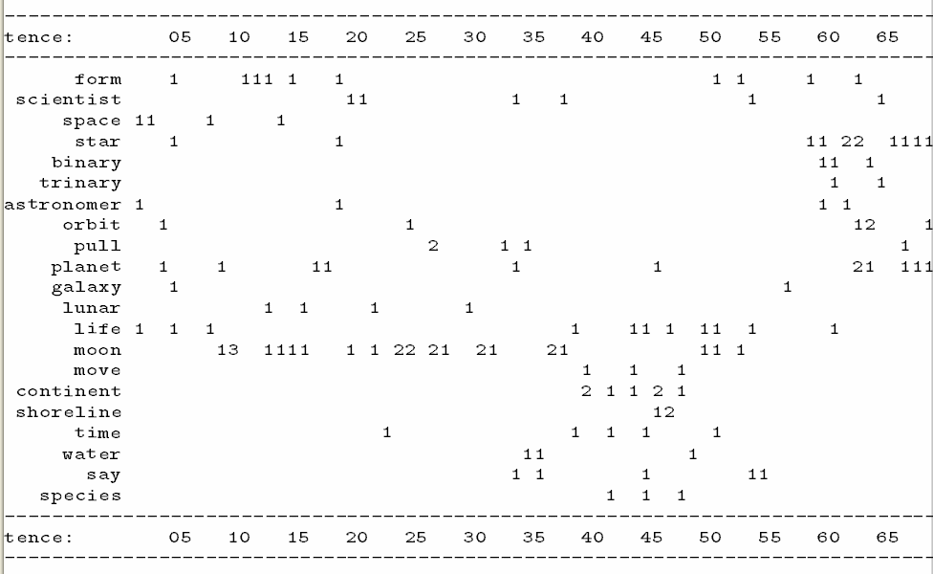

Slide 14
TexTiling (Hearst ’97)
Tokenization
  Each space-delimited word
  Converted to lower case
  Throw out stop list words
  Stem the rest
  Group into pseudo-sentences (windows) of length w=20
Lexical Score Determination: cohesion score
  Three part score including
    Average similarity (cosine measure) between gaps
    Introduction of new terms
    Lexical chains
Boundary Identification

Slide 15
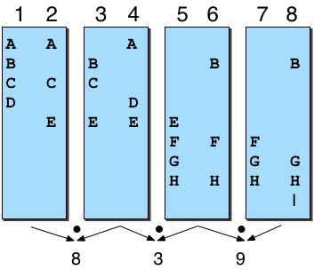
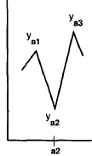
TexTiling Method

Slide 16
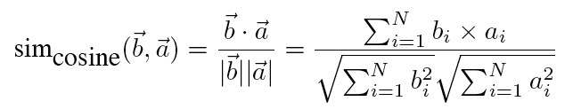
Cosine Similarity
Notes:
Normalized (by length) dot product of 2 lexical feature vectors

Slide 17
Vector Space Model
In the vector space model, both documents and queries are represented as vectors of numbers
    For TexTiling: both segments are represented as vectors
    For document categorization, both documents are represented as vectors
Numbers are derived from the words that occur in the collection

Slide 18
Representations
Start with bit vectors
This says that there are N word types in the collection and that the representation of a document consists of a 1 for each corresponding word type that occurs in the document.
We can compare two docs or a query and a doc by summing the bits they have in common

Slide 19
Term Weighting
Bit vector idea treats all terms that occur in the query and the document equally
Better to give more important terms greater weight
    Why?
    How would we decide what is more important?

Slide 20
Term Weighting
Two measures used
  Local weight
    How important is this term to the meaning of this document?
    Usually based on the frequency of the term in the document
  Global weight
    How well does this term discriminate among the documents in the collection?
    The more documents a term occurs in the less important it is -- the fewer the better

Slide 21
Term Weighting
N= number of documents; n_{i} = number of documents with term i
Local weights
  Generally, some function of the frequency of terms in documents is used
Global weights
  The standard technique is known as inverse document frequency

Slide 22
Tf-IDF Weighting
To get the weight for a term in a document, multiply the term’s frequency-derived weight by its inverse document frequency

Slide 23
Back to Similarity
We were counting bits to get similarity
Now we have weights
But that favors long documents over shorter ones
We need to normalize by length

Slide 24
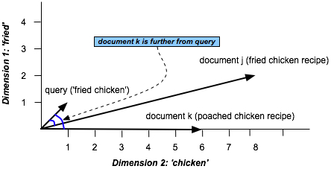
Similarity in Space
(Vector Space Model)

Slide 25
Similarity
View the document as a vector from the origin to a point in the space, rather than as the point.
In this view it’s the direction the vector is pointing that matters rather than the exact position
We can capture this by normalizing the comparison to factor out the length of the vectors

Slide 26
Similarity
The cosine measure normalizes the dot product by the length of the vectors

Slide 27
TextTiling algorithm

Slide 28
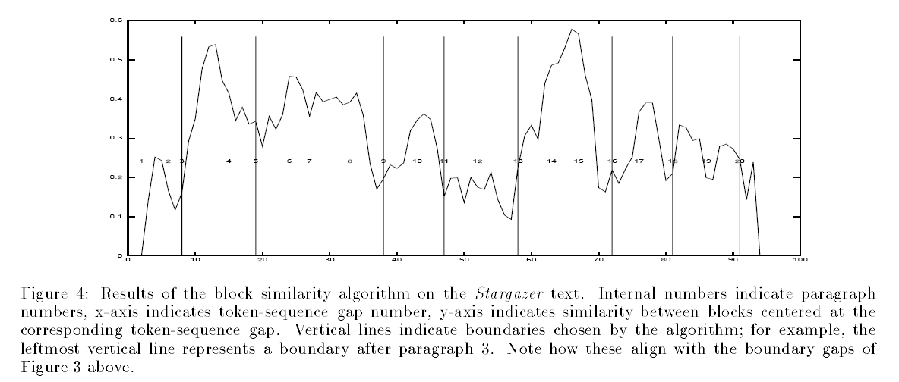

Slide 29
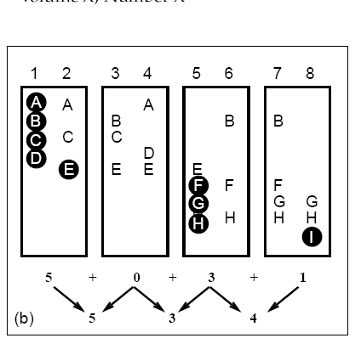
Lexical Score Part 2: Introduction of New Terms
Notes:
Cohesion score is negative of number of new terms that occur in left and right blocks.

Slide 30
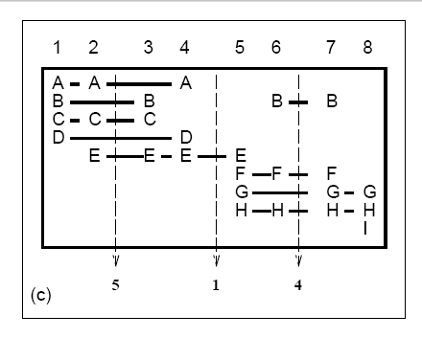
Lexical Score Part 3: Lexical Chains
Notes:
Cohesion: negative of number of lexical chains that span gap

Slide 31
Supervised Discourse segmentation
Discourse markers or cue words
  Broadcast news
    Good evening, I’m <PERSON>
    …coming up….
  Science articles
    “First,….”
    “The next topic….”

Slide 32
Supervised discourse segmentation
Supervised machine learning
  Label segment boundaries in training and test set
  Extract features in training
  Learn a classifier
  In testing, apply features to predict boundaries

Slide 33
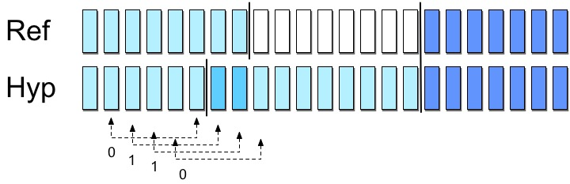
Supervised discourse segmentation
Evaluation: WindowDiff (Pevzner and Hearst 2000)
assign partial credit
Notes:
Mean number of boundary differences within windows (averaged over numbers of scans)

Slide 34
Text Coherence
What makes a discourse coherent?
The reason is that these utterances, when juxtaposed, will not exhibit coherence. Almost certainly not. Do you have a discourse? Assume that you have collected an arbitrary set of well-formed and independently interpretable utterances, for instance, by randomly selecting one sentence from each of the previous chapters of this book.

Slide 35
Or….
Assume that you have collected an arbitrary set of well-formed and independently interpretable utterances, for instance, by randomly selecting one sentence from each of the previous chapters of this book. Do you have a discourse? Almost certainly not. The reason is that these utterances, when juxtaposed, will not exhibit coherence.

Slide 36
Coherence
John hid Bill’s car keys. He was drunk.
??John hid Bill’s car keys. He likes spinach.

Slide 37
What makes a text coherent?
Appropriate use of coherence relations between subparts of the discourse -- rhetorical structure
Appropriate sequencing of subparts of the discourse -- discourse/topic structure
Appropriate use of referring expressions

Slide 38
Hobbes ’79: Coherence Relations
Result
  Infer that the state or event asserted by S0 causes or could cause the state or event asserted by S1.
  The Tin Woodman was caught in the rain. His joints rusted.

Slide 39
Explanation
  Infer that the state or event asserted by S1 causes or could cause the state or event asserted by S0.
  John hid Bill’s car keys. He was drunk.

Slide 40
Parallel
  Infer p(a1, a2..) from the assertion of S0 and p(b1,b2…) from the assertion of S1, where ai and bi are similar, for all I.
  The Scarecrow wanted some brains. The Tin Woodman wanted a heart.

Slide 41
Elaboration
  Infer the same proposition P from the assertions of S0 and S1.
  Dorothy was from Kansas. She lived in the midst of the great Kansas prairies.

Slide 42
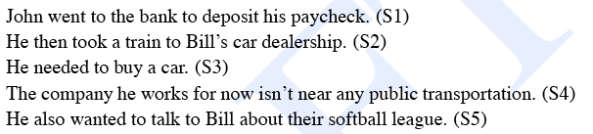
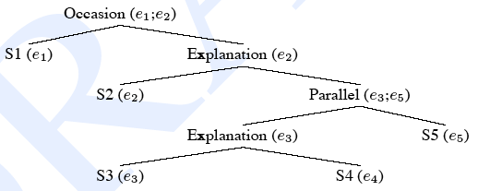
Coherence Relations

Slide 43
Rhetorical Structure Theory
Another theory of discourse structure, based on identifying relations between segments of the text
  Nucleus/satellite notion encodes asymmetry
    Nucleus is thing that if you deleted it, text wouldn’t make sense.
  Some rhetorical relations:
    Elaboration: (set/member, class/instance, whole/part…)
    Contrast: multinuclear
    Condition: Sat presents precondition for N
    Purpose: Sat presents goal of the activity in N

Slide 44
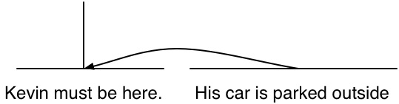
One Rhetorical Relation
Nucleus
Satellite
A sample definition
  Relation: Evidence
  Constraints on N: H might not believe N as much as S think s/he should
  Constraints on Sat: H already believes or will believe Sat
  Effect: H’s belief in N is increased
An example:
  Kevin must be here.
  His car is parked outside.

Slide 45
Automatic Labeling
Supervised machine learning
  Get a group of annotators to assign a set of RST relations to a text
  Extract a set of surface features from the text that might signal the presence of the rhetorical relations in that text
  Train a supervised ML system based on the training set

Slide 46
Features: Cue Phrases
Explicit markers: because, however, therefore, then, etc.
Tendency of certain syntactic structures to signal certain relations:
Infinitives are often used to signal purpose relations: Use rm to delete files.
Ordering
Tense/aspect
Intonation

Slide 47
Some Problems with RST
How many Rhetorical Relations are there?
How can we use RST in dialogue as well as monologue?
RST does not model overall structure of the discourse.
Difficult to get annotators to agree on labeling the same texts

Slide 48
Summarization, Q/A, I/E, Generation, …
Which are more useful where?
    Discourse structure: subtopics
    Discourse coherence: relations between sentences
    Discourse structure: Rhetorical Relations

Slide 49
Summary
Many ways to measure/model coherence and cohesion:
  TexTiling
  Hobbs’ Coherence Relations
  Grosz & Sidner’s Centering Theory
  Rhetorical Relations
Many practical applications
  Summarization, Information Extraction, Q/A, Generation

