Slide 1
Context-Free Grammars
Julia Hirschberg
CS 4705
Slides with contributions from Owen Rambow, Kathy McKeown, Dan Jurafsky and James Martin

Slide 2
Today
Context Free Grammars
Sentence types and constituents
Recursion and context-freeness
Grammar equivalence
Normal forms
Ambiguity
Penn Treebank
Some types of syntactic contructions

Slide 3
Context-Free Grammars
Defined in formal language theory
  Terminals, nonterminals, start symbol, rules
  String-rewriting system
  Start with start symbol, rewrite using rules, done when only terminals left
Not a linguistic theory, just a formal device

Slide 4
CFG Example
Many possible CFGs for English, here is an example (fragment):
  S → NP VP
  VP → V NP
  NP → DetP NP | AdjP NP
  AdjP → Adj | Adv AdjP
  NP → N
  N → boy | girl
  V → sees | likes
  Adj → big | small
  Adv → very
  DetP → a | the
the very small boy likes a girl

Slide 5
Derivations in a CFG
S
S → NP VP
VP → V NP
NP → DetP N | AdjP NP
AdjP → Adj | Adv AdjP
N → boy | girl
V → sees | likes
Adj → big | small
Adv → very
DetP → a | the
S

Slide 6
Derivations in a CFG
NP VP
S → NP VP
VP → V NP
NP → DetP N | AdjP NP
AdjP → Adj | Adv AdjP
N → boy | girl
V → sees | likes
Adj → big | small
Adv → very
DetP → a | the
S
NP
VP

Slide 7
Derivations in a CFG
DetP N VP
S → NP VP
VP → V NP
NP → DetP N | AdjP NP
AdjP → Adj | Adv AdjP
N → boy | girl
V → sees | likes
Adj → big | small
Adv → very
DetP → a | the
S
NP
VP
DetP
N

Slide 8
Derivations in a CFG
the boy VP
S → NP VP
VP → V NP
NP → DetP N | AdjP NP
AdjP → Adj | Adv AdjP
N → boy | girl
V → sees | likes
Adj → big | small
Adv → very
DetP → a | the
S
NP
VP
DetP
N
the
boy

Slide 9
Derivations in a CFG
the boy likes NP
S → NP VP
VP → V NP
NP → DetP N | AdjP NP
AdjP → Adj | Adv AdjP
N → boy | girl
V → sees | likes
Adj → big | small
Adv → very
DetP → a | the
S
NP
VP
DetP
N
V
NP
the
boy
likes

Slide 10
Derivations in a CFG
the boy likes a girl
S → NP VP
VP → V NP
NP → DetP N | AdjP NP
AdjP → Adj | Adv AdjP
N → boy | girl
V → sees | likes
Adj → big | small
Adv → very
DetP → a | the
S
NP
VP
DetP
N
V
NP
the
boy
likes
DetP
N
a
girl

Slide 11
Derivations of CFGs
String rewriting system: we derive a string (=derived structure)
But derivation history represented by phrase-structure tree (=derivation structure)
Dominance and immediate dominance
S
NP
VP
the boy likes a girl
DetP
N
V
NP
the
boy
likes
DetP
N
a
girl

Slide 12
Formal Definition of a CFG
G = (V,T,P,S)
V: finite set of nonterminal symbols
T: finite set of terminal symbols, V and T are disjoint
P: finite set of productions of the form
  A → α, A ∈ V and α ∈ (T ∪ V)*
S ∈ V: start symbol

Slide 13
Context in CFGs
The notion of context in CFGs has nothing to do with the ordinary meaning of the word context in language
All it really means is that the non-terminal on the left-hand side of a rule is out there all by itself (free of context)
  A -> B C
  I.e., I can rewrite an A as a B followed by a C regardless of the context in which A is found

Slide 14
Key Constituents (English)
Sentences
Noun phrases
Verb phrases
Prepositional phrases
How are these represented in CFGs?

Slide 15
Sentence Types or Modes
Declaratives: I do not.
  S -> NP VP
Imperatives: Go around again!
  S -> VP
Yes-No Questions: Do you like my hat?
S -> Aux NP VP
WH Questions: What are they going to do?
  S -> WH Aux NP VP

Slide 16
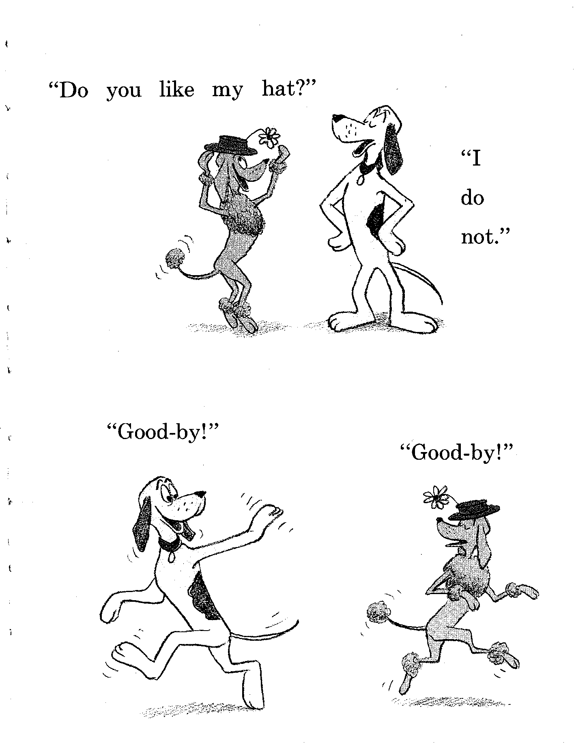

Slide 17
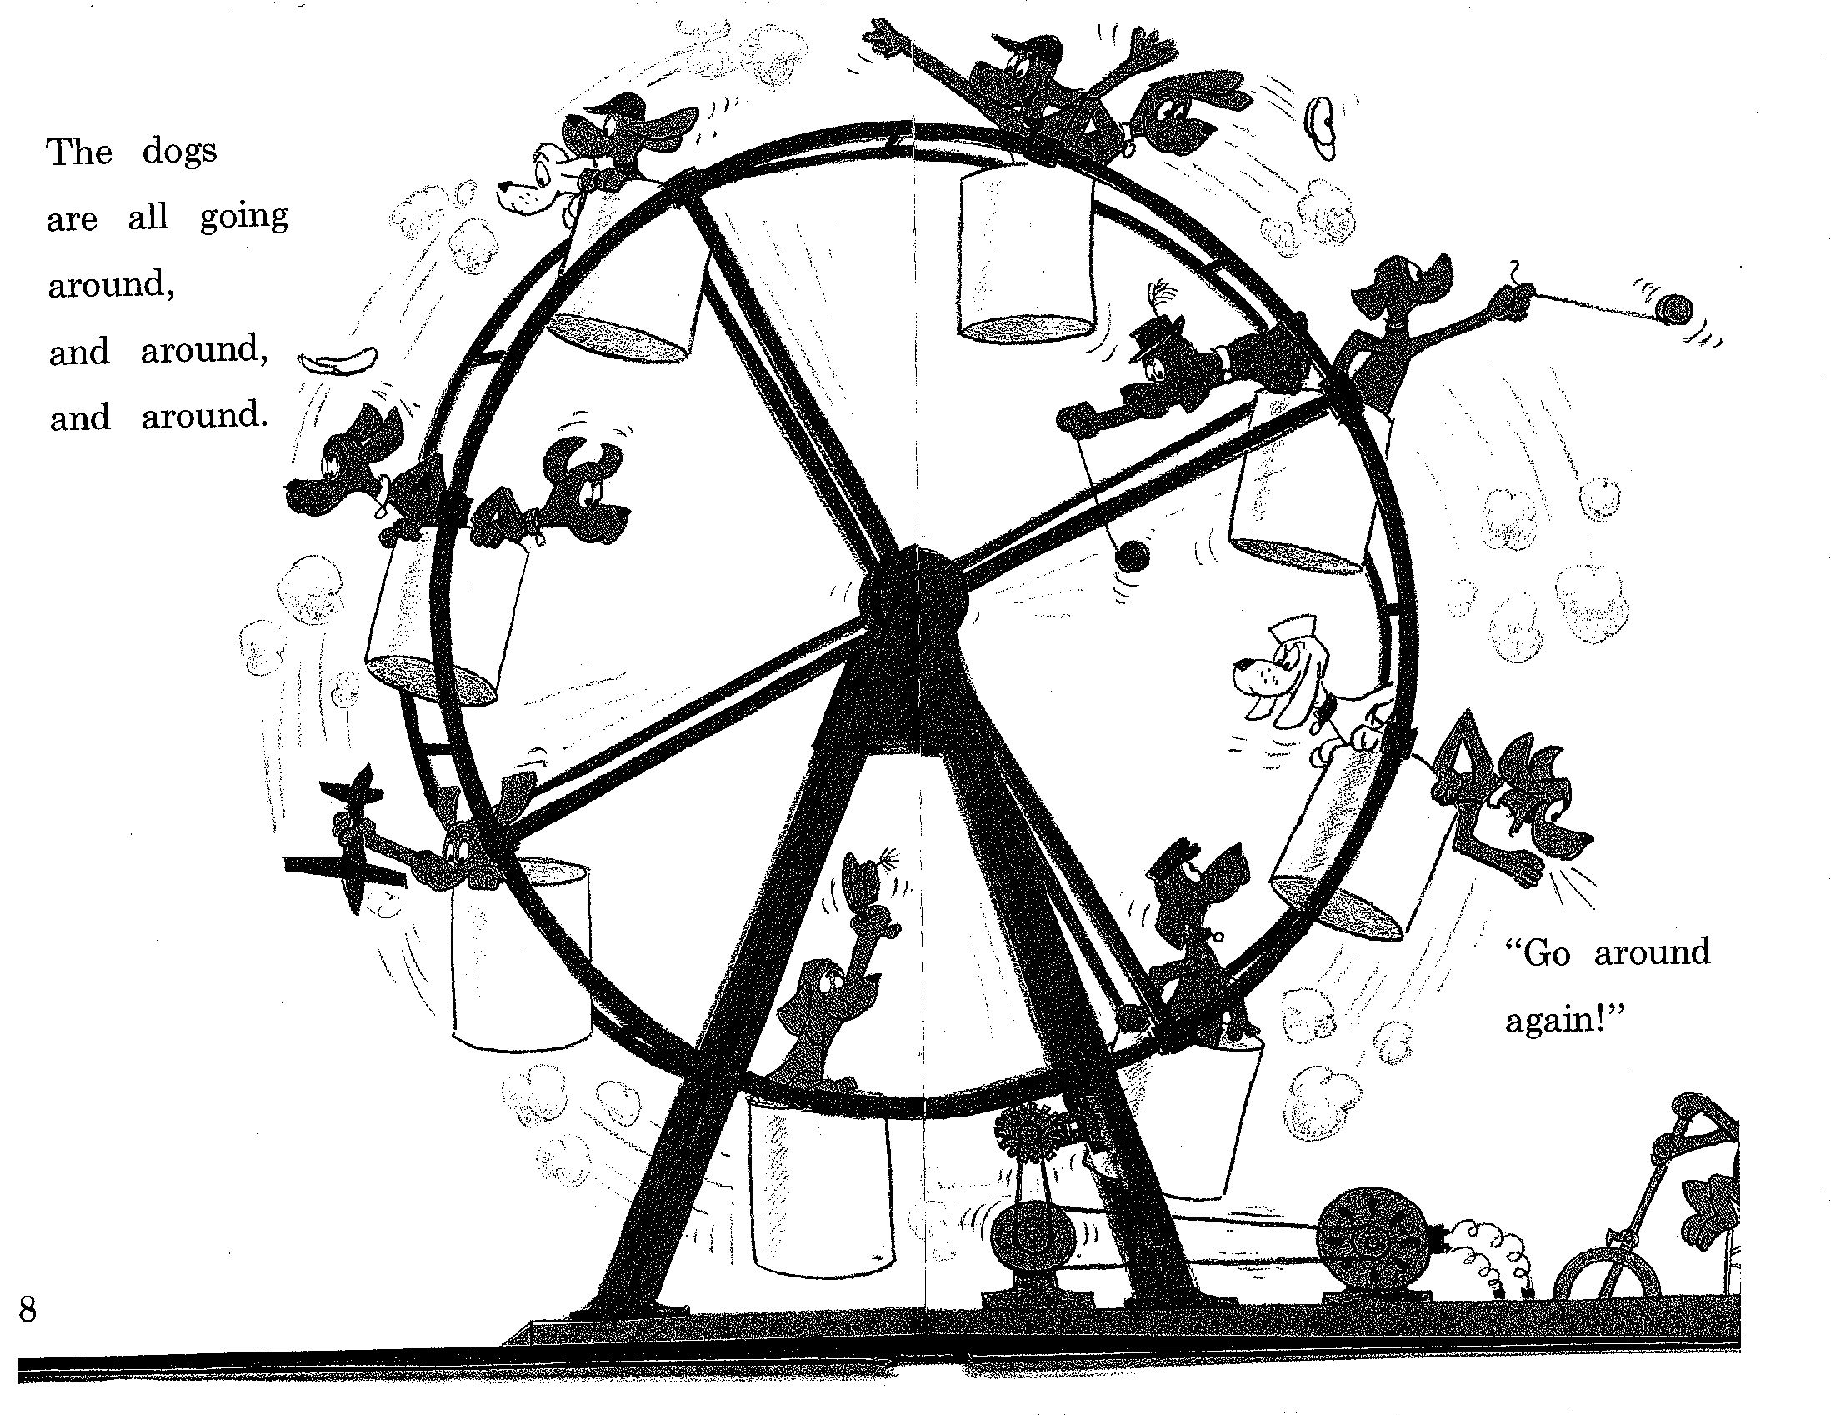

Slide 18
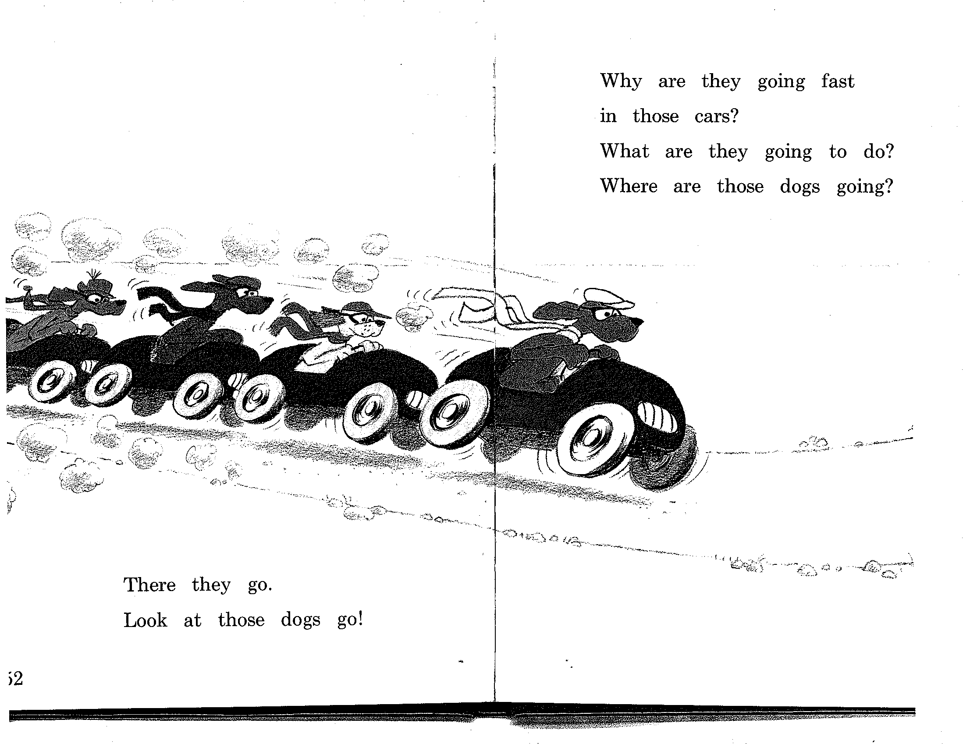

Slide 19
NPs
NP -> Pronoun
  I came, you saw it, they conquered
NP -> Proper-Noun
  New Jersey is west of New York City
  Lee Bollinger is the president of Columbia
NP -> Det Noun
  The president
NP -> Nominal
Nominal -> Noun Noun
  A morning flight to Denver

Slide 20
PPs
PP -> Prep(osition) NP
  Over the house
  Under the house
  To the tree
  At play
  At a party on a boat at night

Slide 21
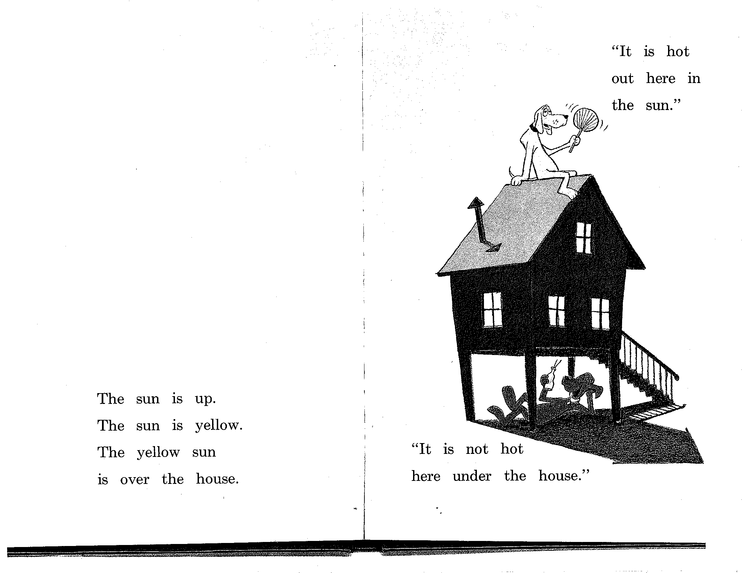

Slide 22
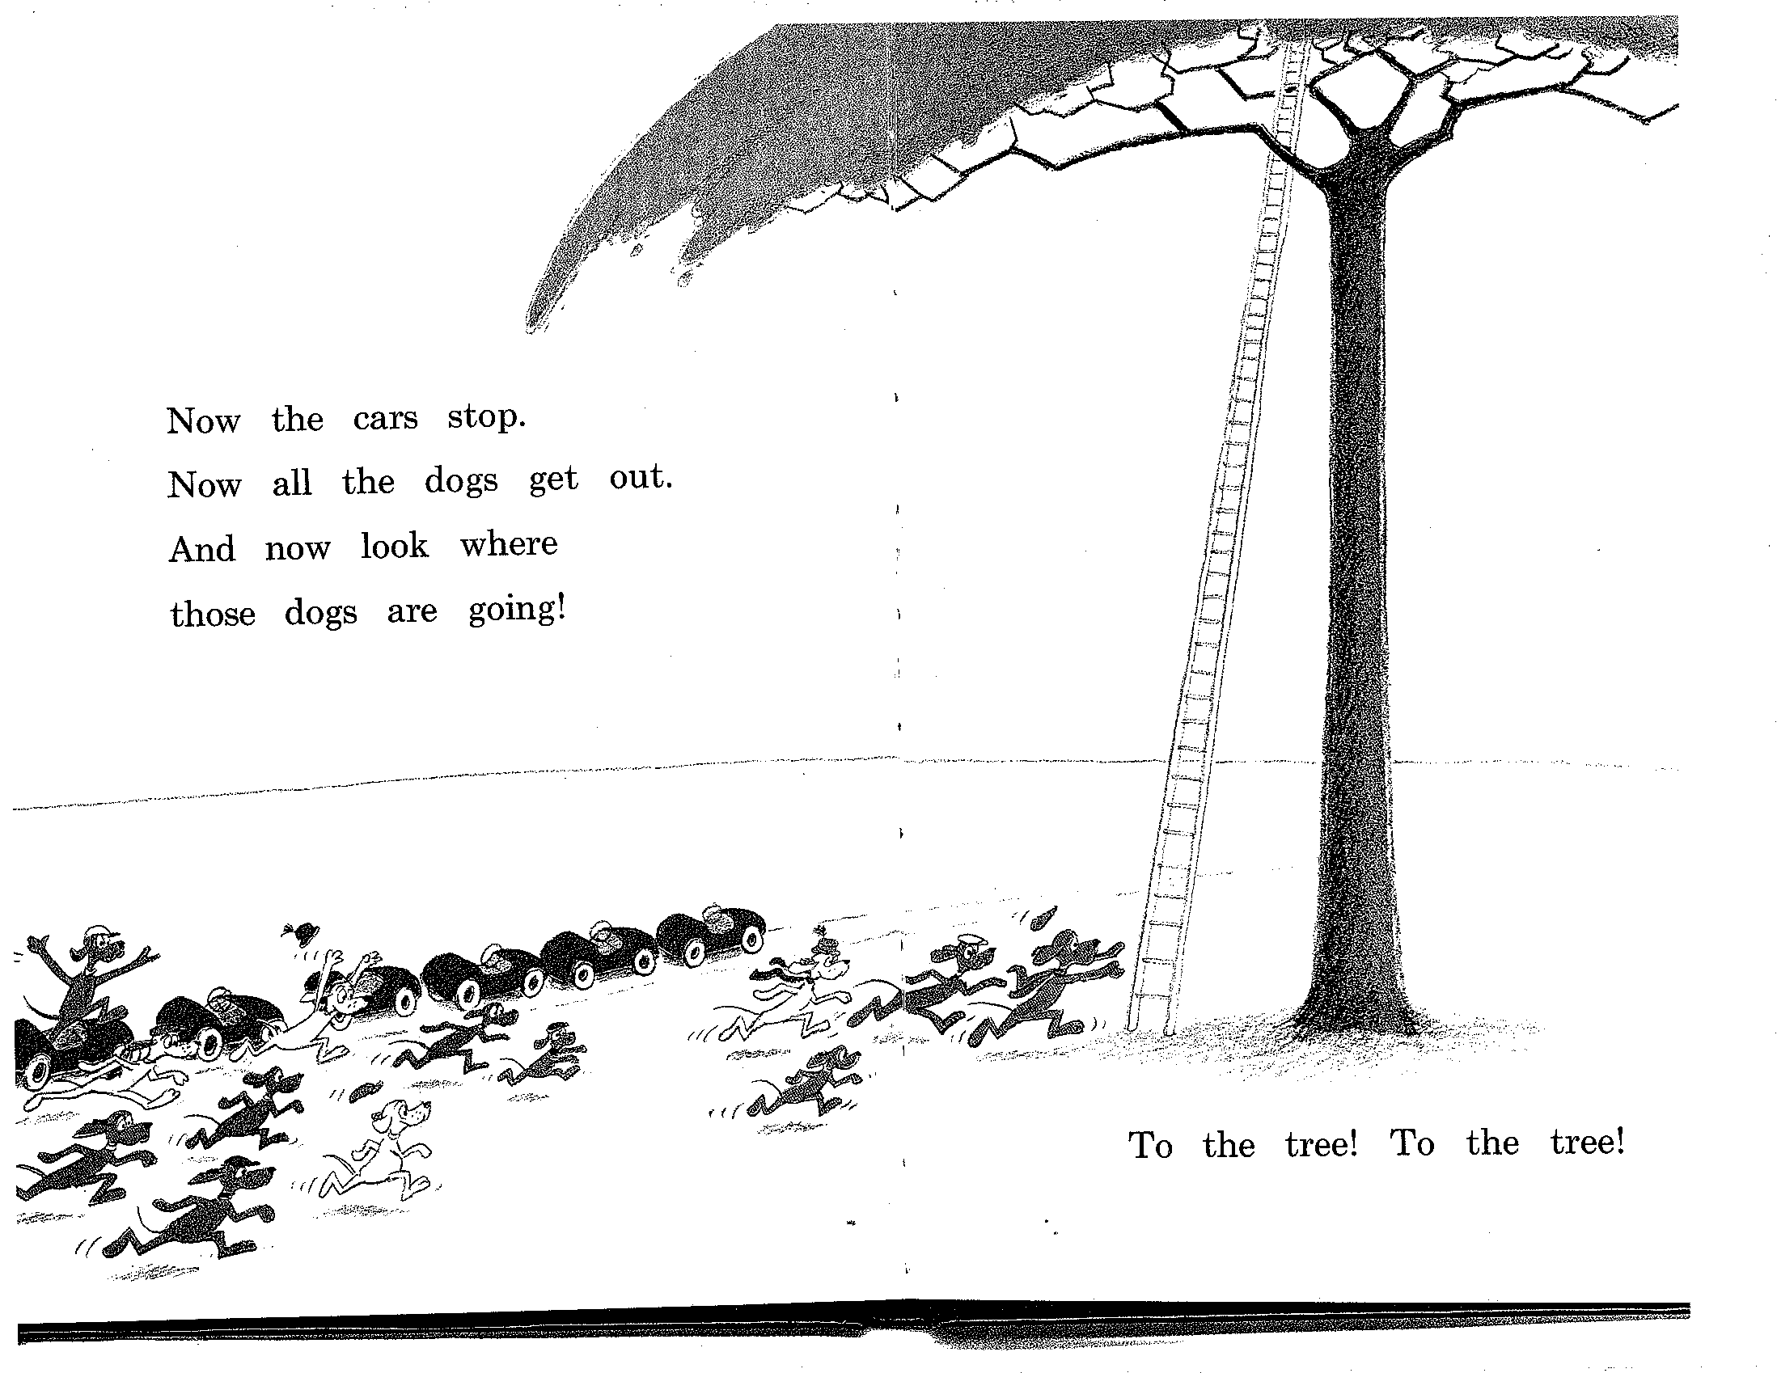

Slide 23
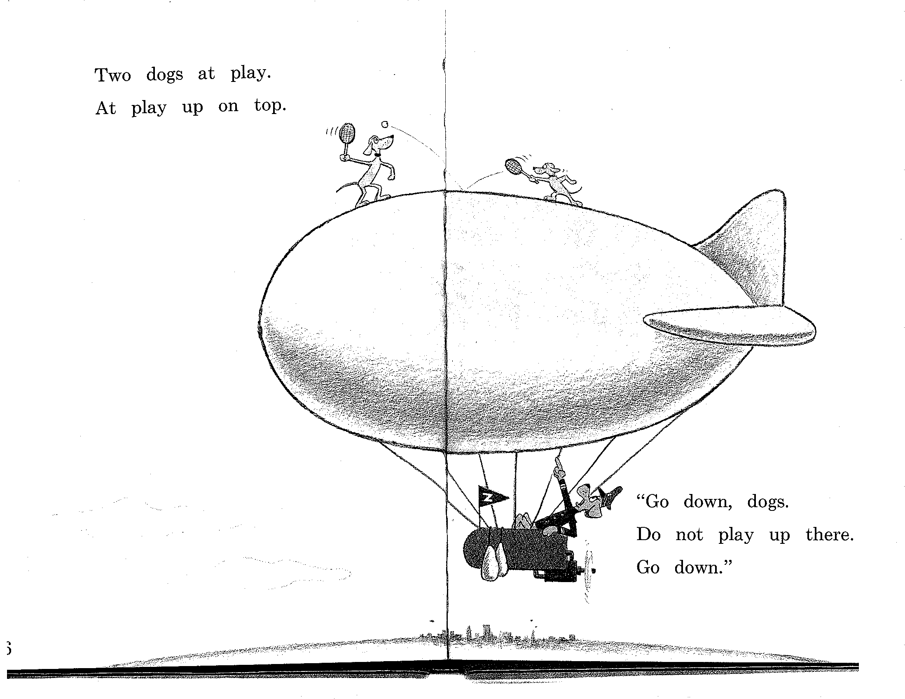

Slide 24
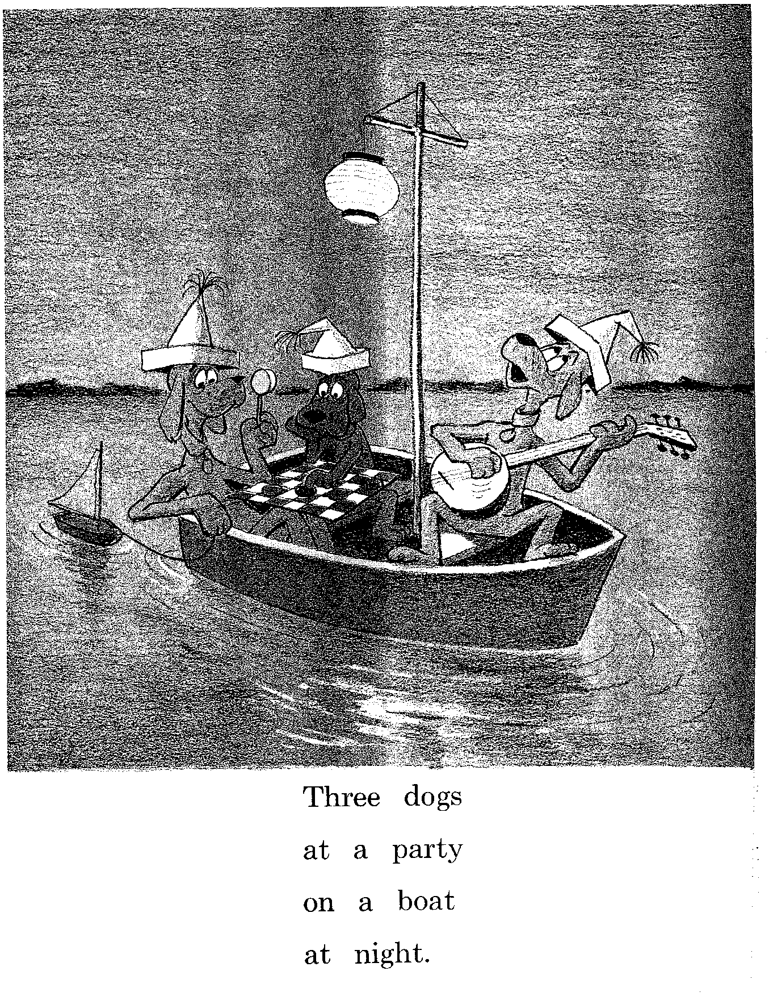

Slide 25
Recursion
We have to deal with rules such as the following, where the non-terminal on the left also appears somewhere on the right
  (directly)
  NP -> NP PP [[The flight] [to Boston]]
  VP -> VP PP [[departed Miami] [at noon]]
  (indirectly)
  NP -> NP Srel
  Srel -> NP VP [[the dog] [[the cat] likes]]

Slide 26
Recursion
  S
  S[the dog the mouse the cat ate bit bites]
  S-> NP VP
  NP[the dog the mouse the cat ate bit] VP[bites]
  NP-> NP Srel
  NP[the dog ] Srel[the mouse the cat ate bit]
  Srel -> NP VP
  NP[the mouse the cat ate] VP[bit]

Slide 27
  NP -> NP Srel
  NP[the mouse] Srel[the cat ate]
  Srel -> NP VP
  NP[the cat] VP[ate]
  S [NP [NP [the dog ] Srel [NP [NP[the mouse] Srel [NP[the cat] VP[ate]] ] VP[bit]]] VP[bites]]

Slide 28
Recursion
  [[Flights] [from Denver]]
  [[[Flights] [from Denver]] [to Miami]]
  [[[[Flights] [from Denver]] [to Miami]] [in February]]
  [[[[[Flights] [from Denver]] [to Miami]] [in February]] [on a Friday]]
  Which rule(s) should we apply?
    NP –> NP PP
    NP → NP PPs
    PPs →PPs PP
    PPs → PP

Slide 29
Implications of Recursion and Context-Freeness
VP -> V NP
(I) hate
  flights from Denver
  flights from Denver to Miami
  flights from Denver to Miami in February
  flights from Denver to Miami in February on a Friday
  flights from Denver to Miami in February on a Friday under $300
  flights from Denver to Miami in February on a Friday under $300 with lunch

Slide 30
This is why context-free grammars are appealing!
If you have a rule like VP -> V NP
  The rule only cares that the thing after V is an NP
  It doesn’t need to know about the internal structure of that NP

Slide 31
Grammar Equivalence
Different grammars may generate same set of strings (weak equivalence)
  Grammar 1: NP → DetP N and DetP → a | the
  Grammar 2: NP → a N | NP → the N
Different grammars may generate the same set of strings and assign the same phrase structure to every sentence (strong equivalence)
  Grammar 2: NP → a N | NP → the N
  Grammar 3: Nom → a N | Nom → the N
Strong equivalence implies weak equivalence

Slide 32
Chomsky Normal Form
Useful to specify normal forms for grammars
A CFG is in Chomsky Normal Form (CNF) if all productions are of one of two forms:
  A → BC with A, B, C nonterminals
  A → a, with A a nonterminal and a a terminal
  No ε transitions
Every CFG has a weakly equivalent CFG in CNF

Slide 33
Generative Grammar
Formal languages: formal device to generate a set of strings (such as a CFG)
Linguistics (Chomskyan linguistics in particular): approach in which a linguistic theory enumerates all possible strings/structures in a language (=competence)
Chomskyan theories do not really use formal devices – they use CFG + informally defined transformations
  E.g. passive sentences to active structures

Slide 34
Nobody Uses Simple CFGs (Except Intro NLP Courses)
All major syntactic theories (Chomsky, LFG, HPSG, TAG-based theories) represent both phrase structure and dependency, in one way or another
All successful parsers currently use statistics about phrase structure and about dependency
Derive dependency through head percolation: for each rule, say which daughter is head, and specify features on head

Slide 35
Massive Ambiguity of Syntax
For a standard sentence, and a grammar with wide coverage, there are 1000s of derivations!
Example:
  The large portrait painter told the delegation that he sent money orders in a letter on Wednesday
  Where do we find the likely sources of syntactic ambiguity?

Slide 36
Penn Treebank (PTB)
Syntactically (phrase structure) annotated corpus of news text
  The newspaper texts are naturally occurring data, but the PTB is not!
  PTB annotation represents a particular linguistic theory (a fairly “vanilla” one)
Particularities
  Very indirect representation of grammatical relations (need for head percolation tables)
  Completely flat structure in NP (brown bag lunch, pink-and-yellow child seat )
  Has flat Ss, flat VPs
  Neutral about PP attachment

Slide 37
PTB Example
( (S (NP-SBJ It)
(VP 's
(NP-PRD (NP (NP the latest investment craze)
(VP sweeping
(NP Wall Street)))
:
(NP (NP a rash)
(PP of
(NP (NP new closed-end country funds)
,
(NP (NP those
(ADJP publicly traded)
portfolios)
(SBAR (WHNP-37 that)
(S (NP-SBJ *T*-37)
(VP invest
(PP-CLR in
(NP (NP stocks)
(PP of
(NP a single foreign country)))))))))))
Notes:
PP-CLR phrasal verbs

Slide 38
Not All Verbs are Syntactically the Same
Is this the same construction?
  An elf decided to clean the kitchen
  An elf seemed to clean the kitchen
  An elf cleaned the kitchen
Is this the same construction?
  An elf decided to be in the kitchen
  An elf seemed to be in the kitchen
  An elf was in the kitchen

Slide 39
Is this the same construction?
  There is an elf in the kitchen
  *There decided to be an elf in the kitchen
  There seemed to be an elf in the kitchen
Is this the same construction?
It is raining/it rains
  ??It decided to rain/be raining
  It seemed to rain/be raining

Slide 40
Is this the same construction?
  An elf decided that he would clean the kitchen
  * An elf seemed that he would clean the kitchen
  An elf cleaned the kitchen

Slide 41
Types of Syntactic Constructions
Conclusion:
to decide: only full nouns that are referential can appear in upper clause
to seem: whatever is embedded surface subject can appear in upper clause
Two different types of verbs, represented differently in syntax

Slide 42
Types of Syntactic Constructions: Analysis
S
S
NP
VP
VP
an elf
S
S
V
V
to decide
NP
VP
to seem
NP
VP
an elf
PP
an elf
PP
V
V
to be
in the
kitchen
to be
in the
kitchen

Slide 43
Types of Syntactic Constructions: Analysis
S
S
NP
VP
VP
an elf
S
S
V
V
decided
NP
VP
seemed
NP
VP
PRO
PP
an elf
PP
V
V
to be
in the
kitchen
to be
in the
kitchen

Slide 44
Types of Syntactic Constructions: Analysis
S
S
NP
VP
VP
an elf
S
S
V
V
decided
NP
VP
seemed
NP
VP
PRO
PP
an elf
PP
V
V
to be
in the
kitchen
to be
in the
kitchen

Slide 45
Types of Syntactic Constructions: Analysis
S
S
NP
VP
NP_{i}
VP
an elf
S
an elf
S
V
V
decided
NP
VP
seemed
NP
VP
PRO
t_{i}
V
PP
V
PP
to be
in the
kitchen
to be
in the
kitchen

Slide 46
Control Verbs
to decide: a control verb
Main argument of control verb is also main argument of non-finite verb
Syntactic solution: subject is in upper clause and co-refers with an empty subject in lower clause
  an elf decided (an elf to clean the kitchen)
  an elf decided (PRO to clean the kitchen)
  an elf decided (he cleans/should clean the kitchen)
  *it decided (an elf cleans/should clean the kitchen)

Slide 47
Raising Verbs
to seem: a raising verb
Argument of a lower clause appears syntactically as the subject of seem
Syntactic solution: lower surface subject raises to upper clause
seems (there to be an elf in the kitchen)
  there seems (t to be an elf in the kitchen)
  it seems (there is an elf in the kitchen)

Slide 48
Lessons Learned from Raising/Control Issue
Use distribution of data to group phenomena into classes
Use different underlying structure as basis for explanations
Allow things to `move’ around from underlying structure -> transformational grammar
Check whether the explanation you give makes predictions

Slide 49
Examples from PTB
(S (NP-SBJ-1 The ropes)
(VP seem
(S (NP-SBJ *-1)
(VP to
(VP make
(NP much sound))))))
(S (NP-SBJ-1 The ancient church vicar)
(VP refuses
(S (NP-SBJ *-1)
(VP to
(VP talk
(PP-CLR about
(NP it)))))

Slide 50
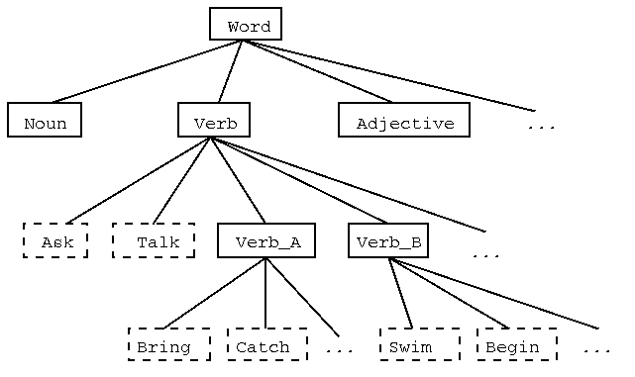
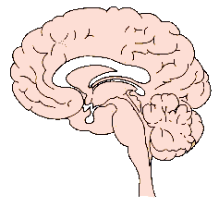



The Big Picture
Empirical Matter
or
Formalisms
Data structures
Formalisms
Algorithms
Distributional Models
descriptive
theory is
about
Maud expects there to be a riot
*Teri promised there to be a riot
Maud expects the shit to hit the fan
*Teri promised the shit to hit the
uses
predicts
explanatory
theory is about
Linguistic Theory
Content: Relate morphology to semantics
Surface representation
Deep representation
Correspondence

Slide 51
Summary
Context Free Grammars a useful (expository) grammar formalism, altho not much used in practice except for very small applications
Problems for practical application
  Recursion
  Ambiguity
Grammar equivalence useful to identify
Different verb types lead to different syntactic structures
Next: Parsing with CFGs

