Slide 1
Information Retrieval and Question-Answering
Julia Hirschberg
CS 4705

Slide 2
Today
Information Retrieval
  Review of Methods
  TREC IR Tracks
Question Answering
  Factoid Q/A
  A Sample System: UT Dallas (Harabagiu)
  A simpler alternative from MSR

Slide 3
Information Retrieval
Basic assumption
  `Meanings’ of documents can be captured by analyzing (counting) the words they contain
  Bag of words approach
`Documents’ can be web pages, news articles, passages in articles,…

Slide 4
Inverted Index
Fundamental operation required
  Ability to map from words to documents in a collection of documents
Approach:
  Create an inverted index is of words and the document ids of the documents that contain them
  Dog: 1,2,8,100,119,210,400
  Dog: 1:4,7:11,13:15,17

Slide 5
Stop Lists and Stemming
Used by all IR systems
Stop List
  Frequent (function/closed-class) words not indexed (of, the, a …)
  Reduces size of inverted index with virtual no loss of search accuracy
Stemming issues
  Are dog and dogs separate entries or are they collapsed to dog?

Slide 6
Phrasal Search
Google et al allows users to perform phrasal searches, e.g. big red dog
  Hint: they don’t grep the collection
  Add locational information to the index
    dog: 1{104}, 2{10}, etc
    red: 1{103},…
    big: 1{102},…
  Phrasal searches can operate incrementally by piecing the phrases together

Slide 7
Ranked Retrieval
Inverted index is just the start
Given a query, find out how relevant all the documents in the collection are to that query

Slide 8
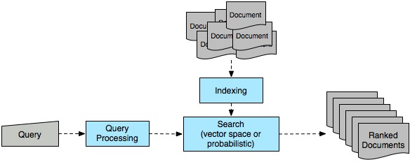
Ad Hoc Retrieval Task

Slide 9
Representation
Represent documents and queries as bit vectors
  N word types in collection
  Representation of document consists of a 1 for each corresponding word type that occurs in the document
  Compare two docs or a query and a doc by summing bits they have in common

Slide 10
Term Weighting
Which words are more important?
  Local weight
    How important is this term to the meaning of this document?
    → How often does it occur in the document?
    Term Frequency (tf)

Slide 11
  Global weight
    How well does this term discriminate among the documents in the collection?
    → How many documents does it appear in?
    Inverse Document Frequency (idf)
      N= number of documents; n_{i} = number of documents with term I
  Tf-idf weighting
    Weight of term i in vector for doc j is product of frequency in j with log of inverse document frequency in collection

Slide 12
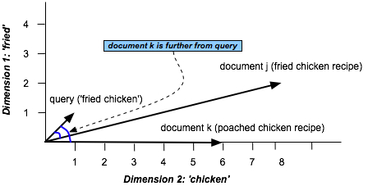
Vector Space Model

Slide 13
Cosine Similarity
Normalize by document length

Slide 14
Ad Hoc Retrieval
Given a user query q and a document collection D
Find vectors of all documents in D that contain any of the terms in q → candidate documents C
Convert the q to a vector using weighting scheme used to represent documents in D
Compute cosine similarity between q’s vector and vectors of C documents
Sort result and return

Slide 15
Advanced Issues in IR
Query Expansion
  Typical queries very short
  Expand user query using an initial search and taking words from top N docs, using a thesaurus, using term clustering or WordNet to find synonyms….
Tasks beyond Ad Hoc query support
  Passage Retrieval, Multilingual IR, Speech IR, Summarization, Question Answering…

Slide 16
Question-Answering Systems
Beyond retrieving relevant documents -- Do people want answers to particular questions?
Three kinds of systems
  Finding answers in document collections
  Interfaces to relational databases
  Mixed initiative dialog systems
What kinds of questions do people want to ask?

Slide 17
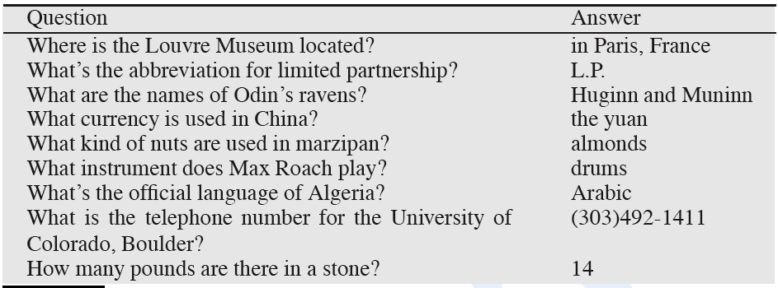
Factoid Questions

Slide 18
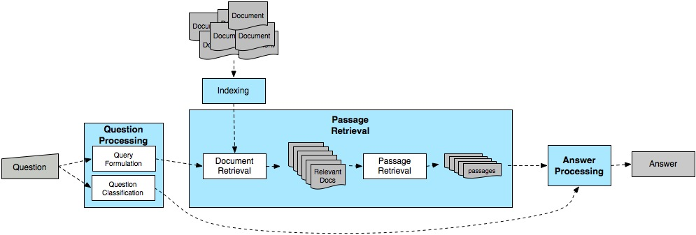
Typical Q/A Architecture

Slide 19
UT Dallas Q/A Systems
Contains many components used by other systems
More complex in interesting ways
Most work completed by 2001
Documentation:
  Paşca and Harabagiu, High-Performance Question Answering from Large Text Collections, SIGIR’01.
  Paşca and Harabagiu, Answer Mining from Online Documents, ACL’01.
  Harabagiu, Paşca, Maiorano: Experiments with Open-Domain Textual Question Answering. COLING’00

Slide 20
UT Dallas System Architecture
Extracts and ranks passages
using surface-text techniques
Captures the semantics of the question
Selects keywords for PR
Extracts and ranks answers
using NL techniques
Question Semantics
Q
Question
Processing
Passage
Retrieval
Answer
Extraction
A
Keywords
Passages
WordNet
WordNet
Document
Retrieval
Parser
Parser
NER
NER

Slide 21
Question Processing
Two main tasks
  Question classification: Determine the type of the answer
  Query formulation: Extract keywords from the question and formulate a query

Slide 22
Answer Types
Factoid questions…
  Who, where, when, how many…
  Answers fall into limited, fairly predictable set of categories
    Who questions will be answered by…
    Where questions will be answered by …
  Generally, systems select answer types from a set of Named Entities, augmented with other types that are relatively easy to extract

Slide 23
Answer Types Can Be More Complicated
Who questions can have organizations or countries as answers
  Who sells the most hybrid cars?
  Who exports the most wheat?
Which questions can have people as answers
  Which president went to war with Mexico?

Slide 24
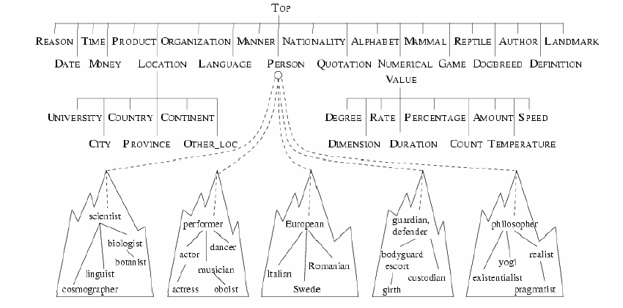
Taxonomy of Answer Types
Contains ~9000 concepts reflecting expected answer types
Merges NEs with the WordNet hierarchy

Slide 25
Answer Type Detection
Use combination of hand-crafted rules and supervised machine learning to determine the right answer type for a question
But how do we make use of this answer type once we hypothesize it?

Slide 26
Query Formulation: Extract Terms from Query
Questions approximated by sets of unrelated words (lexical terms)
Similar to bag-of-word IR models
Question (from TREC QA track) | Lexical terms
Q002: What was the monetary value of the Nobel Peace Prize in 1989? | monetary, value, Nobel, Peace, Prize
Q003: What does the Peugeot company manufacture? | Peugeot, company, manufacture
Q004: How much did Mercury spend on advertising in 1993? | Mercury, spend, advertising, 1993
Q005: What is the name of the managing director of Apricot Computer? | name, managing, director, Apricot, Computer

Slide 27
Passage Retrieval
Extracts and ranks passages
using surface-text techniques
Captures the semantics of the question
Selects keywords for PR
Extracts and ranks answers
using NL techniques
Question Semantics
Q
Question
Processing
Passage
Retrieval
Answer
Extraction
A
Keywords
Passages
WordNet
WordNet
Document
Retrieval
Parser
Parser
NER
NER

Slide 28
Passage Retrieval Loop
Passage Extraction
  Extract passages that contain all selected keywords
  Passage size and start position dynamic
Passage quality assessed and keywords adjusted accordingly
  In first iteration use first 6 keywords selected
  If number of passages found is lower than a threshold ⇒ query too strict ⇒ drop a keyword
  If number of passages found is higher than a threshold ⇒ query too relaxed ⇒ add a keyword

Slide 29
Scoring the Passages
Passages scored based on keyword windows
  E.g., if question contains keywords: {k1, k2, k3, k4}, and a passage matches k1 and k2 twice, k3 once, and k4 not at all, following windows built:
Window 1
Window 2
k1 k2
k3
k2
k1
k1 k2
k3
k2
k1
Window 3
Window 4
k1 k2
k3
k2
k1
k1 k2
k3
k2
k1

Slide 30
Passage ordering performed using a sort that involves three scores:
  Number of words from question recognized in same sequence in window
  Number of words that separate the most distant keywords in the window
  Number of unmatched keywords in the window

Slide 31
Answer Extraction
Extracts and ranks passages
using surface-text techniques
Captures the semantics of the question
Selects keywords for PR
Extracts and ranks answers
using NL techniques
Question Semantics
Q
Question
Processing
Passage
Retrieval
Answer
Extraction
A
Keywords
Passages
WordNet
WordNet
Document
Retrieval
Parser
Parser
NER
NER

Slide 32
Ranking Candidate Answers
Q066: Name the first private citizen to fly in space.
Answer type: Person
Text passage:
  “Among them was Christa McAuliffe, the first private citizen to fly in space. Karen Allen, best known for her starring role in “Raiders of the Lost Ark”, plays McAuliffe. Brian Kerwin is featured as shuttle pilot Mike Smith...”

Slide 33
Ranking Candidate Answers
Q066: Name the first private citizen to fly in space.
Answer type: Person
Text passage:
  “Among them was Christa McAuliffe, the first private citizen to fly in space. Karen Allen, best known for her starring role in “Raiders of the Lost Ark”, plays McAuliffe. Brian Kerwin is featured as shuttle pilot Mike Smith...”
Best candidate answer: Christa McAuliffe
How is this determined?

Slide 34
Features Used in Answer Ranking
Number of question terms matched in the answer passage
Number of question terms matched in the same phrase as the candidate answer
Number of question terms matched in the same sentence as the candidate answer
Flag set to 1 if the candidate answer is followed by a punctuation sign
Number of question terms matched, separated from the candidate answer by at most three words and one comma
Number of terms occurring in the same order in the answer passage as in the question
Average distance from candidate answer to question term matches
SIGIR ‘01

Slide 35
How does this approach compare to IE-based Q/A?
When was Barack Obama born?
Where was George Bush born?
What college did John McCain attend?
When did John F Kennedy die?

Slide 36
An Online QA System
http://tangra.si.umich.edu/clair/NSIR/html/nsir.cgi

Slide 37
Is Q/A Different on the Web?
In TREC (and most commercial applications), retrieval is performed against a small closed collection of texts
More noise on the Web and more diversity
  Different formats
  Different genres
How likely are you to find the actual question you asked?
How likely are you to find a declarative version of your question?

Slide 38
AskMSR
Rewrite questions to turn them into statements and search for the statements
  Simple rewrite rules to rewrite original question into form of a statement
  Must detect answer type
Do IR on statement
Extract answers of right type based on frequency of occurrence

Slide 39
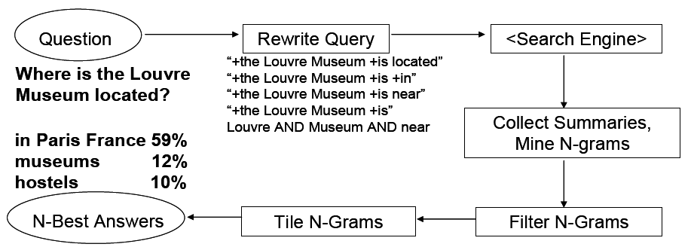
AskMSR Example

Slide 40
Question-Rewriting
Intuition: User’s question often syntactically close to sentences containing the answer
  Where is the Louvre Museum located?
    The Louvre Museum is located in Paris
  Who created the character of Scrooge?
    Charles Dickens created the character of Scrooge

Slide 41
Question Classification
Classify question into one of seven categories
  Who is/was/are/were…?
  When is/did/will/are/were …?
  Where is/are/were …?
  Hand-crafted category-specific transformation rules
  e.g.: For where questions, move ‘is’ to all possible locations
  Look to the right of the query terms for the answer.
  “Where is the Louvre Museum located?”
  → “is the Louvre Museum located”
  → “the is Louvre Museum located”
  → “the Louvre is Museum located”
  → “the Louvre Museum is located”
  → “the Louvre Museum located is”

Slide 42
Query the Search Engine
Send all rewrites to Web search engine
Retrieve top N answers (100-200)
For speed, rely just on search engine’s snippets, not full text of the actual document

Slide 43
Gather Ngrams
Enumerate all Ngrams (N=1,2,3) in all retrieved snippets
Weight of ngrams: occurrence count, each weighted by reliability (weight) of rewrite rule that fetched the document
  Example: “Who created the character of Scrooge?”
    Dickens 117
    Christmas Carol 78
    Charles Dickens 75
    Disney 72
    Carl Banks 54
    A Christmas 41
    Christmas Carol 45
    Uncle 31

Slide 44
Filter Ngrams
Each question type associated with one or more data-type filters (regular expressions for answer types)
  Boost score of ngrams that match expected answer type
  Lower score of ngrams that don’t match
E.g.
  Filter for how-many queries prefers a number
    How many dogs pull a sled in the Iditarod?
  So… disprefer candidate ngrams like
    Dog race, run, Alaskan, dog racing
  Prefer candidiate ngrams like
    Pool (of)16 dogs

Slide 45
Tiling the Answers: Concatenate Overlaps
Scores
20
15
10
merged, discard
old n-grams
Charles Dickens
Dickens
Mr Charles
Score 45
Mr Charles Dickens
Notes:
Start with highest scoring candidate and iterate using greedy approach

Slide 46
Evaluation
Usually based on TREC-devised metric
In Q/A most frequent metric is
  Mean Reciprocal Rank
    Each system returns N answers
    Score is 1/<rank of first correct answer>
    Average score over all questions attempted

Slide 47
Results
Standard TREC test-bed (TREC 2001)
  1M documents; 900 questions
  AskMSR technique would have placed in top 9 of ~30 participants with MRR = 0.507
  But….with access to Web…would have come in second on TREC 2001
    Be suspicious of any after-the-bake-off is over results

Slide 48
Which Approach to Q/A is Better?
Does it depend on question type? On document collection available? On?
How can we handle harder questions, where answers are fluid and depend on putting together information from disparate texts over time?
  Who is Condoleezza Rice?
  Who is Stephen Harper?
  Why did San Francisco have to hand-count ballots in the last election?

Slide 49
Summary
Information Retrieval
Question Answering
  IE-based (e.g. Biadsy)
  UT Dallas style
  Web-based (e.g. AskMSR)
Next: Summarization

